Slide 1
Templates & STL
By
Nachiket Gangan

Slide 2
Overview
Templates
Function Templates
Class Templates
How Templates Work
STL (Standard Template Library)
Containers
Iterators

Slide 3
Templates
Templates are functions or classes that are written for one or more types not yet specified. A class template is like a macro which produces an entire class as its expansion.
A template is not compiled once to generate code usable for any type; instead, it is compiled for each type or combination of types for which it is used.
Function Templates
Class Templates

Slide 4
Function Templates
Function templates are used to use a common code to specify an entire range of overloaded functions.
Syntax
template <class T>
returntype FunctionName( T param1, …..
{
.
.
.
};

Slide 5
A generic swap function to swap two objects of the same data type.
template <class T>
void Swap(T& a, T&b)
{
T temp = a;
a = b;
b = temp;
}
int main()
{
int i=10,j=100;
char c = 'A', d = 'S';
Swap(i,j);
Swap(c,d);
cout << i << " " << j <<endl;
cout << c << " " << d << endl;
return 0;
}
Output:
100 10
S A

Slide 6
Q: What is the output of the following program?
template <class T>
void Swap(T& a, T&b)
{
T temp = a;
a = b;
b = temp;
}
int main()
{
char str1[8],str2[8];
strcpy(str1,"Hello");
strcpy(str2,"World");
Swap(str1,str2);
cout << str1 << " " << str2;
return 0;
}
Output:
Compilation Error

Slide 7
Q: How do we call a template function which does not have any parameters of its template argument types
template<class T>
T* newArray(int size = 10)
{
T *p_array = new T[size];
if(p_array == 0)
cout << "Error allocating memory";
return p_array;
}
Ans:
int* iArr = newArray<int>();
char* cArr = newArray<char>(20);

Slide 8
Q: What is the output of the following program?
template <class T>
void Swap(T& a, T&b)
{
T temp = a;
a = b;
b = temp;
}
void Swap(int& a, int&b)
{
cout << "In int Swap\n";
int temp = a;
a = b;
b = temp;
}
int main()
{
int i=10,j=100;
char c = 'A', d = 'S';
Swap(i,j);
Swap(c,d);
return 0;
}
Output:
In int Swap
In template Swap

Slide 9
Q: What is the output of the following program?
template <class T>
void Swap(T& a, T&b)
{
T temp = a;
a = b;
b = temp;
}
void Swap(int& a, int&b)
{
cout << "In int Swap\n";
int temp = a;
a = b;
b = temp;
}
Template Function Specialization
template <>
void Swap<int>(int& a, int&b)
{
cout << "In int template Swap\n";
int temp = a;
a = b;
b = temp;
}
int main()
{
int i=10,j=100;
char c = 'A', d = 'S';
Swap(i,j);
Swap(c,d);
return 0;
}
Output:
In int template Swap
In template Swap

Slide 10
Class Templates
Syntax
template <class T>
class ClassName
{
.
.
.
};

Slide 11
A generic array class
template <class T>
class Array
{
public:
Array(int size_i = 10)
{
m_size = size_i;
p_array = new T[m_size];
}
private:
T * p_array;
int m_size;
};
int main()
{
Array<int> iArray;
Array<char> cArray(20);
return 0;
}

Slide 12
How do templates work?
A template is rather like a macro which produces an entire class/function as its expansion.
int main()
{
Array_int iArr1;
Array_char cArray;
printf("Size of Int array= %d", iArr1.Size());
printf("Size of Char array= %d", cArray.Size());
return 0;
}
#define Array(T) \
class Array_##T \
{ \
private: \
T * p_array; \
int m_size; \
public: \
Array_##T(int size_i = 10) \
{ \
m_size = size_i; \
p_array = new T[m_size]; \
} \
\
int Size() \
{ \
return m_size; \
} \
}; \
Array(int) /* Macro expands to class Array_int */
Array(char) /* Macro expands to class Array_char */

Slide 13
Q: Point out errors in the program if any
template <class T>
class Array
{
public:
Array(int size_i = 10)
{
m_size = size_i;
p_array = new T[m_size];
}
int Size()
{
return m_size;
}
private:
T * p_array;
int m_size;
};
template <class T = char>
int main()
{
Array<int> iArr;
Array<> cArr;
return 0;
}
// Defaults to a char.
Ans: error C2976: 'Array' : too few template arguments

Slide 14
Q: What is the output of the following program?
template <class T, class P>
class A
{
protected:
T m_data1;
T m_data2;
public:
A(T value1,P value2)
{
cout << "Constructor of A\n";
m_data1 = value1;
m_data2 = value2;
}
void PrintData()
{
cout << "Data1=" << m_data1 << endl;
cout << "Data2=" << m_data2 << endl;
}
};
int main()
{
A<int, char> objA(1000, 'Z');
objA.PrintData();
return 0;
}
P m_data2;
Output:
Constructor of A
Data1=1000
Data2=90
Output:
Constructor of A
Data1=1000
Data2=Z

Slide 15
Template Class as a member variable
template <class T>
class Base
{
protected:
T m_data;
public:
friend ostream & operator << (ostream& out, Base<T> b);
Base (T value)
{
cout << "Constructor of Base\n";
m_data = value;
}
T GetData() { return m_data; }
};
template <class T>
class A
{
protected:
Base<T> m_base;
public:
A(T value):m_base(value)
{
cout << "Ctor of A\n";
}
void PrintData()
{
cout << m_base;
}
};
int main()
{
A<int> objA(1000);
objA.PrintData();
return 0;
}
template <class T>
ostream & operator << (ostream& out, Base<T> b)
{
out << "Value @ Base=";
out << b.m_data << endl;
return out;
}

Slide 16
Nesting of Templates classes
template <class T>
class Base
{
protected:
T m_data;
public:
Base (T value)
{
cout << "Ctor of Base\n";
m_data = value;
}
void SetData(T data) { m_data = data; }
T GetData() { return m_data; }
friend ostream & operator << (ostream& out, Base<T> b);
};
template <class T>
ostream & operator << (ostream& out, Base<T> b)
{
out << "Value @ Base=";
out << b.m_data << endl;
return out;
}
template <class T>
class A
{
protected:
T data;
public:
A():data(0)
{ cout << "Ctor of A\n"; }
void PrintData()
{
cout << data;
}
};
int main()
{
A< Base<int> > objA;
objA.PrintData();
return 0;
}

Slide 17
Q: Is it possible to define a base class containing derived class objects/pointers as members?
template <class T>
class Base
{
protected:
T m_data;
public:
Base (T value):m_data(value)
{
cout << "Constructor of Base\n";
m_data = value;
}
void SetData(T data) { m_data = data; }
T GetData() { return m_data; }
};
template <class T>
class Derived: public Base <T>
{
public:
Derived(T value):Base<T> (value)
{
cout << "Constructor of Derived\n";
}
};
Q: What is the sequence of constructors?
int main()
{
Base< Derived<int> > objB(1000);
objB.GetData();
return 0;
}
Output:
Constructor of Base
Constructor of Derived
Constructor of Base
This design is called : curiously recurring template pattern (CRTP)

Slide 18
Memory Map of objB
Base
m_data is Derived
Derived
Base
m_data is int

Slide 19
Use Case
This technique achieves a similar effect to the use of virtual functions, without the costs of dynamic polymorphism. (This polymorphism is static)

Slide 20
template<class T>
class Currency
{
protected:
T* mp_type;
int value;
public:
Currency(int i):value(i)
{ mp_type = (T*) this; }
int GetValue()
{
return mp_type->GetValue();
}
};
Output:
Currency Value = 500
Currency Value = 630
class Dollar : public Currency<Dollar>
{
public:
Dollar(int i) : Currency<Dollar>(i)
{
}
int GetValue()
{
return value*50;
}
};
class Euro : public Currency<Euro>
{
public:
Euro(int i) : Currency<Euro>(i)
{
}
int GetValue()
{
return value*63;
}
};
template<typename T>
void CurrencyValue(Currency<T>& a)
{
cout << "Currency Value = " << a.GetValue() << endl;
}
int main()
{
Dollar oD(10);
Euro oE(10);
CurrencyValue(oD);
CurrencyValue(oE);
return 0;
}

Slide 21
Advantages & Disadvantages of Templates
Advantages
Code is generic and easy to maintain.
If templates are compared to macros
  Templates are "type-safe".
  Macros are always expand as inline, whereas templates are only expanded inline when the compiler deems it appropriate.
Disadvantages
Inappropriate usage may lead to code bloating.
Extra overhead at compile-time lead to longer build times.
All the function definitions must be placed in the header files.

Slide 22
Solutions for making Templates as libraries
If your compiler supports 'export' keyword. (Currently a very few like 'Comeau' do).
For Eg:
------ Source File ------
template<class T>
export int Vector<T>::Size()
{
return m_size;
}
Add "template class ClassName<datatype>;" to the template source file for each type or combination of types for which it may be used. (Inappropriate usage may result code bloating)
For Eg:
----- Source File ------
template<class T>
int Vector<T>::Size()
{
return m_size;
}
template class Vector<int>;
template class Vector<char>;

Slide 23
STL (Standard Template Library)
The standard template library (STL) is a generic template based library that provides solutions to managing collections of data with modern and efficient algorithms.
Containers
Iterators

Slide 24
Containers
Containers are used to manage collections of objects of a certain kind.
Sequence Containers
Sequence containers are ordered collections in which every element has a certain position. This position depends on the time and place of the insertion, but it is independent of the value of the element.
  Vectors
  Deques
  Lists
Associative Containers
Associative containers are sorted collections in which the actual position of an element depends on its value due to a certain sorting criterion.
  Set
  MultiSet
  Map
  Multimap

Slide 25
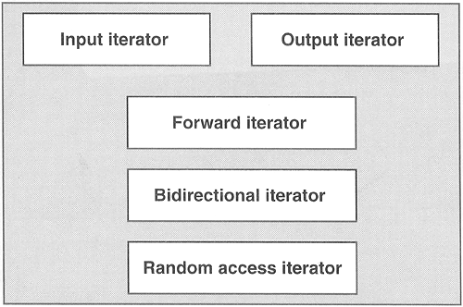
Iterators
Iterators are used to step through the elements of collections of objects. These collections may be containers or subsets of containers.

Slide 26
Abilities of Iterator Categories
Iterator Category | Ability | Providers
Input iterator | Reads forward | istream
Output iterator | Writes forward | ostream, inserter
Forward iterator | Reads and writes forward
Bidirectional iterator | Reads and writes forward and backward | list, set, multiset, map, multimap
Random access iterator | Reads and writes with random access | vector, deque string, array

Slide 27



Sequence Containers
Internal Structure of Sequence Containers
Vectors
Supported Operations:
add, delete, random access, swap contents, copy, resize, erase, clear etc.
Deques
Supported Operations:
add front, add back, delete, random access, swap contents, copy, resize, erase, clear etc.
Lists
Supported Operations:
add , insert, delete, swap contents, copy, resize, erase, clear etc.

Slide 28
Vectors
A vector manages its elements in a dynamic array.
It enables random access, which means you can access each element directly with the corresponding index. Appending and removing elements at the end of the array is very fast. However, inserting an element in the middle or at the beginning of the array takes time because all the following elements have to be moved to make room for it while maintaining the order.
Example:
int main()
{
vector<string> obj;
obj.push_back("This");
obj.push_back("is");
obj.push_back("a");
obj.push_back("Vector");
for(int i=0;i<obj.size();i++)
cout << obj[i] << " ";
cout << endl;
return 0;
}
Output:
This is a Vector

Slide 29
Deques
It manages its elements with a dynamic array, provides random access, and has almost the same interface as a vector. The difference is that with a deque the dynamic array is open at both ends. Thus, a deque is fast for insertions and deletions at both the end and the beginning.
Example:
int main()
{
deque<string> obj;
obj.push_front(string("is"));
obj.push_back(string("a"));
obj.push_back(string("deque"));
obj.push_front(string("this"));
for(int i=0; i< obj.size();i++)
cout << obj[i] << " ";
cout << endl;
return 0;
}
Output:
this is a deque

Slide 30
Lists
A list manages its elements as a doubly linked list.
It does not provide random access. For example, to access the fifth element, you must navigate the first four elements following the chain of links.
Inserting and removing elements is fast at each position, and not only at one or both ends. You can always insert and delete an element in constant time because no other elements have to be moved. Internally, only some pointer values are manipulated.

Slide 31
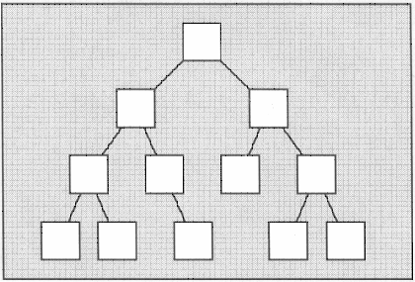
Associative Containers
Internal Structure of Associative Containers

Slide 32
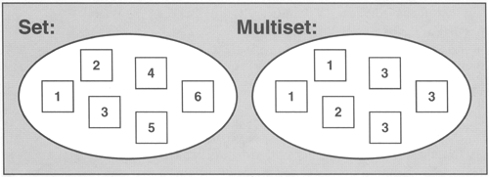
Sets & MultiSets
A set is a collection in which elements are sorted according to their own values. Each element may occur only once, thus duplicates are not allowed.
A multiset is the same as a set except that duplicates are allowed.

Slide 33
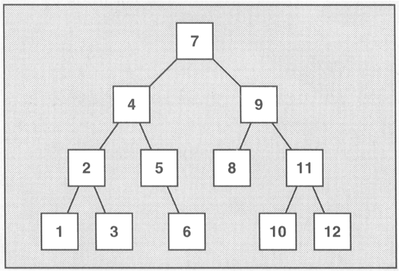
Internal structure of Sets and MultiSets

Slide 34
Set Example
Used to maintain any data in sorted form
int main()
{
set<int> obj;
obj.insert(4);
obj.insert(2);
obj.insert(3);
obj.insert(1);
set<int>::iterator pos;
for (pos = obj.begin(); pos != obj.end(); ++pos)
cout << *pos << ' ';
cout << endl;
return 0;
}
Output:
1 2 3 4

Slide 35
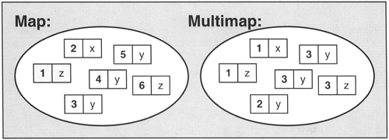
Maps & MultiMaps
A map contains elements that are key/value pairs. Each element has a key that is the basis for the sorting criterion and a value. Each key may occur only once, thus duplicate keys are not allowed.
A multimap is the same as a map except that duplicates are allowed.

Slide 36
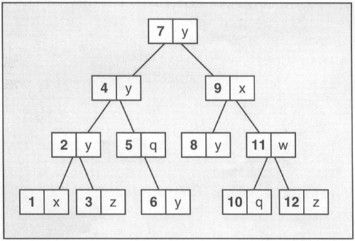
Internal structure of Maps and MultiMaps
Examples: Stock and Dictionary

Slide 37
Use case for Map
The map is used as a variable to hold stock values :
Output:
stock: ACC LIMITED price: 531.5
stock: GRASIM price: 1326.2
stock: RANBAXY price: 209
stock: TATA STEEL price: 182
int main()
{
map<string,float> stocks;
stocks["GRASIM"] = 1326.20;
stocks["TATA STEEL"] = 182.00;
stocks["RANBAXY"] = 209.00;
stocks["ACC LIMITED"] = 531.50;
map<string,float>::iterator pos;
for(pos = stocks.begin(); pos != stocks.end(); ++pos)
{
cout << "stock: " << pos->first << "\t"
<< "price: " << pos->second << endl;
}
cout << endl;
return 0;
}

Slide 38
Heterogeneous Containers
One can store different types of objects in the same container. These are called heterogeneous containers.
Heterogeneous containers are not a part of the standard STL library.

Slide 39
Questions?

Slide 40
Thank You

