Slide 1
Object Oriented Programming in C++
Presented by Bhimashankar T
E-Mail: bhima.t@gmail.com
PhNo:+91 9980156833 / 6363863430

Slide 2
DAY 03

Slide 3
Inheritance – walk through the codes
Codes for Inheritance (click here)

Slide 4
Passing values to base class – walk through the codes
Passing values to base class (click here)

Slide 5
The new operator
allocates memory on the heap at runtime for an object, or a primitive data type, and returns a pointer to the object or the primitive data type thus allocated.
Eg:
int *p = new int;
int *pia = new int[4]; // allocates an array of four integer elements.
In addition to allocating memory, new also creates an object by calling the object’s constructor.
The object actually allocated on the free store is un-initialized. We can specify an initial value by: int *pi=new int(1024);

Slide 6
The delete operator
Frees the memory occupied by an object on the heap previously allocated to it using new.
delete p; //deletes a single object
delete [] pia; //deletes an array of objects
In addition to de-allocating memory occupied by an object, delete also destroys the object by calling the object’s destructor.
Memory allocated using new should be freed only using delete.

Slide 7
C++ Polymorphism
The word “polymorphism” means having many forms. In simple words, we can define polymorphism as the ability of a message to be displayed in more than one form. A real-life example of polymorphism is a person who at the same time can have different characteristics. A man at the same time is a father, a husband, and an employee. So the same person exhibits different behavior in different situations. This is called polymorphism. Polymorphism is considered one of the important features of Object-Oriented Programming.

Slide 8
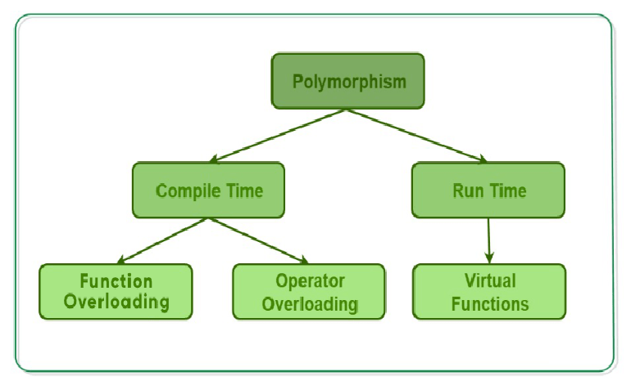
Types of Polymorphism
Compile-time Polymorphism
Runtime Polymorphism

Slide 9
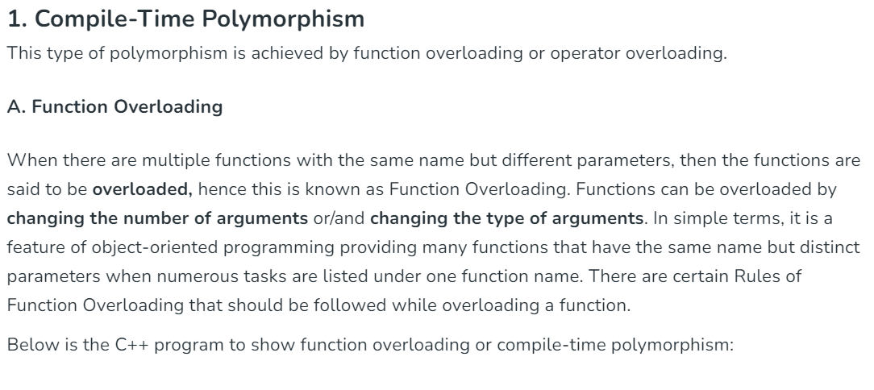

Slide 10
// C++ program to demonstrate function overloading or Compile-time Polymorphism
class Test {
public:
// Function with 1 int parameter
void func(int x)
{
cout << "value of x is " << x << endl;
}
// Function with same name but
// 1 double parameter
void func(double x)
{
cout << "value of x is " << x << endl;
}
// Function with same name and
// 2 int parameters
void func(int x, int y)
{
cout << "value of x and y is " << x << ", " << y << endl;
}
};

Slide 11
// Driver code
int main()
{
Test obj1;
// Function being called depends
// on the parameters passed
// func() is called with int value
obj1.func(7);
// func() is called with double value
obj1.func(9.132);
// func() is called with 2 int values
obj1.func(85, 64);
return 0;
}

