Slide 1

QUIZ EVALUATION SOFTWARE
Presented by:-
Shivani Sinha
Shaik Saahera banu Under guidance of
Nukala Vasanthi Bhimashankar Takalki
Lavanya Anugu

Slide 2
TEAM MEMBERS
NAME | EMPLOYEE ID
SHIVANI SINHA | 46281991
SHAIK SAAHERA BANU | 46279750
NUKALA VASANTHI | 46279757
LAVANYA ANUGU | 46279713

Slide 3
TOOLS & CONTRIBUTION
Tools :-
Ubuntu Linux as platform.
C language.
Draw io is used for pictorial representations.
Makefile is use for compilation.
Gcov is used to check code coverage.
Valgrind to find memory leaks.
Splint is used for static analysis.
GCC is an optimizing compiler
Shivani Sinha - SRS Documentation + Coding(Admin function)
Shaik Saahera banu - Design Documentation +Coding(Trainer function)
Nukala Vasanthi - UT_IT Plan + Coding(Login test function)
Lavanya Anugu - RTM + Coding(Participant function) & Tools

Slide 4
INTRODUCTION
The ‘MCQ Quiz Evaluation’ project will developed to overcome the time consuming problem of manual system.
Apart from that in current system, checking the answer sheets after taking test, waste the examiners time, so this application will check the correct answer and save the examiner time and carry the examination in an effective manner.
The users who are using this system don’t need to high computing knowledge and also system will inform them while entering invalid data.
Quiz evaluation software using C and its various supporting tools. To computerized the manual system and help the examiners to save their valuable time and important data.
Apart from this, data which are exist in this system, will exist for long period of time and will be easy accessible. This project helps the examiners to manage their services in a good way and provide a better service to their users.

Slide 5
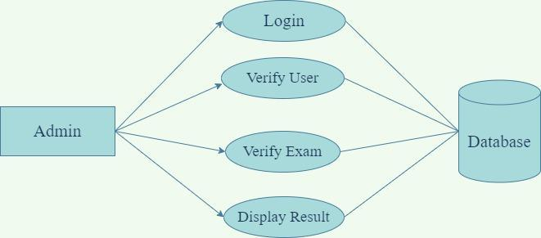
DESIGN OVERVIEW
In Quiz Evaluation Software, consists of login/registration page to check the credentials of the user.
If the participant enter credentials are valid, he can take the quiz and evaluate their knowledge.
If the participant credentials is not valid, system asks to enter valid credentials.

Slide 6
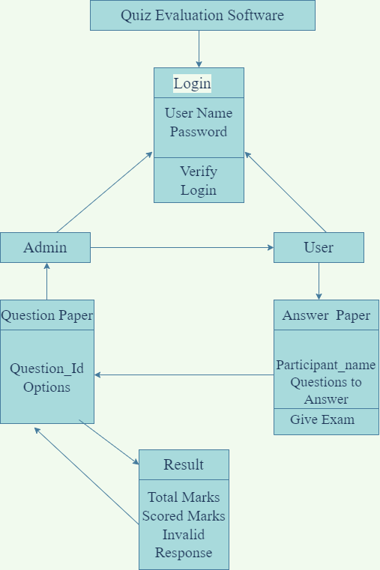
CLASS DIAGRAM

Slide 7
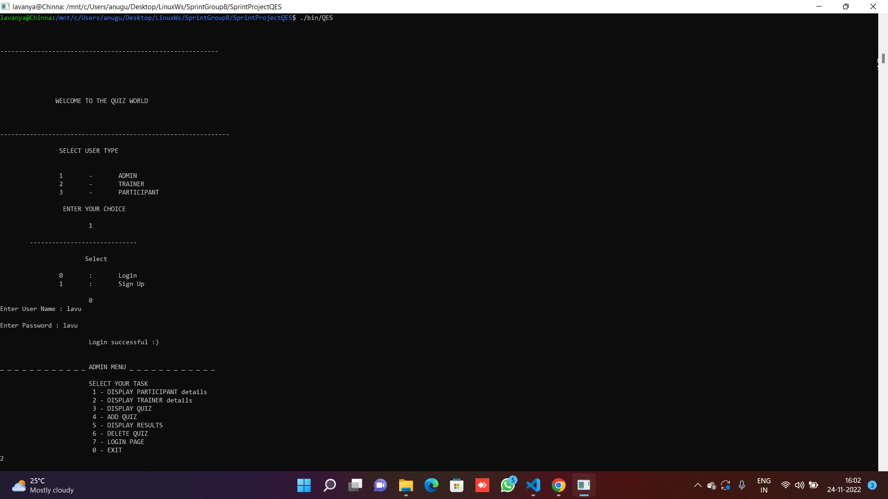
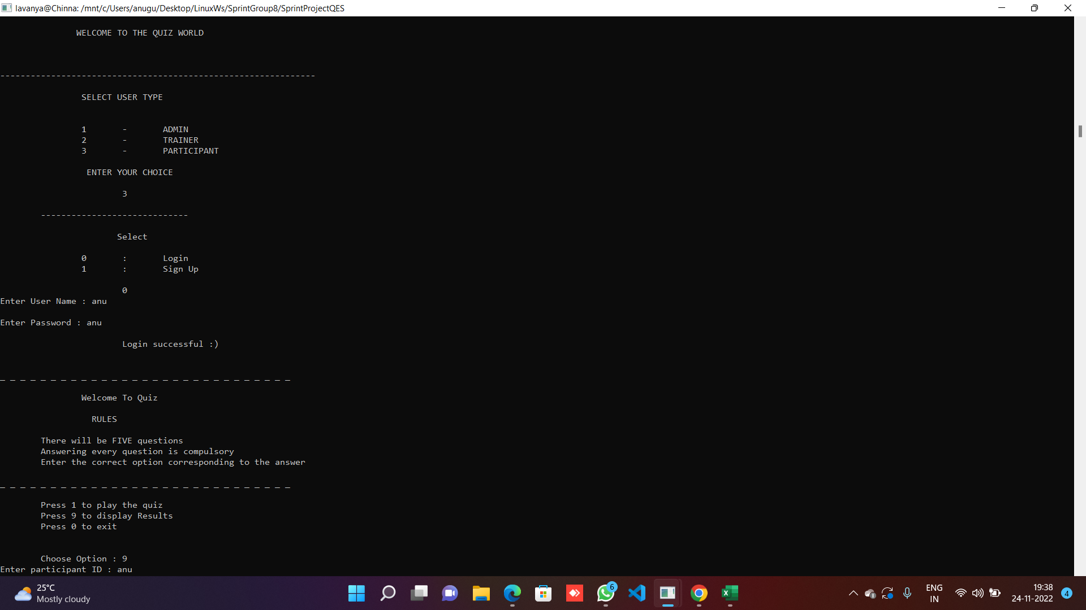
OUTPUT
Output for Successful Logins

Slide 8
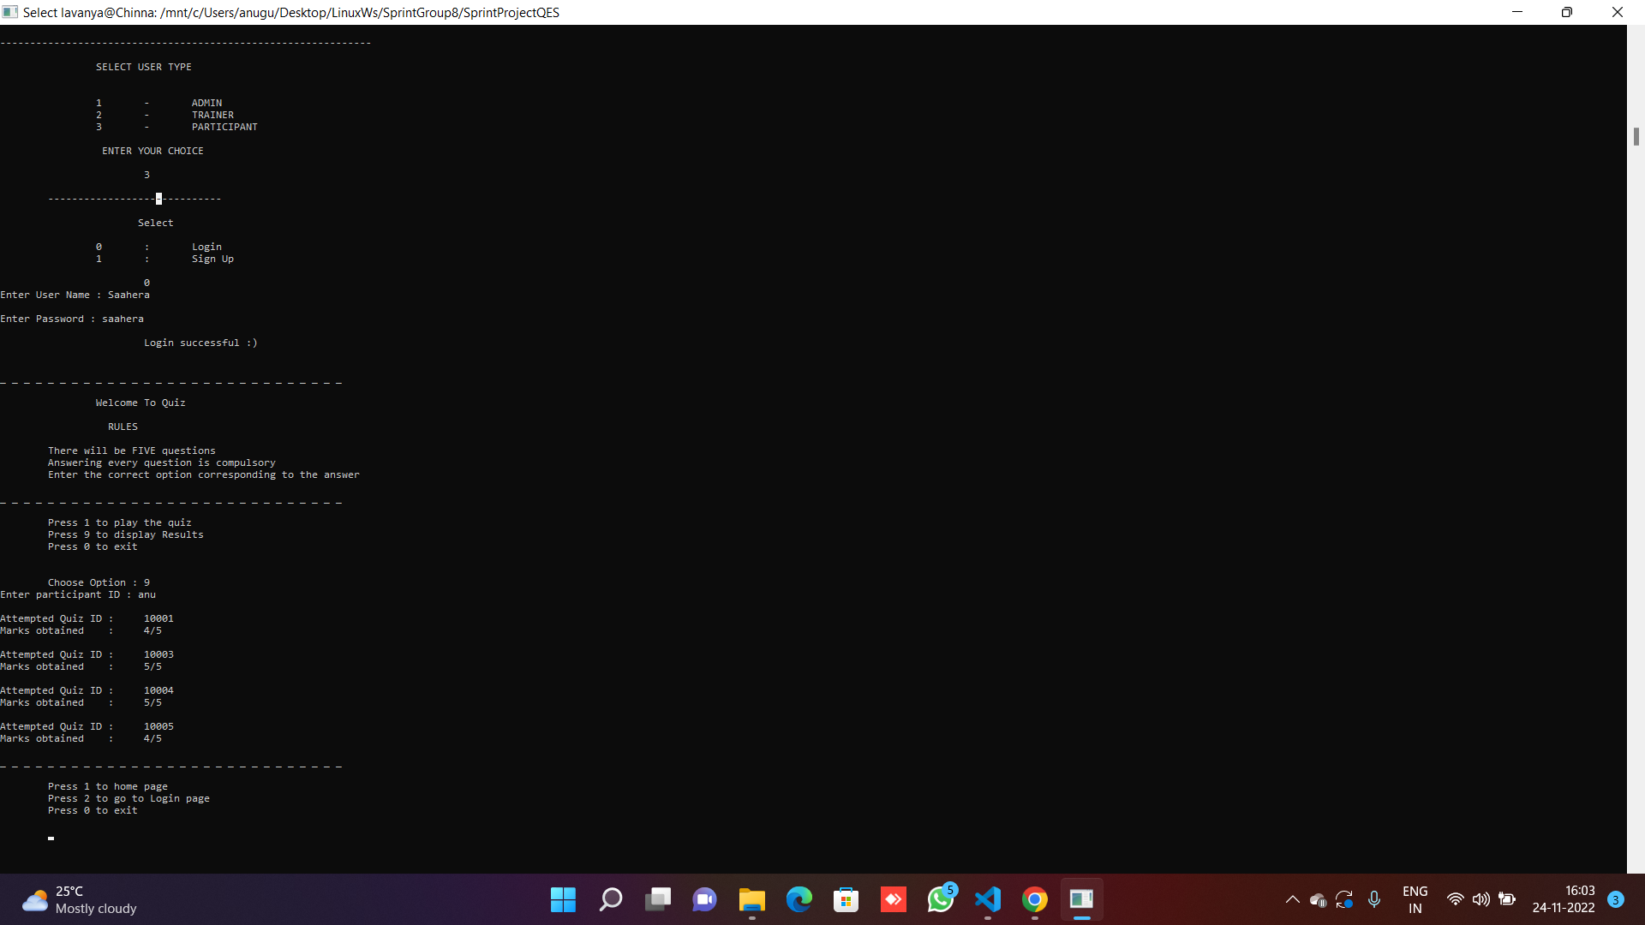
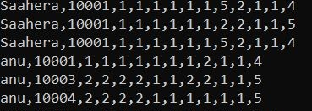
Format of participant results in csv.txt file
Output displayed based on Participant choice

Slide 9
.
THANK YOU

