Slide 1
CAB BOOKING MANAGEMENT SYSTEM
- By Group07

Slide 2
TEAM MEMBERS
S.No | Members Name
1. | Ekta Sharma
2. | Talla Yamini Sai Padmavathi
3. | Polasu Teja Sri
4. | Annayasha Paul
5. | Rashmi Kumari
1

Slide 3
INTRODUCTION
This project aims to create an online cab booking system like Uber where users can book a cab for their destination.
The application is to be developed as Desktop Application.
There are two entities User and Cab driver.
2

Slide 4
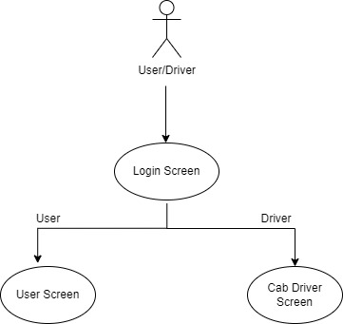
REQUIREMENTS
User and cab driver should be able to login into the application.
User should be able to Book a trip.
User should be able to details of the booking confirmation along with cab driver details after booking.
Cab driver must be able to update his/her profile.
Cab driver must be able to update car details.
Cab driver must be able to check booked trips and mark completed trips.
When MyCab starts it displays Following Screen –
Login Screen
User Screen
Cab Driver Screen
3

Slide 5
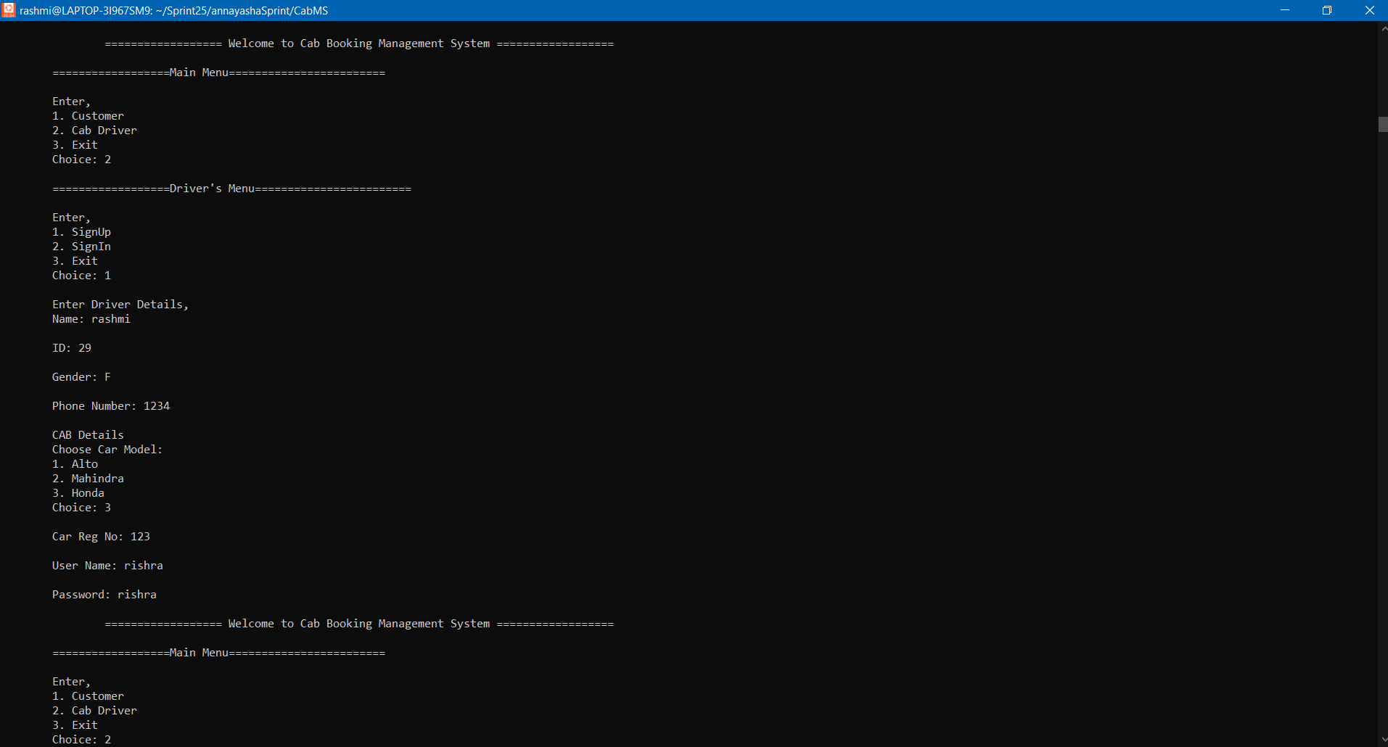
OUTPUT
4

Slide 6
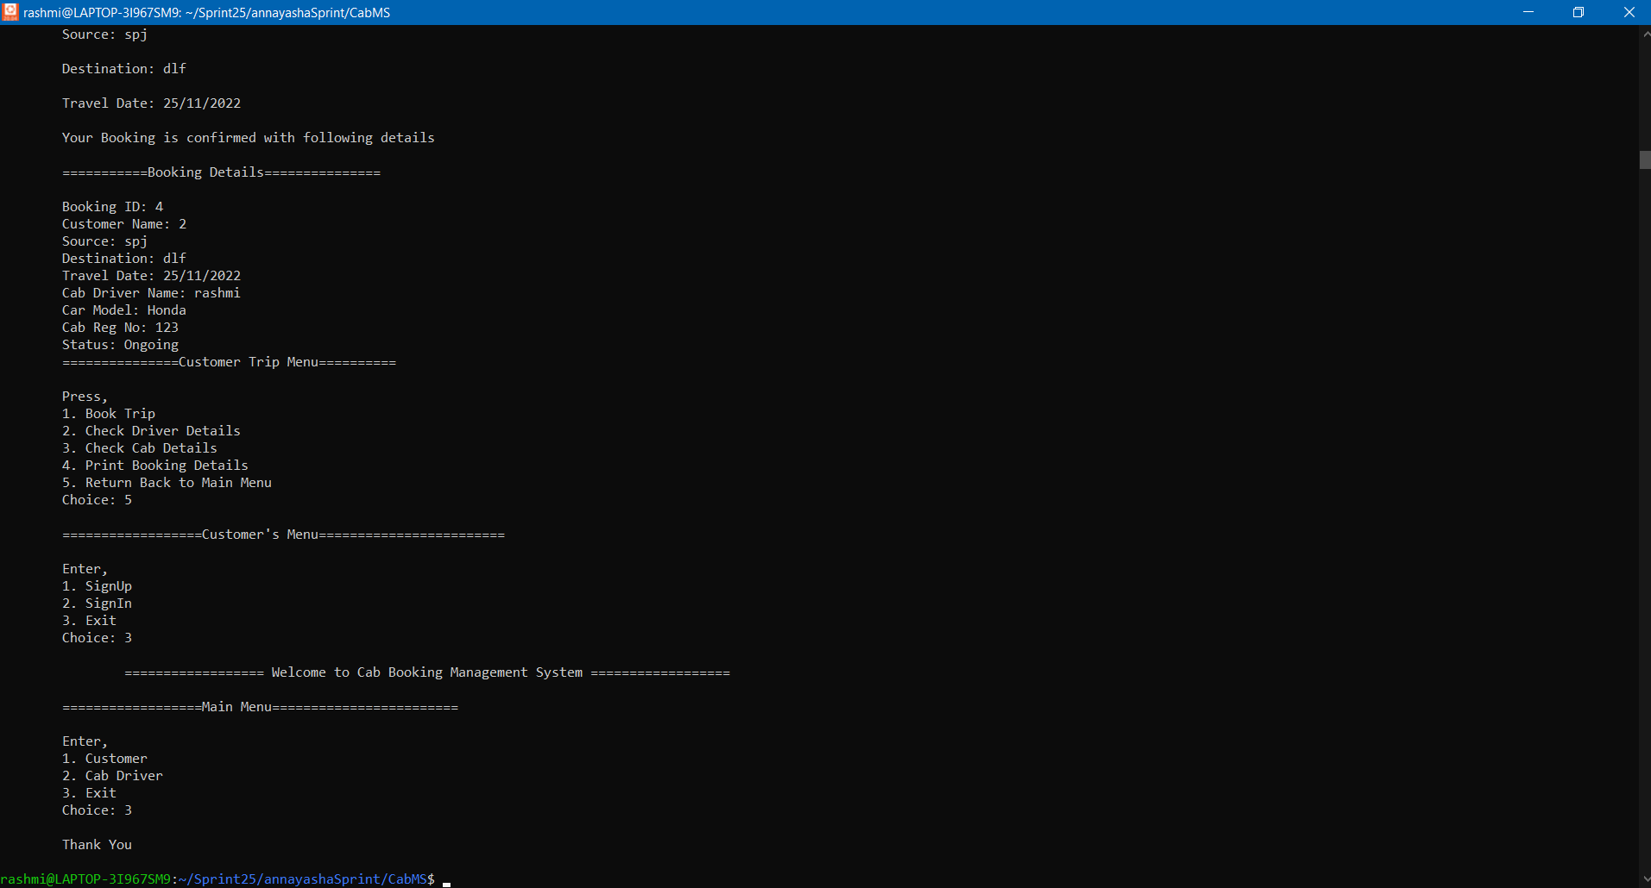
5

Slide 7
PROJECT CHALLENGES
Improper Time Management.
Improperly Divided the Parts at the Beginning.
Output was not Matching with the Expected Output.
Got Segmentatiom Error Many Times.
5. Lack of Clear Project Goals.
6

Slide 8
THANK YOU !

