Slide 1
MultiThreading In Python

Slide 2
Multithreading in Python allows you to execute multiple threads (lightweight processes) concurrently, enabling parallel execution of tasks and improving overall program performance, especially for I/O-bound operations. Python provides a built-in module called threading for working with threads.

Slide 3
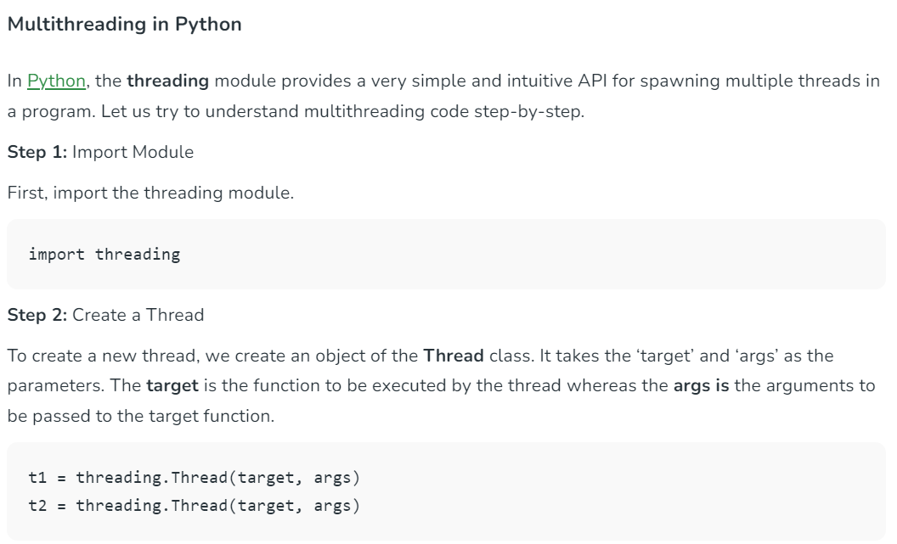

Slide 4
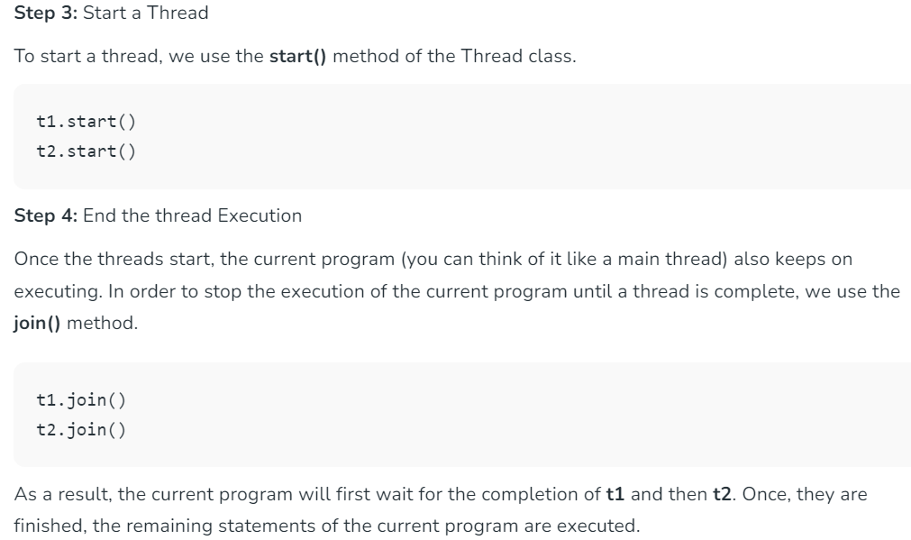

Slide 5
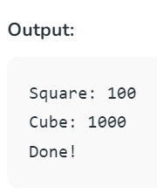
Example
import threading
def print_cube(num):
print("Cube: {}" .format(num * num * num))
def print_square(num):
print("Square: {}" .format(num * num))
if __name__ =="__main__":
t1 = threading.Thread(target=print_square, args=(10,))
t2 = threading.Thread(target=print_cube, args=(10,))
t1.start()
t2.start()
t1.join()
t2.join()
print("Done!")

Slide 6
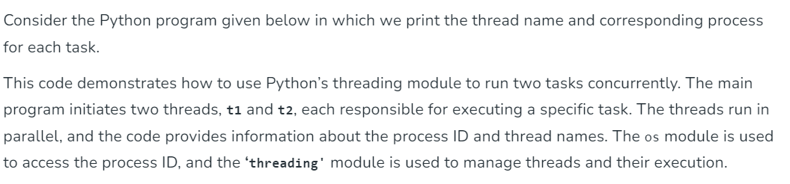
import threading
import os
def task1():
print("Task 1 assigned to thread: {}".format(threading.current_thread().name))
print("ID of process running task 1: {}".format(os.getpid()))
def task2():
print("Task 2 assigned to thread: {}".format(threading.current_thread().name))
print("ID of process running task 2: {}".format(os.getpid()))
if __name__ == "__main__":
print("ID of process running main program: {}".format(os.getpid()))
print("Main thread name: {}".format(threading.current_thread().name))
t1 = threading.Thread(target=task1, name='t1')
t2 = threading.Thread(target=task2, name='t2')
t1.start()
t2.start()
t1.join()
t2.join()

Slide 7
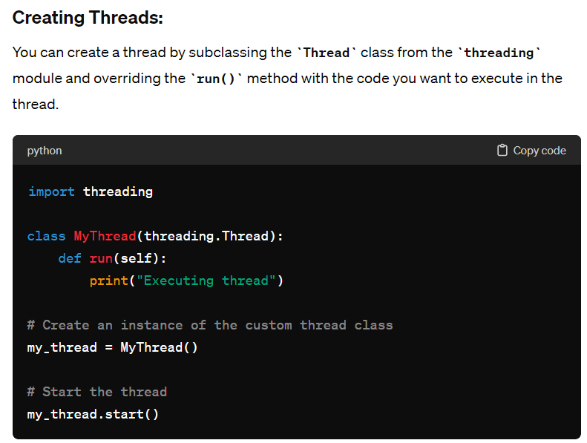

Slide 8
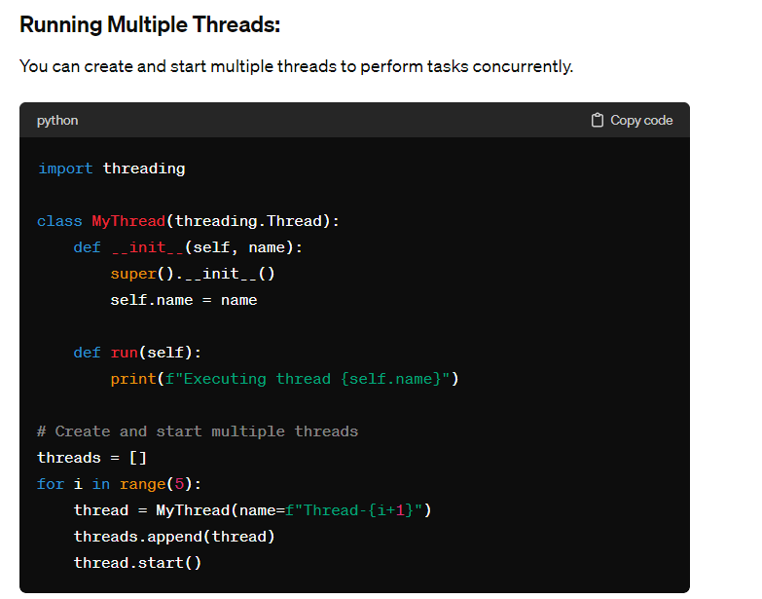

Slide 9
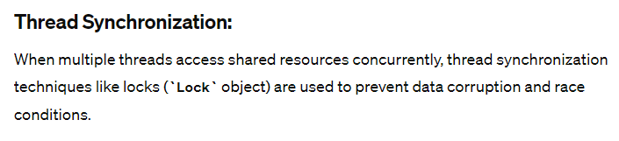
import threading
shared_resource = 0
lock = threading.Lock()
def increment():
global shared_resource
for _ in range(100000):
lock.acquire()
shared_resource += 1
lock.release()
# Create and start multiple threads
threads = []
for _ in range(5):
thread = threading.Thread(target=increment)
threads.append(thread)
thread.start()
# Wait for all threads to complete
for thread in threads:
thread.join()
print("Final value of shared resource:", shared_resource)

Slide 10
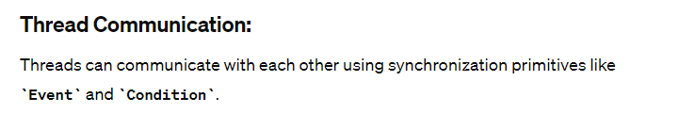
import threading
event = threading.Event()
def worker():
print("Waiting for event to be set")
event.wait()
print("Event is set, continuing execution")
# Create and start the worker thread
thread = threading.Thread(target=worker)
thread.start()
# Main thread waits for some time
threading.Event().wait(2)
# Set the event
print("Setting the event")
event.set()
# Wait for the worker thread to complete
thread.join()

Slide 11
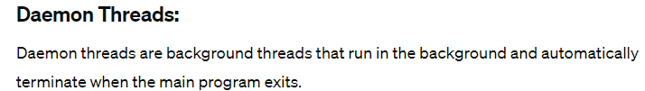
import threading
import time
def daemon_function():
while True:
print("Daemon thread is running")
time.sleep(1)
# Create and start a daemon thread
daemon_thread = threading.Thread(target=daemon_function)
daemon_thread.daemon = True
daemon_thread.start()
# Main thread waits for some time
time.sleep(3)
print("Main thread is exiting")

