Slide 1
Multiprocessing In Python

Slide 2
Multiprocessing in Python refers to the ability to run multiple processes concurrently, utilizing multiple CPU cores to perform tasks in parallel. This is particularly useful for CPU-bound tasks that can benefit from parallel execution. Python provides the multiprocessing module for working with multiple processes.

Slide 3
import multiprocessing
def worker():
"""Function to be executed by each process"""
print("Worker function executing")
if __name__ == "__main__":
# Create and start a process
process = multiprocessing.Process(target=worker)
process.start()
# Wait for the process to finish
process.join()
print("Main process exiting")

Slide 4
In this example:
We define a worker function that represents the task to be executed by each process.
We create a multiprocessing.Process object and specify the target argument as the worker function.
We start the process using the start() method.
We wait for the process to finish using the join() method.
Finally, we print a message indicating that the main process is exiting.

Slide 5
Passing Arguments to Processes:
import multiprocessing
def worker(num):
"""Function to be executed by each process"""
print(f"Worker function executing with argument: {num}")
if __name__ == "__main__":
# Create and start a process with an argument
process = multiprocessing.Process(target=worker, args=(10,))
process.start()
process.join()
print("Main process exiting")

Slide 6
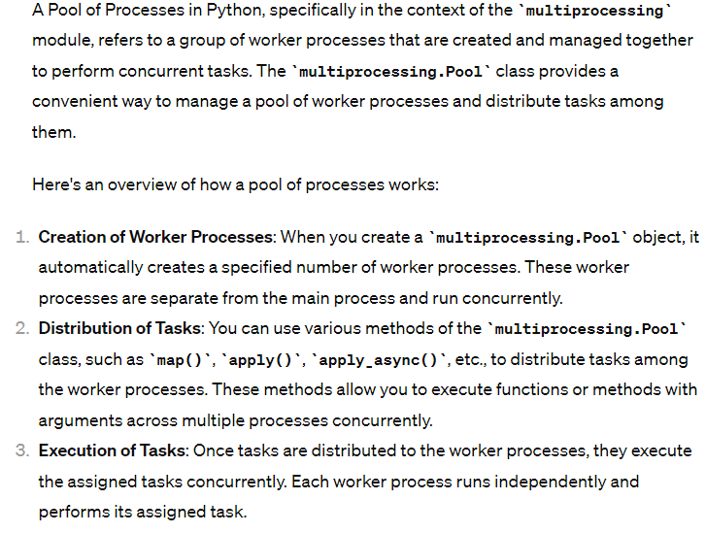

Slide 7
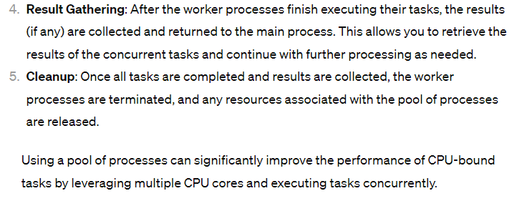

Slide 8
Pool of Processes:
import multiprocessing
def worker(num):
"""Function to be executed by each process"""
return num * 2
if __name__ == "__main__":
# Create a pool of processes
pool = multiprocessing.Pool(processes=4)
# Map the worker function to multiple arguments
results = pool.map(worker, [1, 2, 3, 4, 5])
# Close the pool and wait for all processes to finish
pool.close()
pool.join()
print("Results:", results)

