Slide 1
Stacks

Slide 2
Stack
A stack is a list of data elements which inserts an element at the end of the list, and deletes an element from the same end.
• No insertion or deletion from anywhere else is allowed.
• It is also called a LIFO (last in first out) list

Slide 3
Operations on stack
1. Create Creates a new empty stack.
2. Push Inserts a new element at top of the stack. Top points to the new added element.
3. Pop It removes the topmost element from the stack Stack size reduced by one

Slide 4
4. Isempty Checks whether the stack is empty. It returns true (1) if stack is empty else false (0). Used by pop operation.
5. Isfull Checks whether the stack is full. It returns true(1) if stack is full else false(0). Used by push operation

Slide 5
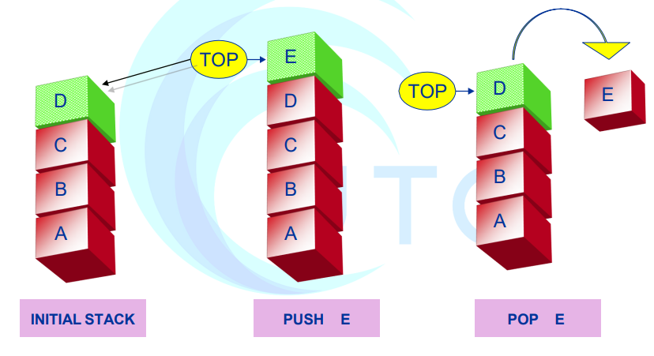
Pictorial representation of static stack

Slide 6
Implementation of stack
Two ways of stack implementation are
• Static stack using arrays
• Dynamic stack using link list

Slide 7
Code
Creates an Empty Stack:
class Stack:
def __init__(self, size):
self.stack = []
self.MAX_SIZE = size
self.values = -1
print(“Empty Stack is Created: ”,self.stack)
AStack = Stack()

Slide 8
Code
Adding Data to Stack:
def add(self, dataval):
if self.values == MAX_SIZE :
return (“Stack is Full")
else:
self.stack.append(dataval)
print(self.dataval, “Value added to Stack:”, self.)

Slide 9
Code
Deleting Data from Stack:
def remove(self):
if len(self.stack) <= 0:
return ("No element in the Stack") else:
print(“Deleted value:”, self.stack.pop())
return self.stack.pop()

Slide 10
Code
Deleting Data from Stack:
def remove(self):
if len(self.stack) <= 0:
return ("No element in the Stack") else:
print(“Deleted value:”, self.stack.pop())
return self.stack.pop()

Slide 11
Code
Deleting Data from Stack:
def isFull(self):
if self.values == self.MAX_SIZE:
return True
else:
return False

Slide 12
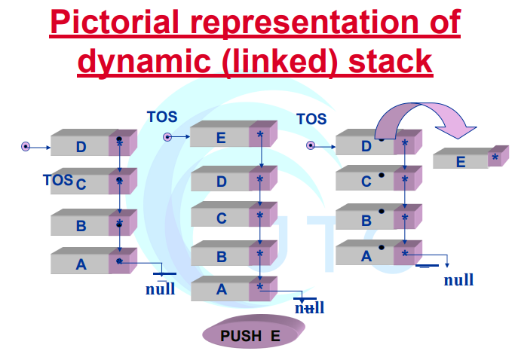

Slide 13


Slide 14
Algebraic Expressions
An algebraic expression is a legal combination of operators and operands. Operand is the quantity on which a mathematical operation is performed. Operand may be a variable like x, y, z or a constant like 5, 4, 6 etc. Operator is a symbol which signifies a mathematical or logical operation between the operands. Examples of familiar operators include +, -, *, /, ^ etc.

Slide 15
An algebraic expression can be represented using three different notations. They are infix, postfix and prefix notations:
Infix: It is the form of an arithmetic expression in which we fix (place) the arithmetic operator in between the two operands.
Example: (A + B) * (C - D)

Slide 16
Prefix: It is the form of an arithmetic notation in which we fix (place) the arithmetic operator before (pre) its two operands. The prefix notation is called as polish notation (due to the polish mathematician Jan Lukasiewicz in the year 1920).
Example: * + A B – C D

Slide 17
Postfix: It is the form of an arithmetic expression in which we fix (place) the arithmetic operator after (post) its two operands. The postfix notation is called as suffix notation and is also referred to reverse polish notation. Example: A B + C D - *

Slide 18
The three important features of postfix expression are:
1. The operands maintain the same order as in the equivalent infix expression.
2. The parentheses are not needed to designate the expression unambiguously.
3. While evaluating the postfix expression the priority of the operators is no longer relevant.

Slide 19
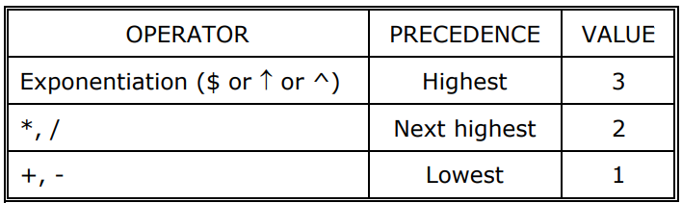
We consider five binary operations: +, -, *, / and $ or ↑ (exponentiation). For these binary operations, the following in the order of pre
cedence (highest to lowest):

Slide 20
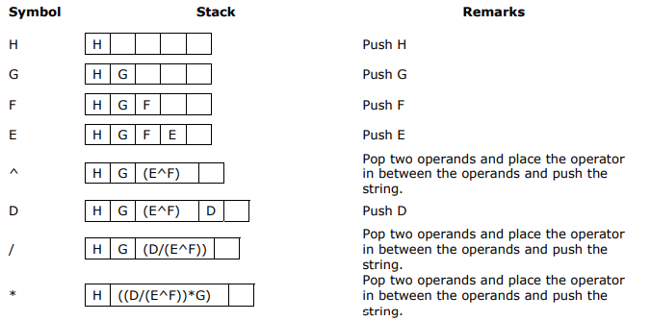
Example: Convert the following prefix expression + A * - * B C * / D ^ E F G H into its equivalent infix expression.

Slide 21
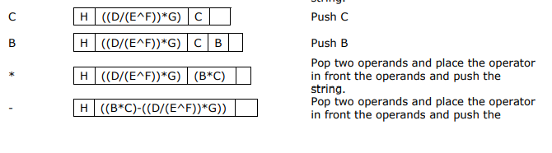
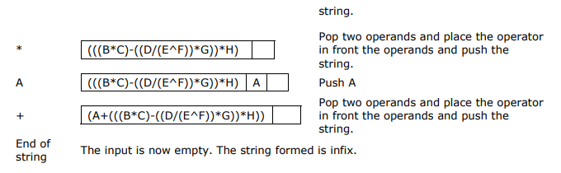

Slide 22
Conversion from prefix to postfix
Procedure to convert prefix expression to postfix expression is as follows:
1. Scan the prefix expression from right to left (reverse order).
2. If the scanned symbol is an operand, then push it onto the stack.
3. If the scanned symbol is an operator, pop two symbols from the stack and create it as a string by placing the operator after the operands and push it onto the stack.
4. Repeat steps 2 and 3 till the end of the expression.

Slide 23
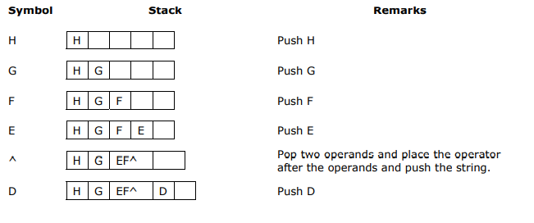
Example: Convert the following prefix expression + A * - * B C * / D ^ E F G H into its equivalent postfix expression.

Slide 24
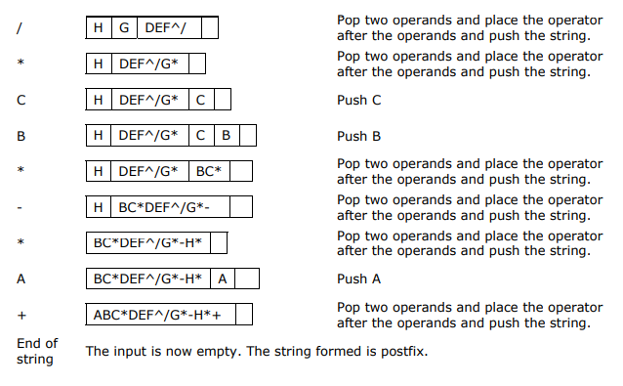

Slide 25
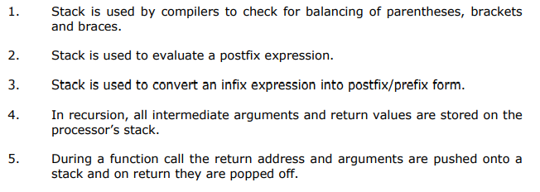
Applications of stacks:

Slide 26
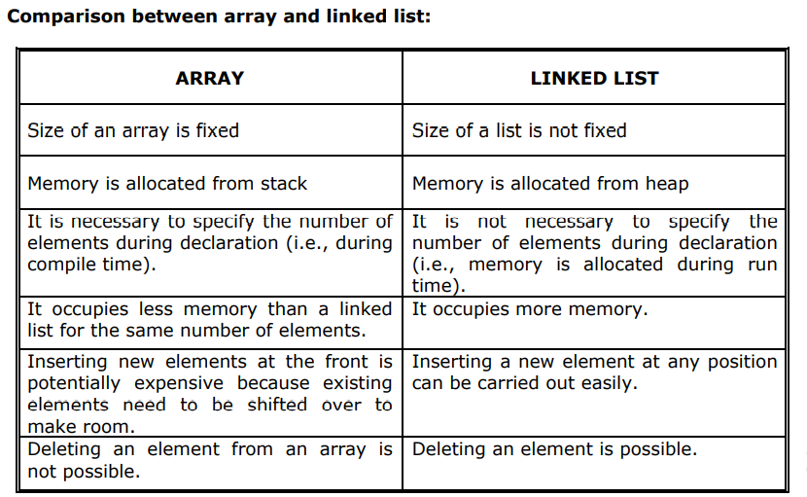
Diffrence Between Arrays and Linked list

Slide 27
QUEUE
A queue is a list of data elements that inserts an element at the rear-end of the list, and deletes an element from the front-end.
• No insertion or deletion from anywhere else is allowed.
• It is also called a FIFO (first in first out) list

Slide 28
Operations on Queue
The operations performed on queue are
• Creates a new empty queue.
• Add - also called Enqueue
Inserts a new element at rear-end of the
queue.
Rear points to the new added element.
Delete - also called Dequeue
It removes the element from the front-end of
the queue .

Slide 29
Types of Queue
Static queue (using arrays)
Linear queue - Circular queue
Dynamic queue (using linked list)

Slide 30
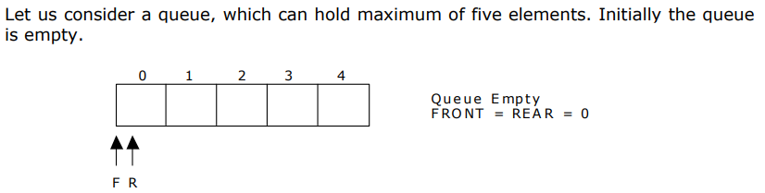
Representation of Queue

Slide 31
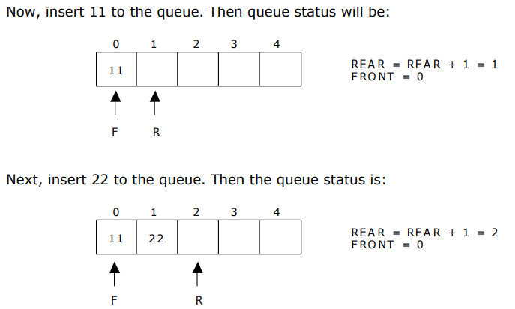

Slide 32
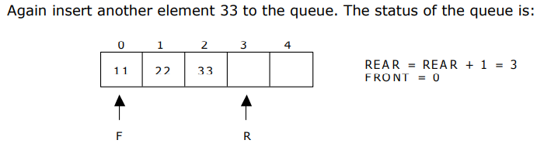
`

Slide 33
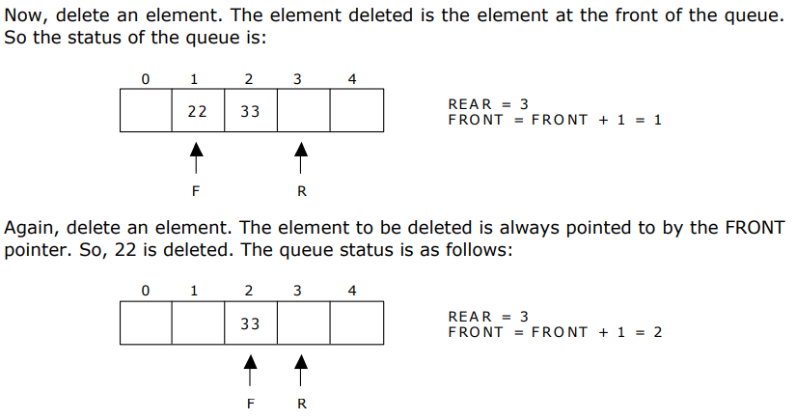

Slide 34
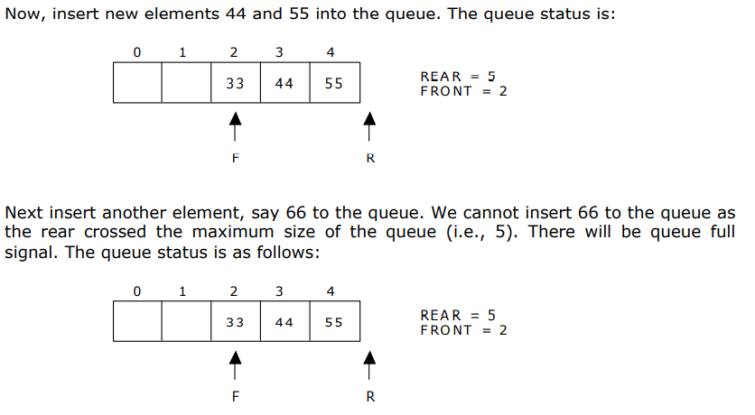

Slide 35
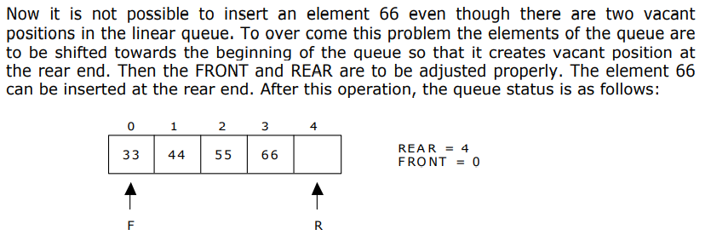
This difficulty can overcome if we treat queue position with index 0 as a position that comes after position with index 4 i.e., we treat the queue as a circular queue.

Slide 36
class Queue():
def __init__(self, s):
self.front = -1
self.rear = -1
self.size = s
self.queue = []

Slide 37
def enQueue(self, value):
if (self.rear == self.size - 1):
print("Queue is Full!!")
else:
if (self.front == -1):
self.front = 0
self.rear +=1
self.queue.insert(self.rear, value)
print("Inserted -> ", value)

Slide 38
def deQueue(self):
if (self.front == -1):
print("Queue is Empty!!")
else:
print("Deleted :", self.queue[self.front])
self.front += 1
if (self.front > self.rear):
self.front = self.rear = -1

Slide 39
def display(self):
if (self.rear == -1):
print("Queue is Empty!!!")
else:
print("Queue elements are:")
for i in range(self.front, self.rear+1):
print(self.queue[i])
print()

Slide 40
Circular Queue
The queue which we saw previously has a drawback.
• Once the queue is full, even if we release some space by deleting the elements from the frontend, we still cannot add any more elements.
• The solution is circular queue.
• In circular queue the if there is space in the front side of the array caused due to deletion of elements, the new elements can be added to the front side of the array

Slide 41
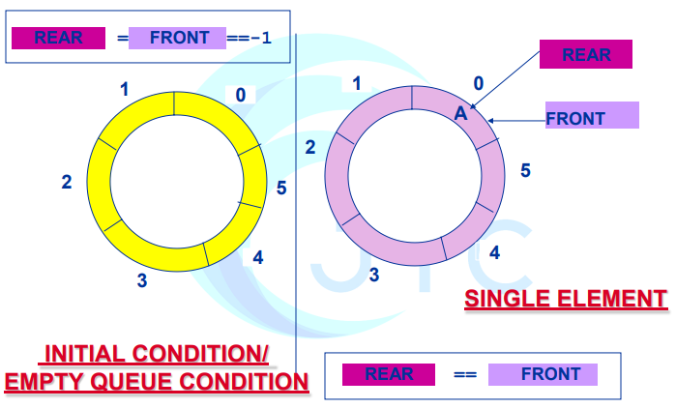
Pictorial representation of circular queue

Slide 42
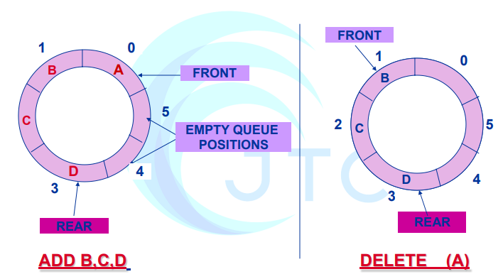
Pictorial representation of circular queue

Slide 43
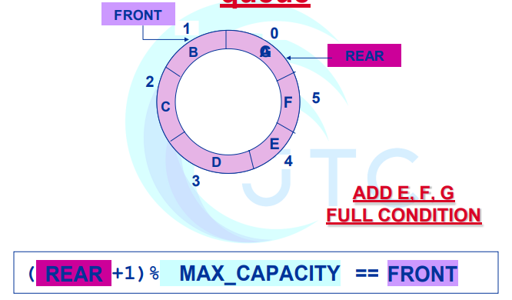
Pictorial representation of circular queue

Slide 44
Linked lists
Linked lists and arrays are similar since they both store collections of data. Array is the most common data structure used to store collections of elements.

Slide 45
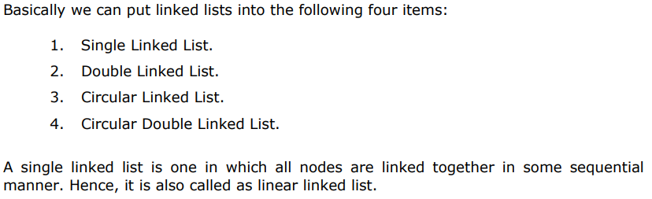
Types of Linked Lists

Slide 46
Single Linked List:
A linked list allocates space for each element separately in its own block of memory called a "node". The list gets an overall structure by using pointers to connect all its nodes together like the links in a chain. Each node contains two fields; a "data" field to store whatever element, and a "next" field which is a pointer used to link to the next node. Each node is allocated in the heap memory. The front of the list is a pointer to the “head” node.

Slide 47
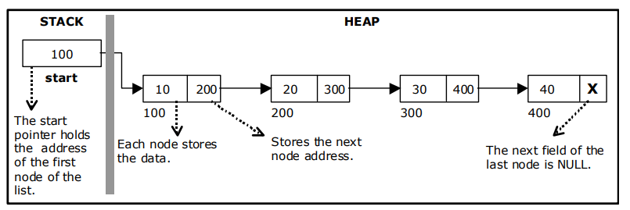
A single linked list
The beginning of the linked list is stored in a “head" pointer which points to the first node. The first node contains a pointer to the second node. The second node contains a pointer to the third node, ... and so on.

Slide 48
Implementation of Single Linked List
Before writing the code to build the above list, we need to create a start node, used to create and access other nodes in the linked list.
Creating a structure with one data item and a next pointer, which will be pointing to next node of the list.
This is called as self-referential structure.
• Initialise the start pointer to be NULL

Slide 49
The basic operations in a single linked list are:
Creation.
• Insertion.
• Deletion.
• Traversing.

Slide 50
Creating a node for Single Linked List:
Creating a singly linked list starts with creating a node. Sufficient memory has to be allocated for creating a node.
The function node(), is used for creating a node, after allocating memory for the structure of type node, the information for the item (i.e., data) has to be read from the user, set next field to NULL and finally returns the address of the node.

Slide 51
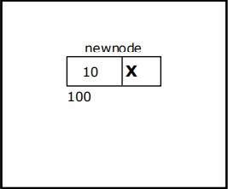
new node with a value of 10
class Node:
def __init__(self, data):
self.data = data
self.next = None
n1 = Node(10)

Slide 52
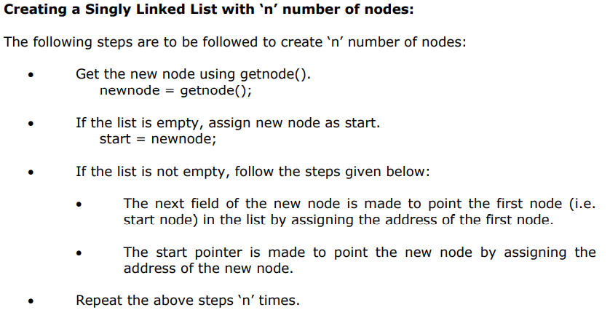

Slide 53
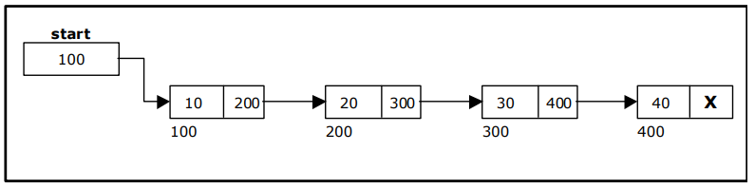
Single Linked List with 4 nodes

Slide 54
Creating Multiple Nodes
class Node:
def __init__(self, data):
self.data = data
self.next = None
n1 = Node(10)
n2 = Node(20)
n3 = Node(30)
data
next
n1
10
None
data
next
n2
20
None
data
next
n3
30
None

Slide 55
new node can then be inserted at three different places namely
Inserting a node at the beginning.
Inserting a node at the end.
Inserting a node at intermediate position.

Slide 56
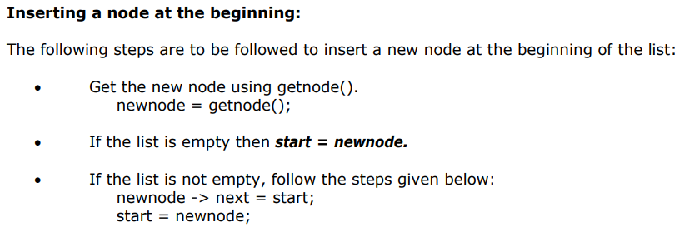
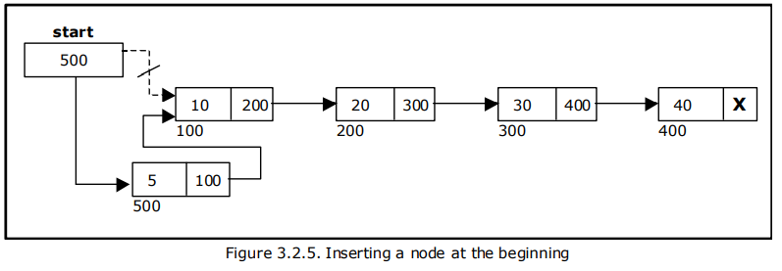

Slide 57
class Node:
def __init__(self, data):
self.data = data
self.next = None
class LinkedList:
def __init__(self):
self.head = None
def addFirst(self, val):
newNode = Node(val)
newNode.next = self.head
self.head = newNode
llist = LinkedList()
llist.addFirst(10)
llist.addFirst(20)
llist.addFirst(30)

Slide 58
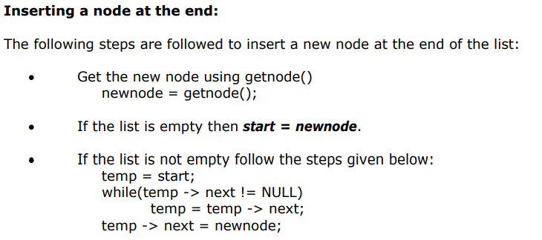

Slide 59
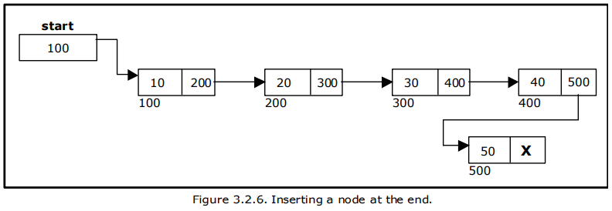

Slide 60
def addLast(self, val):
newNode = Node(val)
if self.head == None:
self.head = newNode
else:
lastNode = self.head
while (lastNode.next != None):
lastNode = lastNode.next
lastNode.next = newNode

Slide 61
def printList(self):
temp = self.head
print("The LinkedList Elements Are:") while(temp):
print(temp.data)
temp = temp.next
llist.printList()

