Slide 1
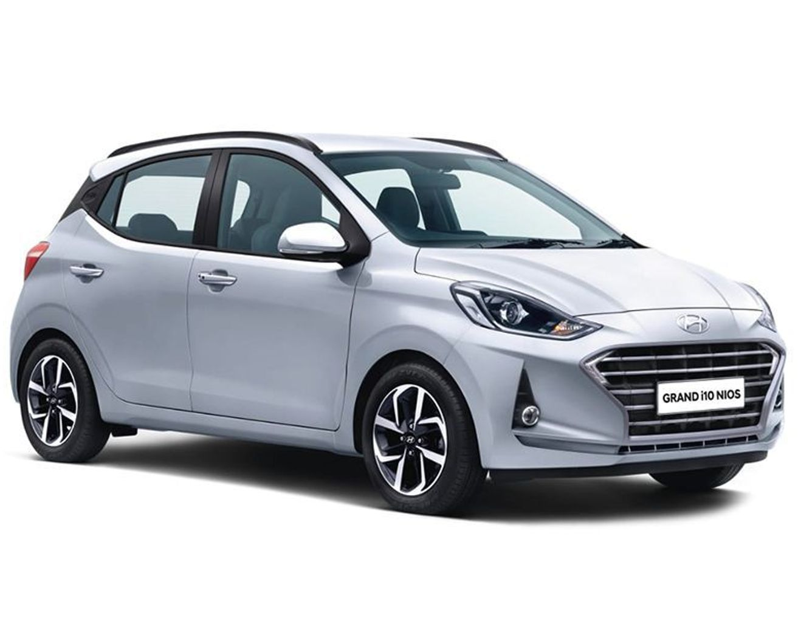
CAR
Properties
Color: silver
Brand: Hundai
Price: 7,00000
Rating: 3.5
Use Cases: Travelling
Attributes:
Color = silver
Brand = Hundai
Price = 700000
Rating = 3.5
Methods:
Action1 = movement
Action2 = Sound

