Slide 1
PYTHON · EDA PROJECT
Exploratory Data Analysis
of Global Water Consumption
Understanding Water Usage Patterns & Scarcity Trends Using Python
Presented by: Bhimashankar Teli , Sridhar Alagandala, RAMKUMAR S , Bhargav S V, Amrithya Muralikrishnan

Slide 2
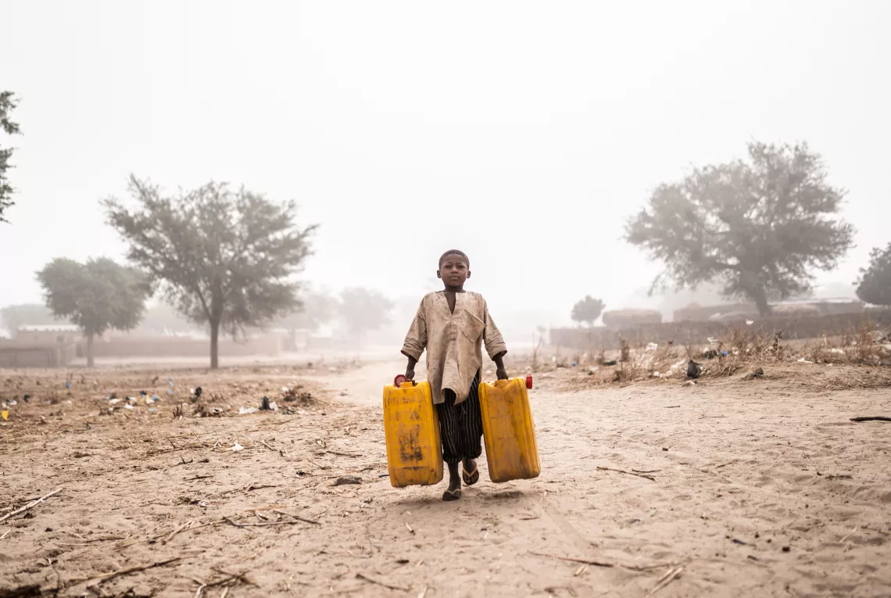
Context
Key Facts
Four billion people — almost two thirds of the world’s population — experience severe water scarcity for at least one month each year.
Over two billion people live in countries where water supply is inadequate.
Half of the world’s population could be living in areas facing water scarcity by as early as 2025.
Some 700 million people could be displaced by intense water scarcity by 2030.
By 2040, roughly 1 in 4 children worldwide will be living in areas of extremely high water stress.
Water scarcity | UNICEF

Slide 3
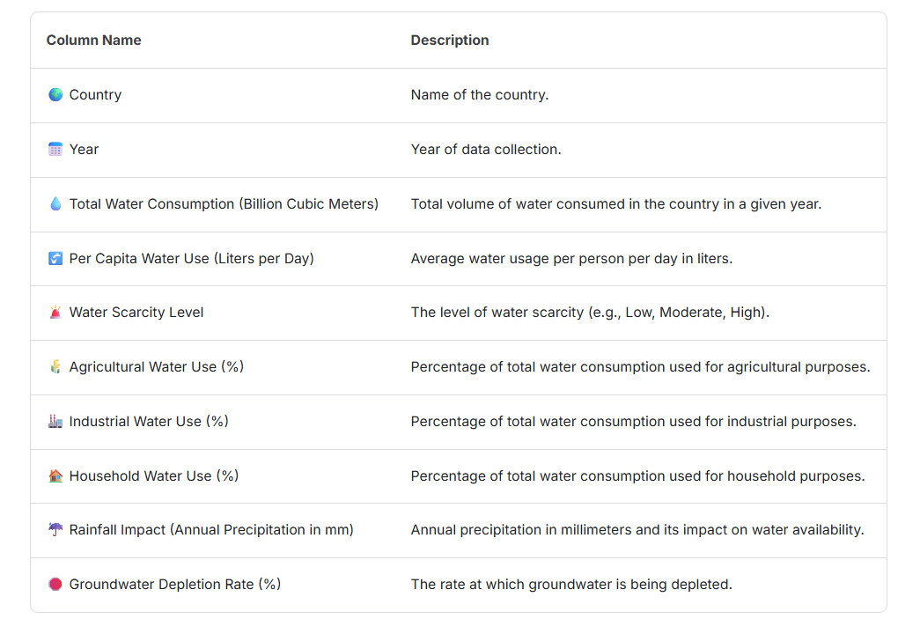
Globol Water Consumption Dataset Columns

Slide 4
OBJECTIVE & DATASET
Objective
Dataset Source
Perform EDA on a global water consumption dataset
Analyse water usage patterns across countries and years
Identify relationships between environmental factors and water scarcity
Generate insights supporting sustainable water management
Kaggle
3,900
Source
Records
Multi-var
None
Features
Missing Values
Multiple environmental and consumption features captured across countries and years.

Slide 5
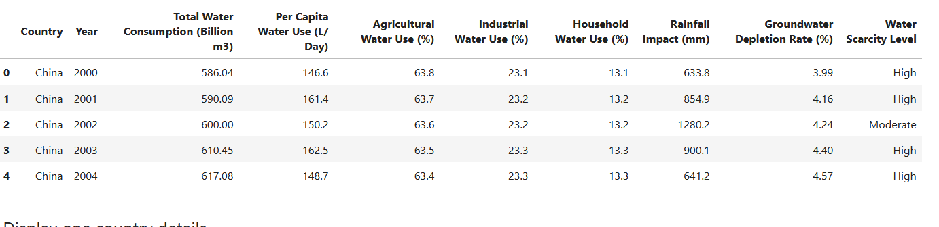
DATASET OVERVIEW
Key Stats
Dataset Preview
3,900
Total Records
0
Missing Values
Multi-year
Time Coverage
Global
Country Scope
Key Features
Total Water Consumption · Agricultural & Industrial Use · Household Water Use · Rainfall Levels · Groundwater Depletion Rate · Water Scarcity Level

Slide 6
DATA CLEANING & PREPARATION
01
Import
02
Inspect
03
Validate
Imported dataset using Pandas library
Examined structure with df.info() and df.describe()
Verified absence of missing values and checked duplicates
04
Convert
05
Prepare
Tools Used
Python · Pandas · NumPy
Matplotlib · Seaborn
Converted and standardised numerical data types
Finalised clean dataset for analysis

Slide 7
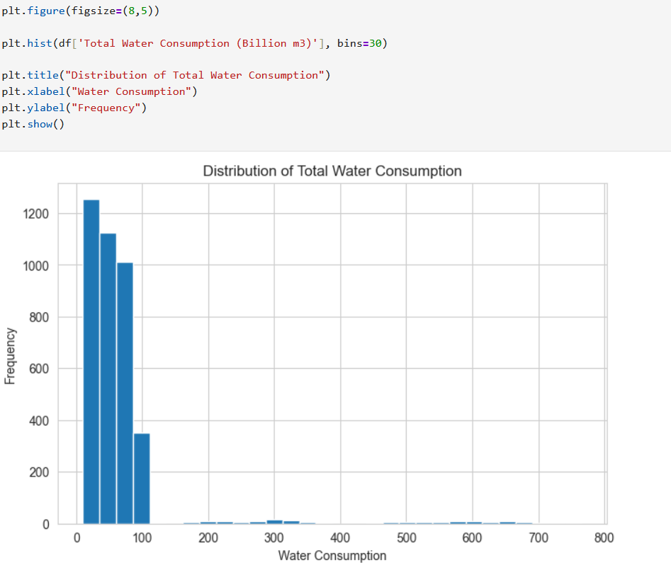
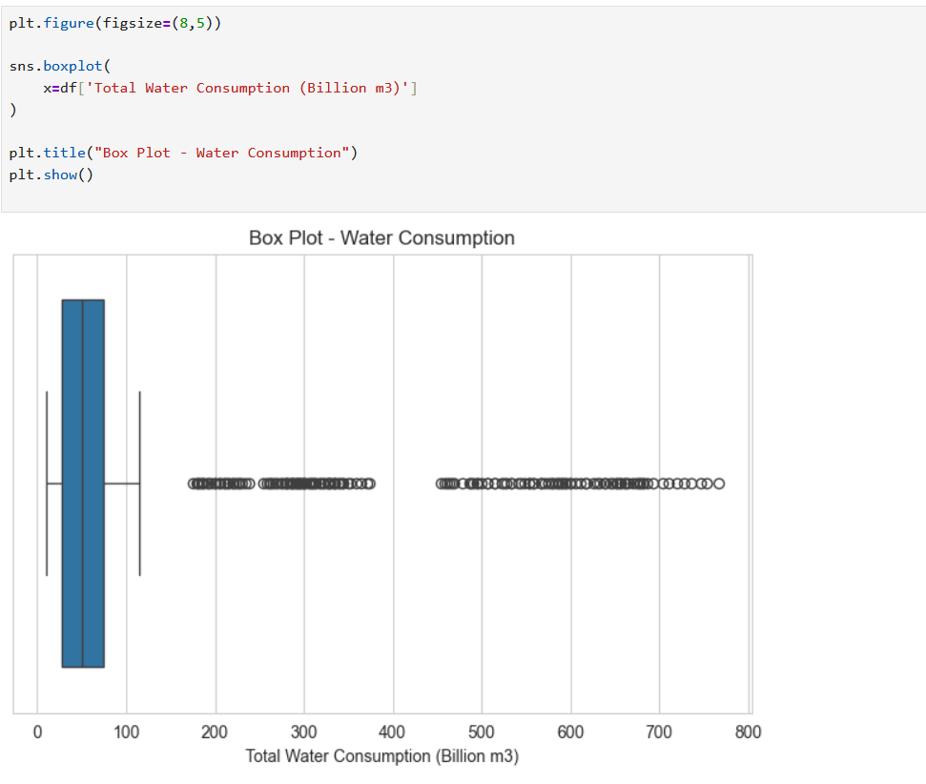
DISTRIBUTION ANALYSIS
Histogram – Variable Distribution
Box Plot – Outlier Detection
Key Insight
Histograms revealed moderate variation across countries · Box plots flagged extreme outliers in certain regions · Some countries exhibit unusually high water consumption levels

Slide 8
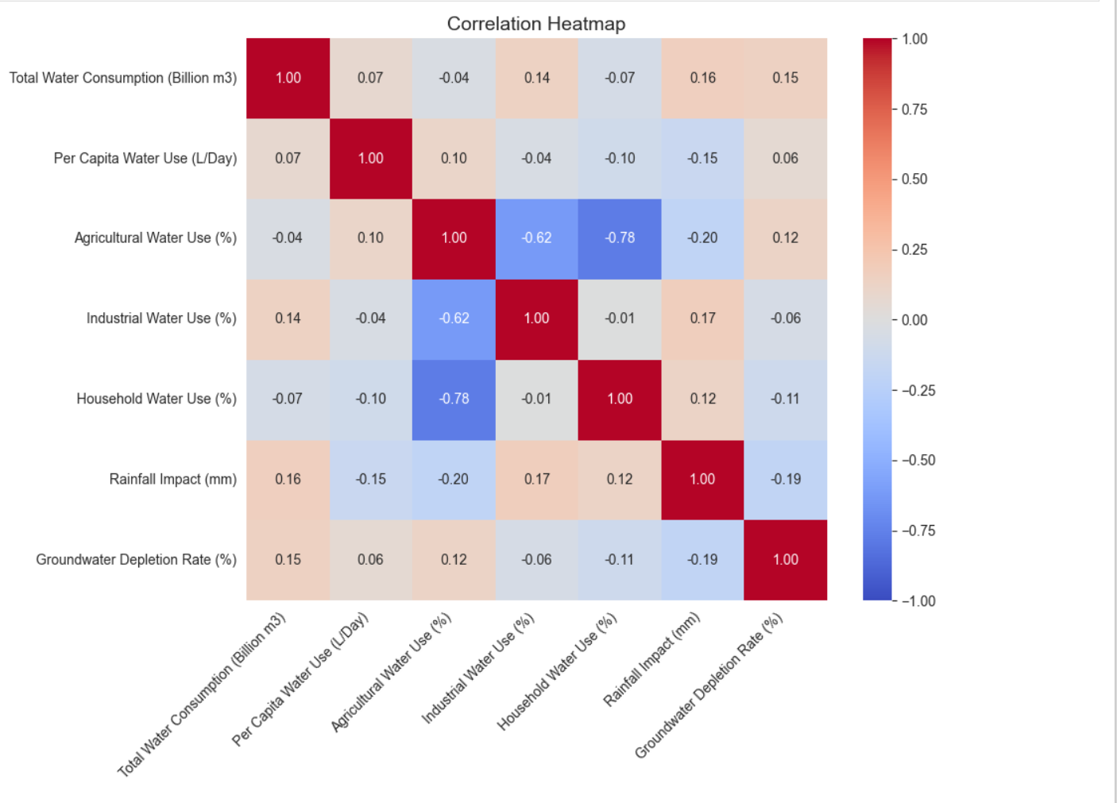
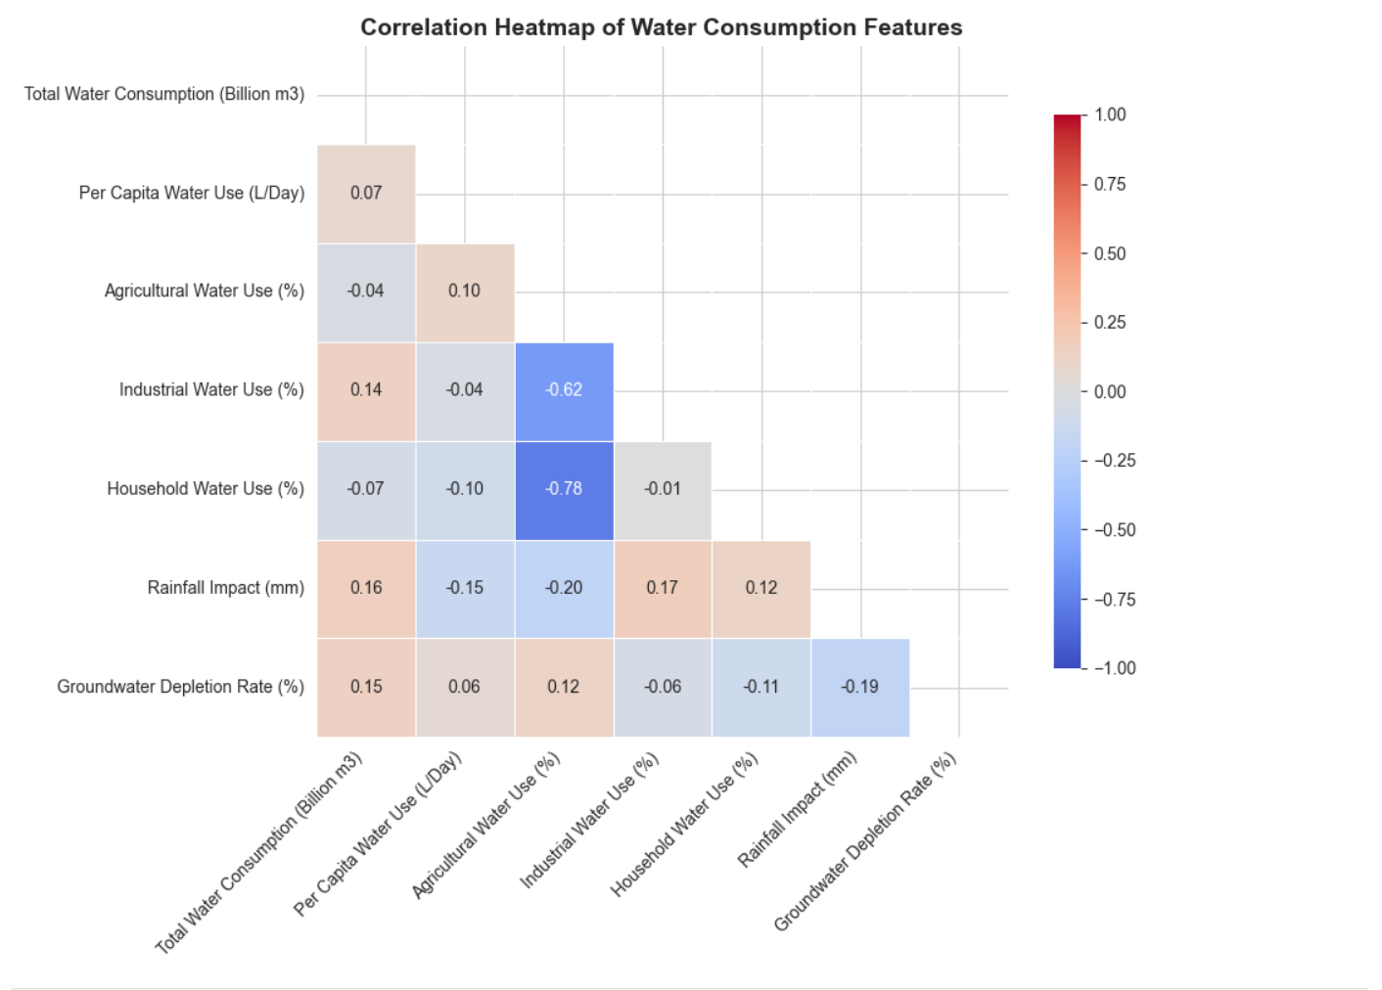
FEATURE RELATIONSHIPS
Correlation Heatmap
Scatter Analysis
Correlation Findings
Strong positive correlation between Total Water Consumption & Agricultural Water Use · Higher groundwater depletion linked with water scarcity · Lower rainfall regions depend more on groundwater

Slide 9
TRENDS OVER TIME
Gradual Increase
Water consumption shows steady yearly growth in several countries
Population Growth
Rising population drives increased demand for water resources
Industrial Expansion
Industrial activity significantly contributes to rising consumption

Slide 10
TRENDS OVER TIME
While the world’s population tripled in the 20th century, the use of renewable water resources has grown six-fold. Within the next fifty years, the world population will increase by another 40 to 50 %. This population growth – coupled with industrialization and urbanization – will result in an increasing demand for water and will have serious consequences on the environment.

Slide 11
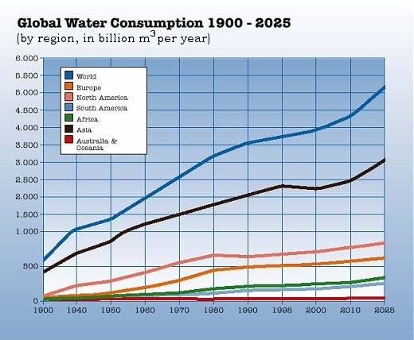
Globol Water Consumption
While the world’s population tripled in the 20th century, the use of renewable water resources has grown six-fold. Within the next fifty years, the world population will increase by another 40 to 50 %. This population growth – coupled with industrialization and urbanization – will result in an increasing demand for water and will have serious consequences on the environment.
Global Water Consumption 1900-2025 | SIMCenter

Slide 12
KEY INSIGHTS & OBSERVATIONS
01
Agriculture Dominates
02
Multi-Factor Scarcity
Agriculture is the single largest contributor to total water consumption globally
Water scarcity is driven by multiple environmental factors acting together
03
Groundwater Stress
04
Regional Variation
Groundwater depletion is a critical sustainability concern for future water security
Significant differences in consumption and scarcity exist across regions worldwide

Slide 13
FUTURE WORK
1
ML Forecasting
2
Risk Identification
Predict future water consumption using regression and time-series ML models
Identify countries at risk of severe water scarcity using classification models
3
Country Clustering
4
Sustainability Trends
Cluster countries based on usage patterns using K-Means or DBSCAN
Study long-term sustainability trends and policy impact on water usage

Slide 14
CONCLUSION
Key Takeaways
Exploratory Data Analysis revealed meaningful patterns in global water consumption. Agricultural usage and groundwater depletion emerged as the primary contributors to water stress and scarcity.
Foundation Built
Predictive Potential
Sustainable Planning
EDA establishes a strong analytical base for further modelling
Patterns support development of accurate forecasting models
Insights can guide evidence-based resource management
Group 2

Slide 15
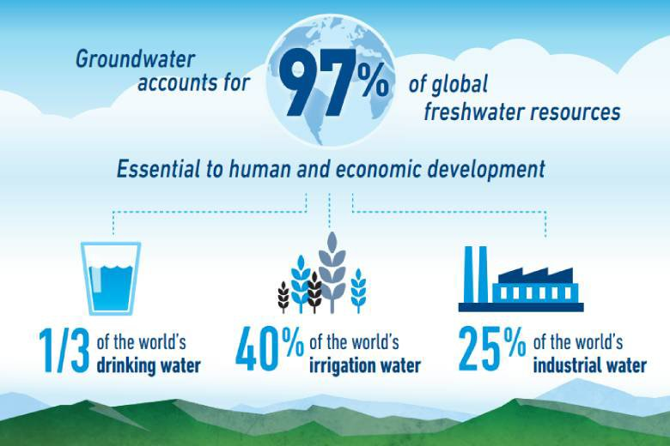
Water Stewardship
Groundwater May Be Hidden, But the Secret to Its Sustainability Is Not

