Slide 1


Innovation Meeting Strategy
Conducting Effective Innovation Meetings. This presentation outlines the strategy for productive innovation meetings.
Date: March 20, 2025.
by Muralikrishna Bhimavarapu

Slide 2
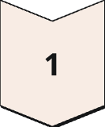
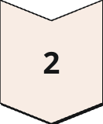
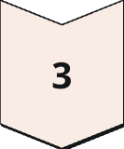
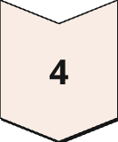

Idea Flow: Submission to Implementation
Idea Submission
Submit ideas through a dedicated portal, including a clear problem statement and proposed solution.
Scoring
Evaluate and score ideas based on their potential impact on the organization.
Stage-Gate Process
Implement a structured Stage-Gate process to manage ideas through various development stages.
Cross-functional Team
Assign a diverse, cross-functional team to champion and execute the idea.
Resource Allocation
Develop a comprehensive resource allocation plan to support the implementation of the idea.

Slide 3






Innovation Meeting Topics
Automation & AI
Process Optimization
Customer Experience
Security & Compliance
Automating repetitive tasks to improve efficiency.
Improving internal workflows.
Enhancing user satisfaction.
Strengthening data protection.
Cost Optimization
New Product/Feature Ideas
Reducing operational expenses.
Brainstorming innovative offerings.

Slide 4




Outcome
Regular Cadence
Establish monthly meetings.
Track Impact
Measure implemented ideas.
Foster Culture
Improve innovation across org

