Slide 1
racing vehicle lap-time optimization with obstacles and the battery state of charge
Bimlendra Ray
UT Dallas

Slide 2
Track
Introduction​
Vehicle Dynamics
Velocity Profile Generation
MPC Cost and Simulation
Optimization
​Results​

Slide 3
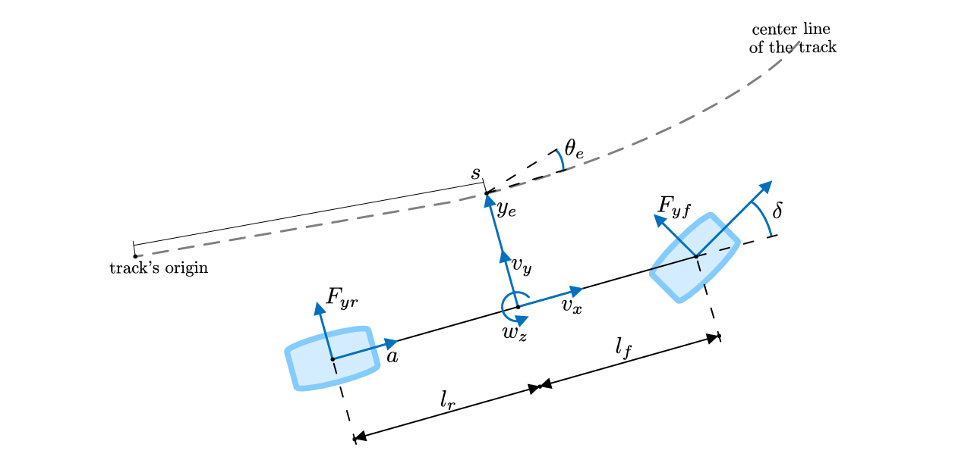
Introduction
Autonomous racing requires:
  Fast nonlinear dynamics
  Tight input/safety constraints
  Precise tracking of high-speed maneuvers
  ACADOS → SQP based solver → sub-millisecond MPC iterations
Goal: implement a full racing OCP using:
  7-state bicycle model
  Track curvature
  Lateral error constraints
  Lateral deviation
  Reference speed profile

Slide 4
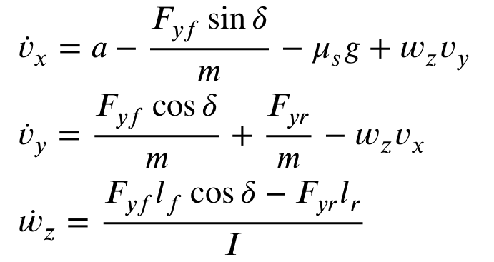
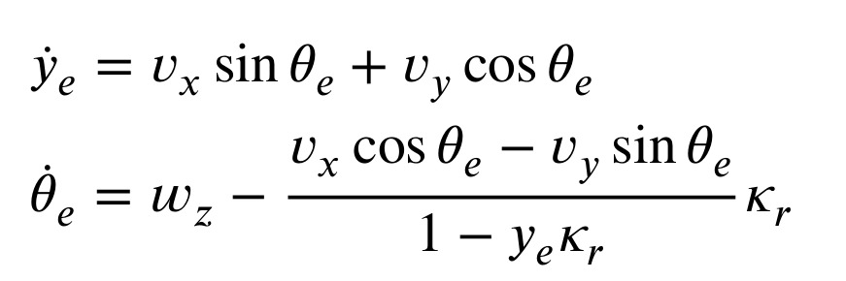
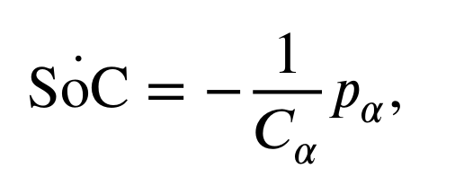
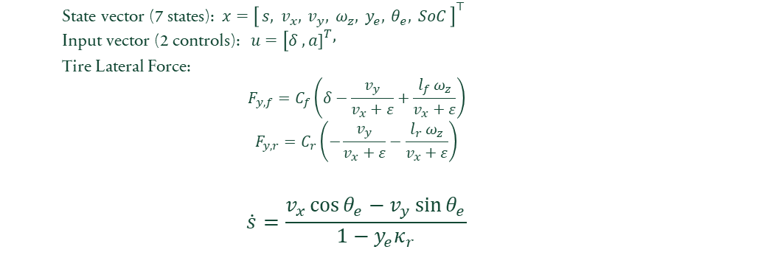
Vehicle dynamics
  $$\text{State} \text{vector}\text{ (}\text{7 }\text{states}\text{):} x={\left[ s, v_{x}, v_{y}, ω_{z}, y_{e}, θ_{e}, SoC \right]}^{⊤}$$
  $$\text{Input} \text{vector}\text{ (}\text{2 }\text{controls}\text{):} u=[δ ,a{\left.]\right.}^{T},$$
  Tire Lateral Force:
  $$F_{y,f}=C_{f}\left(δ−\frac{v_{y}}{v_{x}+ε}+\frac{l_{f} ω_{z}}{v_{x}+ε}\right)$$
  $$F_{y,r}=C_{r}\left(−\frac{v_{y}}{v_{x}+ε}−\frac{l_{r} ω_{z}}{v_{x}+ε}\right)$$
  $$\dot{s}=\frac{v_{x}\cos{θ_{e}}−v_{y}\sin{θ_{e}}}{1−y_{e}κ_{r}}$$
Dynamics: Explicit model
Includes:
  Road curvilinear frame (s, ye, θe)
  Lateral slip dynamics
  Yaw rate coupling
  Steering & acceleration nonlinear effects

Slide 5
Vehicle parameters
Racing Car = 1/10 scaled
m= 1.8; % mass [kg]
Iz = 0.03; % yaw inertia [kg*m^2]
lf = 0.125; % CG to front axle [m]
lr = 0.125; % CG to rear axle [m]
Cf = 68; % front cornering stiffness [N/rad]
Cr = 71; % rear cornering stiffness [N/rad]
mu_tyre = 1.2; % have huge effect -convergence/dynamics
g = 9.81;
% Battery / aero parameters
Cd = 0.35; %drag coeff.
rho = 1.225; % air density
Ar = 0.05; %Frontal tire area
C_alpha = 3000; %battery power

Slide 6
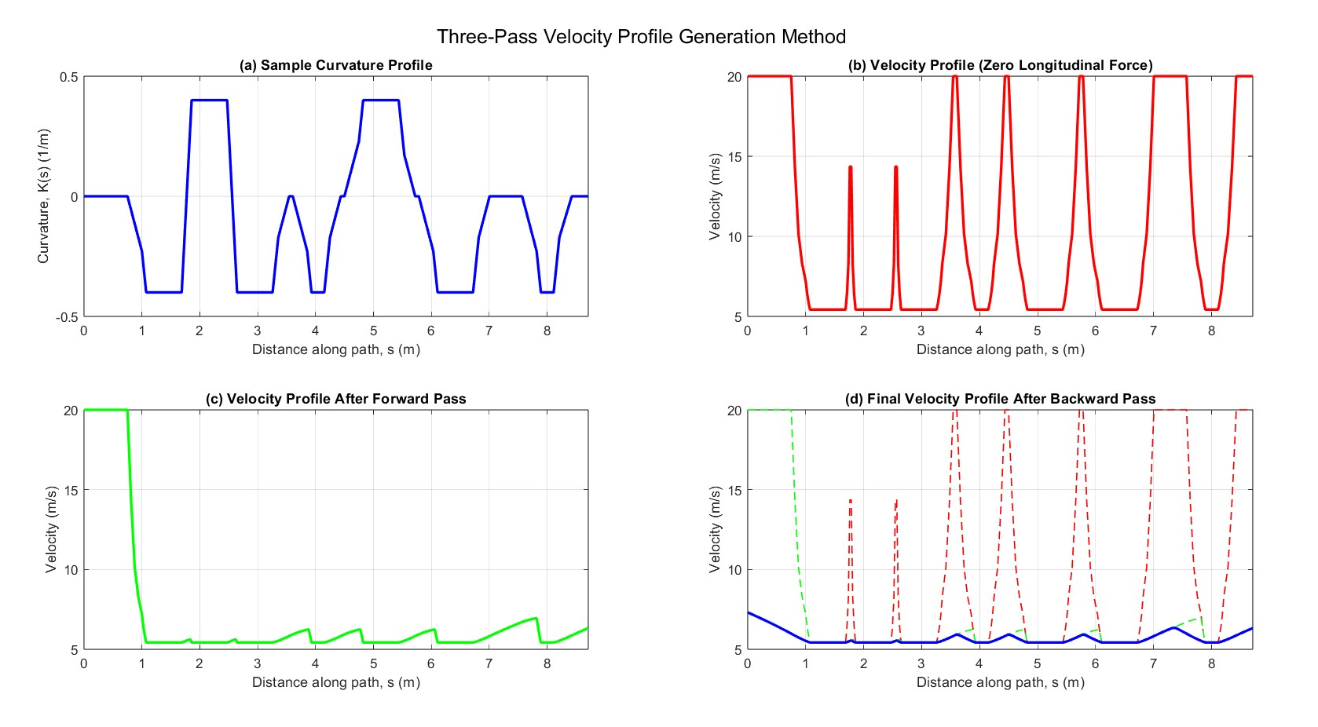
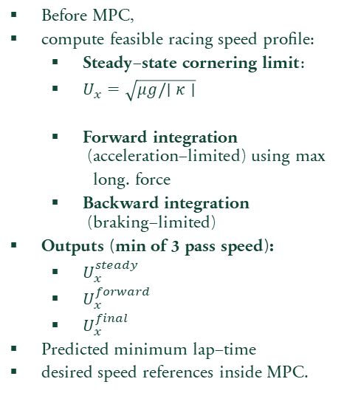
Velocity profile generation
    Lap Time : 1.5373s
$\text{Before} \text{MPC}\text{, }$
$\text{compute} \text{feasible} \text{racing} \text{speed} \text{profile}\text{:}$
    $\text{Steady}\text{−}\text{state} \text{cornering} \text{limit}$:
    $U_{x}=\sqrt{μg/∣κ∣}$
    $\text{Forward} \text{integration}\text{ (}\text{acceleration}\text{−}\text{limited}\text{)}$ using max
      long. force
    $\text{Backward} \text{integration}\text{ (}\text{braking}\text{−}\text{limited}\text{)}$
$\text{Outputs}\text{ (}\text{min} \text{of} \text{3 }\text{pass} \text{speed}\text{): }$
    $U_{x}^{steady}$
    $U_{x}^{forward}$
    $U_{x}^{final}$
$\text{Predicted} \text{minimum} \text{lap}\text{−}\text{time}$
desired speed references inside MPC.

Slide 7
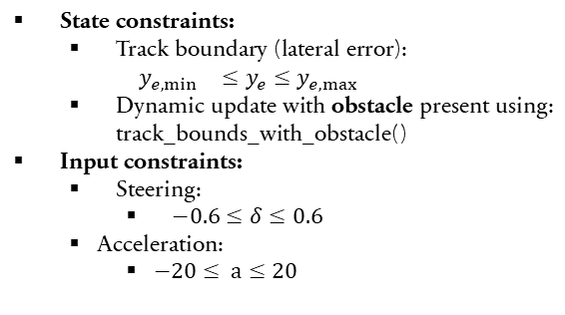
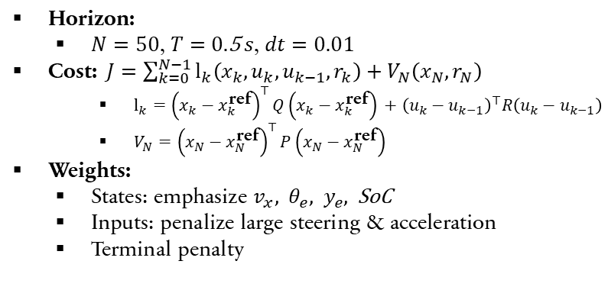
Mpc cost
$\text{Horizon}\text{:}$
  $N=50\text{, }T=0.\text{5} s\text{, }dt=0.01$
$\text{Cost}\text{:} J=\sum_{k=0}^{N−1}{l_{k}\left(x_{k},u_{k},u_{k−1},r_{k}\right)}+V_{N}\left(x_{N},r_{N}\right)$
    $l_{k}={\left(x_{k}−x_{k}^{\text{ref}}\right)}^{⊤}Q\left(x_{k}−x_{k}^{\text{ref}}\right) +{\left(u_{k}−u_{k−1}\right)}^{⊤}R\left(u_{k}−u_{k−1}\right)$
    $V_{N}={\left(x_{N}−x_{N}^{\text{ref}}\right)}^{⊤}P\left(x_{N}−x_{N}^{\text{ref}}\right)$
$\text{Weights}\text{:}$
  $\text{States}\text{: }\text{emphasize} v_{x}, θ_{e}, y_{e}, \text{SoC}$
  $\text{Inputs}\text{: }\text{penalize} \text{large} \text{steering} \text{\& }\text{acceleration}$
  $\text{Terminal} \text{penalty}$
Constraints
$\text{State} \text{constraints}\text{:}$
  $\text{Track} \text{boundary} \text{(}\text{lateral} \text{error}\text{):}$
  $$y_{e,\min{}}≤y_{e}≤y_{e,\max{}}$$
  $\text{Dynamic} \text{update} \text{with} \text{obstacle} \text{present} \text{using}\text{:}$
  $\text{track}\text{_}\text{bounds}\text{_}\text{with}\text{_}\text{obstacle}\text{()}$
$\text{Input} \text{constraints}\text{:}$
  $\text{Steering}\text{:}$
    $−0.6≤δ≤0.6$
  Acceleration:
    $−20≤ a≤20$

Slide 8
Solver settings
ACADOS settings:
  nlp_solver: SQP
  sim_method: ERK4, 3 steps
  QP solver: partial-condensing HPIPM
This gives fast solve times below 1–3 ms per iteration.
s_obs = 5.0;
ye_obs = 0.05;
obs_w = 0.05;
obs_L = 0.05;
track_width = 0.24;
x0 = [0.0; % s
0.5; % vx
0.0; % vy
0.0; % wz
0.0; % ye
0.0; % theta_e
95.0]; % SoC
N = 50; % prediction horizon
T = 1.0; % horizon duration
dt = T/N;

Slide 9
Computational cost
MPC Timing
Average MPC solve time : 0.00083s
Maximum MPC solve time : 0.00336s
Sampling time Ts : 0.010 s
CI_avg = Tc_avg/Ts : 0.083 (computational load)
CI_max = Tc_max/Ts : 0.339
Status: REAL-TIME OK (CI_max < 1)
Lap-time : 1.65142
Velocity Profile: 1.5373

Slide 10
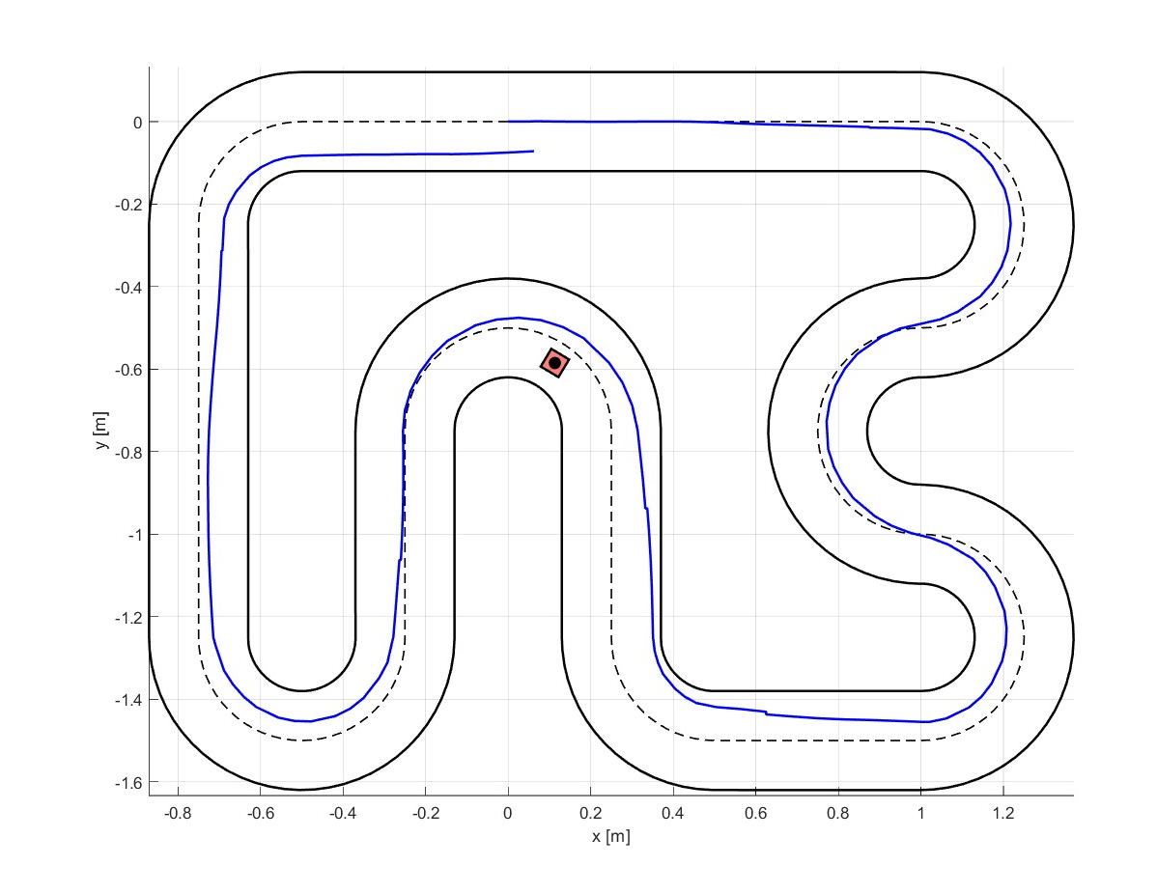
Track generation
start

Slide 11
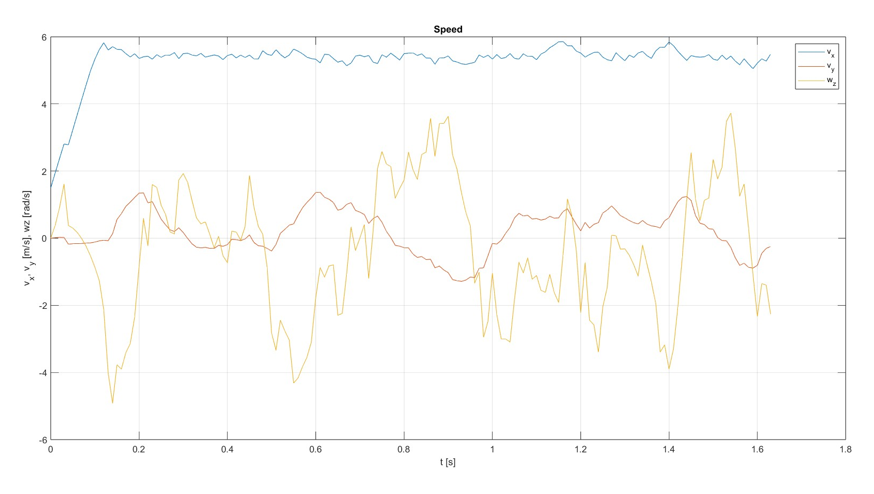
States: vx, vy, wz

Slide 12
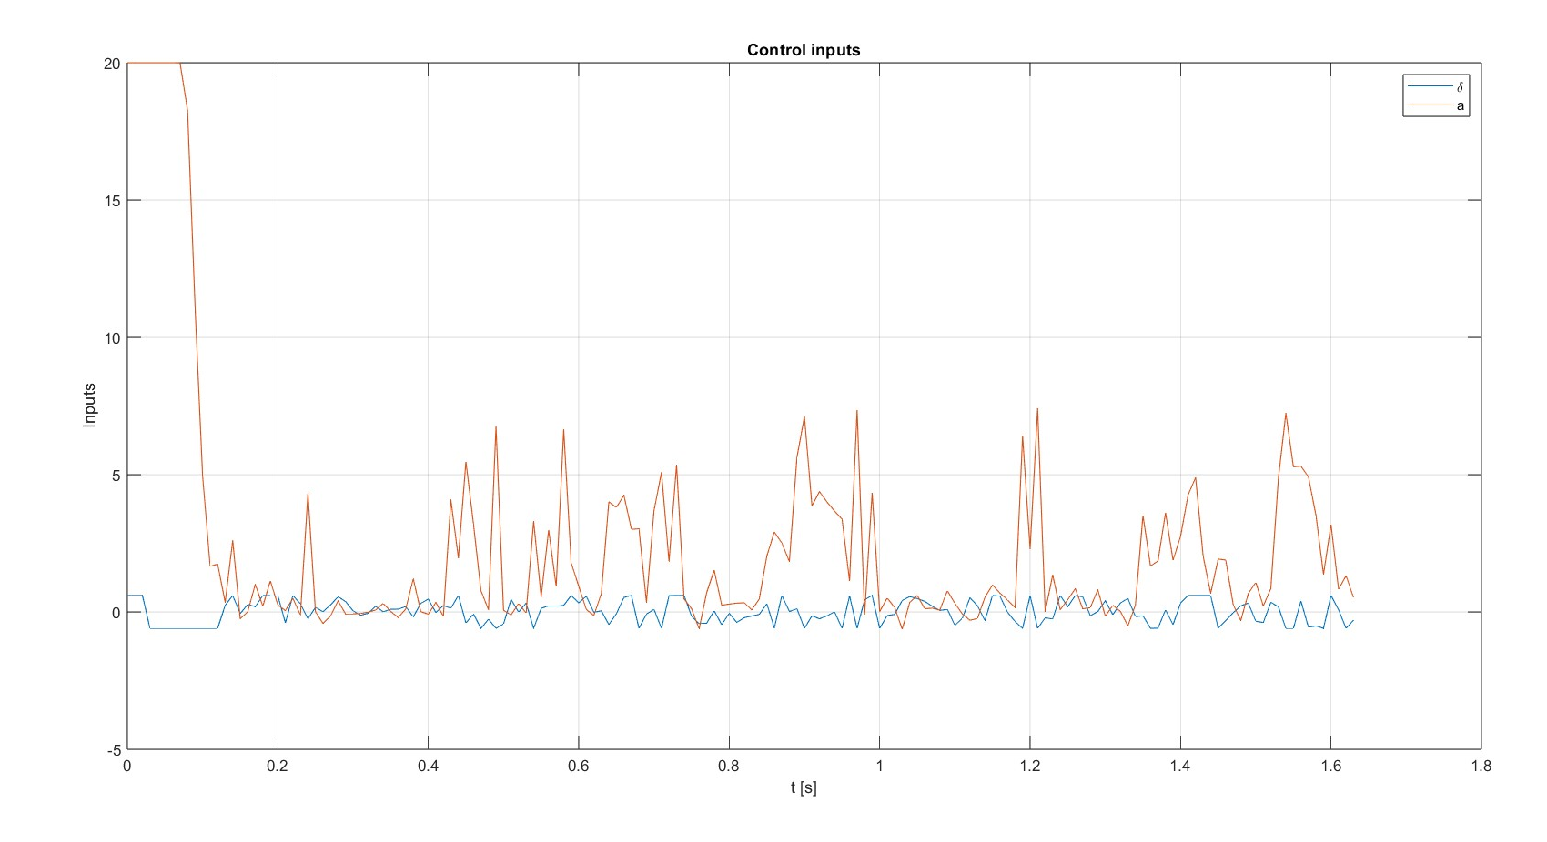
Input: steering angle and acceleration

Slide 13
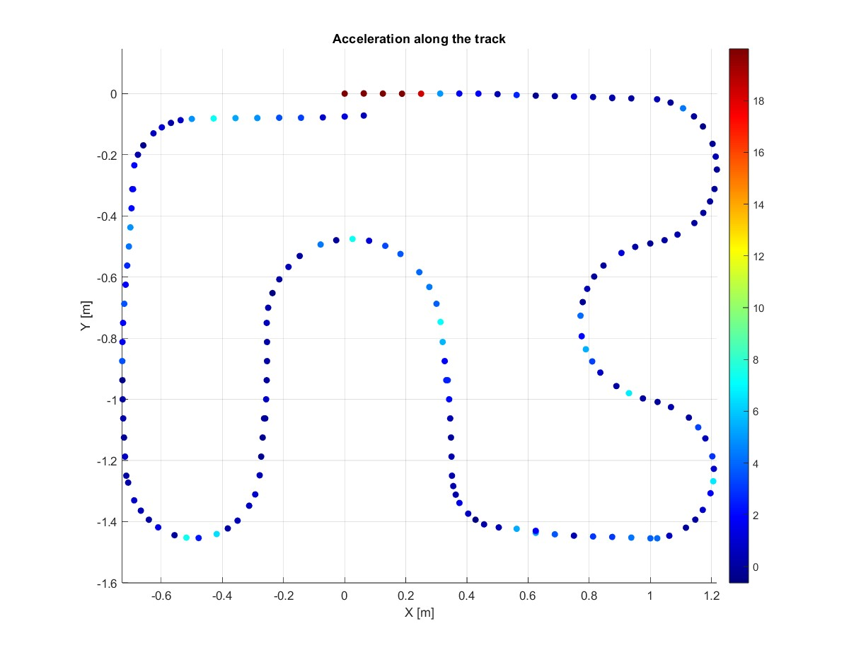
Acceleration

Slide 14
THANK YOU

