Slide 1
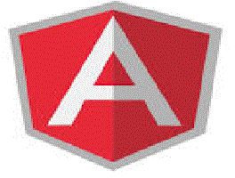
Angular JS (Scopes)

Slide 2
Objectives
Understanding scopes
Characterestics
Implementations

Slide 3
What is Scope
Scope is an object that refers to the application model. It is an execution context for expressions.
Scopes are arranged in hierarchical structure which mimic the DOM structure of the application.
Scopes can watch expressions and propagate events.

Slide 4
Characterestics
Scopes provide APIs ($watch) to observe model mutations.
Scopes provide APIs ($apply) to propagate any model changes through the system into the view from outside of the "AngularJS realm" (controllers, services, AngularJS event handlers).
Scopes can be nested to limit access to the properties of application components while providing access to shared model properties.
Nested scopes are either "child scopes" or "isolate scopes".
A "child scope" (prototypically) inherits properties from its parent scope. An "isolate scope" does not.

Slide 5
Data-Model
Scope is the glue between application controller and the view. During the template linking phase the directives set up $watch expressions on the scope.
The $watch allows the directives to be notified of property changes, which allows the directive to render the updated value to the DOM.
The controller and directives references the scope.

Slide 6
Scope Hierarchies
Each AngularJS application has exactly one root scope, but may have any number of child scopes.
The application can have multiple scopes, because directives can create new child scopes.
When new scopes are created, they are added as children of their parent scope.
This creates a tree structure which parallels the DOM where they're attached.

Slide 7
Scope Creation
AngularJS creates the initial scope, which it calls $rootScope. It then compiles the document, starting at the root element.
As it traverses the DOM ,it encounters and processes directives.
During process directives like ng-controller requests new scopes.
Once compilation is done Angular-JS creates mirror of the DOM Tree.
$rootScope binds root element, and child scopes are bound to DOM elements.

Slide 8
Scope Creation Example
app.controller('OuterController', function($scope) { $scope.outer = 'From the outside';});
app.controller('InnerController', function($scope) { $scope.inner = 'looking in.';});
<div ng-controller="OuterController">
<div ng-controller="InnerController"> {{outer}},
{{inner}}
</div>
</div>

Slide 9
Scope Inheritance
In javaScript it inheritance doesn’t exist. It has a special property called prototype.
If the property doesn’t exist it will search prototype in it’s chain.
Angular JS uses object prototypes to implement child scopes.
When creating new scope, default it sets new scope’s prototype to it’s parent.

Slide 10
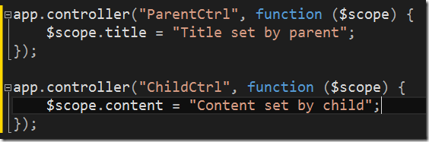
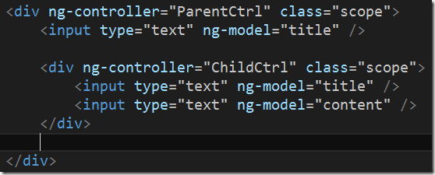
Scope Inheritance Example

Slide 11
Isolated Scope
Angular-JS has it’s default scope inheritance model can be very useful to divide up parts of a large application, but sometimes it causes problems.
When reusability of the scope causes complexity, Angular-JS provides Isolated Scope, these are similar to normal scope

Slide 12
Isolated Scope Example
app.directive('isolated', function() { return { scope: {}, template:
'<input ng-model= "message.content"> <span>{{message.content}}</span>' };
});
<div ng-controller="EditController">
<input ng-model="message.content"> <span>{{message.content}}</span>
<div isolated></div></div>

Slide 13
Shared Scope
myApp.factory('Data', function () {
return { FirstName: '' }; });
myApp.controller('FirstCtrl', function ($scope, Data) {
$scope.Data = Data; });
myApp.controller('SecondCtrl', function ($scope, Data) { $scope.Data = Data; });
<div ng-controller="FirstCtrl">
<input type="text" ng-model="Data.FirstName">
<br>Input is : <strong>{{Data.FirstName}}</strong>
</div>
<hr> <div ng-controller="SecondCtrl">
Input should also be here: {{Data.FirstName}} </div>

Slide 14
Controller
AngularJS application mainly relies on controllers to control the flow of data in the application.
A controller is defined using ng-controller directive.
Each controller accepts $scope as a parameter which refers to the application/module that controller is to control.
A controller is a JavaScript Object, created by a standard JavaScript object constructor.

Slide 15
Controller Methods
<div ng-app="myApp" ng-controller="personCtrl"> First Name: <input type="text" ng-model="firstName"><br> Last Name: <input type="text" ng-model="lastName"><br> <br> Full Name: {{fullName()}} </div> <script> var app = angular.module('myApp', []); app.controller('personCtrl', function($scope) { $scope.firstName = “Ram"; $scope.lastName = “Kumar"; $scope.fullName = function() { return $scope.firstName + " " + $scope.lastName; } }); </script>

Slide 16
Angular JS Controller Example:
<div ng-app=“App" ng-controller="myCtrlr"> First Name: <input type="text" ng-model="firstName"><br> Last Name: <input type="text" ng-model="lastName"><br> <br> Full Name: {{firstName + " " + lastName}} </div> <script> var app = angular.module('App', []); app.controller('myCtrlr', function($scope) { $scope.firstName= “Ram"; $scope.lastName= “Gopal"; }); </script>

Slide 17
Angular JS Object
<div ng-app="" ng-init ="person={firstName:'John',lastName:'Doe'}"> <p>The name is {{ person.lastName }}</p> </div>

Slide 18
Arrays in Angular JS
Arrays are initialized in Angular JS with the declaration of variable ex:
<div ng-app=“ “ ng-init=“days=[‘sun’,’mon’,’tue’]”>
<p> Selected Day {{ days[0] }}</p>
</div>

