Slide 1
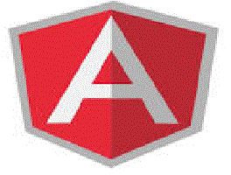
Angular JS

Slide 2
Objectives
Angular JS Expression
Angular JS Controller
Scopes of Angular JS
Angular JS Objects
Arrays in Angular JS
External JS

Slide 3
AngularJS Expressions
AngularJS expressions are written inside double braces:
{{ expression }}.
AngularJS expressions binds data to HTML the same way as the ng-bind directive.
AngularJS will "output" data exactly where the expression is written.

Slide 4
Angular Js Expression Example
<div ng-app="" ng-init="quantity=1;cost=5"> <p>Total in dollar: {{ quantity * cost }}</p> </div>

Slide 5
Angular JS Controller
Angular JS controller used for grouping of models.
In order to create Angular JS controller we need to set Controller with application Directive
Ex:
<div ng-app=“MyApp” ng-controller=“myCtrl”>
Note: In this ng-app directive defines the application,
the ng-controller directive defines the controller.
Controller Continued…

Slide 6
Scope in Angular JS
In an AngularJS application, the controller and view share an object called a scope.
The controller sets properties on the scope, and the view binds to those properties.
Types of Scopes:
Scope Creation
Scope Inheritance
Isolating Scope
Sharing Scope

Slide 7
Scope Creation
AngularJS creates the initial scope, which it calls $rootScope. It then compiles the document, starting at the root element.
As it traverses the DOM ,it encounters and processes directives.
During process directives like ng-controller requests new scopes.
Once compilation is done Angular-JS creates mirror of the DOM Tree.
$rootScope binds root element, and child scopes are bound to DOM elements.

Slide 8
Scope Creation Example
app.controller('OuterController', function($scope) { $scope.outer = 'From the outside';});
app.controller('InnerController', function($scope) { $scope.inner = 'looking in.';});
<div ng-controller="OuterController">
<div ng-controller="InnerController"> {{outer}},
{{inner}}
</div>
</div>

Slide 9
Scope Inheritance
In javaScript it inheritance doesn’t exist. It has a special property called prototype.
If the property doesn’t exist it will search prototype in it’s chain.
Angular JS uses object prototypes to implement child scopes.
When creating new scope, default it sets new scope’s prototype to it’s parent.

Slide 10
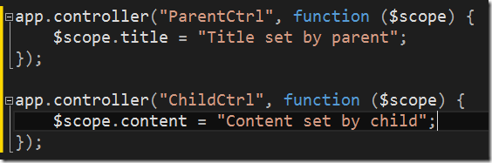
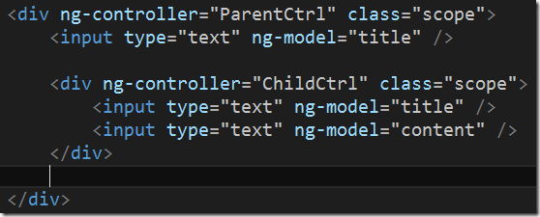
Scope Inheritance Example

Slide 11
Isolated Scope
Angular-JS has it’s default scope inheritance model can be very useful to divide up parts of a large application, but sometimes it causes problems.
When reusability of the scope causes complexity, Angular-JS provides Isolated Scope, these are similar to normal scope

Slide 12
Isolated Scope Example
app.directive('isolated', function() { return { scope: {}, template:
'<input ng-model= "message.content"> <span>{{message.content}}</span>' };
});
<div ng-controller="EditController">
<input ng-model="message.content"> <span>{{message.content}}</span>
<div isolated></div></div>

Slide 13
Shared Scope
myApp.factory('Data', function () {
return { FirstName: '' }; });
myApp.controller('FirstCtrl', function ($scope, Data) {
$scope.Data = Data; });
myApp.controller('SecondCtrl', function ($scope, Data) { $scope.Data = Data; });
<div ng-controller="FirstCtrl">
<input type="text" ng-model="Data.FirstName">
<br>Input is : <strong>{{Data.FirstName}}</strong>
</div>
<hr> <div ng-controller="SecondCtrl">
Input should also be here: {{Data.FirstName}} </div>

Slide 14
Controller
AngularJS application mainly relies on controllers to control the flow of data in the application.
A controller is defined using ng-controller directive.
Each controller accepts $scope as a parameter which refers to the application/module that controller is to control.
A controller is a JavaScript Object, created by a standard JavaScript object constructor.

Slide 15
Controller Methods
<div ng-app="myApp" ng-controller="personCtrl"> First Name: <input type="text" ng-model="firstName"><br> Last Name: <input type="text" ng-model="lastName"><br> <br> Full Name: {{fullName()}} </div> <script> var app = angular.module('myApp', []); app.controller('personCtrl', function($scope) { $scope.firstName = “Ram"; $scope.lastName = “Kumar"; $scope.fullName = function() { return $scope.firstName + " " + $scope.lastName; } }); </script>

Slide 16
Angular JS Controller Example:
<div ng-app=“App" ng-controller="myCtrlr"> First Name: <input type="text" ng-model="firstName"><br> Last Name: <input type="text" ng-model="lastName"><br> <br> Full Name: {{firstName + " " + lastName}} </div> <script> var app = angular.module('App', []); app.controller('myCtrlr', function($scope) { $scope.firstName= “Ram"; $scope.lastName= “Gopal"; }); </script>

Slide 17
Angular JS Object
<div ng-app="" ng-init ="person={firstName:'John',lastName:'Doe'}"> <p>The name is {{ person.lastName }}</p> </div>

Slide 18
Arrays in Angular JS
Arrays are initialized in Angular JS with the declaration of variable ex:
<div ng-app=“ “ ng-init=“days=[‘sun’,’mon’,’tue’]”>
<p> Selected Day {{ days[0] }}</p>
</div>

Slide 19
Iteration of Array
<div ng-app=“ “ ng-init=“ days={‘sun’,’mon’,’tue’,’wed’,’thu’,’fri’,’sat’}”>
<p>
<ul>Days in a Week
<li ng-repeat=“day in days”>
{{day}}
</ul>
</p>

Slide 20
Array with Pair of Values
<div ng-app="" ng-init=“ names=[ {name:'Jani', country:'Norway'}, {name:'Hege', country:'Sweden'}, {name:'Kai', country:'Denmark'}] “ > <ul> <li ng-repeat="x in names"> {{ x.name + ', ' + x.country }} </li> </ul> </div>

