Slide 1

Angular

Slide 2
Objectives
Basic pre requirements for Angular
What are the IDEs used
How do we create Project for Angular

Slide 3
Pre requirements
Following are the basic requisites used for angular
Nodejs
Npm
Angular CLI

Slide 4
NodeJs
This is the primary platform for installation of js frameworks.
This must be pre-installed over your machine before you start Angular.
If already installed please check it’s availability with following Command:
node –v
Check node project module with the command:
npm -v
If Node does not exist install from this url:
https://nodejs.org/en/download/

Slide 5
Angular CLI
Angular Command Line Interface (CLI) is must to install angular
Apply the following command from your OS prompt( note: Ensure your OS connected to internet)
npm install –g @angular/cli
ng new my-proj
cd my-proj
Test execution of project use the command as
ng serve

Slide 6
What are the IDEs preferred
Visual Studio Code
Notepad++

Slide 7
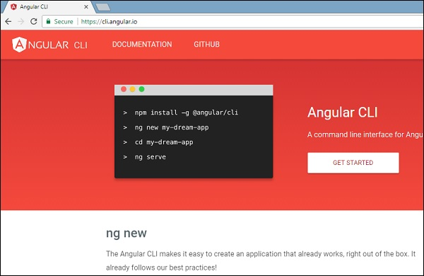
Project Setup

