Slide 1

Angular Installation

Slide 2
Requirements for Angular
Node.js of any latest version
Npm of latest version
After installation of Node and check for the version by using command:
Node –v
Npm -v
Link to download Node.js
https://nodejs.org/en/download/

Slide 3
Installation of Angular
Angular of any version above 2 is installed with the support of Node.js
npm install –g @angular/cli →install angular
This will consume minimum time

Slide 4
Create Project for Angular
Create your project module for angular
ng new my_app → create project

Slide 5
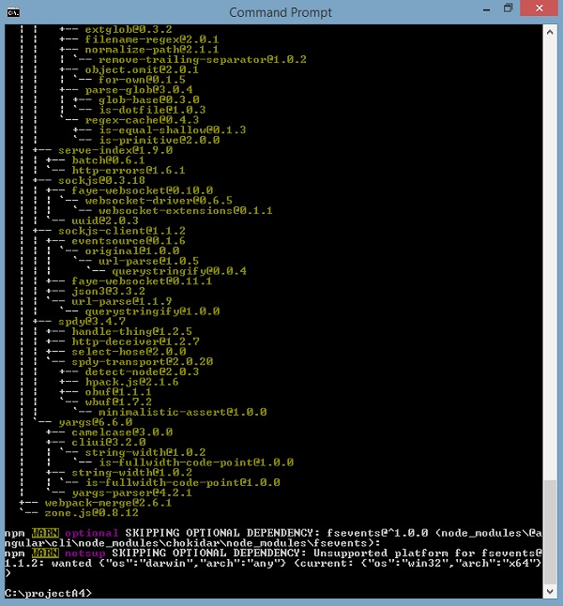
How to confirm project created
At the time of creation of project we find output screen as below …

Slide 6
How to Execute Project
Once project is created Execute It:
cd my_app
ng serve → to run project

Slide 7
GIT key features
GIT is Easy for subdivision and merging of code.
Approach to use multiple techniques for the flow of code within Git.
Git is very fast when compared with other SCM tools.
Offers better data assurance.
Free and open source.
Download GIT from the URL
https://git-scm.com/

Slide 8
Angular Architecture
Component
Component
Component
Service

Slide 9
Angular Component
Component Consist of
Class − This is like a C++ or Java class which consists of properties and methods.
Metadata − This is used to decorate the class and extend the functionality of the class.
Template − This is used to define the HTML view which is displayed in the application.
Template
Class
Metada
Component

Slide 10
What is component
Component is logical segments of code.
Component consist of follow properties:
Template
contains the HTML that needs to be rendered in the application. This part also includes the binding and directives.
Class
This is coded in type script.
Consist of properties and methods.
This is supported for the view.
MetaData
This is an additional information of Angular JS.

Slide 11
How to define Angular JS class
Syntax
class ClassName{
propertyname: property_Type=value;
}
Example:
export class AppComponent {
appTitle: string = ‘Hi…’;
}

Slide 12
Template
Template is the view which needs to be rendered in the application.
Syntax:
Template: `
<HTML code>
class properties `

Slide 13
Parameters
HTML Code − This is the HTML code which needs to be rendered in the application.
Class properties − These are the properties of the class which can be referenced in the template.
Example
template: '
<div> <h1>{{appTitle}}</h1>
<div>Welcome Angular Developers</div> </div> '

Slide 14
Metadata
This is used to decorate Angular JS class with additional information.

Slide 15
Example of Component usage
import { Component } from '@angular/core'; @Component ({ selector: 'app-root',
template: `
<div> <h1>{{appTitle}}</h1> <div>New Experience </div> </div> `, })
export class AppComponent {
appTitle: string = 'Welcome';
}

Slide 16
templateUrl
Syntax:
templateURL: viewname.component.html
Notice:
viewname − This is the name of the app component module.
After the viewname, the component needs to be added to the file name.

Slide 17
Example: templateUrl
In component, templateUrl is used for the direction purpose.
Example
import { Component } from '@angular/core';
@Component ({
selector: 'app-root',
templateUrl: ‘./app.component.html' })
export class AppComponent { appTitle: string = 'Welcome'; }

Slide 18
Modules
Modules are used in Angular JS to put logical boundaries in your application.
Hence, instead of coding everything into one application, you can instead build everything into separate modules to separate the functionality of your application.

Slide 19
Parts of Module
Bootstrap array
This is used to tell Angular JS which components need to be loaded.
Once you include the component in the bootstrap array.
declare them so that they can be used across other components in the Angular JS application.
Export array
This is used to export components, directives, and pipes which can then be used in other modules.
Import array
Just like the export array, the import array can be used to import the functionality from other Angular JS modules.

Slide 20
Module Example
import { NgModule } from '@angular/core';
import { BrowserModule } from '@angular/platform-browser';
import { AppComponent } from './app.component';
@NgModule ({
imports: [ BrowserModule ],
declarations: [ AppComponent ],
bootstrap: [ AppComponent ] })
export class AppModule { }

Slide 22
Create Angular Application using GIT
After installation of GIT
Appy the following command from command prompt.
Git https://github.com/angular/quickstart proj_name
Type git and type url followed by proj_name press return key

Slide 23
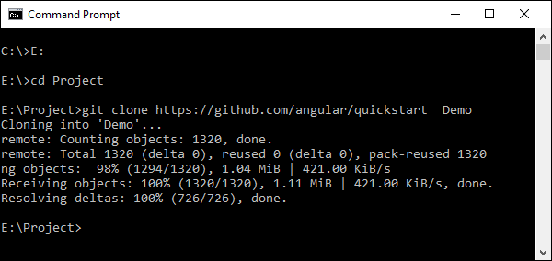
GIT Angular 2 project

Slide 24
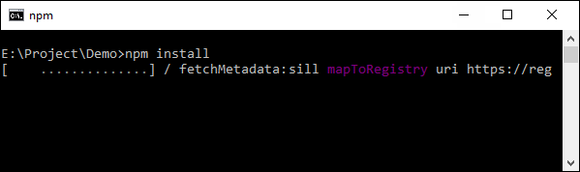
Install NPM for Angular

Slide 25
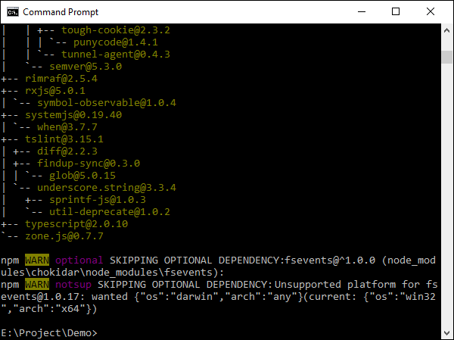

Slide 26
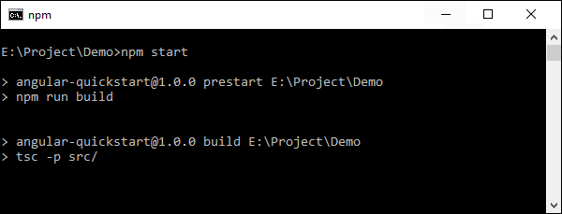
Start NPM

Slide 27
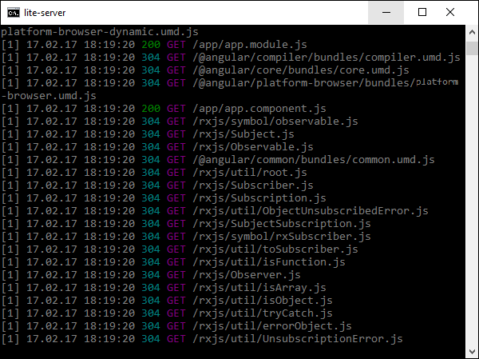

Slide 28
Editing Project
Open source code using any editor.
I would like to open Visual Studio Code

