Slide 1

Angular2

Slide 2
Objectives
What is Routing
Error Handling in Route
How do we navigate
Form Designing

Slide 3
What is Routing
Routing helps in connecting user to other page , on the option they choose on the main page.
Routing, based on the option what they select.
The required Angular Component will be rendered to the user.
We need to import the following libraries in the ng-module:
import { BrowserModule } from '@angular/platform-browser';
import { RouterModule, Routes } from '@angular/router';

Slide 4
Routing Path Setting
const appRoutes: Routes = [
{ path: 'Product', component: Appproduct },
{ path: 'Inventory', component: AppInventory },
];

Slide 5
@ngmodule
Apply the following code for NgModule
@NgModule ({ imports: [ BrowserModule, RouterModule.forRoot(appRoutes)], declarations: [ AppComponent,Your Component Class1,Class2,Class3], bootstrap: [ AppComponent ] })

Slide 6
Override app.component.ts file
@Component ({ selector: 'app-route',
template: `
<ul>
<li><a [routerLink] = "['/Product']">Product</a></li>
<li><a [routerLink] = "['/Inventory']">Inventory</a></li>
</ul> <router-outlet></router-outlet>`})

Slide 7
Error Routing
In Routing, there can be error route.
This can happen if the user goes to a page which does not exist in the application.

Slide 8
Error Route Handling
Add Handler Class
import { Component } from '@angular/core';
@Component ({ selector: 'my-app', template: 'Not Found', }) export class PageNotFoundComponent { }

Slide 9
Update NgModule
….
import { PageNotFoundComponent } from './NotFound.component' ;
import { RouterModule, Routes } from '@angular/router';
const appRoutes: Routes = [
{path: 'Product', component: Appproduct },
{ path: 'Inventory', component: AppInventory },
{ path: '**', component: PageNotFoundComponent } ];
@NgModule ({ imports: [
BrowserModule, RouterModule.forRoot(appRoutes)],
declarations: [ AppComponent,Appproduct,AppInventory,PageNotFoundComponent], bootstrap: [ AppComponent ] })
export class AppModule { }

Slide 10
Navigation
import { Component } from '@angular/core';
import { Router } from '@angular/router';
@Component ({ selector: 'my-app',
template: 'Inventory <a class = "button" (click) = "onBack()">Back to Products</a>' })
export class AppInventory {
constructor(private _router: Router){}
onBack():
void { this._router.navigate(['/Product']); }
}

Slide 11
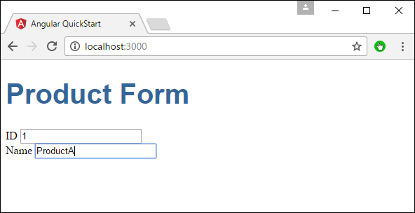
Expected Output

Slide 12
Steps to be followed
Create a model which is a products model. Create a file called products.ts file.
export class Product { constructor ( public productid: number, public productname: string ) { } }
Create a product form component called product-form.component.ts component .
import { Component } from '@angular/core';
import { Product } from './products';
@Component ({ selector: 'product-form', templateUrl: './product-form.component.html' })
export class ProductFormComponent {
model = new Product(1,'ProductA'); }

Slide 13
Steps to be Followed
Create the actual form. Create a file called product-form.component.html
<div class = "container">
<h1>Product Form</h1>
<form>
<div class = "form-group">
<label for = "productid">ID</label>
<input type = "text" class = "form-control" id = "productid" required [(ngModel)] = "model.productid" name = "id"> </div>
<div class = "form-group">
<label for = "name">Name</label>
<input type = "text" class = "form-control" id = "name" [(ngModel)] = "model.productname" name = "name"> </div>
</form>
</div>

Slide 14
Modify Component app.component.ts
import { Component } from '@angular/core';
@Component ({
selector: 'my-app',
template: '<product-form></product-form>' })
export class AppComponent { }

Slide 15
Update app.modules.ts
import { NgModule } from '@angular/core';
import { BrowserModule } from '@angular/platform-browser';
import { AppComponent } from './app.component';
import { FormsModule } from '@angular/forms';
import { ProductFormComponent } from './product-form.component';
@NgModule ({
imports: [ BrowserModule,FormsModule],
declarations: [ AppComponent,ProductFormComponent], bootstrap: [ AppComponent ] })
export class AppModule { }

