Slide 1

Angular Template

Slide 2
Objectives
How to use Template
Usage of Template in app.component.html
Usage of Template in app.component.ts

Slide 3
Usage of template
Angular higher version uses the <ng-template> as the tag instead of <template>which is used in Angular2.
The reason Angular latest version changed <template> to <ng-template> is because there is a name conflict between the <template> tag and the html <template> standard tag.

Slide 4
Usage of template in app.component.html
<!--The content below is only a placeholder and can be replaced.-->
<div>
<span *ngIf = "isavailable;then condition1 else condition2">Condition is valid.</span>
<ng-template #condition1>Condition is valid from template</ng-template>
<ng-template #condition2>Condition is invalid from template</ng-template>
</div>
<button (click) = "myClickFunction($event)">Click Me</button>

Slide 5
app.component.ts usage of template
import { Component } from '@angular/core';
@Component({
selector: 'app-root',
templateUrl: './app.component.html',
styleUrls: ['./app.component.css']
})
export class AppComponent {
title = 'Angular 4 Project!';
//array of months.
months = ["January", "February", "March", "April", "May", "June", "July", "August", "September", "October", "November", "December"];
isavailable = false;
myClickFunction(event) {
this.isavailable = false;
}
changemonths(event) {
alert("Changed month from the Dropdown");
console.log(event);
}
}

Slide 6
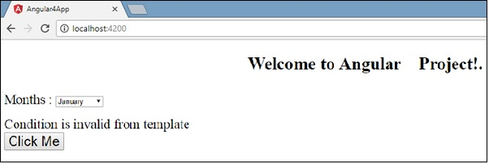
Output

