Slide 1
Angular
Testing

Slide 2
Why we Test….
The reason we test our code is to verify that it behaves as we expect it to.
As a result of this process you'll find you have better feature documentation for yourself and other developers as well as a design aid for your APIs.

Slide 3
Why Karma
Karma is a direct product of the Angular
As a result of this, they made Karma and rightly suggest it as their preferred test runner within the Angular .
Karma provides flexibility for you to tailor Karma to your workflow.
Karma also provides you options to replace Jasmine with other testing frameworks. Such as
Mocha
QUnit

Slide 4
Sample Test
If I have to add two numbers, test cases required to be:
Two positive numbers
One is positive number , other is negative
Positive and Zero
We only care about the answer Adder provides us.
We only care that Adder behaves as expected .

Slide 5
Types of Tests
Unit Test
Test a component in isolation, without external resources like Database, file System, Api end points….
Easy to Write, fast..
Integration Test
Test the component with external resources.
End to End Test
Test the entire application as a whole.

Slide 6
Karma Setup
Install karma
npm install karma karma-jasmine jasmine-core karma-chrome-launcher --save-dev
Install interface
npm install -g karma-cli
For latest versions of angular karma is inbuilt

Slide 7
How to Test my Angular code
Connect to node command prompt
Type the commnad “ng test”
You will find test screen loaded

Slide 8
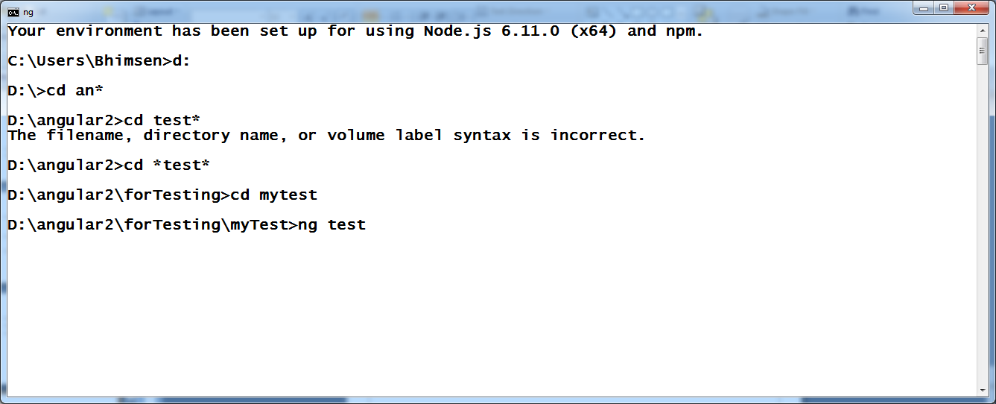

Slide 9
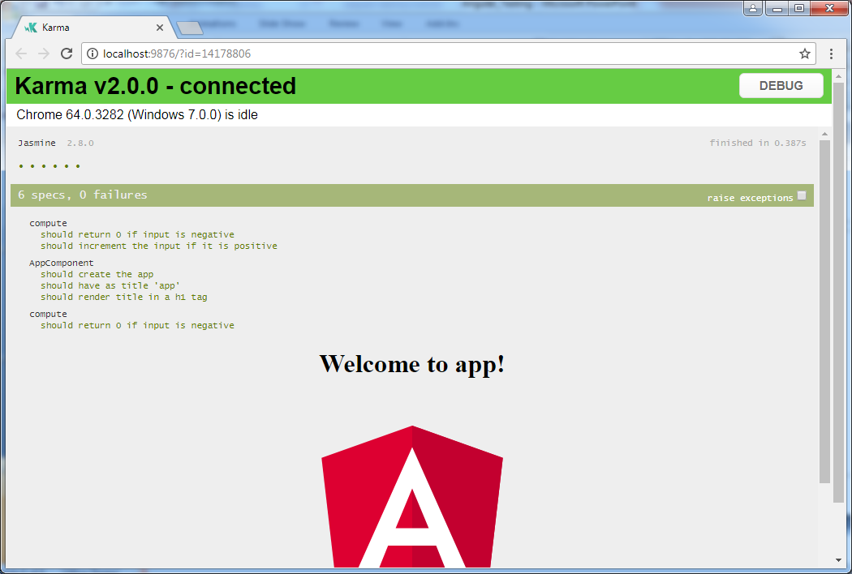

Slide 10
Write Test code
Create MyComponent.ts
Write functionality
Create myComponent.spec.ts
Testing code will be defined here.
Key words used
Describe() for test suite
It() for test specification
Expect() test conditions

Slide 11
Sample component code: compute.ts
export function compute(number){
if(number<0){
return 0;
}
return number+1;
}

Slide 12
Unit Test code: compute.spec.ts
import {compute} from './compute';
describe('compute',()=>{
it('should return 0 if input is negative',()=>{
const result= compute(-1);
expect(result).toBe(0);
})
})

