Slide 1
Node JS
Installation and coding

Slide 2
Pre requisites
Editors
Text Editor
Visual studio code
Latest Browser
Command prompt to execute Node JS Server side commands

Slide 3
Installation Environment
Go to official site of NODE.js
https://nodejs.org/en/download/
Choose your required version
If your OS is window download .msi file.

Slide 4
Download Node.js archive
OS | Archive name
Windows | node-v0.12.0-x64.msi
Linux | node-v0.12.0-linux-x86.tar.gz
Mac | node-v0.12.0-darwin-x86.tar.gz
SunOS | node-v0.12.0-sunos-x86.tar.gz

Slide 5
Installation
OS | Output
Linux | export PATH=$PATH:/usr/local/nodejs/bin
Mac | export PATH=$PATH:/usr/local/nodejs/bin
FreeBSD | export PATH=$PATH:/usr/local/nodejs/bin
Windows | C:\Program Files\nodejs\bin

Slide 6
Node installation

Slide 7
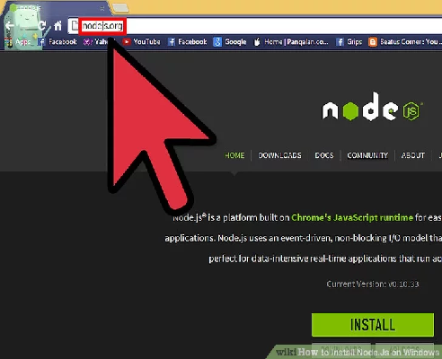

Slide 8
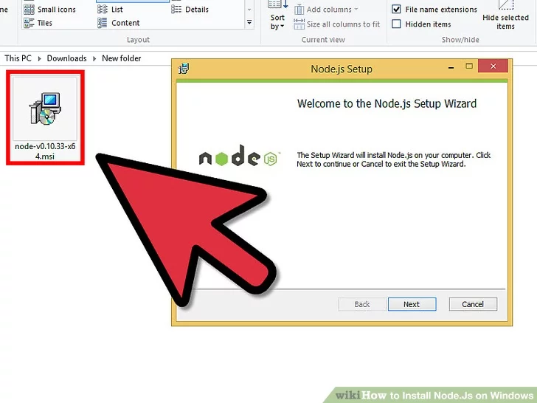

Slide 9
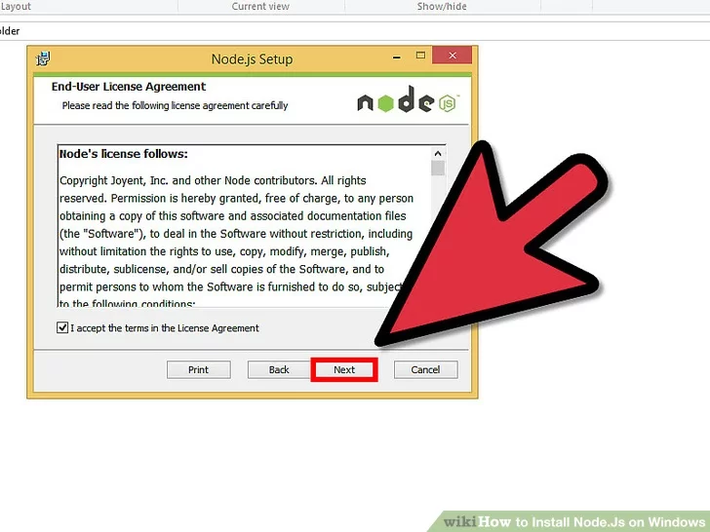

Slide 10
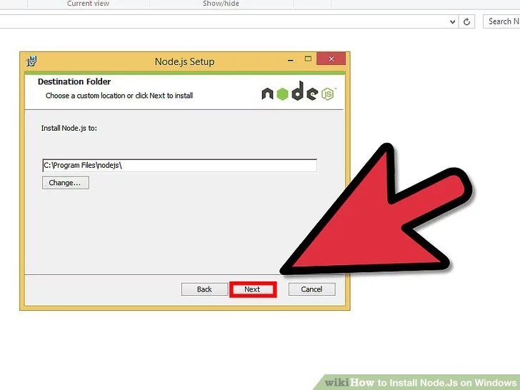

Slide 11
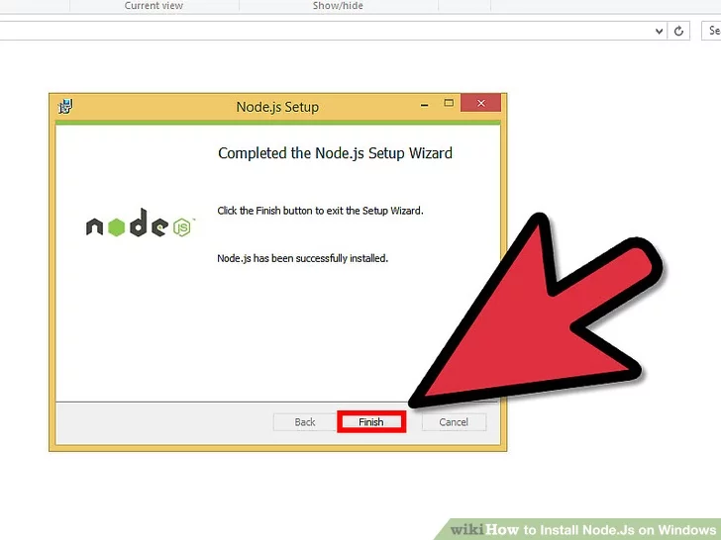

Slide 12
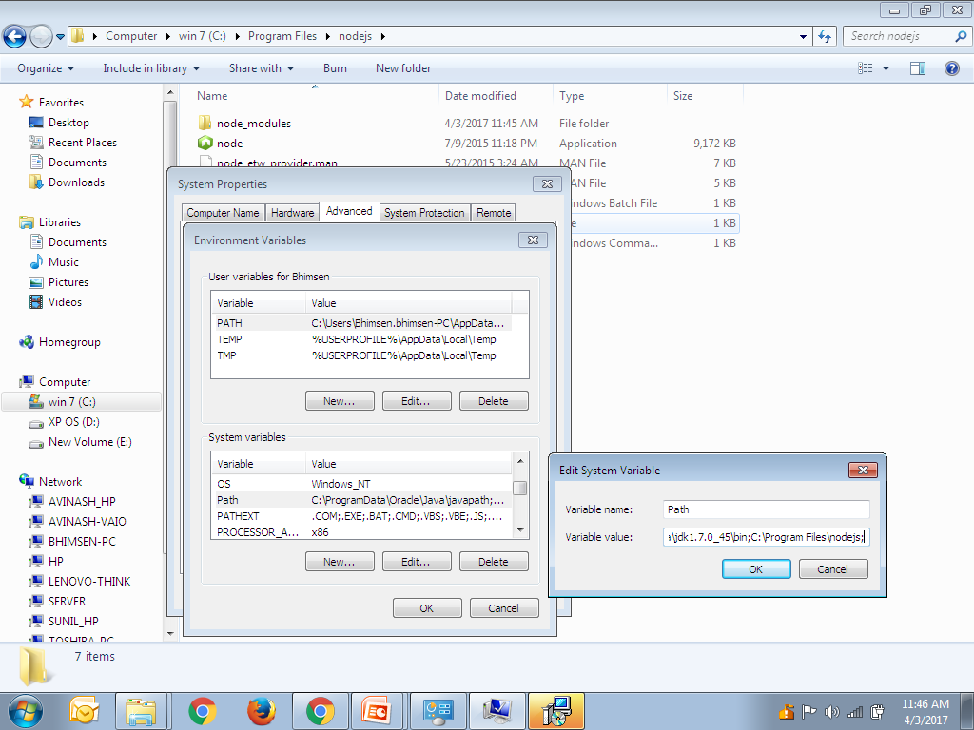
Test Node installation

Slide 13
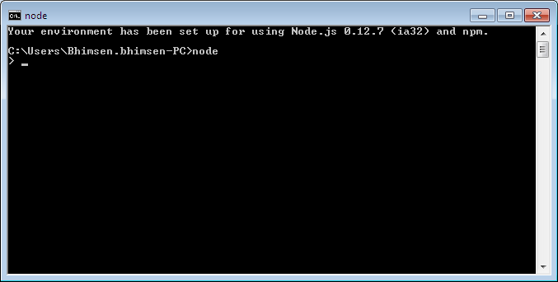
Test Node

Slide 14
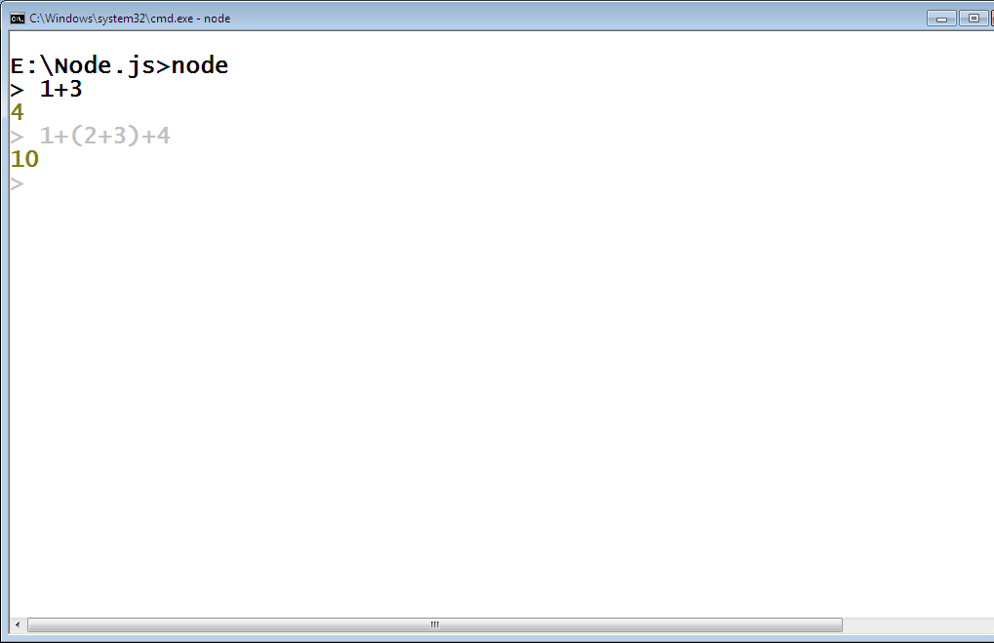
Usage of Node.js
After starting node.js you can use mathematical operations

Slide 15
Variables in Node.js Console
var x=10
var y=20
x+y

Slide 16
REPL
Read - Reads user's input, parse the input into JavaScript data-structure and stores in memory.
Eval - Takes and evaluates the data structure
Print - Prints the result
Loop - Loops the above command until user press ctrl-c twice.

Slide 17
REPL Commands
command
ctrl + c - terminate the current command. ctrl + c twice - terminate the Node REPL. ctrl + d - terminate the Node REPL. Up/Down Keys - see command history and modify previous commands. tab Keys - list of current commands. _{.help - list of all commands.} .break - exit from multiline expression. .clear - exit from multiline expression .save filename - save current Node REPL session to a file. .load filename - load file content

Slide 18
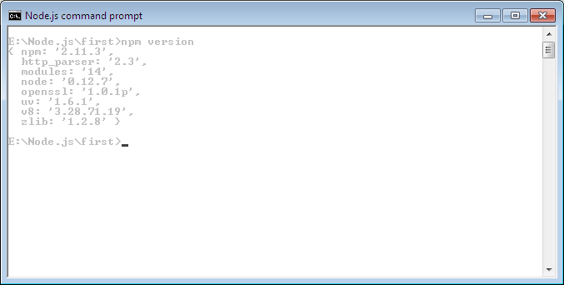
Node JS version testing

Slide 19
Execution of Node JS program
In order to execute your program in node JS
File must be saved with extension as .js
From your command prompt use the following command to test your program:
Ex: Node file.js

Slide 20


