Slide 1
JSF – Java Server Faces
Overview
Architecture
Installing and Configuring
Page Navigation
Managed Beans
Standard Validation

Slide 2
What is JSF?
A server side user interface component framework for Java technology-based web applications.
A set of web-based UI controls (JSF provides many prebuilt HTML-oriented GUI controls, along with code to handle their events).
Defines the programming model
(Event handling, Easy error handling )
Builds HTML from components
Validation and Conversion
Component Tree
JSF is a UI Framework for Java Web Applications

Slide 3
Why JSF ?
Ease/Simplify development
Support from/by tools
  Eclipse, JBuilder, WSAD
Events easily tied to server side code
Ease of extension
Manage UI state
A device-independent GUI control framework
  JSF can be used to generate graphics in formats other than HTML

Slide 4
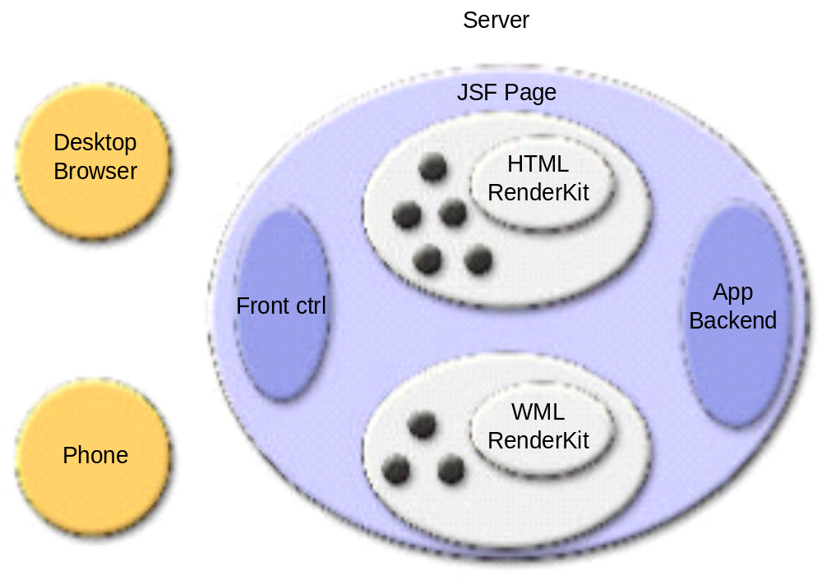
JSF Architecture

Slide 5
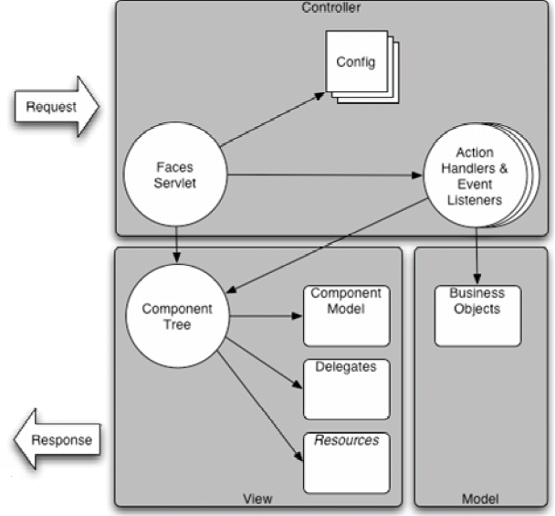
JSF Application Flow

Slide 6
JSF provides Web MVC
Controller
  FacesServlet
  Lifecycle
  Application
  NavigationHandler
  ActionListener
  Conversion and Validation
View
  RenderKit
  Renderers
Model
  JavaBeans
  EJB

Slide 7
Installing JSF
What we need?
  JDK 1.5 or above
  Tomcat 6.0 or above for JSF 1.2
  Download JSF 1.2 from java web site
Create a web project
Copy the following files in project’s lib folder
  jsf-api.jar,
  jsf-impl.jar,
  jsf_core.tld,
  html_basic.tld,
  jstl.jar,
  standard.jar

Slide 8
Configuring JSF
Entries in web.xml
<!-- Faces Servlet -->
<servlet>
<servlet-name>Faces Servlet</servlet-name>
<servlet-class>javax.faces.webapp.FacesServlet</servlet-class>
<load-on-startup> 1 </load-on-startup>
</servlet>
<!-- Faces Servlet Mapping -->
<servlet-mapping>
<servlet-name>Faces Servlet</servlet-name>
<url-pattern>*.jsf</url-pattern>
</servlet-mapping>
A blank faces-config.xml file in WEB-INF
<faces-config xmlns="http://java.sun.com/xml/ns/javaee"
xmlns:xsi="http://www.w3.org/2001/XMLSchema-instance"
xsi:schemaLocation="http://java.sun.com/xml/ns/javaee http://java.sun.com/xml/ns/javaee/web-facesconfig_1_2.xsd"
version="1.2">
</faces-config>

Slide 9
Creating a view
Create a page “first.jsp”
<%@ taglib uri="http://java.sun.com/jsf/core" prefix="f" %>
<%@ taglib uri="http://java.sun.com/jsf/html" prefix="h" %>
<html>
<body>
<f:view>
<h:outputText value="Welcome to First JSF!!!!"/>
</f:view>
</body>
</html>
Create index.jsp
<jsp:forward page="/first.jsf" />
Test the Application

Slide 10
Page Navigation
Static Navigation
  One Result mapping
  No business logic, beans, or Java code of any sort
Dynamic Navigation
  Multiple Result mappings

Slide 11
Static Page Navigation
A form is displayed
  Form uses f:view and h:form
The form is submitted to itself
  ACTION is automatically self (current URL)
  METHOD is automatically POST
Define a action method
  Button specifies return condition
Specify navigation rules in faces-config.xml
  A string that matches from-outcome
  A results page is displayed is specified by to-view-id in the navigation rules

Slide 12
Static Page Navigation - Example
Create a JSP
<%@ taglib uri="http://java.sun.com/jsf/core" prefix="f" %>
<%@ taglib uri="http://java.sun.com/jsf/html" prefix="h" %>
<html>
<body>
<f:view>
<h:form>
<h:outputText value="Button Example!!!!"/>
<h:commandButton action="greeting" value="Greeting"></h:commandButton>
</h:form>
</f:view>
</body>
</html>
Update faces-config.xml for navigation rules
<navigation-rule>
<from-view-id>/first.jsp</from-view-id>
<navigation-case>
<from-outcome>greeting</from-outcome>
<to-view-id>/greeting.jsp</to-view-id>
</navigation-case>
</navigation-rule>

Slide 13
Managed Beans
The bean simply captures the data entered by a user after the user clicks the submit button.
This way the bean provides a bridge between the JSP page and the application logic.
In JSF, the Java Beans are sometimes called "backing beans“ or “Managed Beans”
Beans that represent the form
  form parameters
  action controller methods
  event handling methods
  placeholders for results data.
Beans represent request parameters
Declare beans in faces-config.xml

Slide 14
Managed Beans - Example
Create a Bean
package in.rsrl.beans;
public class Person {
private String personName;
public String getPersonName() {
return personName;
}
public void setPersonName(String personName) {
this.personName = personName;
}
}

Slide 15
Configuring Beans and Page Navigation in faces-config.xml
Configuring Managed Bean
<managed-bean>
<managed-bean-name>personBean</managed-bean-name>
<managed-bean-class>in.rsrl.beans.Person</managed-bean-class>
<managed-bean-scope>request</managed-bean-scope>
</managed-bean>
Page Navigation
<navigation-rule>
<from-view-id>/inputname.jsp</from-view-id>
<navigation-case>
<from-outcome>showPerson</from-outcome>
<to-view-id>/showPerson.jsp</to-view-id>
</navigation-case>
</navigation-rule>

Slide 16
Input form and Output Form
Create a jsp called inputname.jsp
<f:view>
<h:form>
Enter Person Name <h:inputText value="#{personBean.personName}"/>
<h:commandButton type="submit" value="Enter" action="showPerson"></h:commandButton>
</h:form>
</f:view>
showPerson.jsp
<f:view>
Hai <h:outputText value="#{personBean.personName}“/>, <br/>
Welcome to Our New Web Page.
</f:view>
Or we can use JSP 2.0 Expression Language
${personBean.personName} → we can omit taglib declarations and f:view tags

Slide 17
Properties of Form
Pair of getter/setter methods for each request parameter
When form first displayed
  Bean instantiated (assuming request scope)
  Getter methods called (e.g., getPersonName in above example)
  If result is something other than null or empty String, value is placed into textfield
  i.e., textfields are prepopulated with bean default values
When form submitted
  A new copy of the bean is instantiated – (assuming request scope)
  Values from textfields passed to setter methods E.g., setPersonName in above example
  Strings converted to other types as with jsp:setProperty

Slide 18
Providing Default Values
We want to initialize the name value.
In other words, when we first run the application, the input text field should have a value already displayed.
We can provide an initial value in the faces-config.xml file, in the managed bean section.
<managed-bean>
<managed-bean-name>personBean</managed-bean-name>
<managed-bean-class>in.rsrl.beans.PersonBean</managed-bean-class>
<managed-bean-scope>request</managed-bean-scope>
<managed-property>
<property-name>personName</property-name>
<property-class>java.lang.String</property-class>
<value>Pranav</value>
</managed-property>
</managed-bean>

Slide 19
Using Resource Bundles
A properties file is just a file with param=value pairs.
We use the messages stored in the properties file in our JSP pages.
Keeping the messages separate from the JSP page allows us to quickly modify the messages without editing the JSP page.
Create a file messages.properties
prompt=Tell us your name:
greeting_text=Welcome to JSF
button_text=Say Hello
sign=!

Slide 20
Using Resource Bundle
Load file with f:loadBundle
  basename gives base file name
  var gives scoped variable (Map) that will hold results
Relative to WEB-INF/classes, .properties assumed
  E.g., for WEB-INF/classes/messages.properties
<f:loadBundle basename="messages" var="msgs"/>
  E.g., for WEB-INF/classes/package1/test.properties
<f:loadBundle basename="package1.test" var="msgs"/>
Modify inputname.jsp file
<f:loadBundle basename="messages" var="msg"/>
<h:outputText value="#{msg.prompt}"/> <h:inputText value="#{personBean.personName}"/>
<h:commandButton type="submit" value="#{msg.button_text}" action="showPerson“/>

Slide 21
Parameterized Properties
Values contain {0}, {1}, {2}, etc.
var gives scoped variable (Map) that will hold results
nested f:param gives substitution values
  <h:outputFormat value="#{msgs.someName}">
  <f:param value="value for 0th entry"/>
  <f:param value="value for 1st entry"/>
  </h:outputFormat>
Example
  Modify messages.properties text=Please enter your {0}, {1} and {2}
  Modify View
  <h:outputFormat value="#{msg.text}">
    <f:param value="UserName"/>
    <f:param value="Password" />
    <f:param value="EmailAddress"/>
    </h:outputFormat>

Slide 22
Using Standard JSF Validation
We want to make sure that no empty name is submitted.
To do that, we will use the required attribute for the inputText tag in inputname.jsp.
Setting this attribute to true will ensure that no empty value is submitted.
<h:inputText value="#{personBean.personName}" required="true"/>
Printing Error Messages
  For error message warning to the user, JSF provides a special tag to print messages.
  The h:messages tag and also set the color for the messages using the style attribute.
  <h:messages style="color:darkred"/>

Slide 23
Using JSF Standard Validation
Displaying Custom Message
  Use requiredMessage attribute for the component
  <h:inputText value="#{personBean.personName}" required="true" requiredMessage="Name cannot be blank“/>
Adding Code to Check for Reasonable Length of Input for a Name
  We also want to make sure that the name value is at least 3 characters long but not more than 10 long.
  To do that, we will use the f:validateLength tag in this same inputname.jsp file.
  <h:inputText value="#{personBean.personName}" required="true">
  <f:validateLength minimum=“3" maximum="10"/>
  </h:inputText>

Slide 24
Dynamic Navigation
Multiple Result mappings
Define a method signup() in Bean
public String signup()
{
if(personName.equalsIgnoreCase("") || personName == null)
return "rejected";
else
return "accepted";
}
Modify view (inputname.jsp)
<h:inputText id="pname" value="#{personBean.personName}“/>
<h:commandButton type="submit" value="#{msg.button_text}" action="#{personBean.signup}“/>

Slide 25
Dynamic Navigation
Modify faces-config.xml
<navigation-rule>
<navigation-case>
<from-outcome>accepted</from-outcome>
<to-view-id>/accepted.jsp</to-view-id>
</navigation-case>
<navigation-case>
<from-outcome>rejected</from-outcome>
<to-view-id>/rejected.jsp</to-view-id>
</navigation-case>
</navigation-rule>

Slide 26
Working with Tables
Assume you need HTML exposed in JSP page, so you cannot use the non-looping alternatives
  Using JSP scripting elements to loop is unwieldy
  Using JSTL to loop is an option, but is still complex
JSF provides h:dataTable
  You give one row definition, and JSF repeats it for you
<h:dataTable value="#{someBean.someCollection}“ var="rowVar“ border="1">
<h:column>
<h:outputText value="#{rowVar.col1Data}"/>
</h:column>
<h:column>
<h:outputText value="#{rowVar.col2Data}"/>
</h:column>
...
</h:dataTable>

Slide 27
Data Table
value: a collection of data (list of beans, usually).
Legal collection types:
  Array
  List (e.g., ArrayList, LinkedList)
  ResultSet (must be scroll-insensitive: see later section)
  Result (wrapped ResultSet from JSTL)
  DataModel (in javax.faces.model)
var: bound to each collection entry in turn
  This entry should be something the JSF EL can output Bean, array, List, Map
Standard TABLE attributes
  border, bgcolor, width, cellpadding, cellspacing, frame, ...
Style sheet designators
  rowClasses, headerClass, footerClass

Slide 28
Data Table contd., (h:column)
Usually encloses h:outputText elements
  Which reference the variable from the enclosing h:dataTable
<h:column>
<h:outputText value="#{rowVar.colData}"/>
</h:column>
Can enclose other h:Xxxx elements
  h:outputText, h:inputText, etc.
Regular HTML must be enclosed in f:verbatim
<h:column>
<f:verbatim>First Name: </f:verbatim>
<h:outputText value="#{rowVar.firstName}"/>
</h:column>
Table headings and footers specified with f:facet

Slide 29
Data Table - Example
Create a property to get Employee details
private Result employees;
public Result getEmployees()
{
Result rt = null;
try {
Class.forName("sun.jdbc.odbc.JdbcOdbcDriver");
Connection con = DriverManager.getConnection("jdbc:odbc:test“, “scott”, “tiger”);
Statement st = con.createStatement();
ResultSet rs = st.executeQuery("SELECT EName, Job from Emp");
rt = ResultSupport.toResult(rs);
}catch(Exception e) {
e.printStackTrace();
}
return rt;
}

Slide 30
Data Table - Example
Modify the View
<h:dataTable value="#{personBean.employees}" id="dbRow" var="dbRow">
<h:column>
<h:outputText value="#{dbRow.Ename}"/>
</h:column>
<h:column>
<h:outputText value="#{dbRow.Job}"/>
</h:column>
</h:dataTable>

Slide 31
Binding Components
Binding Components helps us to simplify the web development
Create a JSP with following code snippet
<h:form>
<h:outputText binding="#{personBean.label1}" value="Hello every one.!!"/>
<h:commandButton value="Press Me" action="#{personBean.myListener}“/>
</h:form>
Define a property in bean
private HtmlOutputText label1;
// setter and getter
Define a controller in Bean (i.e. myListener method)
public void myListener()
{
label1.setValue("This is new Value");
}

