Slide 1
Spring Boot

Slide 3
What is Spring boot
Spring Boot is an open source Java-based framework used to create a Micro Service.
It is developed by Pivotal Team.
Spring boot is easy to create a stand-alone and production ready spring applications using Spring Boot.

Slide 4
What is Micro Service
Micro Service is an architecture that allows the developers to develop and deploy services independently.
Each service running has its own process and this achieves the lightweight model to support business applications.

Slide 5
Advantages
Easy deployment
Simple scalability
Compatible with Containers
Minimum configuration
Lesser production time

Slide 6
Spring Boot
Spring Boot provides a good platform for Java developers to develop a stand-alone and production-grade spring application that you can just run.
You can get started with minimum configurations without the need for an entire Spring configuration setup.

Slide 7
Spring boot Advantages
Easy to understand and develop spring applications
Increases productivity
Reduces the development time

Slide 8
Features of Spring Boot
Web Development
SpringApplication
Application events and listeners
Admin features
Externalized Configuration
Properties Files
YAML Support
Type-safe Configuration
Logging
Security

Slide 9
Spring Maven Projet
In this scenario we are using Sprint Tool Suite (sts)
This is integrated with Eclipse
We follow steps to create project

Slide 10
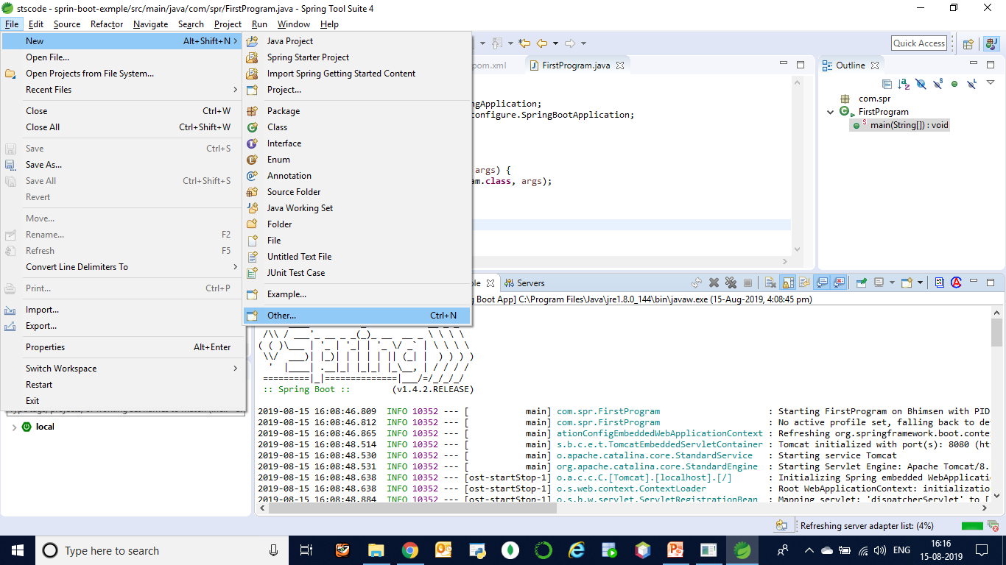
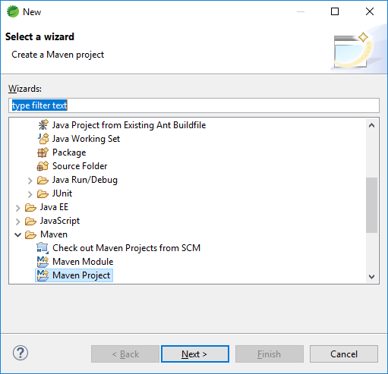
Maven Spring Project

Slide 11
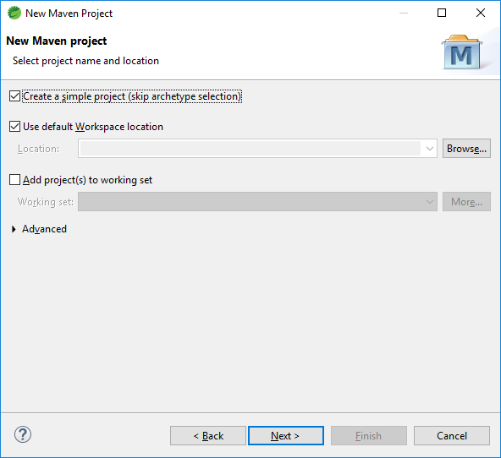

Slide 12
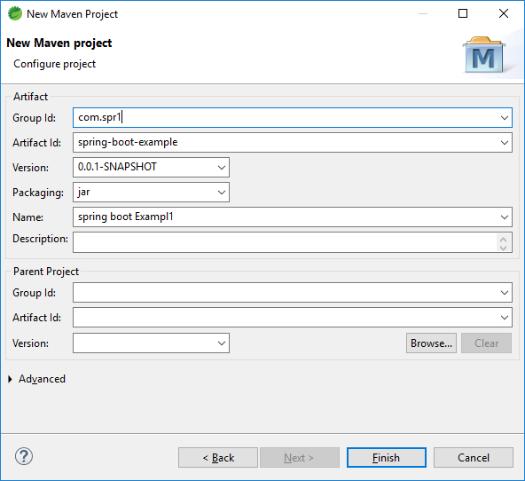

Slide 13
Update your Maven File
<project xmlns="http://maven.apache.org/POM/4.0.0" xmlns:xsi="http://www.w3.org/2001/XMLSchema-instance" xsi:schemaLocation="http://maven.apache.org/POM/4.0.0 http://maven.apache.org/xsd/maven-4.0.0.xsd">
<modelVersion>4.0.0</modelVersion>
<groupId>com.spr1</groupId>
<artifactId>sprin-boot-exmple</artifactId>
<version>0.0.1-SNAPSHOT</version>
<name>Spring Boot Example</name>
<parent>
<groupId>org.springframework.boot</groupId>
<artifactId>spring-boot-starter-parent</artifactId>
<version>1.4.2.RELEASE</version>
</parent>
<dependencies>
<dependency>
<groupId>org.springframework.boot</groupId>
<artifactId>spring-boot-starter-web</artifactId>
</dependency>
</dependencies>
<properties>
<java.version>1.8</java.version>
</properties>
</project>

Slide 14
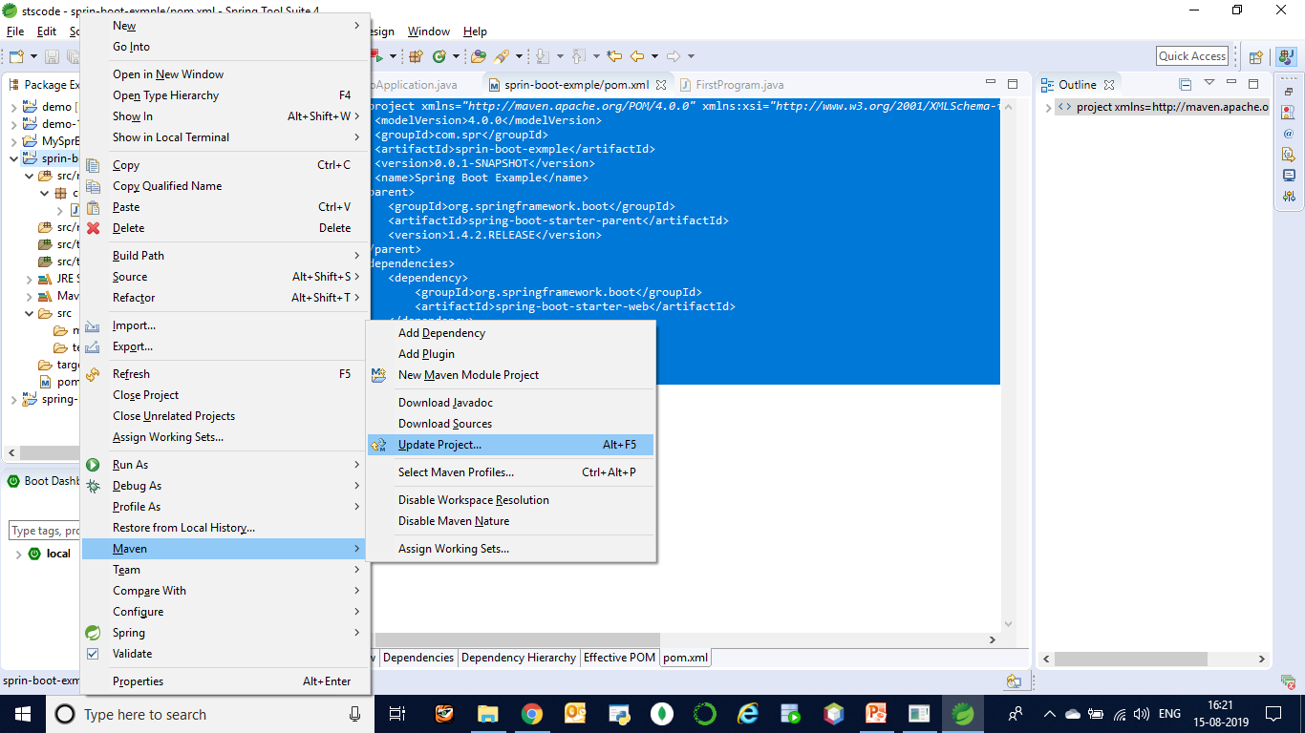

Slide 15
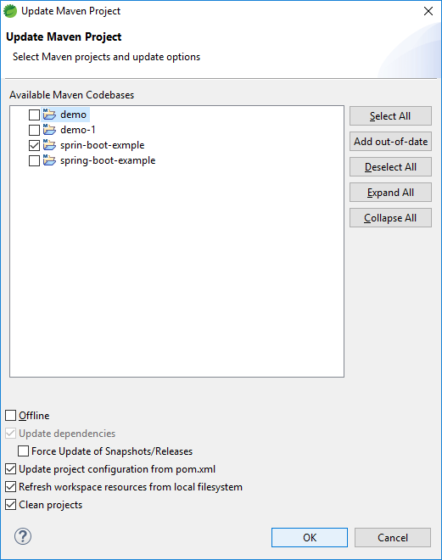

Slide 16
Write your javacode
package com.spr1;
import org.springframework.boot.SpringApplication;
import org.springframework.boot.autoconfigure.SpringBootApplication;
@SpringBootApplication
public class FirstProgram {
public static void main(String[] args) {
SpringApplication.run(FirstProgram.class, args);
}
}
-→ Execute your program

Slide 17
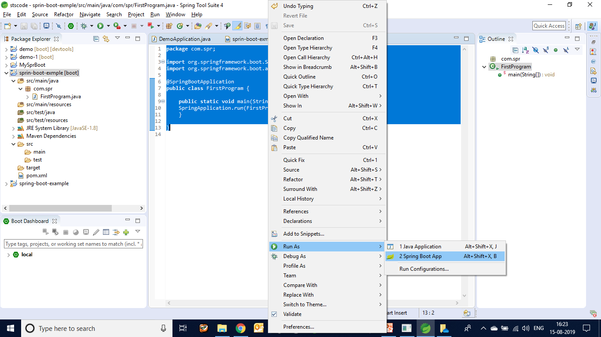
Execution

Slide 18
