Slide 1
Spring Boot Modules

Slide 3
I understood Spring Boot as
Spring Boot is a Spring framework module which provides RAD (Rapid Application Development) feature to the Spring framework.
It is highly dependent on the starter templates feature which is very powerful and works flawlessly.

Slide 4
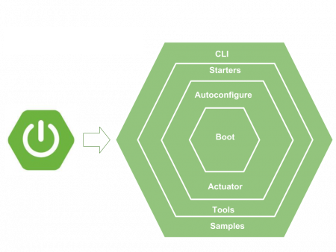

Slide 5
Starter Template
Spring Boot starters are templates that has the collection of all the relevant transitive dependencies that are needed to start a particular functionality.
Advantage:
If we create a Spring WebMVC application in a traditional setup, we have to included all required dependencies ourself.
It leaves the chances of version conflict which ultimately result in more runtime exceptions.
With Spring boot, to create MVC application all you need to import is spring-boot-starter-web dependency.

Slide 6
Example: pom.xml
<parent>
<groupId>org.springframework.boot</groupId>
<artifactId>spring-boot-starter-parent</artifactId>
<version>2.1.6.RELEASE</version>
<relativePath />
</parent>
<!-- Spring web brings all required dependencies to build web application. -->
<dependency>
<groupId>org.springframework.boot</groupId>
<artifactId>spring-boot-starter-web</artifactId>
</dependency>
Note: spring-boot-starter-web dependency, internally imports all given dependencies and add to your project.

Slide 7
Spring boot Autoconfiguration
Autoconfiguration is enabled with @EnableAutoConfiguration annotation.
Spring boot auto configuration scans the classpath, finds the libraries in the classpath and then attempt to guess the best configuration for them, and finally configure all such beans.

Slide 8
How Auto-configuration works
Scan classpath to see if EnableAspectJAutoProxy, Aspect, Advice and AnnotatedElement classes are present.
If classes are not present, no autoconfiguration will be made for Spring AOP.
If classes are found then AOP is configured with Java config annotation @EnableAspectJAutoProxy.
It checks for property spring.aop which value can be true or false.
Based on the value of property, proxyTargetClass attribute is set.

Slide 9
Embedded server
Spring boot applications always include tomcat as embedded server dependency.
It means you can run the Spring boot applications from the command prompt without needling complex server infrastructure.

Slide 10
How to attach other server
In-order to attach other server as embedded server we need add dependency.
Example: adding glassfish server dependency
<!-- https://mvnrepository.com/artifact/org.glassfish.main.core/glassfish -->
<dependency>
<groupId>org.glassfish.main.core</groupId>
<artifactId>glassfish</artifactId>
<version>4.1</version>
</dependency>

Slide 11
Bootstrapping application
To run the application, we need to use @SpringBootApplication annotation. Behind the scenes, that’s equivalent to
@Configuration,
@EnableAutoConfiguration,
@ComponentScan together.

Slide 12
Configure server
Open application.properties file
Set server port as per your choice
### Server port #########
server.port=8980

