Slide 1
Aspect Oriented Programming
AOP

Slide 2
What is AOP
AOP is used to simplify your programming with cross cutting concerns.
AOP will provides a way to increase the modularity of the program.
Aspect-Oriented Programming entails breaking down program logic into distinct parts called so-called concerns.

Slide 3
Where to use AOP
It will allow the user to implement custom requirements to the application.
This type of requirement may include transactions, queries, security and authentication services etc…

Slide 4
AOP concepts and terminologies
Aspect
Advice
Join point
Pointcut
Proxy
Weaving

Slide 5
Aspect
Aspect is a service required for implementation.
Aspect is associated with the modularity of the requirements.
This can be any individual functionality included such as, registration, enquiry, update, delete

Slide 6
Join point
Join point will always represents a particular method to execute from the given aspect.
Based on the application requirements we are focusing a particular or group of methods to be executed.

Slide 7
pointcut
Pointcut is an expression for AOP that matches join points.
PointCut can be identified as a set of one or more JoinPoint where an advice should be executed.
Pointcut can be specified using expressions or patterns.

Slide 8
Advice
Advice is an action taken from the aspect according to the join point.
This will load specific method for execution.

Slide 9
Types of advices
Before Advice it is executed before the actual method call.
After Advice it is executed after the actual method call. If method returns a value, it is executed after returning value.
Around Advice it is executed before and after the actual method call.
Throws Advice it is executed if actual method throws exception.

Slide 10
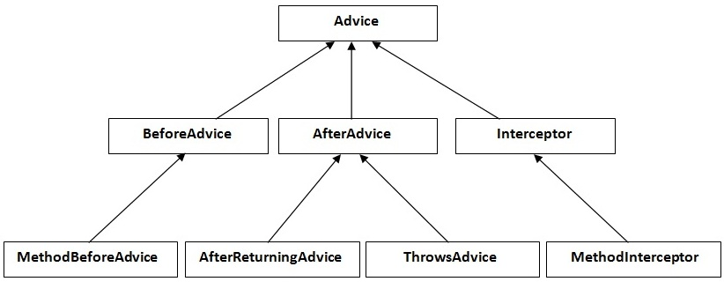
AOP Architecture

Slide 11
Proxy
Proxy makes an contract with jdk or cglib spring framework to load business component, and execute in distributed mode.

Slide 12
Weaving
Weaving is the process of linking aspect with other application types or objects to create an advised object.
Weaving can be done at compile time, load time or runtime.
Spring AOP performs weaving at runtime.

Slide 13
AspectJ with XML
Spring enables you to define the aspects, advices and point-cuts in xml file.
Xml tags are as follows:
aop:before It is applied before calling the actual business logic method.
aop:after It is applied after calling the actual business logic method.
aop:after-returning it is applied after calling the actual business logic method. It can be used to intercept the return value in advice.
aop:around It is applied before and after calling the actual business logic method.
aop:after-throwing It is applied if actual business logic method throws exception.

Slide 14
Spring AOP AspectJ Annotation
Spring AspectJ AOP implementation provides many annotations:
@Aspect declares the class as aspect.
@Pointcut declares the pointcut expression.
The annotations used to create advices are given below:
@Before declares the before advice. It is applied before calling the actual method.
@After declares the after advice. It is applied after calling the actual method and before returning result.
@AfterReturning declares the after returning advice. It is applied after calling the actual method and before returning result. But you can get the result value in the advice.
@Around declares the around advice. It is applied before and after calling the actual method.
@AfterThrowing declares the throws advice. It is applied if actual method throws exception.

Slide 15
Pointcut expressions
Let's try the understand the pointcut expressions by the examples given below:
@Pointcut("execution(public * *(..))")
It will be applied on all the public methods.
@Pointcut("execution(public Operation.*(..))")
It will be applied on all the public methods of Operation class.
@Pointcut("execution(* Operation.*(..))")
It will be applied on all the methods of Operation class.
@Pointcut("execution(public Employee.set*(..))")
It will be applied on all the public setter methods of Employee class.
@Pointcut("execution(int Operation.*(..))")
It will be applied on all the methods of Operation class that returns int value.

