Slide 1
Restful Service
Cache

Slide 2
Objective
What is cache?
Steps to Cache
Test Cache from Browser

Slide 3
What Is Cache
Caching refers to storing the server response in the client.
After Cache, client need not make a server request for the same resource again and again.

Slide 4
Header Description
Sr.No. | Header & Description
1 | Date Date and Time of the resource when it was created.
2 | Last Modified Date and Time of the resource when it was last modified.
3 | Cache-Control Primary header to control caching.
4 | Expires Expiration date and time of caching.
5 | Age Duration in seconds from when resource was fetched from the server.

Slide 5
Cache-Control Header
Sr.No. | Directive & Description
1 | Public Indicates that resource is cacheable by any component.
2 | Private Indicates that resource is cacheable only by the client and the server, no intermediary can cache the resource.
3 | no-cache/no-store Indicates that a resource is not cacheable.
4 | max-age Indicates the caching is valid up to max-age in seconds. After this, client has to make another request.
5 | must-revalidate Indication to server to revalidate resource if max-age has passed.

Slide 6
Best Practice
Always keep static contents like images, CSS, JavaScript cacheable, with expiration date of 2 to 3 days.
Never keep expiry date too high.
Dynamic content should be cached for a few hours only.

Slide 7
Steps to Cache
CacheControl cc = new CacheControl(); cc.setMaxAge(86400);
cc.setPrivate(true);
ResponseBuilder builder = Response.ok(myBook); builder.cacheControl(cc);

Slide 8
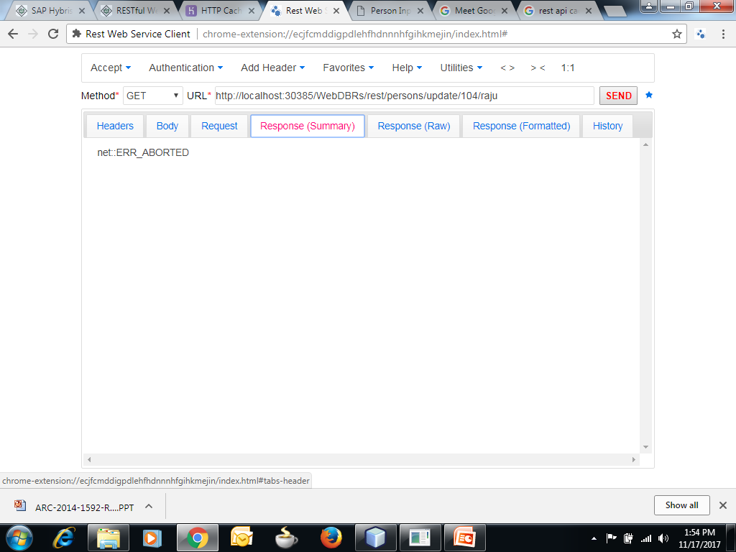

Slide 9
