Slide 1
SOAP Web Services: Overview

Slide 2
Objectives
After completing this lesson, you should be able to:
Describe the basic structure of a Simple Object Access Protocol (SOAP) message and how it is encapsulated by transports
Explain how WSDL defines a web service, including its message representation and transport mechanism
Explain the purpose of WS-I Basic Profile and WS-Policy

Slide 3
Reasons for Using SOAP
The SOAP web services specification sets out to define an interoperable, platform-independent means for component interaction. SOAP web service requirements include:
Decouple message representation from transport mechanisms
Support extensible frameworks
Notes:
SOAP was originally an acronym for Simple Object Access Protocol. In SOAP 1.2 the term SOAP is no longer an acronym. This course primarily uses SOAP 1.1.

Slide 4
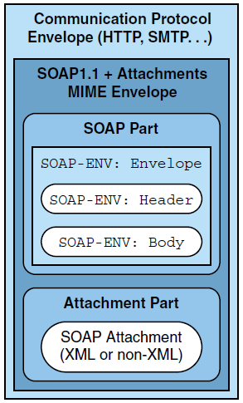
Extensible Message Representation Simple Object Access Protocol

Slide 5
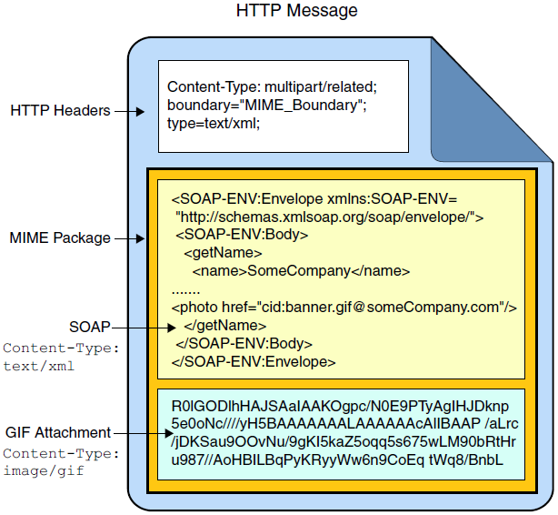
SOAP Over HTTP

Slide 6
Raw SOAP/HTTP Request
Accept: text/html, image/gif, image/jpeg, */*; q=.2
Connection: Keep-Alive
Content-Length: 206
Content-Type: text/xml; charset=utf-8
Host: localhost:7001
SOAPAction: ""
User-Agent: Oracle JAX-RPC 1.1
<env:Envelope
xmlns:env="http://schemas.xmlsoap.org/soap/envelope/">
<env:Header/>
<env:Body>
<getHello xmlns="http://ou/">
<arg0 xmlns="">matt</arg0>
</getHello>
</env:Body>
</env:Envelope>

Slide 7
Raw SOAP/HTTP Response
HTTP/1.1 200 OK
Content-type: text/xml; charset=utf-8
<?xml version='1.0' encoding='UTF-8'?>
<S:Envelope
xmlns:S="http://schemas.xmlsoap.org/soap/envelope/">
<S:Body>
<ns2:getHelloResponse xmlns:ns2="http://ou/">
<return>Hello matt!</return>
</ns2:getHelloResponse>
</S:Body>
</S:Envelope>

Slide 8
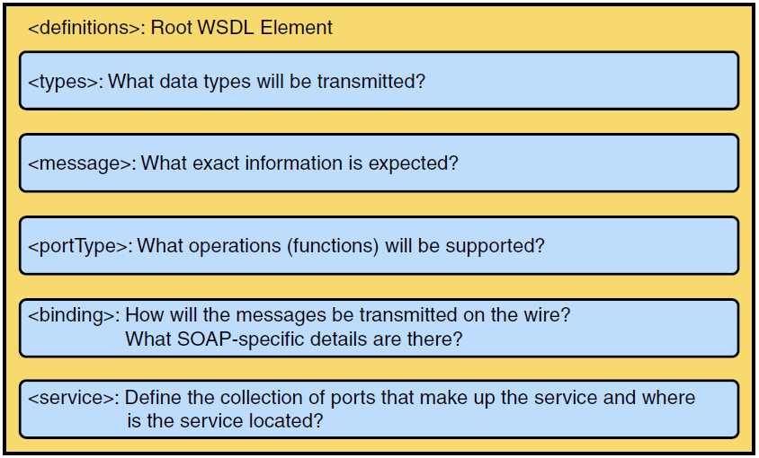
Structure of a WSDL File

Slide 9
WSDL: Sample Structure
<?xml version='1.0' encoding='UTF-8'?>
<definitions xmlns:wsu="http://docs.oasis-open.org/wss/2004/01/oasis-200401-wss-wssecurity-utility-1.0.xsd" xmlns:wsp="http://www.w3.org/ns/ws-policy" xmlns:wsp1_2="http://schemas.xmlsoap.org/ws/2004/09/policy" xmlns:wsam="http://www.w3.org/2007/05/addressing/metadata" xmlns:soap="http://schemas.xmlsoap.org/wsdl/soap/" xmlns:tns="http://ou/" xmlns:xsd="http://www.w3.org/2001/XMLSchema" xmlns="http://schemas.xmlsoap.org/wsdl/" targetNamespace="http://ou/" name="HelloService">
<types><!-- ... --></types>
<message><!-- ... --></message>
<portType><!-- ... --></portType>
<binding><!-- ... --></binding>
<service><!-- ... --></service>
</definitions>
Notes:
The WSDL file for a SOAP service can be downloaded by making an HTTP GET request to the URL of the web service with a wsdl query parameter, for example:
http://localhost:7001/HelloWS/HelloService?wsdl

Slide 10
WSDL types: Sample
The types element documents the XML Schema for the message parts. Schema information can be nested or (more likely) imported.
<types>
<xsd:schema>
<xsd:import namespace="http://ou/" schemaLocation="http://localhost:7001/HelloWS/HelloService?xsd=1"/>
</xsd:schema>
</types>
Make another HTTP GET request to obtain the XML Schema.

Slide 11
WSDL types: Sample Schema
<?xml version='1.0' encoding='UTF-8'?>
<xs:schema xmlns:tns="http://ou/" xmlns:xs="http://www.w3.org/2001/XMLSchema" version="1.0" targetNamespace="http://ou/">
<xs:element name="getHello" type="tns:getHello"/>
<xs:element name="getHelloResponse" type="tns:getHelloResponse"/>
<xs:complexType name="getHello">
<xs:sequence>
<xs:element name="arg0" type="xs:string" minOccurs="0"/>
</xs:sequence>
</xs:complexType>
<xs:complexType name="getHelloResponse">
<xs:sequence>
<xs:element name="return" type="xs:string" minOccurs="0"/>
</xs:sequence>
</xs:complexType>
</xs:schema>
This defines what the content of the SOAP body will look like.

Slide 12
WSDL message: Sample
The message elements list the parts that make up a message.
Each part corresponds to an element in the XML Schema located in the types section.
Older styles of SOAP messaging did not have a one-to-one mapping of messages to parts.
<message name="getHello">
<part name="parameters" element="tns:getHello"/>
</message>
<message name="getHelloResponse">
<part name="parameters" element="tns:getHelloResponse"/>
</message>

Slide 13
WSDL portType: Sample
Roughly, a portType corresponds to a Java class that is part of a web service.
<portType name="Hello">
<operation name="getHello">
<input
wsam:Action="http://ou/Hello/getHelloRequest"
message="tns:getHello"/>
<output
wsam:Action="http://ou/Hello/getHelloResponse"
message="tns:getHelloResponse"/>
</operation>
</portType>
An operation corresponds to a web method in the Java class.
Method parameters
Method return type

Slide 14
WSDL binding: Sample
The binding element controls how a SOAP request is structured. Using the wrong type means clients may not be able to construct messages for your service.
<binding name="HelloPortBinding" type="tns:Hello">
<soap:binding transport="http://schemas.xmlsoap.org/soap/http"
style="document"/>
<operation name="getHello">
<soap:operation soapAction=""/>
<input>
<soap:body use="literal"/>
</input>
<output>
<soap:body use="literal"/>
</output>
</operation>
</binding>
The SOAP body is a “document” instead of an rpc call.
Use XML data types instead of broken SOAP section 5 types.

Slide 15
WSDL service: Sample
The service element controls what URLs your ports are available at. In practice, there is a one-to-one mapping of ports to services.
<service name="HelloService">
<port name="HelloPort" binding="tns:HelloPortBinding">
<soap:address
location="http://localhost:7001/HelloWS/HelloService"/>
</port>
</service>
Where SOAP over HTTP request are sent

Slide 16
Defining a Web Service in WSDL
service
port
name
name
portType
binding
name
name
operation
message
part
name
parameterOrder
name
name
element
type

Slide 17
WSDL Interaction Scenarios
One-way
Request/Response
Client
Service
Client
Service
Solicit/Response
Notification
Client
Service
Client
Service

Slide 18
Logical Versus Implementation Descriptions
<portType>, <operation>, and <message> represent the logical description of a web service, that is, what the service can do.
WSDL files also provide some implementation guidance:
XML Schemas define the representation of the data embedded in messages.
WSDL bindings provide additional guidance:
Style of WSDL to use

Slide 19
Variations of WSDL
Designers have to make two choices when writing WSDL descriptions for web services.
What “style” of WSDL definition to use:
RPC-style
Document-style
What data representation to use:
Literal
SOAP/RPC encoded (discouraged)

Slide 20
WS-I Basic Profile
The SOAP and WSDL specifications leave a lot of room for web services and clients to be able to construct incompatible messages, as well as different versions.
Web Services Interoperability Organization (WS-I) is a group that attempts to define standards to promote interoperability between web service implementations.
WS-I Basic Profile outlines a subset of features that should be used when developing web services.
For example, use document-literal-wrapped
WebLogic 12c supports WS-I Basic Profile 2.0, 1.2, and 1.1.
Notes:
The WS-I Basic Profile 1.2 and 2.0 profiles were tested between WebLogic web services JAX-WS and the Microsoft .NET Framework 4.0. No interoperability restrictions were found. For more information, see http://docs.oracle.com/cd/E24329_01/web.1211/e24963/interop.htm.

Slide 21
WSDL 1.0 Versus WSDL 2.0
WSDL 1.1
WSDL 2.0
definitions
description
Abstract
Section
types
types
message
portType
interface
operation
operation
input
input
output
output
Concrete
Section
binding
binding
service
service
port
endpoint
Notes:
JAX-WS web services use SOAP 1.1 and WSDL 1.0 by default for the greatest compatibility. Currently, WSDL 2.0 is not supported by the JAX-WS reference implementation.
Changes in WSDL 2.0
Addition of further semantics to the description language
Removal of message constructs
No support for operator overloading
portType renamed to interface
Port renamed to endpoint

Slide 22
SOAP and HTTP
SOAP can use other transport technologies.
SOAP over JMS http://www.w3.org/TR/soapjms/
Most realizations of SOAP use HTTP.
HTTP POST:
SOAP message is the request/response body.
SOAPAction HTTP header helps identify the operation.
No longer required in SOAP 1.2.
Any tool that can be used to send a POST request can function as a SOAP web service testing tool.
The SOAP XML elements are small and rarely change.
The SOAP body content is just XML that is constrained by the XML Schemas embedded in the WSDL types section.
Notes:
The SOAPAction HTTP header has been inconsistently supported and some frameworks do not require it when using SOAP 1.1.

Slide 23
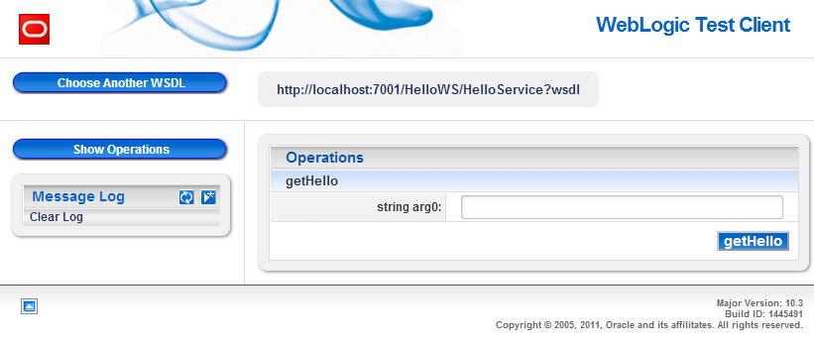
SOAP Test Clients
WebLogic Service includes a web-based web service test client application: http://localhost:7001/wls_utc/.
Notes:
Right-clicking the web service in NetBeans presents a Test Web Service option, which will open a web browser and load the WebLogic Server Test Client.
cURL and the Firefox RESTClient extension can generate HTTP POST requests with any HTTP body content.

Slide 24
WS-* Extensions
WS-I Basic Profile outlines a basic set of interoperable functionality. Many add-on standards have been created:
Web Services Policy Framework (WS-Policy)
Web Services Policy Attachment (WS-PolicyAttachment)
Web Services Security (WS-Security)
Web Services Security Policy (WS-SecurityPolicy)
Web Services Addressing (WS-Addressing)
Web Services Reliable Messaging (WS-ReliableMessaging)
Web Services Reliable Messaging Policy Assertion (WS-RM Policy)
Web Services Secure Conversation Language (WS-SecureConversation)
WS-MakeConnection
Web Services Atomic Transaction
Message Transmission Optimization Mechanism (MTOM)
Notes:
In the slide are just some of the web service enhancements that the WebLogic Web Services Stack supports. The WebLogic Web Services Stack is based on the Metro implementation from project GlassFish. Project Metro also supports a large number of WS-* extensions. Not all web service stacks support the same extensions (and versions of those extensions). When selecting WS-* extensions, you must balance additional features with interoperability.

Slide 25
WS-Policy
A WSDL outlines the basic contract a client must follow when communicating with a web service.
If additional restrictions or requirements for clients are in place then, ideally, they would be included in the WSDL.
WS-Policy is a specification that outlines how extra constraints can be specified by using XML added to a WSDL.
WS-Policy is open ended. It specifies how WS-* extensions can add restrictions.
WS-Policy and WS-* enhancements are not covered by JAX-WS. If and how they work are vendor specific.
WebLogic provides a @weblogic.jws.Policy annotation

Slide 26
@weblogic.jws.Policy
Used to attach WS-Policy requirements by developers.
@Policy(uri="policy:Mc1.1.xml", attachToWsdl=true)
Developers can choose to add the policy element to the generated WSDL or not.
WebLogic Service includes a large number of prewritten policies that should be preferred over custom policies.
Administrators can attach policies to deployed web services.
http://docs.oracle.com/cd/E24329_01/apirefs.1211/e24401/taskhelp/webservices/ConfigureWSPolicyFile.html

Slide 27
Quiz
A request to a SOAP web service endpoint must always be transferred using the HTTP protocol.
True
False
Notes:
Answer: b

Slide 28
Quiz
The definitions element in a completed WSDL should contain which sequence of elements?
types, message, portType, binding, service
Envelope, Header, Body
sequence, choice, enumeration, restriction
types, parts, ports, binding, location
Notes:
Answer: a

Slide 29
Resources
Topic | Website
Simple Object Access Protocol (SOAP) 1.1 | http://www.w3.org/TR/2000/NOTE-SOAP-20000508/
Web Services Description Language (WSDL) Version 1.2 | http://www.w3.org/TR/2002/WD-wsdl12-20020709/
Web Services Policy 1.5 - Framework | http://www.w3.org/TR/ws-policy/

Slide 30
Summary
In this lesson, you should have learned how to:
Understand the basic structure of a SOAP message and how it is encapsulated by transports
Understand how WSDL defines a web service, including its message representation and transport mechanism
Explain the purpose of WS-I Basic Profile and WS-Policy

