Slide 1
SPRING Web-MVC

Slide 2
What is Spring MVC
The Spring MVC is the java framework used to build web application.
Spring follows M-V-C architecture design pattern.
This will follow all the features of Spring such as DI, Inversion of Control, Autowiring.

Slide 3
What is MVC
The Model encapsulates the application data and in general they will consist of POJO similar to JavaBean.
The View is responsible for rendering the model data and in general it generates HTML output that the client's browser can interpret.
The Controller is responsible for processing user requests and building appropriate model and passes it to the view for rendering.

Slide 4
Dispatcher Servlet in Spring
DispatcherServlet is a class that receives the incoming request and maps it to the right resource such as controllers, models, and views.

Slide 5
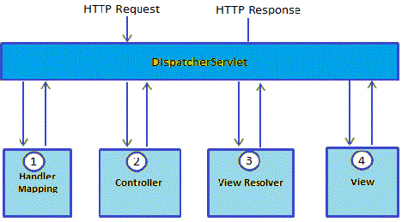
Flow of MVC with Dispatcher
After receiving request it will call HandlerMapping to find appropriate controller.
Controller receives request and based on method (Get/Post), service method will set data-model and returns view name based on business logic to DispatcherServlet.
With the help of view resolver DispacherServlet will pick up view.
Once view finalized based on model data view will be rendered to browser.

Slide 6
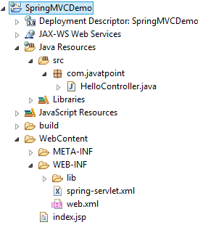
Folder Structure

Slide 7
Steps to Create Application
Step | Description
1 | Create a Dynamic Web Project with a name HelloWeb and create a packagecom.tutorialspoint under the src folder in the created project.
2 | Drag and drop below mentioned Spring and other libraries into the folder WebContent/WEB-INF/lib.
3 | Create a Java class HelloController under the com.tutorialspoint package.
4 | Create Spring configuration files Web.xml and HelloWeb-servlet.xml under theWebContent/WEB-INF folder.
5 | Create a sub-folder with a name jsp under the WebContent/WEB-INF folder. Create a view filehello.jsp under this sub-folder.
6 | The final step is to create the content of all the source and configuration files and export the application as explained below.

Slide 8
Create Servlet
Pacakge com.mybean;
import org.springframework.stereotype.Controller;
import org.springframework.web.bind.annotation.RequestMapping;
import org.springframework.web.bind.annotation.RequestMethod;
import org.springframework.ui.ModelMap;
@Controller
@RequestMapping("/hello")
public class HelloController{
@RequestMapping(method = RequestMethod.GET)
public String printHello(ModelMap model) {
model.addAttribute("message", "Hello Spring MVC Framework!");
return "hello";
}
}

Slide 9
Web.xml
<web-app id="WebApp_ID" version="2.4“ xmlns="http://java.sun.com/xml/ns/j2ee"
xmlns:xsi="http://www.w3.org/2001/XMLSchema-instance"
xsi:schemaLocation="http://java.sun.com/xml/ns/j2ee
http://java.sun.com/xml/ns/j2ee/web-app_2_4.xsd">
<display-name>Spring MVC Application</display-name>
<servlet>
<servlet-name>HelloWeb</servlet-name>
<servlet-class>
org.springframework.web.servlet.DispatcherServlet
</servlet-class>
<load-on-startup>1</load-on-startup>
</servlet>
<servlet-mapping>
<servlet-name>HelloWeb</servlet-name>
<url-pattern>/*</url-pattern>
</servlet-mapping>
</web-app>

Slide 10
HelloWeb-servlet.xml
<beans xmlns="http://www.springframework.org/schema/beans"
xmlns:context="http://www.springframework.org/schema/context"
xmlns:xsi="http://www.w3.org/2001/XMLSchema-instance"
xsi:schemaLocation="
http://www.springframework.org/schema/beans
http://www.springframework.org/schema/beans/spring-beans-3.0.xsd
http://www.springframework.org/schema/context
http://www.springframework.org/schema/context/spring-context-3.0.xsd">
<context:component-scan base-package="com.mybean" />
<bean class="org.springframework.web.servlet.view.InternalResourceViewResolver">
<property name="prefix" value="/WEB-INF/jsp/" />
<property name="suffix" value=".jsp" />
</bean>
</beans>

Slide 11
hello.jsp
<%@ page contentType="text/html; charset=UTF-8" %>
<html>
<head>
<title>Hello World</title>
</head>
<body>
<h2>${message}</h2>
</body>
</html>

Slide 12
Required Jar files
commons-logging-x.y.z.jar
org.springframework.asm-x.y.z.jar
org.springframework.beans-x.y.z.jar
org.springframework.context-x.y.z.jar
org.springframework.core-x.y.z.jar
org.springframework.expression-x.y.z.jar
org.springframework.web.servlet-x.y.z.jar
org.springframework.web-x.y.z.jar
spring-web.jar

