Slide 1
Flask
Session3
Request Handling

Slide 2
Flask Request
In the client-server architecture, the request object contains all the data that is sent from the client to the server.
As we have already discussed in the tutorial, we can retrieve the data at the server side using the HTTP methods.

Slide 3
properties
Attribute | Description
Form | It is the dictionary object which contains the key-value pair of form parameters and their values.
args | It is parsed from the URL. It is the part of the URL which is specified in the URL after question mark (?).
Cookies | It is the dictionary object containing cookie names and the values. It is saved at the client-side to track the user session.
files | It contains the data related to the uploaded file.
method | It is the current request method (get or post).

Slide 4
Static in Python
As web application requires to load static files such as a javascript file or a CSS file for the best look and feel of a web page.
web server is configured to serve them, these files are served from static folder in your package or next to your module and it will be available at /static on the application.

Slide 5
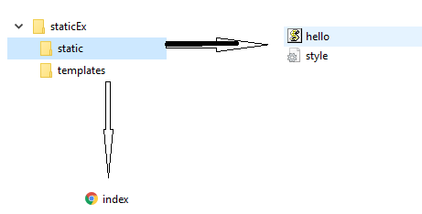
Floder Hierarchy

Slide 6
Session Management

Slide 7
Types of Session management
Cookies
Session

Slide 8
What is Cookie
A cookie is stored on a client’s computer in the form of a text file.
Its purpose is to remember and track data pertaining to a client’s usage for better visitor experience and site statistics.

Slide 9
Cookie
A Request object contains a cookie’s attribute.
It is a dictionary object of all the cookie variables and their corresponding values, a client has transmitted.
In Flask, cookies are set on response object.
Use make_response() function to get response object from return value of a view function.

Slide 10
Cookie handling
use the set_cookie() function of response object to store a cookie.
Ex: resp.set_cookie('userID', user)
The get() method of request.cookies attribute is used to read a cookie.
Ex: request.cookies.get('userID')

Slide 11
Session
Session data is stored on client.
Session is the time interval when a client logs into a server and logs out of it.
The data, which is needed to be held across this session, is stored in the client browser.
The Session data is stored on top of cookies and the server signs them cryptographically.
For this encryption, a Flask application needs a defined SECRET_KEY.

Slide 12
Handle Session
Ex: To initialise session data
Session[‘username’] = ’admin’
Releasing session data done by using pop() method :
session.pop('username', None)

