Slide 1
Data-Driven Storytelling Presentation:
ACCOUNT PERFORMANCE METRICS
AND SALES TREND

Slide 2
INTRODUCTION
Problem Statement
J.P. Morgan Chase & Co. is a leading global financial services firm that offers services and operates worldwide.
The company aims to analyze the account performance metrics over the last 5 years (2017-2021) and the factors contributing to its compound annual growth rate (CAGR) in unit sales. This includes identifying opportunities for further improvement.
Business Questions
Examining the total unit sales for each year.
Analyzing the year-over-year growth in sales.
Identifying which account types are surpassing others in terms of unit sales.

Slide 3
Identifying which account types are surpassing others in terms of unit sales.
Calculating the average 5-year compound annual growth rate (CAGR) based on different account types.
Evaluating the top-performing and bottom-performing accounts.
DATA MODELLING
Utilizing Power Query in MS-Excel, transformed the data for improved organization, giving a more structured foundation for necessary analysis

Slide 4
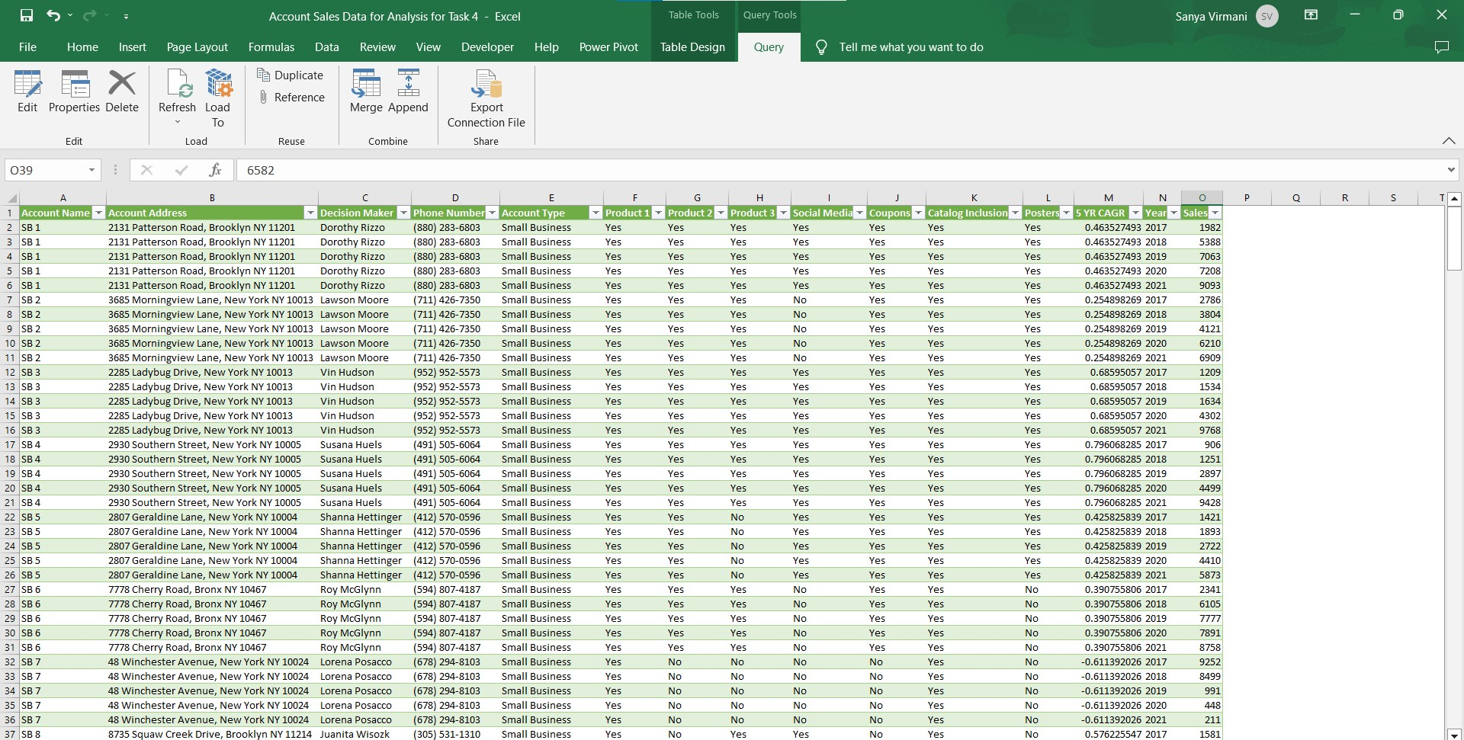

Slide 5
DATA ANALYSIS &VIUALIZATION
Overall, our unit sales growth has been good, with a 5- year CAGR of 21%
Total Unit Sales
2017
189976
2018
242995
2019
288449
2020
350234
2021
409194
0 100000 200000 300000 400000 500000

Slide 6
DATA ANALYSIS &VIUALIZATION
Directing our sales resources and adjusting our sales mix towards online retailer accounts could lead to enhanced sales growth.
Unit Sales by Account Type and Year

Slide 7
DATA ANALYSIS &VIUALIZATION
120000
However, Medium Business account type is experiencing higher profitability driven by the average 5-year CAGR.
Average of 5YR CAGR by Account Type
100000
80000
60000
40000
20000
2017
2018
2019
2020
2021
Medium Business
Online Retailer
Small Business
Wholesale Distributor

Slide 8
DATA ANALYSIS &VIUALIZATION
Wholesale Distributor
3768.8
1
%
Small Business
3409
.21
%
Online Retailer
40
76.96
%
Medium Business
4275.3
1
%
0
5
10
15
20
25
30
35
40
45
Online Retailer generated the highest sales volume, totaling 408,515 units, which accounts for 28% of the total sales volume.

Slide 9





DATA ANALYSIS &VIUALIZATION
Medium Business followed closely with a sales volume of 380,568 units, making up 26% of the total sales volume.
Sales by Account Type
Medium Business Online Retailer Small Business Wholesale Distributor
23
%
26
%
23
%
28
%

Slide 10
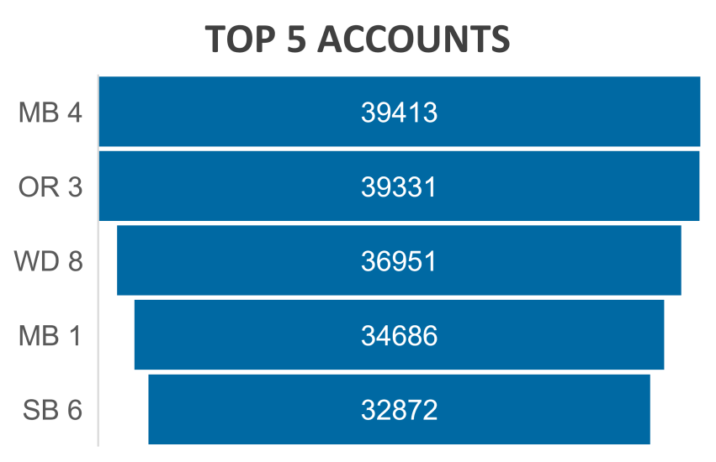
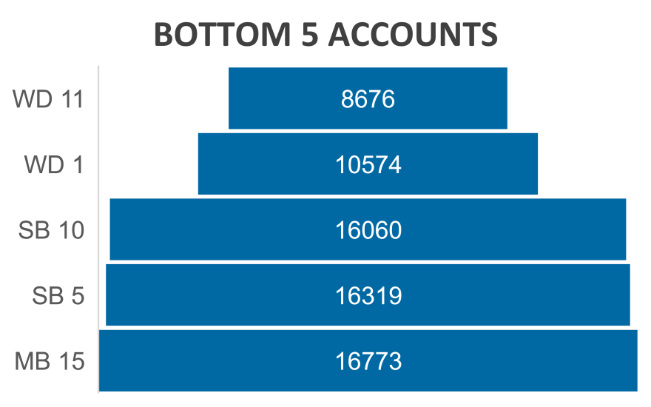
DATA ANALYSIS &VIUALIZATION
The account name MB4 proved to be the highest-performing account, achieving an impressive sales volume of approximately 39,413 units.
On the other hand, accounts WD11, WD1, and SB10 performed at the lowest level in terms of sales volume. Specifically, WD11 accounted for 8,676 units, WD1 for 10,574 units, and SB10 for 16,060 units, all in terms of sales volume

Slide 11
SUMMARY
Despite satisfactory overall sales performance, there is ample room for significant improvement.
Discontinuing poorly performing accounts would free up valuable sales and marketing resources.
Notably, the past five years have witnessed the most robust sales growth in the online retailer account category.
By reallocating the resources saved from closing underperforming accounts to online retailer accounts, sales growth could be maximized
It is advisable to promptly close these underperforming accounts and launch an initiative to identify high-potential online retailer accounts deserving of increased sales and marketing focus.
BY-BHISHAM MOR

