Slide 1
Effects of Wavelength Dependent PSF on Galaxy Shear & Mass Measurement
Physics Ph.D. Prospectus Defense By,
Bhishan Poudel
Date: Apr 25, 2018
Advisor: Dr. Douglas Clowe
Committee Members:
Dr. Hee Jong Seo
Dr. Nancy Sandler
Dr. Jixin Chen

Slide 2
Outline
Schematic Diagram of Project
Introduction
Galaxy Fitting
PSF Creation
Galaxy Simulation using Jedisim
Shear Analysis
Mass Estimation
Timeline
References

Slide 3
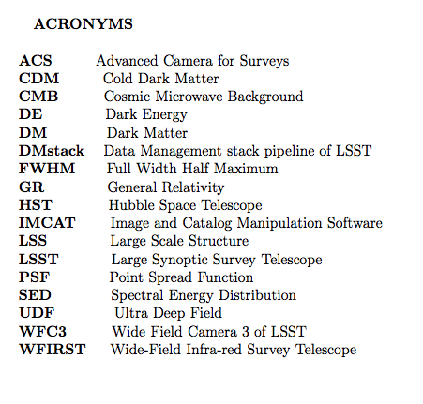

Slide 4
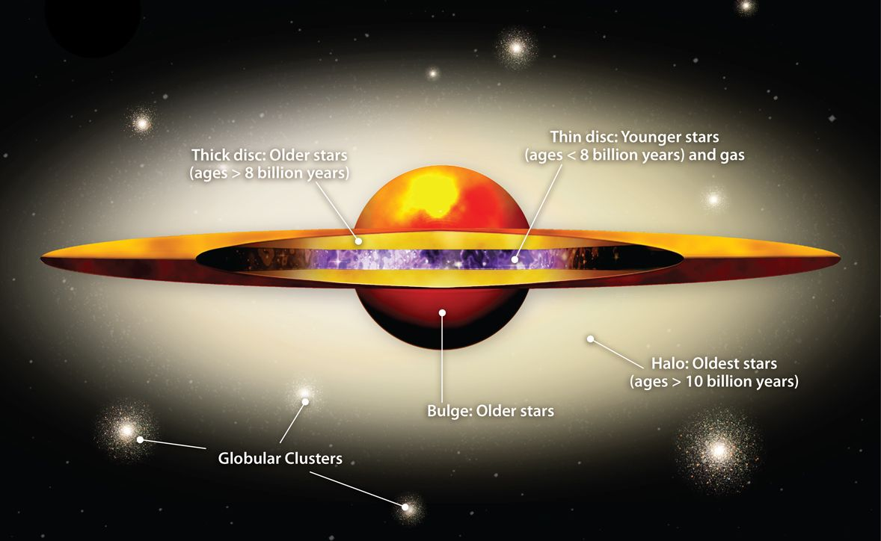
Parts of a Galaxy
Dark Matter Halo
(Source: SolStation.com)

Slide 5
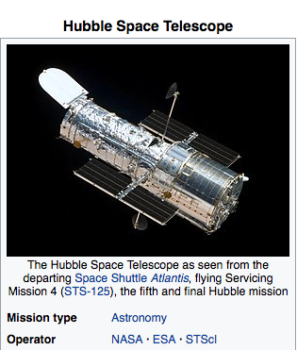
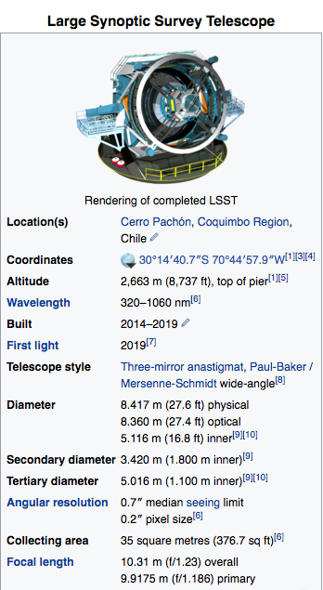
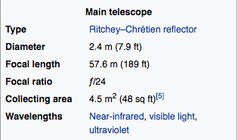
HST & LSST
(HST)t
(LSST)
1. HST (Space Based Telescope)
2. LSST (Ground Based Telescope)
(Source: Wikipedia)

Slide 6
Summary of the Project
Galaxy
HST UDF Images (20,000 from 200 galaxies)
(Appear lensed)
Disk
Bulge
Scaled Bulge
Scaled Disk
Jedisim
SIS Lens
(Cluster,NS,BH,etc)
PSF
Config File
Chromatic
Monochromatic
DMstack
Observe from Earth
LSST + PSF
Shear Estimate
(obs_file)
Mass Estimate
(Clusters)
Notes:
The total brightness of bulge+disk for HST and LSST are kept same, but the ratio is changed due to the star formation history in the galaxy.
We have 200 galaxies from HST UDF Survey, we create 20,000 images from them using similar radius, magnitude, angle, etc.
Then, we put a lens in between observer and the images background. The lens could be galaxy cluster, a neutron star, a black hole or any massive object.
Now, if we observe the background images using LSST. Due to the atmosphere the images appear different than original and we study this effect using PSF files.
My project is mainly studying the effect of choice of psf and its effect on the shear measurement of background galaxies.
We study both wavelength dependent (i.e. chromatic) and independent ( i.e. monochromatic) effects.
On the left hand side, we have the detail structure of the project.
We have a galaxy, we break it into bulge and disk. Every galaxies have galactic disk, but it may not have bulge.
The spiral galaxies generally have both bulge and disk, however, disk galaxies may not have the bulge at the center of the galaxy.
In our simulation, if there is no bulge part, we keep it blank image of the same dimension as that of disk image.
We have galaxies from HST at a given redshift ( here I am taking z = 0.2) and we want to simulate for LSST. at user given redshift (e.g. z = 0.7, 1.0, 1.5 etc).
At different redshifts , due to the star formation history, the ratio of bulge to disk in a galaxy changes and we take this into account and create scaled bulge and scaled disk images. Which will be shown in detail in next slide.

Slide 7
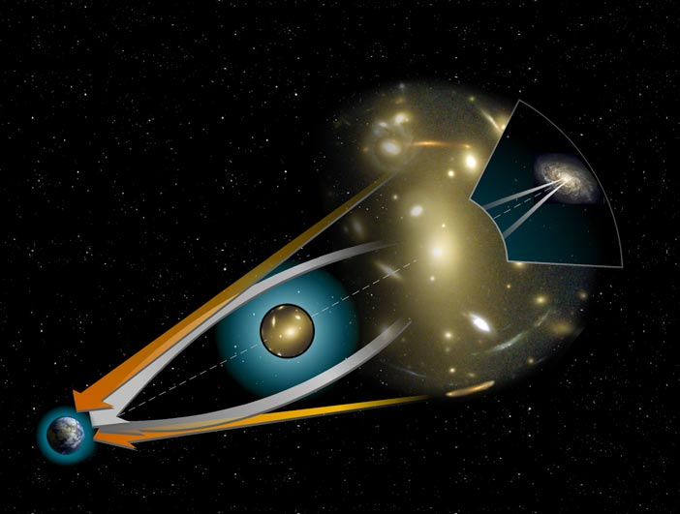
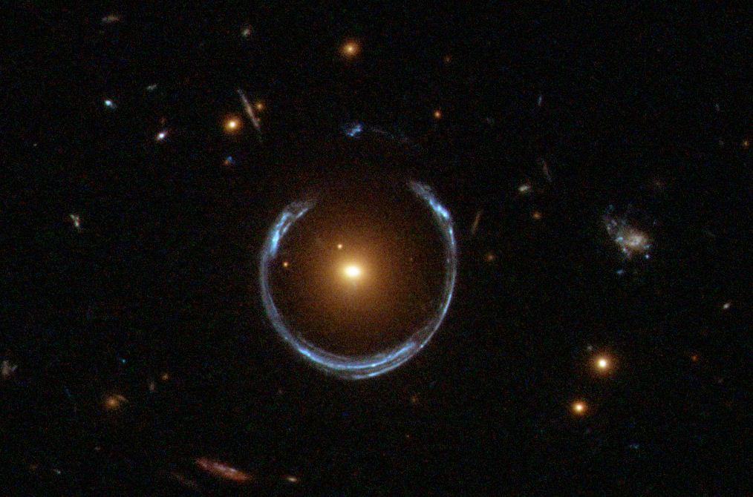
Introduction to Gravitational Lensing
When the light from a distant object is coming to the observer, if there is a massive object near to the line to sight, then the original object appears to be enlarged and distorted (or in some cases a circular ring or multiple images of the same objects are seen) which is called Gravitational Lensing.
Fig: Left: Einstein Ring around a galaxy and Right: Multiple Images due to lensing (Source: Wikipedia)

Slide 8
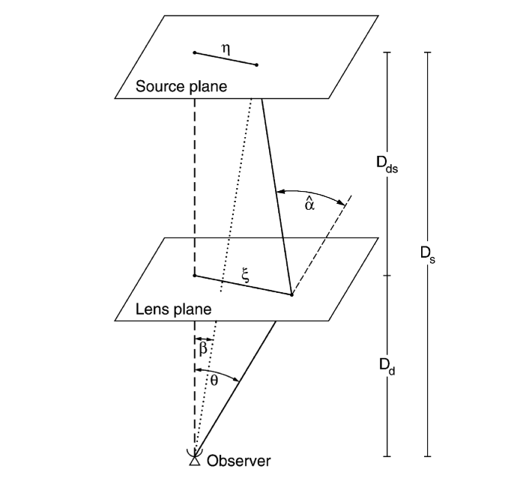

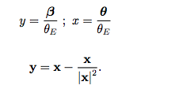

Lensing Theory
Deflection Angle
Lens Equation
Einstein Angle
Fig: Gravitational Lensing (Source: Schneider and Bartelmann 2001)
Notes:
Here is the theory behind the gravitational lensing.
The background source galaxy has angular diameter β.
The foreground lens is at a distance (impact parameter) ξ from the line of sight.
The lens makes the source to be observed as angular diameter θ.
The difference of θ and β is the deflection angle α.
This depends of the mass of the lens, and the impact paramter ξ.
If the lens is at directly at the line of sight, we see a circular ring around the source, which is called Einstein Ring.
If the lens is near to the line of sight, we see multiple images as given by the lensing equation shown in above equation.
The quadratic equation has two solutions and we see two images at the both sides of the source image.

Slide 9
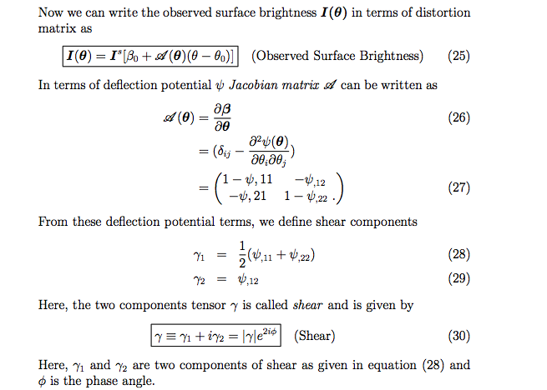




Lensing Theory Contd.
(Source: Schneider and Bartelmann 2001)
Notes:
Here are the some the terms used in gravitational lensing.
A is the distortion matrix,
κ is the convergence, μ is the magnification, γ is the true shear and g is the Reduced shear. (Note: g is for gamma).
Detail is given in the paper and the whole derivation can be found in the source Schneider and Bartelmann book.

Slide 10
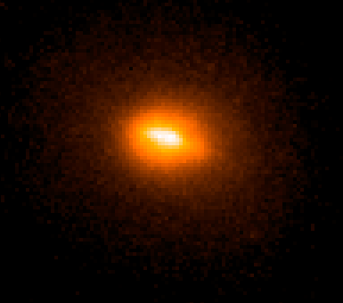

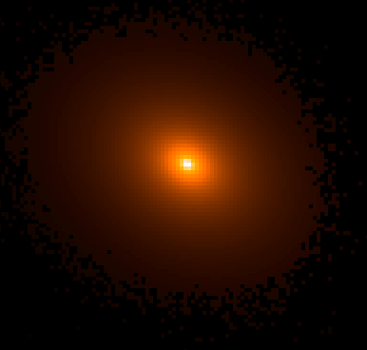
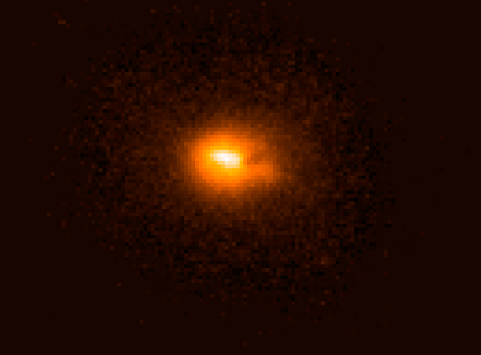
Part 2: Galaxy Fitting (Using Galfit)
HST F814W Image
(Source: HST )
Bulge (deVaucouleur Profile)
Disk (Exponential Disk Profile)
Notes:
We have a galaxy pixel points data.
We fit two models, namely, bulge and disk with above formulas and the two parts.
We again note that not every galaxies have bulge and disk.
All the galaxies have galactic disk, but may not have a bulge.
If there is no bulge we take it blank image.

Slide 11
Rescaling Ratio of Bulge and Disk From HST to LSST
sb0 sd0
sb1 s d1
…
sb200 sd200
g0
g1
…
g200
b0 d0
b1 d1
…
b200 d200
Galfit
Bulge to Disk
Ratio Change
Notes:
We have galaxy stamps from HST at a given redshift (assumed z = 0.2)
We want to simulate stamps for LSST at user given redshift (z = 0.5, 0.7, 1.0, 1.5).
Due to star formation the ration of bulge and disk light from a galaxy changes, we take into this account by creating scaled bulge and scaled disk from b &d.
We keep total light from a galaxy, but the ratio of bulge to disk is changed.

Slide 12
PSF Creation Using PhoSim
PhoSim
psf0
psf1
…
psf20
psfb
psfd
psfm
Background
21 normalized
PSFs
3 PSFs
SED
(21 files)
Instance Catalog
Notes:
PhoSim (Photon Simulator) creates the PSF for the given physics input parameters.
backgroud: saturation 0, blooming 0, chargesharing 0
sed: wavelenth vs flux for LSST we have wavelength range
Instnce catalog: Opsim filter 2, sim_seed 1000, sim_vistime 300, sim_nsnap 1

Slide 13
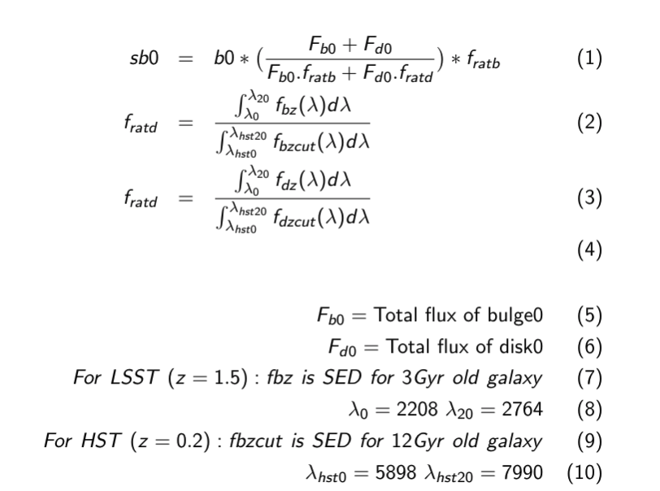
Equation for Rescaling

Slide 14
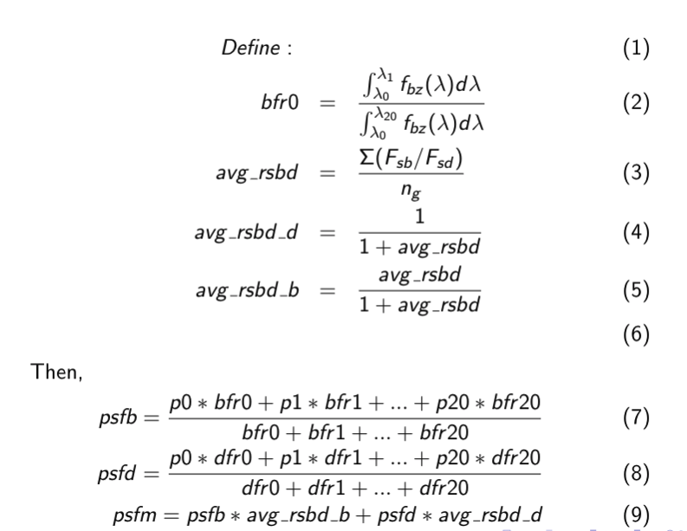
Creating PSF For Bugle, Disk, and Monochromatic

Slide 15
Simulating LSST Images using Jedisim
Created by Daniel Parker and Dr. Ian Dell Antonio of Brown University (2013).
Adapted, Modified, and Maintained by Bhishan with help of Dr. Clowe from 2014.¹
Takes the HST or CANDELS or Other Surveys Images as input and gives LSST
simulated images.
Jedisim takes in three inputs:
* Input galaxies (scaled bulge or scaled disk or scaled_bulge_disk).
* PSF (psfb or psfd or psfm)
* Physics configuration file (configb or configd or configm)
Jedisim gives out following outputs:
* Chromatic Image (lsst)
* Monochromatic Image (lsst_mono).
* 90 degree rotated version of chromatic and monochromatic images.

Slide 16
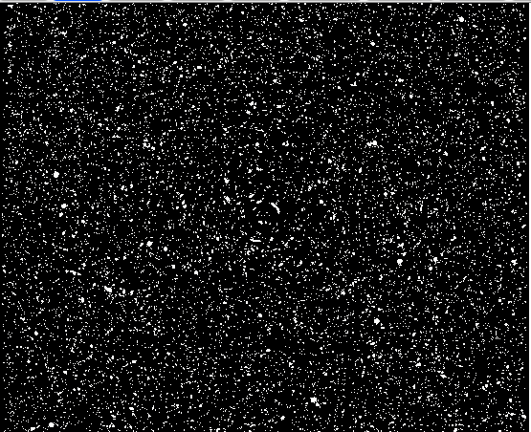
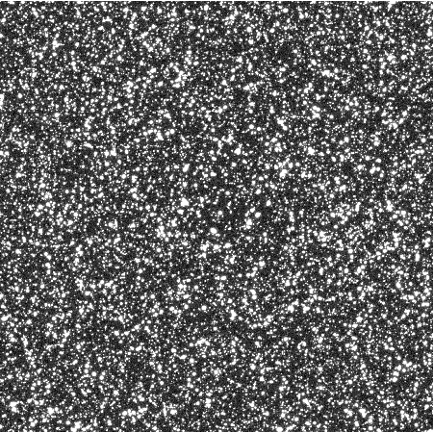
HST and LSST Images

Slide 17
Jedisim Schematic Diagram
Scaled Bulge
Jedisim
Chromatic
Scaled Disk
PSF
Monochromatic
Config File

Slide 18
Creating Catalog
Galaxy Parameters
Magnitude (Power law, 22 < M < 28)
Radius (r50 radius binned by integer magnitude)
Redshift (Constant, also can be changed)
Position (601 * 601 pixels)
Angle

Slide 19
Create Galaxy Stamps Using Jeditransform
We have 201 HST ACS UDF F814W Galaxy cutouts.
The script “Jeditransform.c” will create more images from these.
Jeditransform reads Position, Angle, Magnitude, Redshift, and Radius from the catalog file and create more stamps.
Here we generate 20,000 HST galaxy stamps.

Slide 20

Distort the Stamps Using Gravitational Lens
Program: Jedidistort
lens.txt
create lensed images
Mass Profiles
Navarro-Frenk-White (NFW)
Singular Isothermal Sphere (SIS)
Singular Isothermal Sphere
ρ = $\frac{σ2}{2π G r2}$
ρ is mass density
σ is dispersion velocity

Slide 21
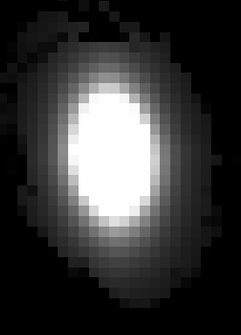
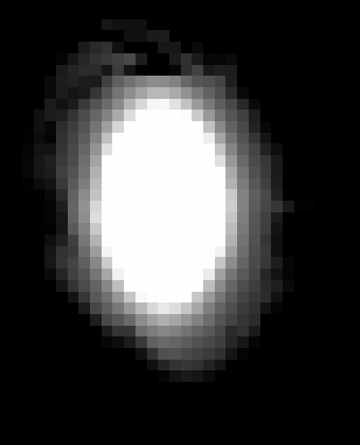
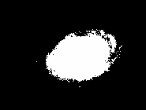
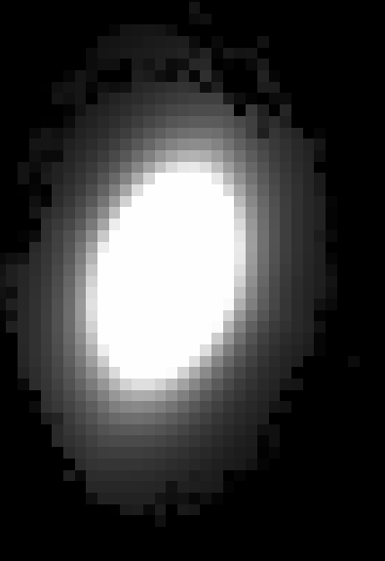
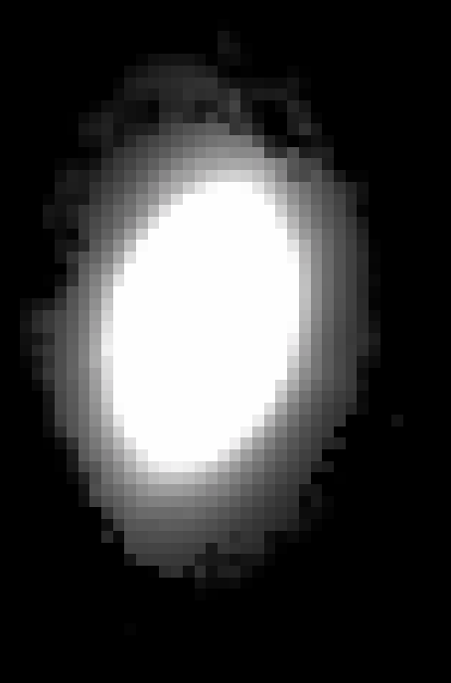
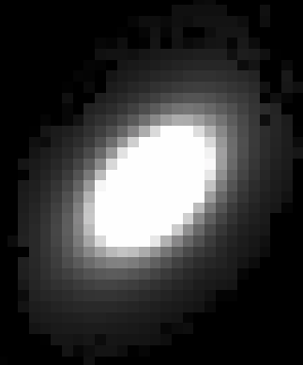
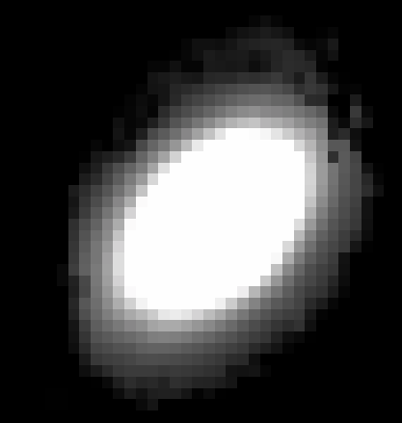
Transform and Distort Image
transformed_118.fits
distorted_118.fits
Transform
Distort (Lens)
bulge0.fits
transformed_360.fits
distorted_360.fits
transformed_765.fits
distorted_765.fits

Slide 22

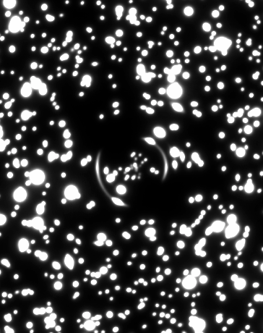
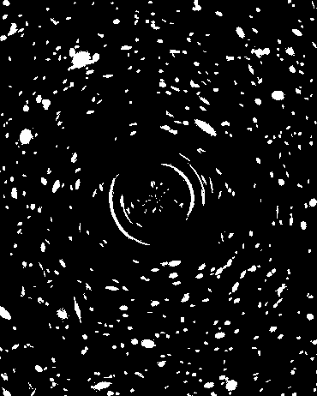
Convolve HST Field with PSF

Slide 23
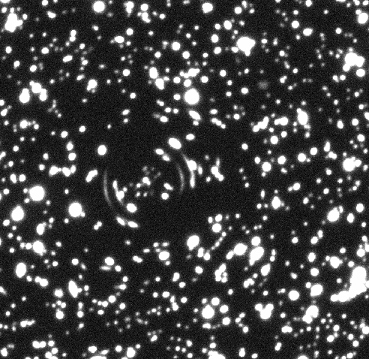
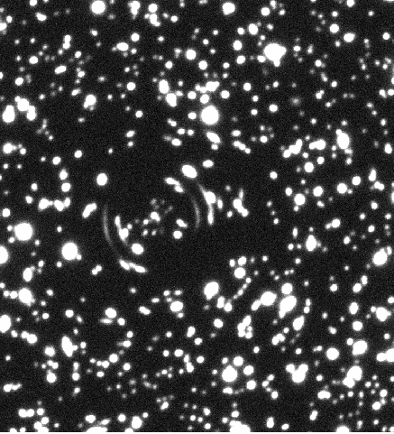
Create Monochromatic and Chromatic Image
lsst.fits (from 20,000 HST Images)
lsst_mono.fits (from 20,000 HST Images)

Slide 24
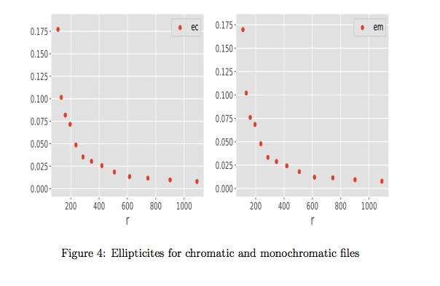
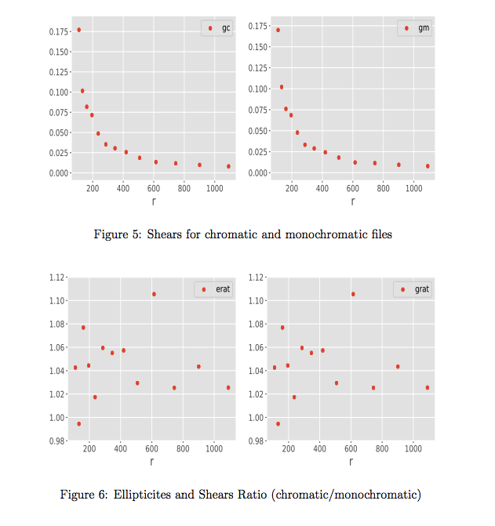
Shear Analysis on LSST Simulated Images (z=0.7)

Slide 25
Mass Estimation Using DMstack
DMstack is LSST Data Management Pipeline
obs_file¹
ingest images
Process CCD
Gives fits table with KSB parameters
Clusters²
Reads fits table in hdf5 format
Add photo-z to hdf5 file
Estimate mass using cluster_mass script
1. https://github.com/bhishanpdl/DMstack_obsfile_Clusters
2. https://github.com/bhishanpdl/DMstack_obsfile_Clusters/tree/master/run_clusters

Slide 26
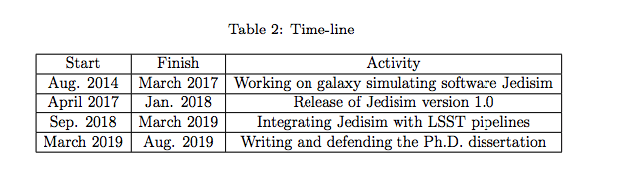
Timeline

Slide 27
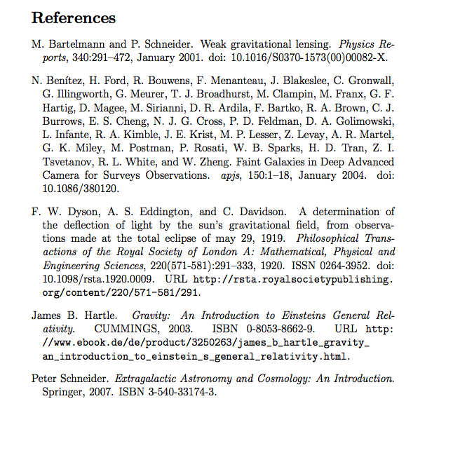
References

