Slide 1

Clustering
Let’s learn something!

Slide 2
Python and Spark
We’ve seen how to deal with labeled data, but what about unlabeled data?
Often you’ll find yourself trying to create groups from data, instead of trying to predict classes or values.

Slide 3
Python and Spark
This sort of problem is known as clustering, you can think of it as an attempt to create labels.
You input some unlabeled data, and the unsupervised learning algorithm returns back possible clusters of the data.

Slide 4
Python and Spark
This means you have data that only contains features and you want to see if there are patterns in the data that would allow you to create groups or clusters.

Slide 5
Python and Spark
This is a key distinction from our previous supervised learning tasks, where we had historical labeled data.
Now we will have unlabeled data, and attempt to “discover” possible labels, through clustering.

Slide 6
Python and Spark
By the nature of this problem, it can be difficult to evaluate the groups or clusters for “correctness”.
A large part of being able to interpret the clusters assigned comes down to domain knowledge!

Slide 7
Python and Spark
Maybe you have some customer data, and then cluster them into distinct groups.
It will be up to you to decide what the groups actually represent.
Sometimes this is easy, sometimes it’s really hard!

Slide 8
Python and Spark
For example, you could cluster tumors into two groups, hoping to separate between benign and malignant.
But there is no guarantee that the clusters will fall along those lines, it will just split into the two most separable groups.

Slide 9
Python and Spark
Also depending on the clustering algorithm, it may be up to you to decide beforehand how many clusters you expect to create!

Slide 10
Python and Spark
A lot of clustering problems have no 100% correct approach or answer, that is the nature of unsupervised learning!
Let’s continue by discussing K-means clustering.

Slide 11
Reading Assignment
Chapter 10 of
Introduction to Statistical Learning
By Gareth James, et al.

Slide 12
K Means Clustering
K Means Clustering is an unsupervised learning algorithm that will attempt to group similar clusters together in your data.
So what does a typical clustering problem look like?
Cluster Similar Documents
Cluster Customers based on Features
Market Segmentation
Identify similar physical groups

Slide 13
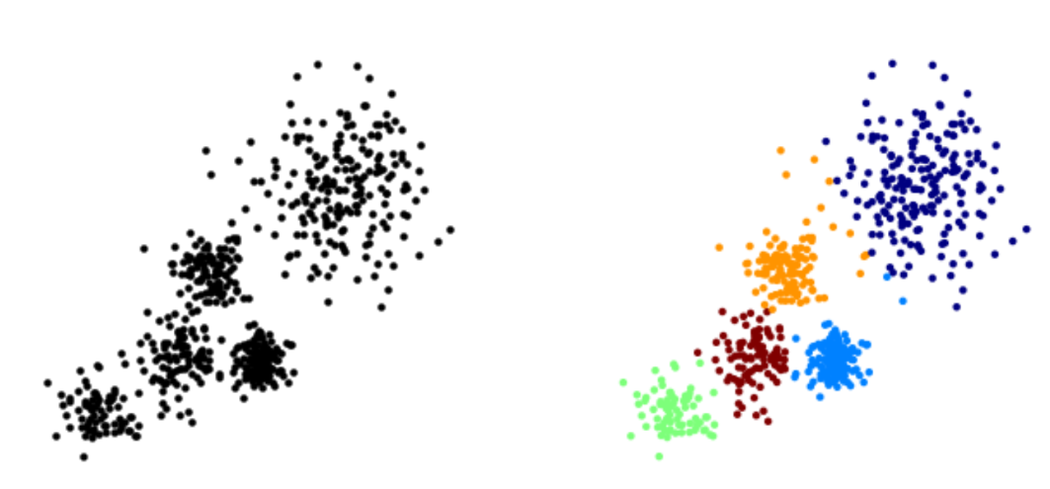
K Means Clustering
The overall goal is to divide data into distinct groups such that observations within each group are similar

Slide 14
K Means Clustering
The K Means Algorithm
Choose a number of Clusters “K”
Randomly assign each point to a cluster
Until clusters stop changing, repeat the following:
For each cluster, compute the cluster centroid by taking the mean vector of points in the cluster
Assign each data point to the cluster for which the centroid is the closest

Slide 15
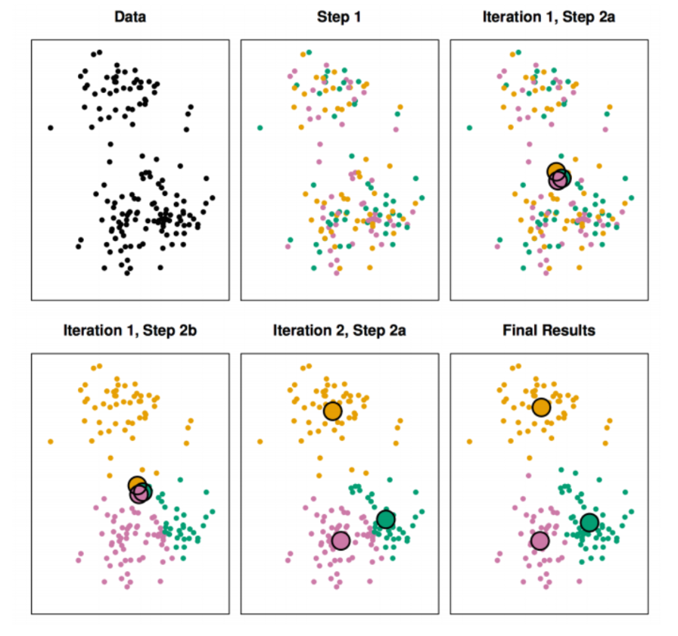
K Means Clustering

Slide 16
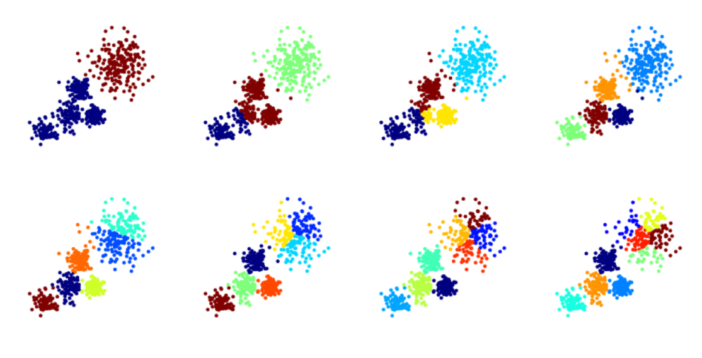
Choosing a K Value

Slide 17
Choosing a K Value
There is no easy answer for choosing a “best” K value
One way is the elbow method
First of all, compute the sum of squared error (SSE) for some values of k (for example 2, 4, 6, 8, etc.).
The SSE is defined as the sum of the squared distance between each member of the cluster and its centroid.

Slide 18
Choosing a K Value
If you plot k against the SSE, you will see that the error decreases as k gets larger; this is because when the number of clusters increases, they should be smaller, so distortion is also smaller.
The idea of the elbow method is to choose the k at which the SSE decreases abruptly.
This produces an "elbow effect" in the graph, as you can see in the following picture:

Slide 19
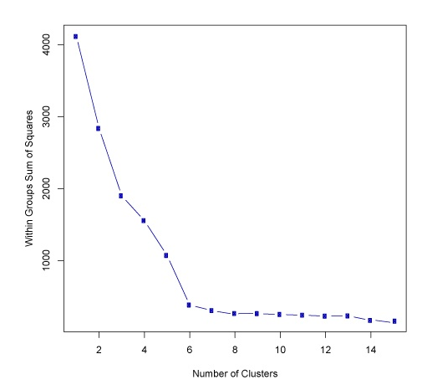
Choosing a K Value

Slide 20
Choosing a K Value
Pyspark by itself doesn’t support a plotting mechanism, but you could use collect() and then plot the results with matplotlib or other visualization libraries.

Slide 21
Choosing a K Value
But don’t take this as a strict rule when choosing a K value!
A lot of depends more on the context of the exact situation (domain knowledge)
We’ll try our best to get a feel for this with the examples and consulting projects!

Slide 22
K-Means Clustering
Documentation Example
Let’s learn something!

Slide 23
Python and Spark
Let’s work through the documentation example for clustering.
Pay close attention to how we don’t need the label column (which makes sense given clustering)

Slide 24
Python and Spark
The documentation’s example is a bit peculiar in its choice of data set, but we’ll explain it along the way.
Hopefully our own custom code along will clarify things further!
Let’s get started!

Slide 25
K-Means Clustering
Code Along

Slide 26
Python and Spark
We’ll work through a real data set containing some data on three distinct seed types.
Notebook: Clustering Code Along.ipynb

Slide 27
Python and Spark
For certain Machine Learning algorithms, it is a good idea to scale your data.
Drops in model performance can occur with highly dimensional data, so we’ll practice scaling features using PySpark!

Slide 28
Python and Spark
Remember, there won’t be any confusion matrix or classification test results.
This is unsupervised learning!
Meaning we don’t have the original labels to actually perform some sort of test against!

Slide 29
Python and Spark
This is a common point of confusion for beginners, you can’t easily check to see how well your clustering algorithm performed, this is the difficulty of all unsupervised tasks!
Let’s get started!

Slide 30
K-Means Clustering
Consulting Project

Slide 31
Python and Spark
You’re becoming world famous due to your machine learning skills!
A technology start-up in California needs your help!

Slide 32

Python and Spark
It’s time for you to go to San Francisco to help out a tech startup!

Slide 33

Python and Spark
They’ve been recently hacked and need your help finding out about the hackers!

Slide 34
Python and Spark
Luckily their forensic engineers have grabbed valuable data about the hacks, including information like session time,locations, wpm typing speed, etc.

Slide 35
Python and Spark
The forensic engineer relates to you what she has been able to figure out so far, she has been able to grab meta-data of each session that the hackers used to connect to their servers.
These are the features of the data...

Slide 36
Python and Spark
'Session_Connection_Time': How long the session lasted in minutes
'Bytes Transferred': Number of MB transferred during session
'Kali_Trace_Used': Indicates if the hacker was using Kali Linux
'Servers_Corrupted': Number of server corrupted during the attack
'Pages_Corrupted': Number of pages illegally accessed
'Location': Location attack came from (Probably useless because the hackers used VPNs)
'WPM_Typing_Speed': Their estimated typing speed based on session logs.

Slide 37
Python and Spark
The technology firm has 3 potential hackers that perpetrated the attack.
They are certain of the first two hackers but they aren't very sure if the third hacker was involved or not.
They have requested your help!

Slide 38
Python and Spark
Can you help figure out whether or not the third suspect had anything to do with the attacks, or was it just two hackers?
It's probably not possible to know for sure, but maybe what you've just learned about Clustering can help!

Slide 39
Python and Spark
One last key fact, the forensic engineer knows that the hackers trade off attacks.
Meaning they should each have roughly the same amount of attacks.

Slide 40
Python and Spark
For example if there were 100 total attacks, then in a 2 hacker situation each should have about 50 hacks, in a three hacker situation each would have about 33 hacks.

Slide 41
Python and Spark
The engineer believes this is the key element to solving this, but doesn't know how to distinguish this unlabeled data into groups of hackers.

Slide 42
Python and Spark
Best of luck with this project, it should be a fun one!
If you get stuck, feel free to go straight to the solution lecture.
Enjoy!

Slide 43
K-Means Clustering
Consulting Project
Solutions

