Slide 1
Open Hardware
@crakensio

Slide 2
What Is Open Hardware?
“Open Source Hardware is hardware whose design is made publicly available so that anyone can study, modify, distribute, make, and sell the design or hardware based on that design”
                - Wikipedia

Slide 3
How things are done ?
Design
Prototype
Test
Final Prototype
Manufacture
Product
User

Slide 4
Open Hardware
Stuffs that makes the Hardware are made publicly Open.
“Open Source Hardware is hardware whose design is made publicly available so that anyone can study, modify, distribute, make, and sell the design or hardware based on that design”

Slide 5
Open Designs
Schematics
Logic diagrams
Blueprints
Drawing Files
Layout Diagrams

Slide 6
Some other stuffs
Bill of Materials
HDL Source Code
Softwares that drive that hardware
What not?
No IP Cores

Slide 7
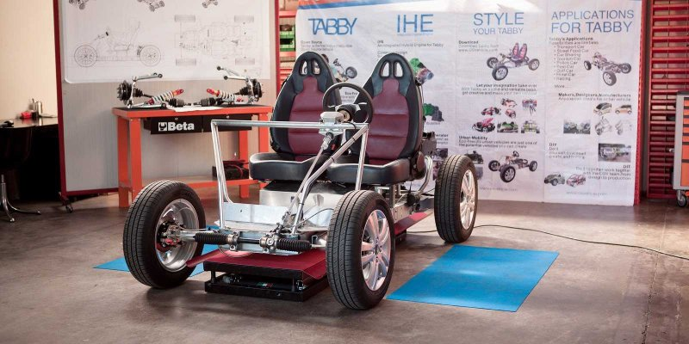
Time for Cool Stuffs
TABBY DIY CAR

Slide 8


Open Desk

Slide 9
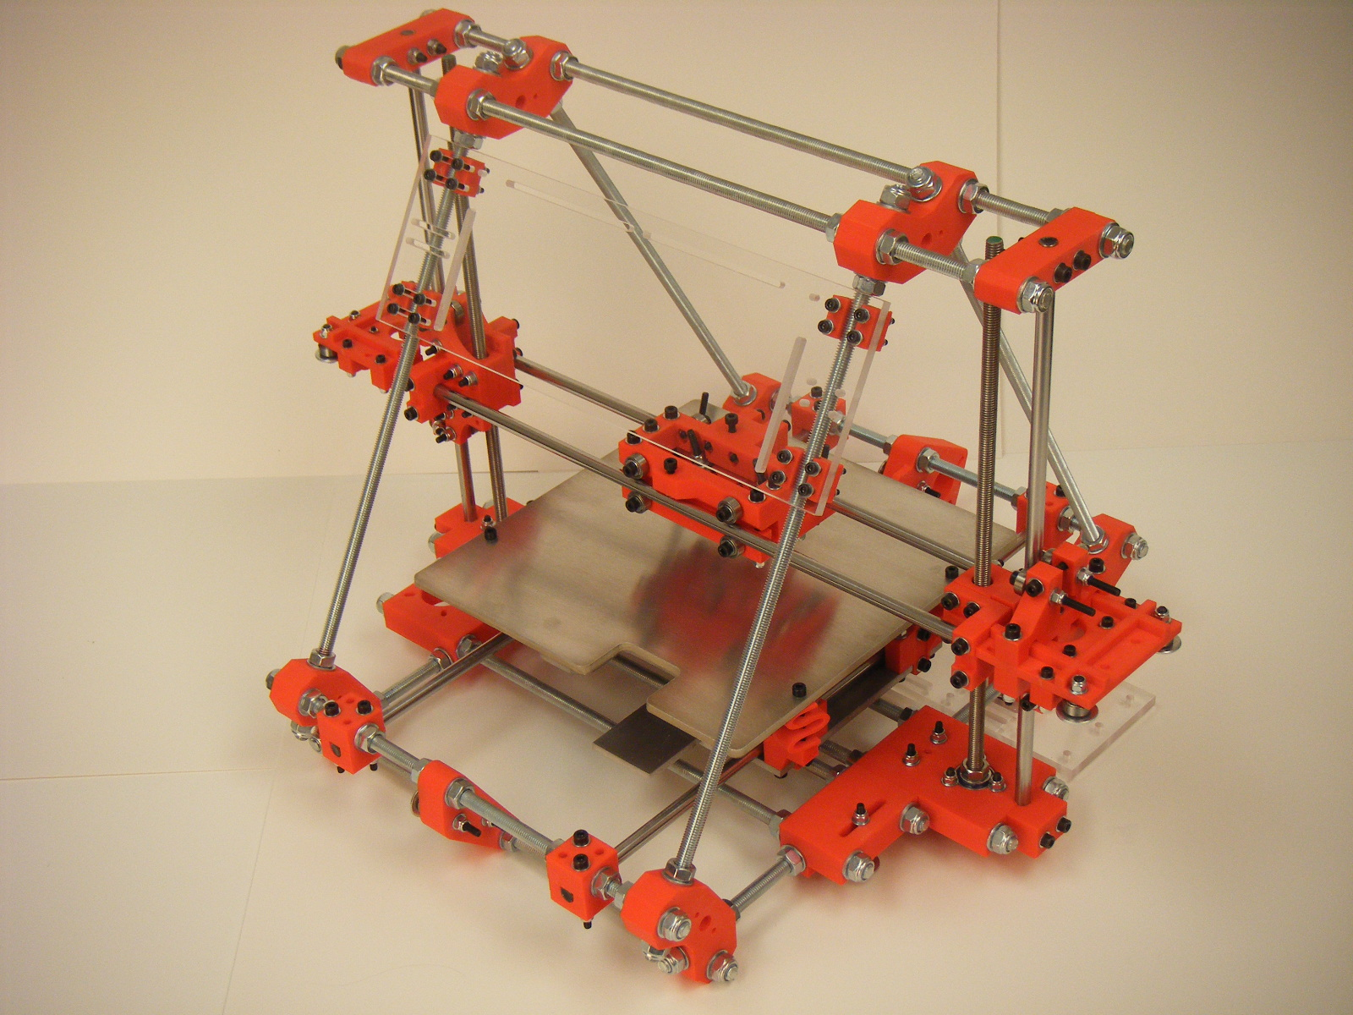
RepRap
“A Printer that print themselves :P”

Slide 10
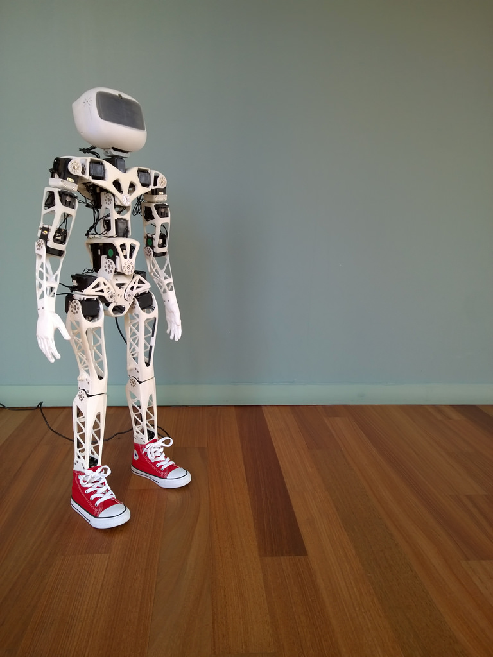
Poppy
An Affodable Humanoid

Slide 11
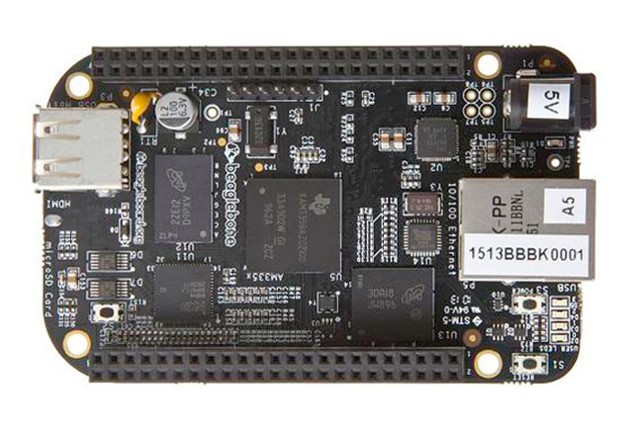
Beagle Board
Low power Single Board Open Hardware Computer

Slide 12
Arduino
Most popular, Successful Open Hardware Development Platform for Electronics
Open Source Electronics Prototyping Platform that enables to do interactive designs.

Slide 13
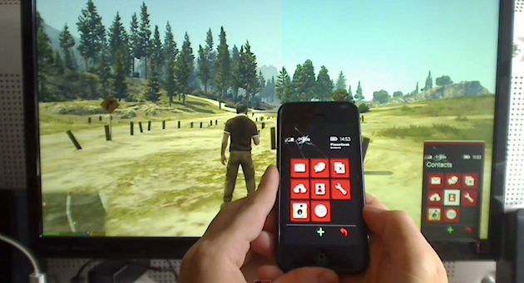
GTA V

Slide 14
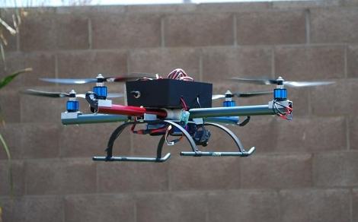
Quadcopters

Slide 15
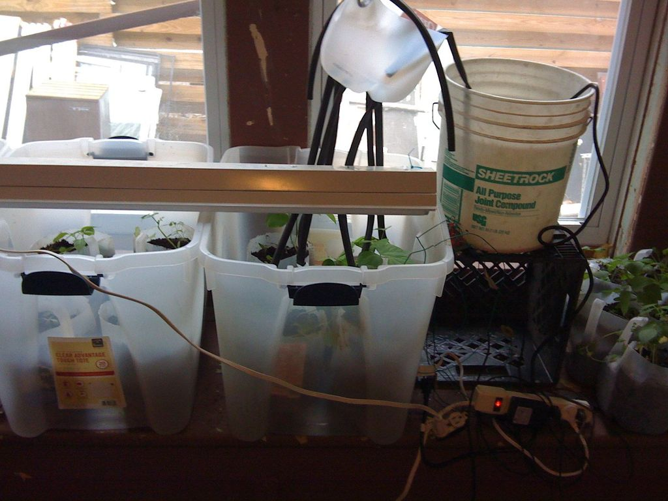
Open Gardening

Slide 16

Arduino Time

Slide 17
What Next?
Open Hardware needs more training at educational institutions
It needs more individuals and hackers to join the movement to spread Openness around
It needs More Professional tools
Be Hacker, Join the movement!
Spread open Hardware

Slide 18

Grazie
@crakensio

