Slide 1
ENGI 301 Sixth Finger Proposal
2/19/2024
Ben Leebron

Slide 2
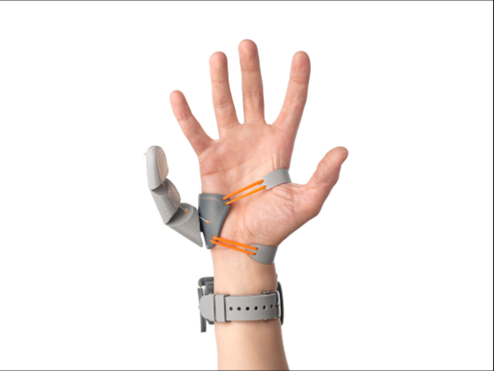
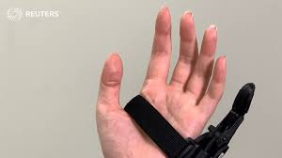
Background Information
A robotic sixth finger
I am missing tip of my pinky so this is interesting to me
Top picture is manually controlled by force sensors under toes
Bottom picture is controlled by reading electric signals from muscles
Innovation: Assistive control with camera (much cheaper and still autonomous)
Controlled by microprocessor with camera inputs to determine best position for finger to hold object when shown to camera (see next slide)
Two motors for finger, one pulling a cable for flexion and one for rotation

Slide 3
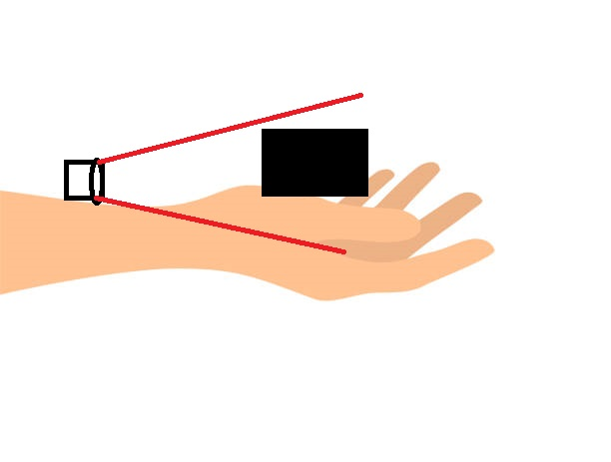
Improvements/Additions
Wrist mounted camera (Hardware addition)
Autonomous Grasping (Software Addition/Improvement)
No Electronic Myography (Cost Improvement)

Slide 4
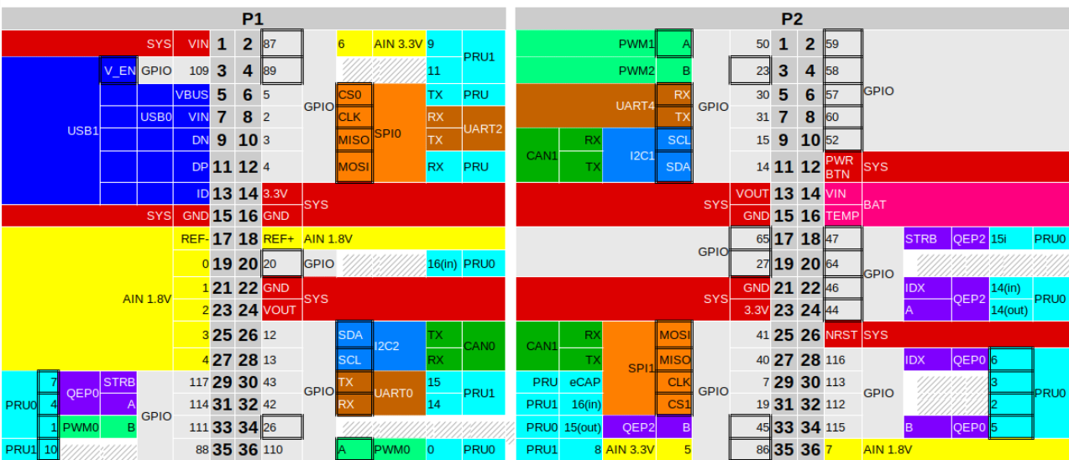
System Block Diagram
Motor PWM
Camera
Camera
Pocket Beagle
AM3358
Servo Motors
FSR90

Slide 5
Power Block Diagram
Create a Power Block Diagram
Label voltages / currents of components
Pocket Beagle
Motor 1 (120-650mA) (4.8 V)
USB Power Bank (5V)
Motor 2 (120-650mA) (4.8 V)
Camera over USB-A

Slide 6
Components / Budget
Component | ENGI301 to Buy? | Cost
https://www.amazon.com/FEETECH-Continuous-Rotation-Matching-Helicopter/dp/B0B42KLJ9G?th=1, Servo x 2 | Yes | 5.40 x 2 = 10.80
https://www.amazon.com/Microphone-Calling-Conferencing-Streaming-Computer/dp/B09TKCBWZ2, Camera x 1 | Yes | 19.99
https://bit.ly/49IwAxt, USB Breakout x 1 (10 pcs) | No | 0.70
http://tinyurl.com/4mftwc87 , USB Power Bank | No | 13.99
http://tinyurl.com/ym94y56s, Black Gloves | No | 7.99
http://tinyurl.com/49m3akmc, Yellow Tape | No | 3.99
See Next Slide for Instructions

