Slide 1
COVID-19 probabilistic modeling

Slide 2
Problem Formulation
What does the model predict ?
The main task is predicting the probability of infection of the user over the past N days (where N=incubation days ,e.g. 14). This means predicting at each inference 14 posterior probabilities given what we know about the past. What we show to the user is a single risk number.
There are some helpful auxiliary tasks:
Predict tests results / very rare but they contain the most informative data.
Predict: symptoms.
Predict number of daily encounters to model the latent variable: risk aversion of person (useful because every app user will have some data as opposed to testing )
Observable variables in the app (all can be missing for any user)
Test results
Symptoms
Contact information: quantized by day, area, duration.
Preconditions

Slide 3
Model v0
Contact tracing (e.g. Singapore app)

Slide 4

Contact tracing: Model 0
Simple contact tracing is the solution adopted by many similar apps
  e.g. app in Singapore, Germany
In order to show the added value of our approach, we need to compare it to this baseline
Contact tracing
  X(u) is binary (Susceptible or Infected)
  R: risk level of user u, i.e. P(X(u) = Infected)
  If user u is tested positive, then all users encountered in the past T days get their risk of being infected increased
  T = 14 or 21?
  n: number of infected users that user u encountered

Slide 5
Model 1: Probability Updates on Contact
At each encounter, users exchange their R(t) values if R(u,t)<R(v,t):
  Prob for u being infected is R(u,t+1) = R(u,t) + (R(v,t)-R(u,t))*transmissionprob (Yoshua)
  = (1 - transmission proba) * R(u,t) + transmission proba * R(v,t) <= 1 (Careful this is only for pairs that are often in contact, otherwise we need the other equations from the overleaf notes …. )
  Initial R is a baseline corresponding to prevalence in the population
  R is set to 0.8 if user gets a positive diagnostic and to 0.1 if negative diagnostic
  TP = Transmissionprob = R0 / nb people you meet
  X = {S, I, R} P(X_u) updated based on P(X_v) and \mu (infection probability) (Irina)
  P(X_ut = I| X_u t-1) = TP * P(X_vt)
Contact tracing
  If user u is tested positive, then all users encountered in the past T days get their risk of being infected increased
  T = 14 or 21? R: risk level of user u, n: number of infected users that user u encountered
Algorithm:
  Each node/smartphone u maintains/update risk R(X_u), values = {S,I, R}
  At each encounter, use a *formula* to update R(Xu) based on R(Xv) and transmission probability, and vice versa
  Maintain history of encounters (user IDs) and their time stamps when encount happened

Slide 6
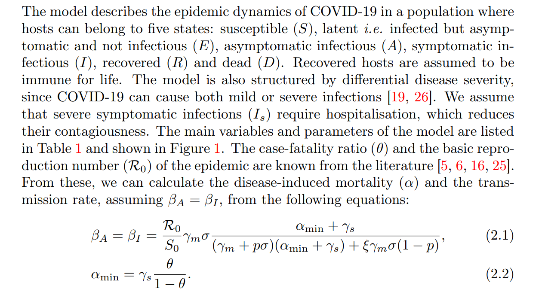
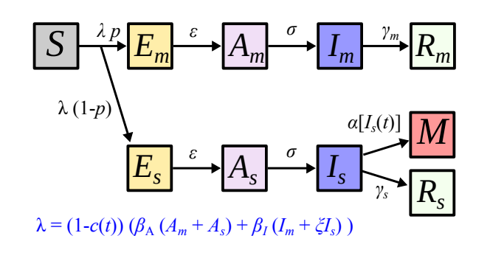
Optimal COVID-19 epidemic control until vaccine deployment - SEAIR model (added by Irina)

Slide 7

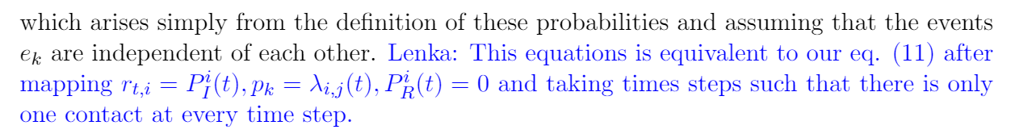
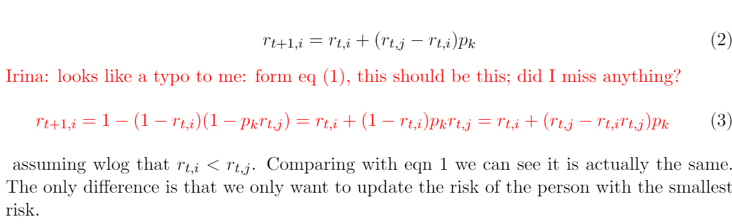
Yoshua’s Model

Slide 8
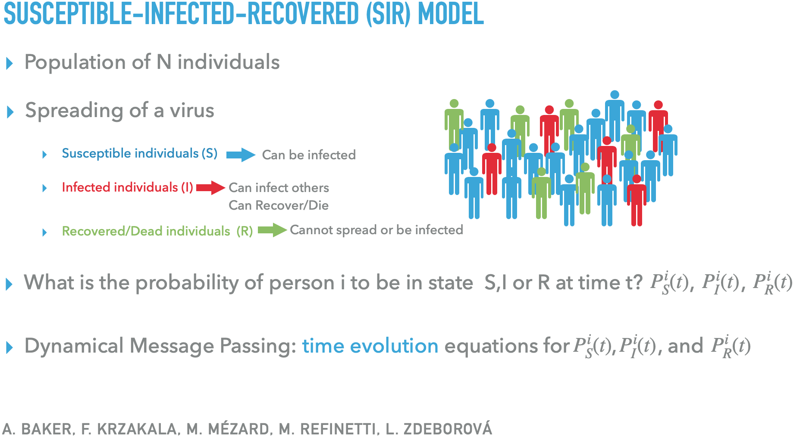
Lenka’s Model

Slide 9
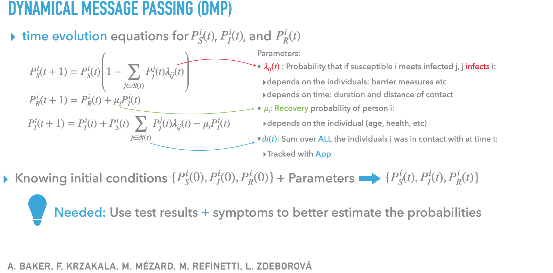
Lenka’s Model

Slide 10
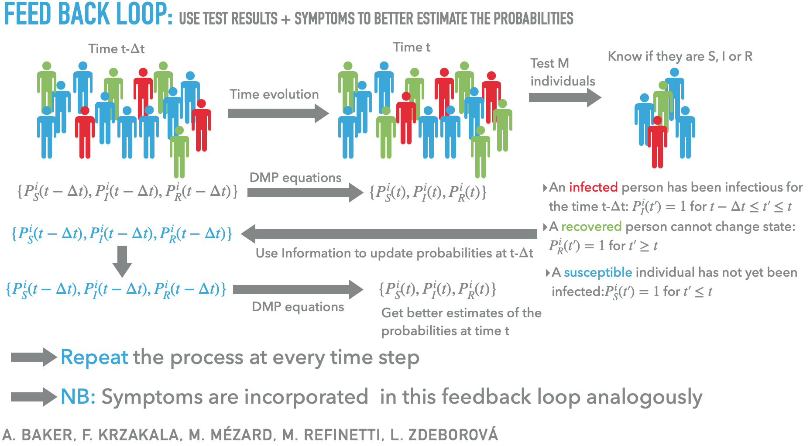

Slide 11
Irina’s Model

Slide 12
Eilif’s model
When there is a contact with user v
If v is not in self.contact_history (Lenka’s version)
  delta_risk += v.risk * transmission_proba
Otherwise (assuming new risk of contact is uncorrelated)
  previous_risk = self.contact_history[v].previous_risk
  delta_risk += (v.risk - previous_risk) * transmission_proba
  + previous_risk * self.contact_history[v].carry_over_transmission_proba
self.risk = min(self.risk + delta_risk, 1)
self.contact_history[v].previous_risk = v.risk
self.contact_history[v].carry_over_transmission_proba = transmission_proba * (1 - delta_risk)

Slide 13
SIR model with Probability Updates on Contact
At each encounter, users exchange their R(t) values if R(u,t)<R(v,t):
  Prob for u being infected is R(u,t+1) = R(u,t) + (R(v,t)-R(u,t))*transmissionprob (Yoshua)
  = (1 - transmission proba) * R(u,t) + transmission proba * R(v,t) <= 1
  Initial R is a baseline corresponding to prevalence in the population
  R is set to 0.8 if user gets a positive diagnostic and to 0.1 if negative diagnostic
  TP = Transmissionprob = R0 / nb people you meet
  X = {S, I, R} P(X_u) updated based on P(X_v) and \mu (infection probability) (Irina)
  P(X_ut = I| X_u t-1) = TP * P(X_vt)
Contact tracing
  If user u is tested positive, then all users encountered in the past T days get their risk of being infected increased
  T = 14 or 21? R: risk level of user u, n: number of infected users that user u encountered
Algorithm:
  Each node/smartphone u maintains/update risk R(X_u), values = {S,I, R}
  At each encounter, use a *formula* to update R(Xu) based on R(Xv) and transmission probability, and vice versa
  Maintain history of encounters (user IDs) and their time stamps when encount happened

Slide 14
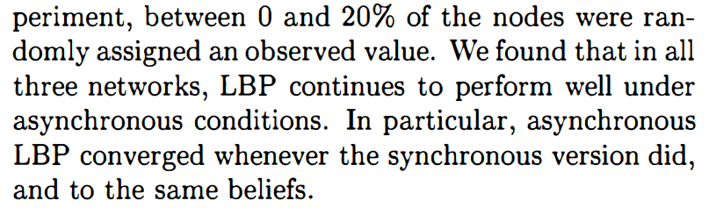
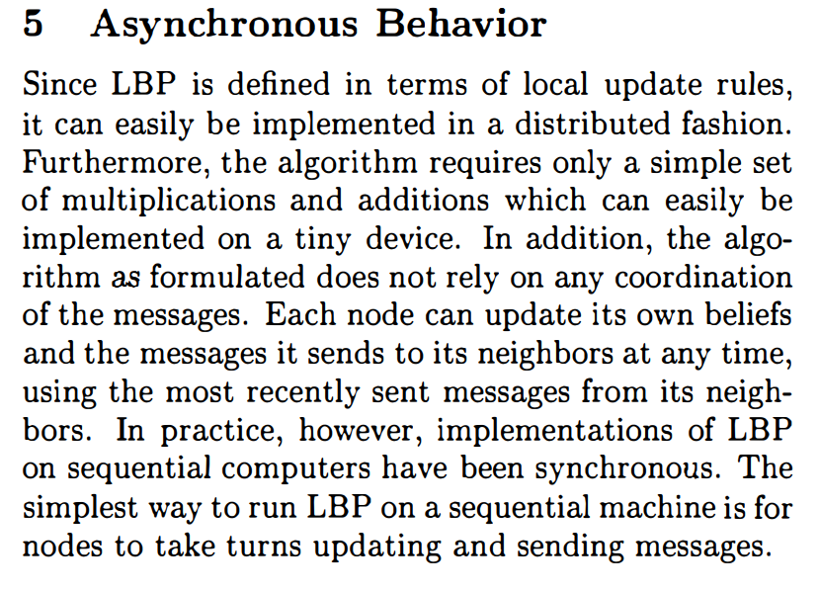
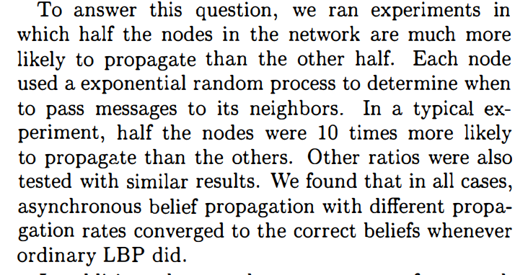
Decentralized Asynchronous Inference
Crick, C. and Pfeffer, A., 2012. Loopy belief propagation as a basis for communication in sensor networks.

Slide 15
Asynchronous Distributed Belief Propagation
Elidan, Gal, Ian McGraw, and Daphne Koller. Residual belief propagation: Informed scheduling for asynchronous message passing. Proc of UAI 2006: “well-known empirical observation that asynchronous message passing algorithms, where messages are updated sequentially, generally converge faster and more often than the synchronous variant, where all messages are updated in parallel. Yet, many practitioners continue to use the synchronous variant, due perhaps to ease of implementation, and to the lack of clear guidelines on scheduling the messages in asynchronous propagation. When sequential updating is used, the “standard” naive schedule is one where a message is propagated as soon as one of its inputs has changed
Gimenes, G.P., Gualdron, H. and Rodrigues, J.F., 2016, December. Vertex centric asynchronous belief propagation algorithm for large-scale graphs. In 2016 IEEE 16th International Conference on Data Mining Workshops (ICDMW) (pp. 93-98). IEEE. distributed processing over frameworks such as MapReduce [7], and others use supercomputers [8]. However, these approaches are not broadly accessible due to their cumbersome infrastructure and, consequently, higher cost if compared to a single-node computer. In fact, Gonzalez et al. [9] states that synchronous versions of BP are highly inefficient, emphasizing that distributed approaches, such as MapReduce over Hadoop, fail to fully explore the graph-level parallelization that asynchronous singlemachine processing could achieve. In 2014, Kang et al. [10] reinforced this drawback, mentioning that the scalability of BP is an important issue with several applications in the context of large web-scale graphs, such as anti-malware and fraud detection.

Slide 16
Model v1
Time and user dependent factor graph, state = SIR

Slide 17





Transmission factor
X is the state of individual u at time t
  X is a discrete variable with values
    Susceptible
    Infected (with low/mid/high level of infectiousness)
    Recovered
  X is unobserved
EC is the unobserved encounter context
  Can model cases where there is no transmission (e.g. infected individual is wearing a mask)
  Can handle false positives (e.g. individual walking by a car)
L is the observed context of the encounter
  e.g. sex, age of individuals, global statistics about the infection

Slide 18

Prior factor
Each state has a prior factor attached to it
Can include features about the individual
  e.g. age, sex, location
This models spontaneous infections
  Cold start at day 1
  Infection from an individual who doesn’t have the app

Slide 19



Observation factor
S are the observed symptoms
  Vector of discrete variables based on the gravity of the symptoms (e.g. cough, fever, etc…)
R are the test results (binary variable)
These observations are given by the user in app (they are special events)
  To account for the infrequency of true observations, S* and R* are latent symptoms and “test result” at any time
The observations are connected up to 21 days in the past to account for incubation
Asymptomatic user = Infected user
(X = Infected) but no symptom observed

Slide 20
Variables
X – State variable, discrete variable, can take values “Susceptible”, “Infected+info”, “Recovered”
  Ideally, we’d like to have info. of time since beginning of infection in “Infected”
  Might have to use bins/phases, as to not increase the size of the state too much
EC – Unobserved context, can be binary (is there transmission or not?)
L – Observed context entered in the app, or e.g. inferred from location
S – Symptoms, vector of (binary) variables (e.g. cough, fever)
R – Test results, binary variable

Slide 21
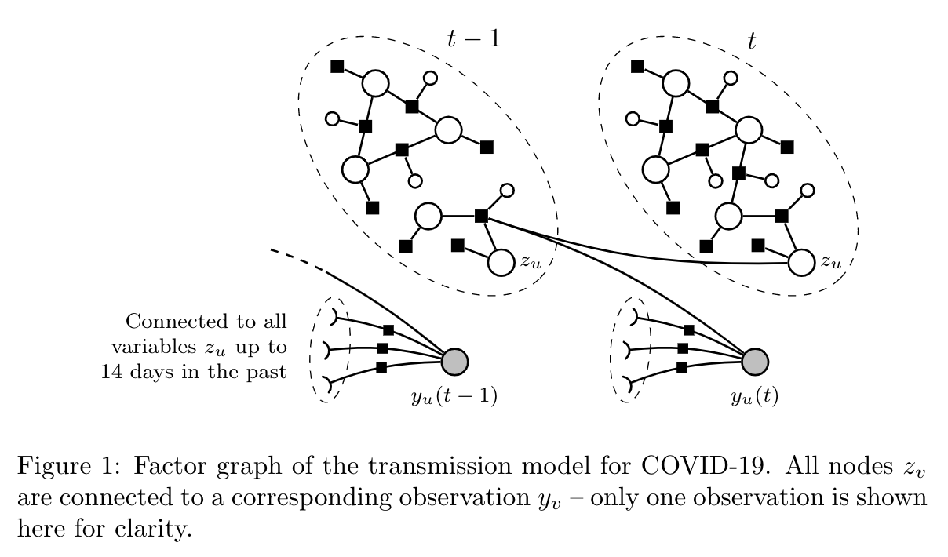
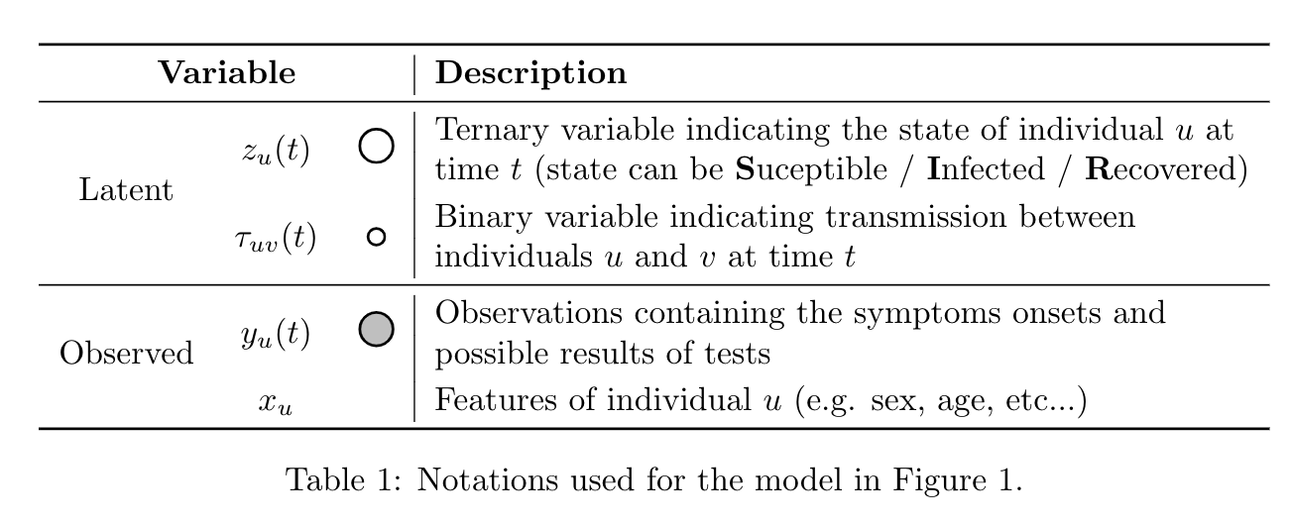
Overview of the model

Slide 22
Factor definition
For cold start at day 0, we need to populate the factors
We can borrow from values found by the simulation team & other reasonable values
Once bootstrapped, these values can be fine-tuned through training
The size of a factor increases exponentially in the number of nodes it is connected to
  The state variable X should have a small enough cardinality
 |  |  |  | Value
Susceptible | Infected (+2 days) | Infected (+1 day) | True | 0.8
Susceptible | Infected (+6 days) | Susceptible | False | 1.5
Infected (+3 days) | Susceptible | Infected (+4 days) | False | 0.9
...

Slide 23
Model v2
User dependent factor graph, state = time of infection

Slide 24

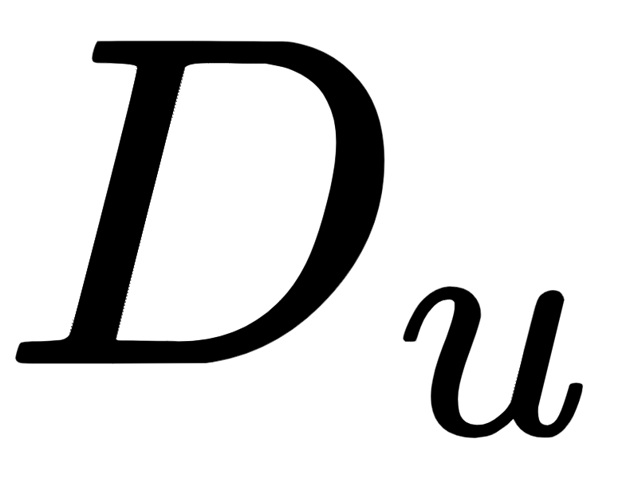
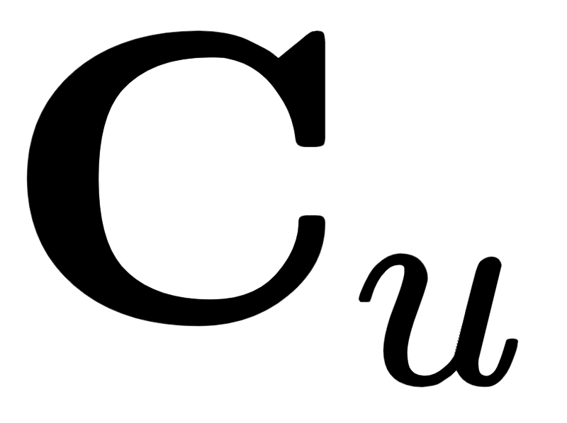
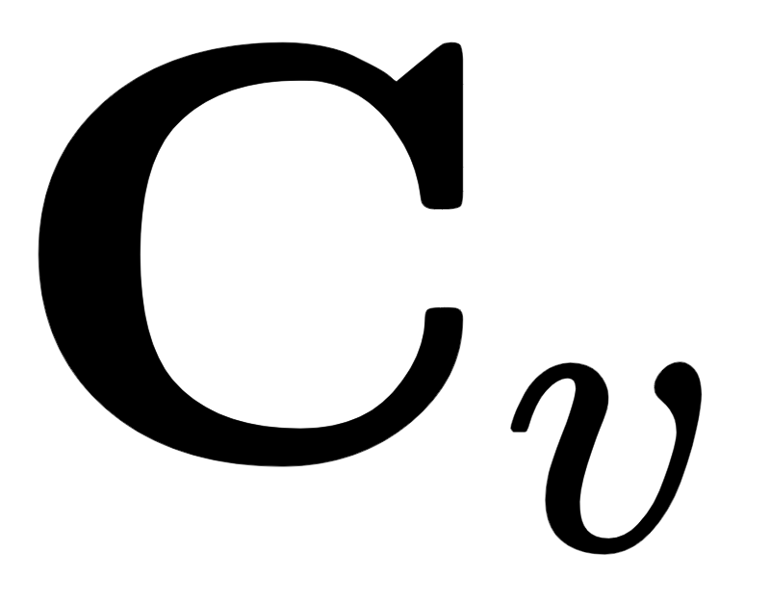
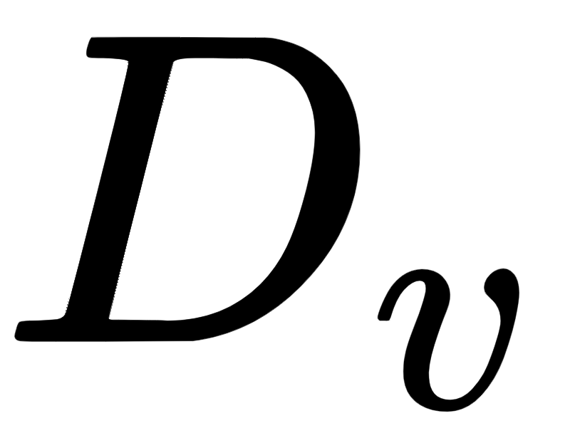
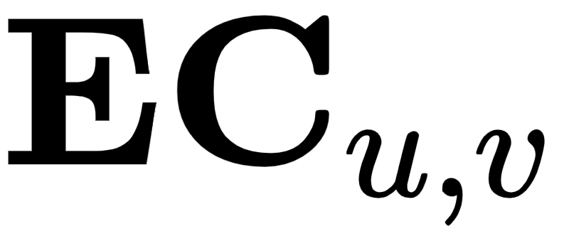
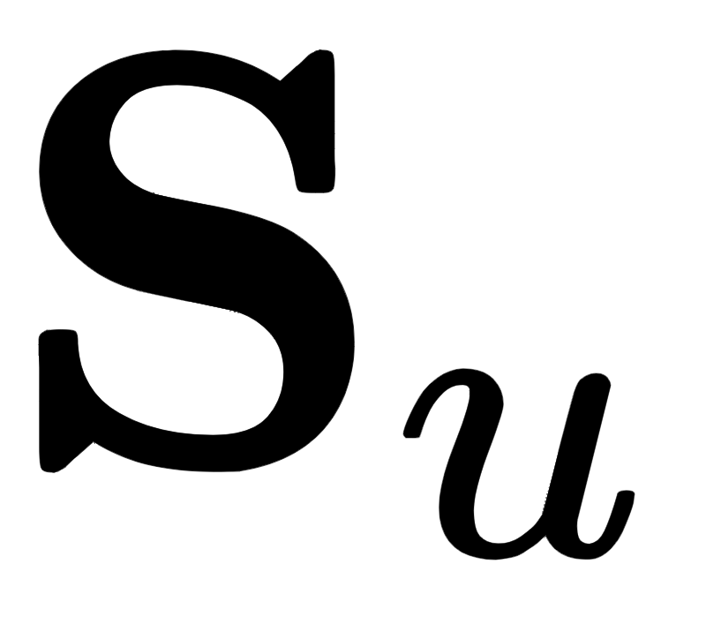
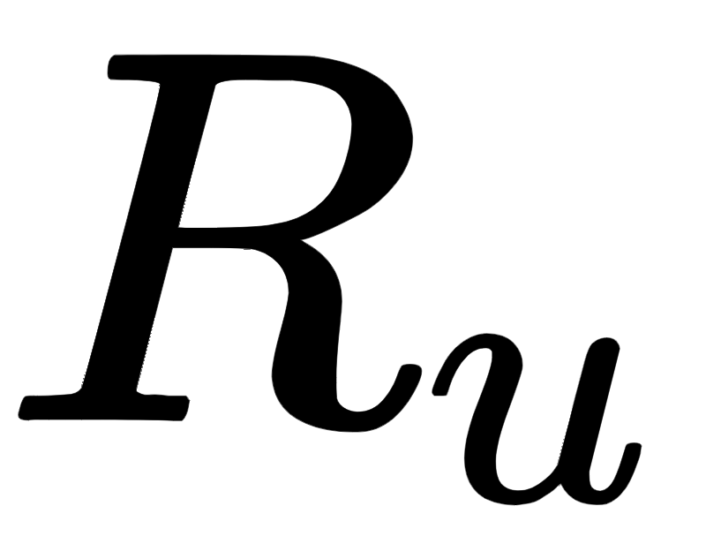
Model 2
Variables:
: days since person u got infected
  Value 1: not infected
  Values 0 … -21: days since infection
: context of the encounter between u and v (duration, distance, location type)
: symptoms reported by u (fever, cough, fatigue, …)
: characteristics of u (age, sex)
: test results of u
: average infection in the population
parameter estimation: copy the simulator!
(Maximum likelihood estimation with fully-observed variables)

Slide 25

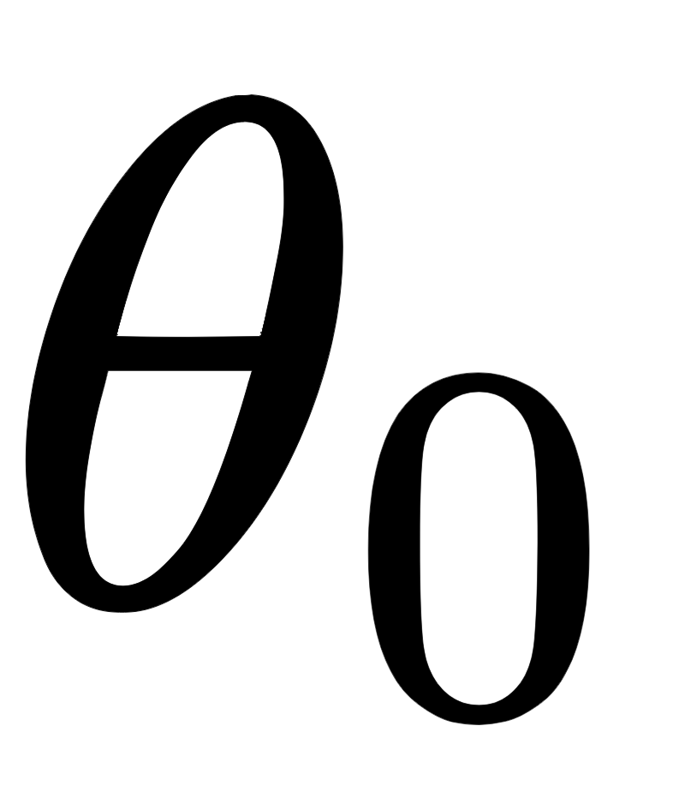

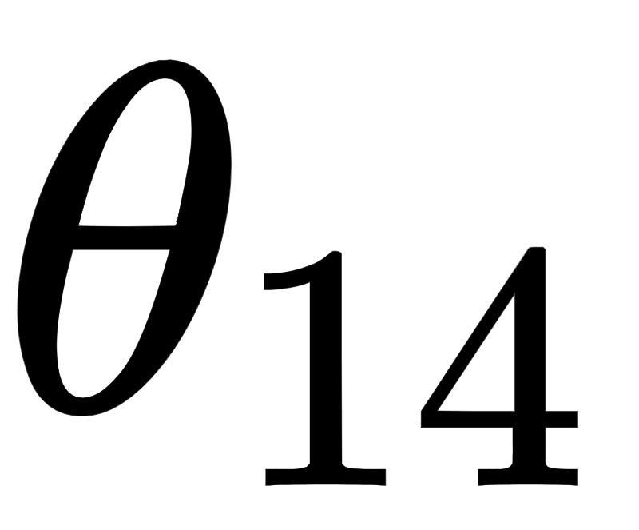
Model 2 - transmission factor
duration | distance | location type |  |  | Log
... | ... | ... | ... | ... | ...
... | ... | ... | -1 | 0
... | ... | ... | 0 | -1
... | ... | ... | ... | ... | ...
... | ... | ... | -14 | 0
... | ... | ... | -1 | -1 | 0.0
... | ... | ... | ... | .... | ...
Encounter has happened today!
few parameters for every value of observed variables
both were infected at the time of encounter

Slide 26
Model 2 - transmission factor
duration | distance | location type |  |  | Log
... | ... | ... | ... | ... | ...
... | ... | ... | 1 2 | 0 1
... | ... | ... | 0 1 | 1 2
... | ... | ... | ... | ... | ...
... | ... | ... | ... | ... | ...
... | ... | ... | 1 2 | 1 2 | 0.0
... | ... | ... | ... | .... | ...
Encounter has happened in previous days? Simply slide the parameters!
few parameters for every value of observed variables
both were infected at the time of encounter

Slide 27
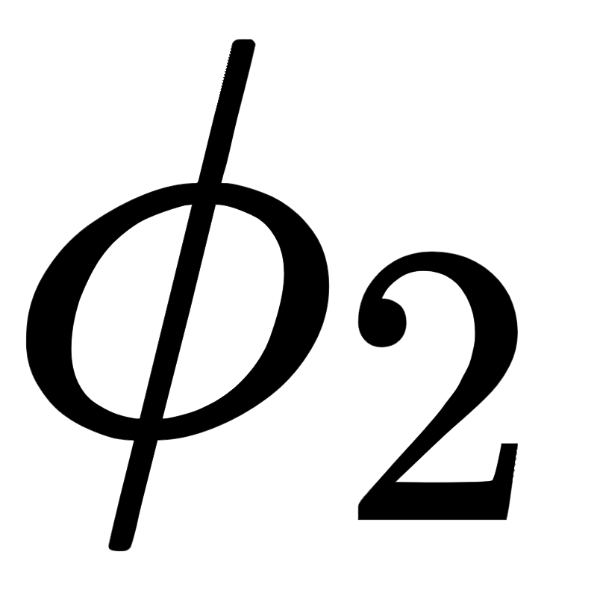

Model 2 - Symptoms
age | ... | fever | cough | ...
... | ... | ... | ... | ... | ... | ...
18 | ... | yes | no | ... | 3
... | ... | ... | ... | ... | ... | ...
“There is strong age dependence in the probability of developing clinical symptoms”

Slide 28
Model 2 - setting the model parameters
Generate fully-observable data using the simulator
Parameterize the model using shared parameters for all individuals
Minimize the log-likelihood of the data (e.g. using gradient-based methods)

Slide 29
Paris SIR model

Slide 30
Inference

Slide 31
Inference
Use Loopy Belief Propagation
When new encounters are detected (e.g. P2P Bluetooth), or an observation is entered (e.g. the user enters a new symptom in the app), compute the message and propagate it
The inference has to be centralized
  We need all the nodes in the network to pass messages, and loopy BP might break if a node appears missing (e.g. a user doesn’t have her app open)
  Proposition: Loopy BP runs constantly on the server, and then the message for one user is updated if it receives a new observation

Slide 32
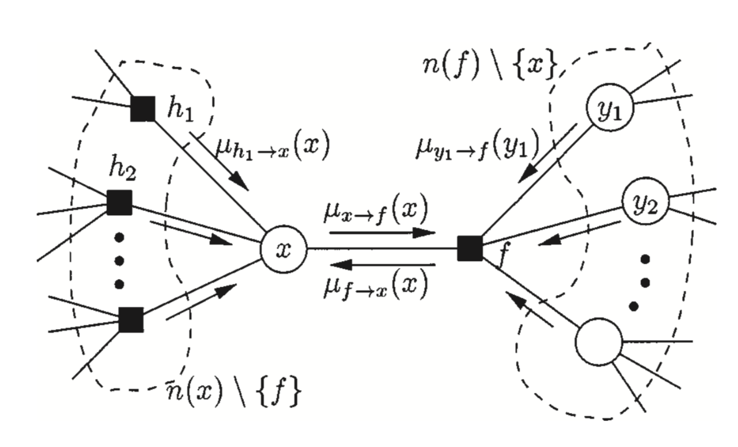
Inference – Loopy Belief Propagation

Slide 33
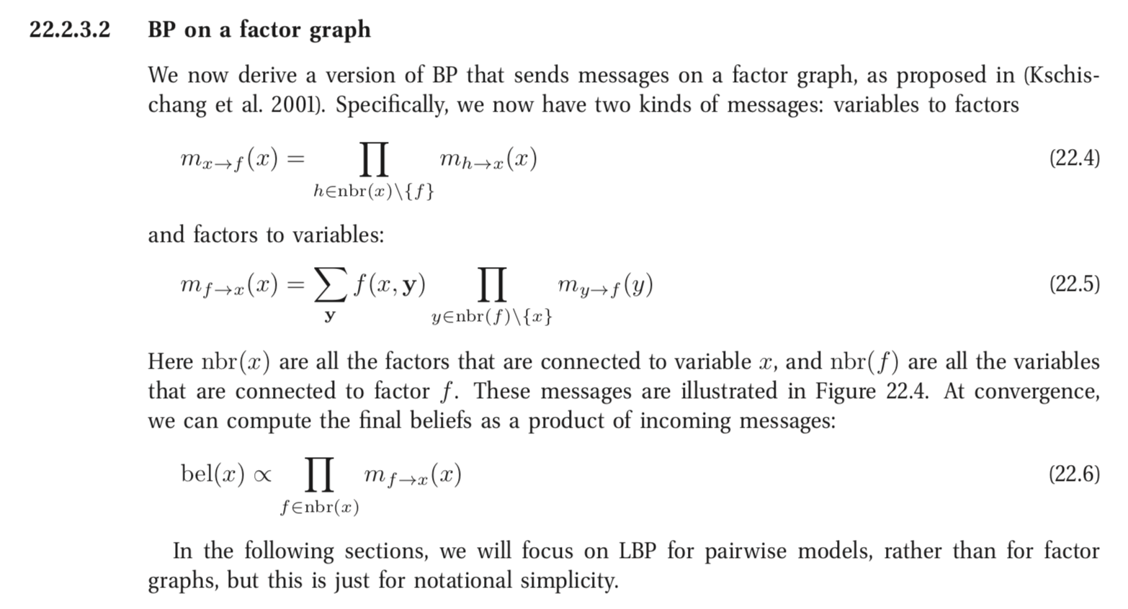
Inference – Loopy Belief Propagation

Slide 34
Decentralized inference
There is no simple way to handle “node failure”
  Loopy BP requires many iterations: all nodes are required to pass messages at all time
  What happens when a user has her app turned off?
Inference is needed across users
and time
  How to handle previous states of the user? Are they one the user’s phone?
Impossible the handle this in a decentralized way with vanilla Loopy BP

Slide 35
Proposed centralized inference
When there is a new event (e.g. new encounter, new symptom entered in app)
  Create the node and insert in the graph on the server
  Compute the message “observed > latent” on the phone
  Send the message to the server; no personal information (location / age / sex) is stored on the server
Iterate Loopy BP constantly on the server
Update the parameters of the model
Server
NEW
EVENT
Send message

Slide 36
Decentralized Asynchronous Inference
Crick, C. and Pfeffer, A., 2012. Loopy belief propagation as a basis for communication in sensor networks.

Slide 37

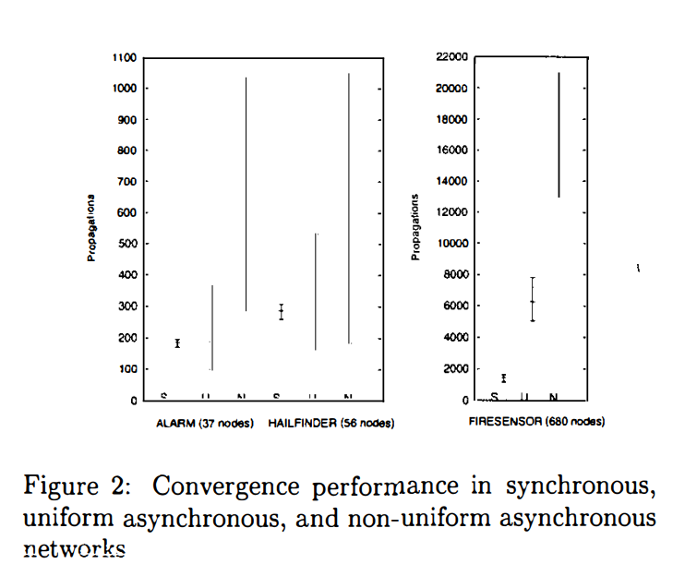
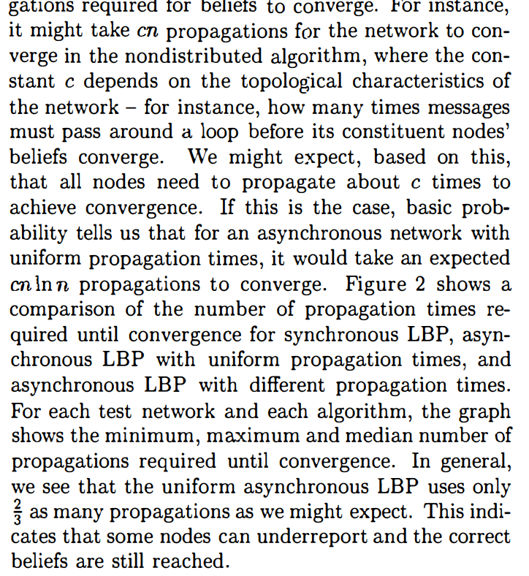

Slide 38
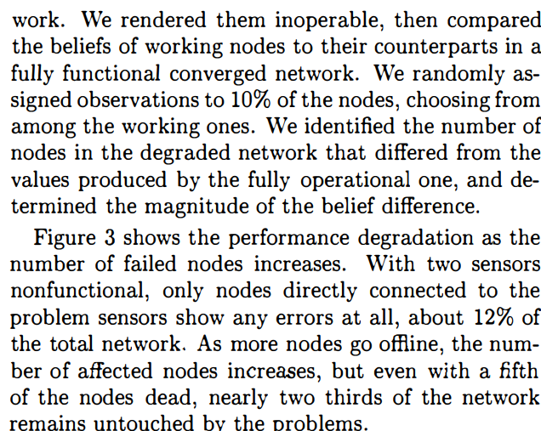
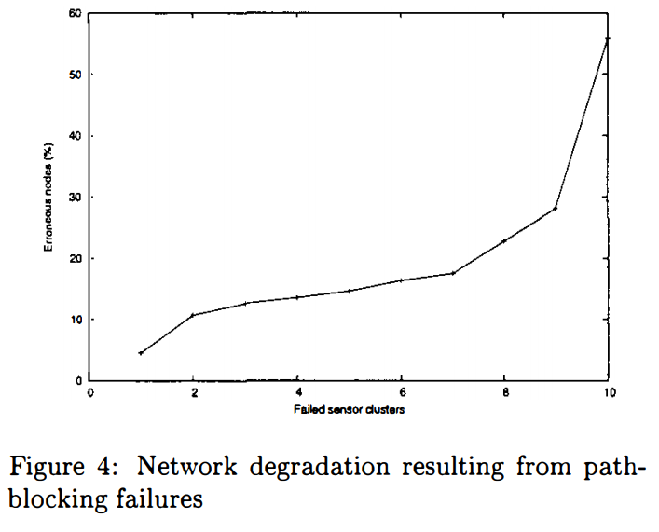

Slide 39
