Slide 1
01 / EXECUTIVE READOUT
Emulator 02 is a controlled etch modifier, not a replacement model.
The preserved Emulator 01 direct sputter output is multiplied by an inspectable ion transmission factor.
Override=1 equality
depo_field = conformal deposition
ion_factor ∈ [0, 1]; deposition is intentionally not attenuated.
0.0e+0 A
sputter_raw = Emulator 01 direct sputter
Zero sputter safety
sputter_effective = sputter_raw × ion_factor
0.0e+0 A
Tests
49 OK
Main decision
Keep Emulator 02 as the experimental ion-arrival layer, with performance optimization as the next engineering focus.
Bottom ion_factor
0.202
Local evaluation generated from current /Users/jib/Documents/Gapsim codebase.

Slide 2
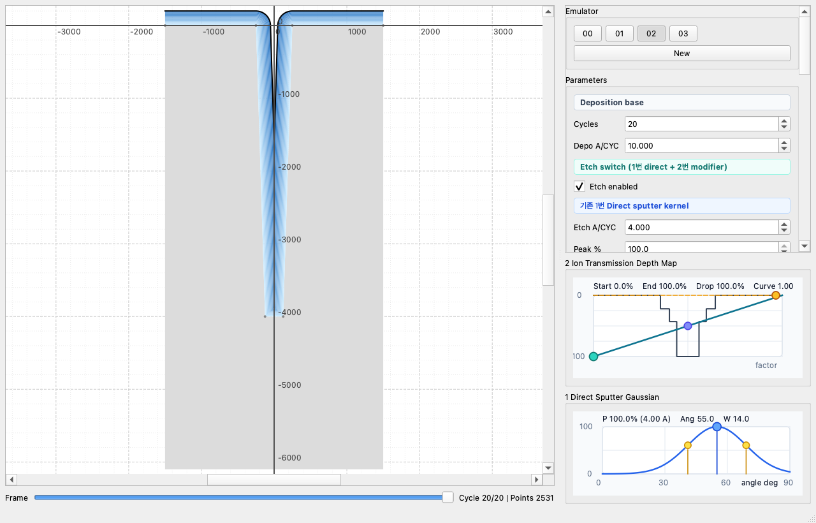
02 / USABILITY STRUCTURE
The UI now reads as one Etch switch with two nested model roles.
Parameters are grouped by physical ownership: deposition base, etch master, direct sputter kernel, ion transmission modifier.
Etch enabled
Master switch gates all etch-side modifiers.
1 Direct sputter
Etch A/CYC, Gaussian peak, width, smoothing
2 Ion depth curve
start, end, drop, floor, curve power
2 Geometry modifiers
aperture, hidden, edge shadow sliders
Debug separation
raw sputter, ion_factor, effective sputter
Usability note: model discovery happens through visible grouping, not hidden config fields.

Slide 3
03 / LITERATURE BASIS
A reduced ion-transmission modifier is aligned with how etch literature separates arrival, angle, and transport.
The deck uses these papers as boundary conditions for what Emulator 02 should and should not claim.
Paper
Source phrase
Implication for Emulator 02
Boundary
Coburn & Winters, 1979
"gas-surface chemical reactions can be enhanced"
Ion bombardment can be modeled as an etch-side driver.
not chemistry solver
Aydil et al., 1998
"determines the shape evolution"
Angle distribution justifies preserving the Gaussian direct-sputter kernel.
not plasma sheath model
Volland & Rangelow, 2003
"direct line-of-sight shadowing"
Ion transmission can be represented as geometric arrival probability.
not ray tracing
Volland et al., 2001
"shadowing of ions by the sidewalls and mask"
Neck/hidden parameters should be separate from depth curve.
not redeposition
Giapis & Hwang, 2000
"ion scattering at the sidewalls"
Reflection/microtrenching belongs outside Emulator 02.
explicitly excluded
Huard et al., 2017
"aspect ratio dependent plasma etching"
Full ARDE requires neutral transport too; Emulator 02 stays reduced.
not full ARDE
Sources: J. Appl. Phys.; Materials Science in Semiconductor Processing; Microelectronic Engineering; Thin Solid Films; JVST A.

Slide 4
04 / IMPLEMENTATION CONTRACT
The stack is explicit: deposition remains independent, etch is the only attenuated branch.
This is the key guardrail that keeps Emulator 02 from becoming a second, incompatible sputter model.
Conformal deposition
+
1 Direct sputter
×
2 Ion transmission
=
Effective etch
depo_field
sputter_raw_field
ion_factor_field
sputter_effective
Debug layers emitted
Excluded by design
depo_field / sputter_raw_field / ion_factor_field / sputter_effective_field / net_growth_field
reflected ion, redeposition, microtrenching, full ray tracing, full ARDE transport solver
Code path: compute_ion_transmission_factors() feeds effective_sputter only.

Slide 5
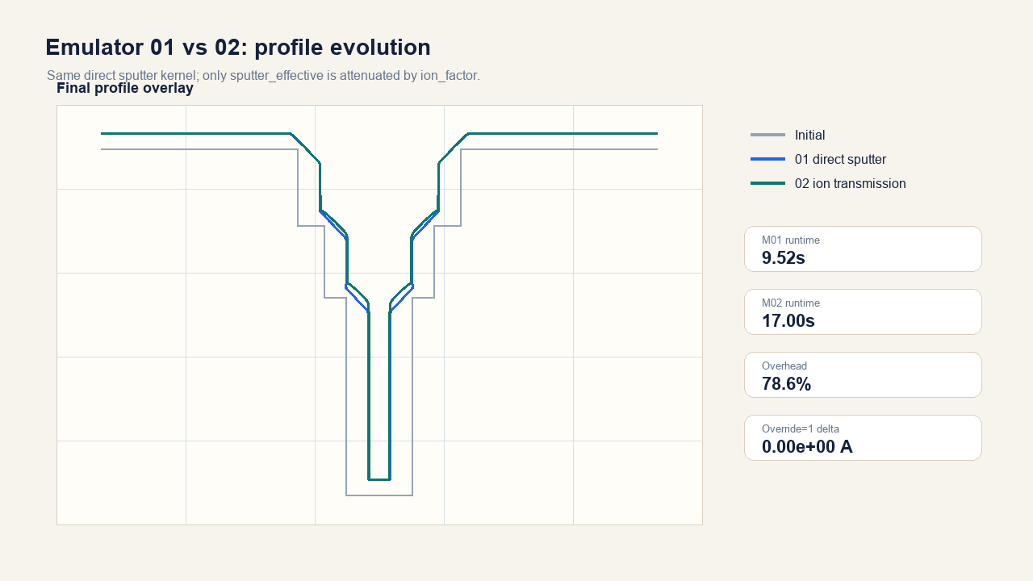
05 / RESULT COMPARISON
Ion transmission weakens bottom and hidden sputter without rewriting Emulator 01.
The visual difference is therefore attributable to ion_factor, not a rewritten direct sputter response.
M01 mean runtime
9.52s
M02 mean runtime
17.00s
Observed overhead
78.6%
Override delta
0.0e+0 A
Performance read: override=1 runs at M01 speed; tuned M02 costs more because attenuated etch changes the evolving profile and cleanup path.
Measured on the current local code path; 18 cycles, stepped trench geometry.

Slide 6
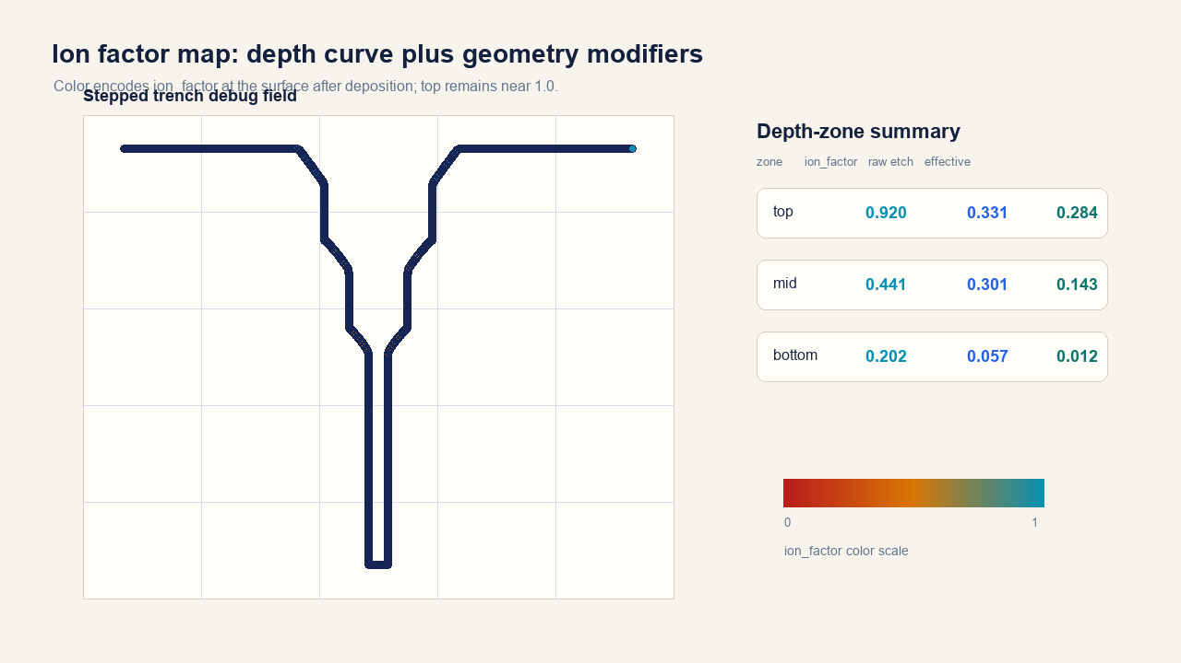
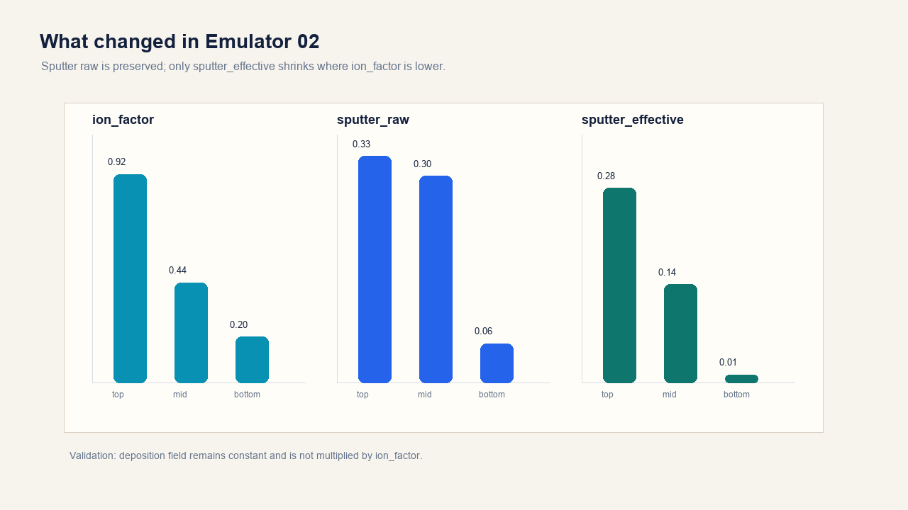
06 / DEBUG EVIDENCE
The debug fields show the intended top-to-bottom attenuation and the raw/effective sputter split.
This is the main observability win for Emulator 02: model behavior is inspectable as fields, not just final geometry.
Top ion_factor
Mid ion_factor
Bottom ion_factor
Bottom effective/raw
0.920
0.441
0.202
0.203

Slide 7
07 / USABILITY ASSESSMENT
Usability is strong for scientific exploration; performance is the only material caveat.
The new grouping makes the model easier to reason about, and debug layers make mistakes visible.
Discoverability
4.5 / 5
Etch master switch plus model-number sections clarify ownership.
What became easier
Users can now tune depth attenuation without touching geometry shadowing, and can disable the whole etch branch with one control.
Adjustability
4.5 / 5
Depth curve is draggable; aperture/hidden/edge are separate sliders.
Observability
5.0 / 5
raw, factor, effective, net fields are separable.
Remaining friction
Safety
5.0 / 5
override=1 and zero sputter invariants hold exactly in tests.
The full tuned model currently spends more time in geometry evolution/cleanup. This should be optimized before broad parameter sweeps.
Performance
3.0 / 5
Full tuned runs are slower; preview deferral keeps toggles responsive.
Heuristic evaluation based on current UI behavior, automated tests, and local run metrics.

Slide 8
08 / NEXT ITERATION
Keep the current model boundary: improve speed and validation before adding new etch physics.
The most valuable next work is calibration and sweep ergonomics, not reflected ions or redeposition in Emulator 02.
1
Lock contract
2
Speed pass
3
Calibration
4
Reporting
Etch switch gates the whole branch; deposition stays independent.
Profile/cleanup cost should be profiled on tuned M02 sweeps.
Fit depth curve and geometry sliders to SEM or trusted simulator profiles.
Persist debug-field summaries with every split/compare run.
Do not mix into Emulator 02
Keep in Emulator 02
reflected ion, redeposition, microtrenching, full ray tracing, diffusion attenuation
current sputter_raw × ion_factor, depth curve controls, independent geometry shadow sliders
Recommended next milestone: benchmark parameter sweeps after profiling the geometry cleanup cost.

