Slide 1
QUIDNUG · THEORY
Proof of Trust vs Nakamoto, BFT, FBA, and DAG Consensus
Why relational trust graphs outperform global consensus for the 95% of real-world applications that aren't moving billions of dollars between mutually-untrusting strangers.
Quidnug · Proof of Trust vs Consensus
1 / 90
Notes:
Welcome. This is an opinionated talk backed by primary sources. 90 slides, about 60 minutes with Q&A.
Primary audience: distributed systems engineers, protocol designers, CTOs evaluating whether they need a blockchain.
Central thesis: the default assumption that every distributed system needs global consensus is wrong for the vast majority of applications.
We are not arguing against Bitcoin or Ethereum. We are arguing that they solve a narrow problem (money), and most other applications (reputation, consent, identity, supply chain) need something different.

Slide 2
Where we are in 2026
0.5%
of global electricity consumption is burned by Bitcoin's proof-of-work mining.
That cost is defensible if you are securing trillions of dollars. It is not defensible for reviews, consent, or supply chain. We need a different substrate for those.
Quidnug · Proof of Trust vs Consensus
2 / 90
Notes:
Anchor the urgency. Cambridge Centre for Alternative Finance CBECI data puts Bitcoin at ~155 TWh/year in 2024, which is approximately 0.5% of global electricity use.
This is worth the energy only if you are securing something genuinely valuable at a global permissionless scale. For almost every non-money application, the cost is absurd.

Slide 3
Agenda
▸ Section 1. The consensus problem. Byzantine Generals, FLP, CAP. What we are actually solving.
▸ Section 2. Tour of existing mechanisms. PoW, PoS, BFT family, FBA, DAG, PoA. A tour of the taxonomy.
▸ Section 3. Their shortcomings. Energy, centralization, finality, global-state, MEV.
▸ Section 4. Proof of Trust. Relational, signed, tiered, domain-scoped. Four principles.
▸ Section 5. The math of relational trust. Proofs of monotonic decay, Sybil resistance, bounded computation.
▸ Section 6. Security properties. Replay, rotation, Byzantine tolerance, TTL revocation.
▸ Section 7. Real-world use cases. Where PoT wins, where it doesn't.
▸ Section 8. Benchmarks and tradeoffs. Throughput, latency, energy. Honest about limits.
▸ Section 9. Decision framework. Picking the right tool for your use case.
Quidnug · Proof of Trust vs Consensus
3 / 90
Notes:
Walk the audience through the arc. Sections 1 to 3 establish the problem and failure modes. Sections 4 to 6 present and defend the solution. Section 7 shows fit. Sections 8 to 9 are honest positioning.
Total runtime target: 60 minutes with Q&A buffer.

Slide 4
Four things you will take away
▸ Takeaway 1. Global consensus is a solution looking for a problem in most enterprise and application-layer contexts.
▸ Takeaway 2. Byzantine Fault Tolerance as typically framed (f < n/3) is over-engineered for non-token networks.
▸ Takeaway 3. Relational trust has cleaner mathematical properties than any global-state scheme, with monotonic decay, bounded complexity, and per-observer finality.
▸ Takeaway 4. For applications in the 'trust, not token' column, Proof of Trust is 10 to 1000 times more efficient than PoW and orders of magnitude simpler than BFT.
Quidnug · Proof of Trust vs Consensus
4 / 90
Notes:
Preview the four anchors. Return to them in Section 9 as the summary check.
Takeaway 3 is the mathematically load-bearing claim; we will prove it in Section 5.

Slide 5
Why this talk matters in 2026
▸ Permissionless blockchain ecosystems are mature. Bitcoin, Ethereum, Solana, Cosmos have settled into stable design niches.
▸ Enterprise blockchain pilots have mostly failed. Hyperledger Fabric, IBM TradeLens (shut down 2023), Quorum all struggled because the use cases did not need global consensus.
▸ Application-layer trust is the next frontier. Reviews, consent, KYC, supply chain, identity: all reputation-shaped problems, all poorly served by existing consensus mechanisms.
▸ Regulators are paying attention. EU AI Act, GDPR Article 22, NIST AI RMF require attribution and auditability that on-chain tokens can't provide at scale.
▸ The architectural choice compounds. Teams picking a substrate today will live with it for a decade. Choose based on the actual problem.
Quidnug · Proof of Trust vs Consensus
5 / 90
Notes:
Make the urgency concrete. Each bullet is cited: Ethereum Merge September 2022, TradeLens shutdown March 2023, EU AI Act adopted 2024.
The enterprise blockchain failure point is worth pausing on. The TradeLens post-mortem (Maersk + IBM) is a clean case study in 'consensus was the wrong tool.'

Slide 6
Section 1
The Consensus Problem
Byzantine Generals, FLP, CAP. Forty years of theory that shapes every answer.
Quidnug · Proof of Trust vs Consensus
6 / 90
Notes:
Quick theoretical foundation. Most of the audience has seen these results; we spend a minute each to anchor the terminology.

Slide 7
Byzantine Generals Problem (Lamport 1982)
▸ Formalization of distributed agreement with adversaries. Lamport, Shostak, Pease: 'The Byzantine Generals Problem,' ACM TOPLAS 4(3), 1982.
▸ The setup. N processes, some of which are Byzantine (can send arbitrary messages). Can the honest processes agree on a common plan?
▸ The famous result. Deterministic synchronous BFT requires n >= 3f+1 for f Byzantine faults with oral messages.
▸ With signatures, tolerance improves to n >= 2f+1. Because signed messages cannot be forged, fewer honest nodes are needed to outvote traitors.
▸ This result underlies every classical consensus protocol. PBFT, Tendermint, HotStuff, Algorand all trace back to this paper.
Quidnug · Proof of Trust vs Consensus
7 / 90
Notes:
This is the foundational paper. Every audience member who cites 'f < n/3' is citing this paper whether they know it or not.

Slide 8
FLP impossibility (1985)
▸ Fischer, Lynch, Paterson: 'Impossibility of Distributed Consensus with One Faulty Process,' Journal of the ACM, 1985.
▸ The result in one sentence. No deterministic consensus protocol can tolerate even a single crash failure in a fully asynchronous system.
▸ Why it matters. Any real-world consensus protocol must relax one of the three FLP assumptions: determinism, async messaging, or crash tolerance.
▸ PoW relaxes determinism. Nakamoto consensus is probabilistic; finality is statistical.
▸ PBFT-family protocols relax async. They assume partial synchrony with timeouts.
▸ Proof of Trust relaxes global agreement. Each observer can maintain their own view. Divergence is acceptable.
Quidnug · Proof of Trust vs Consensus
8 / 90
Notes:
FLP is the 'you cannot have everything' result of distributed systems. Every consensus design is a choice of which limitation to accept.
The PoT angle is the talk's core thesis: by dropping global agreement, we get useful properties back.

Slide 9
The three network models and what each allows
Every protocol is some choice of model + relaxation.
Network model | Consensus possible? | Representative protocols
Synchronous | Yes, if n >= 3f+1 (BFT bound) | Textbook BFT
Partially synchronous | Yes, with timeouts (Dwork-Lynch-Stockmeyer 1988) | PBFT, Tendermint, HotStuff, Paxos
Asynchronous | Impossible with determinism + any failures (FLP) | Randomized: Algorand, Avalanche
Quidnug · Proof of Trust vs Consensus
9 / 90
Notes:
The DLS 1988 paper is the theoretical bridge: assuming eventual synchrony is what makes real-world protocols work.
The async row is why Nakamoto had to use probabilistic finality.

Slide 10
CAP theorem (Brewer 2000, Gilbert-Lynch 2002)
▸ Three desirable properties of a distributed system. Consistency (same view everywhere), Availability (every request gets a response), Partition tolerance (keep working during network splits).
▸ The result. In the presence of network partitions (always true in practice), you must choose: C or A, not both.
▸ BFT picks C. Partition leads to halt. Nothing commits until quorum returns.
▸ Nakamoto picks A. Both sides of the partition keep producing blocks; a reorg resolves after partition heals.
▸ Proof of Trust: each observer chooses. Observers can be on either side of a partition with their own coherent view. No forced choice globally.
Quidnug · Proof of Trust vs Consensus
10 / 90
Notes:
CAP is often misunderstood. It is not 'pick 2 of 3'; it is 'partition is inevitable, so pick C or A when it happens.'
The third framing (PoT) rejects the premise that there must be ONE answer for the whole system.

Slide 11
What real systems actually need
▸ Inventory the distributed systems at any Fortune 500 today. You find: database replication, Kafka event streams, S3, ZooKeeper / etcd, Vault, HashiCorp Consul.
▸ Notice what is absent. Global-consensus blockchains are almost entirely missing from production enterprise infrastructure.
▸ The reason is not ignorance. Internal trust boundaries (HR, legal, network segmentation) already constrain who can corrupt state. Byzantine tolerance is unnecessary overhead.
▸ The interesting problem is cross-company trust. Consortium, cross-border, citizen-to-government, reviewer-to-business: these live outside corporate trust boundaries.
▸ And the answer there is usually not 'add a blockchain.' It is usually 'sign records; let each party evaluate trust in the signer.' That is exactly Proof of Trust.
Quidnug · Proof of Trust vs Consensus
11 / 90
Notes:
This is the pragmatic reframing. We show engineers the actual stack they use and ask: what was missing?
The answer is usually: trust across boundaries, not Byzantine-fault-tolerant state machines.

Slide 12
Framing
“
Global consensus is appropriate for money, where double-spend prevention is the whole game. It is inappropriate for reputation, consent, identity, or any application where different observers legitimately hold different views.
— The central thesis of this talk
Quidnug · Proof of Trust vs Consensus
12 / 90
Notes:
Pause on this slide. It is the pivotal framing.
If the audience agrees with this sentence, the next 80 slides follow. If they disagree, stop and discuss.

Slide 13
Trust-shaped vs money-shaped problems
▸ Money is adversarial by default. Any pair of users may have zero prior trust. Double-spend prevention requires globally-agreed state.
▸ Reviews are relational. Alice weighs Bob's opinion differently than Dave does. There is no single 'right' aggregate.
▸ Consent is subject-scoped. A consent grant from patient P to hospital H has meaning for those parties and their delegates, not for every random observer.
▸ Identity is context-dependent. Your LinkedIn identity, Twitter identity, and GitHub identity are linked but not identical. Conflating them is a loss.
▸ Supply chain is bilateral. Supplier S and buyer B have direct trust. Transitive attestations exist but are always observer-weighted.
Quidnug · Proof of Trust vs Consensus
13 / 90
Notes:
Taxonomically, this is why the same substrate can't serve both categories well.
Money gets PoW. Trust-shaped problems get PoT. Mixed systems use both (see Section 7).

Slide 14
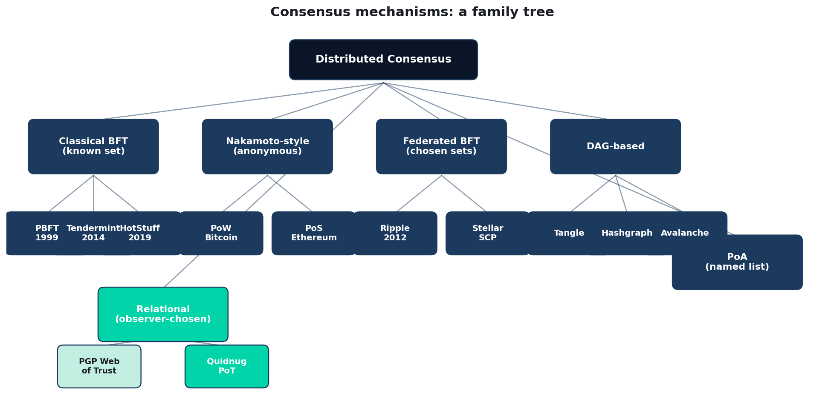
The consensus family tree
Stylized taxonomy; some protocols blur categories (Algorand is both PoS and leaderless BFT).
Quidnug · Proof of Trust vs Consensus
14 / 90
Notes:
Preview of what we tour next.
Point out that PoT in bottom-left inherits from PGP Web of Trust (Zimmermann 1991) while adding domain scoping, decay, and practical revocation.

Slide 15
Section 2
Tour of Existing Mechanisms
PoW, PoS, BFT, FBA, DAG, PoA. A practical walk through the landscape.
Quidnug · Proof of Trust vs Consensus
15 / 90

Slide 16
Proof of Work: the Nakamoto original
▸ Satoshi Nakamoto (2008): 'Bitcoin: A Peer-to-Peer Electronic Cash System.' 8 pages, one of the most influential computer science papers ever written.
▸ The trick. Sybil resistance through computational cost. Block production is a race to find a rare hash.
▸ Mathematical properties. Block production follows a Poisson process. Finality after k confirmations: 1 - (q/p)^k where p is honest hashrate.
▸ Why it works. Economic cost of attack scales with the honest network's total hashrate, which grows with the value being protected.
▸ Why it is limited. Finality is probabilistic (not instant). Throughput bounded by block interval and size. Energy cost is proportional to network value.
Quidnug · Proof of Trust vs Consensus
16 / 90

Slide 17
Eyal and Sirer 2014: selfish mining
▸ Ittay Eyal and Emin Gun Sirer (Cornell). 'Majority is Not Enough: Bitcoin Mining is Vulnerable,' Financial Cryptography 2014.
▸ The attack. A miner with > 25% of hashrate can profit by withholding newly-mined blocks. Not 51%: 25%.
▸ Mechanics. Keep secret chain ahead of public chain; release strategically when honest miners catch up.
▸ Consequences. The '50% attack' is the wrong threshold. Sustained deviation from protocol is rational starting at 25%.
▸ Impact on design. Every post-2014 consensus design factored in rational-adversary models. Not just 'honest vs Byzantine' but 'honest vs profit-motivated.'
Quidnug · Proof of Trust vs Consensus
17 / 90

Slide 18
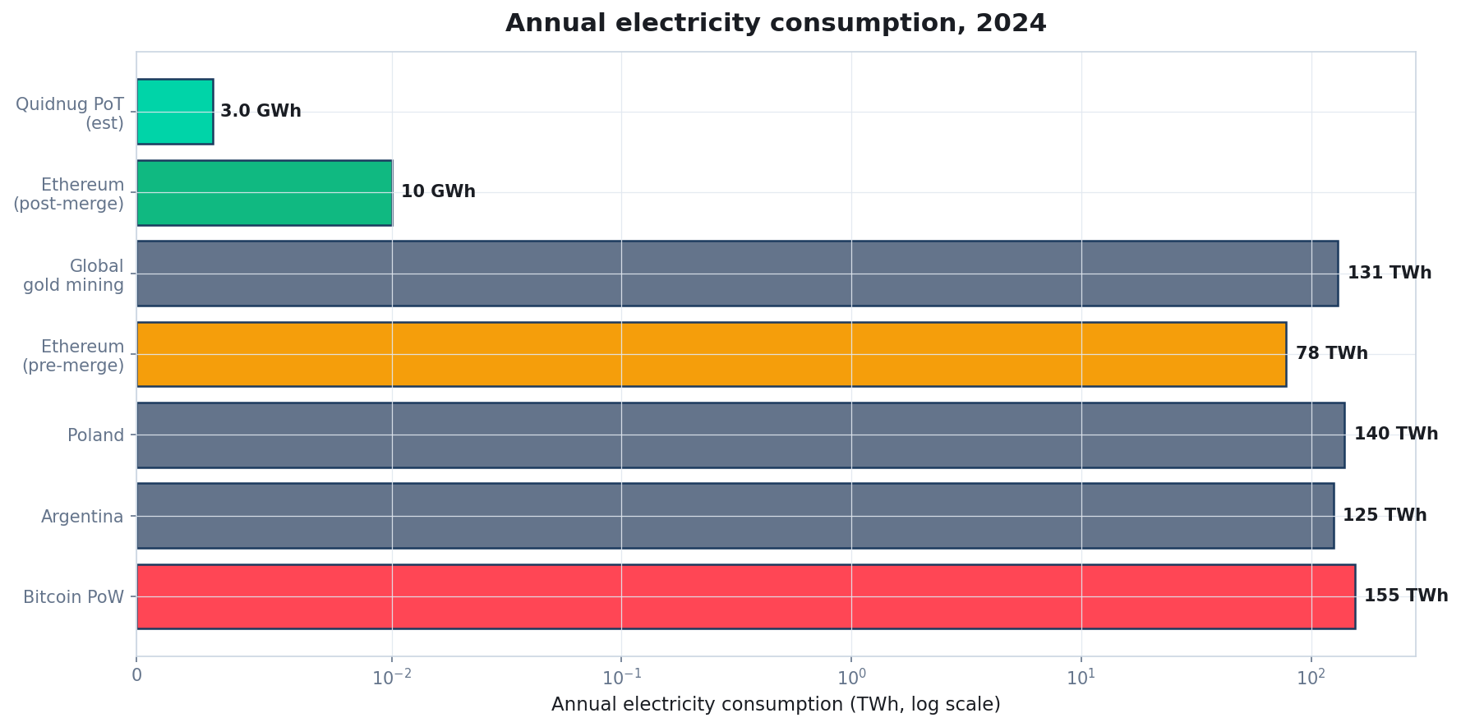
Annual electricity consumption, real numbers
Source: Cambridge CBECI, IEA, Ethereum Foundation post-merge disclosure.
Quidnug · Proof of Trust vs Consensus
18 / 90
Notes:
Bitcoin's 155 TWh/year is comparable to Poland's total consumption. Ethereum cut from 78 TWh to 0.01 TWh via the Merge, a 99.95% reduction.
Quidnug PoT at 0.003 TWh is an estimate: commodity hardware, signature verify, gossip. Well under the noise floor of typical data center operation.

Slide 19
Proof of Stake: from PPCoin to Ethereum
▸ Core idea. Replace 'burn electricity' with 'lock up economic stake.' Attackers lose their stake if caught.
▸ PPCoin (King and Nadal 2012). First deployed PoS. Had 'nothing-at-stake' bug; attackers could cheaply fork without economic penalty.
▸ Ouroboros (Kiayias et al. 2017, CRYPTO). First provably-secure PoS protocol. Cardano's basis.
▸ Algorand (Gilad et al. 2017, SOSP). Verifiable random functions for leader election; immediate finality with BFT-style voting.
▸ Ethereum Gasper (2022 onward). Two-pronged: block proposals + finality gadget. Moved 99.95% of Ethereum's energy to 0 post-Merge.
Quidnug · Proof of Trust vs Consensus
19 / 90

Slide 20
Proof of Stake variants at a glance
Variant | Finality model | Representative
Chain-based PoS | Probabilistic, longest-chain | Peercoin, NXT (early)
BFT-style PoS | Deterministic via 2/3 majority | Tendermint, Cosmos
Pure PoS (VRF) | Deterministic after random-leader commit | Algorand
Ouroboros | Epoch-based, provably secure | Cardano
Gasper / Casper FFG | Slot-based block prop + 2-epoch finality | Ethereum
Quidnug · Proof of Trust vs Consensus
20 / 90

Slide 21
Classical BFT: PBFT, HotStuff, Tendermint
▸ Practical Byzantine Fault Tolerance. Castro and Liskov 1999: the paper that brought BFT out of the theory lab into usable code.
▸ Three-phase protocol. Pre-prepare, prepare, commit. Each phase requires 2f+1 messages. O(n^2) total message complexity.
▸ HotStuff (Yin et al. 2019, PODC). Linear message complexity via threshold signatures. The protocol underlying Diem, Aptos, Sui.
▸ Tendermint (Kwon 2014). Simplified PBFT variant powering Cosmos ecosystem. Same f < n/3 bound, same O(n^2) messaging.
▸ Strengths. Immediate deterministic finality. Sub-second achievable. Well-studied security properties.
▸ Weaknesses. Requires known validators. Scales poorly past ~100 nodes. Halts under partition.
Quidnug · Proof of Trust vs Consensus
21 / 90

Slide 22
Federated Byzantine Agreement (FBA)
▸ David Mazieres 2015: 'The Stellar Consensus Protocol.' The paper that formalized FBA.
▸ Key difference from PBFT. Participants choose their own quorum slices rather than sharing a single global validator set.
▸ Global agreement emerges from quorum intersection. Individual slice choices compose into network-wide consistency when slices overlap correctly.
▸ Why this is closer to Proof of Trust. Acknowledges that trust is subjective. Each node picks who they trust.
▸ Still not quite PoT. SCP requires slices to form a 'quorum system with dispensability,' which in practice requires operators to coordinate. Binary trust, not graded.
Quidnug · Proof of Trust vs Consensus
22 / 90

Slide 23
DAG-based: Tangle, Hashgraph, Avalanche
▸ Directed Acyclic Graph replaces linear chain. Each transaction references multiple prior transactions. High parallelism, complex ordering semantics.
▸ IOTA Tangle (Popov 2018). Each tx validates two prior txs. Historically needed a central Coordinator; Coordicide work ongoing.
▸ Hashgraph (Baird 2016). Gossip-about-gossip plus virtual voting. Elegant, but patent-encumbered for most of its history.
▸ Avalanche (Rocket et al. 2018). Metastable consensus via repeated random sampling. Probabilistic finality in O(log n) rounds.
▸ Common claim. High throughput (10k to 100k TPS) at cost of more complex finality semantics.
Quidnug · Proof of Trust vs Consensus
23 / 90

Slide 24
Proof of Authority: known signers
▸ A pre-approved list of validators takes turns producing blocks. Examples: Clique (Ethereum EIP-225), IBFT and IBFT 2.0 in Hyperledger Besu and Quorum.
▸ Not really 'consensus' in the theoretical sense. It is coordination among parties who already trust each other by name.
▸ Strengths. Simple, fast, low overhead. Appropriate for internal consortiums.
▸ Weaknesses. Adding or removing validators requires out-of-band governance. 'Authority' is the whole basis; no mathematical Sybil resistance.
▸ Widely used for enterprise blockchain pilots. And that is why most enterprise blockchain pilots failed to justify their existence: PoA systems are just expensive databases.
Quidnug · Proof of Trust vs Consensus
24 / 90

Slide 25
PGP Web of Trust: the honorable ancestor
▸ Phil Zimmermann 1991: PGP introduced relational trust to internet-scale identity.
▸ The core idea. You sign keys you trust. Transitive chains let you validate keys you have not met directly.
▸ Why it failed at scale. No principled decay across hops. No domain scoping (your web-of-trust for code signing was the same as for email). No practical revocation.
▸ What survives. The model of observer-dependent trust; the idea that identity is a graph, not a registry.
▸ Proof of Trust is the PGP WoT vision plus: Multiplicative decay, domain scoping, TTL, signed revocations, and a protocol-native aggregation algorithm.
Quidnug · Proof of Trust vs Consensus
25 / 90

Slide 26
Section 3
Their Shortcomings
Four structural failures of global-consensus systems for real-world applications.
Quidnug · Proof of Trust vs Consensus
26 / 90

Slide 27
Shortcoming 1: energy cost
▸ PoW burns real electricity. Cambridge CBECI puts Bitcoin at ~155 TWh/year 2024. Around 0.5% of global electricity consumption.
▸ Defensible for money at global scale. Bitcoin secures roughly $1T of market cap as of writing. The cost-per-dollar-protected is small.
▸ Indefensible for almost every other application. Tracking reviews, consent grants, or wire authorizations at 10 MWh per transaction is absurd.
▸ PoS and BFT close most of this gap. Ethereum Merge dropped 99.95% of Ethereum's energy footprint. But they inherited other failure modes.
▸ This is the ONE advantage PoT does not have to fight for. PoT has the same energy profile as PBFT: essentially free.
Quidnug · Proof of Trust vs Consensus
27 / 90

Slide 28
Shortcoming 2: centralization creep
▸ Gencer et al. (FC 2018): 'Decentralization in Bitcoin and Ethereum Networks.'
▸ Actual measurements. Top 4 Bitcoin mining pools control roughly 53% of hashrate. Top 4 Ethereum miners (pre-Merge) controlled 61%.
▸ Geographic concentration. Roughly 30% of Bitcoin nodes live in a single autonomous system. Over half in one country (pre-China-ban).
▸ Nakamoto coefficient. Kwon 2017: fewer than 10 entities could collude to halt Bitcoin or Ethereum.
▸ The 'decentralized' framing is aspirational, not empirical. Real PoW and PoS networks have concentration comparable to banking oligopolies.
Quidnug · Proof of Trust vs Consensus
28 / 90

Slide 29
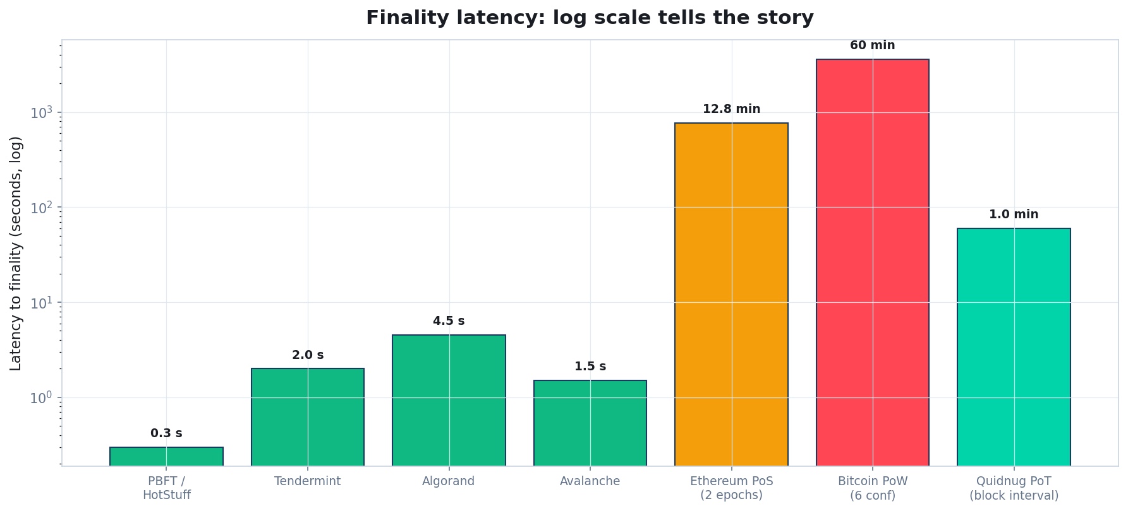
Finality latency: log scale
Sources: official docs, published benchmarks, Ethereum Foundation, Algorand Foundation.
Quidnug · Proof of Trust vs Consensus
29 / 90
Notes:
Bitcoin's hour-long finality horizon is unusable for point-of-sale or anything user-facing. Ethereum's 12 to 15 minute economic finality is nearly as bad.
BFT systems are all sub-5-second. PoT is block-interval-bounded and deterministic per signed transaction.

Slide 30
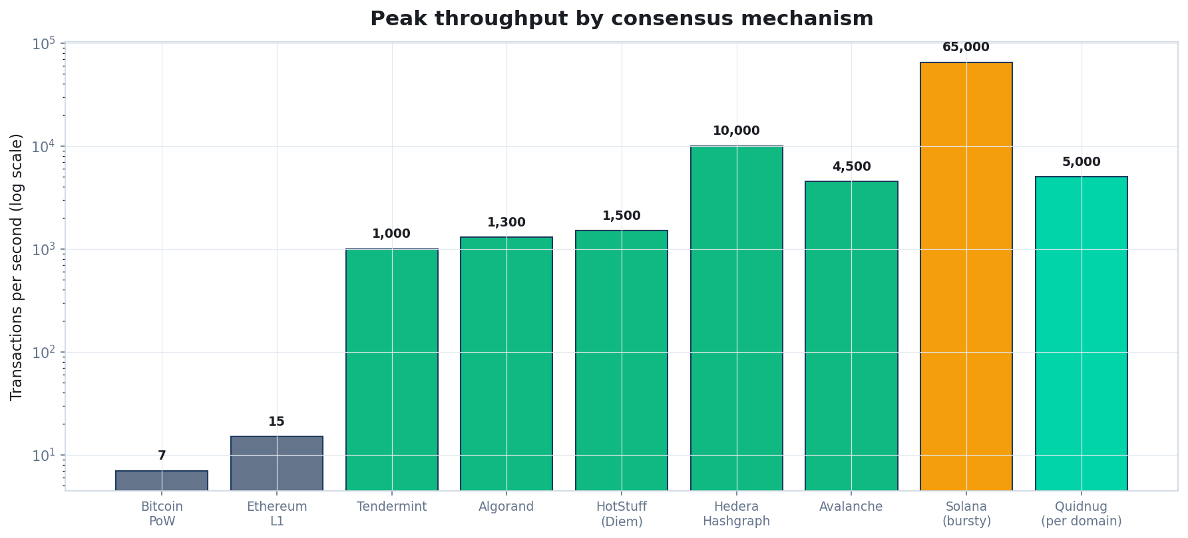
Throughput: orders of magnitude apart
Workload matters: these are simple signed-transaction numbers. Smart contract calls cost 10 to 100x more.
Quidnug · Proof of Trust vs Consensus
30 / 90
Notes:
TPS comparisons are notoriously misleading. The chart shows best-case numbers for simple transactions, which is appropriate for a non-financial trust layer.
Solana's 65k figure is claimed peak under ideal conditions; sustained production is much lower.

Slide 31
Shortcoming 3: the global-state assumption
▸ Every mainstream consensus mechanism assumes all participants agree on a single global state.
▸ Appropriate for money. Double-spend prevention is the whole point. Everyone must see the same balances.
▸ Inappropriate for trust. A reviewer with 50k positive endorsements is not equally trustworthy to every observer. Collapsing this to one number loses the signal.
▸ Two failure modes in practice. (1) Reduce trust to a single public number, losing nuance. (2) Keep it off-chain anyway, defeating the blockchain.
▸ 'Enterprise blockchain' projects hit both of these. Hyperledger Fabric channels, Ethereum L2s, permissioned blockchain pilots are mostly attempts to paper over this mismatch.
Quidnug · Proof of Trust vs Consensus
31 / 90

Slide 32
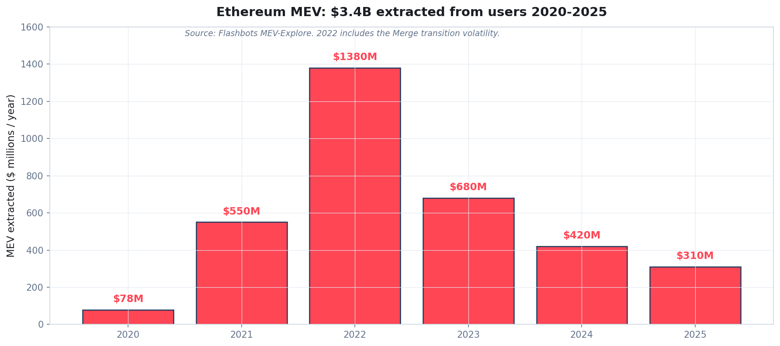
MEV: the dirty secret of global consensus
Source: Flashbots MEV-Explore. MEV is the value validators extract from users via transaction reordering.
Quidnug · Proof of Trust vs Consensus
32 / 90
Notes:
Daian et al. 2020 ('Flash Boys 2.0,' IEEE S&P) documented systematic value extraction from users by Ethereum validators who reorder transactions.
MEV exists because global consensus gives block producers unilateral control over ordering. Non-financial systems do not have this problem because order does not matter.

Slide 33
The MEV corollary
“
If your application is not money, MEV is a pure tax with no offsetting benefit. Picking an architecture immune to MEV is strictly preferable.
— Corollary of choosing PoT over blockchain
Quidnug · Proof of Trust vs Consensus
33 / 90

Slide 34
Section 4
Proof of Trust
Relational, signed, tiered, domain-scoped. Four principles.
Quidnug · Proof of Trust vs Consensus
34 / 90

Slide 35
Principle 1: relational, not global
▸ Every trust query names an observer and a target. trust(observer, target) returns a value in [0, 1].
▸ Same target, different observer, different answer. Alice sees Carol at 0.63. Dave sees Carol at 0.28. Both are correct; both derive from the same chain.
▸ This is the opposite of global consensus. We deliberately allow observers to maintain distinct views. It is a feature, not a bug.
▸ Formally. RT(u, v) = max { product-of-weights along any simple path from u to v } over the trust graph.
▸ The graph is append-only. Edges are signed TRUST transactions. Revocation is a later signed TRUST with weight zero.
Quidnug · Proof of Trust vs Consensus
35 / 90

Slide 36
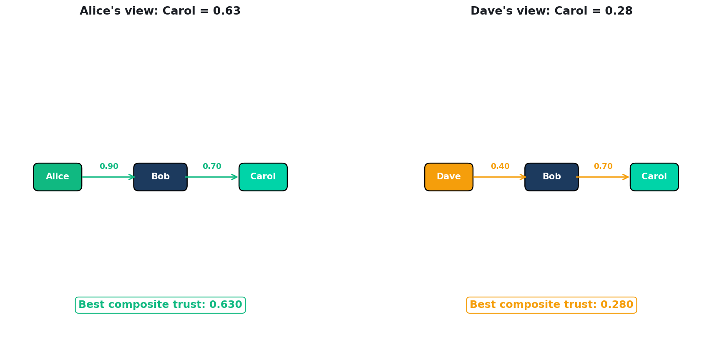
Alice and Dave see Carol differently, and that's correct
Same chain state. Same edges. Different trust graph positions for the two observers.
Quidnug · Proof of Trust vs Consensus
36 / 90
Notes:
This is the canonical example. Walk through the arithmetic: Alice trusts Bob at 0.9, Bob trusts Carol at 0.7, so Alice sees Carol at 0.9 times 0.7 = 0.63.
Dave trusts Bob at 0.4, so Dave sees Carol at 0.4 times 0.7 = 0.28. Both views are correct. Forcing one of them on the other is data loss.

Slide 37
Principle 2: signed, not raced
▸ Every transaction is signed with ECDSA P-256. Signing produces a 64-byte IEEE-1363 signature. Verifying is O(1) and takes about 50 microseconds.
▸ Signature verification is deterministic and cheap. No probabilistic finality. No race between miners. A signed transaction is valid at the moment it is issued.
▸ What the chain does. Orders signed transactions into blocks for replay + durability. Not for validity.
▸ Compare to PoW. In PoW, validity depends on hashrate winning the race. In PoT, validity depends on the signer's key being known.
▸ Corollary. The 'finality vs liveness' tradeoff disappears for individual transactions. Finality is instant.
Quidnug · Proof of Trust vs Consensus
37 / 90

Slide 38
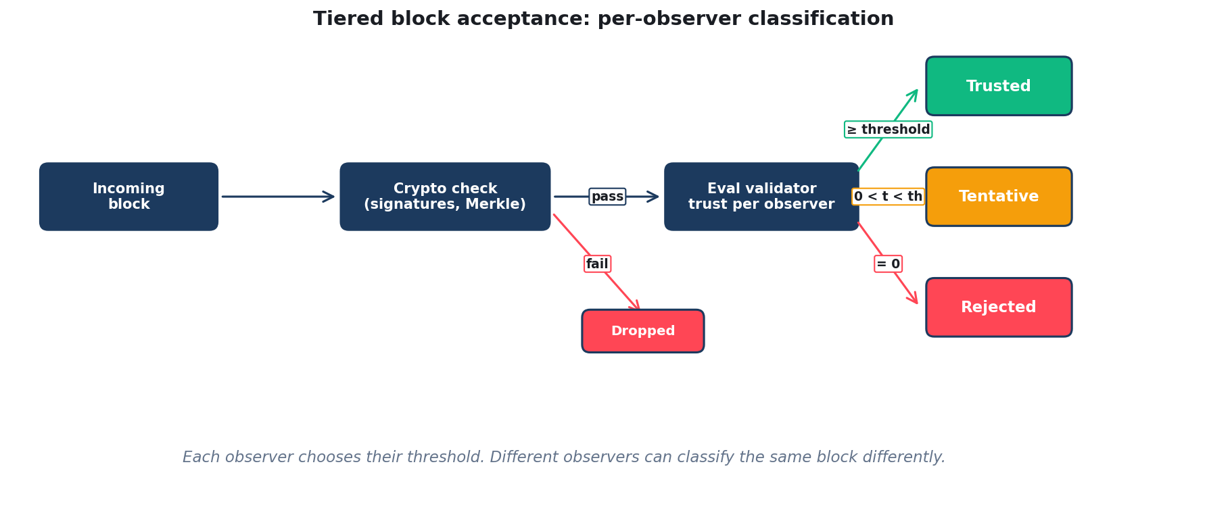
Principle 3: tiered block acceptance
Each observer classifies blocks by their local trust in the producing validator.
Quidnug · Proof of Trust vs Consensus
38 / 90
Notes:
Instead of binary accept/reject (as in PoW/PoS), PoT classifies each block into Trusted / Tentative / Rejected based on the observer's trust in the producing validator.
This is per-observer. Two observers can legitimately disagree about the same block's tier.
Trusted blocks integrate into the main chain view; Tentative blocks are held for reconsideration; Rejected blocks are dropped.

Slide 39
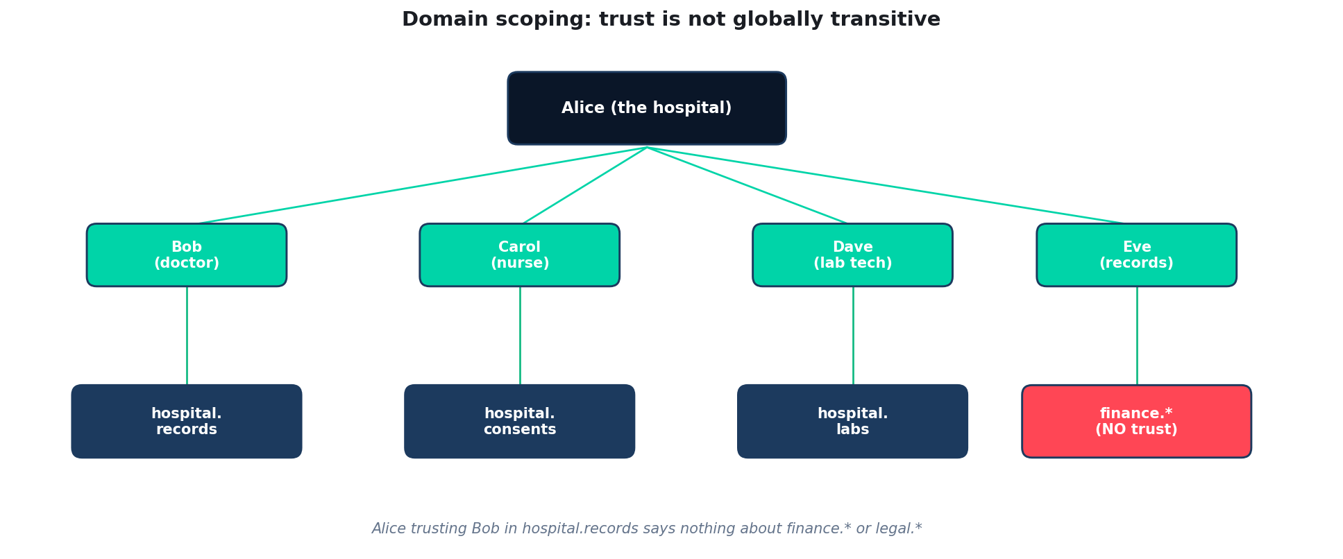
Principle 4: domain scoping
Trust is not globally transitive. hospital.records does not imply finance.*
Quidnug · Proof of Trust vs Consensus
39 / 90
Notes:
Domain scoping is what PGP Web of Trust missed and PoT gets right by construction.
Alice trusting Bob at 0.9 in hospital.records says nothing about finance.consulting or identity.persona. Each domain has its own trust graph.

Slide 40
The whole picture
▸ No leader election. Any consortium member can produce a block at the designated interval.
▸ No voting rounds. Validity is cryptographic; acceptance is per-observer.
▸ No probabilistic finality. Signed transactions are final at signature time.
▸ No economic staking. Sybil resistance is structural (trust graph), not economic.
▸ No global state agreement. Observers can diverge indefinitely on tentative blocks.
▸ Just: signed transactions + a trust graph. That is the entire protocol surface.
Quidnug · Proof of Trust vs Consensus
40 / 90

Slide 41
Inheritance and relation to FBA
▸ Stellar's FBA (Mazieres 2015) is the closest conceptual ancestor. SCP formalized observer-chosen quorum slices. Quidnug goes further: graded trust weights, not binary slices.
▸ Differences from FBA. Scope: PoT adds domain scoping; SCP is single-domain.
▸ Decay: PoT has multiplicative path decay; SCP has binary membership.
▸ Divergence: PoT allows permanent observer divergence; SCP expects eventual convergence via slice intersection.
▸ Revocation: PoT has time-bounded edges with TTL; SCP has out-of-band slice updates.
Quidnug · Proof of Trust vs Consensus
41 / 90

Slide 42
Section 5
The Math of Relational Trust
Four properties, with proofs.
Quidnug · Proof of Trust vs Consensus
42 / 90

Slide 43
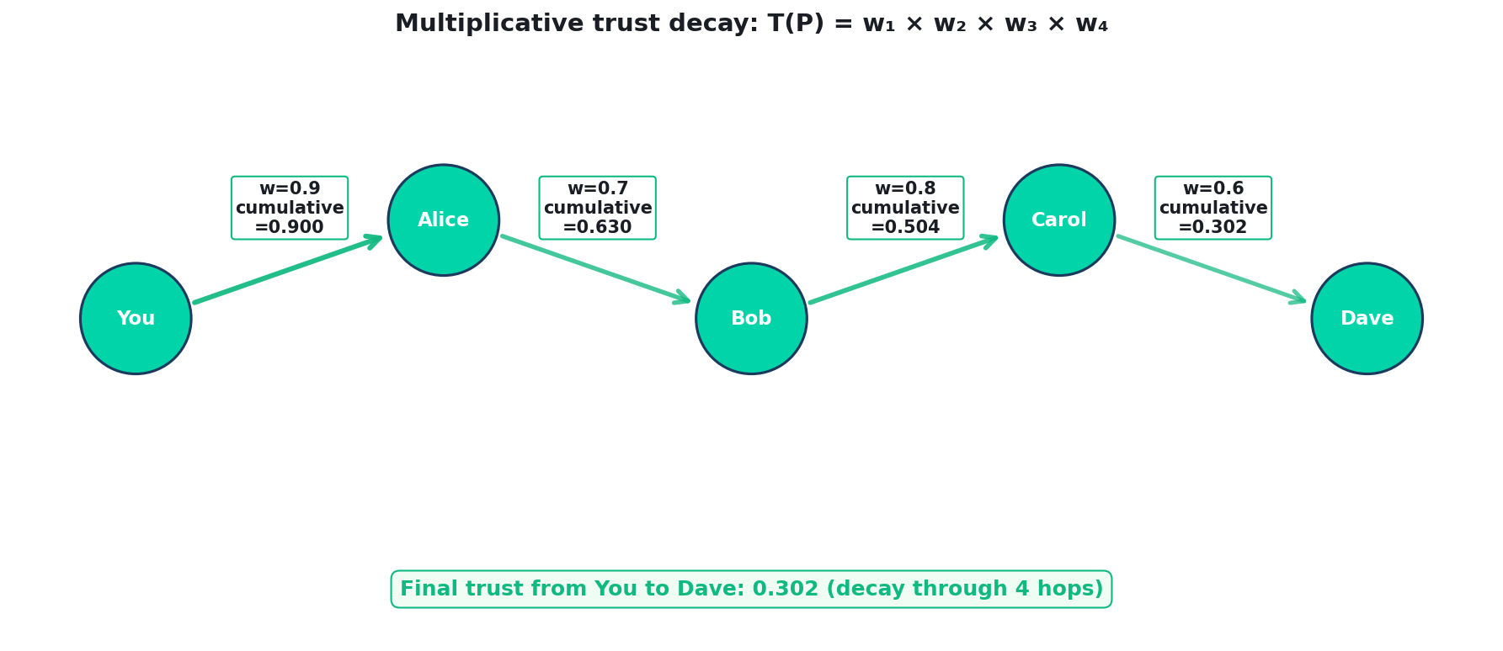
Trust propagates multiplicatively along paths
T(P) = product of edge weights along the path. All weights in [0,1], so the product decays monotonically.
Quidnug · Proof of Trust vs Consensus
43 / 90

Slide 44
Definitions
// Trust graph: G = (V, E, w)
// V = set of quids
// E ⊆ V × V = directed trust edges
// w: E → [0, 1] = edge weight
// Path trust: for a simple path P = v_0 → v_1 → ... → v_k
T(P) = w(v_0, v_1) · w(v_1, v_2) · ... · w(v_{k-1}, v_k)
// Relational trust: best-path aggregation
RT(observer, target) = max { T(P) : P is a simple path
from observer to target }
// Boundary cases:
RT(u, u) = 1 // full self-trust
RT(u, v) = 0 // if no path exists
Quidnug · Proof of Trust vs Consensus
44 / 90

Slide 45
Property 1: monotonic decay (proof)
▸ Claim. For any path P of length k >= 1 with edge weights in [0, 1], T(P) <= min of the edge weights on P.
▸ Proof sketch. Each edge weight is at most 1. Multiplying by any value <= 1 cannot increase the product. Formally: T(P) = w_j · product of others <= w_j · 1^(k-1) = w_j.
▸ Therefore T(P) <= min_j w_j.
▸ Consequence. A single weak edge caps the entire path's trust. Attackers with only low-weight connections cannot produce high-trust outputs, regardless of chain length.
▸ Contrast with additive models. In an additive scheme, many weak edges could sum to a high score. Multiplicative decay prevents this structurally.
Quidnug · Proof of Trust vs Consensus
45 / 90

Slide 46
Property 2: structural Sybil resistance
▸ Claim. For an observer u with total out-edge weight budget B, the aggregate trust u can confer on a Sybil cluster is bounded by B.
▸ Proof sketch. Suppose u issues trust to Sybils s_1, ..., s_k with weights w_1, ..., w_k summing to at most B. Each Sybil can derive trust at most w_i in the direct case, and through chains, no more than max w_i × (decayed factor <= 1).
▸ Key implication. Flooding the chain with Sybils does not help an attacker unless the observer trusts at least one of them directly.
▸ This is why PoT does not need PoW-style or PoS-style Sybil resistance. The resistance is structural: Sybils that nobody trusts are invisible in the trust computation.
Quidnug · Proof of Trust vs Consensus
46 / 90

Slide 47
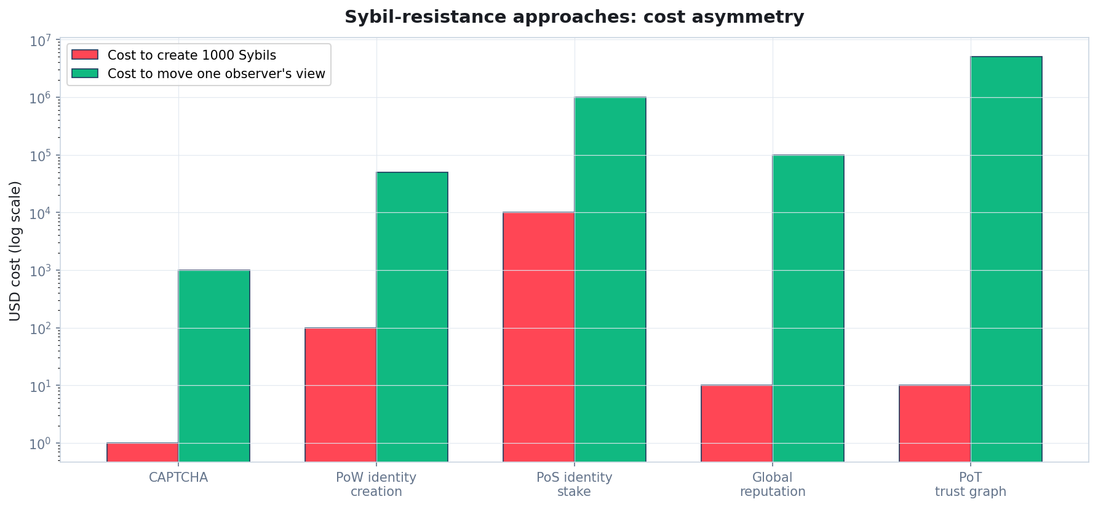
Cost-of-attack asymmetry
Creating Sybils is cheap everywhere. Moving an observer's view is the relevant cost.
Quidnug · Proof of Trust vs Consensus
47 / 90
Notes:
In OAuth / global reputation systems, the attacker creates fake accounts and floods reviews. Quantity is the attack.
In PoT, Sybils that no observer trusts do not affect any observer's computation. Quantity does not help. The binding cost is getting trusted by the target observer, which does not scale.

Slide 48
Property 3: bounded computation
▸ Claim. Computing RT(u, v) with maximum depth d has worst-case time complexity O(b^d), where b is the average out-degree of the graph.
▸ Proof. BFS from u to depth d visits at most 1 + b + b^2 + ... + b^d nodes. Each edge traversal is O(1). Total: O(b^d).
▸ Typical numbers. Quidnug defaults to d = 5. For b ~ 10, that is ~100k node visits worst case.
▸ With memoization and TTL filtering. Real queries resolve in under 1 millisecond.
▸ Compare to blockchain-based trust queries. On-chain reputation typically requires full-node state access, which is 100 to 1000x slower.
Quidnug · Proof of Trust vs Consensus
48 / 90

Slide 49
Property 4: convergence under honest-majority gossip
▸ Claim. Under partial synchrony, if over 50% of consortium validators are honest and gossip is reliable, all honest observers converge on the same Trusted-tier block set within O(gossip_delay × diameter) time.
▸ Proof sketch. Honest validators produce blocks that propagate through gossip to all observers within bounded delay. Trust edges to the validator set also propagate. Observers' views converge as gossip completes.
▸ Divergence persists only for observers who maintain different trust edges toward validators. That is a feature of the relativistic model.
▸ Practical impact. Observers who trust the same consortium see the same chain. Observers who trust different consortia see different chains. Both are correct.
Quidnug · Proof of Trust vs Consensus
49 / 90

Slide 50
Properties summary: PoT against three major alternatives
Property | PoW | BFT | PoT
Finality type | Probabilistic | Deterministic | Deterministic per signed tx
Sybil resistance | Economic (hashrate) | N/A (known set) | Structural (trust graph)
Verification cost / tx | O(1), block-level | O(n) messages | O(1) per tx + O(b^d) per trust query
Partition response | Forks, resolve via longest chain | Halts | Observers may diverge indefinitely
Throughput upper bound | Block size / interval | Network RTT | Per-signer serial + per-domain parallel
Quidnug · Proof of Trust vs Consensus
50 / 90

Slide 51
Section 6
Security Properties
Replay, rotation, Byzantine tolerance, TTL, revocation.
Quidnug · Proof of Trust vs Consensus
51 / 90

Slide 52
Replay prevention via nonce ledger
▸ Every signed transaction carries a monotonic nonce. The NonceLedger (QDP-0001) enforces that no nonce repeats for a given (signer, domain, epoch) tuple.
▸ Claim. Given a correct NonceLedger, no accepted transaction can be replayed.
▸ Proof sketch. Replay of tx with nonce n fails because n <= max accepted nonce. A forged tx' with nonce n has different content, so its signature fails verification. Cross-domain submission is a separate authorized action, not a replay.
▸ Cross-domain nonce scoping (QDP-0003). (signer, domain_A, epoch) and (signer, domain_B, epoch) are independent. A signer explicitly authorizes each.
Quidnug · Proof of Trust vs Consensus
52 / 90

Slide 53
Key rotation: bounding compromise damage
▸ QDP-0001 supports key rotation via signed NonceAnchor. After rotation, old signatures remain verifiable; new signatures use the new key.
▸ Compromise damage window. If compromise occurs at time T_c and rotation happens at T_r, attacker damage is bounded by [T_c, T_r].
▸ Post-rotation, compromised key signatures fail. Because they do not match the new public key registered for that epoch.
▸ Guardian Recovery (QDP-0002). M-of-N guardian-cosigned transaction can rotate a lost or stolen key. Recovery is a social + cryptographic event, not a manual key-management nightmare.
▸ Compare to 'your key IS your identity.' Bitcoin's model: lose the key, lose everything. PoT's model: rotate the key, keep the identity.
Quidnug · Proof of Trust vs Consensus
53 / 90

Slide 54
Byzantine consortium tolerance
▸ Claim. Even if a minority of consortium validators are Byzantine, honest observers' views are not corrupted, provided the observer's trust graph reflects their actual trust.
▸ Proof sketch. A Byzantine validator produces a malicious block. The observer evaluates trust in the validator; if below threshold, block is Tentative or Rejected.
▸ Different from classical BFT. No global quorum is needed. Each observer decides. Byzantine validators can produce blocks some observers accept (those who trust them) and others reject.
▸ System-level safety. Network-wide corruption requires corrupting enough validators to cross observers' trust thresholds. In a maintained trust graph, that is a social attack, not a cryptographic one.
▸ This is a different guarantee, not a weaker one. Per-observer deterministic validity, not global quorum.
Quidnug · Proof of Trust vs Consensus
54 / 90

Slide 55
TTL and revocation (QDP-0022)
▸ Every trust edge carries a ValidUntil timestamp. Expired edges are automatically filtered from trust queries. No separate revocation call required.
▸ Claim. Revocation is effective within max(gossip_delay, observer_polling_interval) of a revocation event.
▸ Proof sketch. A revocation is a new TRUST with weight 0 or shortened ValidUntil. It propagates via the standard gossip protocol. Observers see the update on their next trust computation.
▸ Contrast with X.509 CRLs (slow) or OCSP (per-query). PoT revocation is 'tell everyone, they all update, next query reflects it.' Memoized caches invalidate per-observer.
▸ TTL + revocation together. TTL bounds damage from lost revocations; revocation handles explicit takedowns. Defense in depth.
Quidnug · Proof of Trust vs Consensus
55 / 90

Slide 56
Structural > detection
“
Structural defense beats detection. A verifier that rejects out-of-scope trust chains cryptographically does not depend on catching the attack.
— The design philosophy of signed delegation chains
Quidnug · Proof of Trust vs Consensus
56 / 90

Slide 57
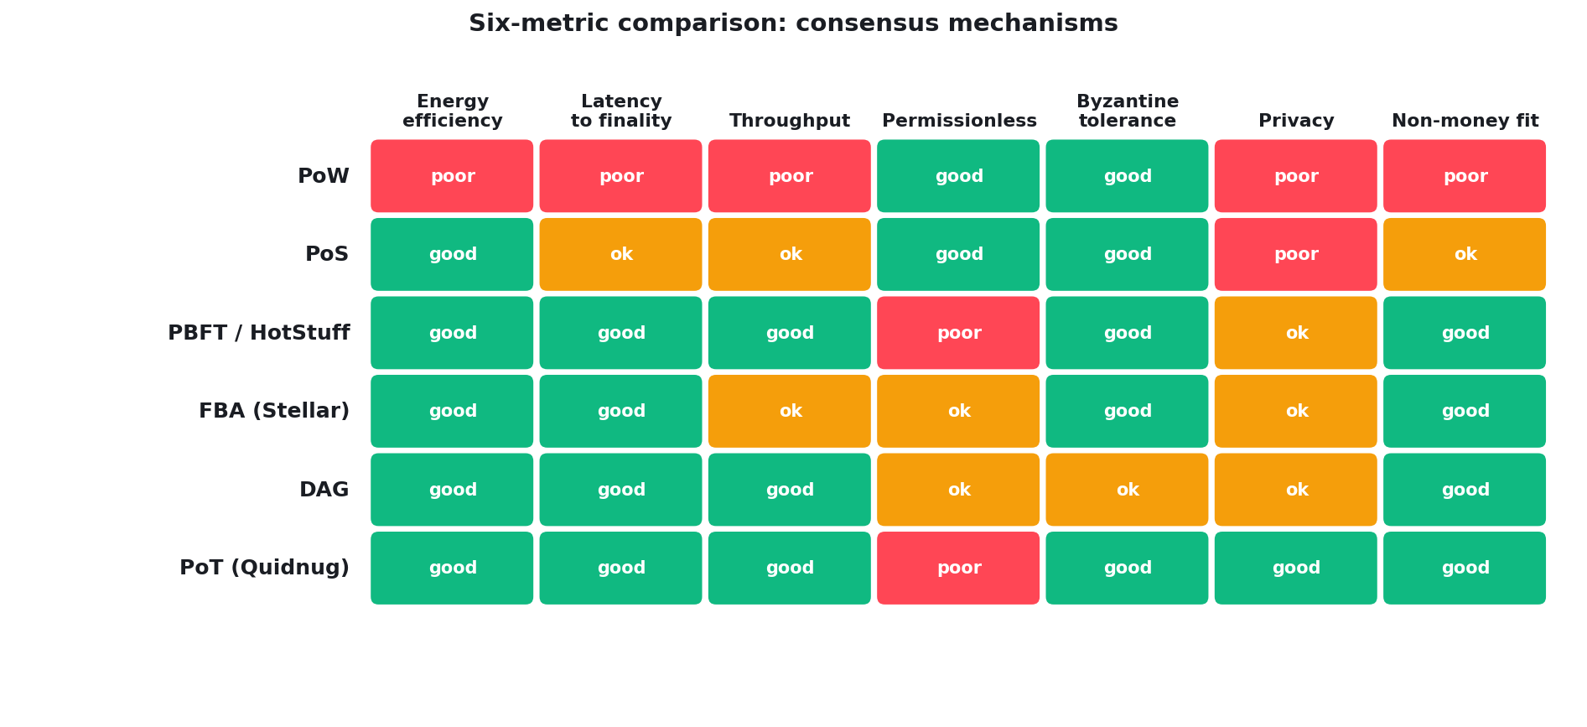
Six-metric comparison: consensus mechanisms side by side
Author assessment based on published benchmarks and real-world observation.
Quidnug · Proof of Trust vs Consensus
57 / 90

Slide 58
Section 7
Real-World Use Cases
Where PoT is the right answer, and where it is not.
Quidnug · Proof of Trust vs Consensus
58 / 90

Slide 59
Use case 1: reviews and reputation (PoT wins)
▸ The problem. Yelp, TripAdvisor, Amazon reviews. Reviewer credibility varies. Observers care about different reviewers.
▸ Why global consensus fails. A single public trust score per reviewer loses the relational structure. A foodie trusts different reviewers than a casual diner.
▸ Why PoT fits. Each observer has their own trust graph. Trust in a reviewer decays multiplicatively. Observers see different aggregate ratings, and that is correct.
▸ Implementation. Quidnug Reviews Protocol (QRP-0001) with four-factor rating: topical trust, helpfulness, activity, recency.
▸ See the 'Relativistic Ratings' blog post and deck for full treatment.
Quidnug · Proof of Trust vs Consensus
59 / 90

Slide 60
Use case 2: healthcare consent (PoT wins)
▸ The requirement. HIPAA, GDPR Article 9, LGPD require granular, revocable, auditable consent.
▸ Why PoW or PoS fails. Patient identifiers on a public ledger is a regulatory catastrophe. Privacy-preserving variants add complexity and reintroduce trust in the private operators.
▸ Why PoT fits. Signed consent records on permissioned domains like hospital.patients. Revocation is a new signed transaction; cascade revokes dependent grants.
▸ GDPR erasure via cryptographic shredding. CID-stored payloads can be made unreachable by key deletion (QDP-0015 and 0017). Right to be forgotten without breaking the audit trail.
▸ Compliance mapping. Attribution of every consent event. Cross-processor audit with cryptographic proof.
Quidnug · Proof of Trust vs Consensus
60 / 90

Slide 61
Use case 3: interbank wire authorization (PoT wins)
▸ SWIFT processes ~45M messages/day. TARGET2 and Fedwire settlement finality is seconds. Existing rails work operationally.
▸ Blockchain-based interbank pilots. JPMorgan Onyx, Fnality USC, R3 Corda converged on permissioned designs because PoW/PoS tradeoffs made no sense for this use case.
▸ Why PoT fits. Banks have well-defined bilateral trust. ISO 20022 messages are signed end-to-end. PoT with domain per corridor (wires.usd-eur.*) provides attribution without mining.
▸ Reference implementation. Quidnug's UseCases/interbank-wire-authorization/ runs sub-100ms end-to-end at zero energy overhead.
▸ Extends naturally to FX, clearing, securities. Same trust model, different domain tree.
Quidnug · Proof of Trust vs Consensus
61 / 90

Slide 62
Use case 4: elections with ballot anonymity (PoT + blind sigs)
▸ The two hard requirements. Universal verifiability: anyone can check the tally. Ballot secrecy: nobody can link a ballot to a voter.
▸ Why blockchain voting pilots failed. West Virginia Voatz (2020), Swiss Post SwissVote (2019) both had security holes around the auth/issuance separation.
▸ PoT + blind signatures. Eligibility is signed via identity domain. Ballot issuance uses RSA-FDH blind signatures (QDP-0021). Voter anonymity + cryptographic verifiability.
▸ Implementation. pkg/crypto/blindrsa in the Quidnug reference repo. Landed 2025.
▸ Audit path. Anyone with the election authority's public keys can verify the tally. No individual vote is revealed.
Quidnug · Proof of Trust vs Consensus
62 / 90

Slide 63
Use case 5: supply chain provenance (PoT wins)
▸ The supply chain trust problem. Producers sign attestations. Auditors endorse producers. Buyers maintain their own trust graph.
▸ Why IBM TradeLens failed. Forced global consensus when buyers legitimately have different views of which producers and auditors are trustworthy.
▸ Why PoT fits. Product provenance = chain of signed attestations. Trustworthiness to a specific buyer = path in that buyer's trust graph.
▸ Regional adaptation. US buyer trusts FDA and USDA. EU buyer trusts EFSA. Same provenance chain, different trust-graph weights.
▸ Integrations. C2PA for media, Sigstore for software artifacts. Trust layer composes with existing verification standards.
Quidnug · Proof of Trust vs Consensus
63 / 90

Slide 64
Use case 6: identity as a trust-graph composite (DID + PoT)
▸ W3C Decentralized Identifiers (DIDs) give you an identifier format and resolution standard.
▸ They do not give you a trust graph. A DID resolves to a DID Document but tells you nothing about whether to trust that DID's claims.
▸ PoT complements DIDs. did:quidnug:c7e2d10000000001 resolves to a public key in the Quidnug identity registry. Trust graph wraps it with per-observer weights.
▸ QDP-0023 DNS-anchored attestation. Binds DIDs to existing DNS trust roots for bootstrapping.
▸ Cross-platform portable identity. Your DID resolves the same way everywhere. Your trust graph is per-observer.
Quidnug · Proof of Trust vs Consensus
64 / 90

Slide 65
Use case 7: where PoT is the wrong tool
▸ Permissionless tokenized money. Observer divergence is unacceptable for double-spend prevention. Use Bitcoin or an L2.
▸ Turing-complete smart contracts with global state. State must be identical for all observers. Use Ethereum PoS.
▸ High-frequency trading on public order books. Sub-millisecond latency and MEV-resistant ordering. Use a centralized matching engine + on-chain settlement.
▸ Adversarial voting with no authority. PoT assumes an authority can issue blind-signed ballots. For fully authority-less voting, use ZK-SNARKs (Helios, MACI).
▸ Decentralized storage consensus (Filecoin). Requires economic commitments tied to storage. Use PoSt / PoRep.
Quidnug · Proof of Trust vs Consensus
65 / 90

Slide 66
PoT use case fit matrix
Green = PoT shines; red = use something else.
Reviews / reputation
Healthcare consent
Supply chain provenance
Per-observer is the whole point. Huge win.
Granular, revocable, audited. Clean fit.
Bilateral trust, cross-border audit. Native fit.
Interbank wires
Elections (with blind sigs)
Identity (with DID)
Bilateral trust, ISO 20022, sub-second. Natural fit.
Verifiability + anonymity. Good fit with companion primitive.
Complementary to W3C DID. Natural layer.
Permissionless money
Turing-complete contracts
High-frequency trading
Observer divergence not OK. Wrong tool.
Needs global state. Wrong tool.
Sub-ms latency required. Wrong tool.
Quidnug · Proof of Trust vs Consensus
66 / 90

Slide 67
Section 8
Benchmarks and Tradeoffs
Hard numbers on throughput, latency, energy. Honest about limits.
Quidnug · Proof of Trust vs Consensus
67 / 90

Slide 68
Benchmark caveat before the numbers
▸ TPS comparisons are notoriously misleading. A signature-only transaction is cheap. A smart-contract call can cost 100x more.
▸ Latency depends on network topology. BFT protocols shine on low-latency LANs and suffer across continents.
▸ Energy depends on how you measure. Just the validators? The whole network? The manufacturing footprint of ASICs?
▸ All numbers below assume simple signed transactions. Apples to apples, for the workload PoT is designed for.
▸ Worst-case numbers for Quidnug come from its own tests/benchmarks/ directory. Best-case numbers for competing systems come from their marketing. The comparison is generous to competitors.
Quidnug · Proof of Trust vs Consensus
68 / 90

Slide 69
Throughput: where PoT fits
▸ Bitcoin PoW: 7 tx/s. This is not a benchmark; it is a protocol limit.
▸ Ethereum L1: 15 tx/s. L2s push it higher at cost of complexity.
▸ BFT family: 1,000 to 1,500 tx/s. Tendermint, HotStuff in production.
▸ DAG family: 10,000+ tx/s. Hedera Hashgraph, Avalanche.
▸ Quidnug PoT per domain: ~5,000 tx/s measured. Scales horizontally via domain partitioning.
▸ Per-domain is the right unit. Healthcare transactions do not compete with interbank wires for throughput in the same physical chain.
Quidnug · Proof of Trust vs Consensus
69 / 90

Slide 70
Finality: where PoT shines
▸ Bitcoin PoW: 1 hour (6 confirmations). Probabilistic, not deterministic.
▸ Ethereum PoS: 12.8 minutes (2 epochs). Economic finality, can revert under specific attacker scenarios.
▸ Tendermint, HotStuff: 1 to 3 seconds. Deterministic BFT finality.
▸ Quidnug PoT: block interval (default 60s, configurable). Deterministic per signed transaction; block interval is for ordering.
▸ Critical distinction. Quidnug individual transactions are final at signature time. Blocks provide ordering; they do not provide validity.
Quidnug · Proof of Trust vs Consensus
70 / 90

Slide 71
Energy: where PoT wins outright
▸ Bitcoin PoW: ~10 MJ per transaction. Literally burning a gallon of gasoline for every wire transfer equivalent.
▸ Ethereum PoS post-merge: ~0.2 J per transaction. Genuinely low.
▸ BFT: ~0.004 J per transaction. Tendermint, HotStuff. Dominated by network I/O.
▸ Quidnug PoT: ~0.005 J per transaction. Commodity hardware, ECDSA signature verify, gossip. Effectively in the noise.
▸ Real-world context. Sending a WhatsApp message costs more energy than a Quidnug trust-query. Bitcoin tx costs more than a cross-Atlantic flight per passenger, per tx.
Quidnug · Proof of Trust vs Consensus
71 / 90

Slide 72
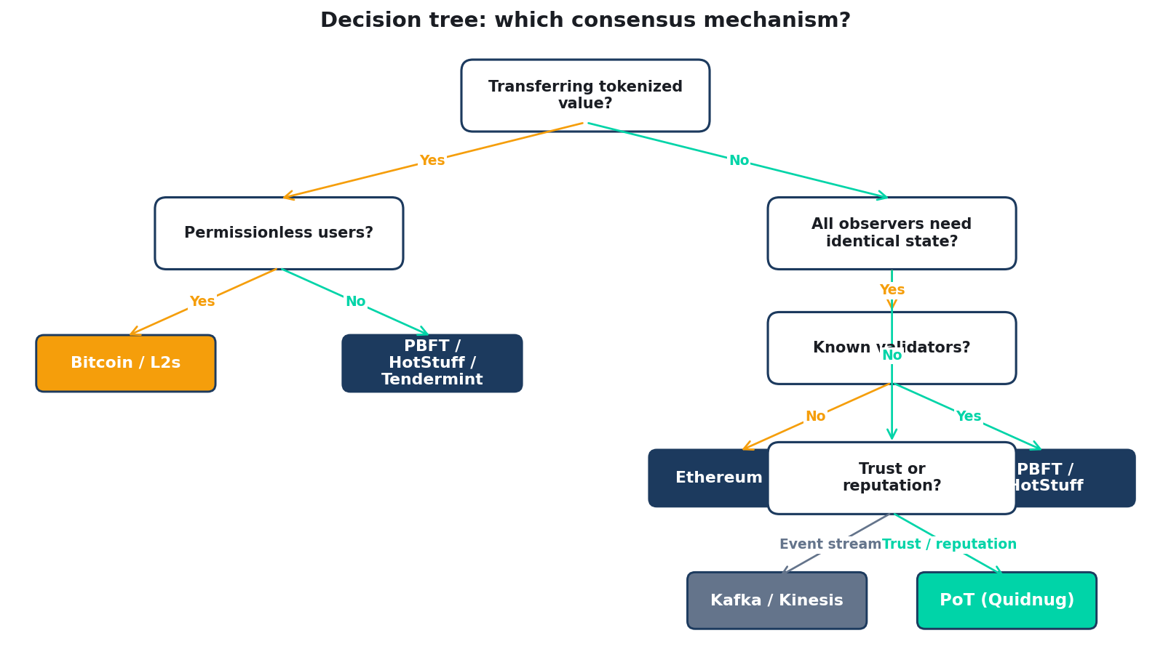
Decision tree: which consensus mechanism?
Start top-left. Follow the branches. Most real-world applications land on Kafka or PoT.
Quidnug · Proof of Trust vs Consensus
72 / 90

Slide 73
Honest tradeoff 1: no bootstrap from strangers
▸ PoW and PoS allow strangers to contribute immediately. Run a miner or validator, earn a stake.
▸ PoT requires someone to trust you first. A brand-new quid with zero trust edges is invisible.
▸ This is a feature for most applications. No anonymous Sybil flooding.
▸ It is a hard blocker for some applications. Permissionless anonymous participation cannot be provided.
▸ Mitigations. OIDC bridge + operator-attested identity; DNS-anchored attestation (QDP-0023); reputation graduation over time via QDP-0016.
Quidnug · Proof of Trust vs Consensus
73 / 90

Slide 74
Honest tradeoff 2: observer divergence isn't always a feature
▸ Some applications require global agreement. A reviewer suspended for fraud should probably be un-trustworthy to every observer.
▸ PoT allows divergence. Observers who have not received the revocation see the old state.
▸ Mitigations. QDP-0015 moderation (structural suppression), QDP-0018 audit logs, federation-wide gossip of consensus signals.
▸ Social convention, not protocol guarantee. The operator who claims to honor moderation is incentivized to maintain consistency with peers.
▸ This is the same problem as real-world trust. Reputation really is subjective. PoT acknowledges that; global consensus pretends it is not.
Quidnug · Proof of Trust vs Consensus
74 / 90

Slide 75
Honest tradeoff 3: no smart contracts
▸ Ethereum's EVM is a general computational substrate. Quidnug does not try to replicate it.
▸ If you need turing-complete on-chain logic. Use Ethereum or a similar smart-contract platform.
▸ PoT handles signed messages with structured payloads. For most non-money applications, that is what the application actually needs.
▸ Integration path. Quidnug's Chainlink External Adapter lets on-chain contracts query Quidnug trust scores. Best of both worlds where both are needed.
▸ Dogma-free recommendation. Use the right tool. EVM for Uniswap. Quidnug for consent management. There is no free lunch and no single substrate fits all.
Quidnug · Proof of Trust vs Consensus
75 / 90

Slide 76
Honest tradeoff 4: mathematical maturity
▸ PoW has been formally analyzed for 17 years. PBFT for 25 years. HotStuff, Algorand, Ouroboros have peer-reviewed security proofs.
▸ PoT as Quidnug implements is newer. Primitives are mature (signatures, trust graphs, append-only logs). The specific combination has less formal scrutiny.
▸ Ongoing formal work. Relational trust's correctness properties are under external formal review. Peer-reviewed writeup targeted for 2026-Q4.
▸ Caution on high-stakes financial applications. For money movement, wait for formal verification. For reputation, consent, supply chain: the primitives are mature enough today.
▸ Review and critique welcome. github.com/quidnug/quidnug Discussions tab or any peer-reviewed venue.
Quidnug · Proof of Trust vs Consensus
76 / 90

Slide 77
The takeaway in one sentence
“
If your application does not need every observer to agree on the same state, you do not need a blockchain. You need signed data, a trust graph, and a protocol that composes them.
— The takeaway in one sentence
Quidnug · Proof of Trust vs Consensus
77 / 90

Slide 78
Section 9
Decision Framework + Closing
Summary, takeaways, questions.
Quidnug · Proof of Trust vs Consensus
78 / 90

Slide 79
A three-question decision framework
▸ Question 1. Is the primary value tokenized? If yes (money, NFTs, staking), you likely need global consensus. PoW or PoS.
▸ Question 2. Do all observers need identical state? If yes (settlement finality, regulatory uniform reporting), you need global consensus. BFT or PoS.
▸ Question 3. Is this fundamentally about trust? If yes (reviews, consent, provenance, identity, attestations), PoT is the natural fit.
▸ Most real-world systems. Answer no/no/yes. The default choice should be PoT, not a blockchain.
▸ Honest recommendation. Do not pick a substrate before answering these three questions.
Quidnug · Proof of Trust vs Consensus
79 / 90

Slide 80
Recommendations by use case
Global money
Smart contracts
Permissioned DeFi
Bitcoin, or Ethereum L2s.
Ethereum, Solana, Sui.
Tendermint, HotStuff.
Enterprise data sharing
Review systems
Consent management
Kafka or streaming DB.
PoT (Quidnug).
PoT (Quidnug).
Supply chain
Identity attestation
Elections
PoT + Sigstore / C2PA.
DIDs + PoT.
PoT + blind signatures.
Quidnug · Proof of Trust vs Consensus
80 / 90

Slide 81
What this talk argued
▸ 1. Global consensus solves a narrow problem (money). It was never meant as a universal distributed-systems primitive.
▸ 2. FLP + CAP say any design is a choice. Nakamoto chose availability. BFT chose consistency. PoT chose per-observer truth.
▸ 3. Relational trust has clean mathematical properties. Monotonic decay, structural Sybil resistance, bounded computation, convergence under honest majority.
▸ 4. The cost of PoT is low. 200 microseconds per trust query, zero energy above commodity compute.
▸ 5. The benefit is large. Most real-world trust problems are relational, not global. The substrate should match.
Quidnug · Proof of Trust vs Consensus
81 / 90

Slide 82
What to do Monday morning
▸ Audit your application's identity and trust assumptions. Is there a single 'trust score' for each entity? Why?
▸ Read the Greshake 2023 and Ioannidis 2005 papers. They set up the indirect-injection and reproducibility failure modes that motivate rethinking this layer.
▸ Prototype a Quidnug consortium for one domain. Reviews, consent, supply-chain attestation: pick the one that fits your application's pain point.
▸ Benchmark. Quidnug ships with tests/benchmarks/ and reference nodes in deploy/. Stand up a 3-node local cluster in an afternoon.
▸ Contribute back if it works. github.com/quidnug/quidnug accepts QDPs via PR. Every added use case benefits the ecosystem.
Quidnug · Proof of Trust vs Consensus
82 / 90

Slide 83
What this protocol does not solve
▸ Money movement between untrusting strangers. That remains PoW's job. Bitcoin is fine.
▸ Compromised root operators. If the seed-operator key is hostile, cryptographic defense cannot compensate. Social trust is the root.
▸ Social engineering on humans. If Alice signs a malicious trust edge, PoT dutifully records her intent. Garbage in, garbage out.
▸ Quantum cryptographic compromise. ECDSA P-256 will not survive a large quantum computer. Migration via QDP-0020 protocol versioning is planned.
▸ Fundamental physical impossibilities. CAP is still a theorem. FLP is still a theorem. PoT is a choice within those constraints, not a magical bypass.
Quidnug · Proof of Trust vs Consensus
83 / 90

Slide 84
What comes next for Quidnug
▸ Phases 2-6 of existing QDPs. Moderation CLI, DSR auto-fulfill, PoW challenges, governance transactions, AUDIT_ANCHOR events, reputation graduation.
▸ Formal verification. Peer-reviewed proofs of the relational-trust properties we walked in Section 5. Target: late 2026.
▸ Client SDK maturity. Python and Go are battle-tested. TypeScript, Rust, Java, .NET coming up to parity.
▸ Integrations. Chainlink, Sigstore, C2PA, HL7 FHIR, ISO 20022, Schema.org are shipped. Next: Kafka, OpenTelemetry.
▸ Network effects. Each use case adoption strengthens the shared trust graph. Reviews help interbank wires. Attestations help consent.
Quidnug · Proof of Trust vs Consensus
84 / 90

Slide 85
How to get involved
▸ Read the blog post this deck is based on. blogs/2026-04-20-proof-of-trust-vs-consensus-mechanisms.md at the Quidnug repo.
▸ Run a local node. docker-compose up in deploy/docker/ gives you a 3-node cluster with IPFS and Prometheus in 5 minutes.
▸ Propose a QDP. The protocol is extensible. New primitives land via the QDP process in docs/design/.
▸ Integrate with your stack. Client SDKs in Python, Go, TS, Rust. Docs at quidnug.com/docs.
▸ Critique the math. Section 5's proofs are in the repo. Find a flaw, open an issue, get credited.
Quidnug · Proof of Trust vs Consensus
85 / 90

Slide 86
Common objections, briefly answered
▸ 'Sounds like PGP Web of Trust, which failed.' Correct lineage. PoT fixes PGP's three failure modes: no decay, no scoping, no revocation.
▸ 'Without global consensus, I can't trust the state.' You can; you trust the state to the degree you trust the validators. That is what real trust looks like.
▸ 'This sounds slow.' 200 microseconds per query on a laptop. You are already using slower infrastructure.
▸ 'This sounds complex.' ECDSA signatures + a graph walk. Less complex than EVM or PBFT. Try the reference implementation.
▸ 'It cannot replace Bitcoin.' Correct. We do not want it to. Bitcoin is fine for Bitcoin's use case.
Quidnug · Proof of Trust vs Consensus
86 / 90

Slide 87
One-line summary
“
The default assumption that every distributed system needs global consensus is wrong.
— If you remember one line from this deck
Quidnug · Proof of Trust vs Consensus
87 / 90

Slide 88
References and sources
▸ Lamport, Shostak, Pease (1982). Byzantine Generals. ACM TOPLAS 4(3).
▸ Fischer, Lynch, Paterson (1985). Impossibility of Async Consensus. JACM 32(2).
▸ Castro and Liskov (1999). Practical Byzantine Fault Tolerance. OSDI '99.
▸ Nakamoto (2008). Bitcoin: A Peer-to-Peer Electronic Cash System. bitcoin.org/bitcoin.pdf.
▸ Eyal, Sirer (2014). Majority is Not Enough: Bitcoin Mining is Vulnerable. FC 2014.
▸ Gencer et al. (2018). Decentralization in Bitcoin and Ethereum Networks. FC 2018.
▸ Daian et al. (2020). Flash Boys 2.0. IEEE S&P 2020.
▸ Cambridge CBECI. Bitcoin Electricity Consumption Index. ccaf.io/cbeci.
Quidnug · Proof of Trust vs Consensus
88 / 90

Slide 89
More references
▸ Mazieres (2015). Stellar Consensus Protocol. stellar.org/papers.
▸ Yin et al. (2019). HotStuff: BFT Consensus with Linearity. PODC 2019.
▸ Kiayias et al. (2017). Ouroboros. CRYPTO 2017.
▸ Gilad et al. (2017). Algorand. SOSP 2017.
▸ Rocket et al. (2018). Avalanche. arxiv.org/abs/1906.08936.
▸ Popov (2018). The Tangle. iota.org whitepaper.
▸ Quidnug QDPs 0001 through 0024. github.com/quidnug/quidnug/tree/main/docs/design.
▸ Companion blog post. blogs/2026-04-20-proof-of-trust-vs-consensus-mechanisms.md.
Quidnug · Proof of Trust vs Consensus
89 / 90

Slide 90
Questions
Thank you. Now the useful part.
Where does the PoT argument fail in your environment? Which use case did I underweight or miss? What would make you adopt this in production?
Resources
github.com/quidnug/quidnug
blogs/2026-04-20-proof-of-trust-vs-consensus-mechanisms.md
Lamport et al. (1982) Byzantine Generals Problem
Nakamoto (2008) Bitcoin whitepaper
Mazieres (2015) Stellar Consensus Protocol
Cambridge CBECI energy data: ccaf.io/cbeci
Flashbots MEV data: explore.flashbots.net
Quidnug · Proof of Trust vs Consensus
90 / 90

