Slide 1
QUIDNUG · CLIMATE
Carbon Credits Are Being Gamed
Trust-anchored provenance fixes the $900 billion ESG market's phantom credit problem.
Quidnug · Carbon Credits
1 / 75

Slide 2
Where we are in 2026
94%
of REDD+ credits from Verra's top-selling methodology are phantom, representing no real emission reductions.
Source: West et al., 'Action needed to make carbon offsets from forest conservation work for climate change mitigation,' Science 381, 873-877 (2023). The voluntary carbon market has an integrity crisis.
Quidnug · Carbon Credits
2 / 75

Slide 3
The market's crisis of confidence
$2.1B
peak annual voluntary carbon market value (2022). Now down to ~$720M after the integrity crisis broke.
The market collapsed on news of the phantom-credit scandal. Restoring integrity is the only path to growth beyond $1T as Paris Agreement targets require.
Quidnug · Carbon Credits
3 / 75

Slide 4
Agenda
▸ 1. How the VCM works. Credit lifecycle, market sizing, registries, methodologies.
▸ 2. The phantom credit problem. West et al 2023, Guardian investigation, other evidence.
▸ 3. Why current verification fails. Verifier selection, registry competition, information asymmetry.
▸ 4. The four integrity dimensions. Additionality, permanence, leakage, measurement.
▸ 5. Trust-anchored attestation architecture. Signed attestations at each step; buyer's trust computation.
▸ 6. Auditor reputation weighting. From reputation-opaque to reputation-computable.
▸ 7. Integration with ICVCM + VCMI. How the substrate composes with existing standards.
▸ 8. Worked example. Evaluating a REDD+ credit batch end-to-end.
Quidnug · Carbon Credits
4 / 75

Slide 5
Four claims this talk defends
▸ 1. The phantom-credit problem is an attestation architecture problem. Not a methodology tweaking problem. Not a regulatory tweaking problem.
▸ 2. Current verification has structural conflicts of interest. Project developer pays the verifier. Market incentives misalign.
▸ 3. Multi-party cryptographic attestation plus trust-weighted auditors solve both. No single verifier can approve alone. Auditor reputation becomes computable.
▸ 4. This composes with ICVCM + VCMI, not against them. Existing standards become mechanically verifiable rather than aspirational.
Quidnug · Carbon Credits
5 / 75

Slide 6
Section 1
How the VCM Works
Credit lifecycle, market sizing, registries, methodologies.
Quidnug · Carbon Credits
6 / 75

Slide 7
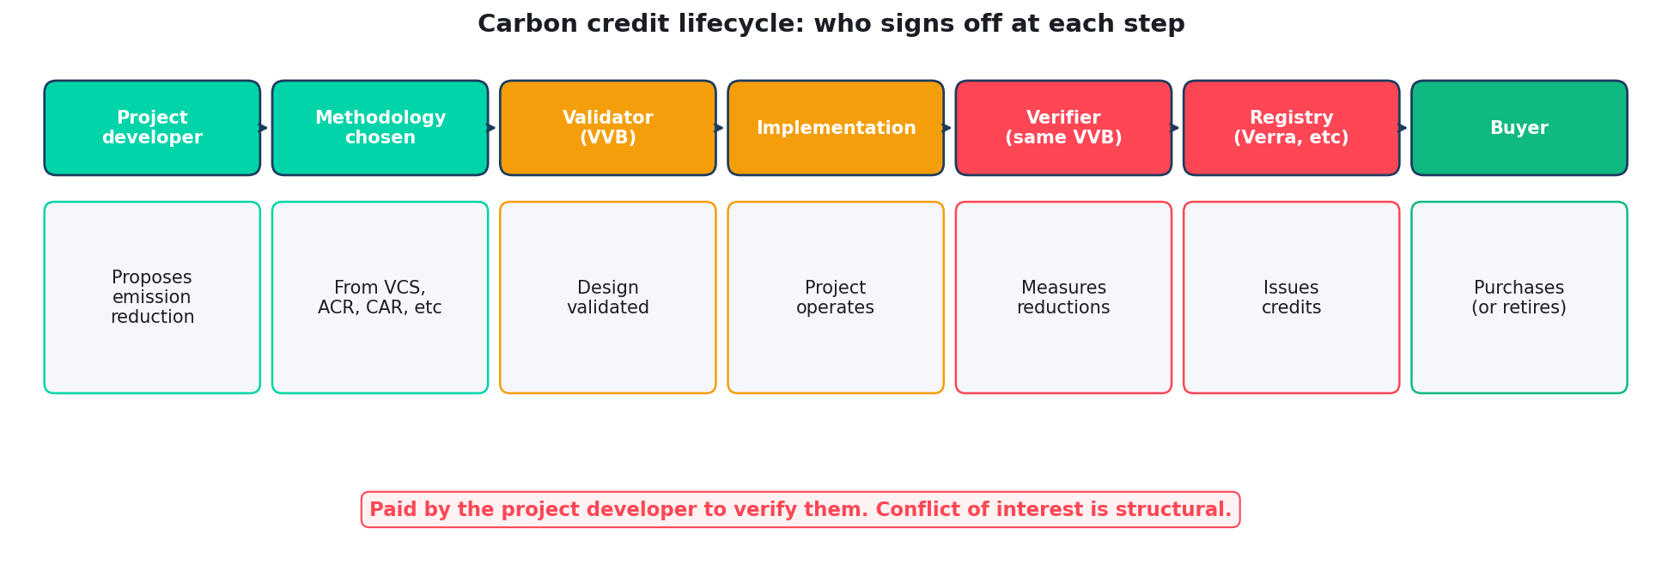
The lifecycle of a carbon credit
Quidnug · Carbon Credits
7 / 75

Slide 8
The credit lifecycle in detail
▸ Project developer identifies an emission reduction opportunity. Forest protection, renewable energy, cookstoves, biochar, etc.
▸ Chooses a methodology. From registries like Verra VCS, Gold Standard, ACR, CAR. Dozens of methodologies per registry.
▸ Submits design for validation. Validation-Verification Body (VVB) reviews. VVBs are paid by the project developer.
▸ Project operates. Emission reductions accumulate over project lifetime (typically 10-100 years).
▸ Same VVB returns for periodic verification. Measures reductions. Submits claim to registry.
▸ Registry issues credits. One credit = 1 tCO2e claimed reduced or avoided.
Quidnug · Carbon Credits
8 / 75

Slide 9
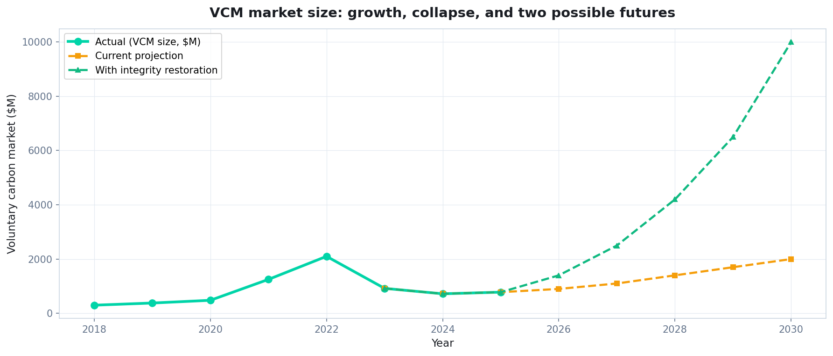
VCM market size: growth, collapse, possible futures
Actual data from Ecosystem Marketplace 2018-2024. Projections based on CMIA, McKinsey, BNEF 2025.
Quidnug · Carbon Credits
9 / 75

Slide 10
The registries
▸ Verra (VCS). Largest by volume. Issues roughly 60% of all VCM credits. Focus: land-use, REDD+, renewable energy.
▸ Gold Standard. Focus on sustainable development co-benefits. More rigorous per-credit but smaller volume.
▸ American Carbon Registry (ACR). North American focus. Methane reduction, forestry.
▸ Climate Action Reserve (CAR). California Air Resources Board compliance market. Hybrid voluntary/compliance.
▸ Plan Vivo. Smallholder + community focus. Smaller volume.
▸ Puro.earth. Engineered removals (biochar, DAC). Newer, technology-focused.
Quidnug · Carbon Credits
10 / 75

Slide 11
Methodology types
▸ Avoidance / reduction. REDD+ (Reducing Emissions from Deforestation and forest Degradation). Renewable energy replacing fossil fuel. Methane avoidance.
▸ Removal. Afforestation / reforestation. Biochar. Direct Air Capture (DAC). Carbonate mineralization.
▸ Risk differences. Avoidance: hard to prove counterfactual (would it have happened anyway?). Removal: easier to measure but often more expensive per tonne.
▸ Market mix. ~80% avoidance / reduction credits historically. ~20% removal. Buyers shifting toward removal post-crisis.
▸ Quality ranking. Engineered removals (DAC, biochar) > nature-based removals (afforestation) > nature-based avoidance (REDD+). Emerging consensus.
Quidnug · Carbon Credits
11 / 75

Slide 12
The buyer profile
▸ Major corporate buyers. Microsoft, Alphabet, Meta, Salesforce, Stripe, Shopify. Net-zero commitments driving demand.
▸ Concerns. Reputational risk. Litigation risk (EU Green Claims Directive). Shareholder scrutiny.
▸ Post-crisis shift. Major buyers moving away from REDD+ avoidance credits. Toward engineered removals and high-integrity nature-based.
▸ Pricing spread widening. Low-quality REDD+ credits ~$2-4. High-quality DAC credits $400-800. The market is segmenting.
▸ Ambition gap. Paris Agreement goals require massive VCM growth. Current integrity crisis blocks that growth.
Quidnug · Carbon Credits
12 / 75

Slide 13
Section 2
The Phantom Credit Problem
Empirical evidence of systematic integrity failure.
Quidnug · Carbon Credits
13 / 75

Slide 14
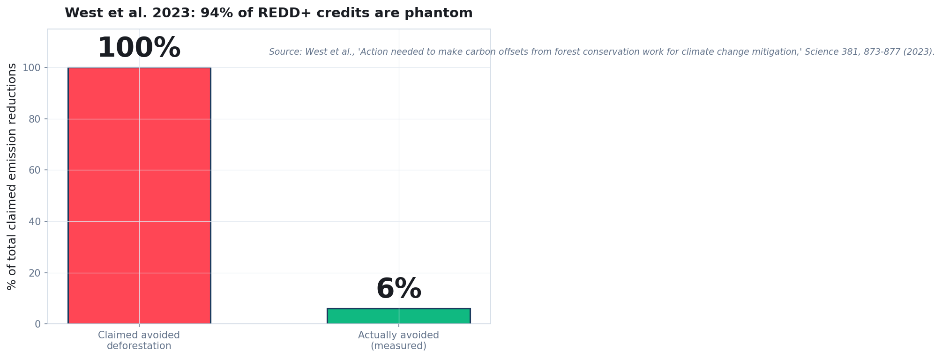
West et al. 2023: 94% phantom
Quidnug · Carbon Credits
14 / 75

Slide 15
West et al. 2023: the landmark study
▸ Thales West and colleagues. 'Action needed to make carbon offsets from forest conservation work for climate change mitigation.' Science, August 2023.
▸ Method. Analyzed 26 REDD+ projects representing ~10% of all VCM REDD+ credits by volume.
▸ Compared credit claims to actual observed forest loss. Satellite-based measurement against counterfactual scenarios.
▸ Result. Only 6% of claimed emission reductions corresponded to actual avoided deforestation.
▸ Publication in Science. Not a niche critique. Peer-reviewed at the top journal. Methodology robust. Conclusions not refuted.
Quidnug · Carbon Credits
15 / 75

Slide 16
The Guardian + Die Zeit investigation
▸ Published January 2023. Joint investigation with SourceMaterial research group.
▸ Focused on Verra's VCS REDD+ methodology. Largest single category of VCM credits.
▸ Finding. More than 90% of Verra's rainforest-credit methodology was phantom. Projects claimed deforestation avoidance that didn't materialize.
▸ Impact. Verra's CEO resigned May 2023. Market collapsed. Corporate buyers paused procurement.
▸ Verra's response. Disputed methodology of the critique. Launched new methodology in 2024. But market confidence damaged.
Quidnug · Carbon Credits
16 / 75

Slide 17
Other documented integrity failures
▸ Cooley et al 2022. Analyzed cookstove credits. Found systematic over-crediting by factor of 10.
▸ Gill-Wiehl et al 2024. Cookstove update: over-crediting likely 5-7x even with methodology improvements.
▸ Thomas et al 2023. Analysis of California forest carbon offsets. Found 29% over-crediting in offset portfolio.
▸ West et al 2020 (earlier work). Independently validated concerns about specific methodology design.
▸ Pattern. Not isolated incidents. Systemic issues across methodology categories.
Quidnug · Carbon Credits
17 / 75

Slide 18
The systematic issue
▸ It's not one bad methodology. Problems documented across REDD+, cookstoves, forest offsets, renewables. Different methodologies, same pattern.
▸ It's the verification architecture. Project developer selects + pays verifier. Verifier has incentive to approve (to keep customer). Registry has incentive to issue (to grow market share).
▸ Each stakeholder rationally optimizes. Systems produce the outcomes that incentives reward.
▸ No one is malicious. But collectively: phantom credits.
▸ Fixing individual methodologies does not solve this. The substrate needs to change.
Quidnug · Carbon Credits
18 / 75

Slide 19
The structural diagnosis
“
Each actor in the carbon credit system rationally optimizes. The collective outcome is phantom credits. No amount of methodology tweaking solves this.
— The structural diagnosis
Quidnug · Carbon Credits
19 / 75

Slide 20
Section 3
Why Current Verification Fails
Verifier selection, registry competition, information asymmetry.
Quidnug · Carbon Credits
20 / 75

Slide 21
The verifier selection problem
▸ Project developer chooses the VVB. From an accredited list. Paid by project developer.
▸ Developer has strong incentive. To choose a VVB who will approve their claims.
▸ VVB has strong incentive. To approve; rejections mean losing customer.
▸ Accreditation bodies (ANSI, UKAS, etc) audit VVBs. But infrequently. Typically every 3-5 years.
▸ The classical conflict of interest. Auditor paid by auditee. Well-documented failure mode across industries (Enron, Arthur Andersen, Wirecard).
Quidnug · Carbon Credits
21 / 75

Slide 22
Registry competition
▸ Registries compete for project registrations. Volume drives their revenue.
▸ Project developer choice. Developer can choose any accredited registry. Developer choose the one most likely to approve.
▸ Race to the bottom. Registries that reject too often lose market share. Registries that approve more loosely gain market share.
▸ Documented behavior. Verra grew to ~60% market share during the very years its methodologies produced the most phantom credits.
▸ Not malice. Rational competitive response to market incentives. Same pattern would emerge under any regulator-less market.
Quidnug · Carbon Credits
22 / 75

Slide 23
Methodology complexity
▸ REDD+ methodology documents run 200+ pages. Highly technical. Complex baseline calculations. Many edge cases.
▸ Buyer cannot independently verify. Understanding whether a specific project genuinely reduces emissions requires specialist expertise.
▸ Information asymmetry. Project developer knows the reality on the ground. Buyer only sees the attestation.
▸ Documentation theater. Voluminous documentation signals rigor. Doesn't prove substance.
▸ Same issue as financial audits of complex derivatives. Lehman-era CDOs had rigorous documentation. The underlying assets were still junk.
Quidnug · Carbon Credits
23 / 75

Slide 24
Information asymmetry
▸ Project developer has complete information. Land use, operations, local political context, actual deforestation without project.
▸ VVB has partial information. Site visit every few years. Trust in project developer's measurements for most ongoing data.
▸ Registry has filtered information. Documents submitted by VVB. Trust VVB for accuracy.
▸ Buyer has minimal information. Credit listing and project description. Trust registry for issuance.
▸ Regulator has almost no information. Unless investigating fraud after-the-fact.
Quidnug · Carbon Credits
24 / 75

Slide 25
The rating agency band-aid
▸ BeZero, Sylvera, Calyx Global emerged 2021-2023. Independent rating of carbon credits. Partial response to the integrity crisis.
▸ They help. Buyers who use ratings do better than buyers who rely on registry alone.
▸ They are limited. Ratings based on same underlying data plus additional analysis. Cannot compensate for upstream information asymmetry.
▸ They are not cryptographic. Same verification model as CRA bond ratings. Subject to same failure modes (over-optimistic bias, post-hoc criticism of AAA ratings of subprime MBS).
▸ They help but don't solve. Trust-anchored substrate solves what ratings agencies cannot.
Quidnug · Carbon Credits
25 / 75

Slide 26
Section 4
The Four Integrity Dimensions
Additionality, permanence, leakage, measurement accuracy.
Quidnug · Carbon Credits
26 / 75

Slide 27
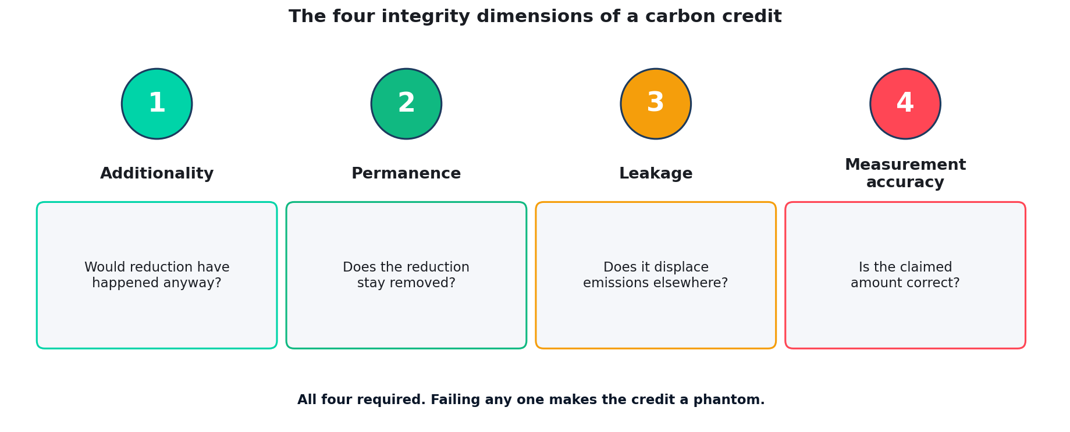
The four integrity dimensions of a carbon credit
Quidnug · Carbon Credits
27 / 75

Slide 28
Dimension 1: additionality
▸ Would the emission reduction have happened anyway? If yes, the credit is not additional. Not a real reduction.
▸ The counterfactual. What would have happened without the project? Hard to measure precisely.
▸ Non-additional examples. Renewable energy credits in markets where renewables are already cheapest option. REDD+ credits in areas not actually at deforestation risk.
▸ Current approach. Project developer argues additionality. VVB accepts or rejects. Often accepted generously.
▸ Substrate approach. Counterfactual signed by independent data source (satellite + economic model). Additionality becomes verifiable.
Quidnug · Carbon Credits
28 / 75

Slide 29
Dimension 2: permanence
▸ Does the reduction stay removed? Forest sequestered carbon can be released by future fire, disease, land-use change.
▸ Forest permanence = ~40-100 years typical. Well below atmospheric CO2 residence time (~1000 years for some fraction).
▸ Geological sequestration (DAC + storage). Effective permanence. Millennia.
▸ Current handling. 'Buffer pools' hold some credits in reserve against reversal. Typically 10-30% of issued credits.
▸ Substrate approach. Permanence monitored continuously via satellite. Reversal events are signed events. Automatic credit retirement on reversal.
Quidnug · Carbon Credits
29 / 75

Slide 30
Dimension 3: leakage
▸ Does the reduction cause emissions elsewhere? Protecting forest in area A may push deforestation to area B. Net reduction: less than claimed.
▸ REDD+ is particularly vulnerable. Driver of deforestation (agricultural demand) doesn't disappear. Moves somewhere.
▸ Current handling. Methodologies attempt to discount for leakage. But estimates often based on narrow geographic scope.
▸ Substrate approach. Regional and national satellite monitoring. Signed attestations from multiple independent analysts. Leakage becomes measurable.
▸ Difficult. Leakage is the hardest of the four dimensions. Requires macro-economic modeling plus satellite data.
Quidnug · Carbon Credits
30 / 75

Slide 31
Dimension 4: measurement accuracy
▸ Is the claimed reduction correctly measured? Satellite-based forest biomass measurement has error bars. Gas emissions from landfills are estimates, not direct measurements.
▸ Methodology matters. Same forest can produce different carbon estimates depending on which allometric equations are used.
▸ Current handling. Methodology specifies measurement approach. VVB verifies adherence.
▸ Substrate approach. Raw measurement data signed by sensors / instruments. Analysis scripts signed. Re-computation possible by any party.
▸ Most tractable dimension. Independent data + signed chain makes measurement accuracy most verifiable of the four.
Quidnug · Carbon Credits
31 / 75

Slide 32
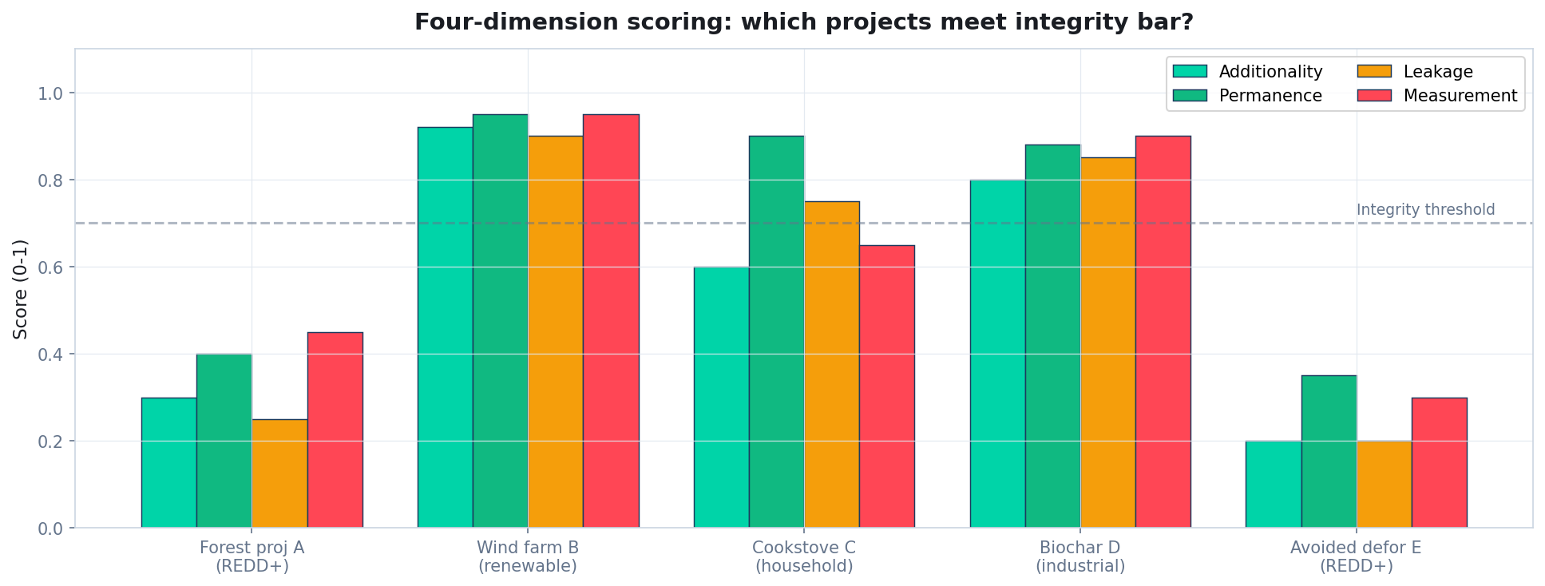
Four-dimension scoring: which projects meet integrity?
A credit can only be high-integrity if all four dimensions meet the threshold.
Quidnug · Carbon Credits
32 / 75

Slide 33
Section 5
Trust-Anchored Attestation Architecture
Signed attestations at each step. Multi-party. Cryptographic.
Quidnug · Carbon Credits
33 / 75

Slide 34
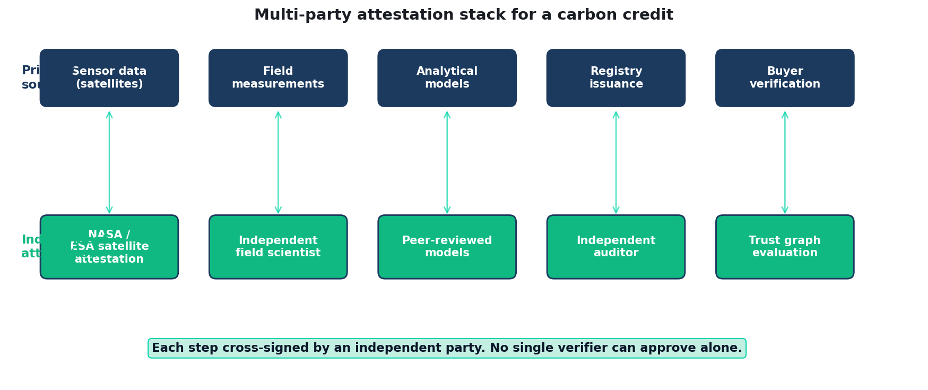
Multi-party attestation stack
Each primary source cross-signed by an independent attesting party.
Quidnug · Carbon Credits
34 / 75

Slide 35
Signed attestations at each step
▸ Satellite data signed at source. NASA MODIS / ESA Sentinel / Planet Labs sign their data cryptographically at acquisition.
▸ Field measurements signed by field teams. Independent field scientists not affiliated with project developer sign observations at collection.
▸ Analytical models signed. Peer-reviewed counterfactual models with signed implementations. Re-runnable by any party.
▸ Auditor signatures carry reputation. VVB signature has computable auditor reputation score attached.
▸ Registry issuance signed with state. Full attestation chain preserved. Buyer sees the whole chain, not just the final claim.
Quidnug · Carbon Credits
35 / 75

Slide 36
Adding independent attestations
▸ NASA signs satellite observations. Public NASA key. Data cannot be altered post-acquisition without breaking signature.
▸ ESA provides independent satellite attestation. Cross-verification with NASA data. Two independent space agencies. Hard to compromise both.
▸ Academic research groups. University forest science departments sign independent analyses.
▸ NGO monitors. Global Forest Watch, Environmental Defense Fund sign independent project reviews.
▸ Each signature is a TRUST edge. Buyer's trust graph decides how to weight each party.
Quidnug · Carbon Credits
36 / 75

Slide 37
The buyer's trust computation
▸ Query: 'What's my exposure to project X's integrity?'
▸ Walk the trust graph. How trustworthy is the VVB? What's NASA's trust weight on their satellite observations? How reliable is the counterfactual model's underlying data?
▸ Aggregate across independent attestations. Multiple signing parties reduce risk of single-source failure.
▸ Apply integrity thresholds. Below threshold: credit rejected. Above: accept at computed confidence.
▸ Result: per-credit quality score. Not issued by registry; computed by buyer from signed evidence.
Quidnug · Carbon Credits
37 / 75

Slide 38
What this changes for buyers
▸ Independent verification of integrity. No longer dependent on registry attestation alone.
▸ Computable quality scores. Can filter credits by integrity threshold. Rejected bad credits before purchase.
▸ Reduced reputational risk. If buyer's public commitment includes integrity standards, they can prove which credits met them.
▸ Better pricing signal. Market can distinguish high-integrity from low-integrity credits. Prices diverge appropriately.
▸ Aligned with regulator direction. EU Green Claims Directive, SEC climate disclosure rules require verifiable claims.
Quidnug · Carbon Credits
38 / 75

Slide 39
What this changes for projects
▸ Higher-integrity projects command premium prices. Market differentiates. Pays for substance.
▸ Lower-integrity projects struggle to sell. Market de-funds them. Projects improve or exit.
▸ Independent verification raises bar. Project developers must actually deliver. Documentation theater insufficient.
▸ Collaboration with data sources. Projects partner with NASA, ESA, academic groups. Transparency becomes a selling point.
▸ Smaller projects can compete. If they meet integrity bar, attestation chain levels the playing field.
Quidnug · Carbon Credits
39 / 75

Slide 40
Section 6
Auditor Reputation Weighting
From reputation-opaque to reputation-computable.
Quidnug · Carbon Credits
40 / 75

Slide 41
The current reputation signal
▸ Accredited VVBs are all formally equal. If accredited by ANSI / UKAS / DAKKS, can sign any methodology.
▸ Buyers cannot tell good from bad VVBs. No public track record of VVB quality.
▸ Rating agencies (BeZero, Sylvera, Calyx) try to fill gap. But their data is proprietary, non-cryptographic, and based on same sources as registries.
▸ Whistleblowers surface egregious cases. E.g., Verra CEO resignation May 2023. But systemic quality differences invisible.
▸ Substrate-based reputation fixes this. Track record made visible, auditable, cryptographically tied to signatures.
Quidnug · Carbon Credits
41 / 75

Slide 42
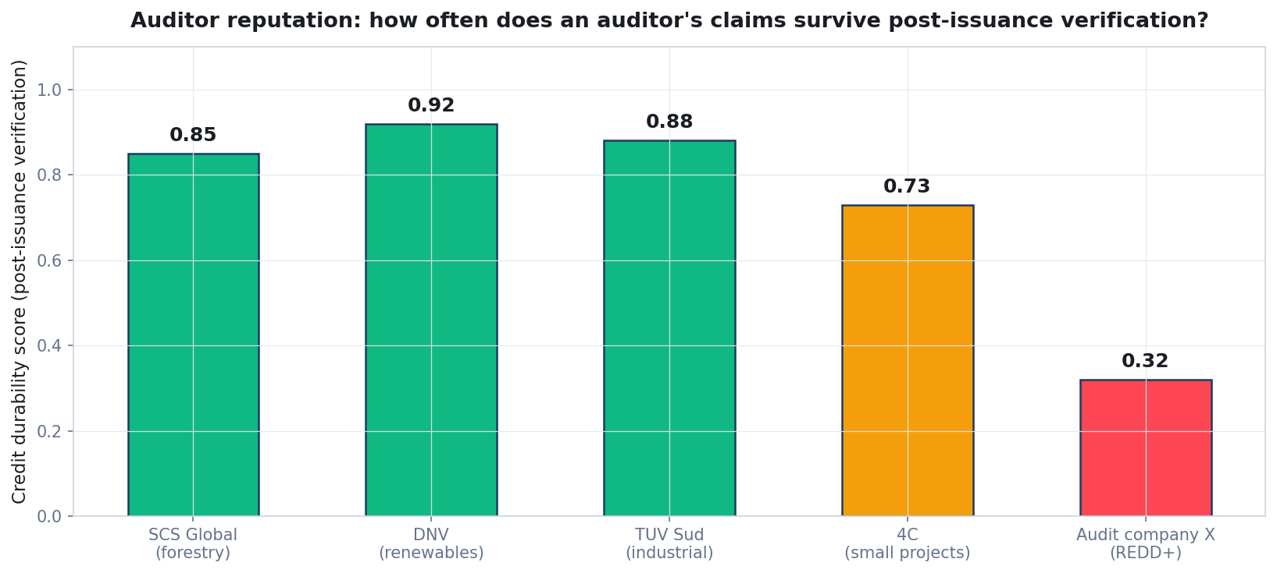
Auditor reputation: how often claims survive?
Illustrative. Reputation = correlation between auditor's approvals and post-issuance independent verification outcomes.
Quidnug · Carbon Credits
42 / 75

Slide 43
Substrate-based verifier reputation
▸ For each VVB, compute over their signature history. How often did their approvals correspond to claims that survived post-issuance independent verification?
▸ Track cumulative behavior. VVBs with consistently high-integrity approvals earn higher reputation.
▸ VVBs approving too loosely face consequences. Reputation drops; buyers discount their signatures; registry market share declines.
▸ Reputation per methodology. VVB can be good at forestry but poor at renewables. Per-domain reputation, not global.
▸ Reputation as computed function. Not opinion. Not PR. Historical data analysis, cryptographically verifiable.
Quidnug · Carbon Credits
43 / 75

Slide 44
The computation
▸ Collect VVB's signature history. All approvals over past 5-10 years.
▸ For each approval, track post-issuance outcome. Did credits survive independent review? Was project re-verified? Did underlying claims hold up?
▸ Multi-factor reputation. Integrity survival rate × volume × recency × domain.
▸ Trust graph aggregation. Other trusted parties' reputation scores for the VVB.
▸ Result: single number per (VVB, methodology, vintage) triple. Buyer's trust-weighted evaluation of the VVB's work.
Quidnug · Carbon Credits
44 / 75

Slide 45
What this changes
▸ VVB quality becomes market-visible. Buyers can select VVBs with high integrity scores.
▸ Project developers reconsider VVB choice. Using a low-reputation VVB may mean credits don't sell. Economic pressure toward rigor.
▸ Bad VVBs either improve or exit. Market selection against low-quality verification.
▸ New VVBs face initial opacity. But substrate provides path to build reputation transparently.
▸ The auditor profession rises. Good auditors earn higher trust. Opaque market becomes meritocratic.
Quidnug · Carbon Credits
45 / 75

Slide 46
The ecosystem effect
▸ Project developer choice of VVB becomes quality signal. Project using top-reputation VVB + willing to pay for rigor is signaling quality.
▸ Project developer choice of registry becomes quality signal. Registry reputation matters; race to the bottom reverses.
▸ Buyer selection criteria. Buyers can require 'VVB reputation > 0.85' + 'registry reputation > 0.8' + 'multi-party attestation.'
▸ Self-reinforcing. Low-integrity projects exit. High-integrity projects command premium.
▸ Over time. The phantom credit problem resolves structurally. Market equilibrium shifts toward integrity.
Quidnug · Carbon Credits
46 / 75

Slide 47
Section 7
Integration with ICVCM and VCMI
How Quidnug composes with existing standards.
Quidnug · Carbon Credits
47 / 75

Slide 48
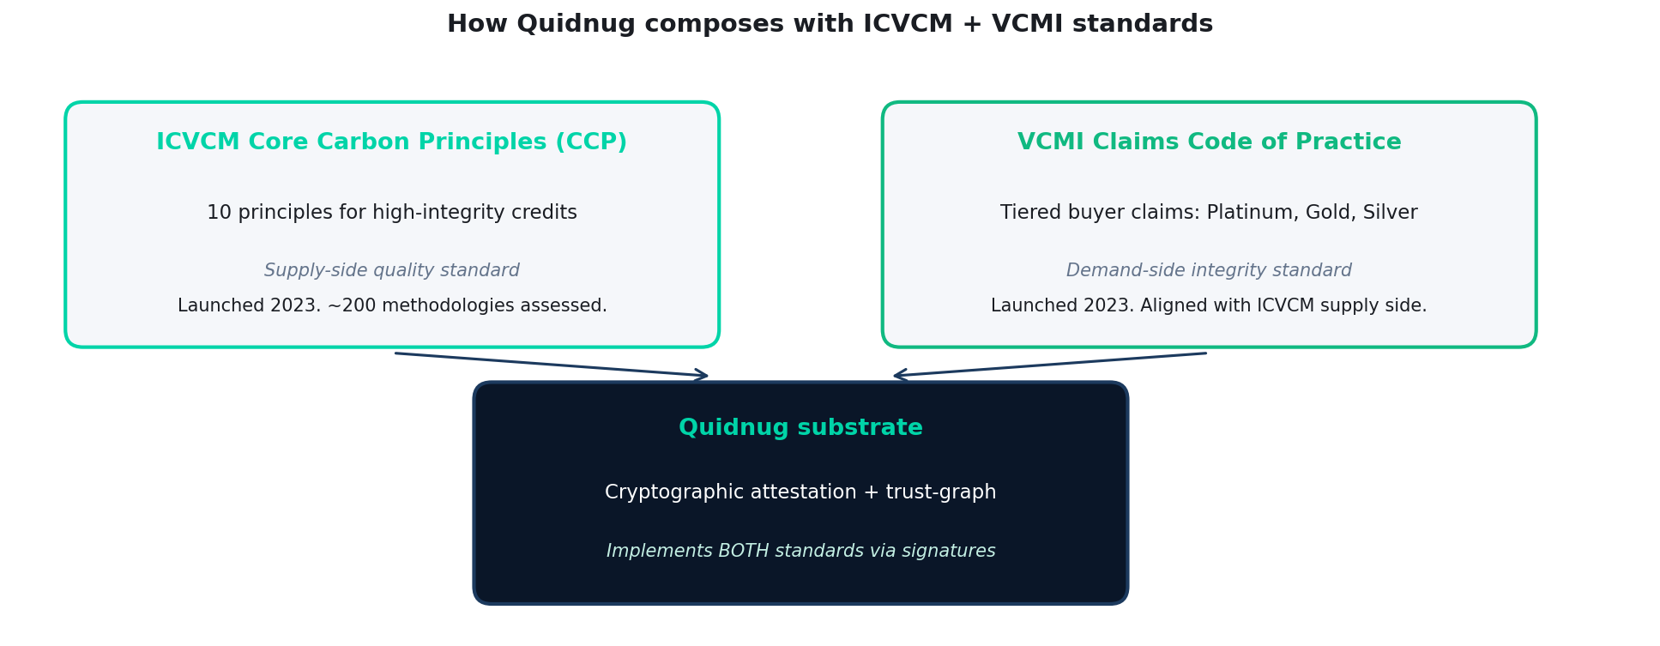
Quidnug composing with ICVCM + VCMI
Quidnug · Carbon Credits
48 / 75

Slide 49
ICVCM Core Carbon Principles
▸ Integrity Council for the Voluntary Carbon Market. Launched 2023 with 10 Core Carbon Principles (CCPs).
▸ Supply-side standard. Certifies methodologies as meeting CCP integrity requirements.
▸ 10 principles. Additionality, permanence, measurement, transparent monitoring, independent verification, no double counting, etc.
▸ Assessment process. ICVCM expert panel reviews methodologies. Approved methodologies receive 'CCP-Approved' label.
▸ Status. ~200 methodologies reviewed as of 2025. Partial list approved. Work ongoing.
Quidnug · Carbon Credits
49 / 75

Slide 50
VCMI Claims Code
▸ Voluntary Carbon Markets Integrity Initiative. Launched 2023 alongside ICVCM. Demand-side standard.
▸ Tiered buyer claims. Platinum: retire 90%+ CCP credits. Gold: 60%+. Silver: partial. Each tier signals buyer commitment.
▸ Designed to pair with ICVCM. Supply-side integrity (ICVCM) + demand-side integrity (VCMI) = full-chain integrity.
▸ Corporate adoption. Microsoft, Salesforce among early adopters. Provides framework for credible climate claims.
▸ Alignment with regulation. EU Green Claims Directive aligning with VCMI Claims Code principles.
Quidnug · Carbon Credits
50 / 75

Slide 51
How the substrate composes
▸ ICVCM assesses methodologies. Quidnug substrate verifies individual projects within those methodologies.
▸ VCMI defines buyer claims. Quidnug substrate provides cryptographic evidence for those claims.
▸ Standards + substrate together. ICVCM says 'this methodology is eligible.' Quidnug says 'this specific project under that methodology has verifiable attestation chain.'
▸ No conflict, no duplication. ICVCM/VCMI provide the rules. Substrate provides the enforcement.
▸ Existing approvals become verifiable. CCP-Approved methodologies become CCP-Approved-AND-verifiable projects.
Quidnug · Carbon Credits
51 / 75

Slide 52
The broader market effect
▸ With substrate deployed. ICVCM approval becomes more credible (methodology-level). VCMI claims become more credible (buyer-level).
▸ Price spreads widen legitimately. High-integrity ICVCM + substrate-verified credits command premium. Low-integrity credits struggle to sell.
▸ Market bifurcation resolved. Current: buyers can't tell integrity. Future: integrity is the primary pricing dimension.
▸ Total market growth. With integrity confidence restored, major buyers return. Market can grow to $10B+ per BNEF optimistic scenario.
▸ Climate impact. If the VCM delivers real reductions at scale, Paris Agreement goals become achievable.
Quidnug · Carbon Credits
52 / 75

Slide 53
Section 8
Worked Example
Evaluating a REDD+ credit batch end-to-end.
Quidnug · Carbon Credits
53 / 75

Slide 54
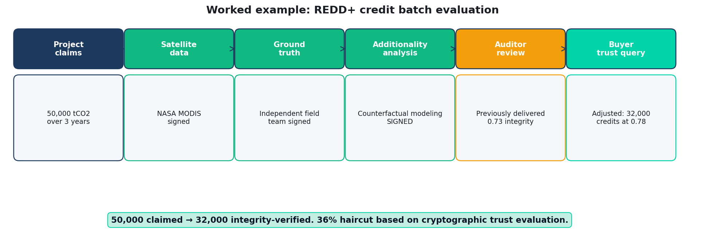
Worked example: REDD+ credit batch evaluation
50,000 credits claimed → 32,000 integrity-verified. 36% haircut based on cryptographic trust evaluation.
Quidnug · Carbon Credits
54 / 75

Slide 55
The scenario
▸ REDD+ project in Brazil state of Para. 100,000 hectares, 3-year vintage (2022-2024).
▸ Project claims. Prevented deforestation of 5,000 hectares per year. 1 hectare prevented = ~10 tCO2e. Total: 50,000 credits per year, 150,000 total.
▸ Methodology. Verra VCS VM0007 (avoided deforestation). Revised 2024 post-crisis.
▸ VVB: DNV. Reputation score 0.84 on REDD+ (from substrate-based history).
▸ Buyer: mid-size corporate. Net-zero commitment. Looking to retire 150,000 credits.
Quidnug · Carbon Credits
55 / 75

Slide 56
The evaluation chain
▸ Step 1: claim verification against NASA MODIS. Independent satellite data signed by NASA. Historical deforestation rate in area verified. Result: project area lost ~1,200 ha/year baseline.
▸ Step 2: counterfactual modeling. Peer-reviewed additionality model signed by University of Oxford team. Expected deforestation without project: ~3,800 ha/year.
▸ Step 3: observed deforestation during project. NASA satellite shows ~1,100 ha/year during project. Reduction: 2,700 ha/year vs counterfactual.
▸ Step 4: conversion to credits. 2,700 ha × 10 tCO2e = 27,000 tCO2e per year. Total over 3 years: 81,000. Haircut from claim: 46%.
▸ Step 5: leakage + permanence adjustments. Further haircut 5-15%. Final: ~68,000 verifiable credits.
Quidnug · Carbon Credits
56 / 75

Slide 57
The decision
▸ Buyer's integrity threshold: 0.70.
▸ Project's computed integrity: 0.78. Above threshold. Credits accepted.
▸ Credit count accepted: 68,000 (not 150,000). 44% haircut relative to original claim.
▸ Pricing. Buyer pays premium ($15-25 per credit vs $3-5 for cheap REDD+). Total: reasonable cost for verified integrity.
▸ Public claim. Buyer can credibly claim 'We retired 68,000 substrate-verified carbon credits.' Cryptographic evidence trail available.
Quidnug · Carbon Credits
57 / 75

Slide 58
Section 9
Adoption and Path Forward
What to do. Who moves first.
Quidnug · Carbon Credits
58 / 75

Slide 59
Who moves first
▸ Major corporate buyers with integrity concerns. Microsoft, Salesforce, Stripe already require substantive integrity evidence. Natural early adopters.
▸ High-quality project developers. Substrate gives them ability to differentiate. Pay more to be verifiably distinct from phantom-credit projects.
▸ Engineered removals. DAC, biochar, mineralization: measurement-driven. Substrate is natural fit.
▸ Nature-based with high integrity. Well-run forest projects with good science. Substrate lets them demonstrate quality.
▸ Sovereign buyers. Singapore's $10B commitment. Tied to integrity standards. Natural use case.
Quidnug · Carbon Credits
59 / 75

Slide 60
Migration path: 5-year roadmap
▸ Year 1. Pilot with one high-integrity registry (Gold Standard or Puro.earth). 10-20 projects. Full stack: signed attestations, VVB reputation.
▸ Year 2. Corporate buyer pilots. Major buyer requires substrate evidence. Creates market pull for project developers.
▸ Year 3. Registry adoption expands. Verra, Gold Standard, ACR all offer substrate-compatible issuance paths.
▸ Year 4. Substrate becomes differentiating feature. Projects without it face discounted prices.
▸ Year 5. Substrate is standard for high-integrity credits. ICVCM/VCMI recognize substrate-verified claims.
Quidnug · Carbon Credits
60 / 75

Slide 61
What to do this year (buyer)
▸ Make substrate a procurement requirement. For credits above $X volume, require cryptographic attestation chain.
▸ Work with 1-2 registries willing to pilot. Gold Standard and Puro.earth most likely partners.
▸ Invest in internal verification tooling. Quidnug SDK + trust graph for carbon credit decisions.
▸ Public commitment to substrate-verified claims. Raises industry bar. Pressures lower-integrity competitors.
▸ Engage ICVCM + VCMI. Substrate adoption strengthens their standards. Alignment is available.
Quidnug · Carbon Credits
61 / 75

Slide 62
What to do this year (registry)
▸ Pilot substrate integration. One methodology, 10-20 projects. Demonstrate operational feasibility.
▸ Partner with NASA/ESA/academic data providers. Integrate their signed data feeds. Pre-establishes independent attestation.
▸ Build VVB reputation tracking. Transparent scoring of verifier quality.
▸ Align with ICVCM + VCMI. Substrate evidence satisfies integrity requirements.
▸ Reposition on integrity. Post-crisis, registry differentiation is integrity. Substrate enables it.
Quidnug · Carbon Credits
62 / 75

Slide 63
What to do this year (project developer)
▸ Sign your project data at source. Satellite data, field observations, analytical models. Start the chain yourself.
▸ Invite independent attestation. Academic partners, NGO monitors. Build multi-party evidence.
▸ Choose high-reputation VVB. Signals quality. Pays off in buyer price.
▸ Public-facing integrity dashboard. Show the substrate evidence. Differentiate from phantom-credit projects.
▸ Higher-integrity projects can charge more. Market now rewards this. No longer race to the bottom.
Quidnug · Carbon Credits
63 / 75

Slide 64
Honest tradeoffs
▸ Substrate adoption requires coordination. No single party can deploy. Registry, VVBs, data providers all needed.
▸ Smaller projects may struggle initially. Substrate tooling not yet accessible to every project. Gradual rollout needed.
▸ Regulatory uncertainty. EU, UK, US regulators still finalizing climate claim requirements. Substrate forward-compatible but not yet standardized.
▸ Cost of independent attestation. NASA/ESA data free. Academic partners willing. But coordination cost real.
▸ Not a silver bullet. Won't fix bad methodologies. Better signal on execution; methodology design still matters.
Quidnug · Carbon Credits
64 / 75

Slide 65
What this does NOT solve
▸ Fundamentally bad methodology. If a methodology is flawed, substrate signs the flawed methodology honestly.
▸ Political conflict over land use. Forest conservation involves indigenous rights, sovereignty, land tenure. Substrate cannot arbitrate.
▸ The fundamental counterfactual problem. What would have happened without the project? Always estimation. Substrate can record measurements; judgment still required.
▸ Climate impact scale. Even a perfect VCM is a small fraction of global emission reduction needed. Offsets are complement, not substitute.
▸ Carbon bubble risk. Aggregate demand for offsets could exceed real supply. Substrate helps distinguish; doesn't grow supply.
Quidnug · Carbon Credits
65 / 75

Slide 66
Summary: the four claims revisited
▸ 1. The phantom-credit problem is an attestation architecture problem. Not methodology tweaking; not regulatory tweaking.
▸ 2. Current verification has structural conflicts of interest. Project developer pays verifier. Market incentives misalign.
▸ 3. Multi-party cryptographic attestation plus trust-weighted auditors solve both. Structural, not procedural.
▸ 4. This composes with ICVCM + VCMI, not against them. Existing standards become mechanically verifiable.
Quidnug · Carbon Credits
66 / 75

Slide 67
What success looks like in 2031
▸ Substrate-verified credits are market default. Credits without substrate evidence trade at discount.
▸ VCM grows to $10B+. With integrity confidence restored, major buyers return. Paris Agreement goals achievable.
▸ Phantom credits drop to <5% of market volume. Structural detection makes them uneconomic.
▸ Rating agencies augment substrate. BeZero, Sylvera, Calyx still valuable; now based on substrate evidence rather than alternative to it.
▸ Corporate climate claims become credible. EU Green Claims Directive + substrate evidence = credible net-zero commitments.
Quidnug · Carbon Credits
67 / 75

Slide 68
References
▸ West et al. 2023. 'Action needed to make carbon offsets from forest conservation work for climate change mitigation.' Science 381, 873-877.
▸ Guardian + Die Zeit + SourceMaterial (January 2023). REDD+ investigation.
▸ Cooley et al. 2022. Cookstove carbon credit analysis.
▸ Gill-Wiehl et al. 2024. Cookstove update, persistent over-crediting.
▸ Thomas et al. 2023. California forest offset analysis.
▸ ICVCM Core Carbon Principles. icvcm.org. 10 principles + methodology assessments.
▸ VCMI Claims Code. vcmintegrity.org.
▸ Ecosystem Marketplace (Forest Trends). Annual VCM sizing reports.
Quidnug · Carbon Credits
68 / 75

Slide 69
More references
▸ EU Green Claims Directive (2024). europa.eu. Regulatory requirement for substantiated environmental claims.
▸ SEC Climate Disclosure Rule (March 2024). Proposed, partially stayed. Evolving regulatory framework.
▸ CDP reporting framework. cdp.net. Voluntary corporate climate disclosure.
▸ Science Based Targets initiative (SBTi). sciencebasedtargets.org. Net-zero target validation.
▸ Verra VCS standard. verra.org. Largest voluntary registry.
▸ Gold Standard. goldstandard.org.
▸ Puro.earth. puro.earth. Engineered removals registry.
▸ Companion blog post. blogs/2026-04-27-carbon-credits-are-being-gamed.md.
Quidnug · Carbon Credits
69 / 75

Slide 70
Common objections, briefly
▸ 'Carbon offsets are inherently problematic.' Real concern. Substrate doesn't solve; it ensures offsets claim what they deliver.
▸ 'Voluntary markets will never work.' Possible. But failing VCM replaced by regulated markets that face same verification challenges.
▸ 'Substrate is premature.' Disagree. Crisis is now. Delaying means phantom credits continue dominating.
▸ 'Too complex for small buyers.' Complexity mostly hidden behind tooling. Buyer sees 'substrate-verified: yes/no.'
▸ 'Registries won't cooperate.' Some will. Market pressure will force others. Post-crisis, no registry wants to be known for phantom credits.
Quidnug · Carbon Credits
70 / 75

Slide 71
One-line summary
“
The $900B ESG market's phantom credit problem is not a methodology problem or a regulatory problem. It is a trust architecture problem. Architecture can be fixed.
— The core thesis
Quidnug · Carbon Credits
71 / 75

Slide 72
Next steps
▸ This week. Audit your current offset portfolio integrity.
▸ This month. Read West et al. 2023 + ICVCM CCPs.
▸ This quarter. Pilot substrate-verified credits (small batch).
▸ This year. Require substrate for major purchases.
▸ Next year. Substrate-verified becomes default.
Quidnug · Carbon Credits
72 / 75

Slide 73
Things we owe ourselves
▸ Transparent methodology assessment. ICVCM + industry consortium.
▸ Open standards for substrate. Quidnug protocol is open; others should exist too.
▸ Independent scientific attestation infrastructure. NASA/ESA already provide. Academic + NGO partnerships needed.
▸ Regulator engagement. EU, UK, US, Singapore. Substrate should align with evolving regulation.
▸ Education for the buyer side. Most corporate sustainability teams underwater on carbon integrity technicals.
Quidnug · Carbon Credits
73 / 75

Slide 74
One-line call to action
“
We do not need better methodologies. We need cryptographic substrate that makes existing methodologies auditable. The tools exist. The political will does not.
— The call to action
Quidnug · Carbon Credits
74 / 75

Slide 75
Questions
Thank you. The climate transition needs integrity.
Where does the substrate architecture fail in your use case? Which adoption constraint matters most? What's your next concrete step?
Resources
github.com/quidnug/quidnug
blogs/2026-04-27-carbon-credits-are-being-gamed.md
West et al. 2023 (Science)
ICVCM: icvcm.org
VCMI: vcmintegrity.org
Guardian REDD+ investigation (January 2023)
Ecosystem Marketplace Annual Reports
Quidnug · Carbon Credits
75 / 75

