Slide 1
QUIDNUG · LIFE SCIENCES
Clinical Trial Data Integrity
How tamper-evident event streams replace ALCOA+ paper-trail compliance, and why FDA inspectors will prefer them.
Quidnug · Clinical Trial Data Integrity
1 / 75

Slide 2
Where we are in 2026
241
FDA 483 data integrity observations in 2024 alone.
5x growth over a decade. The ALCOA+ paper-era framework is failing to prevent systematic data integrity problems.
Quidnug · Clinical Trial Data Integrity
2 / 75

Slide 3
The cost of getting this wrong
$2.5M
average cost of remediating an FDA warning letter for data integrity (Deloitte 2023 industry survey).
Plus potential delays to approval, revenue loss, and reputation damage. The economic case for better substrate is overwhelming.
Quidnug · Clinical Trial Data Integrity
3 / 75

Slide 4
Agenda
▸ 1. ALCOA+ explained. Origin, principles, electronic-record transposition, trust gap.
▸ 2. 21 CFR Part 11 and its failure modes. Key requirements, typical implementations, where they fall apart.
▸ 3. Major fraud cases. Ranbaxy, Theranos, Olympus, Valeant, Duke Potti. Common patterns.
▸ 4. Multi-party trial structure. 8+ parties per trial, current data flow, integrity risks.
▸ 5. Tamper-evident event streams. Per-subject event chain, cross-party signatures, PHI handling.
▸ 6. Worked example. Phase III cardiovascular endpoint adjudication, end-to-end.
▸ 7. Inspector experience. Current vs substrate-enabled inspection workflows.
▸ 8. Integration and adoption. EDC systems, compliance mapping, migration path.
Quidnug · Clinical Trial Data Integrity
4 / 75

Slide 5
Four claims this talk defends
▸ 1. ALCOA+ was designed for paper. Electronic-record transposition works in principle but collapses in the details.
▸ 2. 21 CFR Part 11 compliance is theater at most sponsors. Per-user audit logs inside a system the sponsor controls is not meaningful tamper evidence.
▸ 3. Multi-party cryptographic signatures change the threat model. Sponsor cannot unilaterally rewrite the record.
▸ 4. This is operationally feasible today. EDC vendors, CROs, sites can adopt in phases. Regulators will PREFER it once deployed.
Quidnug · Clinical Trial Data Integrity
5 / 75

Slide 6
Section 1
ALCOA+ Explained
Origin, principles, and the transposition problem.
Quidnug · Clinical Trial Data Integrity
6 / 75

Slide 7
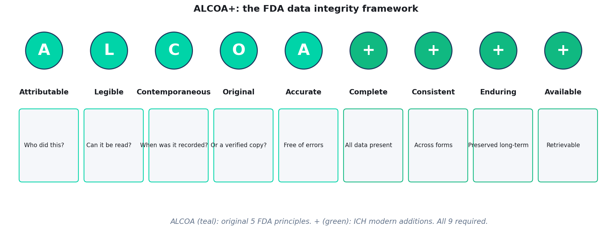
The ALCOA+ framework
ALCOA (1990s FDA): Attributable, Legible, Contemporaneous, Original, Accurate. + (modern ICH): Complete, Consistent, Enduring, Available.
Quidnug · Clinical Trial Data Integrity
7 / 75

Slide 8
Origin story: why ALCOA existed
▸ Coined by Stan Woollen (FDA) in the 1990s. Articulated data integrity expectations for pharmaceutical submissions.
▸ Paper era context. Lab notebooks, paper CRFs, wet-ink signatures, file cabinets. Controls were physical: locked cabinets, signed-out pens, numbered pages.
▸ ALCOA as mnemonic. Inspectors could check: was this record attributable, legible, contemporaneous, original, accurate?
▸ Each principle had a paper-era operational meaning. 'Contemporaneous' meant 'recorded at the time of the observation, not copied later.'
▸ Expanded to ALCOA+ in ICH E6(R2) and EMA GMP Annex 11. Four additional principles for complex multi-site electronic records.
Quidnug · Clinical Trial Data Integrity
8 / 75

Slide 9
The electronic-record transposition
▸ Attributable. Paper: signature on each page. Electronic: username + timestamp in audit log.
▸ Legible. Paper: readable handwriting. Electronic: renderable format, accessible indefinitely.
▸ Contemporaneous. Paper: date stamp at recording. Electronic: system timestamp at entry, no post-hoc editing.
▸ Original. Paper: source document. Electronic: authoritative version vs working copies.
▸ Accurate. Paper: correction with initialing. Electronic: validated inputs + edit checks.
Quidnug · Clinical Trial Data Integrity
9 / 75

Slide 10
The trust gap
▸ Electronic records have ALL the formal ALCOA properties. Username? Check. Timestamp? Check. Audit log? Check.
▸ But. Every control is internal to the sponsor's system. The same sponsor runs the database, owns the audit log, writes the validation procedures.
▸ Self-attestation at scale. A sophisticated actor can rewrite the audit log, backdate entries, manipulate timestamps.
▸ Inspectors cannot independently verify. They see what the system shows them. If the system was manipulated, inspectors see the manipulated version.
▸ ALCOA in letter. Not in spirit. Paper-era controls depended on physical impossibility of certain manipulations. Electronic controls depend on trusting the system owner.
Quidnug · Clinical Trial Data Integrity
10 / 75

Slide 11
The architectural diagnosis
“
Paper-era controls were physical. Electronic-era controls require cryptographic substrate. We've had the first for 50 years and are still waiting for the second.
— The architectural diagnosis
Quidnug · Clinical Trial Data Integrity
11 / 75

Slide 12
Section 2
21 CFR Part 11 and Its Failure Modes
The rule that governs electronic records in FDA-regulated industries.
Quidnug · Clinical Trial Data Integrity
12 / 75

Slide 13
21 CFR Part 11: key requirements
▸ Electronic signatures legally equivalent to handwritten. Title 21 of the Code of Federal Regulations, Part 11. Signed into force March 1997.
▸ Required controls. Audit trails showing who did what and when. Validation of electronic systems. Access controls. Time-stamped records.
▸ Electronic signature requirements. Biometric OR password + second factor. Linked to the signed record. Cannot be copied to another record.
▸ Validation. Documented evidence that the system does what it's supposed to do, consistently.
▸ Covers any electronic record submitted to FDA. Clinical trial data, manufacturing batch records, adverse event reports.
Quidnug · Clinical Trial Data Integrity
13 / 75

Slide 14
Typical compliance implementation
▸ Password protection on EDC system. Monthly password rotation. Second factor usually email-based, sometimes SMS.
▸ Audit trail as database table. Row per change event: user, timestamp, old value, new value.
▸ Validation package. Hundreds of pages of test protocols and evidence. Updated for each system version.
▸ Access control. Role-based: investigator, monitor, sponsor, CRO. Each role sees different subset of data.
▸ This is the industry-standard implementation. Every major EDC vendor ships this. Compliance boxes all checked.
Quidnug · Clinical Trial Data Integrity
14 / 75

Slide 15
Where this fails
▸ All audit trails live in the sponsor's (or vendor's) database. Whoever controls the database controls the audit trail.
▸ Database administrators can modify audit trails. DBA credentials bypass every application-layer control. If a DBA is compromised (or coerced, or motivated), audit records can be altered.
▸ Backup restoration can overwrite history. 'We had to restore from backup after a system issue.' Plausible-sounding excuse for losing inconvenient records.
▸ Vendor of the EDC system has access. Medidata, Veeva, Oracle run the infrastructure. Their employees can theoretically access your trial data.
▸ Inspectors see what the system shows them. They have no way to independently verify the audit trail wasn't modified before their visit.
Quidnug · Clinical Trial Data Integrity
15 / 75

Slide 16
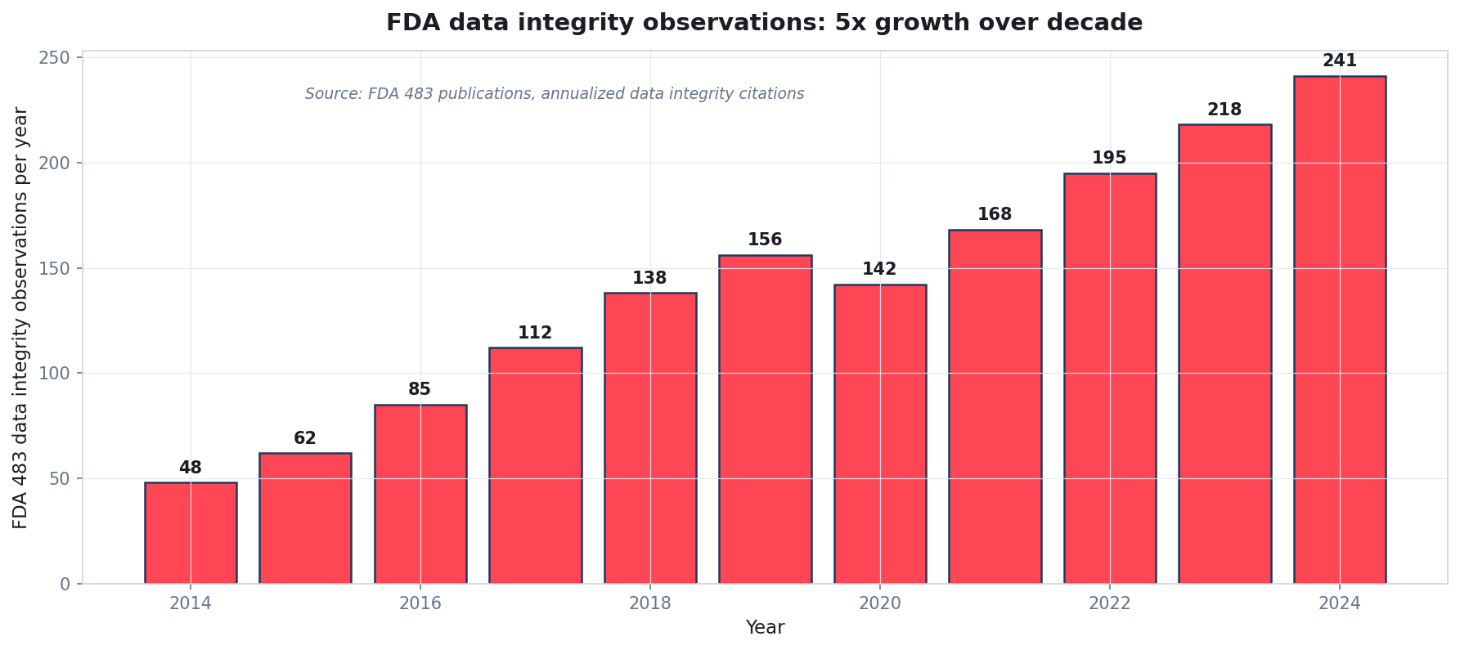
FDA data integrity warning letters: 5x growth
Source: FDA Warning Letter database, filtered for data integrity observations (21 CFR 11.10 violations).
Quidnug · Clinical Trial Data Integrity
16 / 75

Slide 17
Warning letter examples
▸ Most common observation: 'audit trails were not reviewed.' Companies have audit trails but don't review them. Accountability theater without accountability.
▸ Second most common: 'CAPA for data integrity issue inadequate.' Issues discovered by inspectors are then inadequately remediated. Pattern of non-escalation.
▸ Third most common: 'retesting without documentation.' Running tests multiple times until one produces the desired result. A form of p-hacking on regulatory data.
▸ Fourth: 'sharing of login credentials.' Attributability collapses when multiple people use the same username.
▸ Fifth: 'backdated entries.' Recording observations later with a falsified earlier timestamp. Contemporaneous principle violated.
Quidnug · Clinical Trial Data Integrity
17 / 75

Slide 18
GAMP 5 as it actually operates
▸ Good Automated Manufacturing Practice (ISPE). Validation framework for pharmaceutical software. 5th edition published 2008, 2nd ed 2022.
▸ Risk-based approach. Validation effort proportional to patient safety and data integrity impact.
▸ What it requires. User requirements, functional specifications, design specifications, IQ/OQ/PQ test protocols, validation reports.
▸ What it actually produces. Thousands of pages of documentation. Regulatory expectation met. Cost: millions per system.
▸ What it does not produce. Guarantees the system wasn't compromised, modified, or corrupted since validation. That requires ongoing cryptographic verification.
Quidnug · Clinical Trial Data Integrity
18 / 75

Slide 19
Section 3
Major Fraud Cases
Five high-profile cases. Common patterns. What would have changed.
Quidnug · Clinical Trial Data Integrity
19 / 75

Slide 20
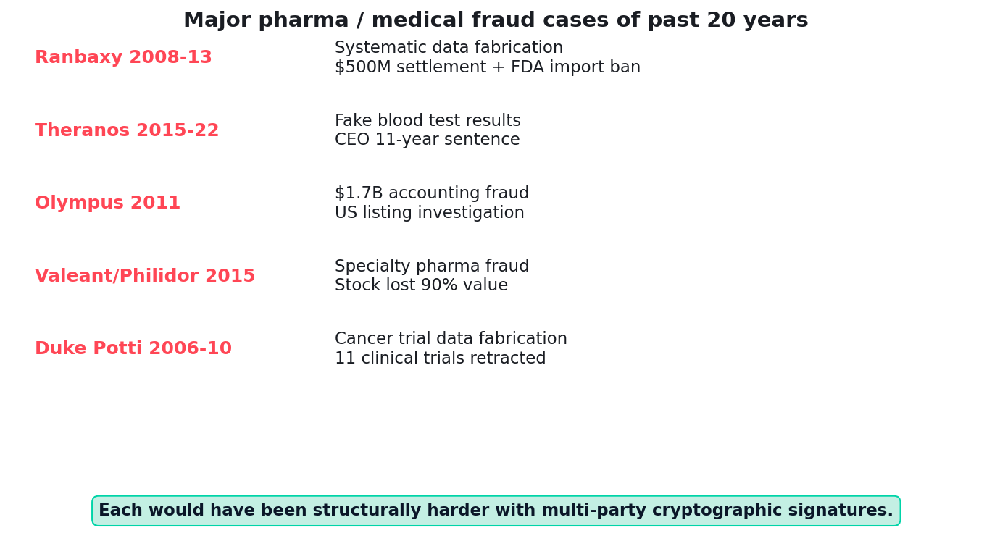
Five major pharma / medical fraud cases
Each case took years to surface and cost billions in aggregate harm.
Quidnug · Clinical Trial Data Integrity
20 / 75

Slide 21
Ranbaxy 2008-2013: the scale case
▸ Indian generic manufacturer, largest in India at the time.
▸ Whistleblower revealed systematic data fabrication. Stability data invented. Tests not actually performed. Batches released without verification.
▸ Scale. Affected products for decades. Numerous APIs and finished dosage forms.
▸ Outcome. 2013: $500M criminal + civil settlement. US import ban on specific facilities. Ranbaxy sold to Sun Pharma.
▸ How substrate would have helped. Independent signed lab records would have made fabrication detectable. Instruments that sign test results directly remove the lab technician's ability to invent data without caught signatures.
Quidnug · Clinical Trial Data Integrity
21 / 75

Slide 22
Theranos 2015-2022: the brand case
▸ Elizabeth Holmes's blood-testing startup, valued $9B at peak.
▸ Fraud: Edison device performed only 12 of 200+ advertised tests. Other tests secretly run on Siemens competitor machines, with Theranos-branded results sent back.
▸ Internal culture of secrecy prevented detection. Employees who questioned results were isolated or terminated.
▸ Outcome. Theranos dissolved 2018. Holmes 11-year sentence (2022). Former president Sunny Balwani 13 years.
▸ How substrate would have helped. Instrument-signed test results would have made the Edison's limited capability impossible to obscure. Regulatory inspectors would have seen the pattern much earlier.
Quidnug · Clinical Trial Data Integrity
22 / 75

Slide 23
Duke Potti 2006-2010: the trial data case
▸ Anil Potti at Duke Cancer Institute. Published chemosensitivity predictions from microarray analyses in Nature Medicine and elsewhere.
▸ Started enrolling patients in 3 cancer trials based on the predictions. Publications were later shown to have fabricated data.
▸ Whistleblowers: biostatisticians Keith Baggerly and Kevin Coombes. Found the fabrication through independent re-analysis of raw data the journals required.
▸ Outcome. Potti resigned 2010. 11 papers retracted. Trials halted. Multiple patient lawsuits. Duke settled out of court.
▸ How substrate would have helped. If raw data had provenance chain from instrument to publication, fabrication would be detectable automatically. Re-analysis is unnecessary if the chain itself is tamper-evident.
Quidnug · Clinical Trial Data Integrity
23 / 75

Slide 24
The common pattern
▸ Internal data controlled by interested party. Whether sponsor, CRO, or principal investigator.
▸ Review processes depend on the interested party. They pick reviewers, provide data to reviewers, remediate findings.
▸ External verification is either not possible or very expensive. FDA inspections happen, but are infrequent and constrained by what the system shows.
▸ Whistleblowers are the primary detection mechanism. Insider with conscience plus willingness to be retaliated against is our data integrity safeguard. Not sustainable.
▸ Multi-party cryptographic signatures change all of this. No single party can unilaterally rewrite the record. Verification becomes mechanical, not dependent on whistleblowers.
Quidnug · Clinical Trial Data Integrity
24 / 75

Slide 25
Section 4
The Multi-Party Structure of a Clinical Trial
8+ parties. Each with distinct interests. All must agree on the data.
Quidnug · Clinical Trial Data Integrity
25 / 75

Slide 26
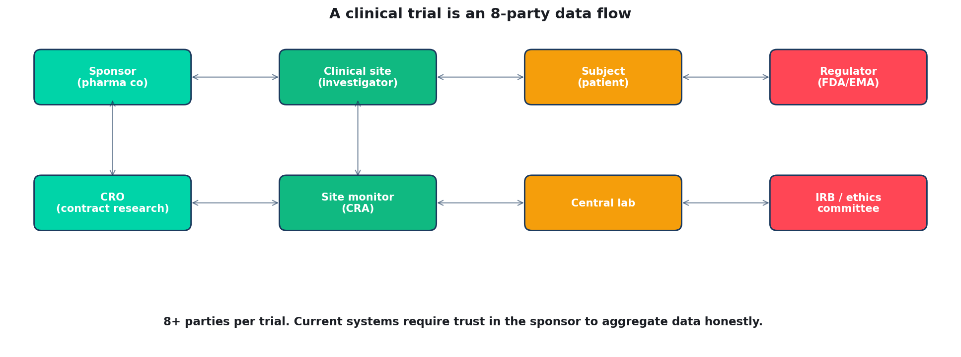
Clinical trial: 8+ parties per typical Phase III
Each party produces or touches trial data. Current system requires trust in ONE party (sponsor) to aggregate all data honestly.
Quidnug · Clinical Trial Data Integrity
26 / 75

Slide 27
The parties in detail
▸ Sponsor. Pharmaceutical company funding the trial. Owns the data. Has most to gain from favorable outcomes.
▸ CRO (Contract Research Organization). Pharma outsource. Data management, statistical analysis, regulatory submissions. Paid by sponsor.
▸ Clinical site investigator. Physician running the trial at a specific hospital or clinic. Enrolls patients, administers interventions, records outcomes.
▸ Site monitor (CRA). Independent verifier from CRO. Visits sites, checks data entry against source documents.
▸ Subject (patient). Signs informed consent, receives interventions, reports adverse events. Whose data is this?
▸ Central lab, IRB, regulator. Additional parties with specialized roles. Each produces signed artifacts.
Quidnug · Clinical Trial Data Integrity
27 / 75

Slide 28
Current data flow
▸ Subject is examined at site. Investigator records observation in electronic case report form (eCRF).
▸ Monitor visits site periodically. Checks eCRF entries against source documents (patient medical record, lab reports, etc).
▸ Data goes into sponsor's EDC system. Medidata Rave, Veeva Vault, Oracle InForm. Vendor infrastructure, sponsor configuration.
▸ Sponsor (or CRO) analyzes. Statistical analysis, safety reporting, interim analyses, final reports.
▸ Submissions to regulator. Via electronic submissions gateway (FDA ESG, EMA CESP). Regulator reviews; may conduct inspection.
Quidnug · Clinical Trial Data Integrity
28 / 75

Slide 29
Why this structure has integrity risks
▸ Sponsor has economic incentive to favorable outcomes. Billions of dollars hang on Phase III success.
▸ CRO reports to sponsor. Not an independent adjudicator; paid by the party whose product is being tested.
▸ Sites are also under pressure. Enrollment targets, deviation minimization, not looking like a 'difficult site' for future contracts.
▸ Monitors perform source data verification on a sample. Usually 10-15%. Most data is not independently verified.
▸ Single point of data aggregation. Sponsor's EDC. If that data is incorrect (accidentally or deliberately), everything downstream is wrong.
Quidnug · Clinical Trial Data Integrity
29 / 75

Slide 30
What multi-party signed attestation changes
▸ Each party's contribution is signed independently. Subject signs consent. Site investigator signs data entry. Central lab signs results. Each goes into a shared event stream.
▸ Cross-verification becomes cryptographic. Monitor's SDV visit produces a signed attestation: 'I verified entries X, Y, Z match source documents.' That attestation goes into the chain.
▸ No party can unilaterally alter records. Sponsor's signature doesn't override site's signature. The chain preserves every signatory.
▸ Regulators see the full chain. Can verify each signature independently. No need to trust the sponsor's aggregation.
▸ Structural property. ALCOA compliance becomes a mechanical consequence, not an organizational practice.
Quidnug · Clinical Trial Data Integrity
30 / 75

Slide 31
The structural shift
“
Tamper-evidence requires no party to be trusted. Sponsor, CRO, site, regulator, patient each sign independently. The record becomes multi-party verified by construction.
— The structural shift
Quidnug · Clinical Trial Data Integrity
31 / 75

Slide 32
Section 5
Tamper-Evident Event Streams Applied to Trial Data
Per-subject event chain, cross-party signatures, PHI handling.
Quidnug · Clinical Trial Data Integrity
32 / 75

Slide 33
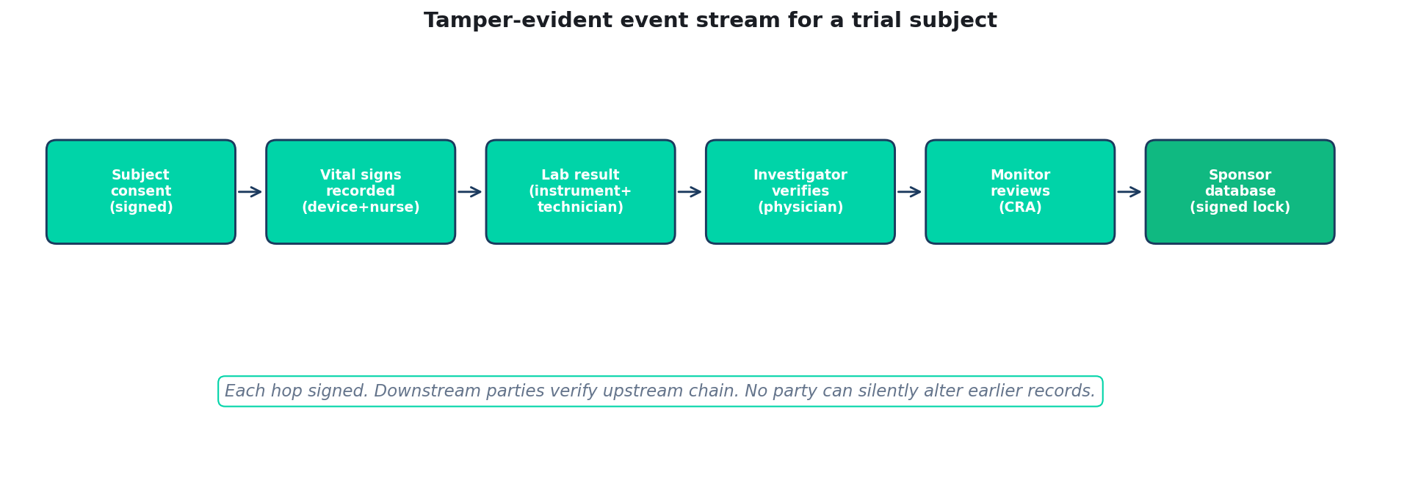
Per-subject event stream: chain of custody
Quidnug · Clinical Trial Data Integrity
33 / 75

Slide 34
Per-subject event stream: structure
▸ Each trial subject has a signed event stream. Identified by a pseudonymous quid (not PHI). Chain begins at informed consent.
▸ Events flow into the stream chronologically. Consent signed, screening visit, randomization, interventions administered, follow-up visits, adverse events, endpoint adjudication.
▸ Each event signed by the observing party. Investigator for physical exam findings. Nurse for vitals. Lab for test results. Patient for patient-reported outcomes.
▸ Each event references prior events. Continuous chain. No gaps possible.
▸ At study end. Every subject's full trial history is a verified, tamper-evident record. Available to sponsor, CRO, regulator independently.
Quidnug · Clinical Trial Data Integrity
34 / 75

Slide 35
Cross-party signatures
▸ Source Data Verification (SDV) as signed attestation. Monitor reviews entries. If they match source, monitor signs: 'I verified these entries against source on date X.'
▸ Discrepancies also signed. 'Entry N says 98.5 F; source says 98.6 F. Discrepancy logged.'
▸ Adjudication committees sign. Endpoint adjudication panels sign their consensus determinations. Independent of sponsor.
▸ IRB continuing reviews sign. 'IRB reviewed this site on date Z. Found: [findings]. Approval continues.'
▸ Sponsor signs aggregations. Sponsor's statistician signs final analysis. Aggregation from signed source events; anyone can recompute to verify.
Quidnug · Clinical Trial Data Integrity
35 / 75

Slide 36
Source data verification 2.0
▸ Current SDV. Monitor visits site. Samples ~10% of entries. Checks against source documents. Writes report.
▸ Risk-based SDV (RBM). Focus on high-risk data points (endpoints, serious AEs). Reduces cost but still sample-based.
▸ Substrate-enabled SDV. Source documents themselves cryptographically signed at source. Match with EDC entries becomes automated.
▸ Remote SDV. If source is signed at instrument / patient record, monitor's job is reduced to reviewing signatures. Mostly remote. Site visits only for training + investigator relationship.
▸ 100% SDV becomes feasible. Every entry automatically verified against signed source. No sampling.
Quidnug · Clinical Trial Data Integrity
36 / 75

Slide 37
What becomes automatically detectable
▸ Fabricated data. Missing instrument signature = unsignable = unacceptable. Stapel / Potti-style fabrication becomes structurally infeasible.
▸ Backdated entries. Cryptographic timestamps at entry. Retrospective modification breaks signature chain.
▸ Credential sharing. Each signature links to a specific quid. Login sharing becomes visible.
▸ Database tampering. Chain-hash verification at every read. Any database modification breaks the chain visibly.
▸ Statistical anomalies. Signed event streams are queryable. Benford's-law analysis, p-curve analysis, ratio tests all work better on structured signed data.
Quidnug · Clinical Trial Data Integrity
37 / 75

Slide 38
Privacy and PHI
▸ Subject identity must be protected. HIPAA, GDPR, state and country privacy laws apply.
▸ Pseudonymous quids. Subject identified by a Quidnug quid, not by name. Pseudonym mapping stored separately at site.
▸ PHI stored off-chain. Encrypted at rest at the site. Signatures cover hashes of PHI, not the PHI itself.
▸ Selective disclosure to regulators. With subject consent or court order, pseudonym can be linked to identity for specific regulatory queries.
▸ Provenance without PHI exposure. Provenance chain is verifiable without revealing protected health information.
Quidnug · Clinical Trial Data Integrity
38 / 75

Slide 39
Section 6
Worked Example: Phase III Endpoint Adjudication
A real Phase III cardiovascular trial workflow.
Quidnug · Clinical Trial Data Integrity
39 / 75

Slide 40
The scenario
▸ Phase III cardiovascular outcomes trial. Primary endpoint: composite of cardiovascular death, MI, stroke.
▸ 6,000 subjects enrolled at 185 sites in 23 countries. 4-year follow-up. Hundreds of endpoint events expected.
▸ Independent adjudication committee. Cardiologists not affiliated with sponsor review each potential endpoint event.
▸ Complex data flow. Site investigator reports event. Central AE committee reviews. Adjudication committee classifies. Final statistical analysis.
▸ Where integrity matters most. Each endpoint classification directly affects study outcome. Adjudication is the highest-stakes judgment in the trial.
Quidnug · Clinical Trial Data Integrity
40 / 75

Slide 41
The endpoint event flow
▸ Subject experiences potential endpoint event. Patient has chest pain. Reports to site. Investigator initiates workup.
▸ Investigator documents + signs. Signs: 'Subject X reported chest pain at T. Workup showed Y. Hospitalized for Z hours. Discharge diagnosis: myocardial infarction.'
▸ Central lab processes samples. Troponin, ECG. Each signs its results. Linked to subject's event stream.
▸ Adjudication committee receives blinded case file. 3 cardiologists independently classify. Each signs their determination.
▸ Final consensus. If agreement: signed consensus. If disagreement: committee meets, resolves, signs reasoning.
Quidnug · Clinical Trial Data Integrity
41 / 75

Slide 42
What inspections can verify
▸ Inspector queries subject X's event stream. Sees investigator signature, lab signatures, adjudication signatures. Each independently verified.
▸ Inspector verifies adjudication independence. Adjudicators are different quids from sponsor. Their signatures cryptographically prove non-sponsor identity.
▸ Inspector spot-checks cross-signatures. Pulls 20 endpoints. Verifies chain for each. If all verify, confidence is very high. If any don't, targeted investigation.
▸ Inspector can query across studies. 'Show me all endpoints adjudicated by this committee across sponsor studies.' Pattern analysis becomes feasible.
▸ Compare to current inspections. Inspector travels to sponsor HQ. Views reports produced by sponsor. Very limited independent verification possible.
Quidnug · Clinical Trial Data Integrity
42 / 75

Slide 43
If something goes wrong
▸ Investigator backdates event. Timestamp on signature is at signing. Cannot be retrospectively forged without breaking chain. Auto-detected.
▸ Sponsor pressures adjudicator. Adjudicator's signatures on this trial can be compared to adjudicator's pattern across other trials. Outliers visible.
▸ Site fabricates endpoint. No lab signatures corresponding to the fabricated event. Structural impossibility of full fabrication.
▸ Central lab results manipulated. Lab's signatures are independent of sponsor's infrastructure. Requires compromising multiple parties.
▸ CRO re-interprets data. Re-interpretation is a new signed event, not a silent edit. Trail preserved.
Quidnug · Clinical Trial Data Integrity
43 / 75

Slide 44
Section 7
The Inspector Experience
Current vs substrate-enabled inspection workflows.
Quidnug · Clinical Trial Data Integrity
44 / 75

Slide 45
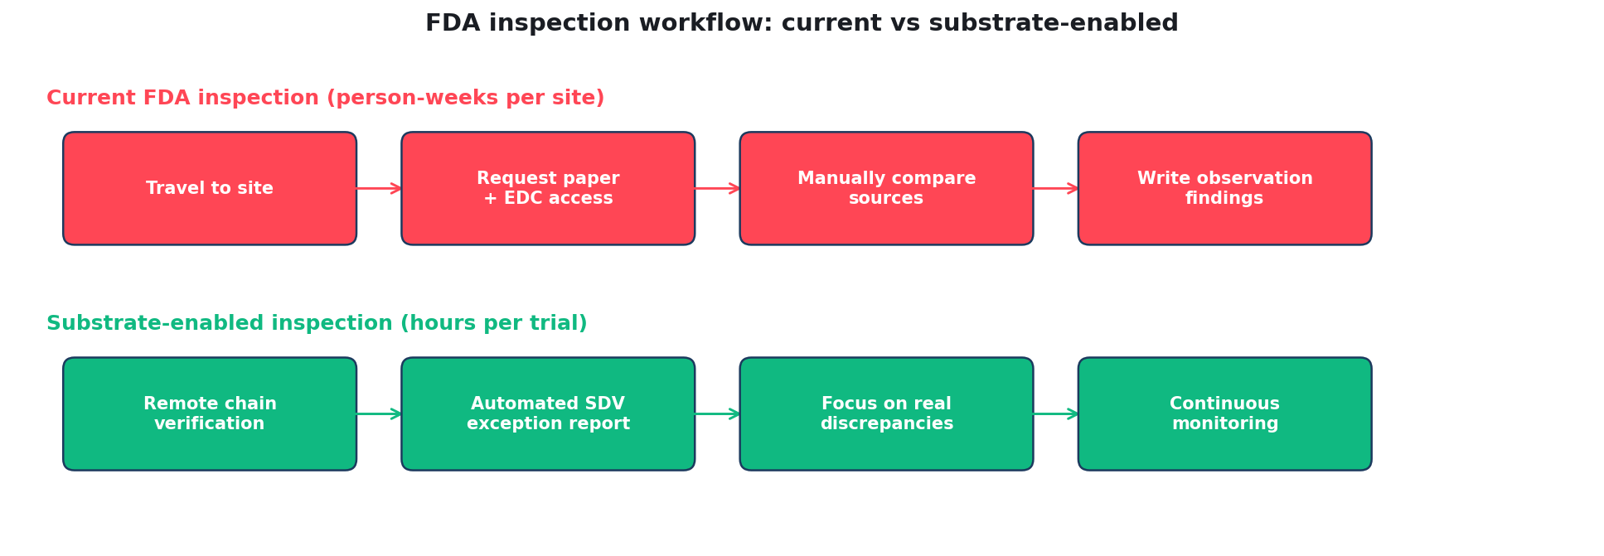
Current vs substrate-enabled inspection
Quidnug · Clinical Trial Data Integrity
45 / 75

Slide 46
Current inspection workflow
▸ Pre-inspection notification. FDA schedules visit to sponsor (or CRO). Typically 2-4 weeks advance notice. Sponsor prepares.
▸ On-site visit. 2-5 days at sponsor HQ. Sometimes additional site visits. Expensive for inspectors; limits frequency.
▸ Document requests. Inspector asks for specific records. Sponsor produces. Inspector reviews.
▸ Discussion. Inspector asks questions. Sponsor explains processes. Inspector takes notes.
▸ Outcome. 483 observations issued if deficiencies found. Sponsor responds. Potentially followed by Warning Letter.
▸ Bottleneck. Very person-intensive. FDA can only inspect a fraction of trials per year.
Quidnug · Clinical Trial Data Integrity
46 / 75

Slide 47
Substrate-enabled inspection workflow
▸ Continuous access to trial event streams. FDA has permissions on the trust network to query any signed artifact. No pre-scheduled visit needed.
▸ Automated anomaly detection. FDA runs queries: 'Show me any trials with signature chain breaks.' 'Show me any adjudication pattern outliers.' Triaged automatically.
▸ Targeted inspection for exceptions. Only trials flagged by automated analysis get on-site visits. 10x more trials can be monitored with same inspector headcount.
▸ On-site focus shifts. From 'verify the data' to 'verify operations produce the expected data.' Training, procedures, culture.
▸ Continuous monitoring. No waiting for annual inspection. Issues visible within days of occurrence.
Quidnug · Clinical Trial Data Integrity
47 / 75

Slide 48
What inspectors can do that they couldn't
▸ Cross-trial pattern detection. 'Does this adjudicator consistently favor one sponsor?' Answerable now.
▸ Cross-sponsor comparison. 'Is this sponsor's AE rate systematically lower than peers?' Comparable signed data across sponsors.
▸ Site-level quality scoring. 'What's the data integrity profile of this site?' Based on signature patterns across many trials.
▸ Real-time safety monitoring. Aggregate adverse event signatures across trials. Early safety signals visible within days.
▸ Retrospective investigations. Once tamper-evidence is standard, historical questions become answerable.
Quidnug · Clinical Trial Data Integrity
48 / 75

Slide 49
What inspectors can still do that they always could
▸ On-site interviews. Culture, training, procedures. Not verified by signatures.
▸ Direct source document review. For trials not yet on substrate, traditional inspection continues.
▸ For-cause inspections. Reactive inspections in response to complaints still happen. Substrate gives inspectors more data to work with.
▸ International coordination. FDA, EMA, PMDA inspections can now share signed verification data. Consistent regulatory outcomes.
▸ Formal sanctions. Warning letters, consent decrees, import bans. Same tools, informed by better data.
Quidnug · Clinical Trial Data Integrity
49 / 75

Slide 50
The regulator's position
▸ FDA has signaled support for better data integrity mechanisms. Multiple guidance documents 2016-2024 emphasizing ALCOA+ principles.
▸ EMA is aligned. EMA Annex 11 updates, ICH E6(R3) expected 2026, all pointing toward enhanced electronic integrity.
▸ FDA expects tamper-evidence as operational practice. Warning letters cite failures. Explicit technology recommendations not typically included; outcomes are.
▸ Substrate adoption is aligned with regulatory direction. Not ahead of it; not behind it. Meets the regulatory standard better than current practice.
▸ Regulators will PREFER substrate-enabled trials. Less inspector burden. Better data quality. Same regulatory authority.
Quidnug · Clinical Trial Data Integrity
50 / 75

Slide 51
Section 8
Integration and Adoption
EDC systems, compliance mapping, migration path.
Quidnug · Clinical Trial Data Integrity
51 / 75

Slide 52
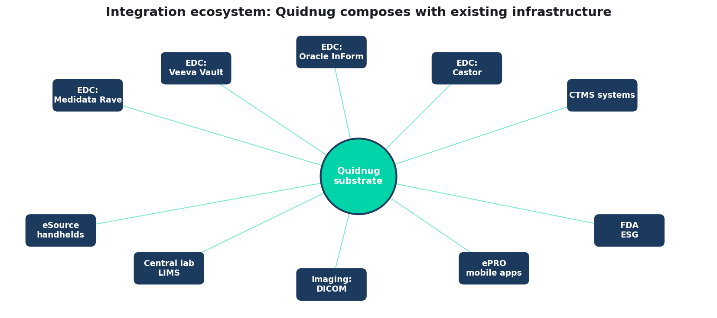
Integration with existing clinical trial infrastructure
Quidnug · Clinical Trial Data Integrity
52 / 75

Slide 53
EDC systems: Medidata, Veeva, Oracle, Castor
▸ Medidata Rave. Dominant EDC. Substrate integration via API layer: Quidnug signatures for every eCRF save operation.
▸ Veeva Vault Clinical. Rising enterprise option. Native API supports signature injection. Faster path to integration.
▸ Oracle InForm. Legacy dominant in large-pharma. Integration via configurable workflow extensions.
▸ Castor (emerging). Cloud-native. Built for flexibility. Likely fastest to adopt signatures natively.
▸ Integration principle. Substrate sits BELOW the EDC, not instead of. Existing workflows unchanged; cryptographic evidence layer added underneath.
Quidnug · Clinical Trial Data Integrity
53 / 75

Slide 54
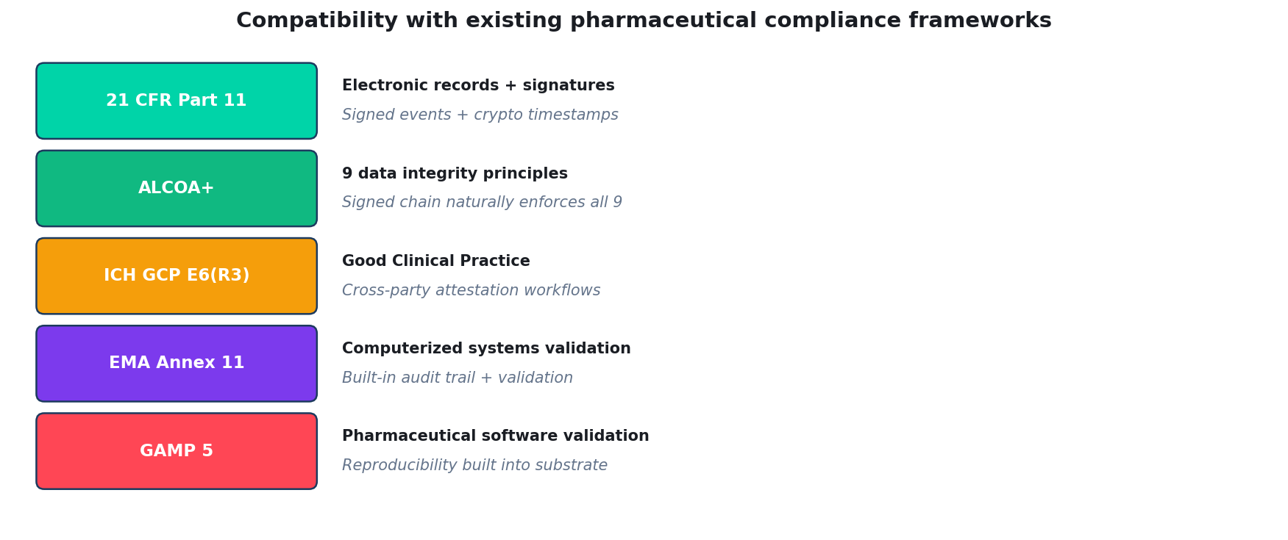
Compatibility with existing compliance frameworks
Quidnug · Clinical Trial Data Integrity
54 / 75

Slide 55
Migration path: 5-year roadmap
▸ Year 1. Pilot on a single Phase I trial. Single sponsor, single CRO, single site. 50-100 subjects. Prove operational feasibility.
▸ Year 2. Expand to Phase II. Multiple sites, still one sponsor. Demonstrate multi-site workflow.
▸ Year 3. Run parallel traditional + substrate for Phase III. Both systems operational. Compare inspection outcomes, cost, data quality.
▸ Year 4. First substrate-only Phase III submissions. FDA accepts. Industry watches outcomes.
▸ Year 5. Broader adoption. Major CROs integrate. Top 20 pharma evaluate. Mainstream consideration.
Quidnug · Clinical Trial Data Integrity
55 / 75

Slide 56
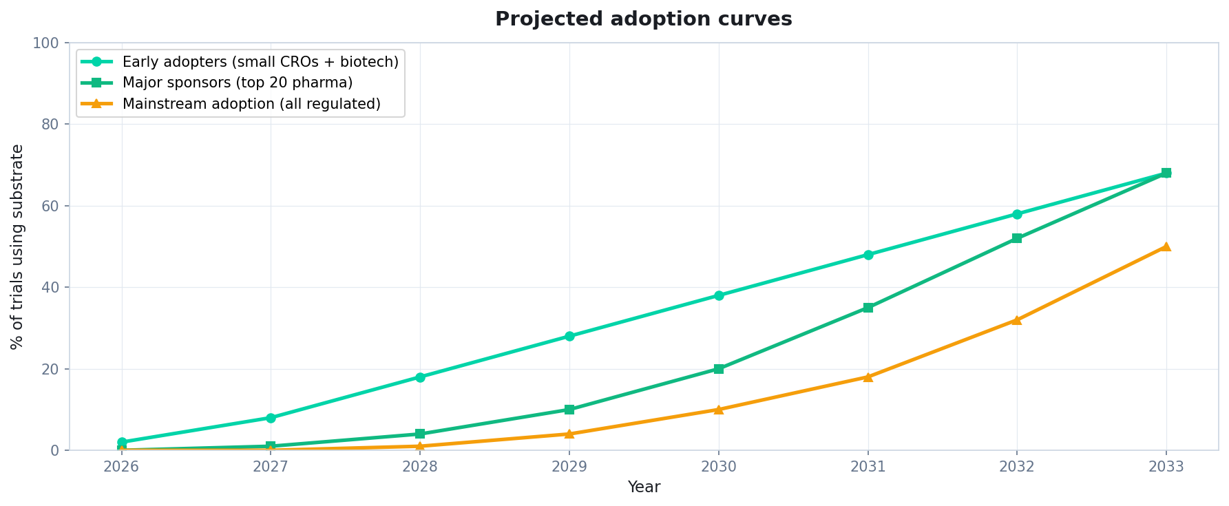
Projected adoption curves
Quidnug · Clinical Trial Data Integrity
56 / 75

Slide 57
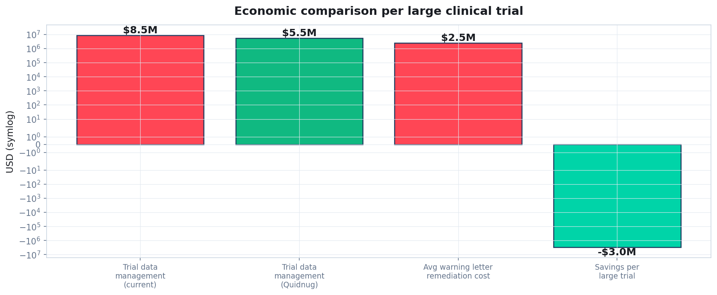
Economics: substrate vs current data management
Quidnug · Clinical Trial Data Integrity
57 / 75

Slide 58
Economic breakdown
▸ Current large-trial data management. ~$8.5M per large Phase III (industry average, Deloitte 2023).
▸ Substrate-enabled. ~$5.5M per trial (projected, based on automated SDV + reduced monitoring).
▸ Savings. ~$3M per large trial from data management alone.
▸ Avoided warning letter costs. Average $2.5M per incident. Substrate reduces incidents.
▸ Accelerated regulatory approval. Faster inspections → faster approvals → earlier revenue. Per blockbuster drug: $50-500M of earlier revenue per month of acceleration.
Quidnug · Clinical Trial Data Integrity
58 / 75

Slide 59
Honest tradeoff 1: organizational change
▸ Adopters face large process change. CROs, sites, sponsors all change workflows.
▸ Training burden. Thousands of investigators, monitors, data managers need to learn new tools.
▸ Legacy system coexistence. Existing trials continue under old system. New trials adopt. Takes years for full transition.
▸ Mitigation. Phased rollout. Reference implementations. Vendor integration support.
▸ This is standard for major industry technology transitions. Comparable to EMR adoption 2009-2020 or electronic prescribing adoption.
Quidnug · Clinical Trial Data Integrity
59 / 75

Slide 60
Honest tradeoff 2: regulatory validation
▸ FDA hasn't yet explicitly endorsed a substrate-based approach. Current expectation: 21 CFR Part 11 compliance via standard mechanisms.
▸ Industry coordination needed. ISPE, DIA, FDA-industry working groups can develop guidance for substrate adoption.
▸ Pioneer risk. First adopters face regulatory uncertainty. They must over-document compliance.
▸ Mitigation. Run parallel systems for pioneer trials (both substrate and traditional). Regulatory safety net.
▸ Long-term. Guidance will catch up once demonstration projects establish substrate reliability.
Quidnug · Clinical Trial Data Integrity
60 / 75

Slide 61
Honest tradeoff 3: vendor consolidation
▸ EDC market is concentrated. Medidata, Veeva, Oracle dominate. Substrate adoption depends on their participation.
▸ Risk: vendor lock-in. If one vendor dominates substrate integration, they dictate implementation.
▸ Mitigation: open standards. Quidnug protocol is open. Multiple vendors can implement compatibly.
▸ Smaller EDC options (Castor, OpenClinica). More flexible; faster to adopt. Provide market pressure on larger vendors.
▸ Over time. Substrate adoption across vendors ensures interoperability.
Quidnug · Clinical Trial Data Integrity
61 / 75

Slide 62
Honest tradeoff 4: PHI handling complexity
▸ Clinical trial data includes PHI. HIPAA, GDPR, local regulations. Cryptographic substrate must handle.
▸ Pseudonymous identifiers partially solve. Quid replaces subject ID. Mapping stored separately.
▸ Cross-border data flows. GDPR Article 44+ restricts EU subject data outside EU. Substrate deployment must respect this.
▸ Mitigation. Data locality: PHI stored at site's jurisdiction. Signatures cover hashes, not raw PHI.
▸ Selective disclosure. PHI revealed only to authorized parties (site, specific regulators with legal authority).
Quidnug · Clinical Trial Data Integrity
62 / 75

Slide 63
What this protocol does NOT solve
▸ Bad science. Wrong hypothesis, poorly-designed trial: substrate signs the bad science honestly.
▸ Selection bias in trial design. Substrate doesn't address inclusion/exclusion criteria, randomization quality, blinding effectiveness.
▸ Statistical analysis errors. Substrate verifies data. Doesn't verify analysis choice.
▸ Incomplete adverse event reporting. Investigator didn't report an AE: substrate doesn't conjure the missing report.
▸ Fundamental misunderstanding of endpoints. If the primary endpoint is the wrong measure, substrate doesn't fix.
Quidnug · Clinical Trial Data Integrity
63 / 75

Slide 64
Summary: the four claims revisited
▸ 1. ALCOA+ was designed for paper. Electronic transposition works in principle but has trust-gap problems.
▸ 2. 21 CFR Part 11 compliance is theater at most sponsors. Internal audit logs inside systems the sponsor controls are inadequate tamper-evidence.
▸ 3. Multi-party cryptographic signatures change the threat model. No party can unilaterally rewrite the record. Fraud becomes structurally harder.
▸ 4. This is operationally feasible today. EDC integration, compliance mapping, migration paths all exist. Adoption is the question, not implementation.
Quidnug · Clinical Trial Data Integrity
64 / 75

Slide 65
What to do this year (sponsor)
▸ Pilot on a Phase I trial. Small scale, single site. Measure: data quality, inspection readiness, operational cost.
▸ Engage your EDC vendor. Push for substrate integration timeline.
▸ Train data management team. Understand signature workflows, chain verification.
▸ Prepare for regulatory dialogue. FDA pre-submission meetings on substrate approach.
▸ Coordinate with other sponsors. Industry consortium for shared guidance development.
Quidnug · Clinical Trial Data Integrity
65 / 75

Slide 66
What to do this year (CRO)
▸ Develop substrate-aware monitoring services. Automated SDV tools. Remote chain verification capabilities.
▸ Pilot with willing sponsors. Small trials, low risk. Build case studies.
▸ Integrate with Quidnug SDKs. Python, JavaScript, Go. Build internal tooling.
▸ Train CRAs on new workflows. Less site-visit volume, more remote verification.
▸ Position as differentiation. Offer substrate-enabled trials as premium service.
Quidnug · Clinical Trial Data Integrity
66 / 75

Slide 67
What to do this year (regulator)
▸ Issue guidance on substrate acceptability. FDA draft guidance on cryptographic evidence for 21 CFR Part 11 compliance.
▸ Participate in industry pilots. Observer role at pilot trial inspections. Build institutional knowledge.
▸ Update inspector training. Inspectors need to verify cryptographic chains, not just read audit logs.
▸ International coordination. FDA, EMA, PMDA alignment on substrate acceptability.
▸ Recognize the substrate advantage. Substrate-enabled trials require less inspection burden. Make this explicit in guidance.
Quidnug · Clinical Trial Data Integrity
67 / 75

Slide 68
What to do this year (EDC vendor)
▸ Add Quidnug signing at eCRF save. API-level integration. Thin layer above existing workflow.
▸ Include chain verification in audit exports. Inspector-friendly output.
▸ Partner with Quidnug + pilot sponsors. Co-develop reference implementation.
▸ Support selective disclosure for PHI. Signatures over hashes; PHI stays off-chain.
▸ Publish integration timeline. Customers planning substrate trials need visibility into vendor support.
Quidnug · Clinical Trial Data Integrity
68 / 75

Slide 69
What success looks like in 2031
▸ Majority of new Phase III trials substrate-enabled. Major pharma, major CROs, major EDCs all aligned.
▸ Routine cross-party verification. Site, CRO, sponsor, regulator each independently verify trial data. No single party trust required.
▸ Data integrity warning letters reduced 50%+. Substrate makes entire classes of issues structurally impossible.
▸ Inspection frequency doubled. Same FDA headcount can monitor 2x more trials with substrate.
▸ Trust in clinical trial data restored. Post-Theranos, post-Potti, post-Ranbaxy: verifiable trial integrity rebuilt.
Quidnug · Clinical Trial Data Integrity
69 / 75

Slide 70
References
▸ 21 CFR Part 11. Electronic Records; Electronic Signatures. Title 21 Code of Federal Regulations, Part 11.
▸ FDA Guidance for Industry: Data Integrity and Compliance With CGMP (Dec 2018).
▸ ICH E6(R2), E6(R3). Good Clinical Practice. International Council for Harmonisation.
▸ EMA Annex 11. Computerised Systems. EudraLex Volume 4 (GMP).
▸ ISPE GAMP 5, 2nd edition (2022). Risk-Based Approach to Compliant GxP Computerized Systems.
▸ Ranbaxy US DOJ Press Release (May 2013). Largest drug safety case in history at the time.
▸ Senate Permanent Subcommittee on Theranos testimony (2018).
▸ Baggerly and Coombes on Duke Potti (2009). Annals of Applied Statistics.
Quidnug · Clinical Trial Data Integrity
70 / 75

Slide 71
More references
▸ FDA Warning Letter database. fda.gov/inspections-compliance-enforcement-and-criminal-investigations/warning-letters.
▸ Clinical Trials Transformation Initiative (CTTI). Cross-industry initiative on trial efficiency.
▸ TransCelerate BioPharma. Industry consortium for trial acceleration.
▸ Companion blog post. blogs/2026-04-26-clinical-trial-data-integrity.md.
▸ Quidnug protocol. github.com/quidnug/quidnug.
Quidnug · Clinical Trial Data Integrity
71 / 75

Slide 72
Common objections, briefly
▸ 'This is too disruptive to workflow.' Substrate sits below EDC. Existing workflows unchanged. Cryptographic layer added underneath.
▸ 'FDA won't accept it.' FDA guidance emphasizes ALCOA+. Substrate exceeds requirements. Early adopter discussion already underway.
▸ 'Our EDC doesn't support it.' Integration via API. All major EDCs exposing necessary hooks.
▸ 'It's too expensive.' Long-term, saves $3M+ per trial. Short-term investment amortizes over 2-3 trials.
▸ 'What about existing trials?' Legacy trials continue current approach. New trials gradually adopt.
Quidnug · Clinical Trial Data Integrity
72 / 75

Slide 73
One-line summary
“
ALCOA+ was designed for paper. Multi-party cryptographic signatures are what ALCOA+ requires in 2026. The technology exists. What we need is institutional momentum.
— The one-line summary
Quidnug · Clinical Trial Data Integrity
73 / 75

Slide 74
Next steps
▸ This week. Assess your current 21 CFR Part 11 compliance gaps.
▸ This month. Read FDA data integrity guidance + relevant warning letters.
▸ This quarter. Pilot Quidnug substrate on one Phase I trial.
▸ This year. Cross-organizational working group (industry + FDA observers).
▸ Next year. First substrate-enabled Phase II submissions.
Quidnug · Clinical Trial Data Integrity
74 / 75

Slide 75
Questions
Thank you. The substrate awaits adoption.
Where does the substrate architecture fail in your trial context? Which EDC or regulatory constraint matters most? What would your pilot look like?
Resources
github.com/quidnug/quidnug
blogs/2026-04-26-clinical-trial-data-integrity.md
FDA Data Integrity Guidance (2018)
21 CFR Part 11
ICH E6(R2), ICH E6(R3)
ISPE GAMP 5 2nd edition (2022)
Clinical Trials Transformation Initiative
Quidnug · Clinical Trial Data Integrity
75 / 75

