Slide 1
QUIDNUG · INFORMATION INTEGRITY
Deepfakes Are Trust's Endgame
Why C2PA is necessary but insufficient, and what the full defense architecture actually looks like.
Quidnug · Deepfakes Are Trust's Endgame
1 / 75
Notes:
75 slides, ~60 min with Q&A.
Audience: journalism leaders, platform trust and safety, policy staff, technology decision-makers in media.
Central thesis: detection cannot scale; provenance must. C2PA is good but only Layer 1 of a three-layer stack.

Slide 2
The 2024 inflection
5,600x
growth in detected deepfake media in circulation, 2019 to 2025.
Detection is losing the arms race. The defenders must shift from detection to provenance.
Quidnug · Deepfakes Are Trust's Endgame
2 / 75

Slide 3
Operational political tool, worldwide
11
documented deepfake election incidents across 9 countries in 2024 alone.
From Slovakia to Indonesia to Romania (where the first round of presidential elections was annulled in November 2024 over deepfake-driven manipulation).
Quidnug · Deepfakes Are Trust's Endgame
3 / 75

Slide 4
Agenda
▸ 1. The 2024 elections. Documented incidents, scale measurements, beyond politics.
▸ 2. Why detection is losing. Asymmetry, evasion dynamic, what detection IS good for.
▸ 3. What C2PA gets right. Capture-to-display chain. Adoption status. Where it stops.
▸ 4. Layer 2: DNS-anchored publisher identity. Bind existing trusted brands to crypto identity.
▸ 5. Layer 3: relational trust. Per-observer publisher weighting. Composes with C2PA + DNS.
▸ 6. Protecting sources without exposing them. Selective disclosure for investigative journalism.
▸ 7. End-to-end architecture. Full pipeline from witness to reader.
▸ 8. Adoption strategy and tradeoffs. Who moves first. What the next 5 years look like.
Quidnug · Deepfakes Are Trust's Endgame
4 / 75

Slide 5
Four claims this talk defends
▸ Detection is necessary but losing. Generator quality is improving faster than classifier accuracy.
▸ Provenance-first architecture is the only durable answer. Sign at capture; verify at display; trust per-observer.
▸ C2PA is correct but insufficient. It is Layer 1 of three. We need Layers 2 and 3 too.
▸ Source protection composes with provenance. Selective disclosure preserves credibility without identity exposure.
Quidnug · Deepfakes Are Trust's Endgame
5 / 75

Slide 6
Section 1
The 2024 Elections
When deepfakes became operational political tools.
Quidnug · Deepfakes Are Trust's Endgame
6 / 75

Slide 7
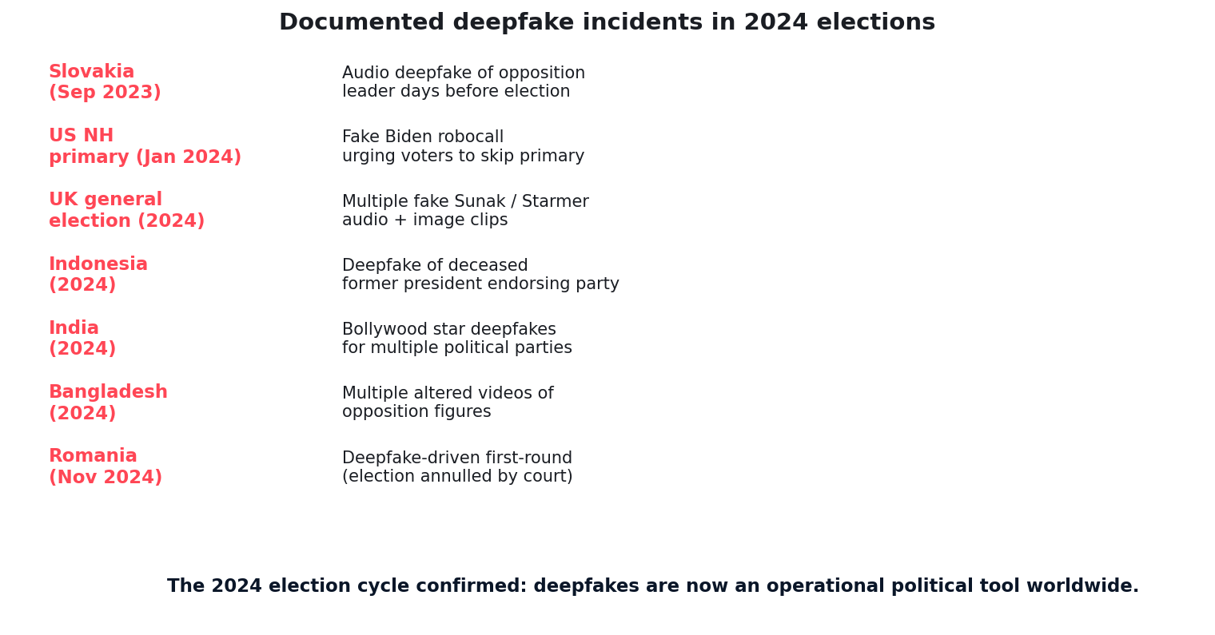
Documented deepfake election incidents 2024
Quidnug · Deepfakes Are Trust's Endgame
7 / 75

Slide 8
Slovakia September 2023: the first proof point
▸ Days before the September 30 parliamentary election. An audio deepfake of opposition leader Michal Simecka circulated on social media.
▸ Content. Fake conversation between Simecka and a journalist about rigging the election.
▸ Detection happened. But not before significant viral spread, days before voting.
▸ Outcome contested. His party narrowly lost; impossible to say if the deepfake was decisive.
▸ The first time a deepfake was credibly tied to an election outcome. Not the last.
Quidnug · Deepfakes Are Trust's Endgame
8 / 75

Slide 9
US NH primary January 2024: AI robocalls
▸ Two days before the New Hampshire Democratic primary. A robocall went out impersonating President Biden's voice, urging voters to skip the primary.
▸ Reach: estimated 5,000 to 25,000 calls. FCC fined the source $6M in May 2024.
▸ This was a US federal election. Not a hypothetical. Not a foreign country. Not a fringe platform.
▸ The technical bar. Eleven Labs voice cloning. Public Biden recordings. Roughly $1 of compute.
▸ FCC banned AI-generated robocalls in February 2024. After the fact.
Quidnug · Deepfakes Are Trust's Endgame
9 / 75

Slide 10
Romania November 2024: election annulled
▸ First round of Romanian presidential elections held November 24, 2024. Far-right candidate Calin Georgescu won surprisingly with significant margin.
▸ Days later: Romania's intelligence services declassified evidence of coordinated TikTok campaign. Estimated 25,000 accounts. Massive use of AI-generated content.
▸ December 6, 2024: Constitutional Court annulled the election. First time in EU history.
▸ Re-vote held in May 2025. Different outcome, but the precedent is set.
▸ The lesson. Even when caught, deepfake-driven elections can pass the threshold of legitimacy. Annulment is the extreme remedy.
Quidnug · Deepfakes Are Trust's Endgame
10 / 75

Slide 11
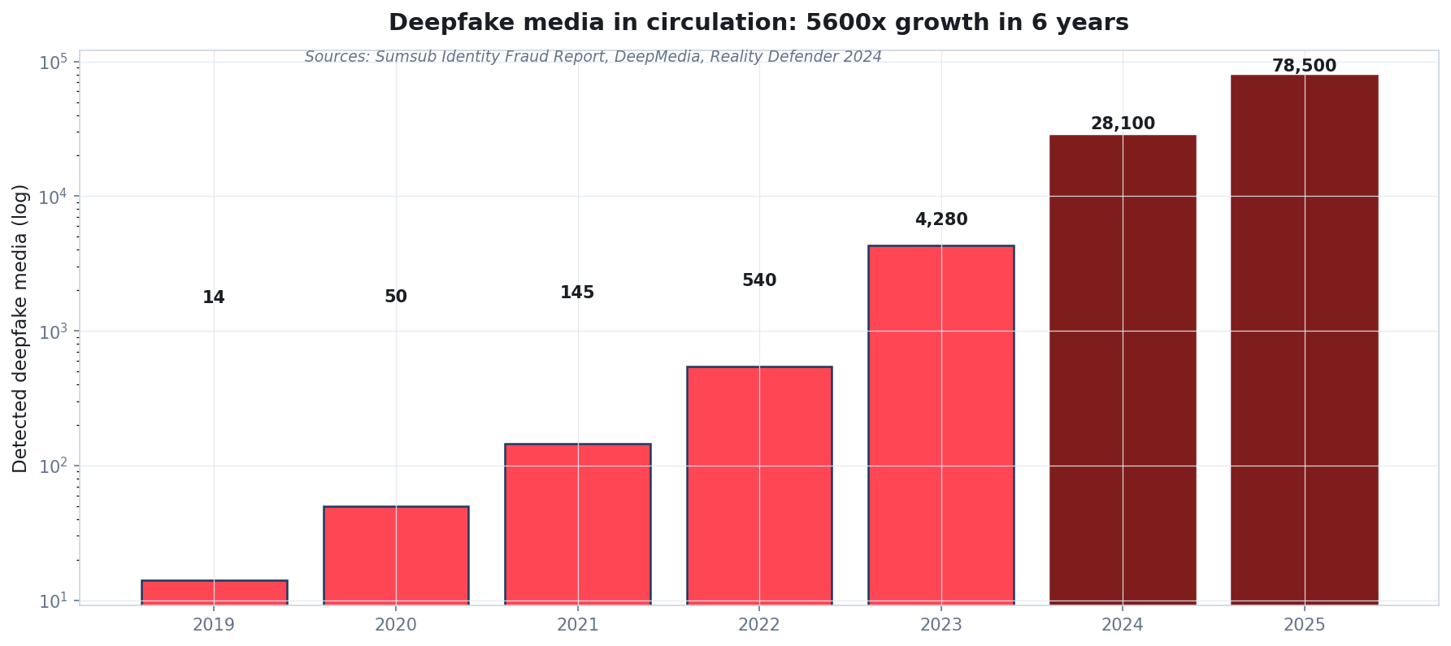
Deepfake media in circulation: log-scale growth
Sumsub Identity Fraud Report 2024; DeepMedia; Reality Defender 2024 industry estimates.
Quidnug · Deepfakes Are Trust's Endgame
11 / 75

Slide 12
Beyond politics: financial fraud, NCII, scams
▸ Financial fraud via deepfake video calls. February 2024: Hong Kong CFO transferred $25M after video conference call where multiple 'colleagues' were deepfakes.
▸ Non-consensual intimate imagery. Internet Watch Foundation: 11x increase in AI-generated CSAM 2023-2024. Catastrophic individual harm.
▸ Romance scams. Pig-butchering schemes now use AI video to impersonate love interests.
▸ Corporate impersonation. Fake CEO video issued to investors during M&A negotiations.
▸ This is not a future problem. It is a present one. The trust crisis touches every domain that relies on visual / audio authenticity.
Quidnug · Deepfakes Are Trust's Endgame
12 / 75

Slide 13
Section 2
Why Detection Is a Losing Arms Race
Asymmetry, evasion, the substrate problem.
Quidnug · Deepfakes Are Trust's Endgame
13 / 75

Slide 14
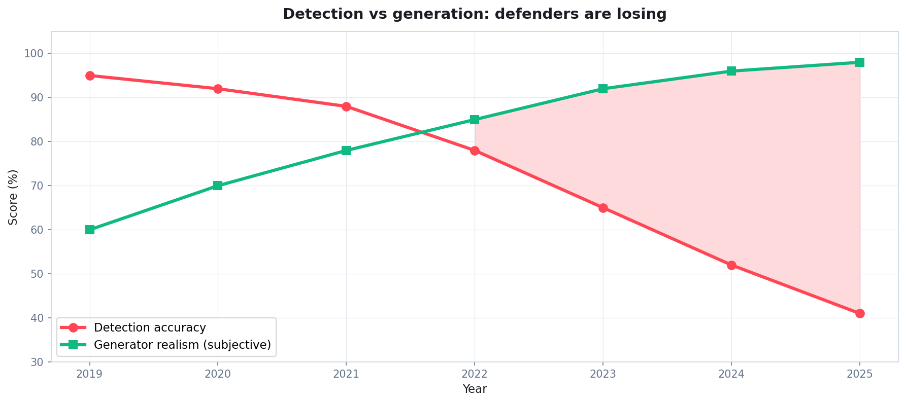
Detection accuracy declining as generation improves
Composite: Reality Defender, Pindrop, DeepMedia industry reports.
Quidnug · Deepfakes Are Trust's Endgame
14 / 75

Slide 15
The asymmetry problem
▸ Detection requires near-100% accuracy at scale. False positives erode trust in real content. False negatives erode trust in detection.
▸ Generation requires only ONE successful piece. Slovakia: one audio file. NH primary: one robocall script. The attacker only needs one.
▸ Generation cost approaches zero. Voice cloning: minutes. Video: hours. Cost: low single digits of dollars.
▸ Detection cost is increasing. Each generator improvement requires retraining classifiers on new examples.
▸ Compounding effect. Defender investment scales linearly; attacker capability scales with model frontier (rapidly).
Quidnug · Deepfakes Are Trust's Endgame
15 / 75

Slide 16
The evasion dynamic
▸ Adversarial robustness is largely an unsolved problem. Goodfellow et al 2014 explained adversarial examples; 10 years later, no general defense.
▸ Anti-detection techniques. Adversarial perturbations, model fingerprint laundering, post-processing filters.
▸ Defender publishes detection method. Attacker now knows what to evade. Publishing accelerates the arms race.
▸ Defender doesn't publish. Then independent verification of detection accuracy is impossible. Public can't audit.
▸ Either way, defenders are at a structural disadvantage. This is why detection alone cannot win.
Quidnug · Deepfakes Are Trust's Endgame
16 / 75

Slide 17
What detection IS good for
▸ Triage at scale. Platforms processing billions of uploads need a fast filter. Detection is fine here, even if imperfect.
▸ Bulk content review. Pre-screening for human reviewers in trust and safety teams.
▸ Forensic post-hoc analysis. After incidents, detection helps identify what was AI-generated for legal/journalistic purposes.
▸ Generator-specific defense. When you know the attacker is using a specific model, targeted detection can work.
▸ What detection cannot do. Provide individual users with reliable trust signals at consumption time. That requires provenance.
Quidnug · Deepfakes Are Trust's Endgame
17 / 75

Slide 18
The pivot
“
We need provenance-first architecture, not detection-first. Sign at capture, verify at display, trust per-observer.
— The strategic pivot
Quidnug · Deepfakes Are Trust's Endgame
18 / 75

Slide 19
Section 3
What C2PA Gets Right
Coalition for Content Provenance and Authenticity. Layer 1 of the defense.
Quidnug · Deepfakes Are Trust's Endgame
19 / 75

Slide 20
C2PA core model
▸ Coalition for Content Provenance and Authenticity. Founded 2021 by Adobe, Microsoft, Truepic, BBC, Sony, Nikon, others. Open spec at c2pa.org.
▸ Manifest attached to media. JSON document signed by the camera or editor. Contains claims about the content.
▸ Claims include. Capture device, location (optional), editing actions, creator identity, timestamp.
▸ Each transformation adds a signed assertion. Camera signs at capture. Editor signs after edits. Publisher signs at publication.
▸ Reader / viewer verifies the chain at display. If signatures verify, reader sees a 'verified' indicator. If broken, sees 'unable to verify'.
Quidnug · Deepfakes Are Trust's Endgame
20 / 75

Slide 21
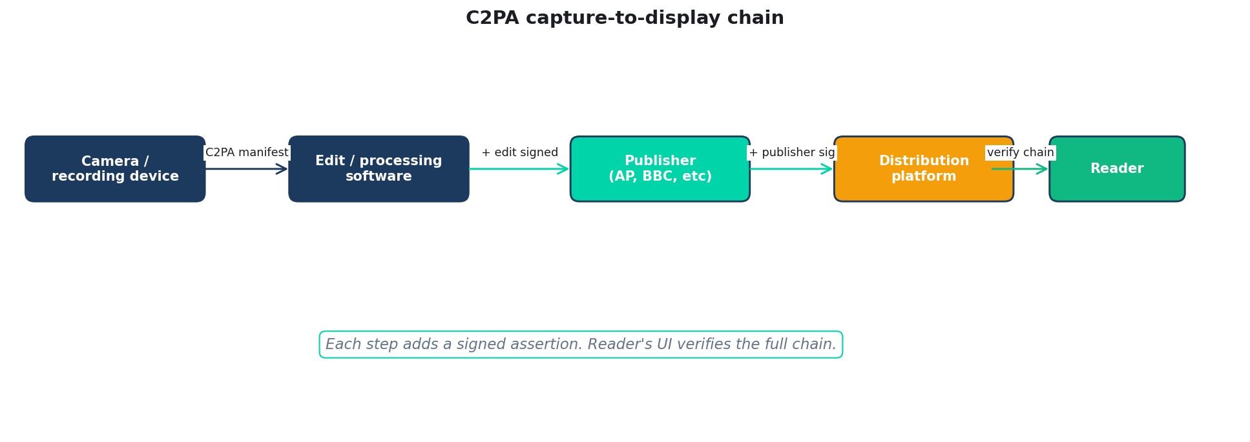
C2PA capture-to-display chain
Quidnug · Deepfakes Are Trust's Endgame
21 / 75

Slide 22
What's attested in a C2PA manifest
▸ Recording device fingerprint. If using a C2PA-enabled camera (Sony Alpha 9 III, Leica M11-P, Nikon Z9 firmware), device signs at capture.
▸ Edit operations. Crop, color correction, resize: each appears as a signed assertion in the chain.
▸ Creator identity. Optional, but most newsroom workflows include photographer ID.
▸ Timestamp. When the media was captured and edited.
▸ AI generation flags. If any AI tool was used, the type and extent are logged.
Quidnug · Deepfakes Are Trust's Endgame
22 / 75

Slide 23
Why C2PA is well-designed
▸ Cryptographic, not heuristic. Verification is deterministic. No 'detection probability' to interpret.
▸ Open standard. Spec at c2pa.org. Anyone can implement. No vendor lock-in.
▸ Backwards compatible. Media without C2PA still displays. Just lacks the verification badge.
▸ Privacy aware. Creator can choose what to include. Location optional. Identity optional.
▸ Multi-vendor traction. Adobe Content Credentials, Truepic, Microsoft, BBC, AP, Reuters all engaged.
Quidnug · Deepfakes Are Trust's Endgame
23 / 75

Slide 24
C2PA deployment status (early 2026)
▸ C2PA-enabled cameras shipping. Sony Alpha 9 III, Leica M11-P, Nikon Z9 firmware update.
▸ Adobe Content Credentials. Photoshop, Lightroom, Premiere Pro all attach C2PA manifests for AI-generated content.
▸ AP and Reuters. All wire-service photos signed at point of capture or import.
▸ Browser display. Chrome, Edge, Firefox have varying levels of C2PA manifest UI.
▸ Adoption gap. Maybe 5% of news media bears valid C2PA today. Most social-media-shared content does not.
Quidnug · Deepfakes Are Trust's Endgame
24 / 75

Slide 25
Where C2PA stops
▸ C2PA tells you who SIGNED the content. Adobe says 'this was edited in Photoshop.' Sony says 'this came from a Sony camera.'
▸ It does NOT tell you whether to trust the signer. Adobe is signing the editor; the editor's brand is separate.
▸ It does NOT tell you the publisher's reputation. Adobe doesn't know if Reuters or InfoWars is publishing the result.
▸ It does NOT give you per-observer trust. Everyone sees the same C2PA badge regardless of their trust in the publisher.
▸ These are Layers 2 and 3. C2PA is necessary; it is not sufficient for a complete defense.
Quidnug · Deepfakes Are Trust's Endgame
25 / 75

Slide 26
Section 4
Layer 2: DNS-Anchored Publisher Identity
Bind existing trusted brands to cryptographic identity.
Quidnug · Deepfakes Are Trust's Endgame
26 / 75

Slide 27
The existing infrastructure we can leverage
▸ DNS is the most-deployed identity system in human history. Every news organization has a domain. Every domain has a verifiable owner via DNS records and TLS certificates.
▸ Reuters.com is Reuters. BBC.co.uk is the BBC. Fox.com is Fox News. The brand lives in the domain name.
▸ DNSSEC + Certificate Transparency. Two cryptographic layers below most people's awareness already authenticate domain ownership.
▸ Quidnug DNS-anchored attestation (QDP-0023). Lets a Quidnug quid prove DNS ownership, then carry that brand identity into Quidnug's trust graph.
▸ Bootstrap is essentially free. Existing news organizations don't need new identity. They have one.
Quidnug · Deepfakes Are Trust's Endgame
27 / 75

Slide 28
How the binding works
▸ Reuters publishes a TXT record at _quidnug.reuters.com. Containing their Quidnug quid (16-char hex).
▸ Quidnug attestation root checks the record. Must match the Quidnug quid that signs articles.
▸ Attestation root signs an attestation. 'Reuters.com is owned by quid abcdef1234567890 as of 2026-04-22.'
▸ Renewable. Annual or quarterly renewal. Revocation by domain owner or attestation root if compromised.
▸ End result. Reader's UI can display 'Verified Reuters' alongside the C2PA badge with cryptographic certainty.
Quidnug · Deepfakes Are Trust's Endgame
28 / 75

Slide 29
Why DNS-anchored identity works
▸ Existing trust transfer. Decades of brand recognition for major publishers. The binding makes that brand machine-verifiable.
▸ No new authority required. Reuters does not need to convince anyone they ARE Reuters. The DNS record proves it.
▸ Adversary cost. To impersonate Reuters, an attacker would have to compromise reuters.com (DNSSEC + cert validation). Far harder than 'create a website.'
▸ Compatible with takedown. If a publisher loses the domain, attestation auto-expires. No vendor lock-in.
▸ Federation-friendly. Works equally for major outlets and small bloggers. DNS scales to all.
Quidnug · Deepfakes Are Trust's Endgame
29 / 75

Slide 30
Composition with C2PA
▸ C2PA proves: 'This image came from a Sony camera and was edited in Photoshop.'
▸ DNS-anchored adds: 'And it was published by reuters.com.'
▸ Both layers use cryptographic verification. No conflict between them. They compose.
▸ Reader UI shows both. C2PA chain badge plus 'Verified Reuters' badge.
▸ Attack surface dramatically reduced. Faking C2PA + DNS together requires compromising both the camera vendor's signing infrastructure AND the publisher's domain.
Quidnug · Deepfakes Are Trust's Endgame
30 / 75

Slide 31
Institutional coverage
▸ News organizations. Every reuters.com, ap.org, nytimes.com, bbc.co.uk could be DNS-anchored within months.
▸ Government. .gov, whitehouse.gov, treasury.gov etc. official communications cryptographically anchored to domain.
▸ Universities. .edu domains for academic publications. mit.edu = MIT verified.
▸ Major brands. Apple, Google, Microsoft press releases verifiably theirs.
▸ Citizen journalists and small publishers. Anyone with a domain can DNS-anchor. Lower the bar to verified-publisher status.
Quidnug · Deepfakes Are Trust's Endgame
31 / 75

Slide 32
Section 5
Layer 3: Relational Trust
Per-observer publisher weighting. Composes with C2PA + DNS.
Quidnug · Deepfakes Are Trust's Endgame
32 / 75

Slide 33
The per-observer problem
▸ C2PA + DNS gives you 'this is genuinely from publisher X.' It does NOT tell you whether to trust publisher X.
▸ Different readers reasonably trust different publishers. A US conservative may trust Fox News and distrust the New York Times. The opposite may also be true.
▸ A platform that imposes a global trust hierarchy is censoring. But a platform that ignores trust signals entirely is useless.
▸ Relational trust solves this. Each reader has their own trust graph. Quidnug PoT computes publisher trust per-observer.
▸ Compatible with both ends of the political spectrum. Trust is the user's choice; the platform provides the computation, not the verdict.
Quidnug · Deepfakes Are Trust's Endgame
33 / 75

Slide 34
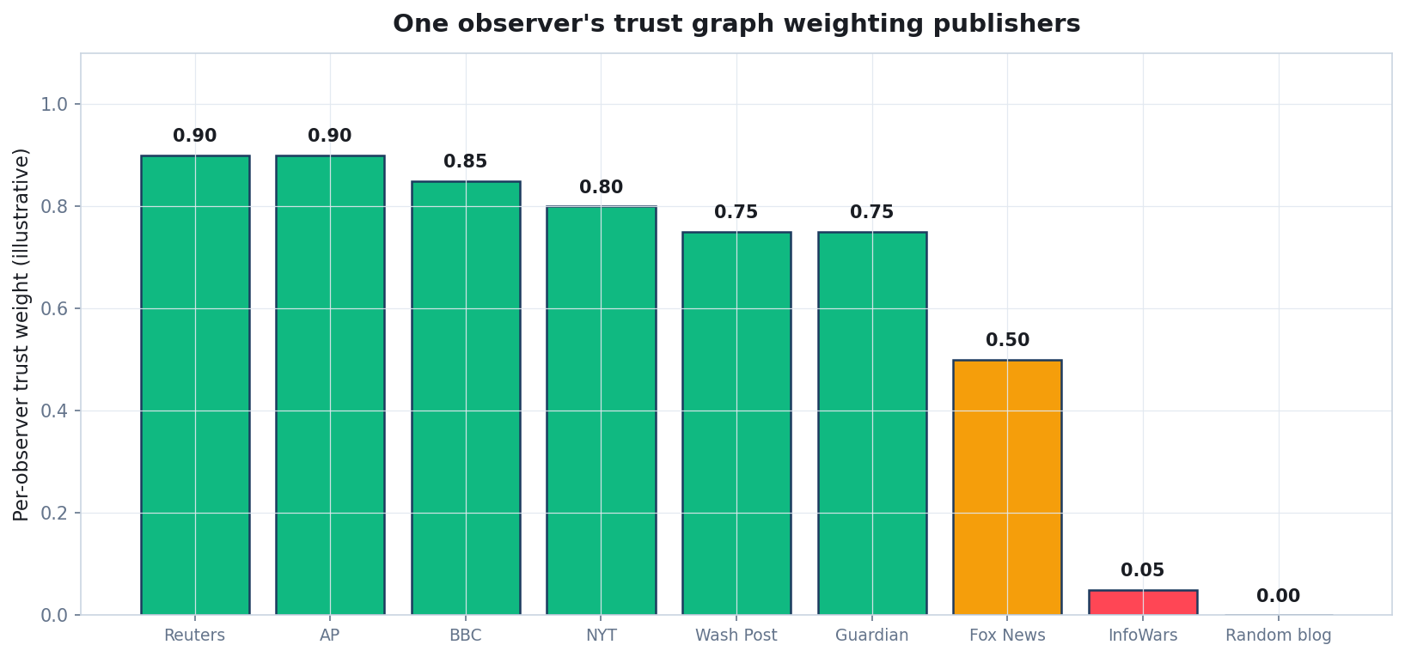
One observer's publisher trust weighting
Each viewer's weighting is their own. The platform shows them what their trusted sources think.
Quidnug · Deepfakes Are Trust's Endgame
34 / 75

Slide 35
Operationalizing on content
▸ Each piece of media has a publisher quid (Layer 2). Reader's trust in that publisher determines weight.
▸ Aggregate trust across multiple publishers covering the same event. If Reuters, AP, and BBC all publish similar accounts, trust is high. If only InfoWars covers it, trust is much lower for most observers.
▸ Same four-factor formula as relativistic ratings. Trust × event coverage × recency × independence.
▸ Per-observer aggregation. Each reader sees the trust score of an event computed from THEIR trusted publishers.
▸ Filter bubble concern addressed. Platform can show 'how would your view differ if you weighted publishers differently?' (Optional control).
Quidnug · Deepfakes Are Trust's Endgame
35 / 75

Slide 36
The display model
▸ Verification badge: cryptographic. C2PA verified, DNS verified, no question of reality.
▸ Trust score: per-observer, calibrated. 'Your trusted sources rate this story 0.85.'
▸ Provenance trace: drilldown. Click to see the C2PA chain, the publisher attestation, and your trust path to the publisher.
▸ Crowd score: optional comparison. 'The general public's average is 0.62.' Always available as a sanity check.
▸ UX similar to existing news platforms. Layered detail. Most users see the badge; curious users drill down.
Quidnug · Deepfakes Are Trust's Endgame
36 / 75

Slide 37
User opt-in calibration
▸ Onboarding: ask the user about their trust priors. 'Which of these publishers do you trust?' List of major outlets.
▸ From a few seed selections. Quidnug trust graph propagates: who do those publishers trust? Builds a starting graph.
▸ Ongoing adjustment. User can up-weight or down-weight any publisher at any time. Visible UI.
▸ Diversity nudge. Optional: 'Your trust graph is concentrated in conservative outlets. Consider weighting some others?' Opt-in.
▸ Always reversible. User remains in control. Platform never imposes.
Quidnug · Deepfakes Are Trust's Endgame
37 / 75

Slide 38
Section 6
Protecting Sources Without Exposing Them
Selective disclosure for investigative journalism.
Quidnug · Deepfakes Are Trust's Endgame
38 / 75

Slide 39
The tension
▸ Investigative journalism depends on confidential sources. Snowden, Watergate, Panama Papers, every major exposure.
▸ A signed-content world raises a question. How do you sign source content without identifying the source?
▸ Naive answer: don't sign source material. But then we lose verification. Adversaries claim 'this leak is fake.'
▸ Better answer: signed by the JOURNALIST, with selective disclosure of source metadata. Cryptographic credibility without identity exposure.
▸ Quidnug primitives that enable this. Selective disclosure (QDP-0024 partial), private communications (QDP-0024 full), and pseudonymous quids.
Quidnug · Deepfakes Are Trust's Endgame
39 / 75

Slide 40
What Quidnug offers: selective disclosure
▸ Source has a Quidnug identity (could be pseudonymous). Journalist receives content from this identity over an encrypted channel.
▸ Journalist signs an attestation. 'I have verified this content originates from a source with these credentials [doctor, hospital insider, verified by my newspaper] without disclosing identity.'
▸ Reader's trust calculation. Trust in the journalist + trust in the journalist's selective disclosure verification.
▸ Not blind trust. Reader knows the journalist's track record. Bad sources tank the journalist's reputation; honest sources build it.
▸ Source identity remains protected. Cryptographic separation between source identity and verification of source credentials.
Quidnug · Deepfakes Are Trust's Endgame
40 / 75

Slide 41
QDP-0024: private communications
▸ Group-keyed encryption built on MLS protocol. RFC 9420. Industrial-grade end-to-end encryption.
▸ Source-journalist channel. Encrypted, with forward secrecy. Past messages remain private even if current keys are compromised.
▸ Selective metadata disclosure. Journalist can prove 'I received this from someone with X credentials' without revealing who or how.
▸ Compatible with publishing. When ready to publish, journalist signs the article with embedded source-credibility attestations.
▸ Compatible with legal protection. Cryptographic separation gives stronger source protection than current 'trust the journalist's notes' model.
Quidnug · Deepfakes Are Trust's Endgame
41 / 75

Slide 42
The full stack for investigative journalism
▸ Source obtains evidence (documents, video, audio).
▸ Source contacts journalist via encrypted channel. Quidnug private communications (QDP-0024).
▸ Journalist verifies authenticity in their newsroom. Internal review process, fact-checking, legal review.
▸ Journalist publishes article. C2PA-signed manuscript. Selective-disclosure attestation of source credibility. DNS-anchored to publisher.
▸ Reader's trust calculation. Layer 1 (C2PA verified) + Layer 2 (verified publisher) + Layer 3 (per-observer trust in publisher).
▸ Source remains protected throughout. End-to-end.
Quidnug · Deepfakes Are Trust's Endgame
42 / 75

Slide 43
The credibility-without-identity tradeoff
▸ Stronger than current 'trust the journalist's word.' Cryptographic verification of journalist's attestation; source verification process explicit.
▸ Weaker than 'fully named source.' Reader cannot independently verify the source. Must trust the journalist's verification.
▸ Better fit for the modern threat model. Sources are increasingly at risk. Source protection is increasingly important.
▸ Newsroom incentives align. Reputation tracks accurate sourcing. Burning sources or accepting bad ones costs reputation.
▸ This is the architecture for the next decade of investigative work. Same primitives that enable healthcare consent and elections.
Quidnug · Deepfakes Are Trust's Endgame
43 / 75

Slide 44
Section 7
End-to-End Architecture
The full pipeline from witness to reader.
Quidnug · Deepfakes Are Trust's Endgame
44 / 75

Slide 45
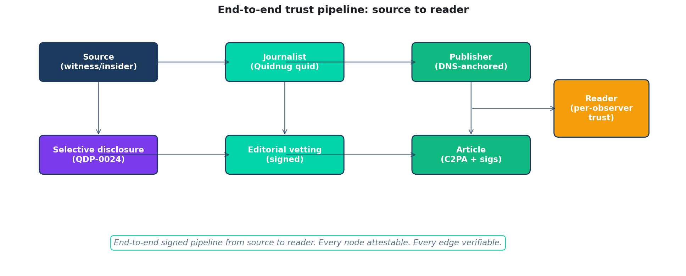
End-to-end trust pipeline
Source to reader, every node attestable, every edge verifiable.
Quidnug · Deepfakes Are Trust's Endgame
45 / 75

Slide 46
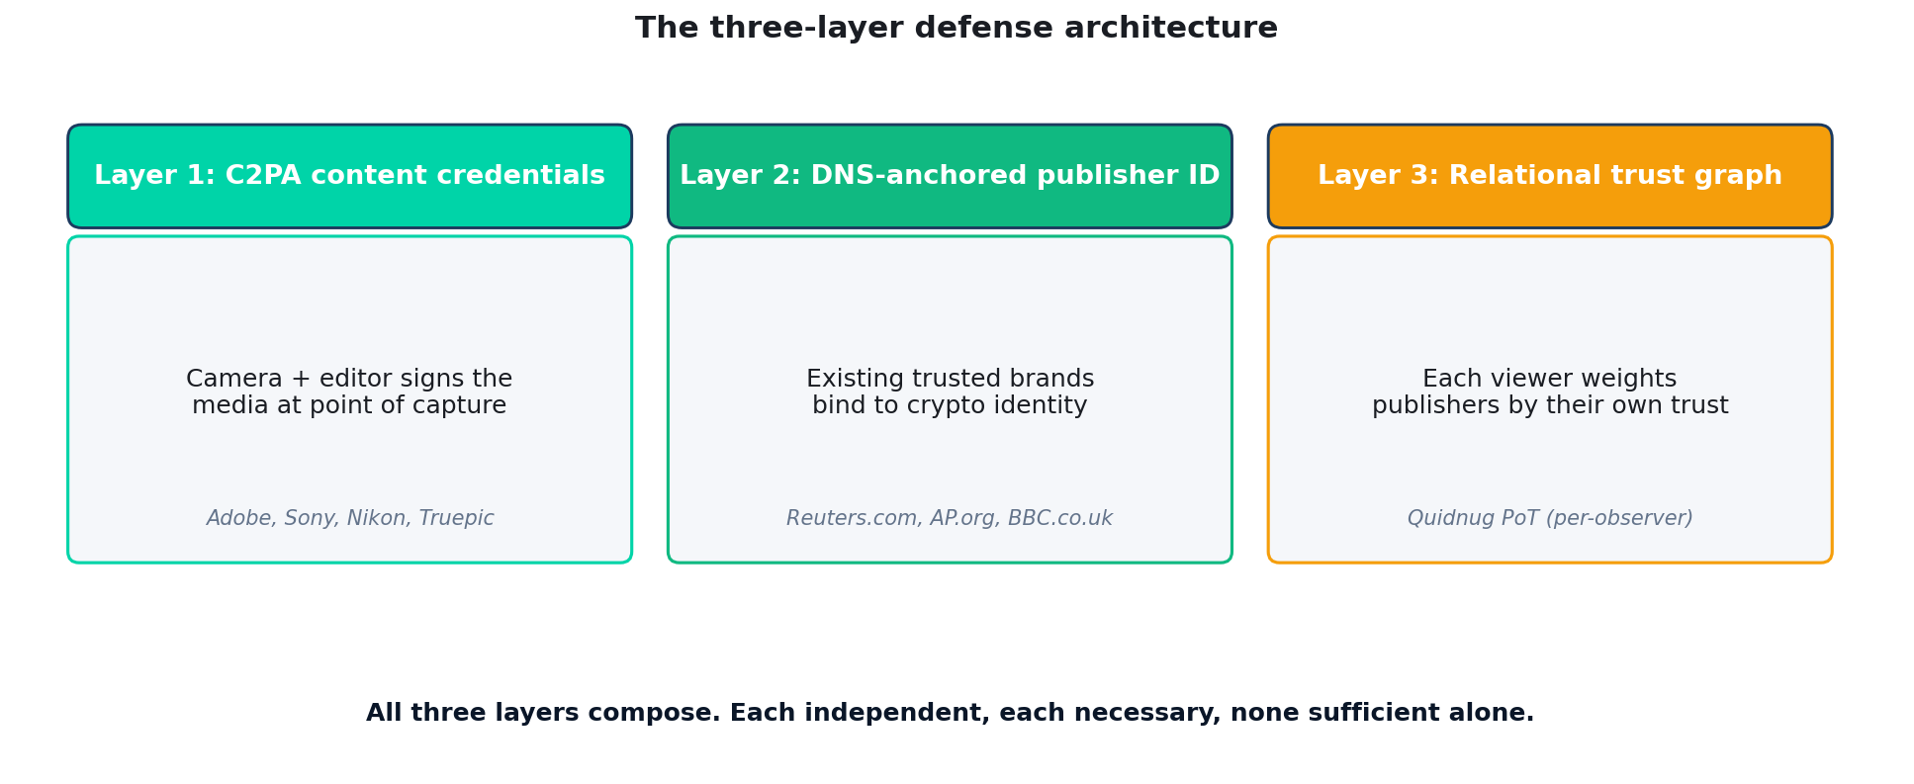
The three-layer defense, explicit
Quidnug · Deepfakes Are Trust's Endgame
46 / 75

Slide 47
Worked example: Reuters publishes a war photo
▸ Step 1. Photographer Sarah uses Sony Alpha 9 III in the field. Camera signs C2PA at capture.
▸ Step 2. Sarah uploads to Reuters editing pipeline. Editor crops; edit signed.
▸ Step 3. Reuters editorial sign-off. Article published with Reuters publisher signature.
▸ Step 4. Distribution to subscriber platforms (NYTimes, Washington Post, etc). Each receives signed article.
▸ Step 5. Reader on Twitter sees the photo. Twitter UI displays: 'Verified by Reuters via Sony Alpha 9.'
▸ Step 6. Reader's Quidnug trust graph: 0.85 trust in Reuters. Composite trust: very high.
Quidnug · Deepfakes Are Trust's Endgame
47 / 75

Slide 48
What fails under this architecture
▸ Adversary scrapes the photo, strips C2PA. Reposts on social media. Loses verification badge. Readers see no trust signal.
▸ Adversary creates a fake publisher. deepfake-news.com. No DNS attestation, no major publisher trust. Most readers' trust graphs weight this near zero.
▸ Adversary uses a cracked C2PA signing key. Camera vendor revokes; chain breaks. Visible to readers.
▸ Adversary impersonates Reuters. Has to compromise reuters.com domain or DNS. Hard.
▸ Adversary publishes a real photo with false caption. Image is verified. Caption is the journalist's claim. Journalist's reputation absorbs the cost.
Quidnug · Deepfakes Are Trust's Endgame
48 / 75

Slide 49
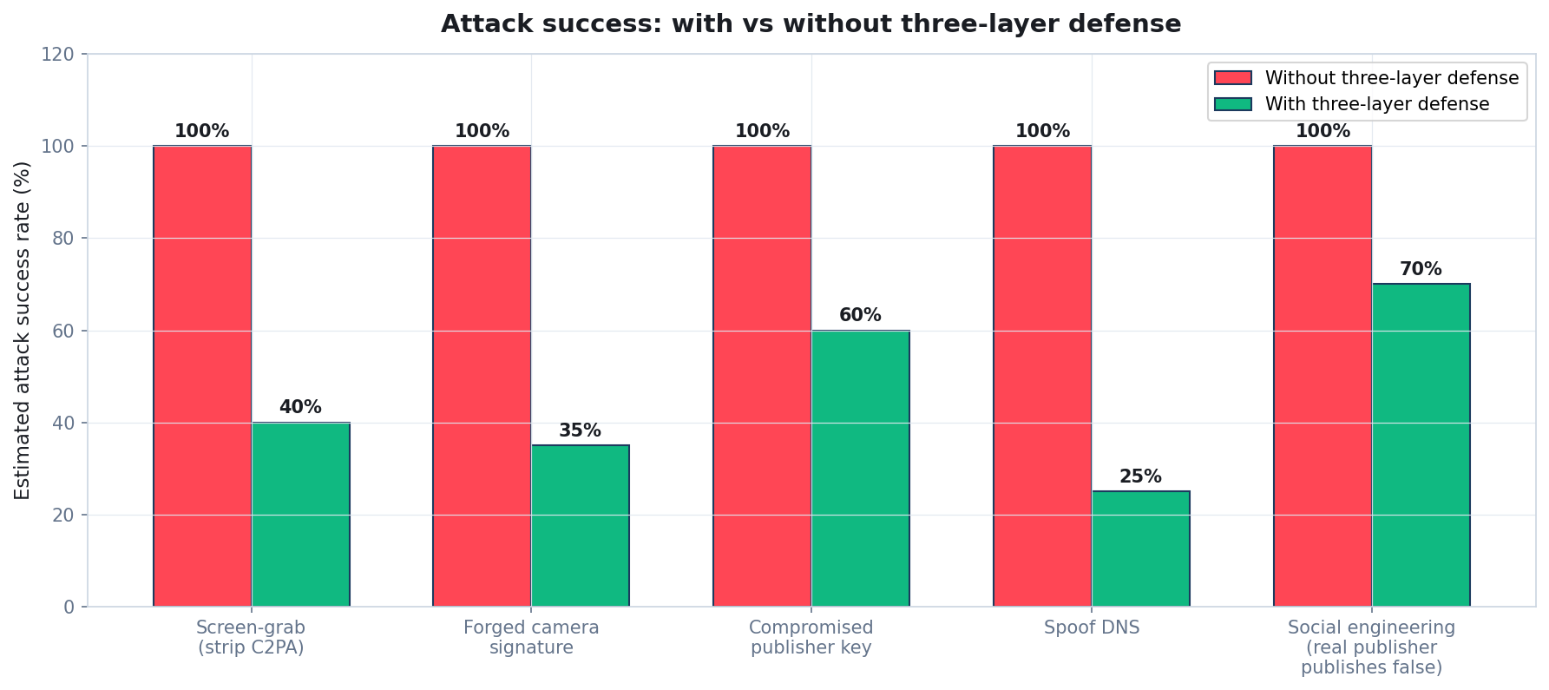
Attack surface: with vs without three-layer defense
Quidnug · Deepfakes Are Trust's Endgame
49 / 75

Slide 50
Section 8
Adoption Strategy and Tradeoffs
Who moves first. What the next 5 years look like.
Quidnug · Deepfakes Are Trust's Endgame
50 / 75

Slide 51
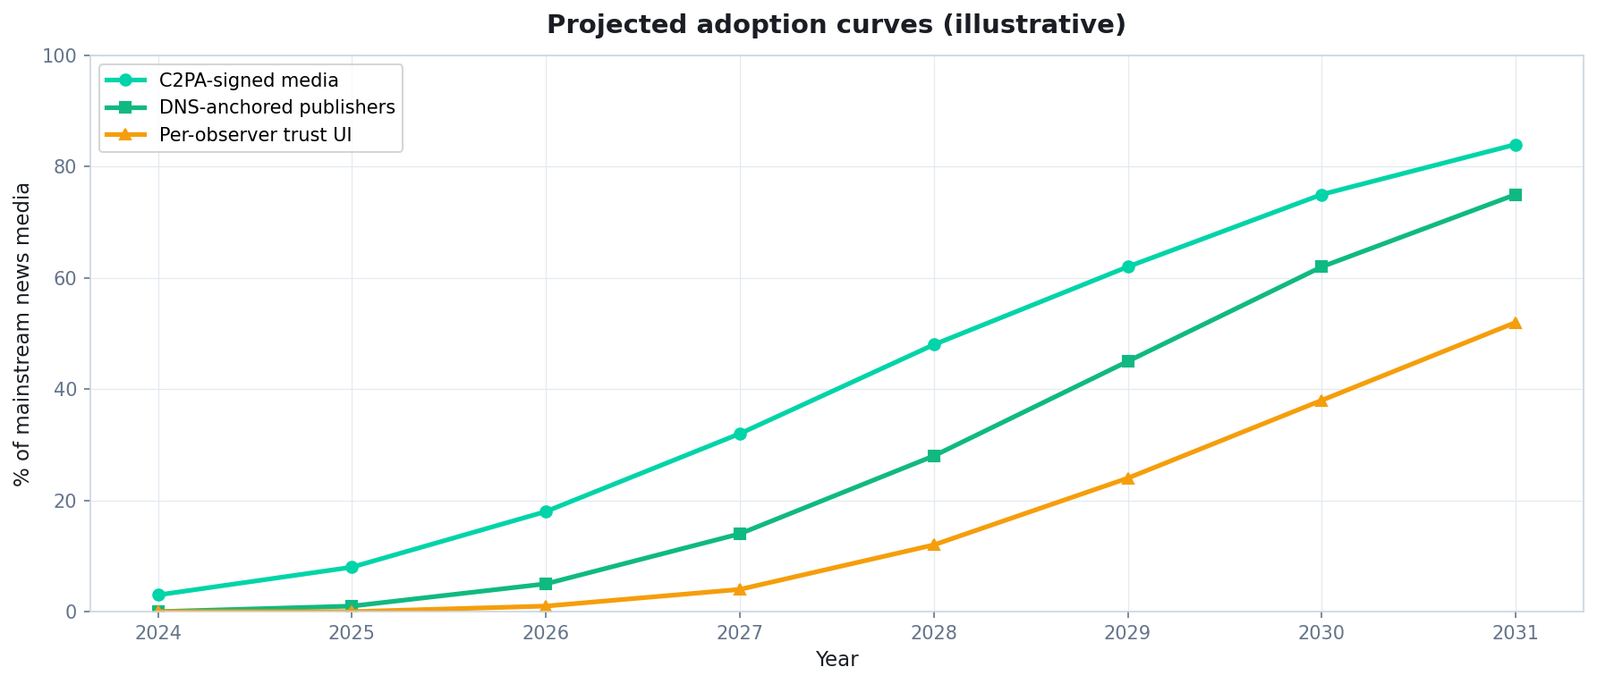
Projected adoption curves
Layer 1 (C2PA) leads; Layers 2-3 follow over 5-7 years.
Quidnug · Deepfakes Are Trust's Endgame
51 / 75

Slide 52
Who moves first
▸ AP and Reuters. Already C2PA-engaged. Could DNS-anchor in months. Industry moves with them.
▸ Major broadcasters: BBC, NHK, ARD, France TV. Public-service broadcasters have institutional incentives for credibility infrastructure.
▸ Investigative outlets: ProPublica, ICIJ, OCCRP. Source-protection use case is most acute for them.
▸ Camera and software vendors. Sony, Nikon, Adobe, Truepic already in C2PA. They're the Layer 1 ecosystem.
▸ Browser vendors. Chrome, Edge, Firefox already adding C2PA UI. Layer 2-3 extensions follow.
Quidnug · Deepfakes Are Trust's Endgame
52 / 75

Slide 53
What the next 5 years look like
▸ Year 1. More C2PA-enabled cameras and editors. Major news organizations DNS-anchor. Pilot platforms display trust badges.
▸ Year 2. Critical mass of mainstream news C2PA-signed. Browser-native verification UI ships.
▸ Year 3. Per-observer trust calibration UI in major news platforms. Citizen journalists routinely DNS-anchor.
▸ Year 4. Detection-only fact-checking augmented by provenance analysis. Election misinformation reduced.
▸ Year 5. Three-layer architecture is standard. Unverified content is flagged by default. The trust ecosystem rebuilds.
Quidnug · Deepfakes Are Trust's Endgame
53 / 75

Slide 54
Honest tradeoff 1: legacy content
▸ Decades of pre-C2PA media exists. Cannot be retroactively signed. Legacy content stays unverified.
▸ Not a fatal problem. Future content gets signed; legacy content remains in legacy mode. Coexistence.
▸ Some institutions can sign retroactively with attestations. 'We the BBC verify this 2010 footage from our archives.' Different signature; still verifiable.
▸ Legacy will be a smaller fraction of viewed content over time. New content shipped daily; legacy fades naturally.
▸ This is also true for HTTPS. Decade-old http:// pages still exist. New ones are https://. We adapted.
Quidnug · Deepfakes Are Trust's Endgame
54 / 75

Slide 55
Honest tradeoff 2: privacy concerns
▸ Photographer identity in C2PA manifest can leak source info. Especially in conflict zones or authoritarian regimes.
▸ Mitigation: pseudonymous credentials. Reuters can attest 'this is from a verified Reuters stringer' without naming the photographer.
▸ Location stripping. C2PA allows excluding location metadata. Newsrooms should default to strip in sensitive contexts.
▸ Selective disclosure. Same primitive that protects sources protects photographers in dangerous situations.
▸ Privacy is a feature, not a bug. The architecture explicitly supports it.
Quidnug · Deepfakes Are Trust's Endgame
55 / 75

Slide 56
Honest tradeoff 3: institutional trust
▸ DNS-anchored identity assumes major publishers are trustworthy. Many readers (left, right, otherwise) increasingly doubt that.
▸ The architecture does not force trust. It makes trust user-controllable. Reader chooses weights; doesn't have to trust everyone.
▸ Trust must be earned over time. Publishers caught publishing falsehoods see their trust decline in user calibration.
▸ Smaller, specialized publishers. DNS-anchored identity equally available. Substack writers, citizen journalists, etc.
▸ Decentralization possible. Federation rather than monoculture. Many different trust hierarchies coexist.
Quidnug · Deepfakes Are Trust's Endgame
56 / 75

Slide 57
Honest tradeoff 4: technical complexity
▸ C2PA + DNS attestation + Quidnug trust graph is more complex than 'view the picture.'
▸ Most users don't need to understand the layers. UI abstracts: 'Verified Reuters - Trust 0.85'. Three layers reduced to one badge.
▸ Curious users can drill down. Click to see C2PA chain, DNS attestation, trust path. Optional.
▸ Implementation engineers need to know the layers. Same as TLS, OAuth, DNSSEC. Not user-visible complexity.
▸ Standards mature over time. C2PA spec stabilizing. DNS attestation following the same path. Quidnug trust graph similarly.
Quidnug · Deepfakes Are Trust's Endgame
57 / 75

Slide 58
What this protocol does NOT solve
▸ Real photos with false captions. Image verifies; caption is journalist's claim. Trust in journalist absorbs the cost.
▸ Honest reporting on uncertain events. Provenance verifies what was reported, not whether it's true.
▸ State-actor disinformation with full publisher infrastructure. If a state-controlled publisher is DNS-anchored, they're verified; trust is in the user's hands.
▸ Confirmation bias. User who only trusts publishers that align with their priors will continue to do so.
▸ This is one defense layer. Critical thinking and media literacy still matter.
Quidnug · Deepfakes Are Trust's Endgame
58 / 75

Slide 59
What to do this year (newsroom)
▸ Adopt C2PA at scale. Camera firmware updates, editing workflow integration.
▸ DNS-anchor your publication. Quidnug attestation root + TXT record. Few days of work.
▸ Train staff on selective disclosure for source protection. Internal workflows for sensitive sources.
▸ Update publication standards. Sign articles. Attestation as part of editorial completion.
▸ Lobby browser vendors. Push for C2PA UI to be enabled by default.
Quidnug · Deepfakes Are Trust's Endgame
59 / 75

Slide 60
What to do this year (platform)
▸ Display verification badges. C2PA + DNS attestation visible to users.
▸ Build trust calibration UI. Let users adjust their trust weights. Make it visible and reversible.
▸ Surface provenance on demand. Drill-down for curious users. C2PA chain, publisher attestation, trust path.
▸ Don't impose a global trust hierarchy. Let users decide. Platform provides the math, not the verdict.
▸ Combat unverified content. Don't ban; flag. 'This content has no provenance verification' lets users decide.
Quidnug · Deepfakes Are Trust's Endgame
60 / 75

Slide 61
What to do this year (regulator / policy)
▸ Mandate C2PA for synthetic media disclosure. EU AI Act + similar laws can require provenance metadata for AI-generated content.
▸ Fund the standards. C2PA spec, browser implementation, library development. Public-good investment.
▸ Recognize cryptographic provenance in legal frameworks. Court admissibility of signed evidence.
▸ Avoid centralized authority. DNS + open standards, not government certification regime.
▸ Coordinate internationally. EU + US + Asia alignment on C2PA + similar standards. Avoid fragmentation.
Quidnug · Deepfakes Are Trust's Endgame
61 / 75

Slide 62
What to do this year (citizen)
▸ Look for verification badges. Train yourself to expect them. Suspect content without them.
▸ Calibrate your trust graph thoughtfully. Diverse sources. Not just one outlet.
▸ Push platforms to display provenance. Demand the verification UI.
▸ Support C2PA-enabled creators. Photographers, journalists, news organizations who sign their work.
▸ Be skeptical of unverified viral content. Especially political, especially before elections.
Quidnug · Deepfakes Are Trust's Endgame
62 / 75

Slide 63
The architecture in one sentence
“
C2PA + DNS-anchored identity + relational trust. Three layers, none sufficient alone, all necessary together.
— The deepfake defense in one sentence
Quidnug · Deepfakes Are Trust's Endgame
63 / 75

Slide 64
Summary: the four claims revisited
▸ 1. Detection is necessary but losing. Generator quality outpaces classifier accuracy. Defenders must shift strategy.
▸ 2. Provenance-first architecture is the durable answer. Sign at capture, verify at display, trust per-observer.
▸ 3. C2PA is correct but insufficient. Layer 1 of three. Layers 2 (DNS) and 3 (relational trust) close the gap.
▸ 4. Source protection composes with provenance. Selective disclosure preserves credibility without identity exposure.
Quidnug · Deepfakes Are Trust's Endgame
64 / 75

Slide 65
References
▸ Coalition for Content Provenance and Authenticity (C2PA). c2pa.org. Spec v1.3 (2025).
▸ Adobe Content Credentials. contentcredentials.org.
▸ Sumsub Identity Fraud Report 2024. Documented deepfake growth metrics.
▸ Reality Defender 2024 industry report. Detection accuracy trends.
▸ EU AI Act 2024. Article 50: synthetic content disclosure obligations.
▸ Romania Constitutional Court Decision (Dec 6, 2024). First election annulment over deepfake-driven manipulation.
▸ Quidnug QDP-0023 (DNS-anchored attestation). github.com/quidnug/quidnug/docs/design/0023-*.
▸ Quidnug QDP-0024 (private communications). github.com/quidnug/quidnug/docs/design/0024-*.
Quidnug · Deepfakes Are Trust's Endgame
65 / 75

Slide 66
More references
▸ Goodfellow, Shlens, Szegedy (2014). Adversarial examples. ICLR 2015.
▸ Internet Watch Foundation (2024). AI CSAM report. iwf.org.uk.
▸ FCC ruling on AI-generated robocalls (Feb 2024). fcc.gov.
▸ Microsoft Reuters AP collaboration on C2PA newsroom workflows.
▸ Companion blog post. blogs/2026-04-24-deepfakes-trust-endgame.md.
▸ DNSSEC and Certificate Transparency. Existing infrastructure C2PA + DNS attestation builds on.
▸ WEF Global Risks Report 2024. Misinformation ranked #1 global risk.
Quidnug · Deepfakes Are Trust's Endgame
66 / 75

Slide 67
Common objections, briefly
▸ 'C2PA can be stripped.' True. The badge then shows 'unable to verify.' Users learn to distrust unverified content.
▸ 'DNS can be hijacked.' Rarely, briefly. DNSSEC + Certificate Transparency raise the bar substantially.
▸ 'Per-observer trust = filter bubble.' Constellation view shows the crowd alongside personalized. User-controlled, transparent.
▸ 'This will hurt small publishers.' Opposite. DNS-anchored identity equally available. Lowers the bar to verified-publisher status.
▸ 'Detection still catches some attacks.' Yes. Detection complements provenance. We don't choose; we use both.
Quidnug · Deepfakes Are Trust's Endgame
67 / 75

Slide 68
What success looks like in 2030
▸ Mainstream news media routinely C2PA-signed. Unsigned content is the suspicious exception, not the rule.
▸ Major publishers DNS-anchored. Verified Reuters, Verified BBC, Verified Le Monde displayed natively in browsers.
▸ User-side trust calibration ubiquitous. Every news platform has a trust UI. Personalized, transparent, reversible.
▸ Source protection workflow standardized. Selective disclosure attestations a normal part of investigative journalism.
▸ Election deepfake incidents drop sharply. Not zero, but no longer effective at scale because verification is the default.
Quidnug · Deepfakes Are Trust's Endgame
68 / 75

Slide 69
The outlook
“
Detection is the rear-guard. Provenance is the future. Build for what comes next, not for what we wish hadn't happened.
— The strategic outlook
Quidnug · Deepfakes Are Trust's Endgame
69 / 75

Slide 70
What this conversation enables
▸ Healthier elections. Verified candidate communication. Lower deepfake effectiveness.
▸ Better investigative journalism. Source protection + cryptographic credibility.
▸ Restored public trust in media. Visible chain of evidence.
▸ Reduced financial fraud. Verified business communication.
▸ Reduced individual harm. Lower NCII spread, lower romance scam success.
▸ This is foundational infrastructure. Not a feature; not a product. A substrate for the next twenty years of trust.
Quidnug · Deepfakes Are Trust's Endgame
70 / 75

Slide 71
Things we owe ourselves
▸ Coordinated international standards. EU + US + Asia alignment on C2PA + DNS attestation + relational trust.
▸ Open implementations. Anyone should be able to verify; not gated by vendor.
▸ Public-interest funding. Foundation grants, government infrastructure investment. Not VC-only.
▸ Researcher independence. Adversarial robustness testing by neutral parties, not just vendors.
▸ Civil liberties oversight. Privacy and free speech advocacy in standards bodies. EFF, ACLU, Article 19.
Quidnug · Deepfakes Are Trust's Endgame
71 / 75

Slide 72
What this protocol explicitly avoids
▸ No central truth authority. DNS is decentralized infrastructure; no Ministry of Verified Content.
▸ No mandatory tracking. Photographers can stay pseudonymous. Sources stay protected.
▸ No global trust hierarchy. Each user's trust graph is their own.
▸ No platform censorship via verification. Unverified content is flagged, not blocked.
▸ This is infrastructure, not editorial. It tells you WHO published; not WHETHER to believe.
Quidnug · Deepfakes Are Trust's Endgame
72 / 75

Slide 73
The strategic insight
“
We do not need to detect every deepfake. We need to make signed authenticity the default. The asymmetry shifts back to defenders.
— The strategic insight
Quidnug · Deepfakes Are Trust's Endgame
73 / 75

Slide 74
Next steps
▸ Newsrooms. C2PA at scale. DNS-anchor publication. Sign articles. Push browser vendors for verification UI.
▸ Platforms. Display badges. Build trust calibration UI. Don't impose hierarchy.
▸ Vendors. Camera and software vendors: complete C2PA integration. Continue investment.
▸ Regulators. Mandate disclosure for synthetic content. Fund standards. Recognize cryptographic provenance legally.
▸ Citizens. Look for badges. Calibrate trust thoughtfully. Demand verification UI from the platforms you use.
Quidnug · Deepfakes Are Trust's Endgame
74 / 75

Slide 75
Questions
Thank you. The hard work begins now.
Where does the three-layer architecture fail in your context? Which layer is your stakeholder bottleneck? What's the next concrete step for your org?
Resources
github.com/quidnug/quidnug
blogs/2026-04-24-deepfakes-trust-endgame.md
C2PA spec: c2pa.org
Adobe Content Credentials: contentcredentials.org
Quidnug QDP-0023 (DNS-anchored attestation)
Quidnug QDP-0024 (private communications)
Sumsub Identity Fraud Report 2024
WEF Global Risks Report 2024
Quidnug · Deepfakes Are Trust's Endgame
75 / 75

