Slide 1
QUIDNUG · SCIENCE
The Reproducibility Crisis Needs Tamper-Evident Peer Review
Why 39% of psychology studies replicate, why 70% of researchers have failed to reproduce a colleague's work, and how signed attestation chains fix what traditional peer review can't.
Quidnug · Reproducibility Crisis
1 / 80
Notes:
Welcome. 80 slides, about 60-70 min with Q&A.
Audience: researchers, journal editors, research infrastructure teams, funding-agency staff.
Central thesis: the reproducibility crisis is inseparable from the absence of a tamper-evident trust substrate for peer review.
Cite Ioannidis 2005, OSC 2015, Baker 2016, Begley/Ellis 2012 as the empirical anchors. We will defend each.

Slide 2
Where we are in 2026
39%
of psychology studies in top journals successfully replicated (Open Science Collaboration, Science 2015).
Mean replication effect size was roughly half of the original. The instrument we use to evaluate scientific claims is broken at the substrate level.
Quidnug · Reproducibility Crisis
2 / 80

Slide 3
The most damning data point
11%
of 53 landmark cancer biology papers reproduced at Amgen (Begley & Ellis, Nature 2012).
6 of 53. Not a typo. The most-cited single number in the reproducibility literature.
Quidnug · Reproducibility Crisis
3 / 80

Slide 4
Agenda
▸ Section 1. The empirical scale. Replication rates, retractions, fraud cases, the cost.
▸ Section 2. Systemic causes. Publish-or-perish, p-hacking, low power, peer review blind spots.
▸ Section 3. Fixes that partially work. Preregistration, open data, open review, replication journals.
▸ Section 4. The missing substrate. Four cryptographic primitives current systems lack.
▸ Section 5. Signed peer review. Reviewer identity, signed reviews, append-only chain.
▸ Section 6. Data provenance chains. Lineage from raw collection to published figure.
▸ Section 7. Citation-weighted reputation. Reviewer quality computable, not editorial secret.
▸ Section 8. A paper's life cycle under this system. Concrete walkthrough from preregistration to supersession.
▸ Section 9. Institutional tradeoffs and rollout. What this requires from journals, universities, funders.
Quidnug · Reproducibility Crisis
4 / 80

Slide 5
Four key claims this talk defends
▸ Claim 1. The replication crisis measures infrastructure quality, not researcher quality.
▸ Claim 2. Detection of fraud and selective reporting is a losing arms race. Structural substrates win.
▸ Claim 3. Cryptographic data provenance would have caught at least two of the three highest-profile fraud cases of the past decade before replication teams were needed.
▸ Claim 4. Institutional inertia is real but weaker than what preprint adoption faced. Preprints went from fringe to default in roughly a decade.
Quidnug · Reproducibility Crisis
5 / 80

Slide 6
Section 1
The Empirical Scale
Replication rates, retractions, fraud cases. Hard numbers.
Quidnug · Reproducibility Crisis
6 / 80

Slide 7
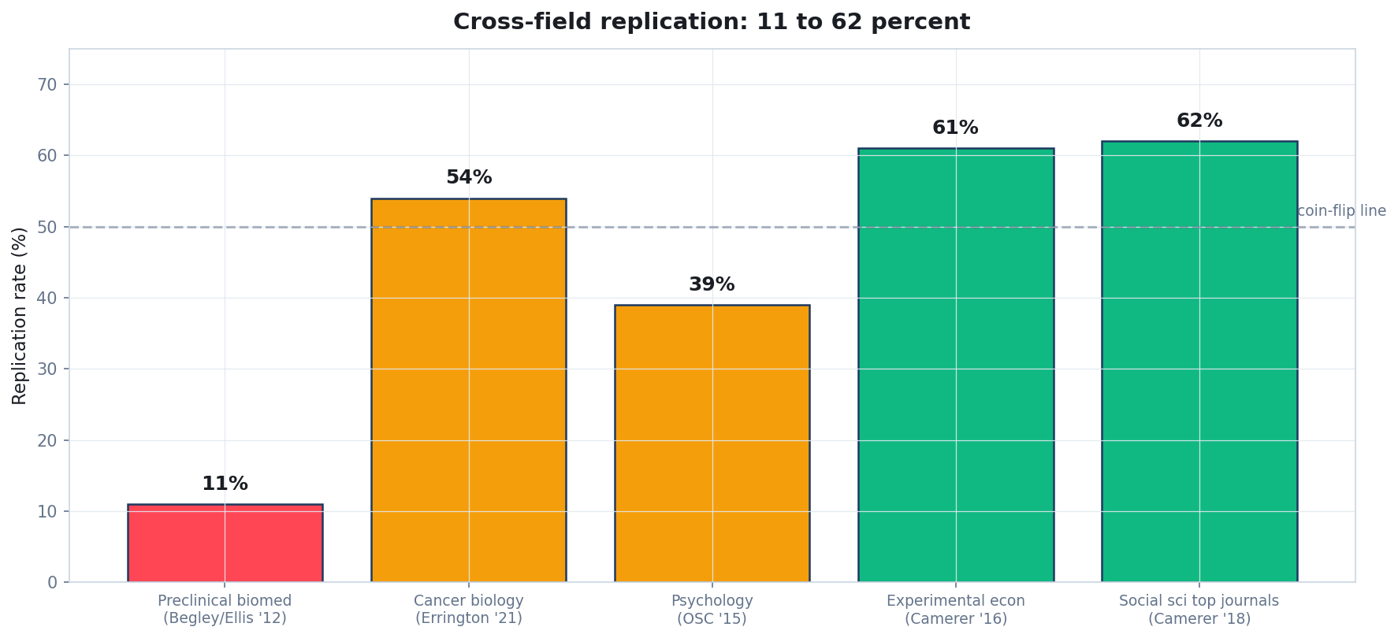
Cross-field replication rates: 11% to 62%
Begley & Ellis (Nature 2012); Errington et al (eLife 2021); OSC (Science 2015); Camerer et al (Science 2016, Nature Human Behaviour 2018).
Quidnug · Reproducibility Crisis
7 / 80

Slide 8
OSC 2015: the most-cited replication study
▸ Open Science Collaboration. 'Estimating the reproducibility of psychological science.' Science 349(6251). aac4716, 2015.
▸ Method. 270 authors recruited to replicate 100 studies from three top psychology journals (JPSP, Psych Sci, JEP).
▸ Result, statistical significance criterion. Only 36% of replications reached p < 0.05 in the same direction as the original.
▸ Result, subjective replication. 39% considered to have replicated.
▸ Effect-size attenuation. Mean replication effect size was roughly half of the original. Not noise; systematic shrinkage.
▸ Cited 7,000+ times. Methodologically scrutinized; not refuted.
Quidnug · Reproducibility Crisis
8 / 80

Slide 9
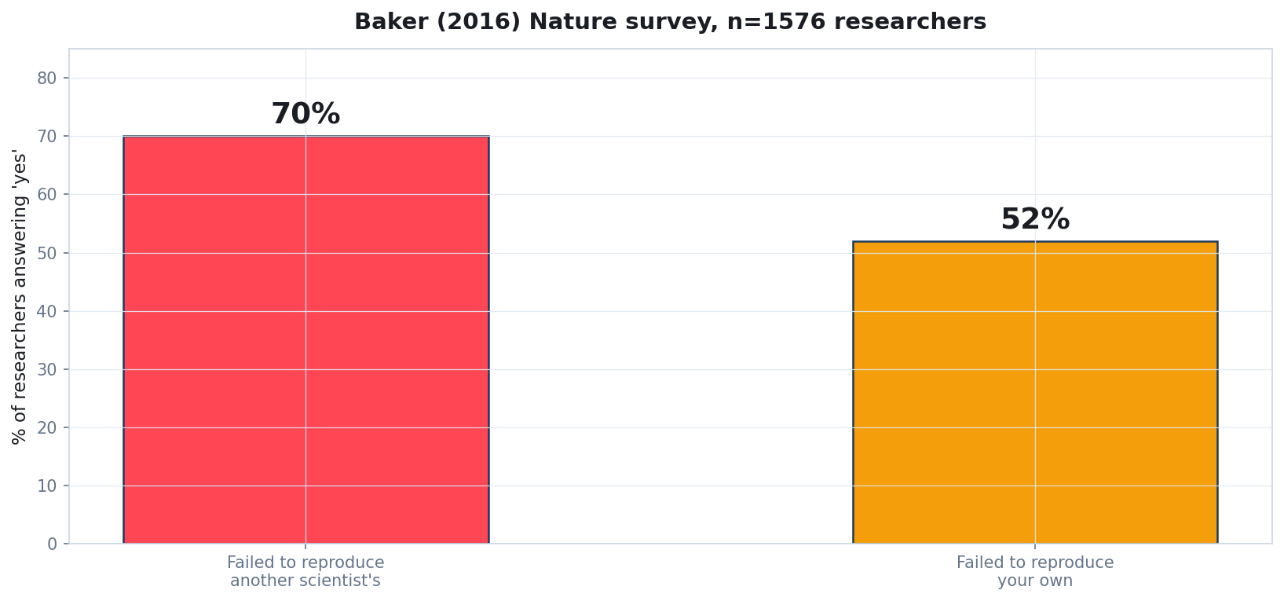
Baker 2016 Nature survey: it is not just one field
Baker, M. (2016). 'Is there a reproducibility crisis?' Nature 533, 452-454. n = 1,576 researchers.
Quidnug · Reproducibility Crisis
9 / 80

Slide 10
Begley & Ellis 2012: the cancer biology number
▸ Begley & Ellis. 'Drug development: Raise standards for preclinical cancer research.' Nature 483, 531-533. 2012.
▸ Method. Amgen's industrial biology team attempted to reproduce 53 landmark oncology studies.
▸ Result. 6 of 53 (~11%) reproduced. The remaining 47 had effects that did not survive replication.
▸ Industry context. Amgen is not a hostile actor; they wanted these to reproduce so they could build drugs on them.
▸ Implication. If only 11% of preclinical cancer biology replicates, drug development based on the literature is built on shifting sand.
Quidnug · Reproducibility Crisis
10 / 80

Slide 11
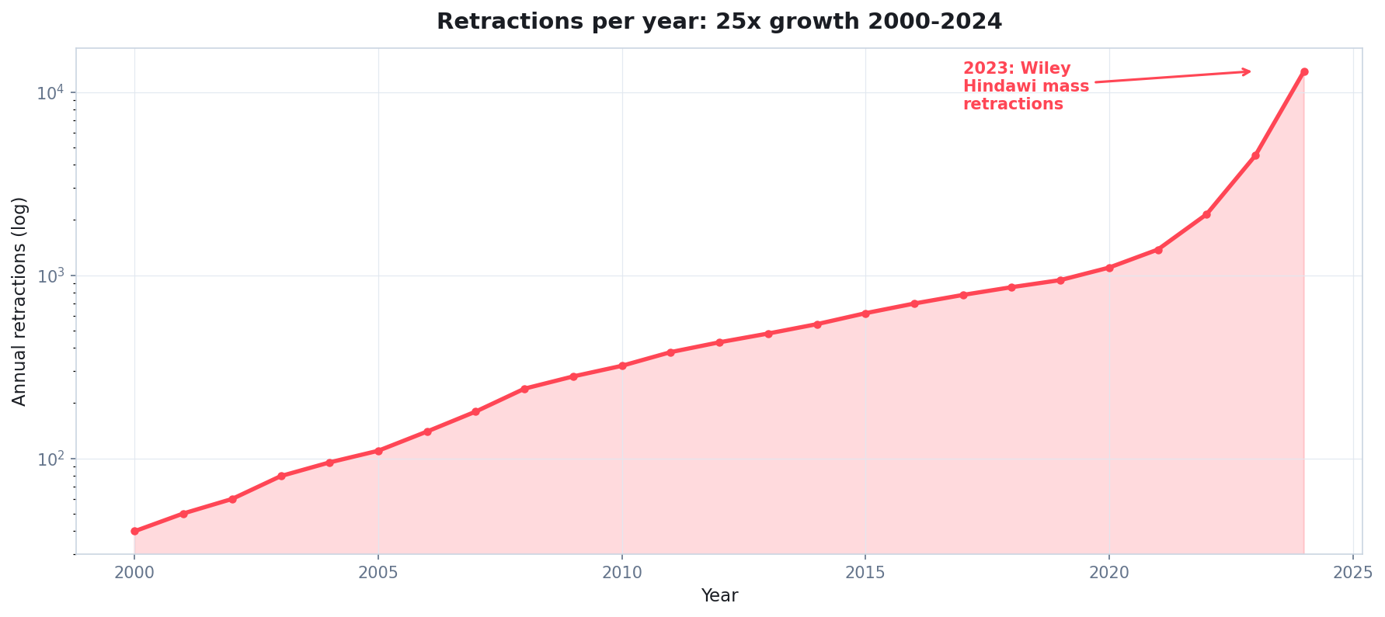
Retractions are accelerating exponentially
Sources: Retraction Watch database, NIH PubMed retraction notices, Wiley/Hindawi 2023 mass-retraction event.
Quidnug · Reproducibility Crisis
11 / 80

Slide 12
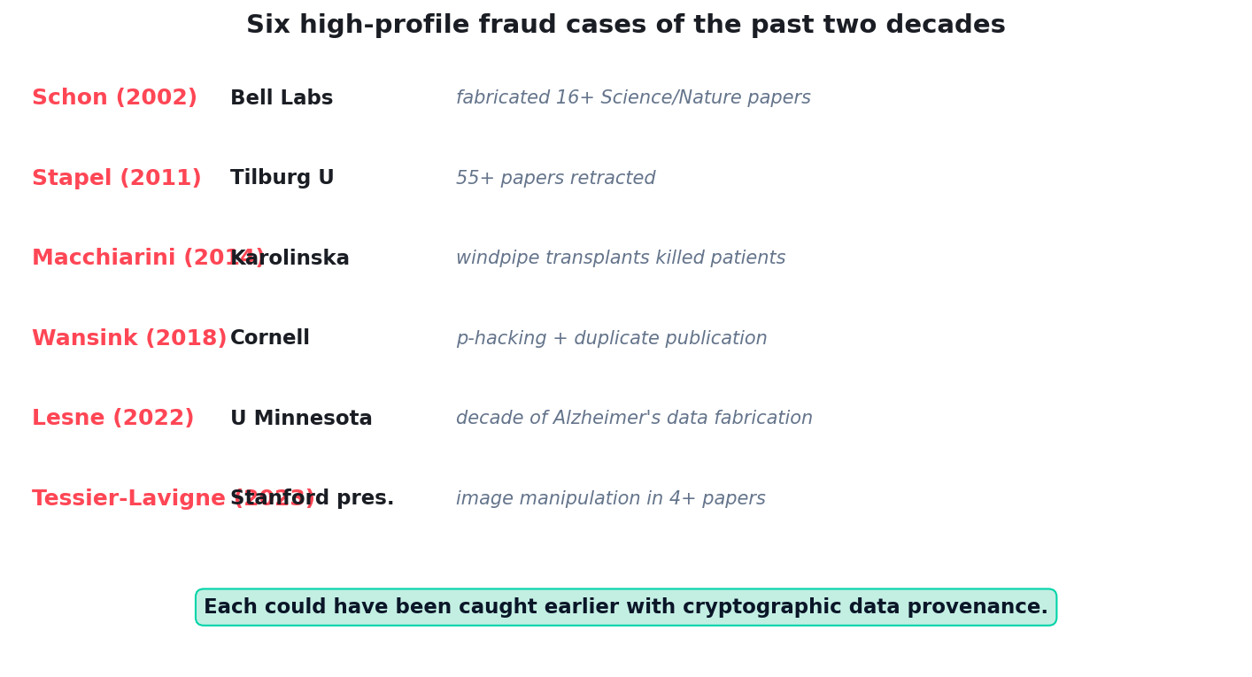
Six high-profile fraud cases of the past two decades
Each case took 5-15 years to surface. Several would have been caught in months with cryptographic data provenance.
Quidnug · Reproducibility Crisis
12 / 80

Slide 13
What this costs society
▸ Direct: irreproducible research wastes ~$28B/year in US preclinical biomedicine alone. Freedman, Cockburn, Simcoe (PLOS Biology 2015).
▸ Indirect: drug pipelines built on bad foundations. Phase II/III failures often trace back to non-replicated preclinical work.
▸ Public trust erosion. Pew Research 2023: 27% of US adults have 'a great deal of confidence' in scientists, down from 39% in 2020.
▸ Policy decisions on shaky ground. Public-health, education, criminal-justice policy frequently cites studies that do not replicate.
▸ Researcher career consequences. Junior researchers cannot tell which findings to build on. Wasted years on dead foundations.
Quidnug · Reproducibility Crisis
13 / 80

Slide 14
The 2005 paper that started this conversation
“
Most published research findings are false.
— John Ioannidis, PLOS Medicine, 2005
The most-cited paper in PLOS Medicine history. Twenty years of empirical work has confirmed something in that neighborhood.
Quidnug · Reproducibility Crisis
14 / 80

Slide 15
Section 2
Systemic Causes
Publish-or-perish, p-hacking, low power, peer review blind spots.
Quidnug · Reproducibility Crisis
15 / 80

Slide 16
Cause 1: publish-or-perish
▸ Tenure, promotion, grant funding all gate on publication count and journal prestige.
▸ Negative results are nearly unpublishable. Franco, Malhotra, Simonovits (Science 2014): only 21% of social-science null results submitted; rest filed away.
▸ Selective reporting becomes rational. Researcher reports the analysis that worked, not the ten that didn't.
▸ Career incentive misalignment. What earns tenure is not what advances science. We currently optimize for the wrong objective.
▸ Substrate fix. Preregistration + signed-claim infrastructure makes selective reporting visible.
Quidnug · Reproducibility Crisis
16 / 80

Slide 17
Cause 2: p-hacking and researcher degrees of freedom
▸ Simmons, Nelson, Simonsohn (Psychological Science 2011). 'False-positive psychology.' Showed that 4 specific common analytical choices can push false-positive rates to 60% or more.
▸ Researcher degrees of freedom. Inclusion criteria, outlier removal, dependent-variable choice, covariate inclusion, transformation choice. Each is a fork in the analytical garden.
▸ Without preregistration, the analyst picks the path that gives p < 0.05. Not necessarily intentionally; cognitive bias is sufficient.
▸ Substrate fix. Preregistered analysis script signed before data collection. Deviations are visible and accountable.
▸ This is mechanical, not moral. Honest researchers fall into this. The substrate removes the temptation.
Quidnug · Reproducibility Crisis
17 / 80

Slide 18
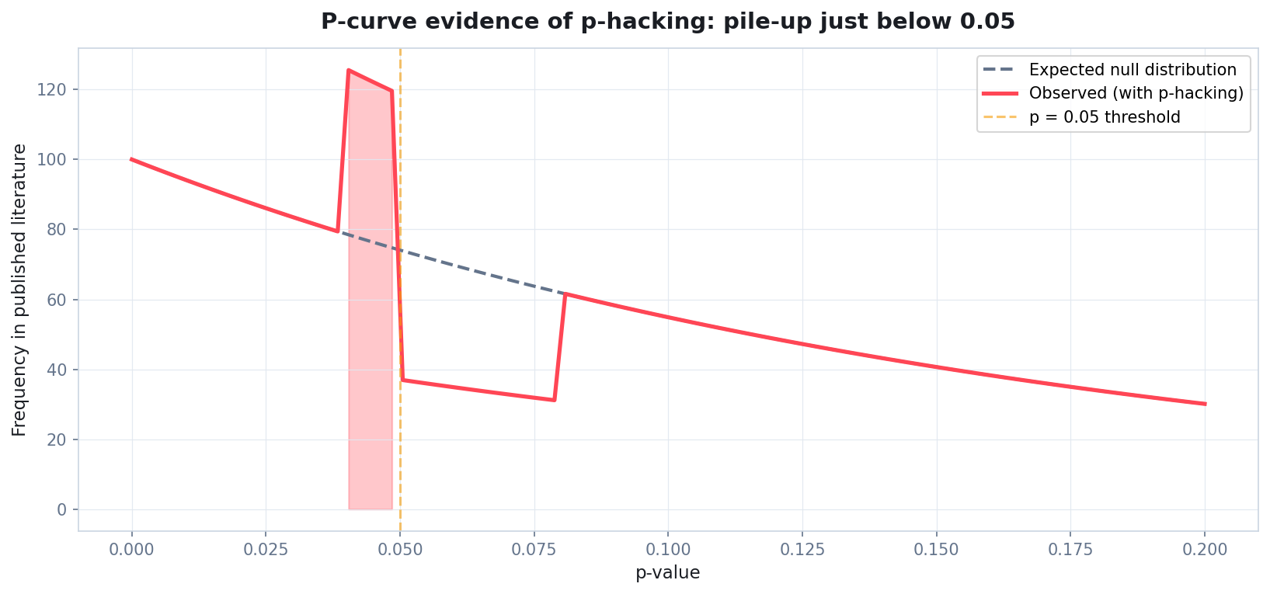
P-curve evidence: pile-up just below 0.05
Simonsohn, Nelson, Simmons (2014) P-curve methodology. Spike in observed distribution just under threshold.
Quidnug · Reproducibility Crisis
18 / 80

Slide 19
Cause 3: low statistical power
▸ Button, Ioannidis et al (Nature Reviews Neuroscience 2013). Median power of neuroscience studies: 21%. Should be at least 80%.
▸ Underpowered studies that DO produce significant results have inflated effect sizes. Statistical artifact called 'winner's curse.'
▸ Replicators measure the true effect, find it smaller, fail to reach significance. Pattern is mechanical, not researcher fault.
▸ Power calculations existed in 1969 (Cohen). Adoption: still partial in 2026.
▸ Substrate fix. Signed pre-registration includes a power calculation. Reviewers can demand justification.
Quidnug · Reproducibility Crisis
19 / 80

Slide 20
Cause 4: peer review does not catch this
▸ What peer review actually does. Review the manuscript. Suggest revisions. Recommend accept/reject.
▸ What it does NOT do. Re-run the analysis. Verify the data. Audit the lab notebook.
▸ Reviewers receive PDFs, not data and code. Even open-data papers are not commonly re-analyzed by reviewers; nobody is paying for that work.
▸ Reviewer time is uncompensated and scarce. Estimate: scholarly publishing extracts ~$2B/year of free reviewer labor (Aczel et al 2021).
▸ Substrate cannot replace peer review. But it can give peer review the materials it needs to actually verify, plus an auditable record of what happened.
Quidnug · Reproducibility Crisis
20 / 80

Slide 21
The incentive summary
▸ Researcher incentive: publish positive, novel results in high-prestige journals.
▸ Journal incentive: publish citable, attention-grabbing papers.
▸ Reviewer incentive: minimal time, anonymous. No reputation stake in being right or wrong.
▸ University incentive: produce papers that earn tenure review credit.
▸ Funder incentive: fund work that produces publications.
▸ None of these incentivize careful, replicable work. The substrate must change incentives by making careful work visible and rewardable.
Quidnug · Reproducibility Crisis
21 / 80

Slide 22
Section 3
Fixes That Partially Work
Preregistration, open data, open review, replication journals. Necessary but not sufficient.
Quidnug · Reproducibility Crisis
22 / 80

Slide 23
Fix 1: preregistration
▸ Researcher commits to hypothesis + analysis plan BEFORE data collection. Commitment is timestamped on a public registry.
▸ Effective when used. Allen & Mehler 2019: registered reports have significantly lower rates of effect-size inflation.
▸ Registration platforms. OSF (Open Science Framework), AsPredicted, ClinicalTrials.gov for clinical trials.
▸ Limitations. Voluntary; not enforced. Researchers can deviate from the plan and not disclose. The 'pre' part is honor-system.
▸ Substrate improvement. Cryptographic signing makes the preregistration tamper-evident and the deviation accountability mechanical.
Quidnug · Reproducibility Crisis
23 / 80

Slide 24
Fix 2: open data
▸ Authors publish raw data alongside the paper. Mandated by some funders (NIH 2023+) and journals (PLOS, BMJ).
▸ Helps when followed. Re-analysis becomes possible. Some errors are caught.
▸ Limitations. Most uploads are post-hoc, not provenance-linked. Connection between 'this is the dataset I analyzed' and 'this is the figure I plotted' is rarely cryptographic.
▸ Selective sharing. Authors share what supports the published claim; not necessarily everything they collected.
▸ Substrate improvement. Provenance chains link instrument to figure with cryptographic continuity.
Quidnug · Reproducibility Crisis
24 / 80

Slide 25
Fix 3: open peer review
▸ Reviewer identity disclosed. EMBO Journal, Wellcome Open Research, eLife. Mostly voluntary.
▸ Helps with accountability. Reviewers cannot hide behind anonymity to provide low-quality reviews.
▸ Limitations. Senior reviewers worry about retaliation from junior authors. Junior reviewers worry about retaliation from senior authors. Both reasonable.
▸ Pseudonymous reviewer identity solves this. Cryptographically stable identifier without real-name exposure. Reputation accrues; safety preserved.
▸ Substrate improvement. Quidnug pseudonymous quids let reviewer reputation form without forcing real-name disclosure.
Quidnug · Reproducibility Crisis
25 / 80

Slide 26
Fix 4: replication journals + registered reports
▸ Royal Society Open Science, Cortex, Comprehensive Results in Social Psychology, others. Publish replication studies and registered reports.
▸ Registered reports model. Editorial decision based on the design BEFORE data collection. If the design is sound, paper publishes regardless of result.
▸ Effective. Reduces publication bias. Allen & Mehler 2019: registered reports have a much higher null-result publication rate (44% vs ~5% for traditional).
▸ Limitations. Still niche. Most fields don't have a registered-reports venue. Adoption is journal-by-journal.
▸ Substrate complement. Not a replacement; the substrate makes registered reports easier to verify and audit.
Quidnug · Reproducibility Crisis
26 / 80

Slide 27
The honest summary
“
Each existing fix is necessary. None is sufficient. Together they cover maybe a third of the failure surface.
— Why we need a substrate, not just policies
Quidnug · Reproducibility Crisis
27 / 80

Slide 28
Section 4
The Missing Substrate
Four primitives current scholarly infrastructure does not provide.
Quidnug · Reproducibility Crisis
28 / 80

Slide 29
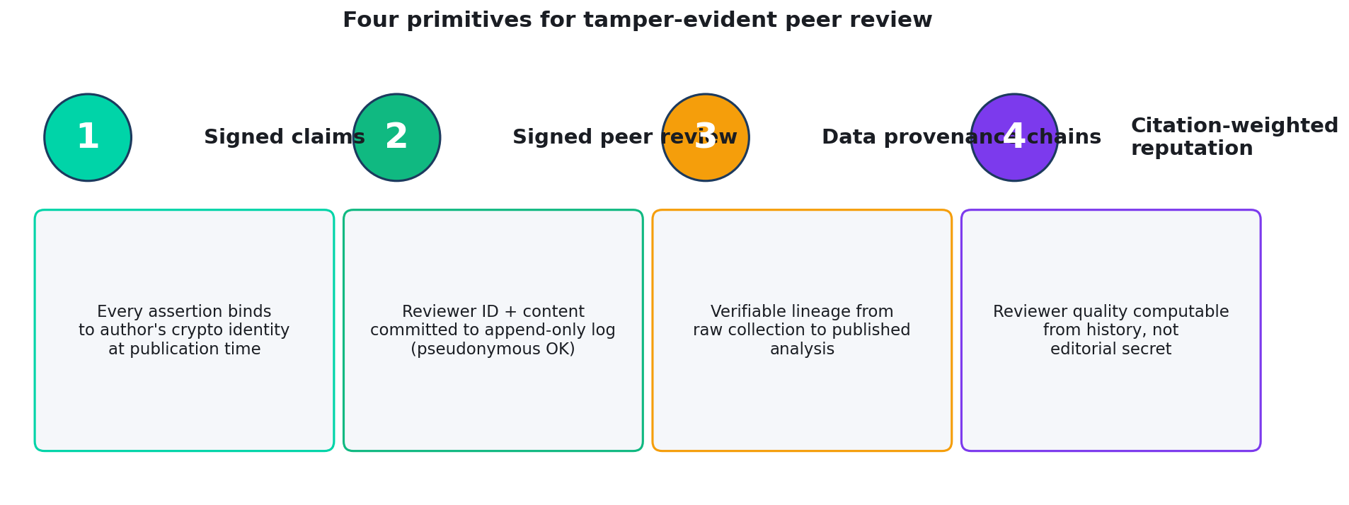
The four primitives
Each primitive maps to an existing failure mode. All four together close the trust gap.
Quidnug · Reproducibility Crisis
29 / 80

Slide 30
Primitive 1: signed claims
▸ Every assertion in a paper binds to the author's cryptographic identity at publication time.
▸ Identity persists across institutional changes. Move universities, change names: the same cryptographic identity carries the publication record.
▸ Disambiguation. ORCID solved part of this; cryptographic signing closes the rest.
▸ Tamper detection. If a published claim is later silently altered, the signature breaks. Visible to anyone who checks.
▸ Cost. ECDSA P-256 signature is 64 bytes. Verification is ~50 microseconds. Trivial overhead.
Quidnug · Reproducibility Crisis
30 / 80

Slide 31
Primitive 2: signed peer review
▸ Each reviewer's review is signed with a stable identity. Pseudonymous OK; the identity is cryptographically consistent across their review history.
▸ Reviewer reputation accrues over time. Computable from review-replication correlation.
▸ Append-only review chain. Editor decisions, reviewer comments, author rebuttals all form an ordered chain.
▸ Anyone can verify the chain. Did this paper actually receive substantive review? Or was it rubber-stamped?
▸ Privacy preserved. Reviewer real name remains hidden if they choose. The cryptographic identity is what the reputation builds on.
Quidnug · Reproducibility Crisis
31 / 80

Slide 32
Primitive 3: data provenance chains
▸ Every dataset cited has verifiable lineage from raw instrument output to published analysis.
▸ Each transformation is signed. Acquisition, validation, cleaning, analysis: each step produces a signed artifact.
▸ Modifications break the chain. Quietly altering a value in the analysis stage breaks the signature; the chain becomes invalid.
▸ Audit becomes mechanical. Replicators don't need to ask 'did you really collect this data this way?' They can verify it.
▸ Compatible with privacy. Sensitive data can be hashed at acquisition; provenance is preserved without exposing raw data.
Quidnug · Reproducibility Crisis
32 / 80

Slide 33
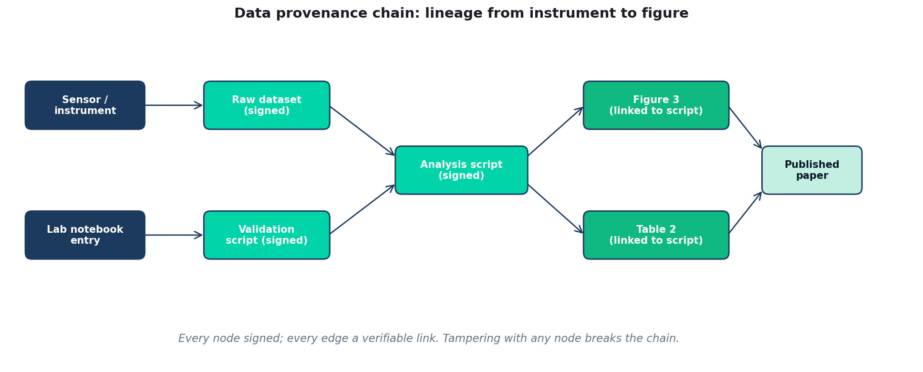
Data provenance: lineage from instrument to figure
Every node signed; every edge a verifiable link. Tampering with any node breaks the chain.
Quidnug · Reproducibility Crisis
33 / 80

Slide 34
Primitive 4: citation-weighted reputation
▸ Reviewer quality is computable, not editorial secret. From review history: how often did their accept/reject decisions correlate with later replication outcomes?
▸ Author reputation similarly. Citation-weighted by who is citing. Citations from high-replication-rate researchers count more than citations from low-replication-rate researchers.
▸ Pseudonymous compatible. Reputation can attach to a stable cryptographic identity without revealing real name.
▸ Operates on the trust graph. Same Quidnug primitives that power reviews and consent power scholarly reputation.
▸ Replaces opaque editorial gatekeeping with auditable computation. Editors still curate; the curation rationale is now visible.
Quidnug · Reproducibility Crisis
34 / 80

Slide 35
Cryptographic properties that matter
▸ Signed, not hashed. Anyone with the public key can verify; nobody can forge.
▸ Append-only. Reviews, citations, retractions all add to the record. The record never silently changes.
▸ Time-ordered. Sequence is preserved cryptographically, not just by filename or upload date.
▸ Domain-scoped. Reputation in oncology does not auto-transfer to neuroscience. Each subfield is its own trust domain.
▸ Revocation as data, not deletion. Retraction is a new signed record; the original remains visible with its retraction status linked.
Quidnug · Reproducibility Crisis
35 / 80

Slide 36
What this does NOT require
▸ No central trust authority. No 'Science Inc.' issuing identities. Researchers self-host or use their institution's existing PKI.
▸ No mandatory adoption. Adopting journals get the benefits. Non-adopting journals continue with current infrastructure. Coexistence is fine.
▸ No new file formats. PDFs, datasets, code repos all stay. The signing metadata wraps existing artifacts.
▸ No blockchain in the consumer sense. Quidnug uses signed records and trust graphs. No proof-of-work, no token economics.
▸ No replacement of human judgment. Editors still decide; reviewers still review. The substrate makes their work auditable.
Quidnug · Reproducibility Crisis
36 / 80

Slide 37
Section 5
Signed Peer Review
Structure of a signed review, pseudonymous identity, review chain on a paper.
Quidnug · Reproducibility Crisis
37 / 80

Slide 38
Structure of a signed review
{
"type": "PEER_REVIEW",
"reviewer_quid": "9a82c4e1f0b7d2c5", // pseudonymous
"paper_doi": "10.1038/s41586-2026-12345",
"submission_round": 1,
"decision": "minor_revision",
"review_text_cid": "bafyrei...", // IPFS pointer
"confidence": 0.85,
"scores": {
"novelty": 4, "methodology": 3,
"reproducibility": 4, "clarity": 4
},
"timestamp": 1714579200,
"signature": "..."
}
Quidnug · Reproducibility Crisis
38 / 80

Slide 39
Pseudonymous reviewer identity
▸ Reviewer creates a cryptographic identity for review work. Optionally separate from their author identity.
▸ All their reviews link to this identity. Reputation accrues via review history.
▸ Real name remains hidden if reviewer chooses. Editor knows the real name (for assignment); the public record sees only the pseudonym.
▸ Pseudonym is stable across years. Persistent reputation without real-name exposure.
▸ Compromise scenario. Senior reviewer wants to give a critical review without career retaliation; junior reviewer wants to be honest without inviting senior pushback. Both work.
Quidnug · Reproducibility Crisis
39 / 80

Slide 40
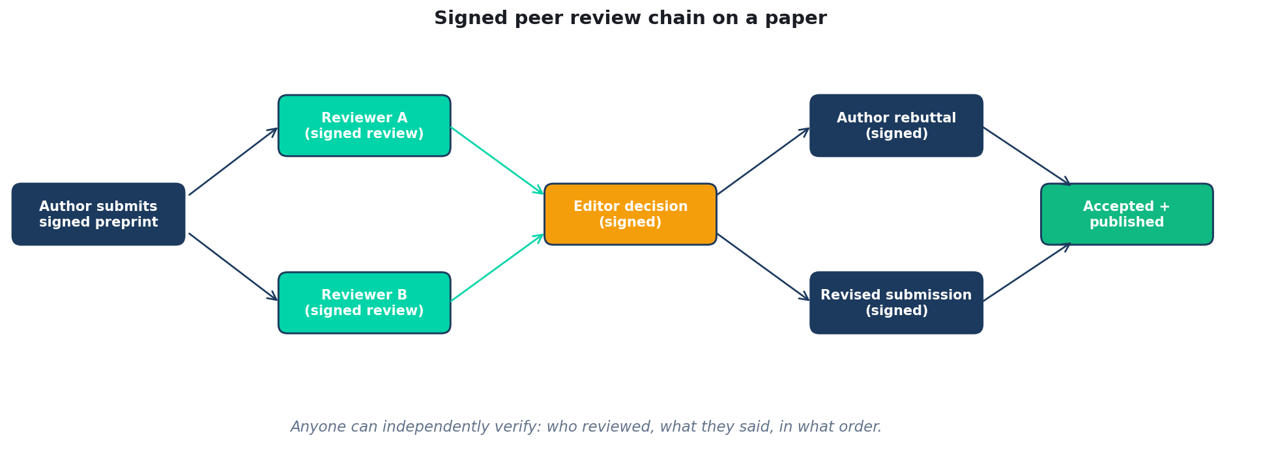
The review chain on a paper
Each step signed. Anyone can independently verify the review history.
Quidnug · Reproducibility Crisis
40 / 80

Slide 41
What signed peer review enables
▸ Visible quality of review. Anyone can see if a paper got 4 substantive reviews or 3 rubber-stamps.
▸ Reviewer accountability. If a reviewer consistently approves papers that don't replicate, their reputation declines.
▸ Deletable reviews surface tamper evidence. If a journal silently changes a review later, the chain breaks visibly.
▸ Review work credit. Pseudonymous reviewers can credibly claim reviewing experience for tenure files (with editor verification).
▸ Cross-journal portability. A review submitted to Journal A can travel with the paper to Journal B, with provenance preserved.
Quidnug · Reproducibility Crisis
41 / 80

Slide 42
Section 6
Data Provenance Chains
Lineage from raw collection to published figure.
Quidnug · Reproducibility Crisis
42 / 80

Slide 43
The lineage graph
▸ Every dataset is a node in a directed acyclic graph. Edges represent transformations: clean, normalize, filter, summarize.
▸ Each node and edge is signed. By the researcher who created it, with timestamp.
▸ Citing a dataset means citing a hash, not a name. Names can collide and change; hashes are unique and stable.
▸ Re-running an analysis recomputes the chain. If the recomputation matches, the chain verifies. If not, the divergence is visible.
▸ Privacy-preserving variants. For sensitive data: hash + Merkle inclusion proofs. Provenance preserved without raw exposure.
Quidnug · Reproducibility Crisis
43 / 80

Slide 44
What tamper-evidence catches
▸ Image manipulation. Tessier-Lavigne 2023 case: altered Western blots in papers from his lab. Provenance chains would have flagged the modifications at submission.
▸ Selective data exclusion. Wansink 2018: dropped data points without disclosure. Provenance chain shows what was collected vs what was analyzed.
▸ Data fabrication. Stapel 2011: invented entire datasets. Provenance chains would have required instrument-level signatures Stapel couldn't produce.
▸ Re-analysis disputes. When reviewers want to re-run, they have exact data + code with verifiable provenance. No 'available on request.'
▸ Honest mistakes. Excel autoconverting gene names (a real problem in genetics): provenance shows the conversion happened, auditable.
Quidnug · Reproducibility Crisis
44 / 80

Slide 45
Integration with existing infrastructure
▸ Works with existing repositories. Zenodo, Dryad, OSF, GitHub, Figshare. Quidnug provenance wraps the existing storage.
▸ Works with existing identifiers. DOIs, ORCIDs, ROR (Research Organization Registry). Maps to Quidnug quids.
▸ Works with existing analysis tools. R, Python, MATLAB, SAS. Sign the script + data + outputs at compute time.
▸ Standards alignment. W3C PROV-O ontology models the same concepts. Quidnug provides the cryptographic enforcement layer.
▸ No vendor lock-in. Trust graph is portable. Researcher leaving an institution takes their reputation with them.
Quidnug · Reproducibility Crisis
45 / 80

Slide 46
What provenance chains do NOT solve
▸ Honest disagreement on analysis choices. Provenance verifies the choice was made; not whether it was right.
▸ Theory selection. A wrong theoretical framework can produce verifiable provenance for verifiably wrong conclusions.
▸ Subjective quality of writing or argument. Peer review still does that work.
▸ Funding-source bias. Disclosure helps; provenance doesn't directly address.
▸ This is one layer of a multi-layer defense. The other layers (open data, preregistration, registered reports) still matter.
Quidnug · Reproducibility Crisis
46 / 80

Slide 47
Section 7
Citation-Weighted Reputation
Reviewer quality computable, not editorial secret.
Quidnug · Reproducibility Crisis
47 / 80

Slide 48
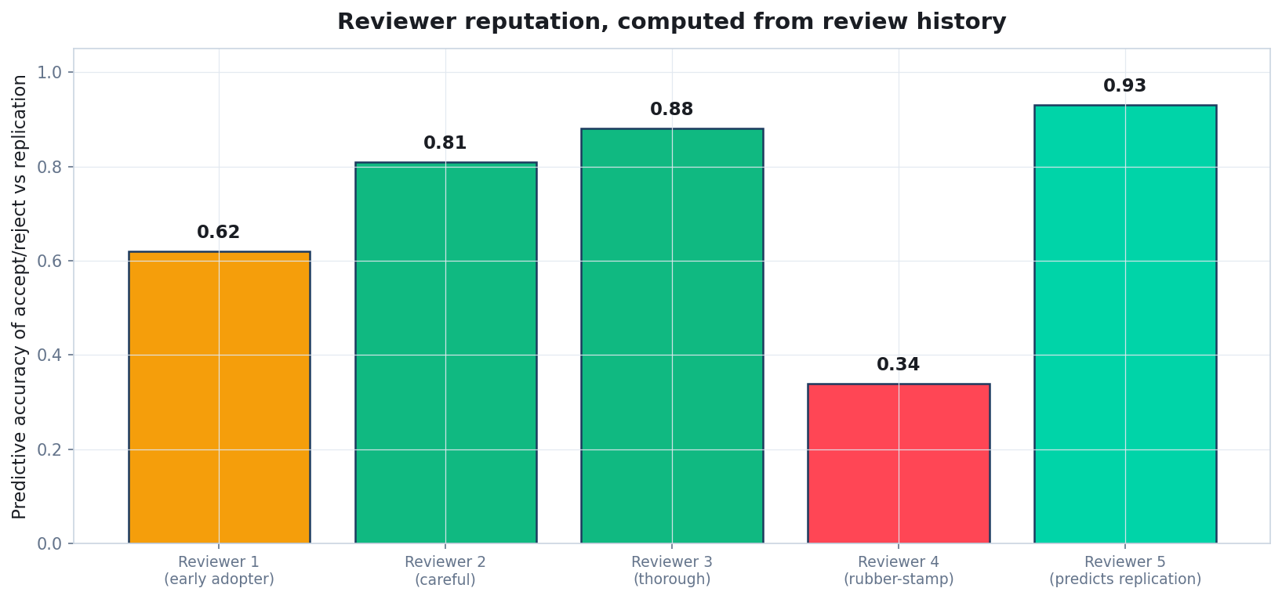
Reviewer reputation: computed from history, not hidden
Reputation = correlation between reviewer's accept/reject decisions and downstream replication outcomes.
Quidnug · Reproducibility Crisis
48 / 80

Slide 49
The reputation computation
▸ For each reviewer, compute over their review history. How often did their accept/reject decisions correlate with subsequent replication?
▸ Other signals. Length and substance of review (vs perfunctory). Specificity of critiques. Spotting of errors that subsequently surfaced.
▸ Combine multiplicatively. Same four-factor pattern as relativistic ratings: predictive accuracy * substance * activity * recency.
▸ Result: each reviewer has a per-domain reputation. Visible to editors and to the trust graph at large.
▸ Replaces opacity. Today, only editors know which reviewers are good. Tomorrow, the field knows.
Quidnug · Reproducibility Crisis
49 / 80

Slide 50
Reviewer scarcity and the cost of being wrong
▸ Current state. Reviewers are unpaid, unrewarded, and anonymous. Their work is captured by publishers.
▸ With reputation. Good reviewing is visible and rewarded. Universities can credit it for promotion.
▸ Cost of being wrong. Today: zero. Tomorrow: reviewer reputation declines, fewer high-stakes assignments.
▸ Cost of being lazy. Today: zero. Tomorrow: substantive review history is visible alongside reviewer's own publications.
▸ Aczel et al 2021: scholarly publishing extracts ~$2B/yr of free reviewer labor. Compensation could come via reputation, not just cash.
Quidnug · Reproducibility Crisis
50 / 80

Slide 51
Gaming the reputation signal
▸ Naive concern: reviewers will accept everything to look agreeable. Mitigation: reputation rewards CORRECTLY rejecting bad papers, not just accepting.
▸ Naive concern: cabals coordinate to inflate each others' reputations. Mitigation: trust-graph-based aggregation. A cabal's internal mutual praise contributes near-zero weight to outsiders.
▸ Naive concern: reviewers refuse hard papers to protect their stats. Mitigation: editor visibility into accept/decline rates for assignments.
▸ Naive concern: reputation reduces to a single number (Goodhart). Mitigation: multi-dimensional reputation (replication correlation, methodology spotting, error identification, constructiveness) prevents single-axis gaming.
▸ These are real concerns; none is unmanageable. Same dynamics as any reputation system, with extra engineering.
Quidnug · Reproducibility Crisis
51 / 80

Slide 52
Author reputation
▸ Symmetric to reviewer reputation. Authors get reputation from how their work performs over time. Replication, citation by replicating researchers, errors, retractions all factor in.
▸ Replaces h-index. h-index is a count metric easily gamed. Reputation is a trust-weighted quality metric.
▸ Tenure committees can use this. Today they look at journal prestige proxies. Tomorrow they could look at predicted-replicate rates.
▸ Funding agencies can use this. NIH, NSF, ERC, Wellcome could weight applications by applicant reputation in the proposed area.
▸ Cross-domain transparency. Researcher's reputation in one subfield doesn't auto-transfer to another. Each field's trust graph is independent.
Quidnug · Reproducibility Crisis
52 / 80

Slide 53
Section 8
A Paper's Life Cycle Under This System
Concrete walkthrough: preregistration to supersession.
Quidnug · Reproducibility Crisis
53 / 80

Slide 54
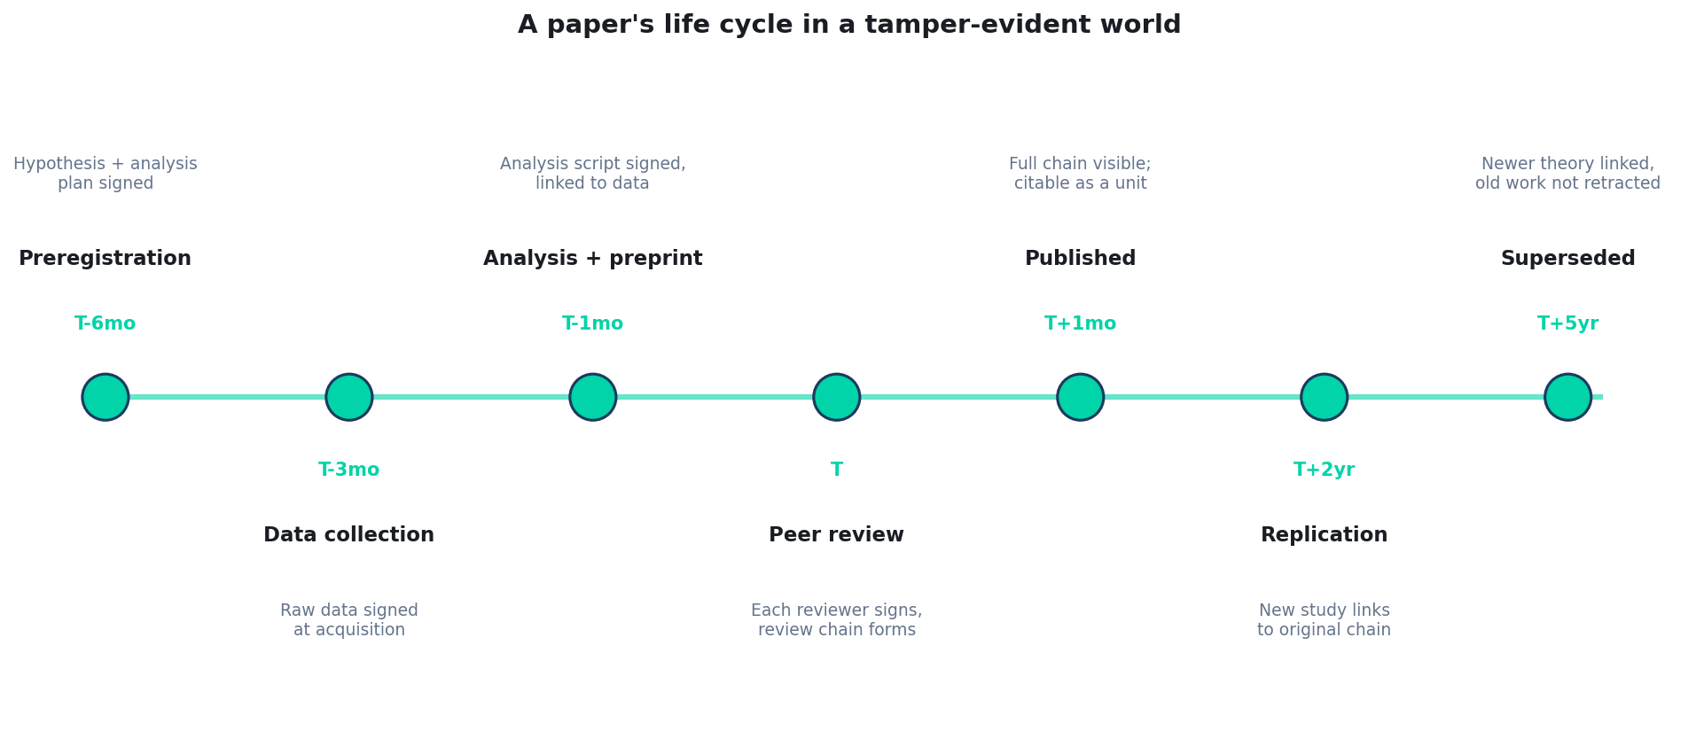
The full life cycle, signed end-to-end
Each milestone produces a signed artifact linked to the prior milestone.
Quidnug · Reproducibility Crisis
54 / 80

Slide 55
T-6 months: preregistration
▸ Researcher signs the hypothesis + analysis plan. Posts to OSF or equivalent.
▸ Quidnug records the signature with timestamp. Tamper-evident: any later change to the plan is visible.
▸ Pre-analysis power calculation included. Reviewers and replicators can audit.
▸ Optional: editorial pre-acceptance via registered reports. Decision based on the design, not eventual results.
▸ Cost. Roughly the same as filling out a current OSF preregistration form. Adds ~5 minutes for the signature step.
Quidnug · Reproducibility Crisis
55 / 80

Slide 56
T-3 months: data collection
▸ Each datum is signed at acquisition. Lab notebook + instrument output produce signed records.
▸ Bulk data: Merkle root signed. Individual records can be hashed-and-included; verifiable inclusion proofs.
▸ Validation steps signed separately. Outlier removal, clean-up, format conversion: each is a node in the provenance chain.
▸ Lab member identity preserved. Each contributor's quid is on the record. Important for credit and for accountability.
▸ Can be batched. Sign daily, weekly, or per-experiment. Granularity is operator choice.
Quidnug · Reproducibility Crisis
56 / 80

Slide 57
T-1 month: analysis and preprint
▸ Analysis script signed. Linked to the signed preregistration. Deviations from preregistered plan are visible (and may be justified, not necessarily a problem).
▸ Outputs (figures, tables) signed. Linked to the script that produced them. Re-running the script must produce matching outputs.
▸ Preprint posted with signed bundle. Manuscript + script + data + provenance chain.
▸ ArXiv, bioRxiv, medRxiv compatibility. Existing preprint servers gain provenance metadata as a sidecar.
▸ Public commitment. From this moment, any change is auditable.
Quidnug · Reproducibility Crisis
57 / 80

Slide 58
T: peer review
▸ Editor assigns reviewers. Editor sees real names; reviewers can choose pseudonymous publication.
▸ Each reviewer signs their review. Linked to the paper, with timestamp and decision.
▸ Author rebuttal signed. Linked to specific reviewer comments.
▸ Editor decision signed. With reasoning, linked to all reviews + rebuttal.
▸ Whole exchange becomes the public review chain. Available to anyone reading the paper, with optional redaction of reviewer identities.
Quidnug · Reproducibility Crisis
58 / 80

Slide 59
T+1 month: published version
▸ Final version signed by all authors. Linked to the review chain that produced it.
▸ DOI assigned per usual. Quidnug provenance metadata accessible via DOI resolver.
▸ Discoverable via search. Same Google Scholar / Semantic Scholar / PubMed paths.
▸ Citable as a unit. Citation includes the cryptographic root that proves what is being cited.
▸ Visible to any future replicator. Full chain available; no need to email authors for supplementary materials.
Quidnug · Reproducibility Crisis
59 / 80

Slide 60
T+2 years: replication attempt
▸ Replication team links their work to the original paper by quid.
▸ They re-run the analysis using the original signed script. If the chain verifies, they have certainty about what was done.
▸ They collect new data, sign it, run analysis. Full provenance for their work too.
▸ Replication outcome is itself a signed event. Linked to original paper. Visible in citation graph.
▸ Reviewer + author reputation updated. If paper replicates: reviewer/author reputation rises. If not: declines, automatically.
Quidnug · Reproducibility Crisis
60 / 80

Slide 61
T+5 years: superseded by better theory
▸ New paper proposes a better explanation. Links to the original paper as a precursor.
▸ Original paper is not retracted. Retraction is for fraud / errors. Supersession is scientific progress.
▸ The chain shows the intellectual lineage. Reader of the new paper sees what came before, what data was used, what changed.
▸ Author of the original gets credit for the contribution. Reputation reflects 'this work was a useful precursor,' not 'this work was wrong.'
▸ Citation graph captures the actual flow of ideas. Today: citations are flat counts. Tomorrow: citations carry semantic weight.
Quidnug · Reproducibility Crisis
61 / 80

Slide 62
The total artifact at T+5 years
▸ One paper has produced. Preregistration + raw data + analysis script + figures + preprint + 4 reviews + rebuttal + editor decision + published version + replication attempt + supersession.
▸ All linked, all signed, all verifiable. Anyone can audit the full lineage.
▸ Storage cost. Roughly 100 KB - 10 MB per paper, depending on data size. Trivial.
▸ Compute cost to verify. Sub-second for the full chain.
▸ This is what a healthy scholarly record looks like. We have the technology. The question is institutional will.
Quidnug · Reproducibility Crisis
62 / 80

Slide 63
Section 9
Institutional Tradeoffs and Rollout
What journals, universities, funders need to do.
Quidnug · Reproducibility Crisis
63 / 80

Slide 64
What journals must do
▸ Accept signed submission bundles. Manuscript + provenance chain + signed authorship.
▸ Issue signed peer reviews. Reviewer signs review; editor signs decision.
▸ Publish review chain alongside paper. Optionally with reviewer identity redacted; the cryptographic identity remains.
▸ Adopt PROV-O / Quidnug-compatible metadata. Sidecar JSON or RDF; publish alongside DOI.
▸ Cost. Mostly editorial workflow software. Major publishers (Wiley, Elsevier, Springer Nature) could deploy in a year if motivated.
Quidnug · Reproducibility Crisis
64 / 80

Slide 65
What universities must do
▸ Issue researcher quids. Tied to ORCID + institutional email. Researcher takes the quid with them when they leave.
▸ Accept reviewer reputation in tenure files. Auditable review record alongside publication record.
▸ Reward replication work. Currently undervalued. Make replications count for tenure review.
▸ Mandate provenance for grant-funded work. When you give a researcher money, require they sign their data and analyses.
▸ Update IT for trust-graph integration. Roughly the same lift as ORCID adoption was 2010-2020.
Quidnug · Reproducibility Crisis
65 / 80

Slide 66
What funders must do
▸ Mandate signed deliverables. NIH, NSF, ERC, Wellcome can require signed data + analysis as a condition of funding.
▸ Weight grant applications by applicant reputation. Reviewer reputation shows which applicants have previously produced replicable work.
▸ Fund infrastructure. Quidnug node hosting at major research universities. Trivial cost relative to research budgets.
▸ Coordinate across funders. International coordination on data-sharing + provenance standards. NIH already drives some of this; needs expanding.
▸ Mandate replication funding. 1-5% of research budgets earmarked for replication studies.
Quidnug · Reproducibility Crisis
66 / 80

Slide 67
Honest tradeoff 1: senior researcher resistance
▸ Senior researchers built careers under the current system. Some see transparency as a threat to existing reputation.
▸ Mitigation. Voluntary at first. Early adopters demonstrate value. Generational turnover gradually shifts norms.
▸ Same as the open-access transition. Took 15+ years from PLoS founding (2001) to mainstream. Not impossible, just slow.
▸ Pseudonymous reviewer identity helps. Senior reviewers can give honest reviews without career retaliation. Lowers the bar.
▸ Generational forcing function. Young researchers entering the field will demand infrastructure that protects them from p-hacking and fraud.
Quidnug · Reproducibility Crisis
67 / 80

Slide 68
Honest tradeoff 2: small labs and developing countries
▸ Adoption requires technical capacity. Small labs may lack IT support to deploy signing tools.
▸ Mitigation. Quidnug ships open-source SDKs in Python, R, Go. Most are CLI-thin. Not a programming-skill threshold.
▸ Institutional hosting. Universities run trust nodes; researchers consume via web UIs. Lab-side complexity stays low.
▸ Cost. Quidnug is open source and free. No SaaS dependency. Smaller labs and developing countries do not have to pay anyone.
▸ Funder mandate. If NIH and Wellcome require it, infrastructure follows. Same pattern as ORCID adoption.
Quidnug · Reproducibility Crisis
68 / 80

Slide 69
Honest tradeoff 3: privacy and pseudonymity
▸ Some reviews require fully anonymous reviewers. Junior reviewing senior with controversial paper. Pseudonymous is sufficient; full anonymity is not.
▸ Trade-off. Pseudonymous accountability + safety. Full anonymity + no accountability.
▸ Most fields can move to pseudonymous. Cryptographic identity persists; real-name exposure remains under reviewer control.
▸ Whistle-blower / sensitive cases. Special handling: editor-only knowledge, encrypted review storage, no public review chain.
▸ Default vs special. Default to pseudonymous-public chain. Allow opt-in to fully-anonymous review for sensitive cases.
Quidnug · Reproducibility Crisis
69 / 80

Slide 70
What this protocol does NOT solve
▸ Bad theory. A wrong theoretical framework can produce verifiable provenance for verifiable nonsense.
▸ Bad measurement. If the instrument is broken, signing the broken output does not fix it.
▸ Politicization of science. Climate denial, vaccine hesitancy: not problems of review infrastructure.
▸ Cargo-cult statistics. Wrong test choice cannot be detected at the substrate layer. Reviewers and replicators still must do thinking.
▸ Funding bias. Companies funding research that benefits them. Disclosure helps; substrate doesn't directly address.
Quidnug · Reproducibility Crisis
70 / 80

Slide 71
Summary: what changes
▸ Replication crisis becomes auditable. Replication failures attached to specific authors and reviewers in a queryable graph.
▸ Fraud detection moves earlier. Tessier-Lavigne-style image manipulation flagged at submission. Stapel-style fabrication impossible without instrument-level signatures.
▸ Reviewer quality becomes visible. Tenure committees can credit substantive reviewing. Lazy reviewing becomes visible.
▸ Citation graphs become semantic. Replication attempts, supersessions, retractions all linked. Citation count alone replaced with quality-weighted reputation.
▸ Public trust in science can be rebuilt. Cryptographic accountability is harder to dismiss than 'trust us, peer review.'
Quidnug · Reproducibility Crisis
71 / 80

Slide 72
What to do this year (researcher)
▸ Preregister your next study. OSF or AsPredicted. Sign the preregistration if your institution supports Quidnug; otherwise PGP.
▸ Open your data. Zenodo, Dryad, OSF. Make it the default.
▸ Open your code. GitHub, GitLab. Tag releases corresponding to paper submissions.
▸ Sign your reviews. Use a stable cryptographic identity. Ask journals to support pseudonymous-signed review.
▸ Cite responsibly. Note when papers you cite have replicated or not.
Quidnug · Reproducibility Crisis
72 / 80

Slide 73
What to do this year (institution)
▸ Issue researcher quids. Pilot with the chemistry or psychology department. Iterate.
▸ Update tenure guidelines. Replication work counts. Substantive reviewing counts.
▸ Pilot signed-submission with one journal you publish in. PNAS, eLife, Royal Society Open Science already experiment.
▸ Allocate replication budget. Even 2% of research budget for replication has outsized signal value.
▸ Train graduate students. New researchers entering the field with these tools as defaults.
Quidnug · Reproducibility Crisis
73 / 80

Slide 74
What to do this year (funder)
▸ Mandate signed deliverables in new grants. Phased: starting in 2027 or 2028.
▸ Fund infrastructure. Quidnug node hosting, SDK development, integration with existing repositories.
▸ Sponsor pilot replication studies. $10M-$50M committed annually buys massive credibility boost.
▸ Coordinate internationally. NIH + Wellcome + ERC + JST + NSFC alignment. Avoid fragmentation.
▸ Reward early adopters. Bonus funding for institutions that pilot signed infrastructure.
Quidnug · Reproducibility Crisis
74 / 80

Slide 75
The takeaway
“
The replication crisis is a measurement of infrastructure quality, not researcher quality. We can fix the infrastructure. The technology exists. What we lack is institutional will.
— The takeaway in one sentence
Quidnug · Reproducibility Crisis
75 / 80

Slide 76
References (canonical sources)
▸ Ioannidis (2005). Why most published research findings are false. PLOS Medicine.
▸ Open Science Collaboration (2015). Reproducibility of psychological science. Science 349(6251).
▸ Baker (2016). Is there a reproducibility crisis? Nature 533, 452-454.
▸ Begley & Ellis (2012). Drug development. Nature 483, 531-533.
▸ Errington et al (2021). Reproducibility Project: Cancer Biology. eLife.
▸ Camerer et al (2016, 2018). Replication studies in experimental economics + social sciences.
▸ Simmons, Nelson, Simonsohn (2011). False-positive psychology. Psychological Science.
▸ Button, Ioannidis et al (2013). Power failure. Nature Reviews Neuroscience.
▸ Freedman, Cockburn, Simcoe (2015). Economics of reproducibility in preclinical research. PLOS Biology.
▸ Allen & Mehler (2019). Open science challenges, benefits and tips. PLOS Biology.
Quidnug · Reproducibility Crisis
76 / 80

Slide 77
More references
▸ Aczel et al (2021). A billion-dollar donation: estimating the cost of reviewers' time. Research Integrity and Peer Review.
▸ Franco, Malhotra, Simonovits (2014). Publication bias in the social sciences. Science.
▸ Simonsohn, Nelson, Simmons (2014). P-curve. JEP General.
▸ Retraction Watch database. retractionwatch.com.
▸ Companion blog post. blogs/2026-04-23-reproducibility-crisis-tamper-evident-peer-review.md.
▸ Quidnug protocol. github.com/quidnug/quidnug. Reference SDKs in Python, R, Go, JavaScript.
▸ ORCID. orcid.org. Researcher identifier compatibility.
▸ OSF (Open Science Framework). osf.io. Existing preregistration platform; integration target.
Quidnug · Reproducibility Crisis
77 / 80

Slide 78
Common objections, briefly
▸ 'My data is sensitive.' Hash + Merkle proofs. Sign the chain without exposing the raw values.
▸ 'My field doesn't have a culture for this.' Neither did open access in 2001. Cultures change when incentives change.
▸ 'It will slow me down.' Net-net it speeds you up: collaborators can verify your work without your help.
▸ 'What if Quidnug fails as a project?' The standards and primitives are open. Other implementations could replace it.
▸ 'I do not have the technical expertise.' Most workflow is CLI-thin. Universities deploy the nodes; researchers consume via web UIs.
Quidnug · Reproducibility Crisis
78 / 80

Slide 79
One-line summary
“
We have the technology. What we lack is institutional will.
— The 2026 status of scholarly trust infrastructure
Quidnug · Reproducibility Crisis
79 / 80

Slide 80
Questions
Thank you. The hard part starts now.
Where does this argument fail in your field? What institutional incentive blocks your adoption? Which of the four primitives matters most to you?
Resources
github.com/quidnug/quidnug
blogs/2026-04-23-reproducibility-crisis-tamper-evident-peer-review.md
Ioannidis (2005). Why most published research findings are false.
OSC (2015). Reproducibility of psychological science. Science.
Baker (2016). Is there a reproducibility crisis? Nature.
Retraction Watch: retractionwatch.com
Open Science Framework: osf.io
Quidnug · Reproducibility Crisis
80 / 80

