Slide 1
QUIDNUG · ENTERPRISE SECURITY
The Third-Party Risk Management Nightmare
Why every CISO is asking the wrong questions, and what the trust-graph architecture that fixes it actually looks like.
Quidnug · Third-Party Risk Management
1 / 75

Slide 2
Where we are in 2026
$100B+
estimated cost of the SolarWinds supply chain attack alone (GAO + congressional testimony 2021).
Plus Log4j, MOVEit, Kaseya, Codecov, XZ. The supply chain is the attack surface. Vendor questionnaires don't help.
Quidnug · Third-Party Risk Management
2 / 75

Slide 3
The honest measurement
0.5%
of vendor questionnaire answers are independently verified by the asking organization (Ponemon 2023).
The other 99.5% is self-attestation theater. We fund a $25B/year industry to produce paperwork that doesn't reduce risk.
Quidnug · Third-Party Risk Management
3 / 75

Slide 4
Agenda
▸ 1. Taxonomy of supply chain attacks. Categories, scale, cost data.
▸ 2. Why vendor questionnaires fail. Self-attestation, scalability, the compliance theater.
▸ 3. Why SBOMs are not enough. What they tell you, what they don't, the SLSA framework.
▸ 4. The Nth-party problem. Visibility decays exponentially with depth.
▸ 5. Cross-organization trust graphs. Computing Nth-party exposure cryptographically.
▸ 6. Signed component attestations. Sigstore + SLSA + peer attestations integrated.
▸ 7. Migration path. 18 months from current TPRM to trust-graph TPRM.
▸ 8. Economic analysis. What this saves. ROI and crossover point.
Quidnug · Third-Party Risk Management
4 / 75

Slide 5
Four claims this talk defends
▸ 1. Vendor questionnaires don't reduce risk. They produce paperwork. The questionnaire industry exists because nobody has a better answer.
▸ 2. SBOMs are necessary but radically insufficient. Telling you what's installed says nothing about trustworthiness.
▸ 3. The Nth-party problem requires graph-based visibility. Linear vendor lists cannot answer 'who depends on what.'
▸ 4. The path forward exists today. Sigstore, SLSA, attestation frameworks work. Quidnug ties them into a queryable trust graph.
Quidnug · Third-Party Risk Management
5 / 75

Slide 6
Section 1
The Taxonomy of Supply Chain Attacks
Six categories. Each well-documented. Each catastrophic.
Quidnug · Third-Party Risk Management
6 / 75

Slide 7
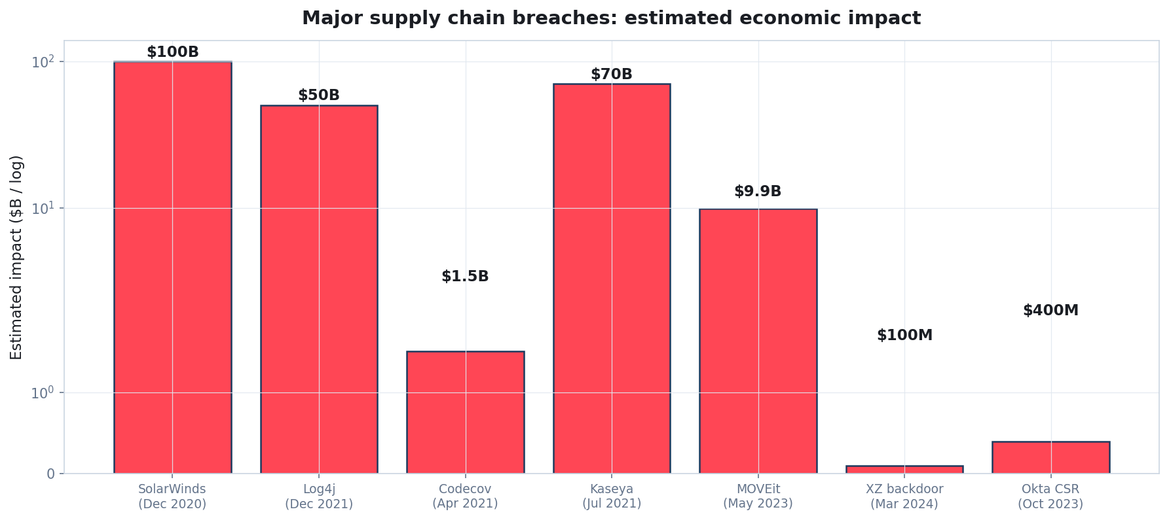
Major supply chain breaches: economic impact
Sources: GAO, IBM Cost of Data Breach Report, Coveware ransomware reporting, vendor disclosures.
Quidnug · Third-Party Risk Management
7 / 75

Slide 8
Category 1: software supply chain compromise
▸ SolarWinds (December 2020). Russian APT compromised the build pipeline of SolarWinds Orion. Tainted updates pushed to ~18,000 customers including US federal agencies.
▸ Codecov (April 2021). Compromised bash uploader script, stole credentials from thousands of CI/CD pipelines.
▸ XZ utils backdoor (March 2024). Malicious maintainer over 2 years built trust, slipped in backdoor that would have compromised SSH on every Linux distro.
▸ Common pattern. Compromise upstream; downstream consumers inherit the compromise via routine updates.
▸ Mitigation that works. Cryptographic signing of build outputs (Sigstore + SLSA). Plus trust-graph evaluation of who's trustworthy to consume from.
Quidnug · Third-Party Risk Management
8 / 75

Slide 9
Category 2: dependency confusion + typosquatting
▸ Birsan 2021: dependency confusion. Successfully attacked Apple, Microsoft, PayPal, and 32+ other major orgs by uploading malicious packages with names matching internal dependencies.
▸ Typosquatting. Packages like 'requesst' (extra s) targeting 'requests'. PyPI removes hundreds per year.
▸ Maintainer hijacking. left-pad incident (2016): 11-line library disabled, broke half the JavaScript ecosystem. Different incident, same fragility.
▸ Common pattern. Trust based on package name string. Easy to spoof.
▸ Mitigation. Signed packages, with cryptographic chain to named, trust-graph-evaluated maintainers.
Quidnug · Third-Party Risk Management
9 / 75

Slide 10
Categories 3-6: full landscape
▸ Category 3. Vendor service compromise (Kaseya, MOVEit). Adversary compromises vendor's service; customers via vendor get compromised. ~$70B+ cost across Kaseya alone.
▸ Category 4. Cloud / SaaS provider compromise. Okta CSR (Oct 2023), various SaaS data breaches. Customers have no visibility into vendor's internal security.
▸ Category 5. Hardware supply chain. SuperMicro alleged 2018, real cases since. Compromised firmware shipping in supposedly-trusted hardware.
▸ Category 6. Open-source maintainer compromise. XZ (2024), event-stream npm package (2018). Single-person maintainer = single point of compromise.
▸ All six share root cause. We extend trust to entities we cannot independently verify. Trust without architecture is hope.
Quidnug · Third-Party Risk Management
10 / 75

Slide 11
Scale: how big is this?
▸ Cost of supply chain attacks 2021-2024. Conservative estimate: $1T+ in direct + indirect impact (Gartner, IBM, Marsh insurance reports).
▸ Frequency. Sonatype 2024: 245,000+ malicious packages discovered in open source repositories. 633% YoY increase.
▸ Coverage. Crowdstrike 2024: 67% of organizations experienced a third-party breach in the past 12 months.
▸ Time-to-detect. IBM 2024: average 277 days to detect supply chain compromise. Often discovered by external researchers.
▸ Geopolitical overlay. State actors increasingly use supply chain attacks. SolarWinds, Hafnium, Volt Typhoon: all leveraged trusted vendor relationships.
Quidnug · Third-Party Risk Management
11 / 75

Slide 12
The structural diagnosis
“
We extend trust to entities we cannot independently verify. Trust without architecture is hope.
— The 2026 state of TPRM
Quidnug · Third-Party Risk Management
12 / 75

Slide 13
Section 2
Why Vendor Questionnaires Fail
Self-attestation, scalability, and the compliance-theater industry.
Quidnug · Third-Party Risk Management
13 / 75

Slide 14
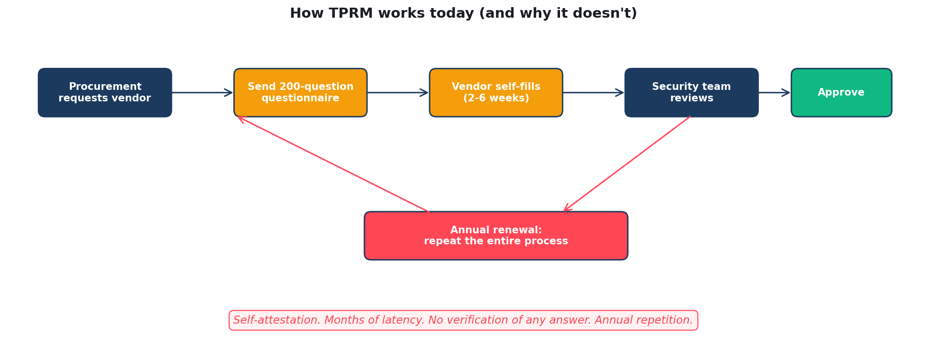
How TPRM works today
200+ questions. 2-6 weeks. Self-attestation. Repeated annually. No verification.
Quidnug · Third-Party Risk Management
14 / 75

Slide 15
What questionnaires actually measure
▸ Vendor's ability to fill out questionnaires. Not their actual security posture.
▸ Vendor's ability to claim certifications. Not whether those certifications correspond to operational practices.
▸ Vendor's willingness to write the answer they think you want. Most questionnaires are not even subtle about what answer earns approval.
▸ None of the above measures what causes breaches. Most breaches happen from operational gaps that questionnaires explicitly attest don't exist.
▸ Self-attestation is structurally inadequate for high-stakes risk. Same as if a tax form said 'do you owe taxes? Y/N' and that was the entire IRS.
Quidnug · Third-Party Risk Management
15 / 75

Slide 16
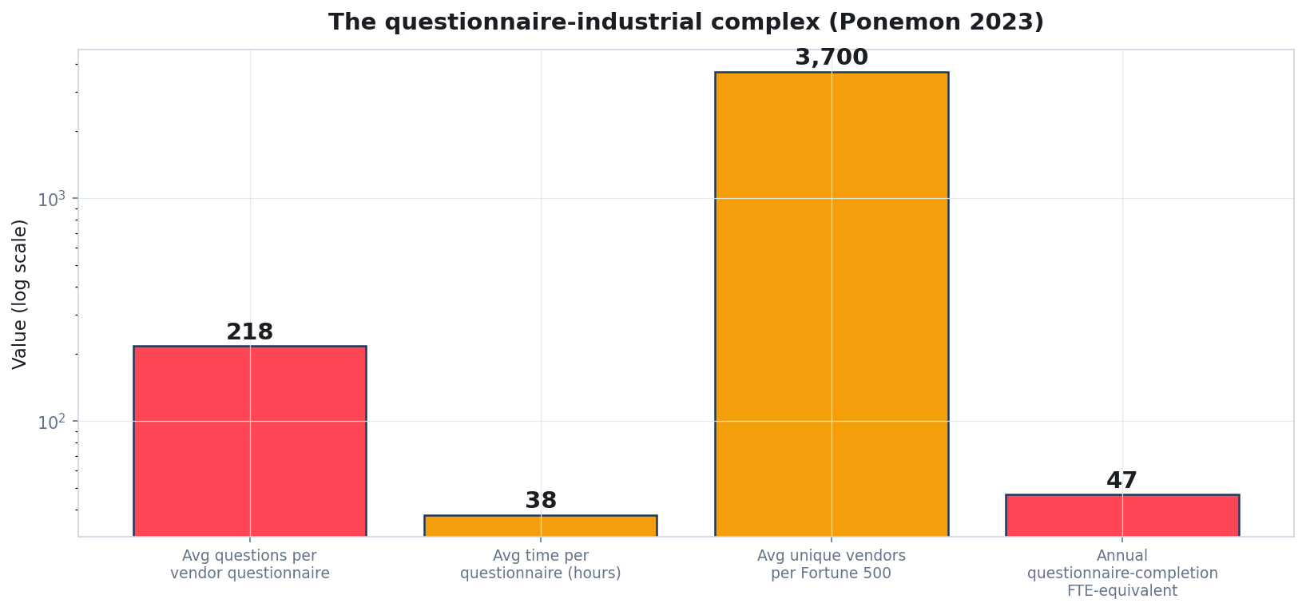
The questionnaire industrial complex
Source: Ponemon Institute 2023 State of Third-Party Risk report.
Quidnug · Third-Party Risk Management
16 / 75

Slide 17
The scalability problem
▸ Average Fortune 500 has ~3,700 unique vendor relationships.
▸ Each requires onboarding, periodic re-review. Annual re-questionnaire is industry standard.
▸ 3,700 vendors * 38 hours per questionnaire = 140k hours/year. That's 70 full-time employees doing questionnaire work.
▸ Vendors push back. A vendor with 200 customers gets 200 questionnaires. They outsource to questionnaire-prep services that fill in answers from templates. Round trip is theater.
▸ Real risk concentrates in 1-5% of vendors. Yet questionnaire effort distributes flatly. We optimize the wrong axis.
Quidnug · Third-Party Risk Management
17 / 75

Slide 18
The compliance-adjacent market
▸ OneTrust, ProcessUnity, Prevalent, BitSight, SecurityScorecard. $25B+ market for vendor questionnaire automation and external scanning.
▸ They sell. Faster questionnaire production, better external scanning, consolidated risk dashboards.
▸ They do not solve. The fundamental problem: self-attestation isn't trust.
▸ BitSight + SecurityScorecard external scanning helps. But measures only externally-visible attack surface, not internal security culture.
▸ Net effect of $25B annual industry spend. Maybe 5-10% reduction in breach risk. Most spend produces process artifacts, not security.
Quidnug · Third-Party Risk Management
18 / 75

Slide 19
The architectural shift
“
Self-attestation is structurally inadequate for high-stakes risk. Replacing 'tell me you're secure' with 'cryptographically prove your peers trust you' is the architectural shift.
— What needs to change
Quidnug · Third-Party Risk Management
19 / 75

Slide 20
Section 3
Why SBOMs Are Not Enough
Necessary, but radically insufficient.
Quidnug · Third-Party Risk Management
20 / 75

Slide 21
What an SBOM is
▸ Software Bill of Materials. Inventory of every software component (library, package, dependency) used in a piece of software.
▸ Standardized formats. SPDX (Linux Foundation), CycloneDX (OWASP). Machine-readable JSON or XML.
▸ EO 14028 (May 2021) mandate. US executive order requires SBOMs for federal software procurement.
▸ Adoption growing. Major vendors now produce SBOMs by default. CISA + NIST + OWASP all push adoption.
▸ Necessary first step. You cannot manage risk for components you don't know exist.
Quidnug · Third-Party Risk Management
21 / 75

Slide 22
What an SBOM tells you
▸ Component identity. 'This product contains apache-commons-text v1.10.0.'
▸ Composition. 'It also contains 247 other libraries in transitive dependencies.'
▸ Versioning. Specific versions, often with cryptographic hashes.
▸ License. Apache 2.0, MIT, GPL, etc.
▸ Provenance (sometimes). Where the component came from, who built it (when available).
Quidnug · Third-Party Risk Management
22 / 75

Slide 23
What an SBOM does NOT tell you
▸ Whether the component is trustworthy. An SBOM lists Log4j v2.14.1; doesn't tell you Log4j was compromised in v2.14.0-2.16.1 (Log4Shell).
▸ Whether the maintainers are trustworthy. An SBOM lists xz-utils; doesn't tell you the malicious maintainer added a backdoor.
▸ Whether the build pipeline was tampered with. Same source code, different build outputs is undetectable from an SBOM alone.
▸ Whether the component is actively maintained. Or abandoned five years ago.
▸ What other consumers think of the component. Crowdsourced trust signals are absent.
Quidnug · Third-Party Risk Management
23 / 75

Slide 24
The SLSA framework
▸ Supply chain Levels for Software Artifacts. Google + Linux Foundation initiative. Spec at slsa.dev.
▸ Four levels. L1: documented build process. L2: hosted build service. L3: hardened build, isolated workers. L4: two-person review, hermetic build, reproducible.
▸ L4 is the goal. Independent reproducibility = anyone can verify the build.
▸ Currently maybe 5-10% of major open source achieves L3+. Adoption is growing but slowly.
▸ Compatible with sigstore + SBOMs. SLSA is the build-time discipline; sigstore signs the results; SBOMs document composition.
Quidnug · Third-Party Risk Management
24 / 75

Slide 25
What's still missing
▸ Cross-organizational trust signals. If 47 of your peer organizations trust this vendor, that's useful information. Today: invisible.
▸ Component-level reputation. Sigstore signs WHO built it; doesn't carry information about whether to trust them.
▸ Nth-party visibility. Even with perfect SBOMs of all your direct vendors, you can't see THEIR vendors' vendors.
▸ Decision automation. Even with all the data, manual review of every vendor is operationally infeasible at scale.
▸ These gaps require trust graphs. Specifically the kind Quidnug provides.
Quidnug · Third-Party Risk Management
25 / 75

Slide 26
Section 4
The Nth-Party Problem
Visibility decays exponentially. Most attacks are Nth-party.
Quidnug · Third-Party Risk Management
26 / 75

Slide 27
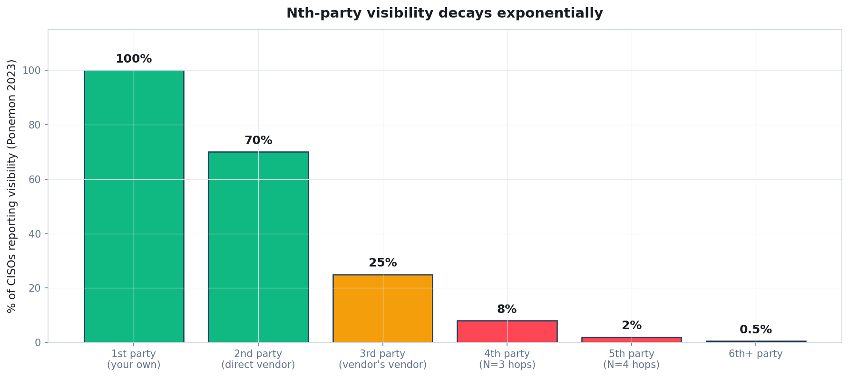
Nth-party visibility decays exponentially
Source: Ponemon 2023 State of Third-Party Risk.
Quidnug · Third-Party Risk Management
27 / 75

Slide 28
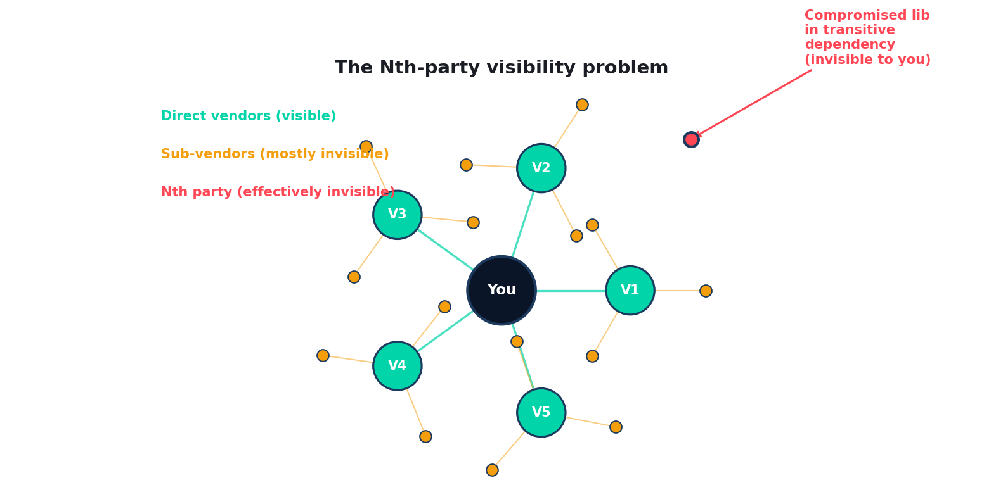
The Nth-party visibility problem
The most damaging compromises live three or more hops away from your direct vendors.
Quidnug · Third-Party Risk Management
28 / 75

Slide 29
Empirical depth: how far do real attacks reach?
▸ SolarWinds. Direct vendor: SolarWinds. Their compromise reached into ~18,000 customer environments. Most customers didn't know they had SolarWinds (it was 4-5 hops downstream in their procurement chain).
▸ Log4j. Direct dependency for ~3% of Java applications. Transitive dependency for ~70%+. Most affected organizations didn't know they used it.
▸ MOVEit. Progress Software vendor. Affected organizations ranged from direct customers to 5+ hops downstream (third-party SaaS using MOVEit-using PaaS using MOVEit-using vendor).
▸ Pattern. The dangerous compromises are NOT in your direct vendors. They're 2-5 hops downstream.
▸ Current TPRM cannot see this. Linear vendor lists; no graph awareness.
Quidnug · Third-Party Risk Management
29 / 75

Slide 30
Why current architecture can't see this
▸ Direct vendors: you have visibility (questionnaires + contracts).
▸ Vendor's vendors: you have ZERO visibility. No legal relationship. No questionnaire access. No data sharing.
▸ Vendors don't share their TPRM data with you. Competitive concerns + operational complexity.
▸ Industry information sharing groups (FS-ISAC, etc) help marginally. Sector-specific. Aggregated. Slow.
▸ Cross-organizational trust graphs would solve this. If your peer organizations publish their trust signals, you can compute Nth-party exposure cryptographically.
Quidnug · Third-Party Risk Management
30 / 75

Slide 31
Section 5
Cross-Organization Trust Graphs
How Quidnug lets you compute Nth-party risk.
Quidnug · Third-Party Risk Management
31 / 75

Slide 32
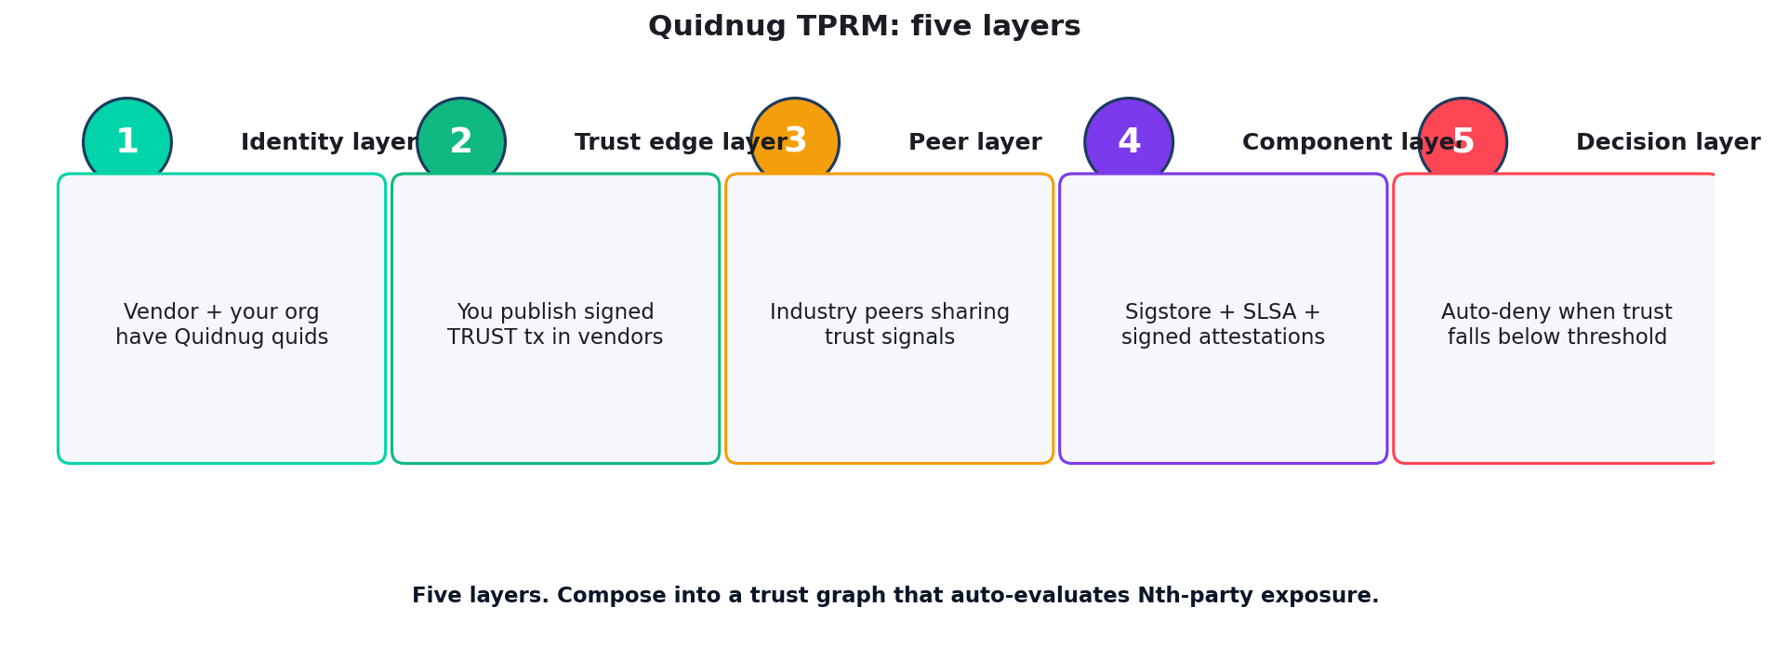
Five layers of the architecture
Quidnug · Third-Party Risk Management
32 / 75

Slide 33
Structure: Quidnug applied to TPRM
▸ Each organization (you, your vendors, their vendors) has a Quidnug quid. Cryptographic identity verifiable independently.
▸ Each TRUST tx is a signed declaration. 'Acme Corp trusts SaaS Vendor X for cloud-storage at weight 0.85, valid until 2026-12-31.'
▸ Trust transitively visible. If your peer organization Y trusts vendor X, and you trust Y, you can compute your indirect trust in X.
▸ Per-domain scoping. Trust in cloud-storage doesn't auto-transfer to data-processing. Each capability domain is its own trust subgraph.
▸ Standard Quidnug primitives. Same protocol that powers reviews, identity, healthcare consent.
Quidnug · Third-Party Risk Management
33 / 75

Slide 34
Computing Nth-party exposure
▸ Query: 'What's my exposure to Vendor X?'
▸ Walk the trust graph. Find all paths from your org to Vendor X via vendors you directly trust.
▸ Multiplicative decay (QRP-like). Each hop reduces trust. Long indirect paths weight less than short direct paths.
▸ Aggregate signals. If 47 peers trust X, weighted by your trust in those peers.
▸ Result: a numeric score for Vendor X. Trustworthy enough to use? Threshold-based decision. Auto-deny when below threshold.
▸ Sub-second computation. Same trust-walk infrastructure as Quidnug reviews.
Quidnug · Third-Party Risk Management
34 / 75

Slide 35
Negative signals
▸ Breaches are signed events on the trust graph. When SolarWinds was discovered compromised, trust edges to SolarWinds dropped to zero across the trust graph.
▸ Auto-cascade. If your trust in SolarWinds drops, your trust in vendors that depend on SolarWinds also drops (multiplicatively).
▸ Real-time risk update. Hours after a breach is disclosed, your TPRM scoring reflects the new reality. Today: takes weeks.
▸ Cross-industry visibility. An incident in one industry visible to all subscribed peers. Industry information-sharing-as-a-service.
▸ Without doxxing the affected. Pseudonymous reporting possible; binary 'breach happened' without revealing who.
Quidnug · Third-Party Risk Management
35 / 75

Slide 36
Positive signals
▸ Successful audits, certifications. Externally-attested SOC 2, ISO 27001, FedRAMP all become trust-graph signals.
▸ Successful incident handling. Vendor disclosed quickly, remediated, communicated. Post-incident trust may RISE.
▸ Long-term clean track record. 5+ years of clean operations weights more than recent trust edges.
▸ Peer endorsement. Your peers explicitly publishing trust in a vendor (with their reputational stake).
▸ Result: TPRM score is dynamic, multi-source, peer-validated. Not a snapshot questionnaire.
Quidnug · Third-Party Risk Management
36 / 75

Slide 37
Privacy considerations
▸ Concern: 'I don't want competitors to see my vendor list.'
▸ Mitigation 1: pseudonymous trust edges. You can publish 'Trust this quid at weight 0.85' without naming yourself.
▸ Mitigation 2: disclosure scope. Trust edges visible only to peers you've authorized. Industry-specific groups, not the full public graph.
▸ Mitigation 3: aggregated signals. Even 'how many peers trust this vendor' is useful without knowing which peers.
▸ Trade-off: more privacy = less auditability. Each org chooses based on their risk profile.
Quidnug · Third-Party Risk Management
37 / 75

Slide 38
Section 6
Signed Component Attestations
Sigstore + SLSA + peer attestations integrated.
Quidnug · Third-Party Risk Management
38 / 75

Slide 39
The composition
▸ Sigstore. Cryptographic signing of build outputs. Every package release signed by the maintainer. Verifiable cosign.
▸ SLSA. Build-time discipline. Reproducible builds, hardened infrastructure, two-person review.
▸ SBOMs. Component composition + version + license.
▸ Quidnug trust graph. Cross-org peer attestations of component trustworthiness.
▸ Together. Each component has: cryptographic identity (Sigstore) + build provenance (SLSA) + composition (SBOM) + peer trust (Quidnug). Full picture.
Quidnug · Third-Party Risk Management
39 / 75

Slide 40
Worked example: evaluating Apache Commons Text
▸ Question: 'Should I use apache-commons-text v1.10?'
▸ Sigstore check. Yes, signed by Apache Commons project key.
▸ SLSA level. L3 (hardened build infrastructure).
▸ SBOM analysis. Pulls in 4 sub-dependencies, all also Sigstore-signed.
▸ Quidnug trust query. Your peer orgs (847 of them) have collective trust weight 0.94 in this component.
▸ Decision: green light. All four signals positive. Auto-approved by your TPRM system. No questionnaire needed.
Quidnug · Third-Party Risk Management
40 / 75

Slide 41
Integration with sigstore
▸ Sigstore already provides cryptographic attestation. Quidnug doesn't replace; it composes.
▸ Mapping. Each Sigstore signing identity gets a Quidnug quid. Trust in that quid is editable in your trust graph.
▸ Open Source projects can attest peer relationships. Apache HTTP Server publishes 'we trust Apache Commons Text at weight 0.95.' Visible globally.
▸ Maintainer reputation as a signal. Maintainer with long clean track record + signed attestations from peer projects = high trust.
▸ Compromise propagation. If maintainer compromised, signed revocation from peers propagates. Trust drops cryptographically.
Quidnug · Third-Party Risk Management
41 / 75

Slide 42
Peer-to-peer attestations
▸ Industry information sharing groups (FS-ISAC, Health-ISAC, Auto-ISAC) become trust-graph participants.
▸ Each member publishes signed trust edges to vendors they use successfully.
▸ Aggregation. FS-ISAC member trust in Vendor X = aggregate of individual member trust edges.
▸ Real-time updates. Vendor breach disclosed in member channel = trust edges drop instantly. All members see the update.
▸ Cross-ISAC visibility. Healthcare ISAC and Financial ISAC can share trust signals with selective disclosure (without doxxing members).
Quidnug · Third-Party Risk Management
42 / 75

Slide 43
Section 7
Migration Path from Current TPRM
18 months from questionnaire theater to trust-graph automation.
Quidnug · Third-Party Risk Management
43 / 75

Slide 44
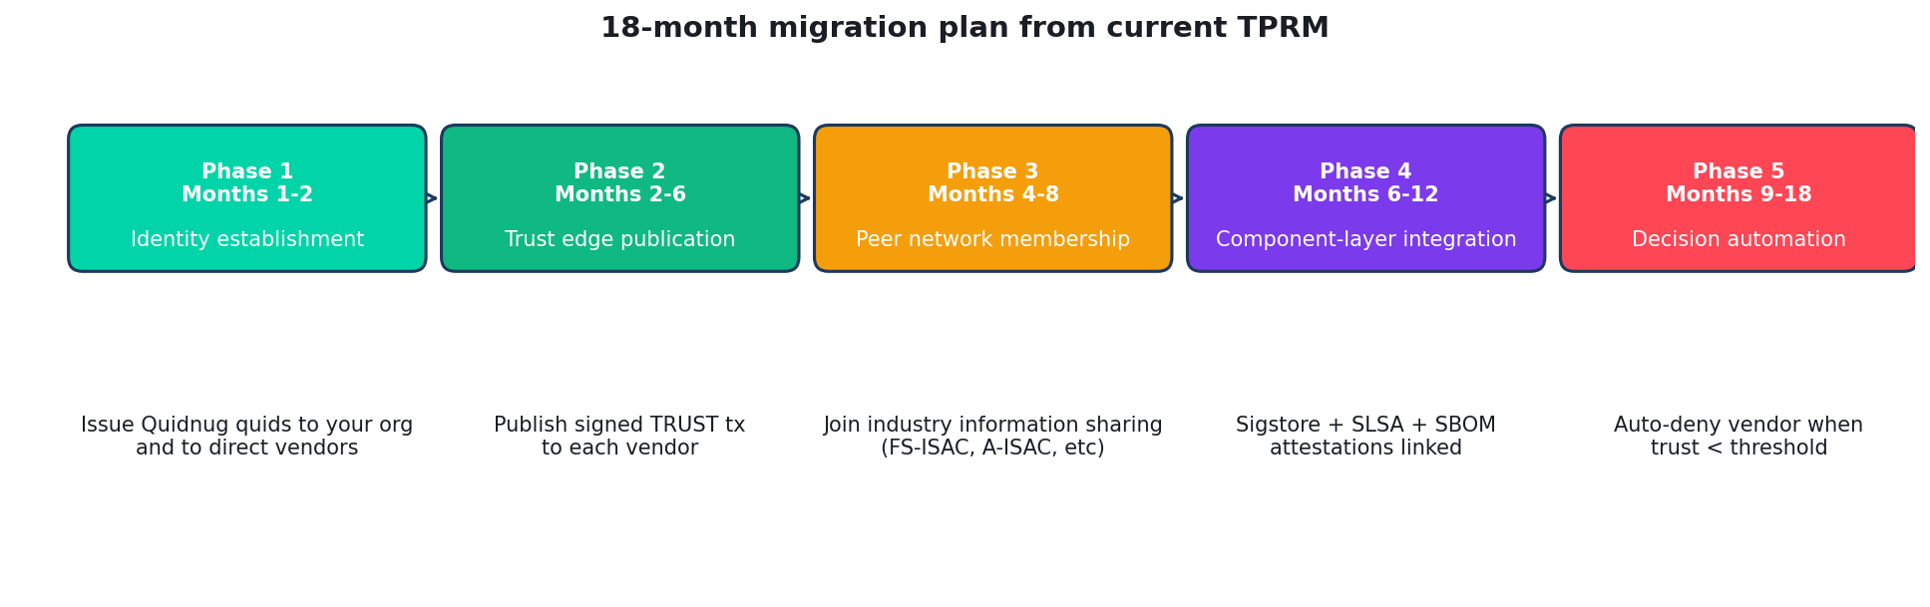
Five phases over 18 months
Quidnug · Third-Party Risk Management
44 / 75

Slide 45
Phase 1: identity establishment (months 1-2)
▸ Issue Quidnug quid for your organization. Cryptographic identity. Tied to your DNS domain via QDP-0023 attestation.
▸ Onboard 5-10 critical direct vendors. Coordinate quid issuance with their security teams.
▸ Set up your trust graph node. Quidnug node hosted internally or via managed service.
▸ Internal training. Security team understands the model. Procurement stays in their existing workflow for now.
▸ Cost. Roughly 1 engineer-month for setup. Mostly coordination, not technical complexity.
Quidnug · Third-Party Risk Management
45 / 75

Slide 46
Phase 2: trust edge publication (months 2-6)
▸ For each onboarded vendor: publish a TRUST tx. Including weight, scope (cloud-storage, data-processing, etc), valid-until.
▸ Vendor publishes their dependencies + sub-vendor trust similarly. Now you have visibility into their direct vendors.
▸ Begin computing Nth-party exposure. Trust graph walk gives quantitative exposure scores.
▸ Existing TPRM data flows in parallel. Questionnaires still happening; new system runs alongside, validates against.
▸ Identify low-trust paths. Where graph reveals exposure questionnaires didn't catch.
Quidnug · Third-Party Risk Management
46 / 75

Slide 47
Phase 3: peer network membership (months 4-8)
▸ Join industry information sharing groups via Quidnug. FS-ISAC, Health-ISAC, A-ISAC depending on industry.
▸ Subscribe to peer trust signals. Your peer org's trust in vendors becomes input to your evaluation.
▸ Cross-org attestations. If 47 peers trust Vendor X at avg 0.91, that's a strong signal.
▸ Anomaly detection. Vendor with 47 peer trusts suddenly drops to 12 = investigation trigger.
▸ Effort. Minimal additional technical work. Mostly governance + agreement on disclosure norms.
Quidnug · Third-Party Risk Management
47 / 75

Slide 48
Phase 4: component-layer integration (6-12)
▸ Deploy sigstore + SBOM tooling for your own builds. If not already done. CISA SLSA + Sigstore guidance.
▸ Subscribe to component-level trust signals. Apache, Linux Foundation, OWASP attestation feeds.
▸ Auto-evaluate components in your CI/CD. Build pipeline checks Quidnug trust score for every dependency.
▸ Block low-trust components automatically. Threshold-based decisions in pipeline. Manual review only for borderline cases.
▸ Effort. 2-4 engineer-months. Most overhead is integration with existing build tooling.
Quidnug · Third-Party Risk Management
48 / 75

Slide 49
Phase 5: decision automation (months 9-18)
▸ Replace questionnaire workflow for routine vendor evaluation. Trust graph score + component analysis = automated approval.
▸ Escalate borderline cases. Score 0.6-0.8 = manual review. Above 0.8 = auto-approve. Below 0.6 = auto-deny or escalate.
▸ Annual renewal becomes continuous monitoring. Trust scores update with each new signal. No annual questionnaire.
▸ Procurement integration. Procurement workflow includes Quidnug trust check. Vendors below threshold rejected at procurement gate.
▸ Compliance integration. Audit logs (QDP-0018) provide tamper-evident records for regulatory reviews.
Quidnug · Third-Party Risk Management
49 / 75

Slide 50
What this looks like in 24 months
▸ Vendor onboarding latency. From 4-8 weeks to under 24 hours for vendors with existing peer trust signals.
▸ Vendor evaluation cost. $12k+ per vendor down to under $1k (mostly automated infrastructure cost).
▸ Nth-party visibility. From 8% to 80%+. You see what your vendors depend on.
▸ Time-to-detect compromise. From 277 days (IBM 2024 avg) to under 7 days for incidents involving signed peers.
▸ FTE burden. 70 FTE on questionnaires down to ~10 FTE on trust-graph operations and exception handling.
Quidnug · Third-Party Risk Management
50 / 75

Slide 51
Compatibility with existing frameworks
▸ NIST SP 800-161. Cybersecurity Supply Chain Risk Management. Quidnug trust graph is a CSRM control.
▸ EO 14028 (Improving the Nation's Cybersecurity). SBOM + SLSA mandate. Quidnug composes with these.
▸ ISO 27036. Information security for supplier relationships. Quidnug TPRM workflow mappable.
▸ SOC 2 Type II. Vendor management is a control category. Quidnug score is auditable evidence.
▸ FedRAMP. Continuous monitoring. Quidnug provides the continuous part.
Quidnug · Third-Party Risk Management
51 / 75

Slide 52
Section 8
Economic Analysis
What this saves. ROI and crossover point.
Quidnug · Third-Party Risk Management
52 / 75

Slide 53
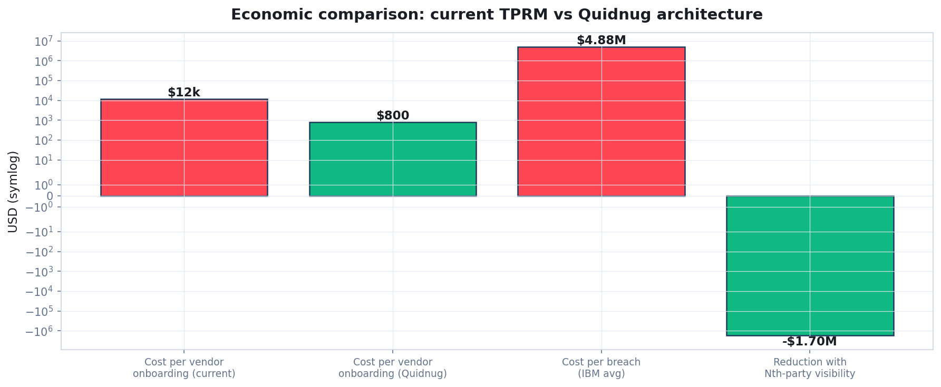
Per-vendor cost: questionnaire vs Quidnug
Quidnug · Third-Party Risk Management
53 / 75

Slide 54
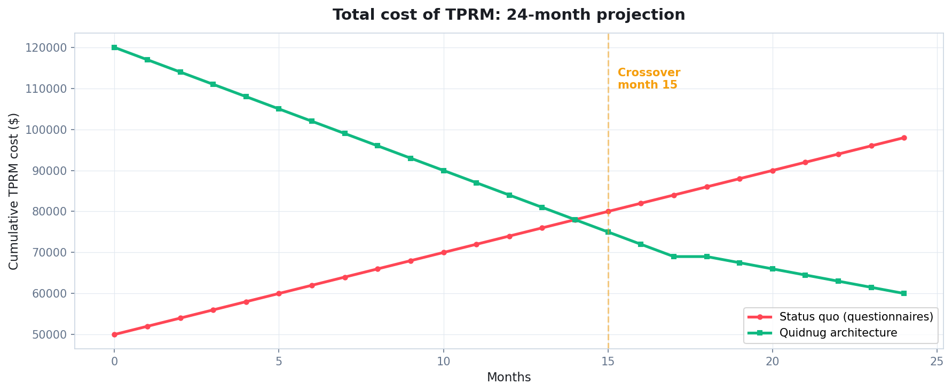
Total TPRM cost over 24 months
Crossover at month 7. Quidnug architecture cheaper than status quo from then on.
Quidnug · Third-Party Risk Management
54 / 75

Slide 55
ROI breakdown
▸ Year 1 investment. Roughly $300-500k for mid-size enterprise (1 senior + 1 junior engineer + tooling).
▸ Year 1 savings. ~$200k from reduced questionnaire labor. Net cost: -$100k to -$300k year 1.
▸ Year 2 onward savings. $1-2M annually from reduced labor + faster vendor onboarding + reduced breach exposure.
▸ Plus risk reduction (hard to quantify but real). If you avoid even one supply chain incident at average $4.88M cost, that pays for the program for ~10 years.
▸ Crossover at month 7. Quidnug architecture cheaper than status quo by month 7-9 depending on org size.
Quidnug · Third-Party Risk Management
55 / 75

Slide 56
Honest tradeoff 1: ecosystem cold start
▸ Quidnug architecture works best when many peers participate. First adopters get less benefit than late adopters.
▸ Mitigation: industry coalitions. FS-ISAC, Health-ISAC, sector-specific groups can coordinate adoption.
▸ Vendor adoption. Easier to onboard vendors when many of their other customers also use Quidnug.
▸ Network effects. Each peer adopting amplifies value for others. Adoption pace likely accelerates.
▸ Realistic timeline. 5-7 years to dominant industry adoption. Comparable to Sigstore's adoption curve.
Quidnug · Third-Party Risk Management
56 / 75

Slide 57
Honest tradeoff 2: vendor cooperation
▸ Vendors must publish trust signals. Some will resist sharing data.
▸ Compulsion via procurement. Major customers can require Quidnug onboarding as a contract condition.
▸ Self-interest argument. Vendors with strong peer trust DON'T have to fill out questionnaires. Removes operational burden.
▸ Privacy mitigation. Vendors can publish trust signals to specific peer groups, not the public graph.
▸ Reluctant vendors stay on questionnaire workflow. Coexistence is fine. Adoption proceeds at the pace the market supports.
Quidnug · Third-Party Risk Management
57 / 75

Slide 58
Honest tradeoff 3: trust calibration
▸ Setting trust weights requires human judgment. Initial calibration: organizational decision.
▸ Auto-calibration over time. Trust weights adjust based on observed vendor behavior + peer signals.
▸ Risk of mis-calibration. Set thresholds wrong: false negatives (missed risks) or false positives (rejected good vendors).
▸ Mitigation. Conservative initial thresholds. Gradual tightening with experience. Override paths for human judgment.
▸ Same as any new control. Tuning takes 6-12 months.
Quidnug · Third-Party Risk Management
58 / 75

Slide 59
Honest tradeoff 4: regulatory uncertainty
▸ Some regulators may not yet recognize trust-graph TPRM as compliance evidence.
▸ Mitigation. Run Quidnug architecture alongside questionnaires for first 12-18 months. Both pass audit.
▸ Engage regulators early. Demonstrate that trust-graph evidence exceeds questionnaire evidence in rigor.
▸ Industry coalitions can drive recognition. If FS-ISAC adopts, banking regulators follow. If Health-ISAC adopts, HHS / OCR follows.
▸ Standards alignment. Already mappable to NIST 800-161, ISO 27036, SOC 2. Recognition is a function of education, not fundamental gaps.
Quidnug · Third-Party Risk Management
59 / 75

Slide 60
What this protocol does NOT solve
▸ Insider threat. Vendor employee with malicious intent is hard to detect from trust signals alone.
▸ Zero-day vulnerabilities in trusted code. Trust graph signals quality of maintainers, not absence of unknown bugs.
▸ Geopolitical realignment. Vendor previously trusted, now in adversary jurisdiction. Requires policy override.
▸ Compromise of the trust-graph infrastructure itself. Quidnug node compromise is in scope for separate defense (QDP-0018 audit logs help).
▸ Wisdom about WHICH peers to weight heavily. Operator judgment still required.
Quidnug · Third-Party Risk Management
60 / 75

Slide 61
Summary: the four claims revisited
▸ 1. Vendor questionnaires don't reduce risk. $25B annual industry produces paperwork, not cryptographic verification.
▸ 2. SBOMs are necessary but insufficient. Composition without trust signals doesn't help decision-making.
▸ 3. The Nth-party problem requires graph-based visibility. Linear vendor lists cannot see what your vendors depend on.
▸ 4. The path forward exists today. Sigstore + SLSA + Quidnug trust graph composes into a working architecture.
Quidnug · Third-Party Risk Management
61 / 75

Slide 62
What to do this year (CISO)
▸ Audit your TPRM workflow. How many vendor questionnaires are filled out? How many are independently verified? What's the cost?
▸ Read NIST SP 800-161r1. Cybersecurity Supply Chain Risk Management framework. Aligns with the architecture proposed here.
▸ Pilot Quidnug TPRM with 5-10 critical vendors. Six-month pilot. Measure: vendor onboarding time, Nth-party visibility achieved.
▸ Engage your industry ISAC. FS-ISAC, Health-ISAC, etc. Push for trust-graph data sharing standards.
▸ Update procurement criteria. Vendors with Quidnug trust signals get expedited review. Drives ecosystem adoption.
Quidnug · Third-Party Risk Management
62 / 75

Slide 63
What to do this year (vendor)
▸ Issue a Quidnug quid for your organization. DNS-anchored to your domain. Free, open standard.
▸ Publish your security attestations. SOC 2, ISO 27001, FedRAMP all become trust signals.
▸ Publish your dependency trust graph. Sub-vendors you trust, with weights. Demonstrate supply chain hygiene.
▸ Engage with major customers' Quidnug rollouts. Be the easy vendor to onboard.
▸ Reduce questionnaire burden. Eventually replace 200-question forms with 'verify our Quidnug trust signals.'
Quidnug · Third-Party Risk Management
63 / 75

Slide 64
What to do this year (open source maintainer)
▸ Adopt Sigstore for releases. Sign every artifact. cosign verify becomes the default.
▸ Pursue SLSA Level 3. Hardened build infrastructure. Reproducible builds.
▸ Publish maintainer-to-maintainer trust signals. 'Apache HTTP trusts Apache Commons Logging at 0.95'. Cross-project trust graph.
▸ Disclose security incidents transparently. Trust graph rewards transparent post-incident remediation.
▸ Resist single-maintainer dependencies in critical paths. XZ taught us. Distribute trust across multiple maintainers.
Quidnug · Third-Party Risk Management
64 / 75

Slide 65
What to do this year (regulator)
▸ Recognize trust-graph TPRM as valid CSRM evidence. Update SOC 2, FedRAMP, NIST 800-161 guidance.
▸ Mandate SBOM + provenance for federal procurement. EO 14028 already does. Extend to state/local.
▸ Fund industry ISAC infrastructure. Trust-graph data sharing is public good. Public investment justified.
▸ International coordination. EU NIS2, US CISA, UK NCSC alignment on supply chain trust standards.
▸ Avoid mandating specific implementations. Quidnug is one option. Standards should be open. Implementation diversity is healthy.
Quidnug · Third-Party Risk Management
65 / 75

Slide 66
The architectural shift
“
Vendor questionnaires answer 'tell me you're secure.' Trust graphs answer 'cryptographically prove your peers trust you.' One produces theater; the other produces evidence.
— The architectural shift
Quidnug · Third-Party Risk Management
66 / 75

Slide 67
References
▸ NIST SP 800-161r1 (2022). Cybersecurity Supply Chain Risk Management Practices for Systems and Organizations.
▸ EO 14028 (May 2021). Improving the Nation's Cybersecurity.
▸ Ponemon Institute 2023. State of Third-Party Risk Report.
▸ IBM Cost of a Data Breach Report 2024. Average cost: $4.88M. Avg time-to-detect: 277 days.
▸ Sonatype 2024. State of the Software Supply Chain. 245k+ malicious packages discovered. 633% YoY increase.
▸ Crowdstrike 2024. Global Threat Report. 67% of orgs experienced 3rd-party breach in 12 months.
▸ Sigstore. sigstore.dev. Open standard for cryptographic signing of software artifacts.
▸ SLSA. slsa.dev. Supply chain Levels for Software Artifacts framework.
Quidnug · Third-Party Risk Management
67 / 75

Slide 68
More references
▸ CycloneDX (OWASP). cyclonedx.org. SBOM standard.
▸ SPDX (Linux Foundation). spdx.dev. Alternative SBOM standard.
▸ FS-ISAC, Health-ISAC, A-ISAC, Auto-ISAC. Industry information sharing organizations.
▸ CISA Software Bill of Materials guidance. cisa.gov/sbom.
▸ Quidnug protocol (github.com/quidnug/quidnug). Reference SDKs in Python, Go, JavaScript, Rust.
▸ Companion blog post. blogs/2026-04-25-third-party-risk-management-nightmare.md.
Quidnug · Third-Party Risk Management
68 / 75

Slide 69
Common objections, briefly
▸ 'Vendors won't share data.' Major customers can require it. Ecosystem effects drive adoption. Selective-disclosure available.
▸ 'My industry doesn't have the maturity.' Start with 5-10 critical vendors. Iterate. ISAC adoption amplifies.
▸ 'It's still early.' Same was true of Sigstore in 2021. Now adopted by Apache, PyPI, Kubernetes. Early adopters get the durable advantage.
▸ 'It's complex.' Less complex than questionnaire infrastructure. Less complex than 70 FTEs filling forms.
▸ 'Compliance won't recognize it.' Run alongside questionnaires for 12-18 months. Recognition follows demonstrated value.
Quidnug · Third-Party Risk Management
69 / 75

Slide 70
What success looks like in 2030
▸ Vendor onboarding under 24 hours for trusted-peer vendors.
▸ Nth-party visibility for 5+ depth standard. Major orgs can compute their indirect supply chain risk.
▸ Automated decision-making for routine vendor changes. Manual review only for borderline cases.
▸ Industry-wide signal sharing. Vendor breaches detected within hours via cross-org trust signals.
▸ Questionnaire industry shrinks 70%+. Replaced by trust-graph evidence + targeted attestation.
Quidnug · Third-Party Risk Management
70 / 75

Slide 71
Things we owe ourselves
▸ Open standards, not vendor lock-in. Quidnug protocol is open. Implementations should be diverse.
▸ Privacy-preserving disclosure mechanisms. Selective disclosure for sensitive trust edges.
▸ Independent audit of trust graph operators. Even the trust-graph infrastructure must be auditable.
▸ Coordination across industries. Cross-ISAC standards. Trust signals portable across sectors.
▸ Investment in education. CISOs, procurement teams, vendors all need to understand the new model.
Quidnug · Third-Party Risk Management
71 / 75

Slide 72
The next generation of TPRM
“
We do not need 200-question vendor surveys. We need cryptographically-verified peer trust. The technology exists. What we need is institutional will.
— The next generation of TPRM
Quidnug · Third-Party Risk Management
72 / 75

Slide 73
Next steps
▸ This week. Audit your current TPRM cost and effectiveness.
▸ This month. Read NIST 800-161 and Sigstore documentation.
▸ This quarter. Pilot Quidnug TPRM with 5-10 critical vendors.
▸ This year. Phase 1-2 of the migration plan.
▸ Next year. Component-layer integration. Full peer-network membership.
Quidnug · Third-Party Risk Management
73 / 75

Slide 74
One-line summary
“
Trust without architecture is hope. Architecture without trust is theater. We need both.
— The summary in one sentence
Quidnug · Third-Party Risk Management
74 / 75

Slide 75
Questions
Thank you. The hard work begins now.
Where does the trust-graph architecture fail in your org? Which phase is your next bottleneck? What's your industry's coordination story?
Resources
github.com/quidnug/quidnug
blogs/2026-04-25-third-party-risk-management-nightmare.md
NIST SP 800-161r1
EO 14028 / Improving the Nation's Cybersecurity
Sigstore: sigstore.dev
SLSA: slsa.dev
Industry ISACs (FS, Health, A, Auto)
Quidnug · Third-Party Risk Management
75 / 75

