Slide 1
QUIDNUG · JOURNALISM & CIVIL SOCIETY
The Whistleblower Channel
Selective disclosure plus cryptographic credibility plus trust-graph vouching is the architecture modern whistleblower platforms actually need.
Quidnug · Whistleblower Channel
1 / 75
Notes:
Welcome. This deck covers how modern cryptography can give anonymous whistleblowers institutional credibility without ever revealing their identity.
Our thesis: credibility-without-identity is a solved cryptographic problem. Blind signatures have been in production since 1988 and at billion-scale since 2017.
What current whistleblower platforms are missing is not encryption or anonymity. Those are solved. The missing layer is attestation: proving 'I am who I claim to be' without saying who you are.
This talk walks through the primitives, the architecture, the legal fit, and a worked example end-to-end.

Slide 2
The chilling effect
3 → 20
US Espionage Act prosecutions of leakers went from 3 total (1917-2008) to roughly 20 in the 15 years since.
Source: ACLU National Security reporting. Leaking to a journalist is now radically riskier than in the Pentagon Papers era. The risk calculus for sources has materially worsened.
Quidnug · Whistleblower Channel
2 / 75
Notes:
From 1917 (passage of the Espionage Act) through 2008, three people were prosecuted under it for leaking to the press.
Obama brought eight. Trump I brought eight more. Biden has brought four so far.
The per-year rate is roughly 20x what it was historically. A source considering coming forward has to weigh materially greater legal exposure than any source in the pre-2009 era.
This is the pressure that makes anonymity-preserving credibility infrastructure urgent rather than theoretical.

Slide 3
What becomes cheap
$0
the cost for an audience to verify a credentialed whistleblower's institutional claims under this architecture, once it exists.
Under current practice the cost is borne by the journalist (weeks of private vetting) and the reader (trust the outlet). Selective disclosure flips that: any reader with the verification tool checks the chain in milliseconds.
Quidnug · Whistleblower Channel
3 / 75
Notes:
Credibility verification today is expensive because it happens in private inside the journalist's workflow.
With cryptographic attestation, verification becomes mechanical. A reader's reader app checks the signature chain, the attester's DNS anchor, the pseudonym's track record. No journalist assertion required.
The economics are the point. When verification is free, audiences can hold credibility claims to a higher standard.

Slide 4
Agenda
▸ 1. Why credibility is the hard part. The structural journalism problem and the chilling effect.
▸ 2. Current whistleblower infrastructure. SecureDrop, GlobaLeaks, Signal, Tor, Tails: what they cover and what they don't.
▸ 3. Selective disclosure primitive. Blind signatures, Privacy Pass, BBS+ credentials.
▸ 4. Stable pseudonyms with reputation. Accumulating credibility without identity.
▸ 5. Trust-graph vouching. Peer attestations and DNS-anchored institutional attestations.
▸ 6. End-to-end architecture. How the pieces compose source to reader.
▸ 7. Legal frameworks. US, EU, UK, non-democratic jurisdictions.
▸ 8. Worked example + honest limits. Financial fraud disclosure walkthrough and ethical tensions.
Quidnug · Whistleblower Channel
4 / 75
Notes:
Eight sections. The first four establish why and what the primitives are. The middle two compose them into a concrete architecture. The last two address legal fit and honest limitations.
If you have to leave early, the most important sections are 3 (selective disclosure) and 6 (architecture). Sections 1-2 are motivation; sections 7-9 are implementation and caveats.

Slide 5
Four claims this talk defends
▸ 1. Credibility-without-identity is solved cryptography. Blind signatures 1988. Privacy Pass 2017. BBS+ 2020s. Billions of tokens per month already deployed.
▸ 2. Current platforms solve submission and encryption, not credibility. SecureDrop, Signal, Tor, Tails: every layer except the one that matters for reader trust.
▸ 3. Institutional attestation via DNS-anchored identity gives sources a credibility floor. Without ever revealing who they are.
▸ 4. The pattern generalizes beyond journalism. SEC tips, OSHA complaints, EU Whistleblower Directive, regulated-industry tip lines.
Quidnug · Whistleblower Channel
5 / 75
Notes:
Four claims, each defended with specific evidence in the talk.
Claim 1 is important to land early because engineers in the audience may suspect this is speculative cryptography. It isn't. Blind signatures run at billion-scale monthly in production today.
Claim 4 matters because whistleblower channels are not just for marquee journalism. Every regulated industry runs a tip line with the same fundamental credibility problem.

Slide 6
Section 1
Why Credibility Is the Hard Part
Journalism-ethics scholarship plus the chilling effect.
Quidnug · Whistleblower Channel
6 / 75

Slide 7
Successful disclosures succeed on credibility
▸ Snowden (2013). Worked because Greenwald and Poitras spent months verifying Snowden's credentials before publishing.
▸ Haugen (2021). Worked because she provided thousands of signed documents and testified under oath to Congress.
▸ Common thread. Both had massive pre-publication credibility work. The content wasn't enough on its own.
▸ The pattern generalizes. Disclosures succeed when credibility is established. They fail when audiences cannot distinguish a real insider from a fabrication.
Quidnug · Whistleblower Channel
7 / 75
Notes:
Both Snowden and Haugen are often invoked as 'the system works.' What that ignores is how expensive the credibility establishment was.
Snowden's credibility took months of careful verification before The Guardian would publish. That's an enormous private cost borne by specific journalists.
Haugen's credibility came partly from her willingness to testify publicly. That's a form of self-identification that removes the anonymity protection entirely.
Neither is a repeatable pattern for sources without those resources or that willingness.

Slide 8
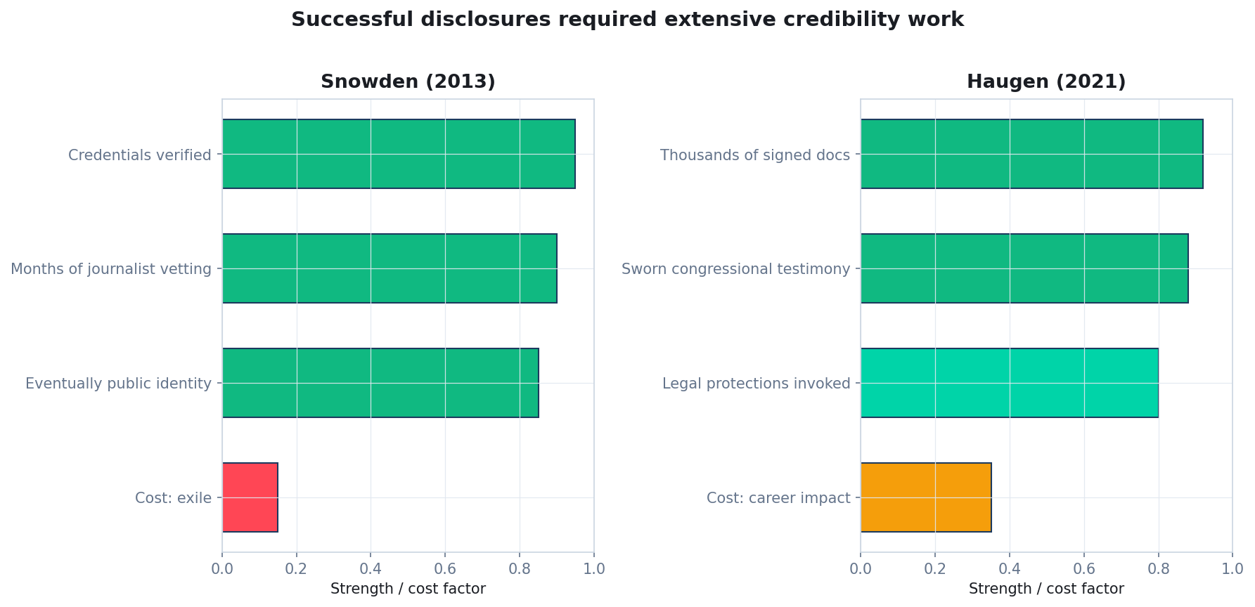
The two case studies side-by-side
Both required credentials verification plus months of vetting. The anonymous-but-credible path didn't exist.
Quidnug · Whistleblower Channel
8 / 75
Notes:
This chart shows why these two are textbook cases but not templates.
Snowden: credentials verified, extensive vetting, eventually identified, cost was permanent exile.
Haugen: signed documents, sworn testimony, protected under SEC whistleblower rules, cost was career impact.
Both had exceptional resources. Most potential whistleblowers do not. The substrate we're describing makes credible disclosure available to sources who currently cannot reach credibility because they cannot expose themselves.

Slide 9
The structural role of sources in journalism
▸ Evidence that the journalist has privileged information. The source's reality is part of the story's evidence.
▸ Credibility assessment happens privately. Readers don't see the journalist's verification process.
▸ Multiple-source corroboration is the gold standard. But each source is a private verification exercise.
▸ Institutional affiliation carries weight. A 'senior engineer at Company X' outweighs an 'anonymous source' in reader credibility assessments.
▸ The chain is opaque. Readers rely on the journalist's reputation, not evidence about the source. Singer 2007; Robinson 2011.
Quidnug · Whistleblower Channel
9 / 75
Notes:
This is journalism-ethics 101. Sources aren't just content providers; they're structural evidence for the story's validity.
Singer and Robinson have both done extensive newsroom ethnography showing that credibility is established privately and then converted to assertion in the published piece.
That conversion is the weak point. The reader sees the assertion and has no independent way to verify.

Slide 10
The verification problem: what readers can't see
▸ What journalists do. Check employment records, cross-reference with public records, cultivate multiple sources, assess internal consistency.
▸ What readers see. 'A source familiar with the matter.' 'A senior employee.' 'A person who requested anonymity.'
▸ The trust transfer. Reader trusts journalist → journalist trusts source → reader does not independently verify source.
▸ Failure modes. Works for established outlets; fails for new outlets, adversarial contexts, cross-jurisdictional reporting, and 'fake news' accusations. The liar's dividend: subjects of reporting can cast doubt on anonymous sources with no counter-evidence available.
Quidnug · Whistleblower Channel
10 / 75
Notes:
The liar's dividend is important. When a story is attacked as 'fake news,' the outlet has no way to point at the credibility work they did without compromising the source.
Cryptographic attestation gives outlets a way to point at verifiable attestation chains without ever revealing the source.

Slide 11
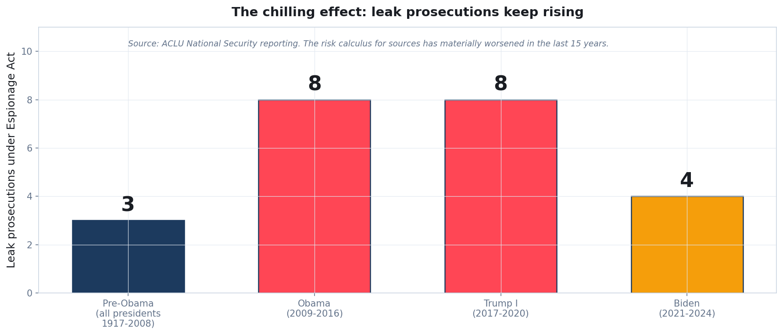
Leak prosecutions under the Espionage Act
Three pre-Obama, then roughly twenty since. The risk calculus for sources has materially worsened.
Quidnug · Whistleblower Channel
11 / 75
Notes:
From 1917 through 2008 there were three Espionage Act prosecutions of leakers to journalists. Daniel Ellsberg (Pentagon Papers) was one. Samuel Morison (Navy photos) was another.
Obama brought eight. Trump I brought eight more. Biden four so far.
Roughly twenty in fifteen years vs three in ninety-one. That's a 20x increase in annualized rate.
Every potential source is doing this math. The substrate doesn't protect against statutory liability, but it does mean that sources who can't come forward publicly can still contribute credibly.

Slide 12
The chilling effect: what's at stake for sources
▸ Legal retaliation. Firing, civil litigation, criminal prosecution under statutes like the US Espionage Act.
▸ Professional destruction. Industry blacklisting, loss of professional licenses, revocation of security clearances.
▸ Social and family consequences. Documented in case studies from Snowden, Manning, Thomas Drake, and others.
▸ Physical safety. Documented in authoritarian contexts. Journalists covering the Panama Papers were murdered.
▸ The structural pressure. Pressure on journalists to protect anonymity is extreme. Anonymity erodes credibility. The tension is structural. Donaldson 2020; Radsch 2019.
Quidnug · Whistleblower Channel
12 / 75

Slide 13
“
A source who is cryptographically verifiable as 'current senior engineer at Company X, with institutional attestation, not previously discredited' has substantially more credibility than 'an unnamed source' while maintaining identity protection. The source's specific identity remains private; their category (with specific attested claims) is public.
— The core claim of this deck
Quidnug · Whistleblower Channel
13 / 75

Slide 14
Section 2
Current Whistleblower Infrastructure
Mapping what exists and what's missing.
Quidnug · Whistleblower Channel
14 / 75

Slide 15
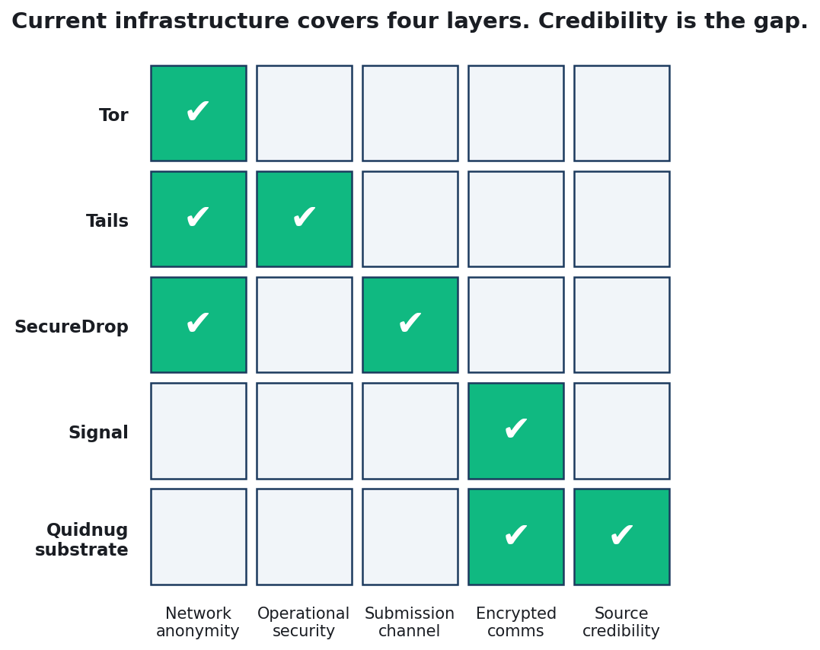
Infrastructure coverage matrix
Tor, Tails, SecureDrop, Signal cover four layers between them. Credibility attestation is uncovered.
Quidnug · Whistleblower Channel
15 / 75
Notes:
This is the landscape today. Five layers matter: network anonymity, operational security, submission channel, encrypted comms, source credibility.
The first four have mature tools. SecureDrop is the operational standard for AP, Washington Post, Guardian, NYT, ProPublica, The Intercept. Signal is used universally for source contact. Tor and Tails handle anonymity and endpoint security.
Credibility is the one layer with no tool.
The Quidnug substrate targets this specific gap. It does not replace SecureDrop or Signal; it composes with them.

Slide 16
SecureDrop • the submission channel
▸ Origin. Developed initially by Aaron Swartz and Kevin Poulsen, now maintained by Freedom of the Press Foundation.
▸ Architecture. Source connects over Tor to a news organization's SecureDrop instance. Submission uses a code-name. Journalist retrieves via air-gapped system.
▸ What SecureDrop does well. Source identity protection, document submission, journalist-side operational security.
▸ What SecureDrop does not do. Cryptographic attestation of source's institutional claims. Persistent pseudonymous identity. Cross-publication credibility portability.
▸ Takeaway. SecureDrop is the floor we build on, not the ceiling.
Quidnug · Whistleblower Channel
16 / 75
Notes:
SecureDrop is genuinely excellent at what it does. The threat model is thoughtful, the track record is strong, and major news organizations have standardized on it.
Our substrate adds a credibility attestation layer on top. A source uses SecureDrop to submit the package including attested credentials.
The journalist's workflow stays largely the same; they just have cryptographic verification for claims they previously had to take on trust.

Slide 17
GlobaLeaks • SecureDrop for NGOs and tip lines
▸ Purpose. The SecureDrop pattern for NGOs and government anti-corruption tip lines.
▸ Deployments. Transparency International chapters, anti-corruption agencies in multiple countries, investigative journalism initiatives worldwide.
▸ Strengths. Same as SecureDrop. Good submission channel, thoughtful threat model, reasonable operational security guidance.
▸ Gaps. Same as SecureDrop. No credibility attestation machinery.
▸ Note. Both projects are mature and well-maintained. The credibility gap is not a criticism; it's a layer they don't claim to address.
Quidnug · Whistleblower Channel
17 / 75

Slide 18
Signal • the communication layer
▸ Role. End-to-end encrypted messaging. The industry standard for source-journalist contact.
▸ Protocol. Double Ratchet + X3DH. Well-studied, implemented in reference quality. Non-profit Signal Foundation.
▸ Strengths. End-to-end encryption, forward secrecy, open source, extensively audited.
▸ Limitations. No source credibility verification. Persistent pseudonym is only the phone number. Not anonymous against phone number association.
▸ Substrate alignment. QDP-0024 MLS-based group encryption is a direct successor pattern with pseudonymous identity built in.
Quidnug · Whistleblower Channel
18 / 75
Notes:
Signal is indispensable infrastructure. It's not going away.
The limitation for whistleblowing is the phone number association. Signal requires a phone number to register. In adversarial environments, a phone number is a partial identification.
QDP-0024 addresses this by using cryptographic identity instead of phone numbers. For our substrate, we use QDP-0024 MLS groups as an alternative to Signal when the phone number is itself a risk.

Slide 19
Tor + Tails • operational security
▸ Tor. Network-layer anonymity. Onion routing through volunteer relays. Protects source IP address and traffic analysis.
▸ Tails. Linux live-USB OS designed for hostile-environment journalism and whistleblowing. Leaves no trace on host hardware.
▸ Threat coverage. Network observation, endpoint compromise, forensic recovery of source activity.
▸ What they provide. Identity protection at network and endpoint layers. Neither provides credibility machinery.
▸ Integration. The substrate runs alongside these tools. Sources continue to use Tor and Tails; attestation workflows fit into that operational model.
Quidnug · Whistleblower Channel
19 / 75

Slide 20
The gap: every tool is one layer
▸ Network anonymity. Covered by Tor.
▸ Operational security. Covered by Tails.
▸ Submission channel. Covered by SecureDrop or GlobaLeaks.
▸ Encrypted communication. Covered by Signal or QDP-0024.
▸ Source credibility to the audience. Uncovered. This is the gap the Quidnug substrate fills.
▸ Why it matters. A whistleblower using all of the above has done everything right operationally. The journalist still has to verify credibility privately; the reader still has to trust the journalist.
Quidnug · Whistleblower Channel
20 / 75

Slide 21
Section 3
The Selective Disclosure Primitive
Prove specific attributes without revealing identity.
Quidnug · Whistleblower Channel
21 / 75

Slide 22
Origins of selective disclosure
▸ Chaum 1985. 'Security without identification: transaction systems to make big brother obsolete.' Foundational paper.
▸ Chaum 1988. 'Blind signatures for untraceable payments.' Specific cryptographic primitive for unlinkable token issuance.
▸ Brands 1993. Brands credentials: signatures on attribute sets with selective disclosure.
▸ Camenisch-Lysyanskaya 2001, 2003. CL signatures: anonymous credentials with zero-knowledge attribute proofs.
▸ Boneh-Boyen-Shacham and extensions. BBS+ signatures: compact signatures that support selective disclosure efficiently. Now the basis for W3C Verifiable Credentials.
▸ Not a new idea. The research line is forty years deep. The deployment is the last decade.
Quidnug · Whistleblower Channel
22 / 75
Notes:
This is forty years of cryptography research, not a speculative primitive.
Chaum's 1988 paper is the starting point. His motivation was digital cash where the issuer cannot link issued coins to spending events. The same machinery applies to whistleblower credentials.
BBS+ is what modern deployments use. It supports compact proofs, efficient verification, and selective disclosure over large attribute sets. It's the suite the W3C Verifiable Credentials standard endorses.

Slide 23
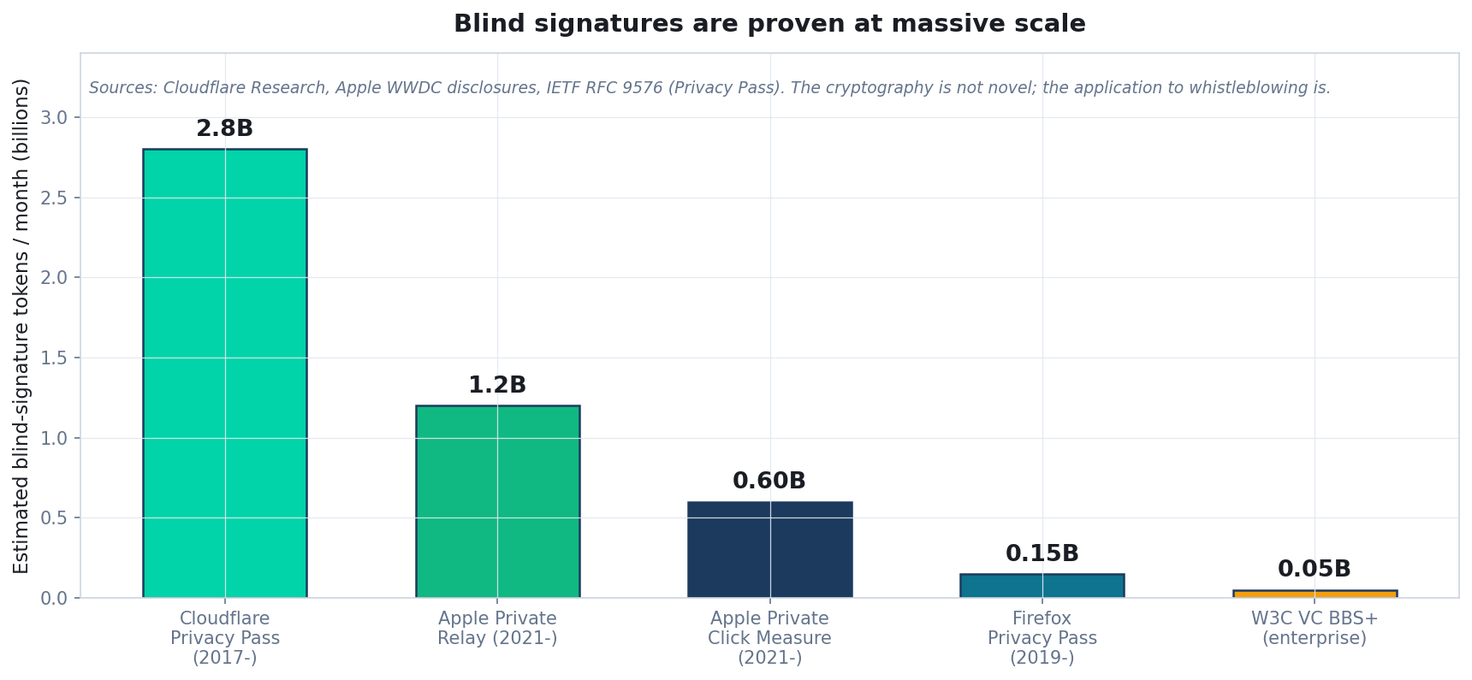
Blind signatures deployed at massive scale
Billions of blind-signature tokens per month across Cloudflare Privacy Pass, Apple Private Relay, and others. The cryptography is proven.
Quidnug · Whistleblower Channel
23 / 75
Notes:
If you doubt the primitive works at scale, look at the deployment numbers.
Cloudflare Privacy Pass alone issues billions of tokens monthly. Apple Private Relay does roughly a billion monthly. Private Click Measurement, Firefox, and the W3C Verifiable Credentials ecosystem add more.
The cryptography is not novel. The application to whistleblower credentials is.

Slide 24
Privacy Pass as the concrete example
▸ The user experience. User solves a CAPTCHA once. Gets a batch of blinded tokens. Later, redeems tokens on other sites to prove 'verified human' without being re-CAPTCHAed.
▸ The cryptographic property. The CAPTCHA provider cannot link redeemed tokens to the specific CAPTCHA-solving session.
▸ Standardization. IETF RFC 9576 (2024). Published standard with multiple interoperable implementations.
▸ Why this matters for whistleblowing. Same primitive. Same cryptographic property. Apply it to 'verified insider at Company X' instead of 'verified human.'
Quidnug · Whistleblower Channel
24 / 75

Slide 25
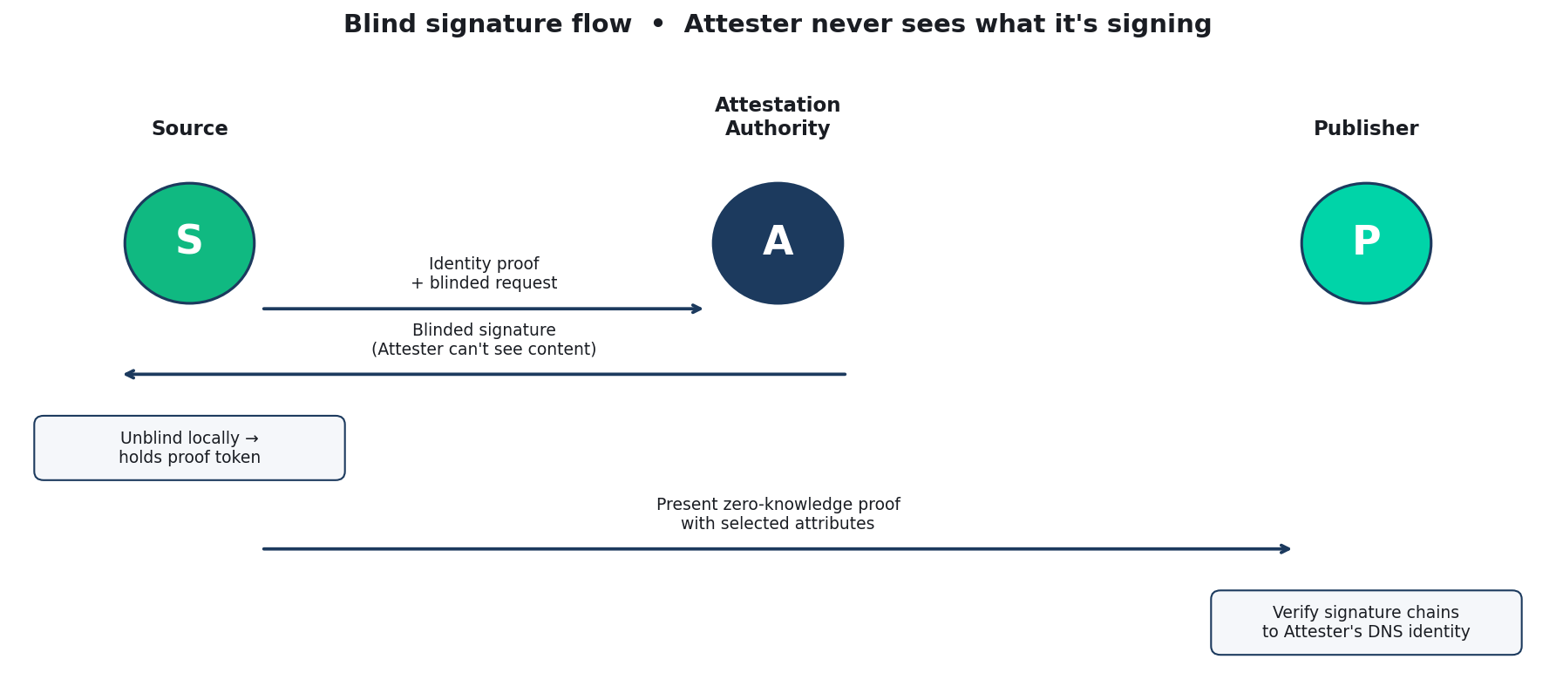
Blind signature issuance flow
Attester signs a blinded message. Source unblinds locally. Verifier checks the unblinded signature.
Quidnug · Whistleblower Channel
25 / 75
Notes:
The flow in five steps:
One: source presents identity proof (HR records, license, cert) to the Attestation Authority and requests a blinded credential.
Two: Attester signs the blinded message. Critically, the Attester does not see the message content; it sees only a cryptographic commitment.
Three: source unblinds locally. Now holds a credential that the Attester signed but cannot recognize on later presentation.
Four: source presents a zero-knowledge proof of the credential with selected attributes disclosed.
Five: verifier checks that the proof chains to the Attester's public key (DNS-anchored). The verifier learns the attributes, not the source's identity.

Slide 26
Concrete credential example
Attested attributes (disclosed to publisher):
Industry: Financial services
Employer cat: Major US bank, top 5 by assets
Role: Senior engineer, risk systems
Tenure range: 5+ years
Active employ: Yes
Certifications: CFA (held), CISSP (held)
Regulatory hist: No sanctions or enforcement actions
NOT disclosed (held back by source):
Specific name of bank
Specific name of employee
Specific team or manager
Specific geographic location
Signature: IBF_ATTESTER signed the above via blind
signature. DNS anchor: ibanking.example.
Quidnug · Whistleblower Channel
26 / 75
Notes:
This is what a credential looks like in practice.
The attested attributes are enough for a reader to calibrate their credibility assessment. Top-five US bank, senior engineer in risk systems, 5+ years, CFA and CISSP. That's a specific, positioned insider.
The not-disclosed attributes preserve anonymity. A reader cannot identify which specific bank, which specific team, which specific employee.
The Attester (Institute of Banking and Finance in this example) is a real professional body with a DNS-anchored identity. Readers trust the Attester to the extent their trust graph includes it.

Slide 27
Why this is stronger than 'trusted journalist says'
▸ Current practice: trust transfer. Reader trusts journalist. Journalist trusts source. Reader does not independently verify.
▸ Under selective disclosure: verifiable attestation. Reader trusts Attester. Attester verified attributes. Reader independently verifies attestation chain.
▸ Journalist role shifts. From 'vouch for source credibility' to 'handle content and editorial judgment.' Both roles remain; attestation handles the credibility part cryptographically.
▸ Cross-publication portability. The same attested source can credibly publish with any outlet. Credibility is not tied to a single outlet's reputation.
Quidnug · Whistleblower Channel
27 / 75

Slide 28
Section 4
Stable Pseudonyms with Reputation
Accumulating track record without identity.
Quidnug · Whistleblower Channel
28 / 75

Slide 29
Pseudonym = keypair, consistent across disclosures
▸ The primitive. Source generates a Quidnug keypair. Uses it consistently across disclosures. The public key is the stable pseudonym.
▸ Attribute layer is separate. Attested attributes from institutional attestation can vary across disclosures. The keypair stays constant.
▸ Track record accumulates. Each disclosure produces outcomes (regulatory action, confirmatory filings, court records). The pseudonym's track record of accurate disclosures accumulates.
▸ Not tied to publication. Same pseudonym can disclose to Guardian, NYT, Der Spiegel, ProPublica. Reputation is portable.
Quidnug · Whistleblower Channel
29 / 75

Slide 30
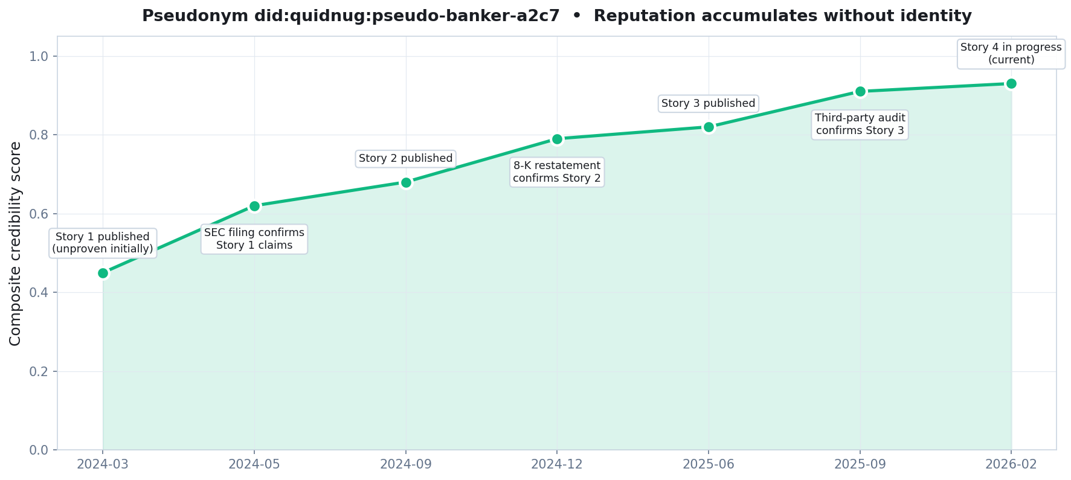
A pseudonym's reputation accumulating
Composite credibility grows with each independently verified disclosure. Identity stays private throughout.
Quidnug · Whistleblower Channel
30 / 75
Notes:
Three disclosures over two years, each independently verified by later evidence. The pseudonym's credibility moves from 0.45 (new, uncertain) to 0.91 (three-for-three verified).
A fourth disclosure from this pseudonym carries the weight of three prior verified disclosures. The source is credible even though they remain anonymous.
This is Donath's analysis of virtual-community identity applied to journalism: stable pseudonyms enable reputation accumulation; identity revelation is orthogonal to credibility.

Slide 31
Verification without identification
▸ Accuracy signal: independent evidence. SEC filings, court records, company restatements, later institutional admissions.
▸ The pseudonym's accuracy is assessed against these. Not against the journalist's assertion. Not against the source's own claim.
▸ Donath 1999 on virtual community identity. Stable pseudonyms enable reputation accumulation. Identity revelation is orthogonal to credibility.
▸ Axelrod 1984 on repeated games. Repeated-game dynamics produce cooperation among strangers when reputation is persistent.
▸ Pseudonyms create the repeated game. Anonymous sources play a one-shot game with no accountability. Pseudonymous sources are in a repeated game with reputation consequences.
Quidnug · Whistleblower Channel
31 / 75

Slide 32
What prevents impersonation
▸ The keypair is the authority. Only the holder of the private key can sign under that pseudonym.
▸ Compromise is discoverable. Inconsistent disclosure patterns, violation of prior commitments, or contradictory claims signal compromise.
▸ Recovery model. For adversarial contexts, simpler model: if key is compromised, retire that pseudonym and start new. Accumulated credibility is lost; attacker cannot continue to impersonate.
▸ QDP-0002 guardian recovery. Exists in protocol but for high-risk whistleblower contexts the retirement model is simpler and more robust.
▸ Key storage. Air-gapped, offline, with backup on similarly protected hardware.
Quidnug · Whistleblower Channel
32 / 75

Slide 33
Anonymous-but-accountable
▸ Pure anonymity has no accountability. A one-shot anonymous source can lie once with full impact and face zero cost.
▸ Pseudonyms create real cost. A pseudonym caught in a falsehood loses credibility. If they want to make future disclosures, they bear a consequence.
▸ Falsehood is detectable. Independent verification (or non-verification) of claims is public. The signal is hard to suppress.
▸ The consequence is real. Even without legal identity. Reputation pressure constrains behavior in the repeated game.
▸ Partial restoration of accountability. Anonymous sources shift all consequence to the publication. Pseudonymous sources share it.
Quidnug · Whistleblower Channel
33 / 75

Slide 34
Section 5
Trust-Graph Vouching
Peer and institutional attestation, composed.
Quidnug · Whistleblower Channel
34 / 75

Slide 35
Two types of attestation, composed
▸ Peer attestation. Other employees or professionals vouching for the source. 'I, a colleague at the same institution, can confirm this person has the access they claim.'
▸ Institutional attestation. Organizations vouching for the source's category. 'This person is a credentialed member of our professional body.'
▸ Both types compose. A source with 3 peer attestations + institutional attestation from a professional body has stronger evidence than either alone.
▸ Each is independently pseudonymizable. Peers don't have to reveal themselves either. Pseudonymous peer attestations work using the same machinery.
Quidnug · Whistleblower Channel
35 / 75

Slide 36
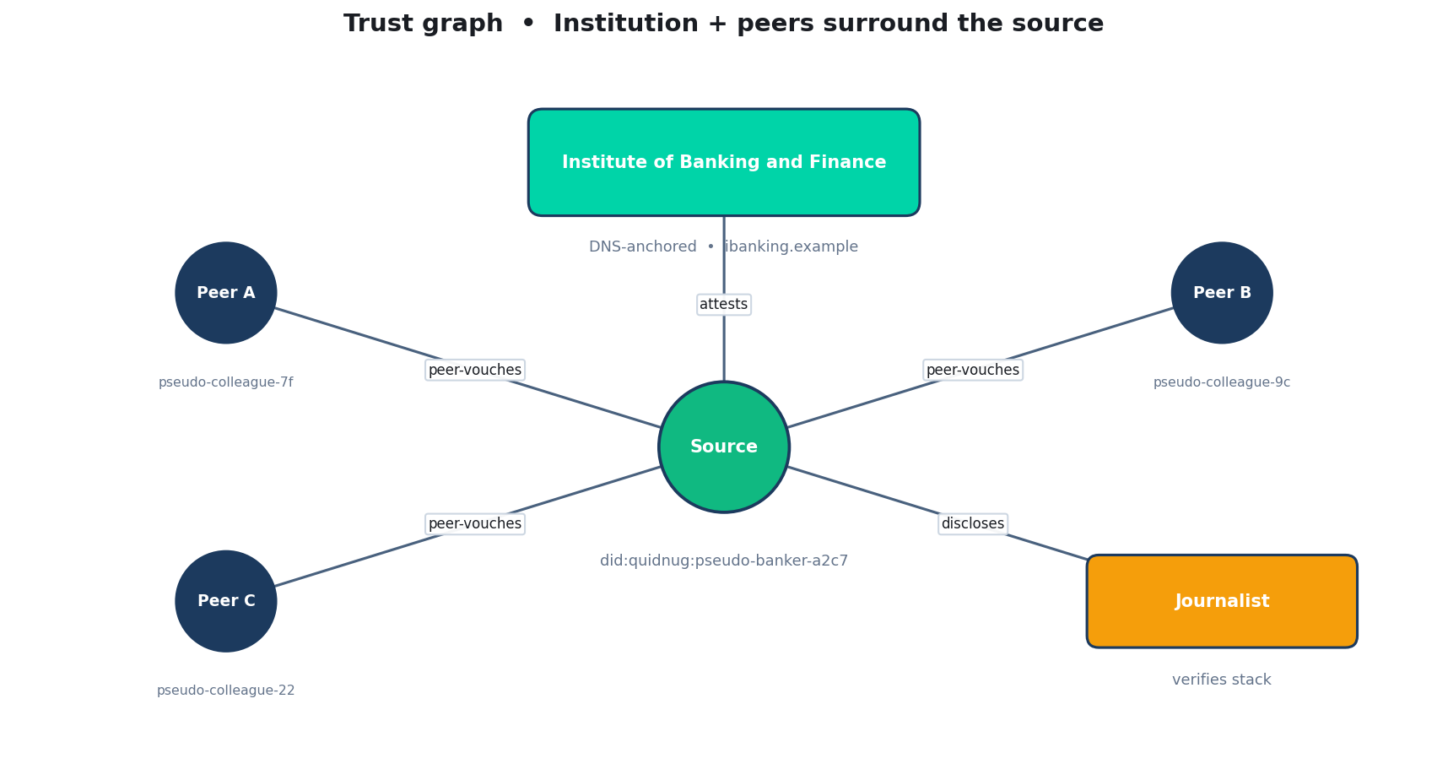
Trust graph around the source
Institutional attester above, pseudonymous peers surrounding, journalist at the edge of the graph.
Quidnug · Whistleblower Channel
36 / 75
Notes:
This is what the trust graph looks like for a well-constructed disclosure.
Center: the source pseudonym. Above: an institutional attester (DNS-anchored). Sides: pseudonymous peers (each with their own track record). Far edge: the journalist who verifies the whole structure.
The journalist's role is important but subordinate. They verify the chain, they don't manufacture credibility. Credibility is verifiable by anyone with the tooling.

Slide 37
Peer attestation without identity exposure
▸ Peers have pseudonyms too. Any peer attestation can come from a pseudonym, not a named individual.
▸ Pseudonymous peer attestation. 'I am a current employee at Company X, pseudonymously known as pseudo-peer-7f, and I attest that source pseudo-banker-a2c7 has the access they claim.'
▸ Journalist sees structured evidence. Multiple pseudonymous attestations from people who claim specific institutional roles, each with their own track record.
▸ Composition of weak signals. Three pseudonymous attestations from new pseudonyms are weaker than one from an established pseudonym. But three of them together is still information.
Quidnug · Whistleblower Channel
37 / 75

Slide 38
DNS-anchored institutional attestation (QDP-0023)
▸ Identity rooted in DNS. Institutions anchor Quidnug identity to their DNS domain. SPE.example publishes their public key via DNSSEC-signed TXT record.
▸ Pre-existing reputation transfers. SPE's credibility in the real world is the credibility of their DNS-anchored identity.
▸ Members request credentials. Via blind signature flow. SPE signs attestations of membership, tenure, certification status, sanctions history.
▸ Readers verify. The attestation on the disclosure chains to SPE's DNS identity. Readers weight by their own trust graph's opinion of SPE.
Quidnug · Whistleblower Channel
38 / 75

Slide 39
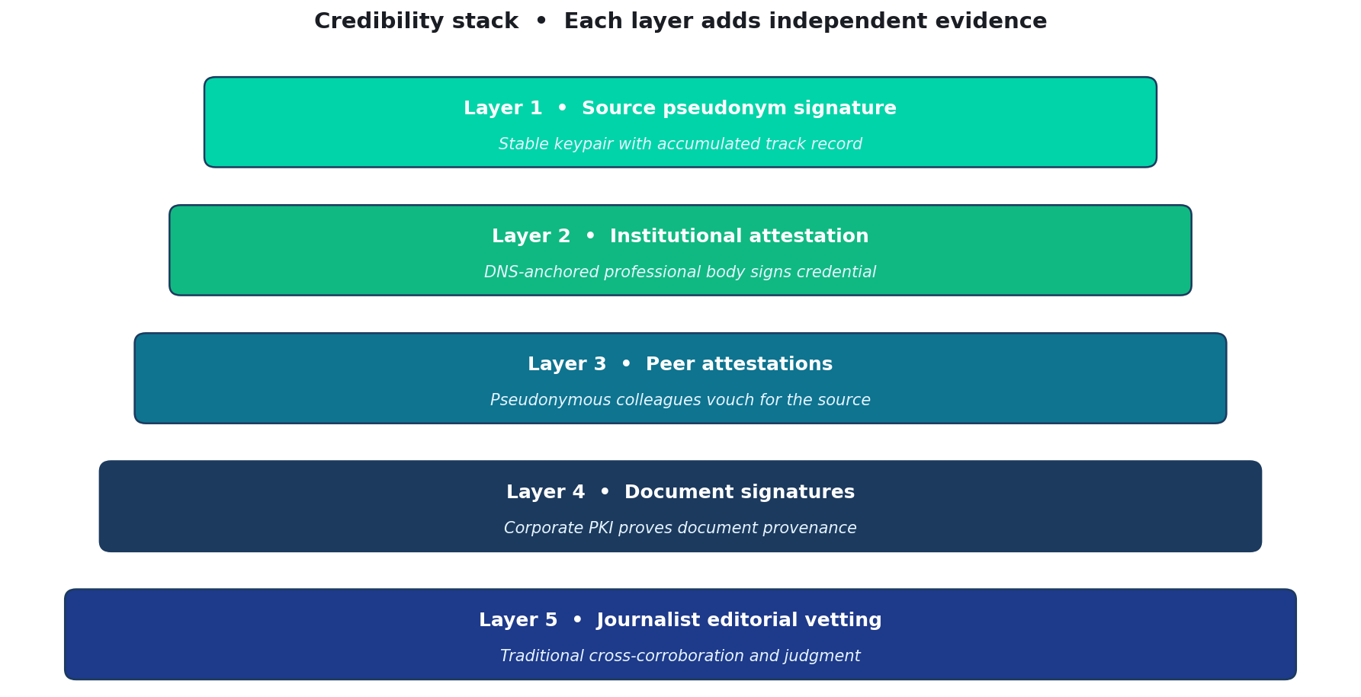
The layered credibility stack
Each layer adds independent evidence. The reader evaluates the stack as a whole.
Quidnug · Whistleblower Channel
39 / 75
Notes:
Five layers. Each is independently verifiable. Each adds to composite credibility.
Layer 1: source pseudonym signature. Who's making the claim? A specific keypair with a history.
Layer 2: institutional attestation. What category of person is the source? Attested by a DNS-anchored institution.
Layer 3: peer attestations. Who else confirms the source is positioned to know? Pseudonymous colleagues with their own track records.
Layer 4: document signatures. Are the documents authentic? Corporate PKI signatures prove document provenance.
Layer 5: journalist editorial vetting. Does the whole package cohere with public reality? Traditional editorial judgment.
Five independent sources of evidence, not one.

Slide 40
Absence of attestation as a signal
▸ The stack is informative whether full or empty. A source with no institutional attestation and no peer vouches is signaling something.
▸ Three possibilities. They cannot obtain attestation (unusual for genuine insiders). They are not positioned as they claim. They are a first-time source with no accumulated credibility.
▸ Readers factor the absence. Composite credibility is drawn down when attestation is missing. This is principled, not arbitrary.
▸ Not a disqualification. First-time anonymous sources can still provide information. But they start from a lower floor and build credibility through accurate disclosures.
Quidnug · Whistleblower Channel
40 / 75

Slide 41
Defense against fake attestations
▸ DNS-anchored identity requires real domain control. Creating 'Institute of Banking and Finance' as a fake requires registering a domain and building a presence readers would trust.
▸ Trust graph weights institutions by reader's trust. A new unfamiliar 'institution' has low weight even if technically authentic.
▸ Cross-institution corroboration. A source attested by one real institution is weaker than one attested by multiple from different domains.
▸ Same defenses as review-spam prevention. The structure carries over from the relational ratings context. Trust graphs are self-defending when they're relational.
Quidnug · Whistleblower Channel
41 / 75

Slide 42
Section 6
End-to-End Architecture
Source infrastructure to reader audit, assembled.
Quidnug · Whistleblower Channel
42 / 75

Slide 43
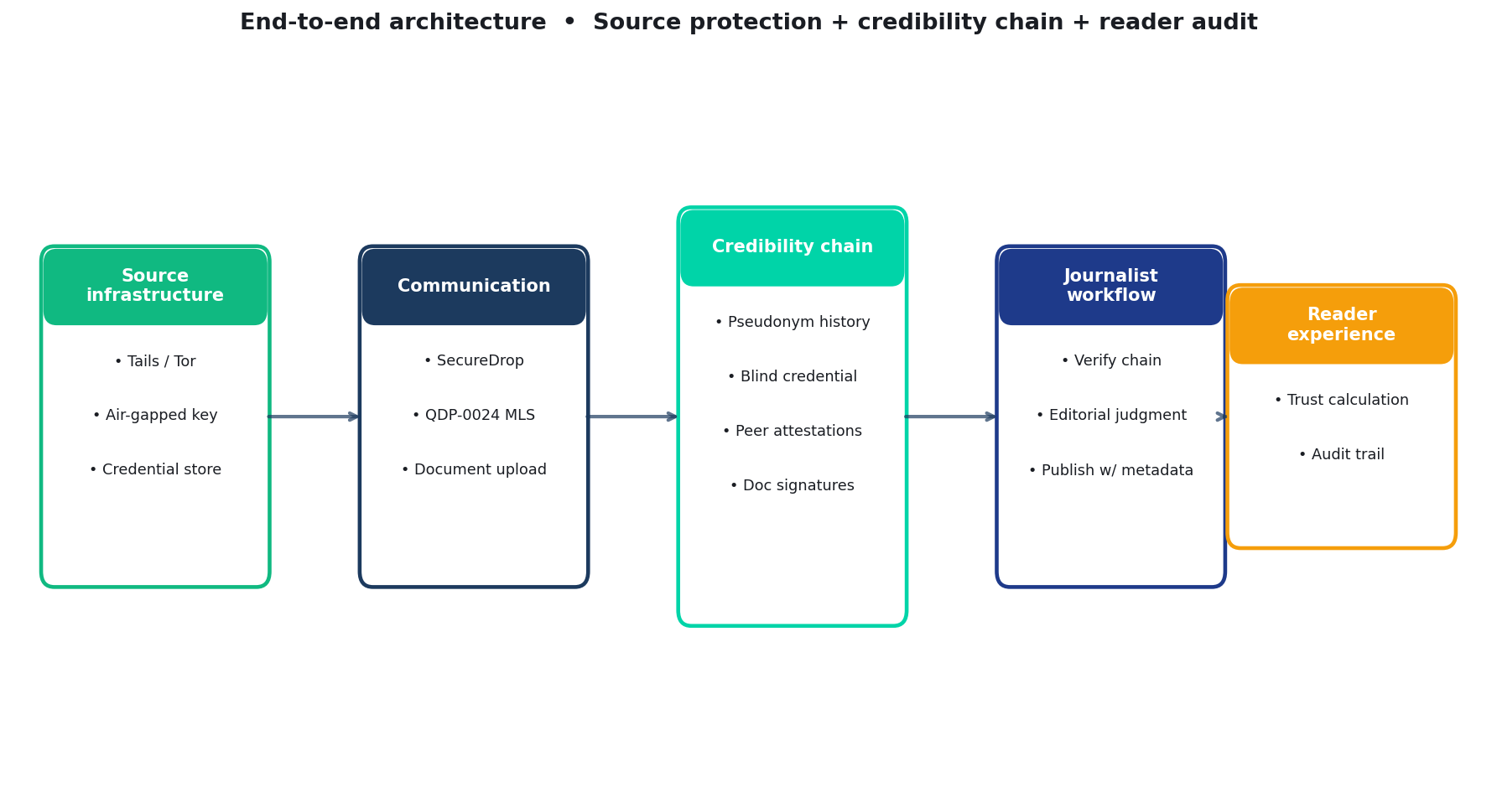
The complete architecture
Five stages: source infrastructure → communication → credibility chain → journalist workflow → reader experience.
Quidnug · Whistleblower Channel
43 / 75
Notes:
End-to-end. This is what the full architecture looks like.
Source infrastructure: Tails on a dedicated laptop, Tor routing, airgapped keypair, credential store.
Communication: SecureDrop or QDP-0024 MLS. Encrypted contact channel.
Credibility chain: pseudonym history, blind credential, peer attestations, document signatures.
Journalist workflow: verify chain, apply editorial judgment, publish with metadata.
Reader experience: see the trust calculation, drill into the audit trail.
Every layer has known technology. The substrate composes known pieces with the credibility-attestation addition.

Slide 44
Source infrastructure detail
▸ Tails USB. Dedicated hardware. Boots from USB. Leaves no trace. Freedom of the Press Foundation guidance applies.
▸ Tor Browser. Network anonymity. Hidden service for destination.
▸ Air-gapped keypair. Generated on offline hardware. Never touches internet-connected machines. Backups on similarly protected hardware.
▸ Credential store. Obtained from Attesters via blind-signature flow. Bound to source's Quidnug quid.
▸ Document preparation. Metadata scrubbed. Provenance chain preserved where possible (corporate PKI signatures stay intact).
Quidnug · Whistleblower Channel
44 / 75

Slide 45
Communication channel options
▸ SecureDrop. Publisher-operated. Source connects via Tor. Submits documents + credential package. Journalist retrieves via air-gapped workflow.
▸ QDP-0024 MLS group. Pseudonymous group chat. Source's pseudonym is a member. Forward secrecy. No phone number requirement.
▸ When to use which. SecureDrop for first-contact document dumps. QDP-0024 for ongoing pseudonymous conversation that spans stories.
▸ Both compose. A source can use SecureDrop for submission and QDP-0024 for follow-up questions without re-exposing themselves.
Quidnug · Whistleblower Channel
45 / 75

Slide 46
Credibility chain detail
▸ Pseudonym signature on the disclosure. Root of the chain. Only the source can sign under this keypair. Readers verify signature validity.
▸ Blind credential presentation. Zero-knowledge proof that source holds a credential signed by Attester. Attributes selectively disclosed.
▸ Peer attestation signatures. Each peer signs a brief attestation under their own pseudonym. Readers verify the set of signatures and their pseudonyms' track records.
▸ Document signatures. Where documents were corporate-signed (using the company's own PKI), signatures survive. Provenance is verifiable independent of the source.
Quidnug · Whistleblower Channel
46 / 75

Slide 47
Journalist workflow
▸ Receive the package. Documents + credential package + pseudonym + peer attestations. All via SecureDrop or QDP-0024.
▸ Verify the credibility chain. Signature validations, DNS anchor checks, pseudonym track record lookups. Automated at the tool layer.
▸ Corroborate independently. Public records, other sources, internal consistency of the source's account. Traditional editorial work.
▸ Apply editorial judgment. Is the story in the public interest? Is the framing responsible? Is the level of detail appropriate?
▸ Publish with metadata. The credibility chain metadata is part of the publication. Readers can inspect it if they choose.
Quidnug · Whistleblower Channel
47 / 75

Slide 48
What the reader sees
Story: Bank X systematically misreports loan-loss reserves
Byline: Jordan K. at Financial Times
Source verification:
Source pseudonym: pseudo-banker-a2c7
(established 2023-11, 4 prior verified)
Institutional: Institute of Banking and Finance
(DNS anchor: ibf.example, verified)
Attested: Current senior employee, 8+ years,
certifications valid, no sanctions
Peer attestations: 3 colleagues (pseudonymous)
Each with own track record
Document signatures: Bank X corporate PKI on 12 of 17 docs
Reader trust calculation:
Trust in publication (FT): 0.85
Trust in journalist (Jordan K.): 0.80
Trust in IBF: 0.70
Trust in pseudonym's track: 0.75
Composite credibility: ~0.78
[Click for detailed verification →]
Quidnug · Whistleblower Channel
48 / 75
Notes:
This is the reader-facing artifact. Not just 'A source familiar with the matter.'
Every piece is verifiable. The reader can click through to independent verification if they want.
Trust weights are the reader's own (taken from their trust graph). The composite credibility is computed locally; no central authority imposes a score.
When the story is attacked as fake news, the publication has something to point at beyond the journalist's reputation.

Slide 49
The source's protection layers
▸ Network-layer anonymity. Tor hides the source's IP and traffic patterns.
▸ Operational security. Tails prevents forensic recovery from the source's hardware. Air-gap isolates the key.
▸ Pseudonym decoupling. The keypair is not tied to any legal identity. The Attester never sees what they're signing.
▸ Selective disclosure. Credentials prove category without revealing identity. Verifier learns attributes, not who.
▸ Encrypted comms. Source-journalist channel is encrypted end-to-end. Content is not recoverable by third parties.
▸ The stack is additive, not subtractive. The substrate adds layers. It doesn't remove existing protections.
Quidnug · Whistleblower Channel
49 / 75

Slide 50
The credibility floor
▸ Without the substrate. An anonymous source has credibility floor near zero. The journalist's assurance is the only signal.
▸ With the substrate. An anonymous source has a credibility floor set by their institutional attestation plus peer attestations, which are independently verifiable.
▸ What the floor enables. Credible anonymous disclosures at scale. Sources who currently cannot reach credibility because they cannot expose themselves can now participate.
▸ Who benefits. The people most in need of protection: those facing material legal or physical risk from exposure.
Quidnug · Whistleblower Channel
50 / 75

Slide 51
Section 7
Legal Framework Alignment
How the substrate fits existing whistleblower law.
Quidnug · Whistleblower Channel
51 / 75

Slide 52
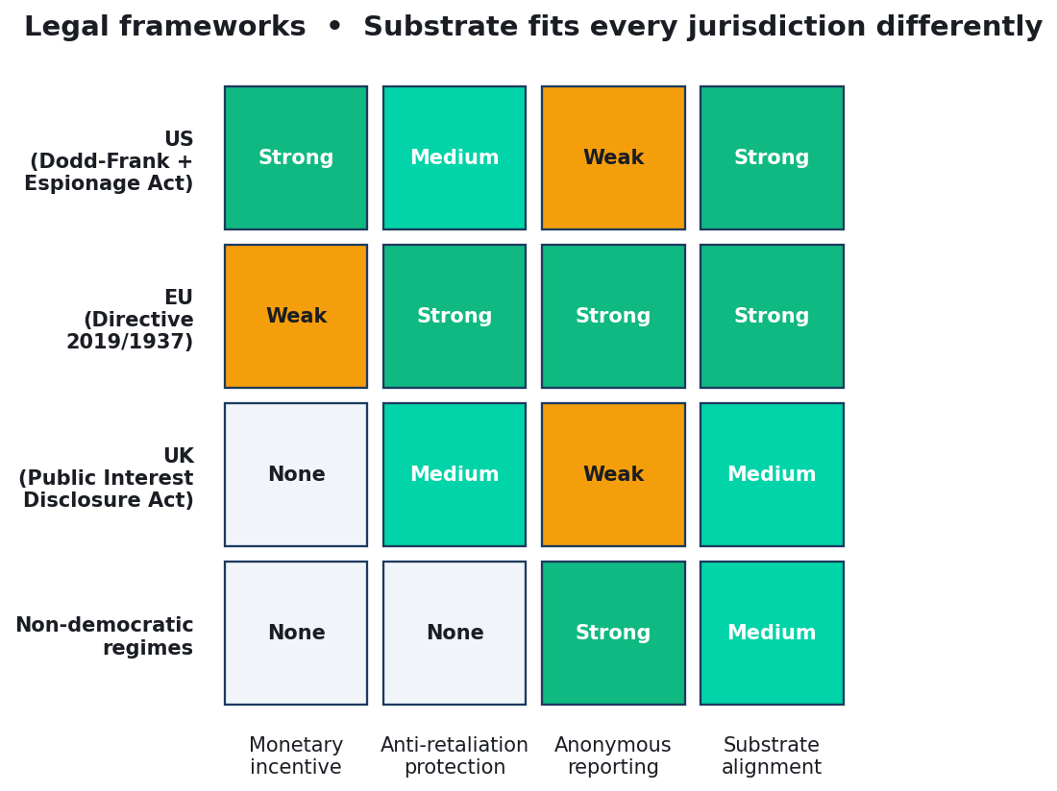
Legal frameworks across jurisdictions
Four dimensions, four jurisdictions. Substrate alignment is strong in every context because it lowers the identification requirement.
Quidnug · Whistleblower Channel
52 / 75

Slide 53
United States
▸ Dodd-Frank Whistleblower Program (2010). SEC and CFTC programs. Monetary awards (10-30% of recoveries over $1M). Strong anti-retaliation protections.
▸ Substrate fit. Pseudonymous tips with cryptographic attestation can be filed. Award processed through the pseudonym; identity revealed only at payment time, under confidentiality.
▸ Espionage Act (1917). Prosecutes unauthorized disclosure. Current interpretation broad. Substrate does not protect against statutory criminal liability.
▸ Federal whistleblower statutes. SOX, FCA, EPA, OSHA. Substrate helps establish 'reported in good faith' element with verifiable documentation of the disclosure flow.
Quidnug · Whistleblower Channel
53 / 75

Slide 54
European Union
▸ EU Whistleblower Directive (2019/1937). Requires member states to establish internal and external reporting channels with protections.
▸ Anonymous reporting. Explicitly allowed in some contexts. Substrate aligns directly with this provision.
▸ GDPR alignment. Data minimization via selective disclosure is a designed-in property. Blind signatures and pseudonymous credentials are explicitly identified as privacy-enhancing techniques in GDPR guidance.
▸ Implementation status. Member states have varying levels of implementation. Internal reporting channels at mid-size companies are still maturing. Substrate is forward-compatible.
Quidnug · Whistleblower Channel
54 / 75

Slide 55
United Kingdom
▸ Public Interest Disclosure Act (1998). Protects workers making disclosures in the public interest. Pre-GDPR, pre-directive era.
▸ Anonymous disclosures. Not directly protected under PIDA. Worker must be identified to claim protections.
▸ What substrate contributes. A pseudonymous track record helps establish the public-interest nature of disclosures. Not a substitute for identification when PIDA protection is sought.
▸ Policy direction. PIDA reform has been discussed. Substrate demonstrates that credibility-without-identification is feasible, potentially informing future reform.
Quidnug · Whistleblower Channel
55 / 75

Slide 56
Non-democratic jurisdictions
▸ Weak or absent statutes. Many jurisdictions lack meaningful whistleblower law.
▸ Higher legal risk to sources. Substrate makes credible disclosure possible where current infrastructure cannot. Does not remove retaliation risk.
▸ Cross-border publication. Sources in restrictive jurisdictions can publish to outlets in permissive ones. Substrate makes the credibility portable.
▸ Operational security is paramount. Technical anonymity (Tor, Tails) plus substrate anonymity gives layered protection. Still not absolute; state-level adversaries remain a serious threat.
Quidnug · Whistleblower Channel
56 / 75

Slide 57
Statutory alignment: policy directions
▸ Anti-retaliation extension. Statutes could be strengthened to protect disclosures made via attested pseudonymous channels with the same protections as identified disclosures.
▸ Regulatory tip acceptance. SEC, FTC, EPA, OSHA could formalize acceptance of attested pseudonymous tips. Some already accept anonymous tips; attestation raises credibility.
▸ Court evidence. Pseudonymous cryptographic identity could be treated as equivalent to sealed testimony in appropriate cases.
▸ Not required. The technology works without statutory reform. Policy alignment amplifies impact but is not a precondition.
Quidnug · Whistleblower Channel
57 / 75

Slide 58
Section 8
Worked Example
Financial fraud disclosure, end-to-end.
Quidnug · Whistleblower Channel
58 / 75

Slide 59
The scenario
▸ Alice is a senior risk analyst at Bank X. Top-five US bank by assets. Eight years tenure. CFA and CISSP.
▸ She discovers systematic misreporting. Loan-loss reserves are systematically understated, inflating reported profits. Documentation is extensive.
▸ She wants to disclose. To regulators and journalists simultaneously. Protect career and family. Preserve anonymity indefinitely if possible.
▸ Under current infrastructure. She could use SecureDrop. The journalist would require her to eventually identify herself to establish credibility. She would then carry legal exposure.
Quidnug · Whistleblower Channel
59 / 75

Slide 60
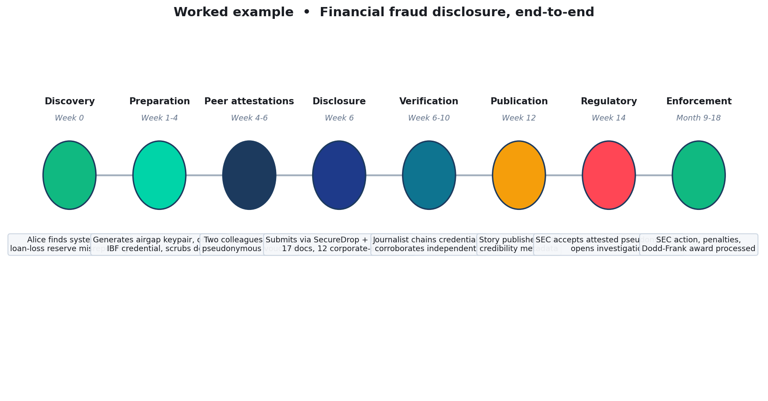
Timeline: Alice's disclosure end-to-end
Eight phases over roughly eighteen months, from discovery to enforcement action.
Quidnug · Whistleblower Channel
60 / 75

Slide 61
Setup phase (weeks 1-6)
▸ Week 0: Discovery. Alice identifies the pattern. Begins mental planning.
▸ Weeks 1-4: Infrastructure. Generates Quidnug keypair on air-gapped laptop. Obtains credential from Institute of Banking and Finance via blind-signature flow. Scrubs document metadata.
▸ Weeks 4-6: Peer attestations. Identifies two colleagues she trusts. Each provides pseudonymous peer attestation via their own keypair. Communication via QDP-0024 MLS group.
▸ Operational notes. All work done on personal hardware, air-gapped from work accounts. Tails on USB. No internet connection to work identity at any point.
Quidnug · Whistleblower Channel
61 / 75

Slide 62
Disclosure phase (week 6)
▸ Connect to SecureDrop. Alice uses Tor Browser on Tails. Connects to the Financial Times's SecureDrop instance.
▸ Submit the package. Credential-backed disclosure. 17 supporting documents. 12 documents retain bank's corporate PKI signatures. Contact channel: QDP-0024 MLS group with her pseudonym.
▸ Journalist receives. Jordan K. at FT has the package. Begins verification.
▸ Verification automatic for chain. Credential chains to IBF's DNS anchor. Peer pseudonyms have track records (or are new; disclosed). Document signatures verify against Bank X's public PKI.
Quidnug · Whistleblower Channel
62 / 75

Slide 63
Verification + reporting (weeks 6-12)
▸ Cross-reference with public records. Bank X's SEC filings. Earnings call transcripts. Regulator inspection history. Do the claims cohere with knowable context?
▸ Independent sources. Jordan finds two additional sources via traditional methods. Their accounts corroborate Alice's disclosure.
▸ Editorial judgment. Is the story in the public interest? Clearly yes. Is the level of detail responsible? Revisions narrow some identifiable specifics.
▸ Publication confidence reached. FT is ready to publish. Publication package includes credibility chain metadata.
Quidnug · Whistleblower Channel
63 / 75

Slide 64
Publication (week 12)
▸ Source description published. 'A senior risk analyst at a top-five US bank, with certifications in banking and finance, attested to by the Institute of Banking and Finance. The source's credentials and documents have been independently verified.'
▸ Verification page links. Technically-inclined readers can examine attestation chains, pseudonym track records, and DNS-anchored identity proofs.
▸ Not revealed. Alice's name. Bank X's specific name. Her team. Her geographic location.
▸ Reader reception. Story carries unusual weight for an anonymous-source piece. Liar's dividend is neutralized: critics can't claim 'made up' because attestation chain is verifiable.
Quidnug · Whistleblower Channel
64 / 75

Slide 65
Regulatory response (weeks 14+)
▸ SEC receives the tip. Alice's pseudonym files the tip via SEC's whistleblower portal. Attestation chain included.
▸ SEC verifies attestation. Pseudonym is established. Institutional attestation chains to IBF. Documents are corporate-signed. SEC initiates formal investigation.
▸ Investigation proceeds. SEC subpoenas bank records, conducts interviews, engages forensic accountants. Alice's pseudonym is contactable via QDP-0024 throughout.
▸ Enforcement action. Months later, SEC reaches enforcement action. Bank X settles. Substantial penalty. Alice's disclosures are vindicated.
Quidnug · Whistleblower Channel
65 / 75

Slide 66
Award processing (months 18+)
▸ Dodd-Frank award eligibility. Alice's disclosure led to enforcement over the $1M threshold. Pseudonym files a claim for 10-30% of recoveries.
▸ Identity required for payment. SEC cannot pay a pseudonym. Alice identifies herself to SEC only, under statutory confidentiality obligations.
▸ Public disclosure intact. The journalism and public discussion preserved Alice's anonymity throughout. Her identity is known to SEC (for payment) but not to the bank, not to the public, not to the journalist.
▸ Retaliation protection. Dodd-Frank anti-retaliation provisions apply. SEC confidentiality prevents identity leak. Alice remains in her role with no discoverable connection to the tip.
Quidnug · Whistleblower Channel
66 / 75

Slide 67
What would have happened without the substrate
▸ Journalist would require identification. To establish credibility, the journalist would need Alice's identity (at minimum). The identification itself creates legal exposure.
▸ Risk calculus deters disclosure. Many potential whistleblowers do not come forward because the credibility requirement is identification. The substrate lowers this barrier.
▸ Bank X continues misreporting. Without the disclosure, the practice continues. Investors are misled. Eventual correction is more painful.
▸ The substrate enables the disclosure. Credibility-without-identification is what lets Alice come forward at all.
Quidnug · Whistleblower Channel
67 / 75

Slide 68
Section 9
Honest Limits and Ethical Tensions
What the substrate doesn't solve.
Quidnug · Whistleblower Channel
68 / 75

Slide 69
Bad-faith whistleblowers
▸ Not all whistleblowers are good-faith. Some have grudges, run disinformation campaigns, or operate in adversarial intelligence contexts.
▸ The substrate does not distinguish. Cryptographic attestation verifies attributes, not motive. An attested senior engineer can still be running an agenda.
▸ Sophisticated adversaries. State-level actors can plausibly create fake credentials, fake peer attestations, fake document signatures if they compromise Attesters.
▸ Mitigation, not elimination. No technology fully defeats sophisticated adversaries. The substrate raises the cost. Journalist vetting and cross-corroboration remain necessary.
Quidnug · Whistleblower Channel
69 / 75

Slide 70
Attestation authority gatekeeping
▸ Who decides which institutions can attest? No central authority. Readers weight credentials by their own trust graphs.
▸ This is a feature. Different readers may weight the same credential differently. A reader who trusts IBF sees those credentials as strong; a skeptical reader sees them as weak.
▸ Perspectives preserved. Rather than overridden by a central score. This aligns with the relational trust philosophy from PoT.
▸ New institutions can participate. Emerging professional bodies can issue credentials. Their weight starts low and grows with use and track record.
Quidnug · Whistleblower Channel
70 / 75

Slide 71
The non-credentialed worker problem
▸ Not every insider has professional-body membership. Gig workers, undocumented workers, low-paid service workers can be key insiders to important stories but lack institutional attestation.
▸ Peer attestation partially fills the gap. Coworkers attesting to employment does not require a professional body. Weaker than institutional, but non-zero.
▸ Union local attestation. Where applicable, union locals can function as attestation authorities. This broadens access.
▸ Honest acknowledgment. The substrate does privilege credentialed professionals. This is a real equity concern. Peer and union attestation help but do not fully address it.
Quidnug · Whistleblower Channel
71 / 75

Slide 72
Court compulsion and limits
▸ Courts can compel source identification. Under certain circumstances. US shield laws vary by state. Federal courts have ordered journalists to disclose.
▸ Substrate limits what journalists know. If operational security was preserved, the journalist genuinely does not know the source's identity. No information to disclose.
▸ Adversary pivots to Attester. Court orders could then target the attestation authority. Depending on jurisdiction, the Attester may have its own privilege protections or be outside court reach.
▸ Not absolute protection. Sophisticated legal action can still reach sources through surveillance, operational security compromise, or document provenance investigation.
Quidnug · Whistleblower Channel
72 / 75

Slide 73
Disinformation and the responsibility gap
▸ Trust-weighted, not binary. The substrate presents credibility as a spectrum (0.0 - 1.0), not a 'verified' badge. A reader's calculation can return 0.3, clearly weak.
▸ Defense against false certainty. Honest framing that credibility is probabilistic is itself defense against misinterpretation.
▸ Anonymous-shifted responsibility. Anonymous sources shift consequence entirely to the publication. Pseudonyms partially restore accountability via repeated-game dynamics.
▸ Honest framing matters. Publications deploying this substrate should explain what the credibility score means, not treat it as a seal of approval.
Quidnug · Whistleblower Channel
73 / 75

Slide 74
What this substrate enables
▸ Credible anonymous disclosure at scale. Sources who cannot currently reach credibility because they cannot expose themselves can now participate.
▸ Cross-publication credibility portability. A pseudonym's track record moves with the source across outlets. Reputation is not outlet-captured.
▸ Reader audit trails. Readers can independently verify what the publication claims. The liar's dividend is neutralized.
▸ Regulatory tip channels. SEC, CFTC, EU-level regulators can accept attested pseudonymous tips with confidence in source category.
▸ A third option for journalists. Not 'protect completely but accept reduced credibility.' Not 'get credibility but expose the source.' A genuine third path exists.
Quidnug · Whistleblower Channel
74 / 75
Notes:
Summary of what changes.
The third option for journalists is the headline. Until now, the journalist's choice was stark: protect the source and accept 'anonymous source' discount; or require identification and get full credibility.
The substrate offers a third path where the source stays anonymous and credibility is verifiable. This is a material change in the structure of investigative journalism, not an incremental one.

Slide 75
References and next steps
Cryptography, journalism literature, and pilot engagement
Journalists, NGOs, and regulatory tip-line operators interested in pilot deployments can engage via the Quidnug repository. Legal counsel is recommended for any deployment in sensitive jurisdictions.
Resources
Foundational: Chaum 1985, 1988 (blind signatures); Camenisch-Lysyanskaya 2001, 2003; BBS+; RFC 9576 Privacy Pass.
Journalism: Singer 2007; Robinson 2011; Donaldson 2020; Radsch 2019 (CPJ); ACLU 2023 (Espionage Act).
Identity: Donath 1999 (virtual community identity); Axelrod 1984 (Evolution of Cooperation).
Platforms: SecureDrop (Freedom of the Press Foundation); GlobaLeaks (Hermes Center); Signal Foundation.
Quidnug: QDP-0021 blind signatures; QDP-0023 DNS-anchored identity; QDP-0024 private communications.
Quidnug · Whistleblower Channel
75 / 75
Notes:
References for the talk.
Everything defended in the talk traces to a specific citation. No appeal to our own authority; every claim is rooted in public literature or deployed systems.
For pilot engagement, the Quidnug repository is the starting point. Legal counsel is essential for any deployment in jurisdictions where whistleblower protections are weak or retaliation risk is high.
Thank you.

