Slide 1
GPU Enhanced LIDAR for Real Time 3D Sensing
San Jose State University,26 Sept 2016
Team Members: Amit Vasant Pachore (669-292-8312)
Bhupendra Naphade (669-251-6508)
Urvashi Agrawal (669-252-6783)
Anush Shankar (925-956-8930)
Project Advisor: Hua Harry Li, Professor
Notes:
To study investigate state of art laser 3d tech, evaluate implement design, test and verify….3 bullets..

Slide 2
Objectives
To study and investigate about the state of the art 3D sensing technology which is used in autonomous vehicles.
To design and implement a real time 3D sensing LIDAR which can measure upto a distance of 10-20m
To test and verify the functioning of the LIDAR for depth sensing the 3D space so that it can be efficiently used it in autonomous vehicles.
Notes:
To study investigate state of art laser 3d tech, evaluate implement design, test and verify….3 bullets..

Slide 3
Project Deliverables
Augmented reality (computer vision) based LIDAR prototype model on NVIDIA Jetson TK1 development board using industry grade camera.
Software package for enhanced sensing with augmented reality features.

Slide 4
Technical Challenges
Camera feed quality
Achieving LIDAR comparable sampling rate using camera
Notes:
Technical challenges we r facing

Slide 5
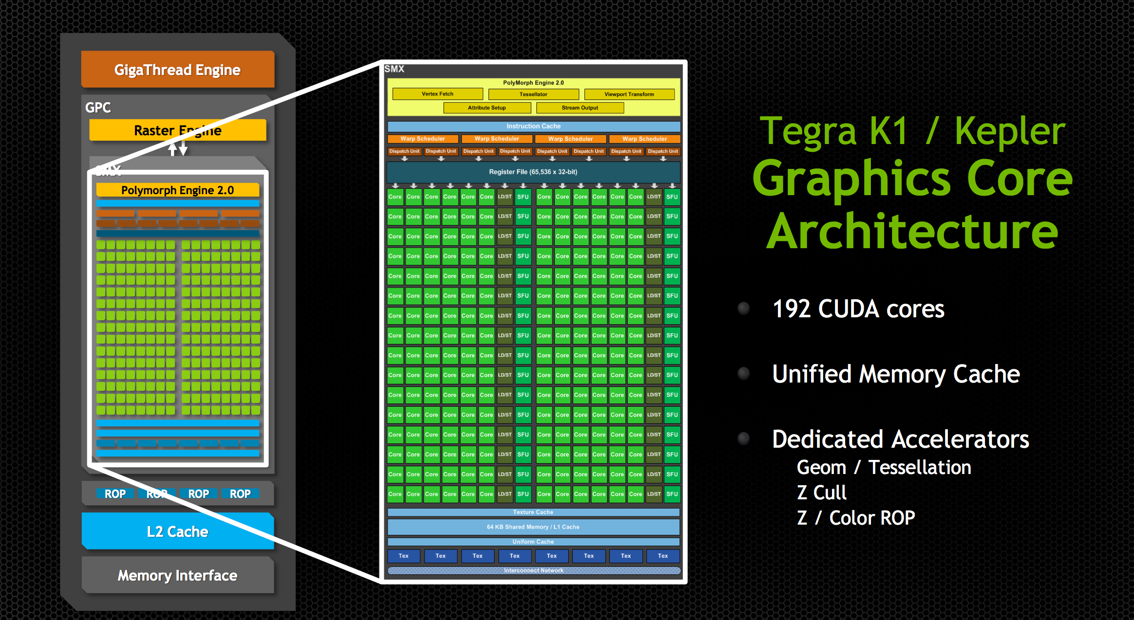
TK1 Architecture

Slide 6
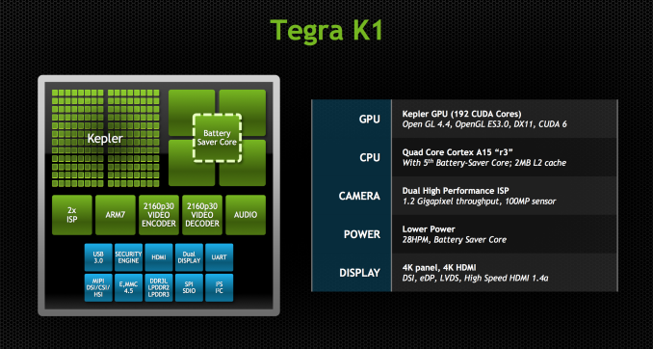
TK1 overview

