Slide 1
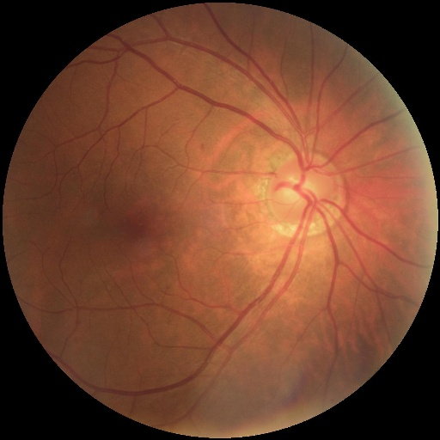
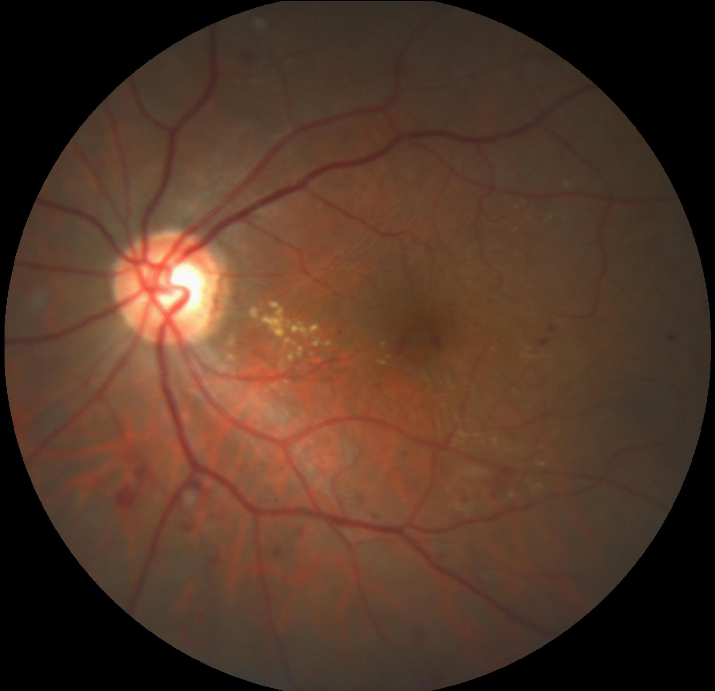
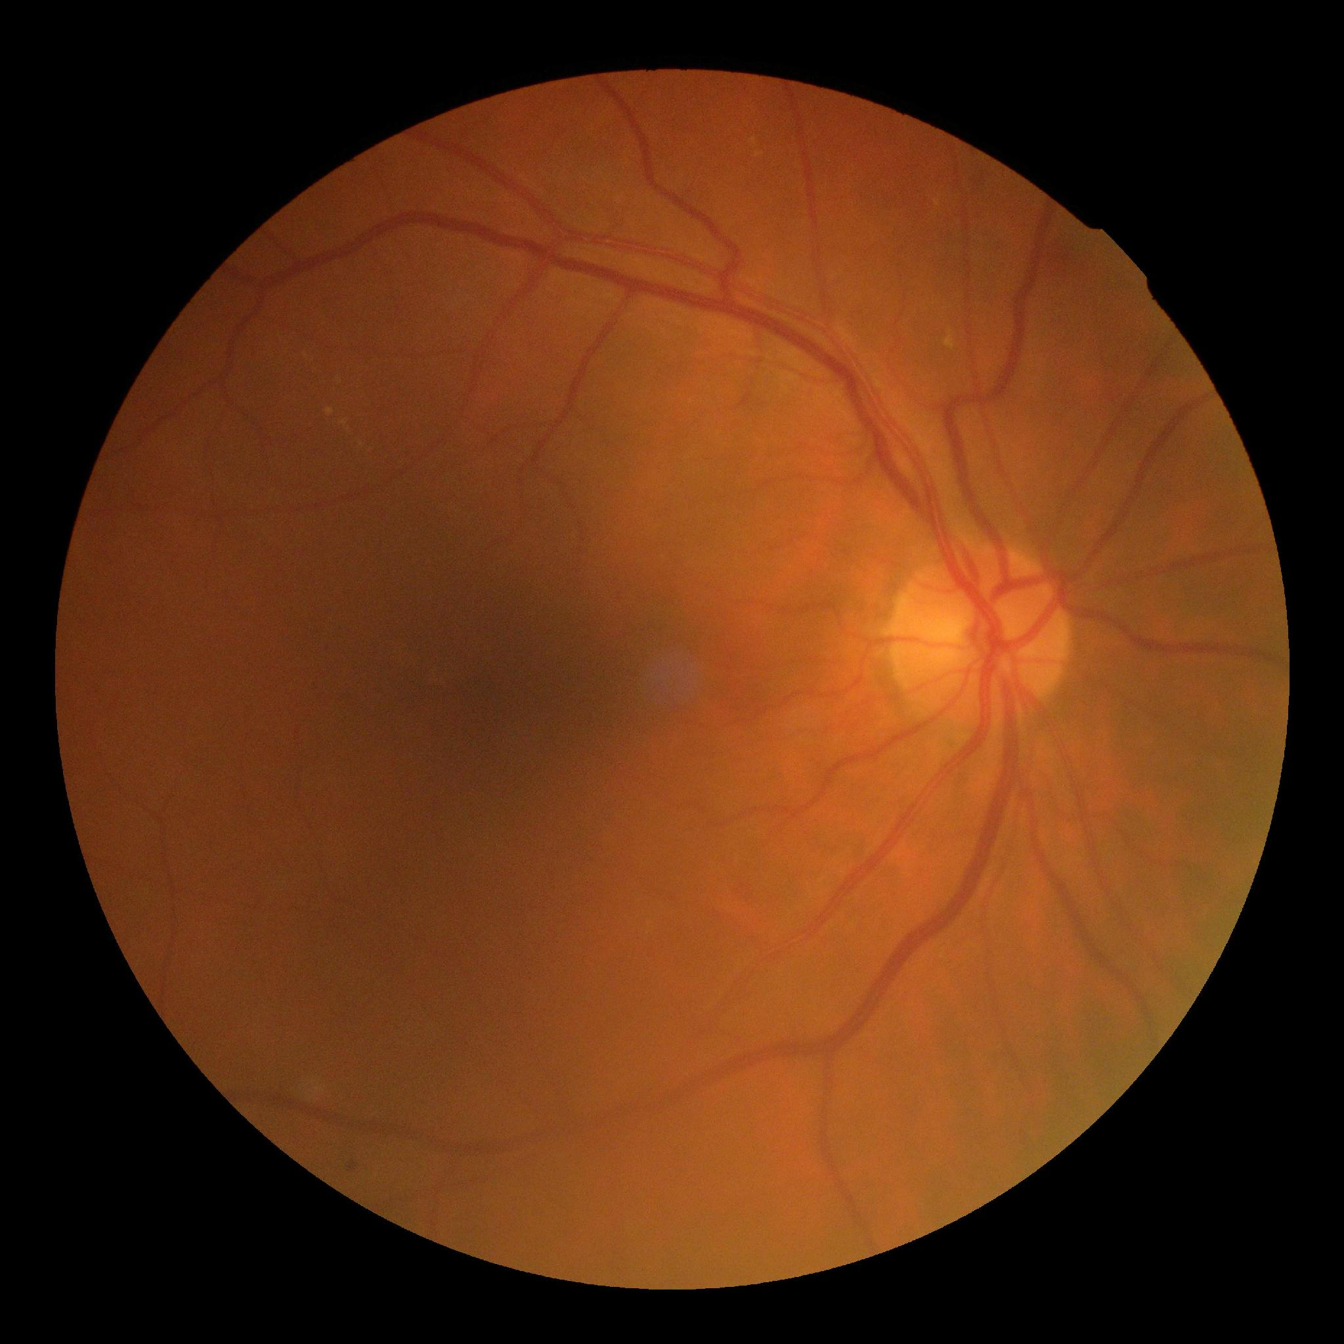

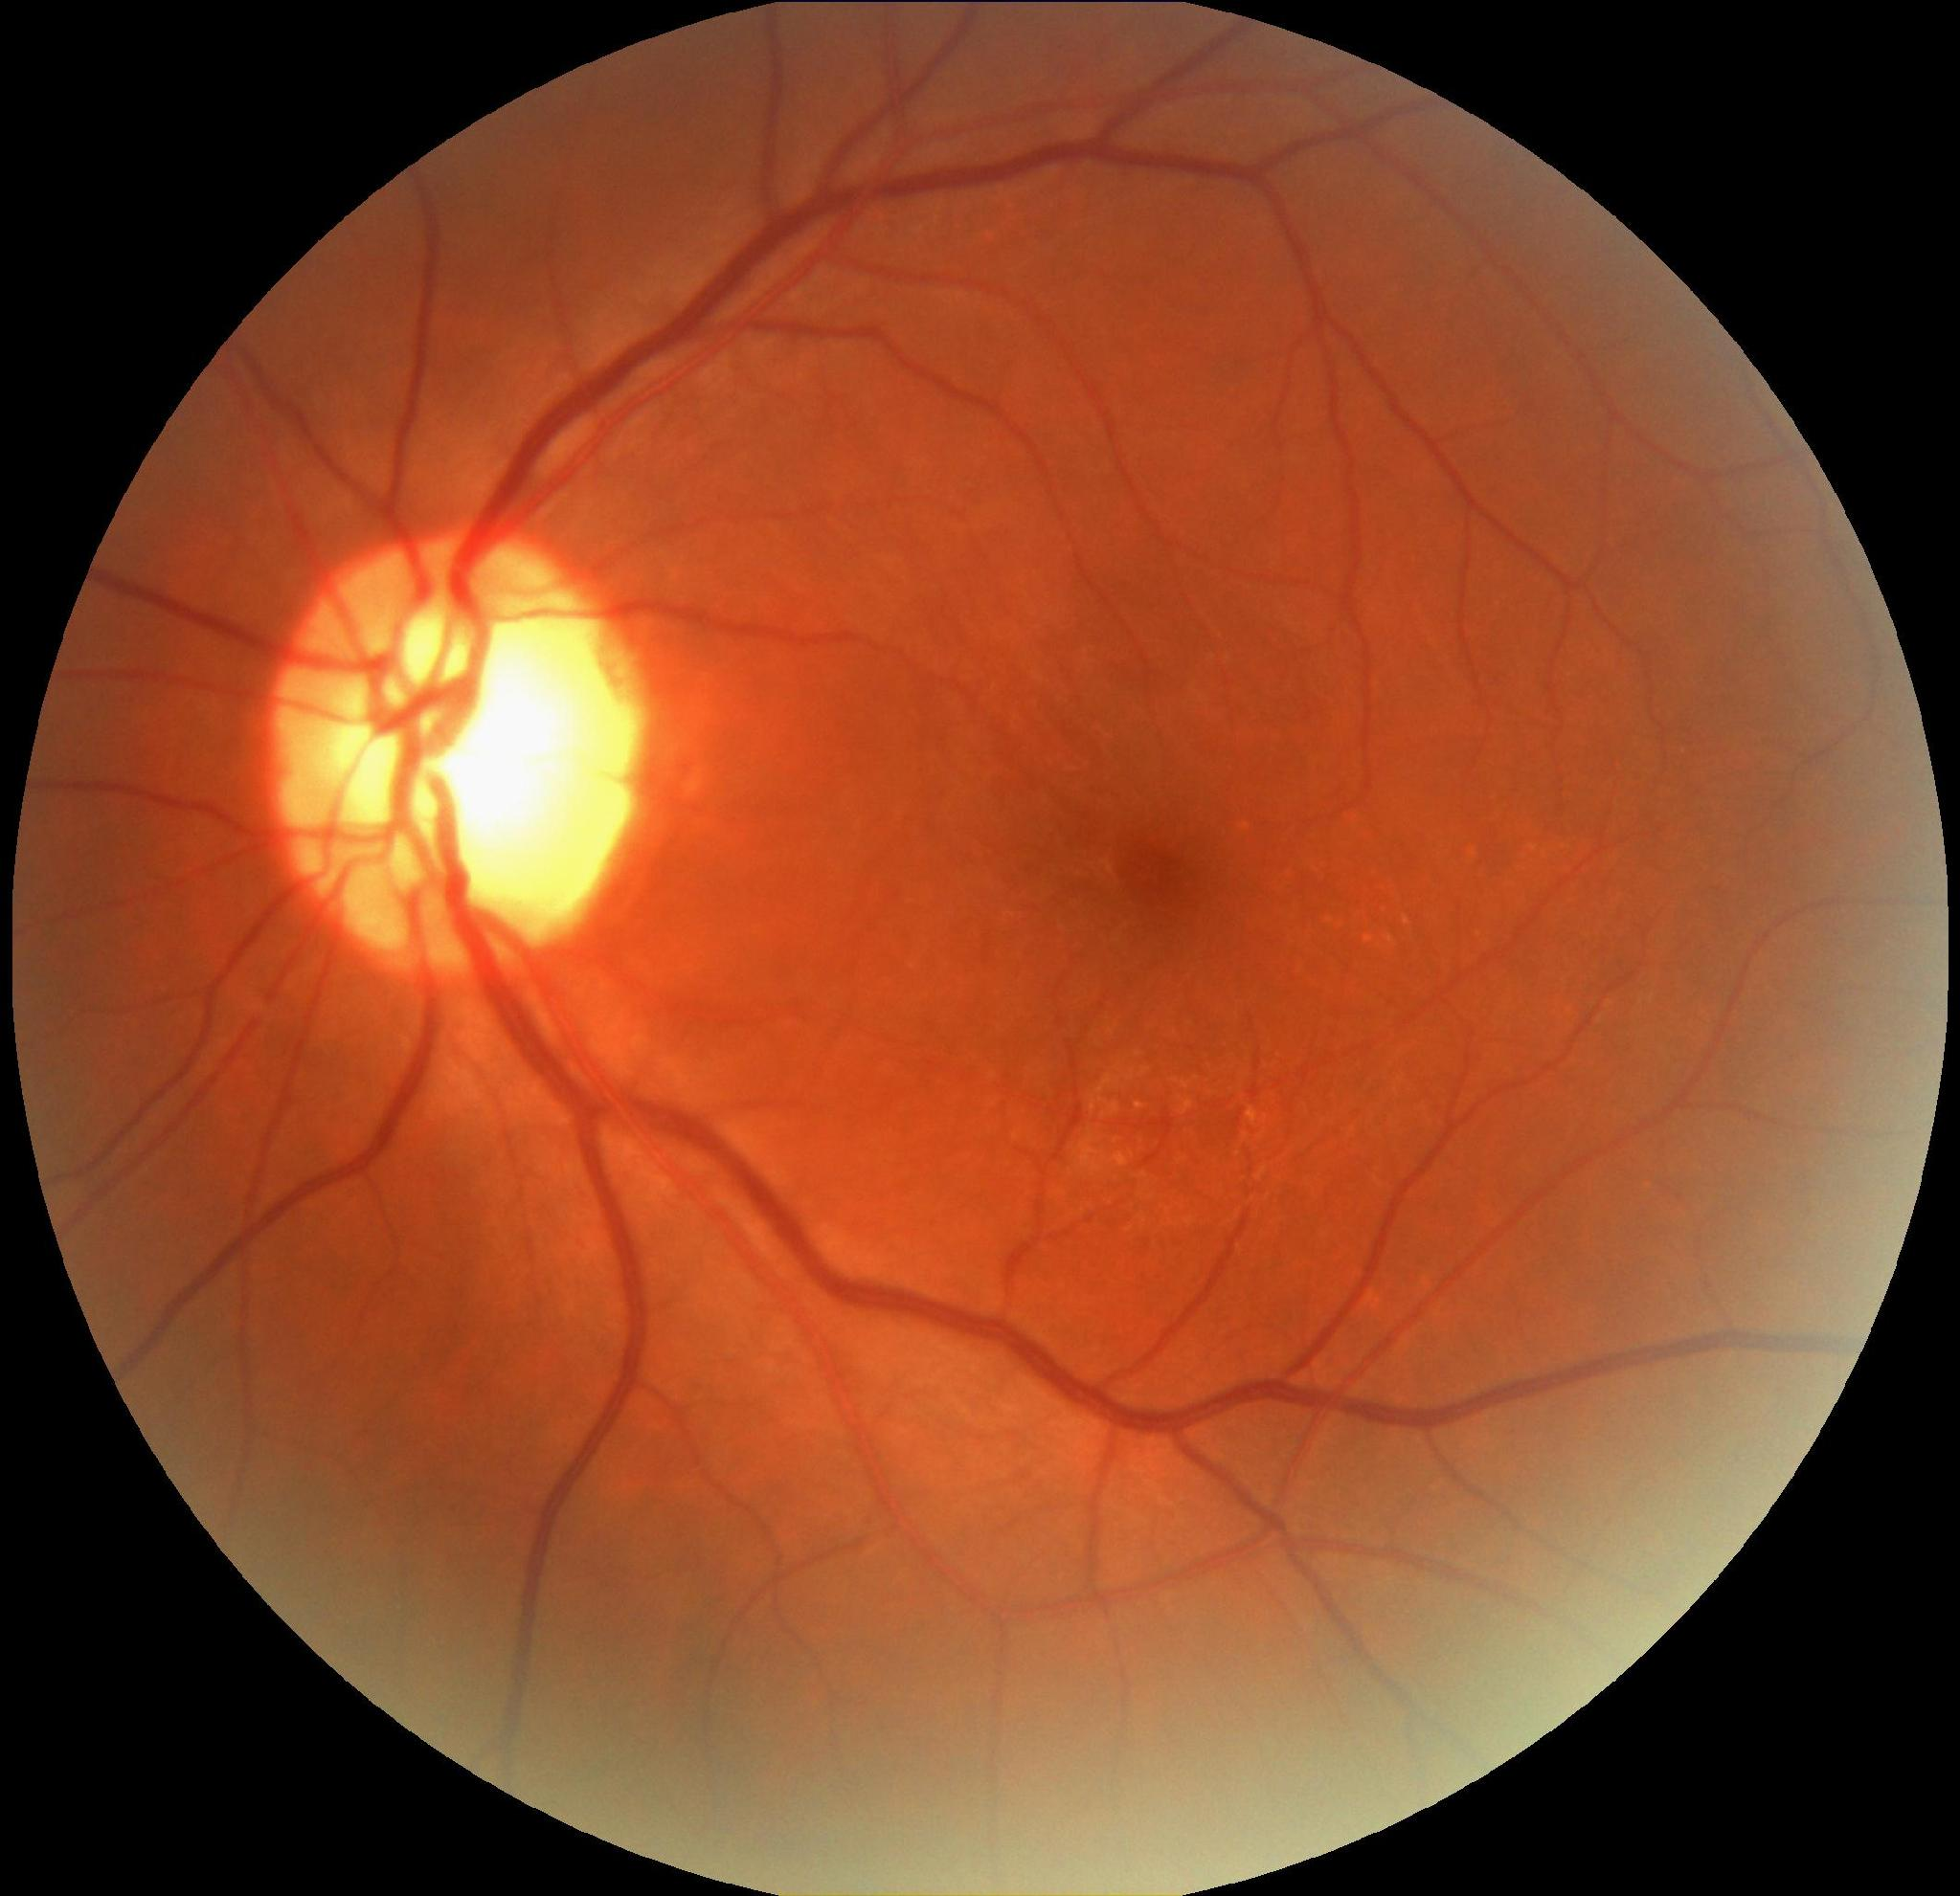
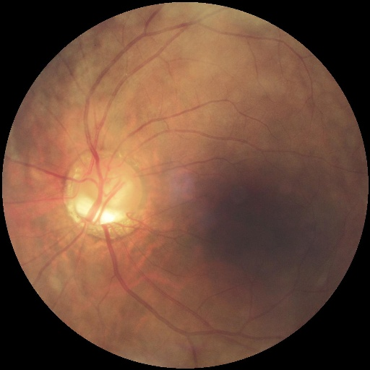
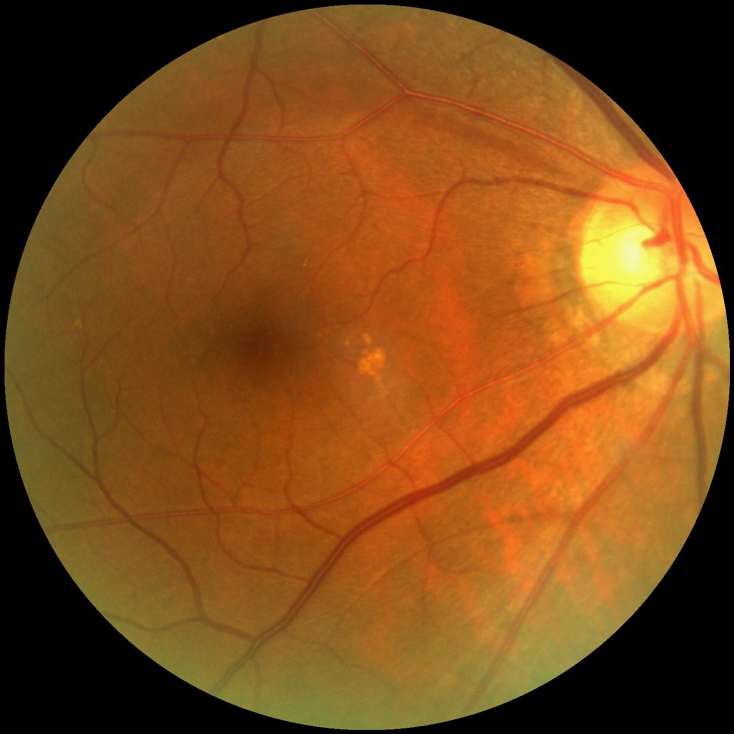
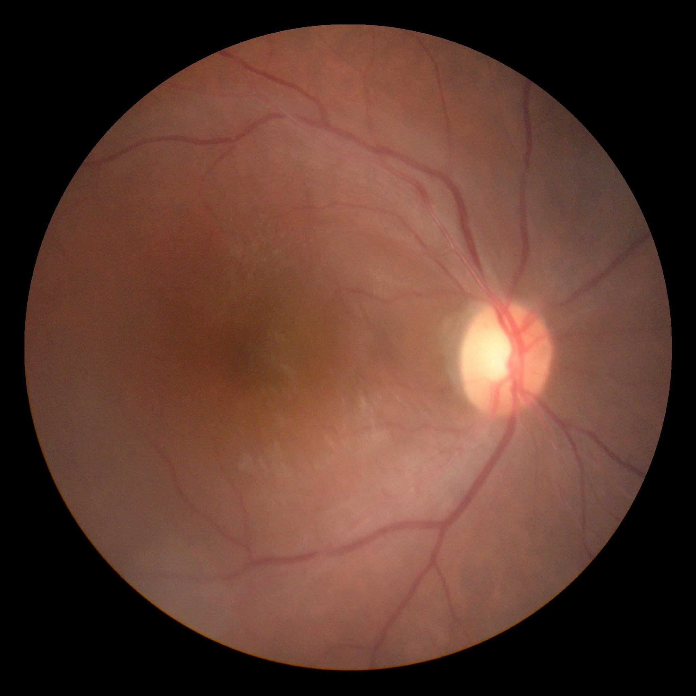
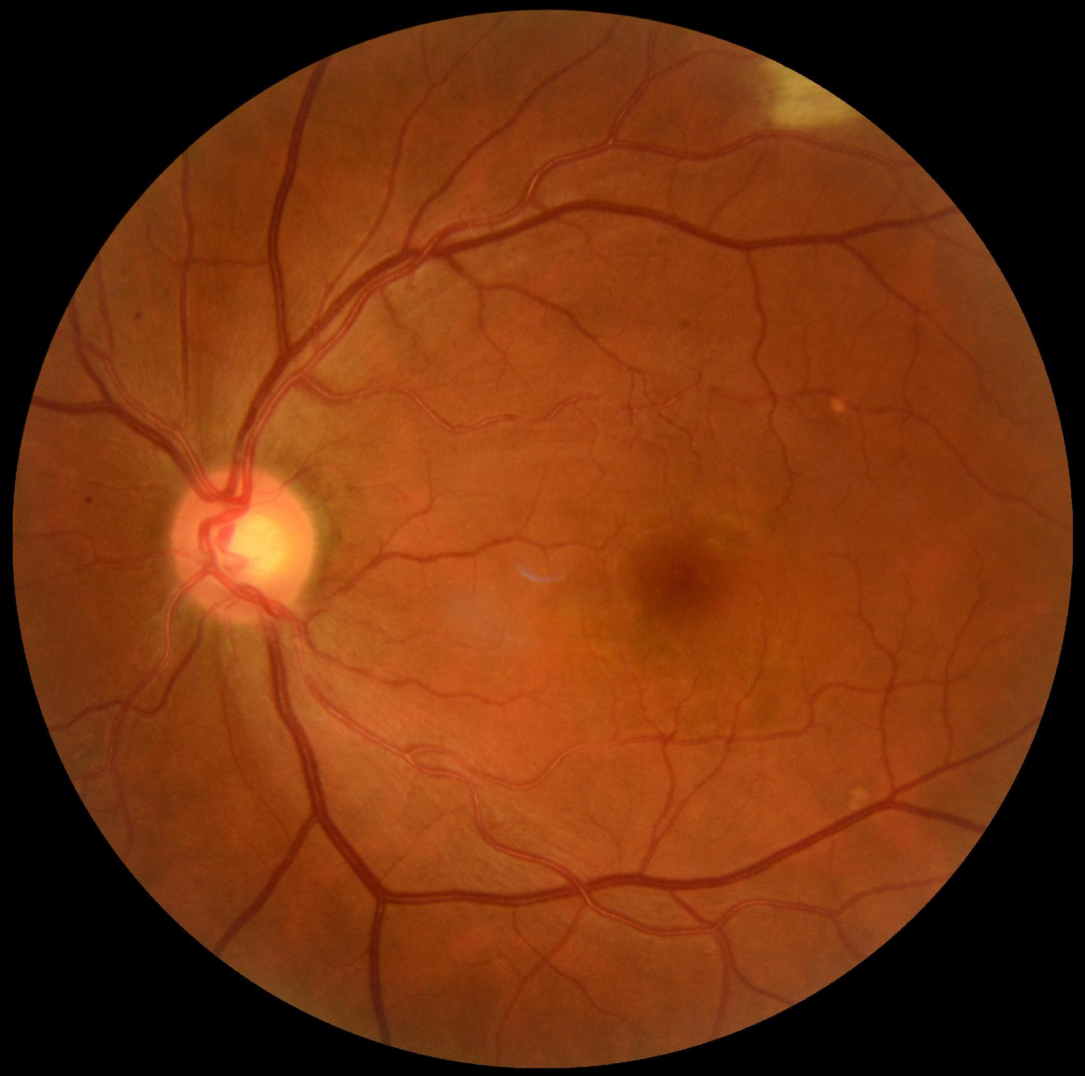
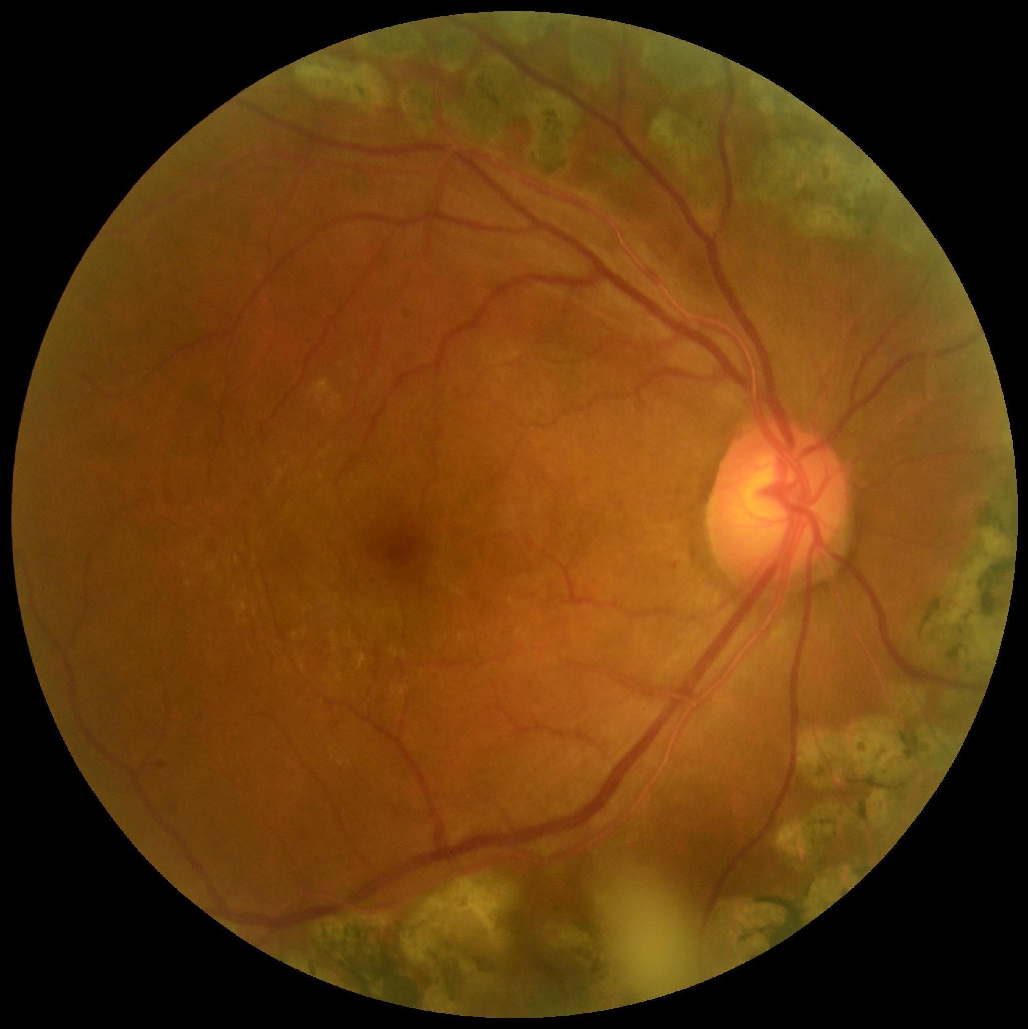
TEAM
EyeQ
SPRINT 1
DUAL
OCULAR DISEASE SCREENER
AI-assisted screening for cataract and glaucoma from a single retinal photograph per eye.
Notes:
Hello everyone, we are Team EyeQ, and this is our Sprint 1 presentation for DUAL, an AI tool that screens for cataract and glaucoma from a single photo of the back of the eye. It’s a triage tool: it helps decide who should see an eye specialist. It does not give a diagnosis.

Slide 2
AGENDA
What we'll cover
01
Team roles and responsibilities
09
Diagrams
02
Improvements from professor feedback
10
Product backlog
03
Project description
11
Sprint 1 backlog and test cases
04
Team working agreement
12
Metrics
05
Personas
13
Retrospective
06
MVP
14
Sprint 2 plan
07
Technologies
15
Demo and GitHub
08
Algorithms
Notes:
Here’s our plan for today. We start with the team and the improvements we made after Sprint 0 feedback. Then a short recap of the project, and then the main part: what we did in Sprint 1. That covers our backlog, test cases, metrics and retrospective, followed by our Sprint 2 plan and a demo. Now each of us will introduce ourselves.

Slide 3
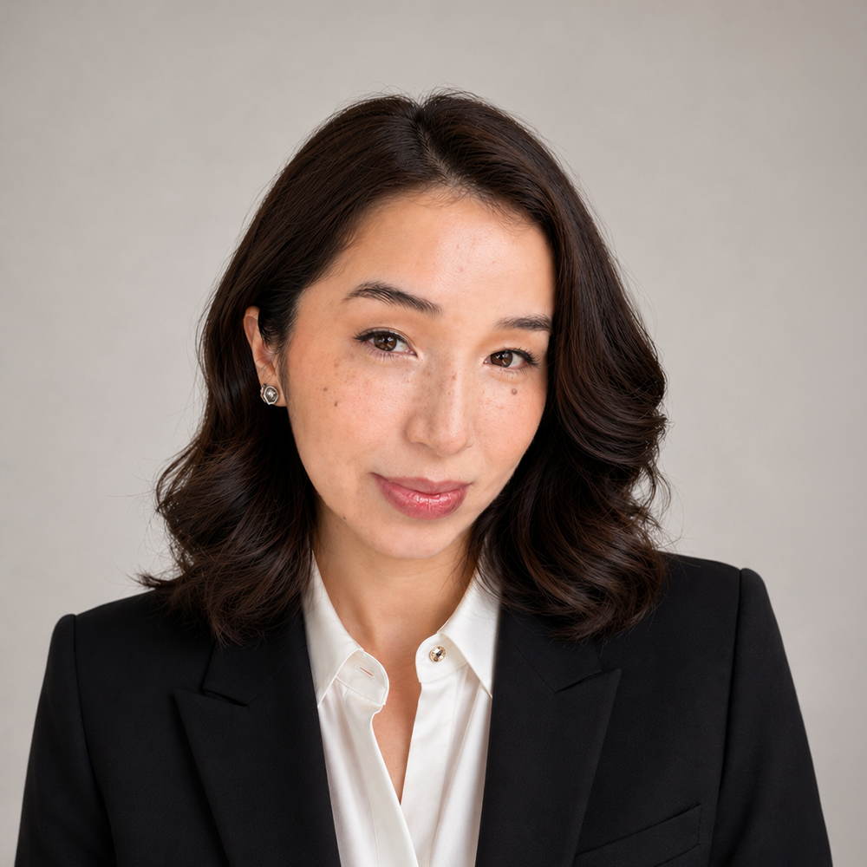
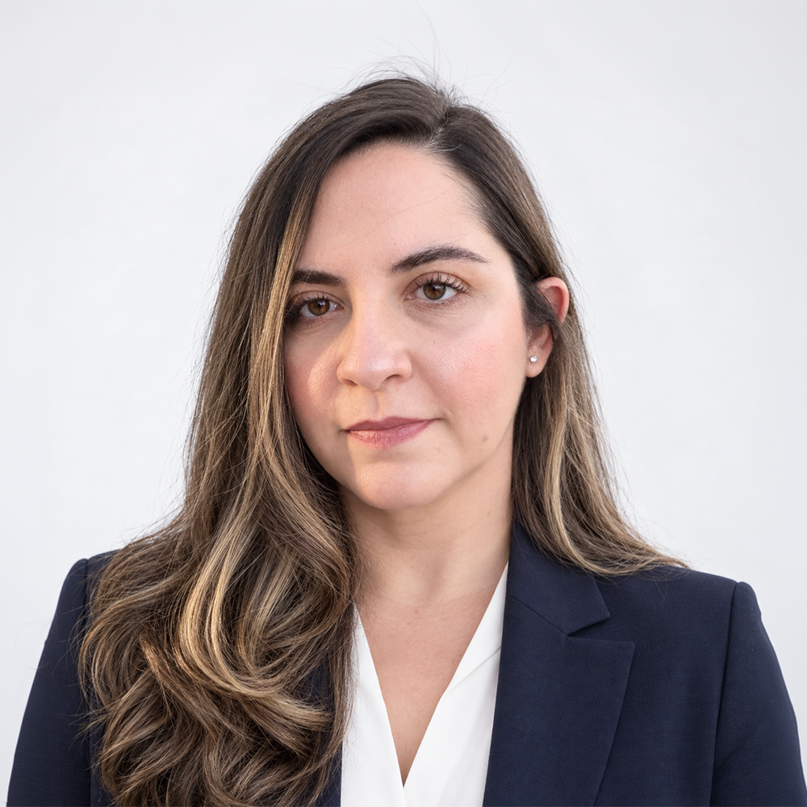
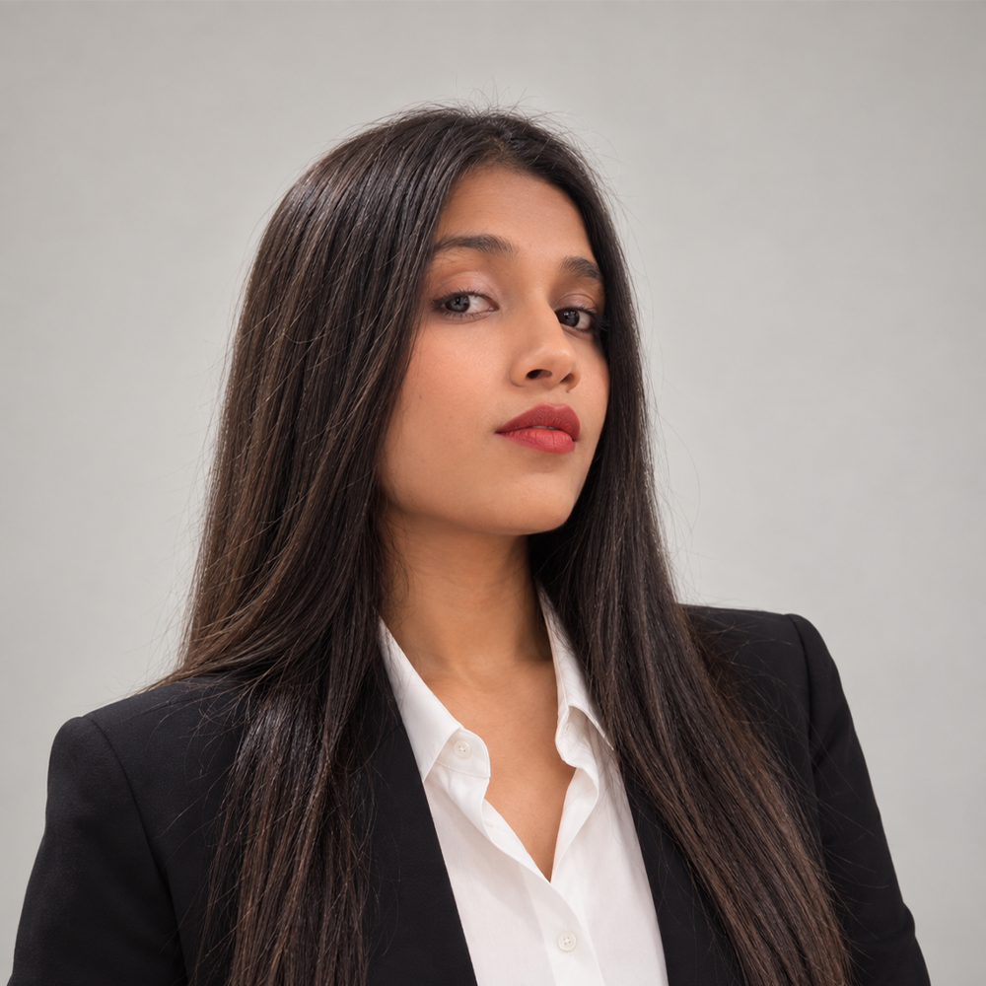
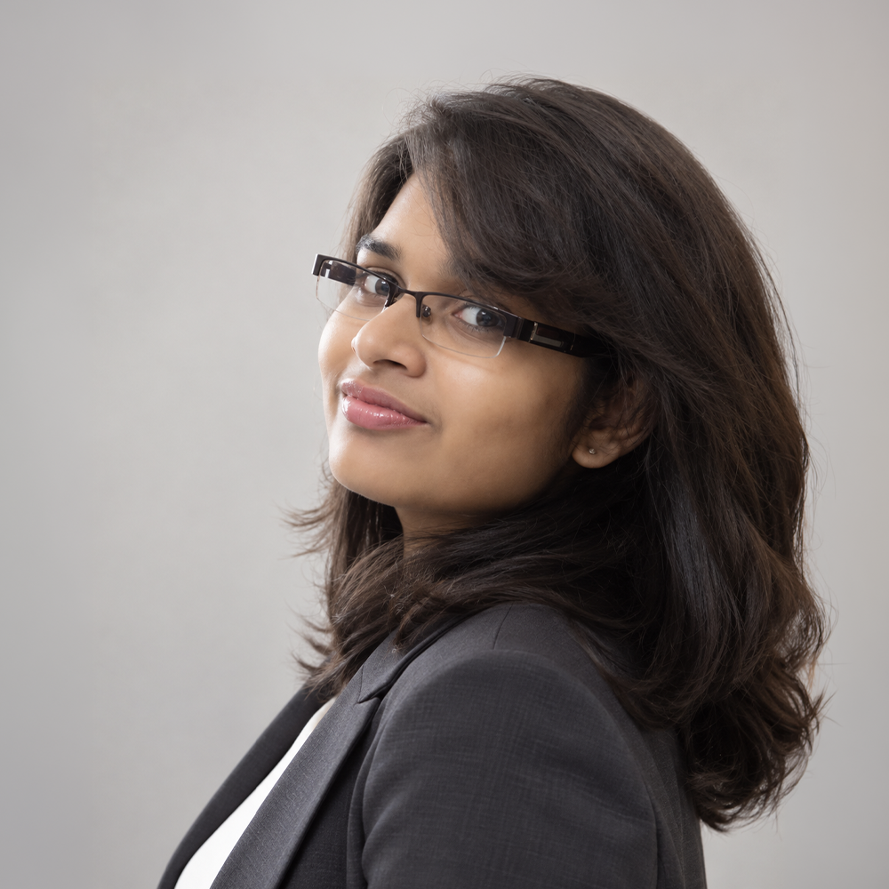
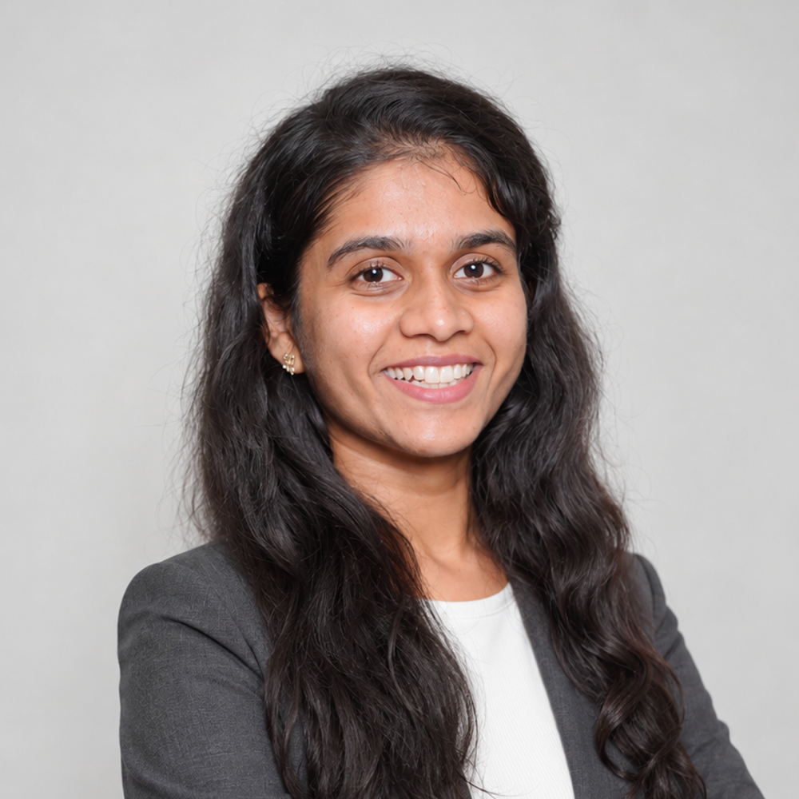
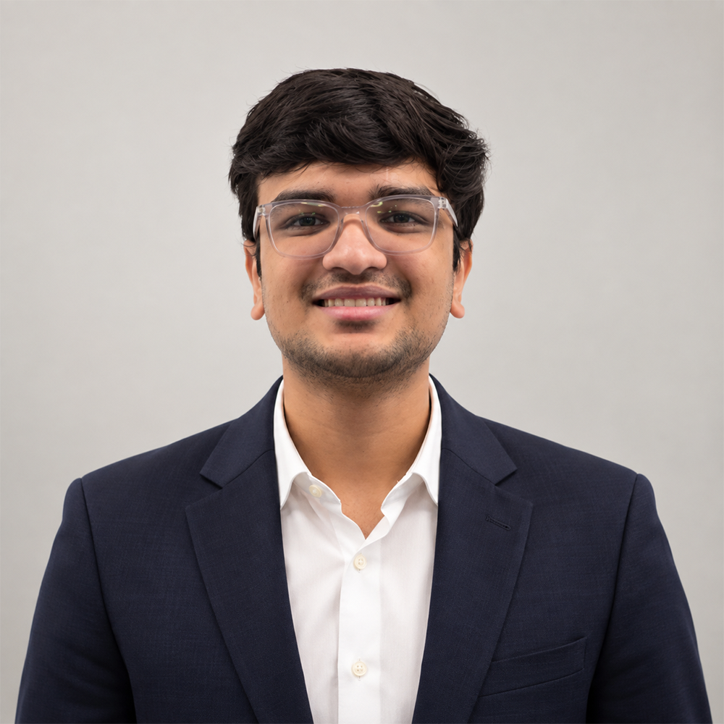
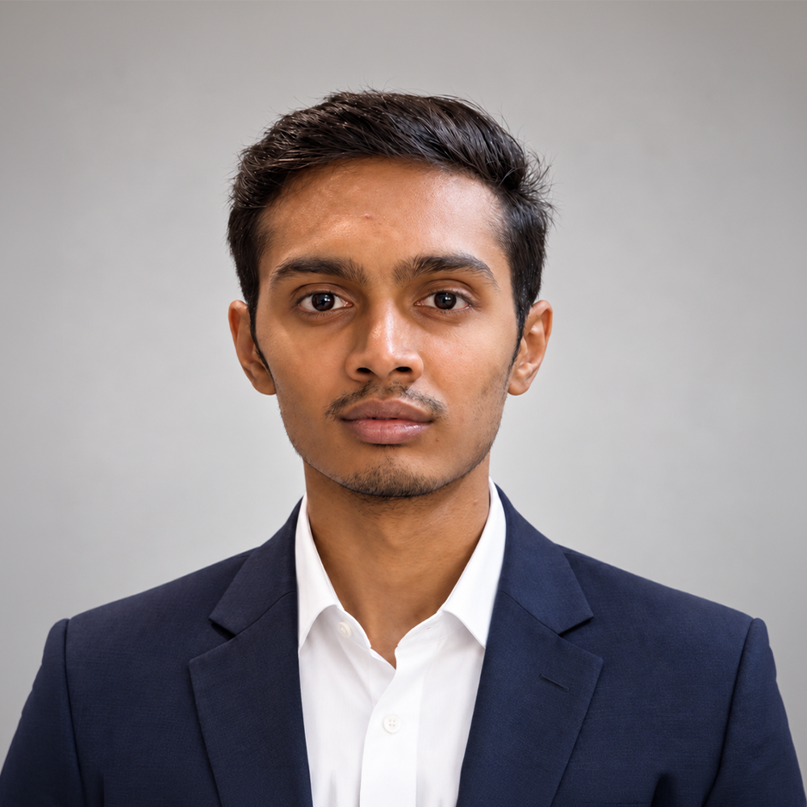
01 · TEAM
Roles & responsibilities
Anel Bazarbayeva
Negar Kamvij
Shridhi Patel
Bhoami Khona
Scrum Master, MLOps/ Integration Developer
ML Developer, External Validation & Calibration
Team Leader, ML Developer, Glaucoma Lead
Full Stack Developer
Krushiben Patel
Ansh Kevadiya
Smit Meghapara
Data Pipeline, MLOps & Integration Developer
ML Developer,
Cataract Lead
ML Developer, Interpretability & Safety

Slide 4
02 · IMPROVEMENTS
Improvements from professor feedback
SPRINT 0 FEEDBACK → CHANGES INCORPORATED IN SPRINT 1
01
Retrospective process
Use silent individual reflection, group similar ideas, discuss as a team, and agree on the top improvement actions.
02
Clear action items
Each retro action fixes one “what can improve” item and has an owner and a check.
03
Task ownership in planning
In sprint planning, each member picks their own items in Jira. No work is assigned before the meeting.
04
Capacity-based planning
Consider each member’s availability and workload before the team commits to Sprint 2 stories and story points.
05
Commitments vs. impediments
Distinguish an unfulfilled commitment from a genuine blocker and define how impediments are communicated and resolved.
Slides changed because of this feedback carry an “Updated after Sprint 0 feedback” tag at the top right.

Slide 5
Project recap
PART 1 OF 4
03 Project description · 04 Working agreement · 05 Personas · 06 MVP
07 Technologies · 08 Algorithms · 09 Diagrams
Notes:
First, a quick recap of the project for anyone who missed Sprint 0

Slide 6
03 · PROJECT DESCRIPTION
Problem statement
PROBLEM STATEMENT
EVIDENCE TO CITE
Cataract and glaucoma cause a large share of the world's vision loss, but they fail patients in opposite ways: cataract is treatable if caught, glaucoma has no symptoms until the damage is already permanent. Both require routine screening that many at-risk patients never get.
45%
of global blindness caused by cataract (WHO / GBD 2020)
Half
of US glaucoma cases go undiagnosed (CDC)
0.90 → 0.58
AI screeners: AUC in-house drops across sites (J Clin Med, 2026)
Notes:
Cataract and glaucoma cause a large share of the world’s vision loss, but in opposite ways. Cataract is treatable if it’s caught, and it causes about 45% of blindness worldwide. Glaucoma has no symptoms until the damage is permanent, and about half of people with glaucoma in the US don’t know they have it. Both need regular screening that many at-risk patients never get. AI screeners also tend to perform worse on photos from clinics they weren’t trained on, which is the problem we focus on.

Slide 7
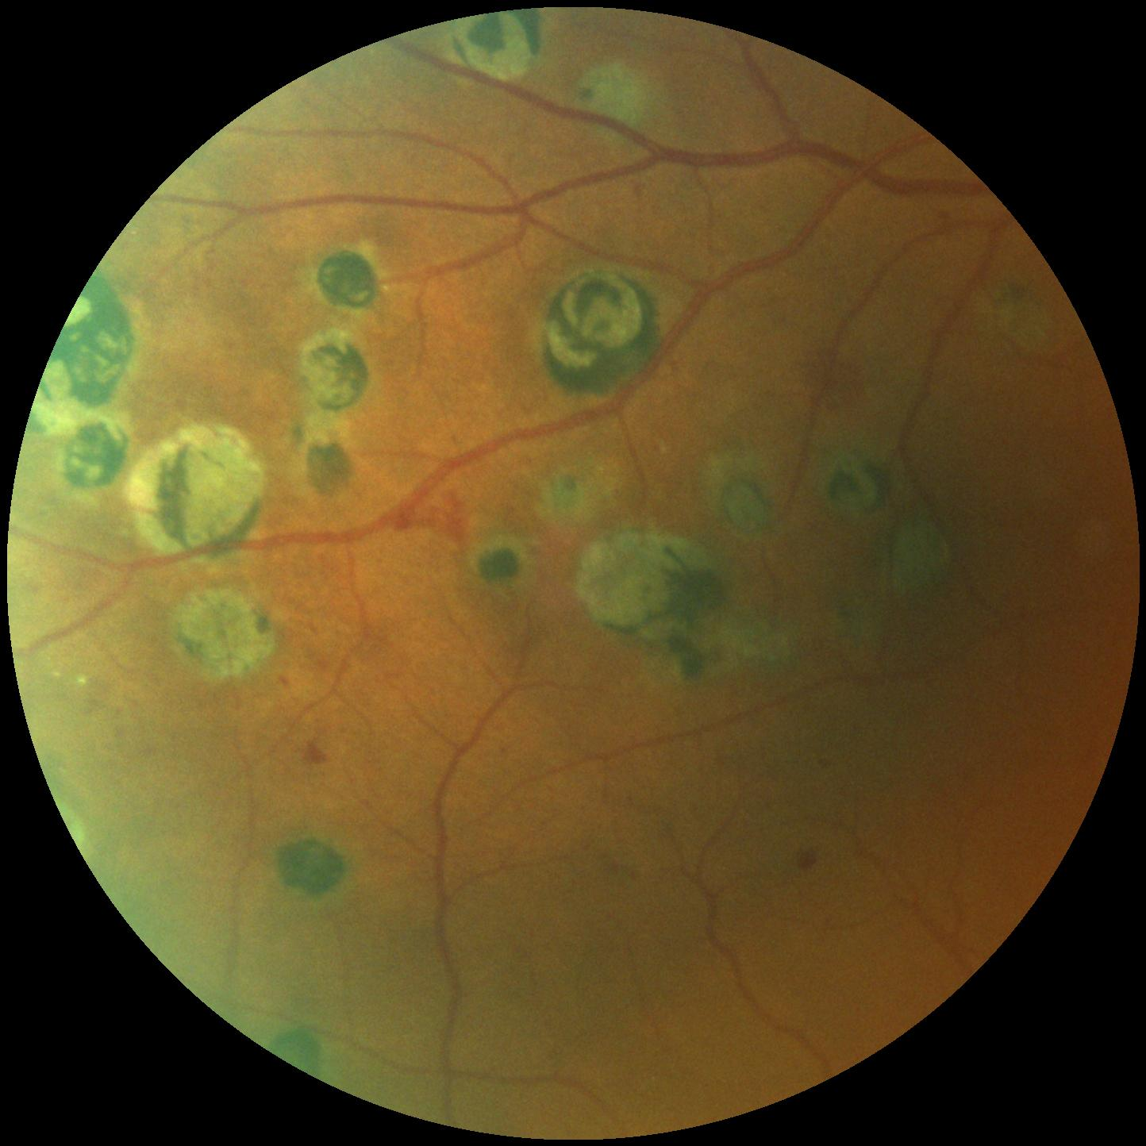
03 · PROJECT DESCRIPTION
Hypothesis
We believe that giving primary care and community screening sites a single-photo AI tool that flags both cataract and glaucoma risk will result in more at-risk patients getting referred before damage is done.
We will know we are right when the model holds up not just on our own test data, but on photos from different fundus cameras and patient populations it never trained on.
Notes:
Our hypothesis: if primary care and community screening sites have a single-photo tool that flags both conditions, more at-risk patients get referred before damage is done. We’ll know we’re right if the model holds up on photos from different cameras and patient groups it never trained on, not only on our own test data.
Next Negar

Slide 8
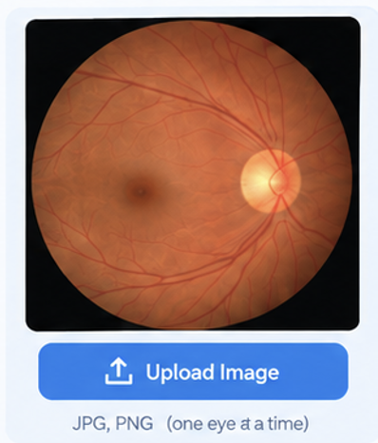
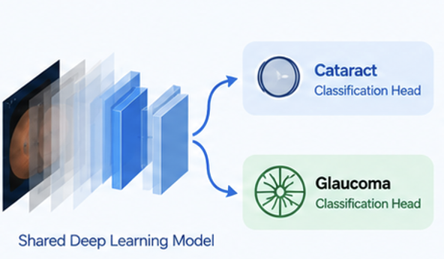
03 · PROJECT DESCRIPTION
What we are building
Dual is a web-based AI screening application that analyzes a fundus photograph of the eye and provides separate risk results for cataract and glaucoma , with confidence information and a referral recommendation when the image or prediction is uncertain.
01
Upload Fundus Image
02
AI Analysis
One shared deep learning model analyzes the image for both cataract and glaucoma.
One retinal photograph per eye is uploaded to Dual.
Notes:
Project description — what the project IS.

Slide 9
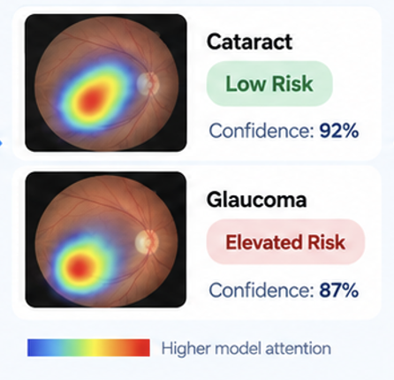
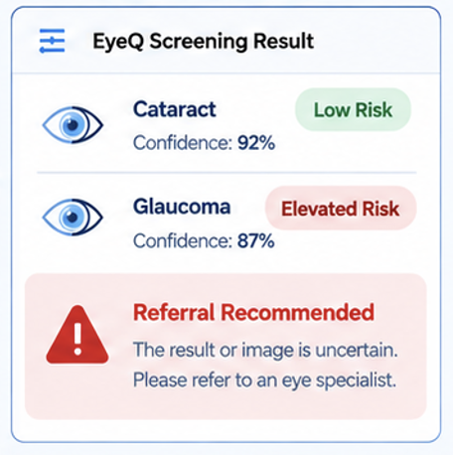
03 · PROJECT DESCRIPTION
Dual Screening Result
03
Risk Results
04
Referral Recommendation
Dual provides separate risk results with confidence levels and highlighted regions in the image.
Dual provides separate risk results with confidence levels and highlighted regions in the image.
Scope: Dual supports screening and referral decisions. It does not provide medical diagnosis, treatment advice, EHR integration, or other eye conditions.
CLEARER VISION HEALTHIER LIVES
Notes:
Steps 3 and 4 of the screening flow, plus scope boundary.

Slide 10
04 · WORKING AGREEMENT
How we work together
Where & when we meet
Communication
Two-hour Zoom meeting every Sunday for project work and planning. Brief follow-up discussions after Tuesday's class.
For Primary channel, use the team group chat for regular updates and coordination. Respond within 24 hour.
If someone doesn't fulfill their responsibilities
Deadlines & reminders
Talk with the member first and work together to resolve the issue. Repeated problems will be discussed as a team and, if necessary, brought to the instructor.
Set internal deadlines ahead of official due dates. The team leader sends reminders before deadlines. Work is considered complete when it is finished, tested, reviewed, and submitted to the team repository.
Notes:
Team working agreement.

Slide 11
04 · WORKING AGREEMENT
Cadence & deliverables
MEETING CADENCE
SPRINT DELIVERABLES
Sprint 0 — SEP-1 to SEP-21
Standup — Quick progress discussion after class.
Finalize the project scope, team responsibilities, personas, technology stack, datasets, and overall development plan.
Working session — Sunday 2-hour Zoom meeting + individual work throughout the week.
Sprint 1 — SEP-21 to OCT-19
Prepare and preprocess retinal images, create the basic user interface, and build initial cataract and glaucoma model functionality.
Sprint Duration — Approximately 4 weeks.
Sprint 2 — OCT-19 to NOV-16
Develop the shared dual-head model, evaluate both disease predictions, integrate the model with the application, and begin external validation.
Sprint 3 — NOV-16 to DEC-14
Complete the end-to-end application, perform final model testing and validation, improve the interface, and finalize project documentation and presentation
Notes:
Project schedule, cadence, and sprint deliverables.

Slide 12

05 · PERSONAS
Helen Whitfield, 68
Retired · At-risk older adult
Last eye exam four years ago
Wants to stay proactive about eye health
GOALS
NEEDS
CONCERNS
Identify possible cataract or glaucoma concerns early
Plain-language results
Confusing medical terminology
Large, easy-to-read text
A clear next step
A frightening result without explanation
Understand her eye health clearly
Not knowing who to ask for help
Know what to do next
“I may not have symptoms now, but I want to understand my screening result and what I should do next.”
“I want to keep seeing the moments that matter.”
SCENARIO
Helen attends a screening visit. A technician captures her fundus image and runs DUAL. She receives a simple explanation of the screening result and the recommended next step. DUAL supports screening and referral; it does not provide a diagnosis.
01 | PATIENT PERSONA
Notes:
Persona 1 of 3 — Helen Whitfield, at-risk older adult.

Slide 13
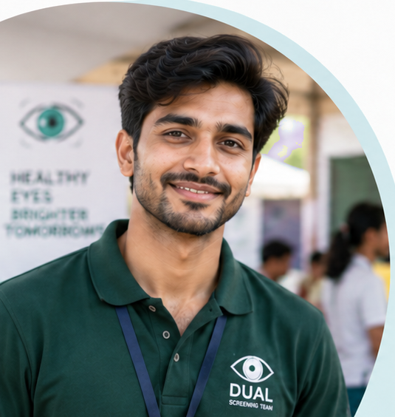
05 · PERSONAS
Arun Desai, 26
Screening Technician
Works at rural and community health camps
Uses a portable retinal/fundus camera
Focused on efficient, reliable screening
GOALS
NEEDS
CONCERNS
Capture high-quality images quickly
Immediate image-quality feedback
Poor-quality or ungradable images
Get easy-to-understand screening results
Simple, step-by-step workflow
Patients leaving before results are ready
Screen patients efficiently
Clear next-step guidance
Misinterpreting screening results
“I need clear feedback right away so I can move to the next patient without delays.”
“I want to help more people get screened, quickly and accurately.”
SCENARIO
Arun captures a patient’s fundus image at a screening camp and uploads it to the DUAL. The system checks image quality and screens for cataract and glaucoma. Arun receives a clear screening result and recommended next step and can generate a report for clinical review when needed.
02 | SCREENING TECHNICIAN PERSONA
Notes:
Persona 2 of 3 — Arun Desai, screening technician.

Slide 14

05 · PERSONAS
Dr. Maya Rao, 41
Primary Care Physician
Family physician in a busy primary care practice
No ophthalmology specialization
Uses screening information to support referral decisions
GOALS
NEEDS
CONCERNS
Identify patients who may need specialist evaluation
Clear cataract and glaucoma screening results
Missing a patient who may need referral
Support early detection and preventive care
Over-referring patients unnecessarily
Clear risk and uncertainty indicators.
Review screening information quickly
Misinterpreting an uncertain AI result
A clear recommended next step
“I need a clear screening result that helps me decide when further eye-care evaluation may be appropriate.”
“I want a quick, reliable way to know which patients may need specialist review.”
SCENARIO
Dr. Rao reviews a DUAL screening report after a technician captures and analyzes a patient’s fundus image. She checks the cataract and glaucoma screening results, uncertainty, and recommended next step, then decides whether further eye-care evaluation is appropriate. DUAL supports screening and referral; it does not diagnose.
03 | PRIMARY CARE PHYSICIAN PERSONA
Notes:
Persona 3 of 3 — Dr. Maya Rao, primary care p
hysician.

Slide 15
DUAL in Action
Early Detection. A Brighter Tomorrow.
01
CAPTURE
02
SCREEN
03
REVIEW
04
NEXT STEP
“Time for my eye screening.”
DUAL
Helen — Patient
“Let me capture your eye image.”
Checking image…
Arun — Screening Technician
Screening Cataract + Glaucoma…
Screening complete!
✓ Cataract
No significant signs detected
⚠ Glaucoma
Possible elevated risk (Refer for further evaluation)
“I’ll review the result.”
Dr. Maya — Primary Care Physician
“Now I know my next step.”
Helen — Patient
Notes:
Walkthrough: capture, screen, review, next step.

Slide 16
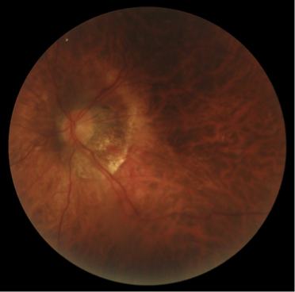
06 · MVP
Minimum viable product
One photo. Two screening results. A clear next step.
01
Upload one eye photo
Choose the patient and left or right eye.
02
View both screening results
Separate results for cataract and glaucoma.
03
See the referral decision
Example fundus photo from ODIR-5K
No concern, Refer, or Uncertain, refer.
Sprint 1
Sprint 2
Sprint 3
Prototype, trained models
Frozen calibration cutoffs
Connect the trained model
Run external evaluation
Grad-CAM heatmaps
Complete app integration

Slide 17
07 · TECHNOLOGIES
Tech Stack
01
02
03
04
Model / ML
Backend
Frontend
Infra & Tooling
Computer vision and deep learning
for robust, clinically relevant
predictions.
High-performance APIs and
data services for secure, reliable
inference.
A responsive, clinician-friendly
interface for seamless screening
workflows.
Scalable infrastructure and modern
developer tooling for iteration
and deployment.
Python
PyTorch
FastAPI
Supabase
PostgreSQL
HTML
CSS
Docker
GitHub
OpenCV
scikit-learn
Supabase Storage
JavaScript
React
GitHub Actions
Vercel
Vite
Render
Kaggle / Google Colab GPU
TRAINING & VALIDATION DATA
REAL DATA
STRONGER MODELS
BETTER OUTCOMES
Train: ODIR-5K
External validation / test-only: ORIGA · DRISHTI-GS · ACRIMA · retina_dataset_2016
Fundus image
React UI
FastAPI
PyTorch model
Screening result
FROM IMAGE
TO INSIGHT
FOR BRIGHTER LIVES
END-TO-END PIPELINE

Slide 18
08 · ALGORITHMS
Approach & evaluation
CANDIDATE APPROACHES
HOW WE WILL JUDGE IT
01
CNN transfer learning
Sensitivity
Use ResNet/EfficientNet to learn disease patterns from eye images.
How well the model detects actual cataract/glaucoma cases.
Specificity
02
Multi-task heads
How well it identifies healthy eyes.
One model detects both cataract and glaucoma using shared features.
AUC (Area Under the Curve)
Overall ability to distinguish between healthy and diseased eyes.
03
Baseline for comparison
Use Logistic Regression as a simple model for comparison.
Confusion Matrix
Shows correct and incorrect predictions for each condition.
Test Set
04
Image-quality classifier
Evaluate on unseen patient images to measure real-world performance.
Detects ungradable or poor-quality eye images before prediction
Key goal • Minimize missed disease cases while maintaining reliable predictions.
Notes:
Algorithms and evaluation plan.

Slide 19
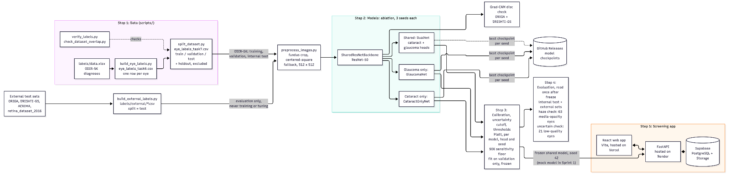
09 · DIAGRAMS
Architecture (conceptual) Diagram
Notes:
This is the overall architecture of DUAL, read from left to right.
First, the data. We build one label per eye from the ODIR-5K spreadsheet and split patients into training, validation and test. Some eyes are held out on purpose, like media-opacity and low-quality photos, so we can use them later as safety checks. The external datasets have their own label files and are used only for testing, never for training or tuning.
All photos go through the same preprocessing: we crop the fundus and resize it to 512 by 512.
In the middle are the models. For our ablation, we trained three versions on the same ResNet-50 backbone: a shared model with both heads, a glaucoma-only model and a cataract-only model, three seeds each. The best checkpoints are stored in GitHub Releases.
Next is calibration. It is fitted on validation data only, separately for each model, and sets the thresholds and when the model is not confident enough, which gives “Uncertain, refer”. The settings are now frozen: at least 90% of sick eyes found on validation, and seed 42 is the model the app will use. Next, we run the evaluation once on the internal test set and the external sets, plus our safety checks.
On the right is the screening app: a React web app talking toa FastAPI backend with a Supabase database and photo storage. In Sprint 1, it runs on a mock model; the real model comes in Sprint 3.

Slide 20
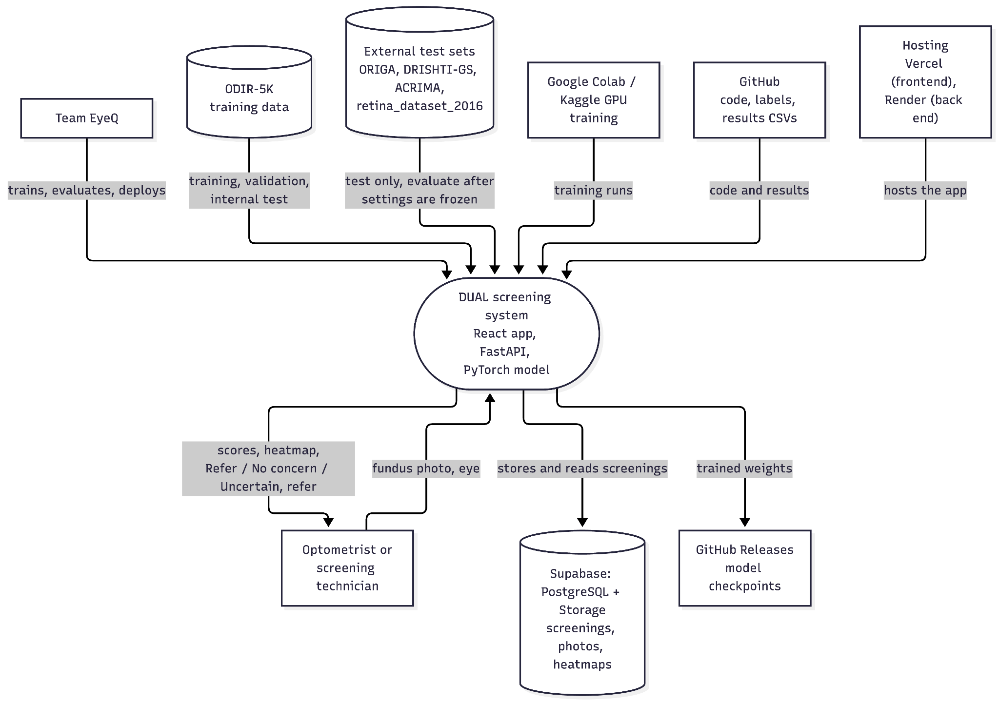
09 · DIAGRAMS
Context Diagram
Notes:
The context diagram shows DUAL as one system and everything around it.
At the top are the inputs. Our team trains and evaluates the system. ODIR-5K gives the training, validation and internal test data, and the external datasets are used only for testing, after all settings are frozen. Training runs on Google Colab and Kaggle GPUs, and our code, labels and results live on GitHub. Hosting is planned for later.
At the bottom are the users and outputs. The optometrist uploads a fundus photo and gets back the scores, a heatmap and the result: Refer, No concern or Uncertain, refer. Screenings and photos are stored in Supabase, and our trained model weights are saved in GitHub Releases

Slide 21
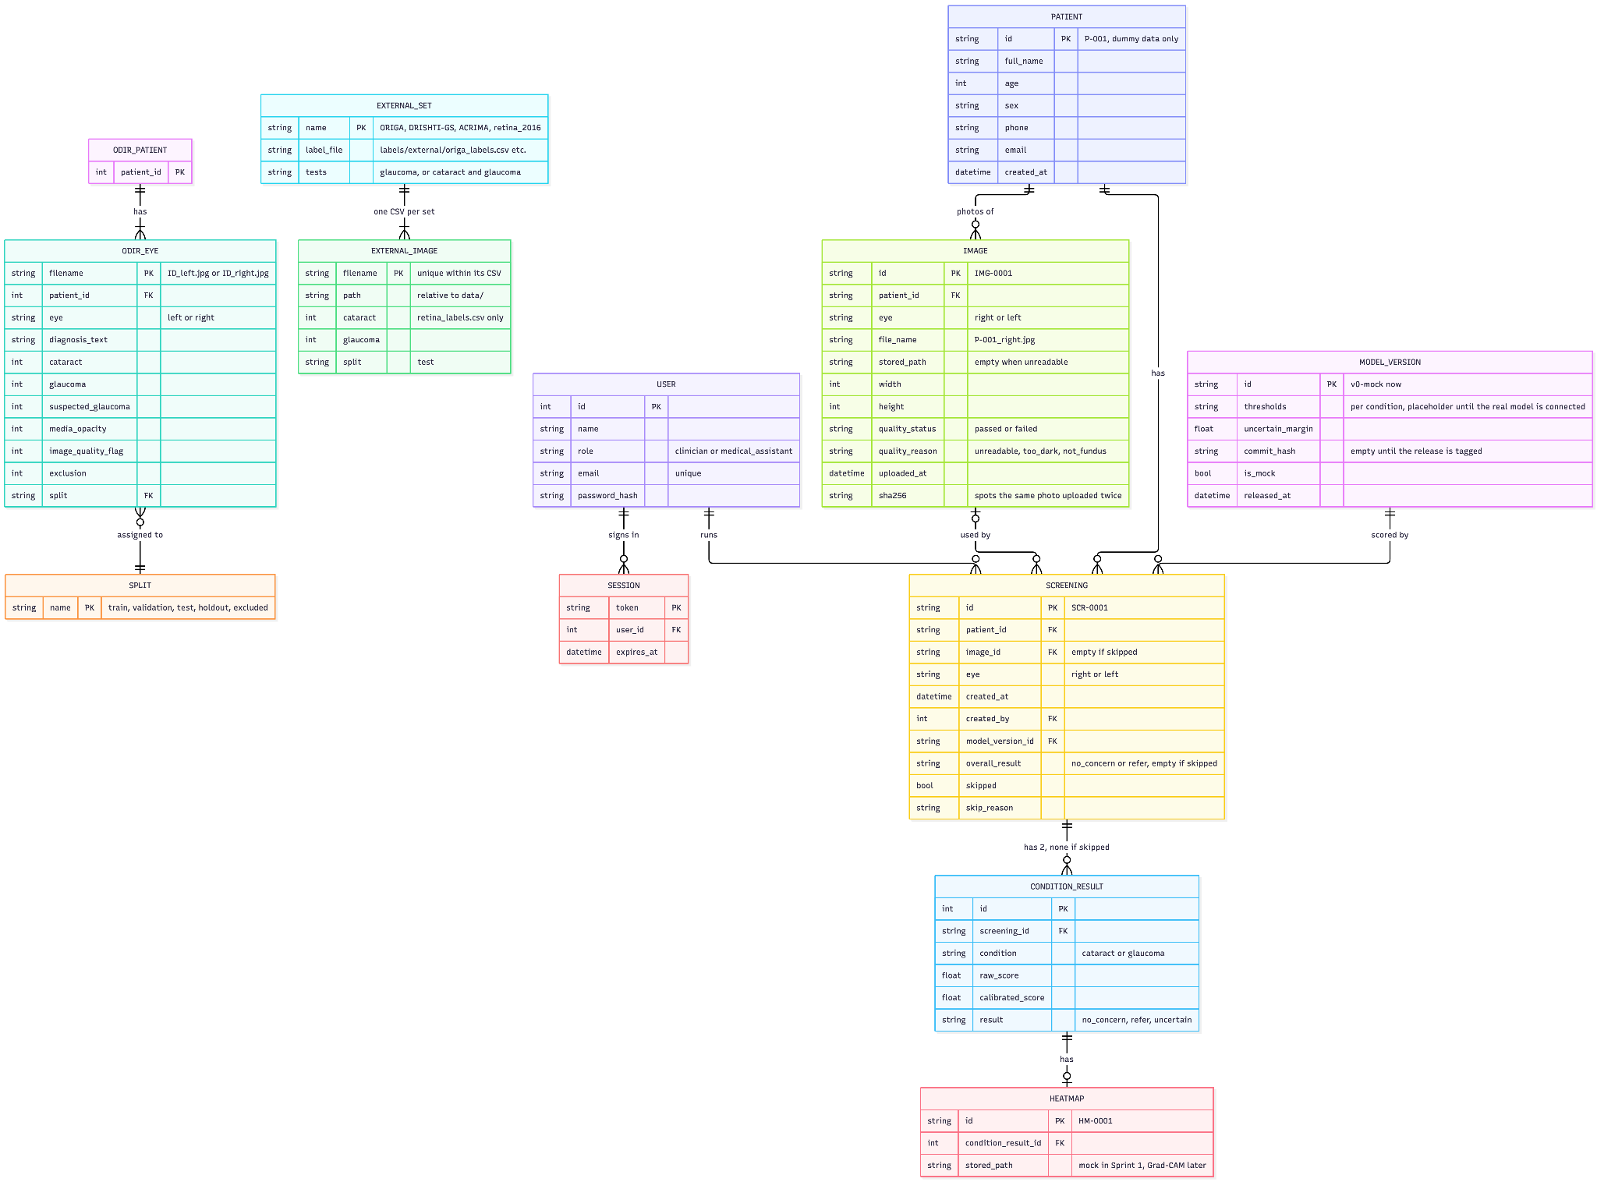
09 · DIAGRAMS
ER Diagram
Notes:
The ER diagram shows our data in two parts.
On the left is the research data. Each ODIR patient has two eyes, and each eye has its labels and belongs to one split: train, validation, test, holdout or excluded. We split by patient, so both eyes of a patient never end up in two different groups among train, validation and test, which avoids data leakage. The external test sets each have their own label file, with one row per image.
On the right is the app database. A user signs in and runs screenings. Each patient has images, and each image records whether it passed the quality check. A screening uses one image and has two condition results, cataract and glaucoma, unless the eye is skipped. Each result has a raw score, a calibrated score and a result. Each condition result can have a heatmap, and every screening records the model version that produced it. Right now that is the mock model, with placeholder thresholds.
To read the tables: PK (primary key) is each table’s unique ID, like SCR-0001 for a screening, and FK (foreign key) is a link to another table’s ID, like a screening pointing to its patient. All patient data in the app is dummy data.

Slide 22
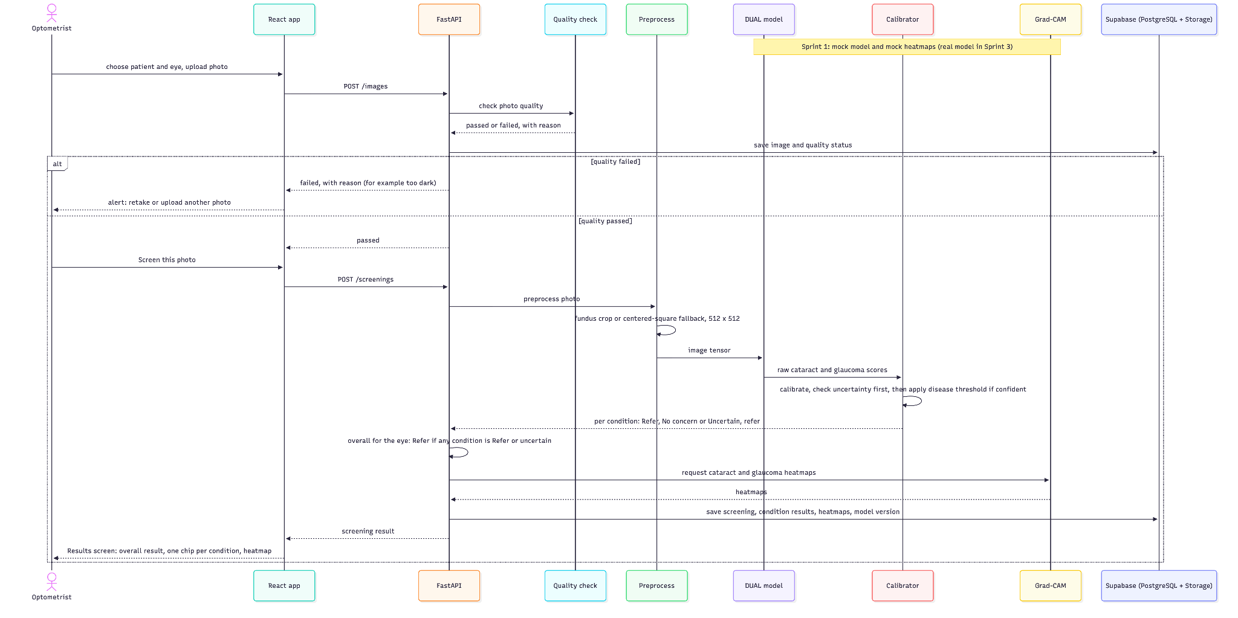
09 · DIAGRAMS
Sequence Diagram
Notes:
This diagram shows one screening, step by step, from top to bottom.
The optometrist chooses a patient and an eye and uploads a photo in the React app. The app sends it to our FastAPI back end, which first runs the quality check. If the photo can’t be used, because the file won’t open, it’s almost black or it isn’t an eye photo, the app shows an alert and asks for a retake.
If the photo passes, the user clicks Screen this photo. The back end preprocesses it and sends it to the model, which gives a raw score for cataract and for glaucoma. The calibrator first checks whether the model is confident; if not, the result is Uncertain, refer. If it is, it applies the disease threshold: Refer or No concern.
The eye is referred if either condition is Refer or Uncertain. Then we create the heatmaps, save everything in the database, and the Results screen shows the overall result, one chip per condition and the heatmap.

Slide 23
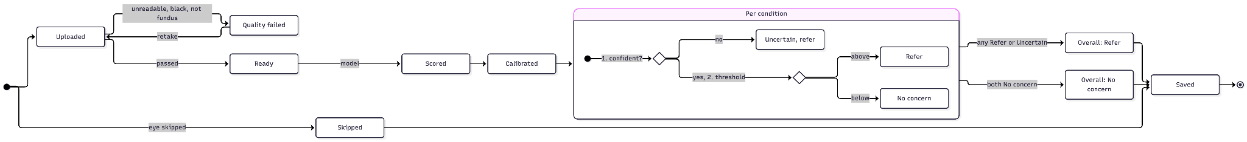
09 · DIAGRAMS
State Diagram
Notes:
This state diagram explains how our EyeQ application processes a single eye image, starting from the upload and ending with the final screening result.
First, when a user uploads an image, the system performs a quality check to make sure the photo is suitable for analysis. For example, if the image is completely black, unreadable, or not a retinal image, the system rejects it and asks the user to retake the photo.
If the image passes the quality check, it moves to our DUAL model, which analyzes the image and generates separate prediction scores for cataract and glaucoma.
These scores then go through a calibration step, which helps make the model's confidence values more reliable.
Now, the important part is how the system makes its decisions. For each disease, it first checks whether the model is confident enough in its prediction.
If the model is uncertain, instead of making a potentially incorrect decision, the system recommends a referral. If the model is confident, it compares the prediction score against the disease-specific threshold to determine whether to refer the patient or report no concern.
Finally, the system combines the results for both diseases. If either cataract or glaucoma requires referral, or if the prediction is uncertain, the overall result becomes Refer. Only when both conditions show no concern does the system return No concern.
The final result is then saved, and the system also records cases where an eye was skipped. So overall, this workflow is designed to prioritize patient safety by avoiding confident decisions when the model is uncertain.

Slide 24
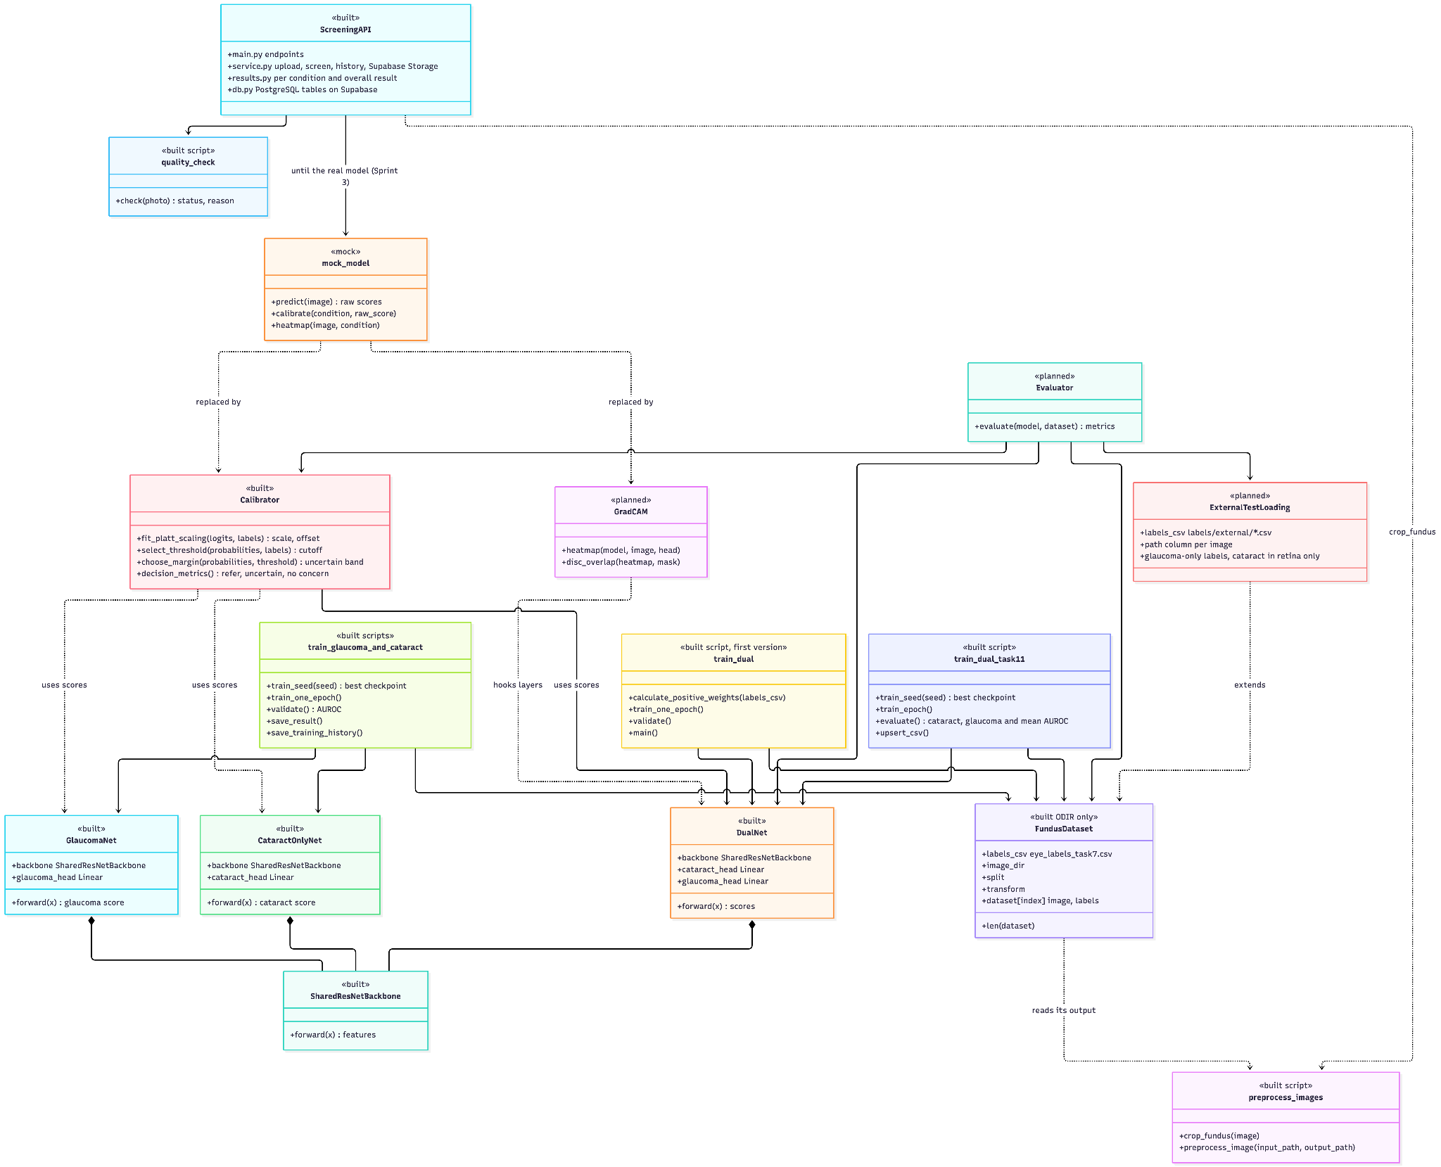
09 · DIAGRAMS
Class Diagram
Notes:
This class diagram shows how the different components of our EyeQ project are organized and connected. Each box represents a component and shows its current status, such as built, in review, planned, or mock. Starting from the top, we have our Screening API, which handles image uploads, quality checks, and screening results. It also connects with Supabase for storing screening information. Currently, the application uses a mock model until the real trained model is integrated. Moving down, we have the Calibrator, which handles prediction scores, thresholds, and uncertain results. We also have Grad-CAM, which is planned for generating heatmaps, and the Evaluator, which will help us test model performance. At the bottom, we have our shared ResNet-50 backbone, which supports three models. DualNet predicts both cataract and glaucoma, while GlaucomaNet and CataractOnlyNet predict each disease separately. These individual models allow us to compare their performance with DualNet. We also have training scripts and FundusDataset, which loads our preprocessed retinal images and labels from the ODIR dataset. Overall, this diagram shows how our existing components and planned features connect to form the complete EyeQ screening application.

Slide 25
Sprint 1 work
PART 2 OF 4
10 Product backlog · 11 Sprint 1 backlog, test cases, stories completed
Notes:
Now the main part: what we did in Sprint 1, starting with our product backlog.

Slide 26
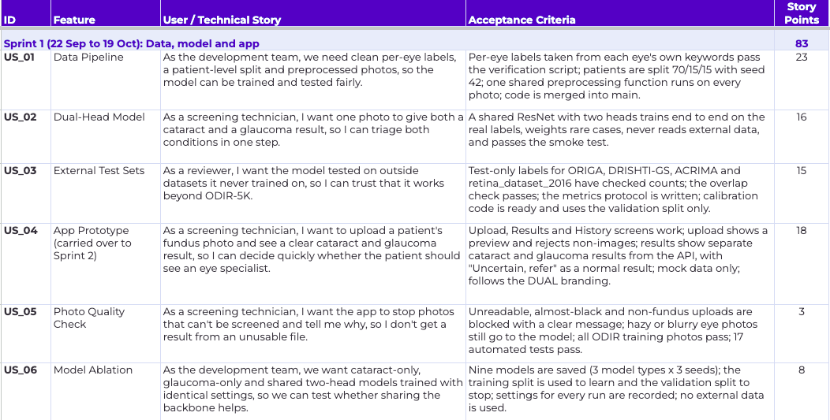
10 · PRODUCT BACKLOG
Product backlog – User Stories
Notes:
The product backlog is everything we need to build to finish DUAL, from the data pipeline to the final documentation. Jira is our source of truth, and this table is taken straight from it.
Each row is one story: an ID, the feature it belongs to, the story itself, its acceptance criteria and its story points. Most are user stories, written from a real user’s point of view, like US_02: a screening technician gets both a cataract and a glaucoma result from one photo. A few are technical stories for the team, like the data pipeline.
The acceptance criteria say exactly when a story counts as done, and story points are our estimate of how big it is compared with the others
The backlog is grouped by sprint. Sprint 1 was about data, model and app: the data pipeline, the two-head model, the external test sets, the app prototype, the photo quality check, and the model ablation, which we added mid-sprint. That’s 6 stories and 83 points. Ansh will go through how Sprint 1 went in the next section

Slide 27
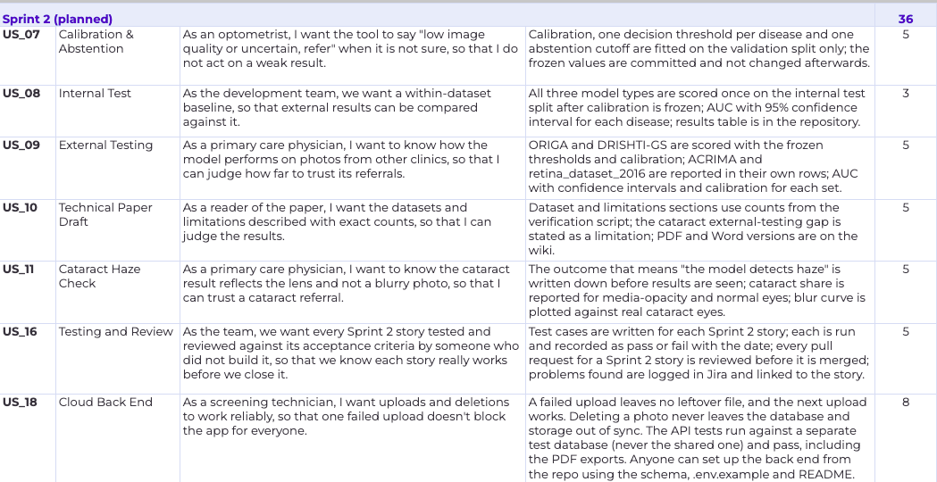
10 · PRODUCT BACKLOG
Product backlog – User Stories
Notes:
Sprint 2 is about trusting the model’s results: calibration, so the tool can say ‘uncertain, refer’; one run on our internal test set and one on the outside datasets, which is the core of our hypothesis; the cataract haze check, which Smit has already started; the first draft of our technical paper. That’s 7 stories and 36 points, including the new cloud back-end story (US_18). Calibration is already finished; it was done early in Sprint 1.

Slide 28
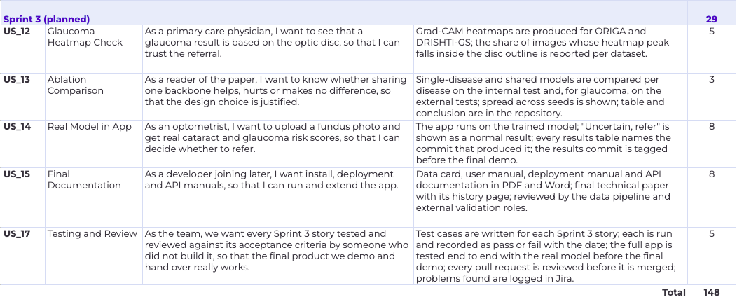
10 · PRODUCT BACKLOG
Product backlog – User Stories
Notes:
Sprint 3 finishes the product: the glaucoma heatmap check, comparing the shared and single-disease models, connecting the real trained model to the app, and the final documentation. That’s 5 stories and 29 points. In total, the backlog has 18 stories and 148 points.
Since Sprint 0 we rebuilt the backlog from Jira, added acceptance criteria to every story, and added a testing and review story to Sprint 2 and Sprint 3. That way every story is tested by someone who didn’t build it. Next, Ansh shows our Sprint 1 backlog.

Slide 29
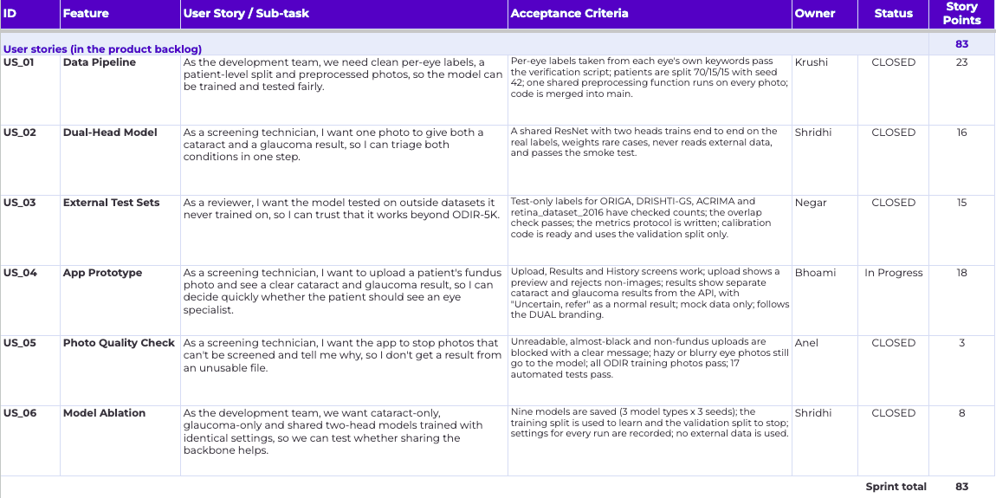
11 · SPRINT 1 BACKLOG
Sprint 1 backlog

Slide 30
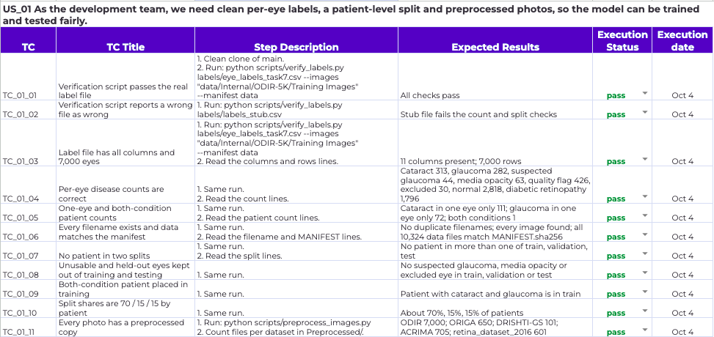
11 · SPRINT 1 BACKLOG
Backend tests: data preparation
WHAT WE CHECK
Labels match the photos.
Patients stay in separate splits.
Preprocessing preserves the original files.
WHY IT MATTERS
The model learns and is tested on correctly prepared data.

Slide 31
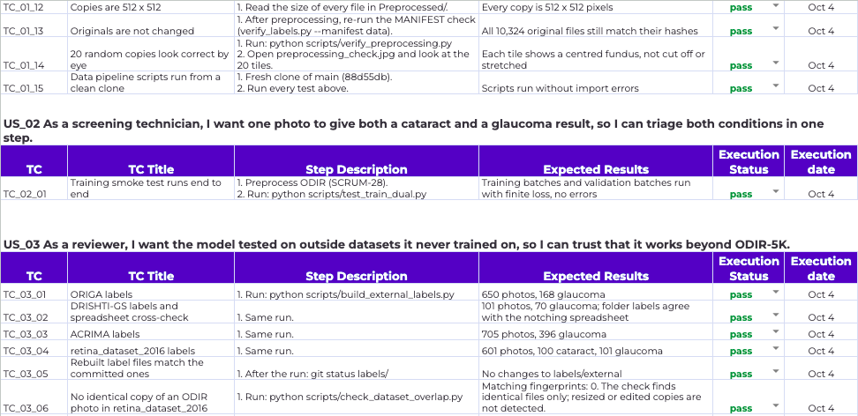
11 · SPRINT 1 BACKLOG
Backend tests: external datasets
WHAT WE CHECK
All four external datasets have the expected labels and counts.
The exact-copy check finds no matching files.
WHY IT MATTERS
External data stays separate for later testing.

Slide 32
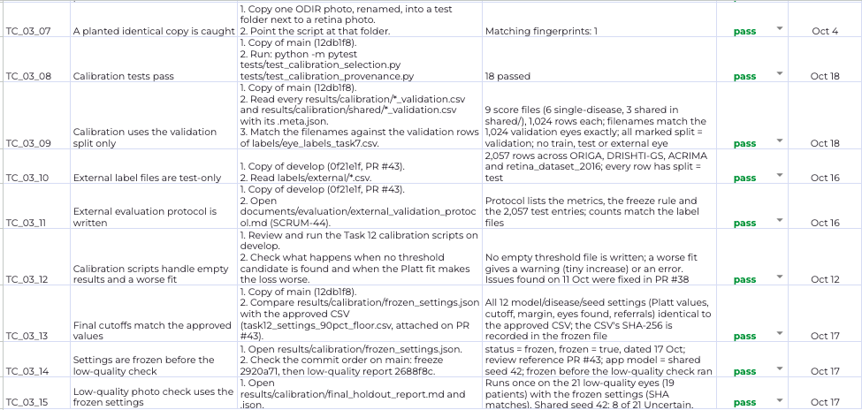
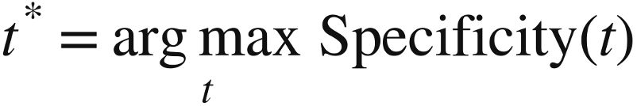

11 · SPRINT 1 BACKLOG
Backend tests: calibration and cutoffs
CURRENT RULE: FROZEN
WEIGHTED YOUDEN: EXPLORATORY
Choose the cutoff t with the largest Jw.
Larger w gives sensitivity more weight.
Compares tradeoffs. The frozen rule stays unchanged.
WHAT WE CHECK
FINAL CHECK
18 calibration tests pass.
Only validation images set the cutoffs.
All 12 settings match the approved values.
Settings froze before the 21-eye holdout check.

Slide 33
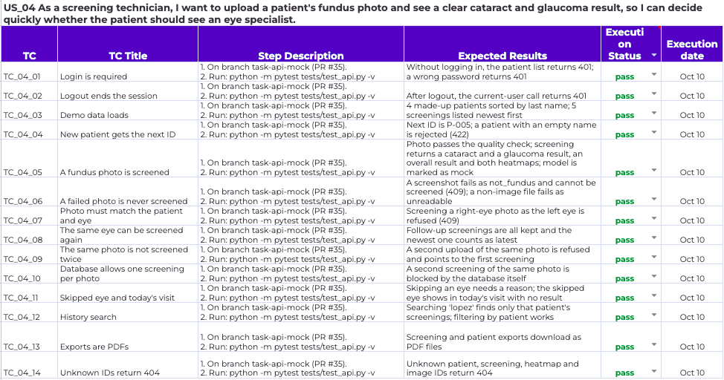
11 · SPRINT 1 BACKLOG
Backend tests: API behavior
WHAT WE CHECK
Login and patient records.
Photo upload and screening.
History, PDF exports and error responses.
CURRENT STATUS
These passes cover SQLite. Supabase test updates are planned for Sprint 2.

Slide 34
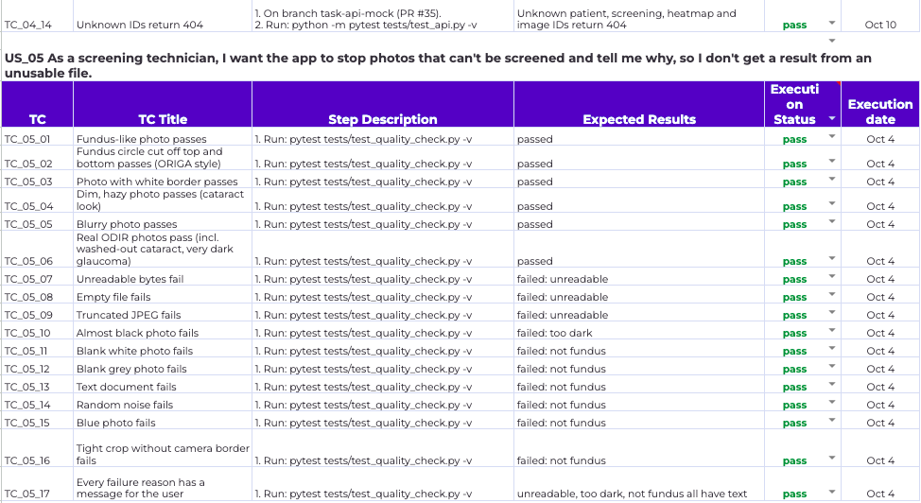
11 · SPRINT 1 BACKLOG
Backend tests: photo quality
WHAT WE CHECK
Blurry or hazy fundus photos can continue.
Unreadable, almost-black and non-fundus inputs stop.
WHY IT MATTERS
Haze can be part of the eye condition, so blur alone should not reject a photo.

Slide 35
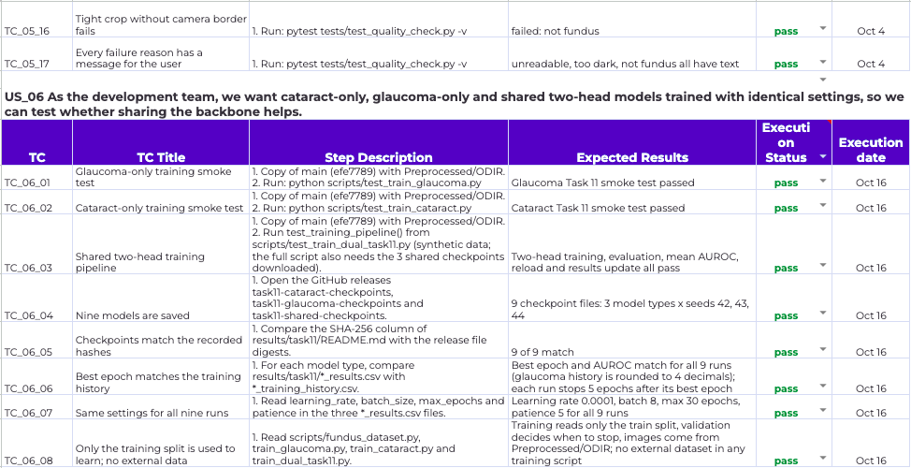
11 · SPRINT 1 BACKLOG
Backend tests: trained models
WHAT WE CHECK
All three training pipelines run.
Nine checkpoints match their hashes.
Results match the training history.
WHY IT MATTERS
The model comparison uses recorded settings and reproducible files.

Slide 36
11 · SPRINT 1 BACKLOG
Test cases (frontend)
TC | TC Title | Step Description | Expected Results | Execution Status
TC_04_15 | Select patient and eye | Open Upload. Choose a demo patient and select Left or Right. | Selected patient and eye appear before screening. | Passed
TC_04_16 | Open main pages | Use navigation to open Home, Upload, Results, History and About. | Available pages open with the correct content. | Passed
TC_04_17 | Upload and preview a photo | Choose a JPG/PNG fundus photo; review its preview before screening. | Selected photo appears in the upload preview. | Passed
TC_04_18 | Reject unsupported files | Try uploading a non-image file, such as PDF or TXT. | Unsupported file is rejected with clear feedback. | Passed
TC_04_19 | Reject poor-quality image | Upload a poor-quality fundus photograph and submit for screening. | Quality warning appears; normal screening does not proceed. | Passed
Notes:
For the frontend, we've outlined test cases covering the main functionality of our application, starting with navigation and image uploads.
We're checking that users can move between pages, select a patient and eye, upload a fundus photograph, and preview it before submitting it for screening.
We've also included negative test cases, because it's important to check what happens when something goes wrong. For example, unsupported files should be rejected, and a poor-quality fundus photograph should trigger a quality warning rather than continue through screening.
These cases focus on making the initial screening workflow functional and easy to use.

Slide 37
11 · SPRINT 1 BACKLOG
Test cases (frontend)
TC | TC Title | Step Description | Expected Results | Execution Status
TC_04_20 | Show screening results | Submit an accepted fundus photo and open the Results page. | Overall result and separate cataract/glaucoma results appear. | Passed
TC_04_21 | Display risk information | Review the condition scores, thresholds, and result details. | Risk information is shown for available mock-model outputs. | Passed
TC_04_22 | Handle Refer / Uncertain | Review screens for Refer and Uncertain outputs when returned. | Correct label and follow-up guidance are displayed. | Passed
TC_04_23 | Review screening history | Open History after completing a screening. | Stored screening records can be retrieved and reviewed. | Passed
TC_04_24 | Switch light/dark theme | Use the theme toggle on the application interface. | Theme changes and content remains readable. | Passed
TC_04_25 | Check mobile layout | Open Home, Upload, Results and History at phone width. | Content fits without cutoff or unwanted horizontal scrolling. | Passed
TC_04_26 | Use demo patient records | Review the patient selection and displayed patient details. | Prototype uses fictional patient records, not real patient data. | Passed
Notes:
The remaining frontend test cases focus on how screening information is presented to the user.
We check that the Results page shows the overall screening outcome as well as separate cataract and glaucoma information. For Sprint 1 these outputs come from our mock model, so the purpose is to verify the interface rather than clinical accuracy.
We also cover screening history, the light and dark themes, phone-size responsiveness, and fictional patient records.
Most of these workflows were shown in our Sprint 1 demo. The cases labeled 'To verify' are specific scenarios that weren't established by the demo, rather than features we are claiming don't work.

Slide 38
11 · SPRINT 1 BACKLOG
Stories completed and not completed
Completed 65 story points
Not completed, carried over 18 pts
ID | Feature | Points | Done
US_01 | Data pipeline | 23 | 21 Sep
US_02 | Dual-head model | 16 | 29 Sep
US_03 | External test sets | 15 | 16 Oct
US_05 | Photo quality check | 3 | 30 Sep
US_06 | Model ablation | 8 | 14 Oct
ID | Feature | Points | Still open
US_04 | App prototype | 18 | Results and Log detail screens, upload and results functions, screen tests
Mostly done: 15 of its 20 sub-tasks are closed (React app, navigation, Upload, About and History screens, mock API). It moves to Sprint 2 with its full 18 points.
All sub-tasks of these stories are closed in Jira.

Slide 39
Metrics and retrospective
PART 3 OF 4
12 Velocity, burndown, completed / committed ratio · 13 Retrospective
Notes:
Chapter divider, part 3 of 4: Metrics and retrospective. Hand over to the next presenter.

Slide 40
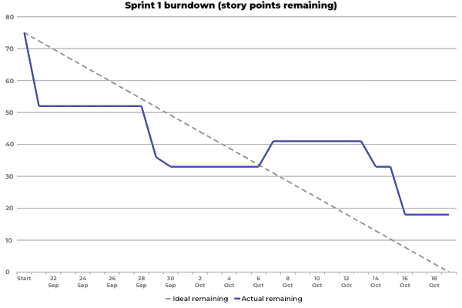
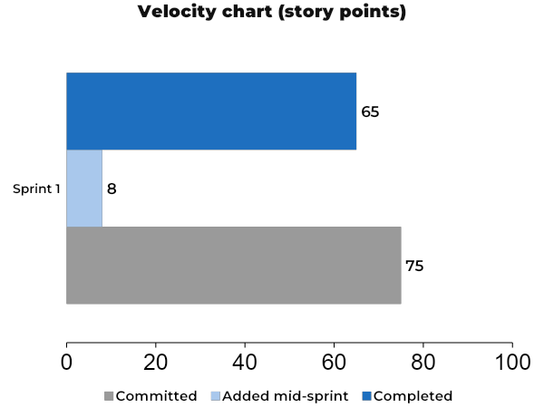
12 · METRICS
Sprint 1 metrics
Team velocity
65 story points
Completed in Sprint 1 (story points, not issues)

Slide 41
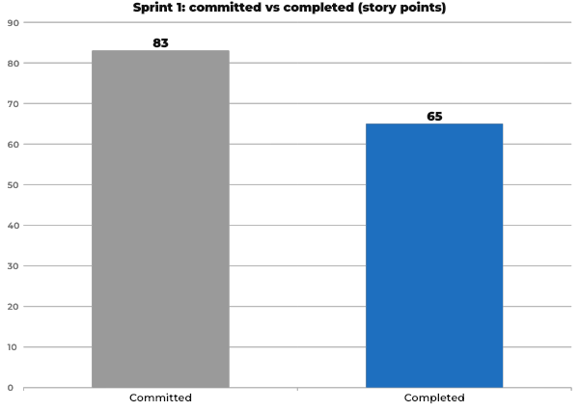
12 · METRICS
Completed / committed ratio
Sprint 1 ratio
78.3%
65 / 83 story points
Story points completed divided by story points committed: 75 at the start plus 8 for US_06, added on 7 Oct. A story counts only when it is finished.
Without the added story: 57 / 75 = 76.0%
Final for Sprint 1 (22 Sep to 19 Oct).

Slide 42
13 · RETROSPECTIVE
UPDATED AFTER SPRINT 0 FEEDBACK
Sprint 1 retro
What went well
What can improve
ACTION 1 → SPRINT 2
• Peer reviews caught real problems before merging.
• Everyone joined the Sunday meetings and stayed engaged.
• We finished the data pipeline, the training code and all nine ablation models.
• Code went in without a pull request or a review. Some work was pushed straight to main or develop, and one PR was merged without a submitted review.
• Jira didn’t match the real status. Statuses were updated in bulk, so the Jira burndown was wrong and finished work still showed “To Do”.
Fixes: code going in without a pull request or review
All changes go through a pull request into develop, with a named reviewer within 48 hours. No direct pushes to main or develop. A PR open longer is raised at the Sunday meeting.
Owner: Whole team
Check: no direct pushes; no PR waits more than 48 hours
ACTION 2 → SPRINT 2
Fixes: Jira not matching the real status
Each member moves their Jira items the same day their work changes status. Done means the CLOSED column. We check the board together at the Sunday meeting.
Owner: Whole team
Check: the Jira burndown matches GitHub; no finished work left in To Do
Notes:
Sprint 1 retrospective. Two actions feed the Sprint 2 backlog.

Slide 43
Sprint 2 plan and demo
PART 4 OF 4
14 Sprint 2 stories and capacity · 15 App, API, GitHub and wiki

Slide 44
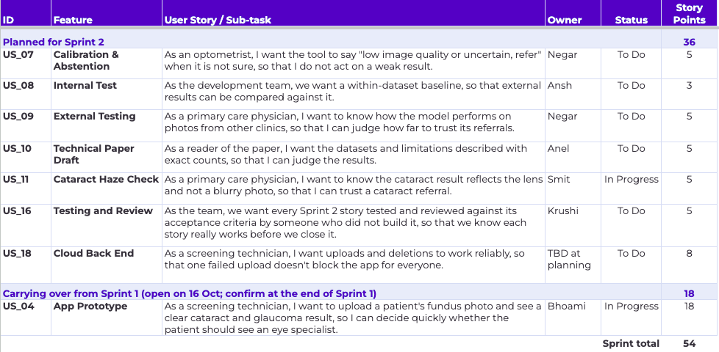
14 · SPRINT 2 PLAN
Stories planned for Sprint 2

Slide 45
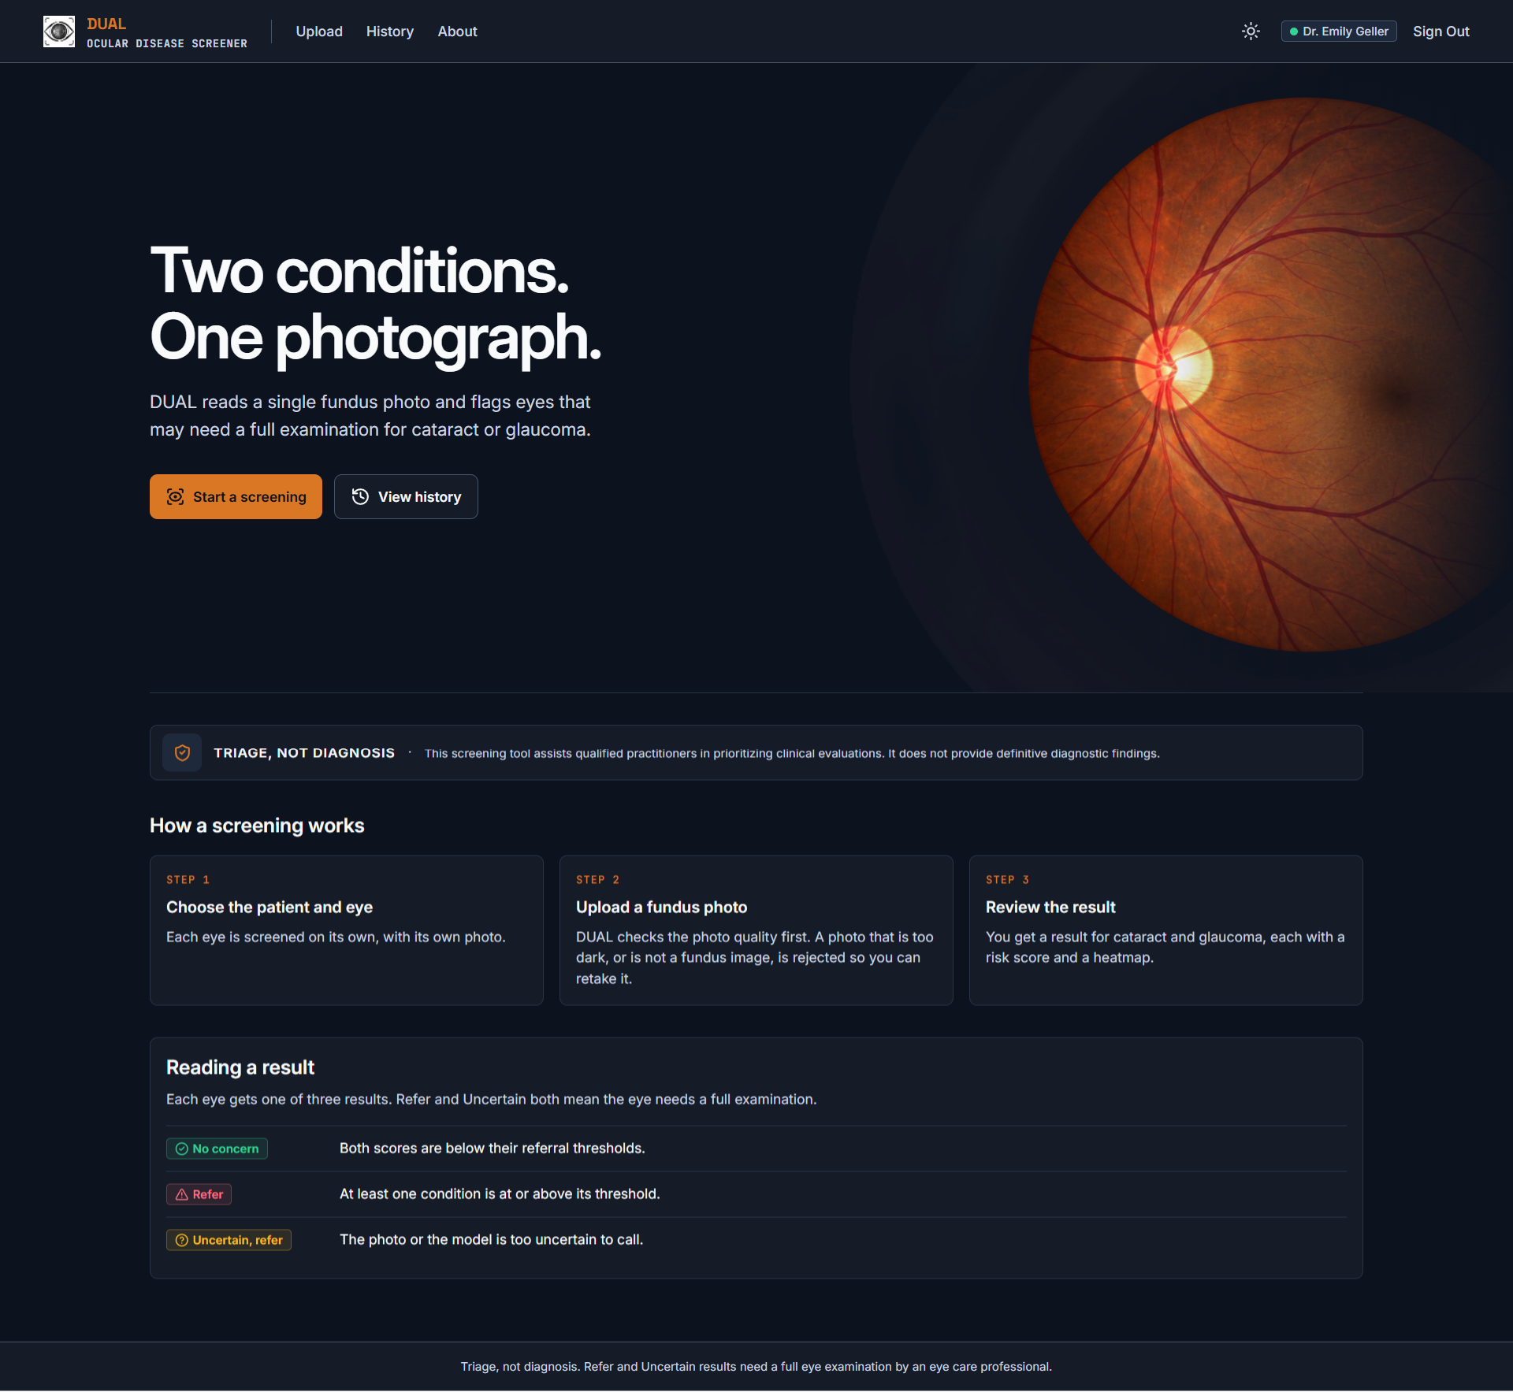
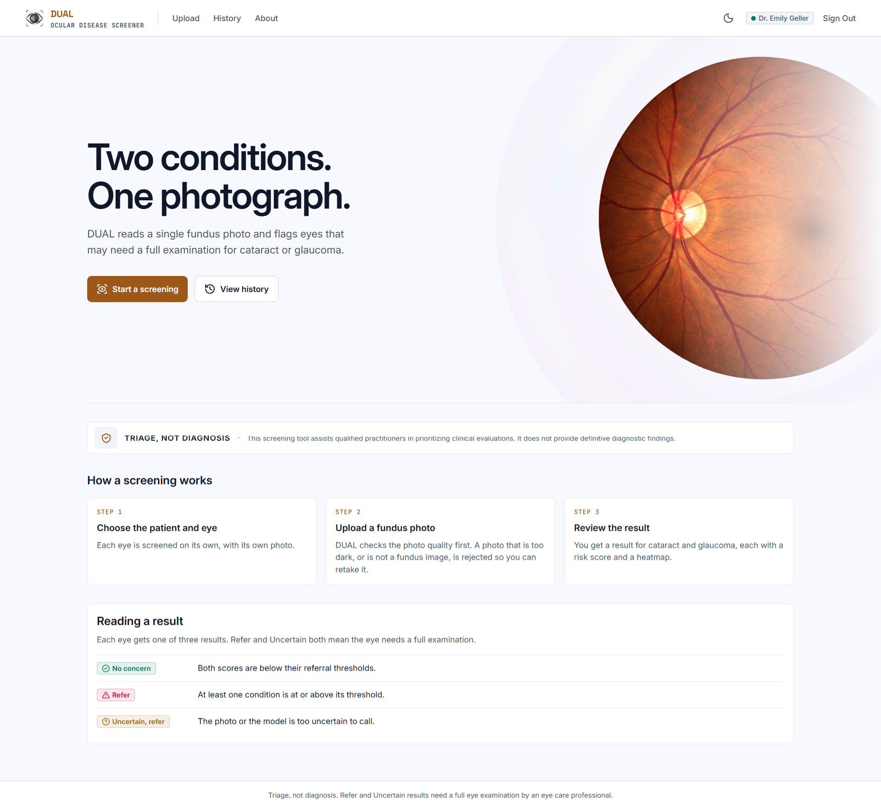
15 · DEMO
App screenshots: Home screen
Notes:
Starting with the Home screen, this is the main entry point to DUAL.
We've kept the interface straightforward, with a clear introduction to the application and a three-step overview of the screening process: selecting a patient and eye, uploading a fundus photograph, and reviewing the results.
The Home screen also explains our three possible screening outcomes: No Concern, Refer, and Uncertain.
Here, we're showing both the dark and light themes, which are available throughout the application.

Slide 46
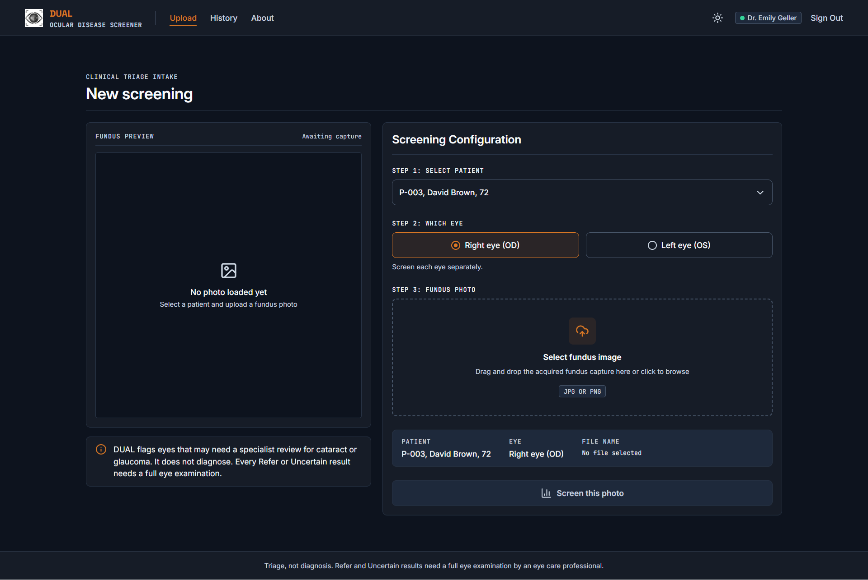
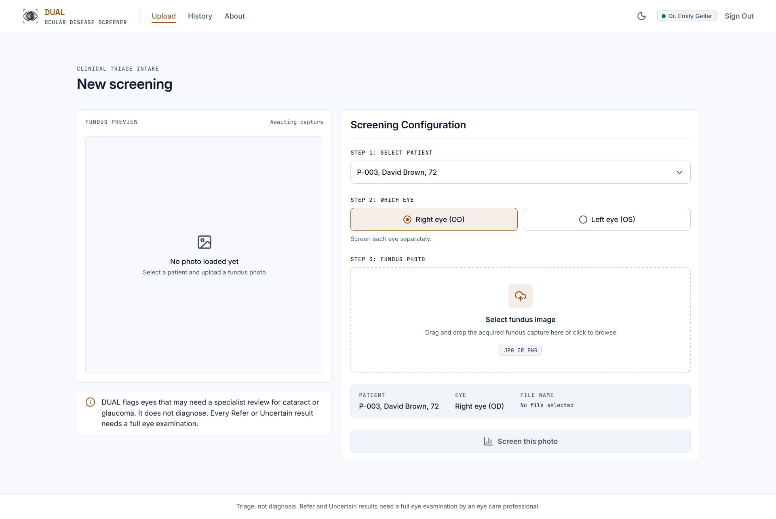
15 · DEMO
App screenshots: Upload screen
Notes:
Moving on to the Upload screen, this is where the screening process begins.
The clinician selects a patient, chooses the left or right eye, and uploads a fundus photograph.
We support both file selection and drag-and-drop uploads, with a preview of the selected image before screening.
The interface also displays the selected patient, eye, and file information, allowing the clinician to review everything before submitting the photograph.
Both themes maintain the same functionality and layout.

Slide 47
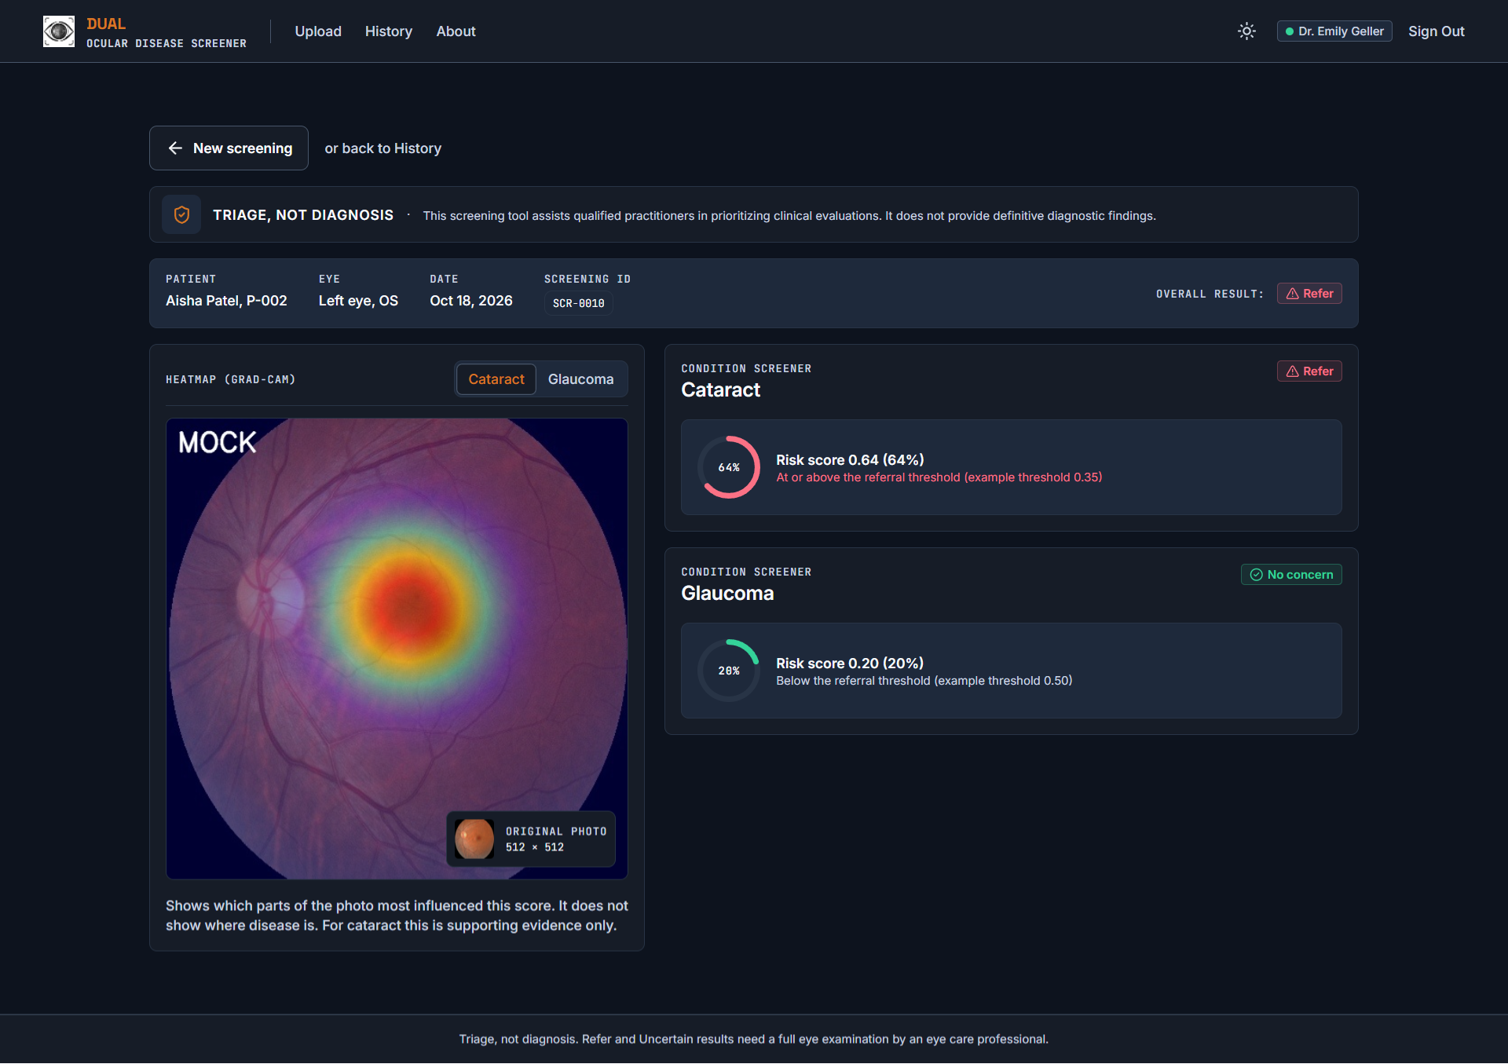
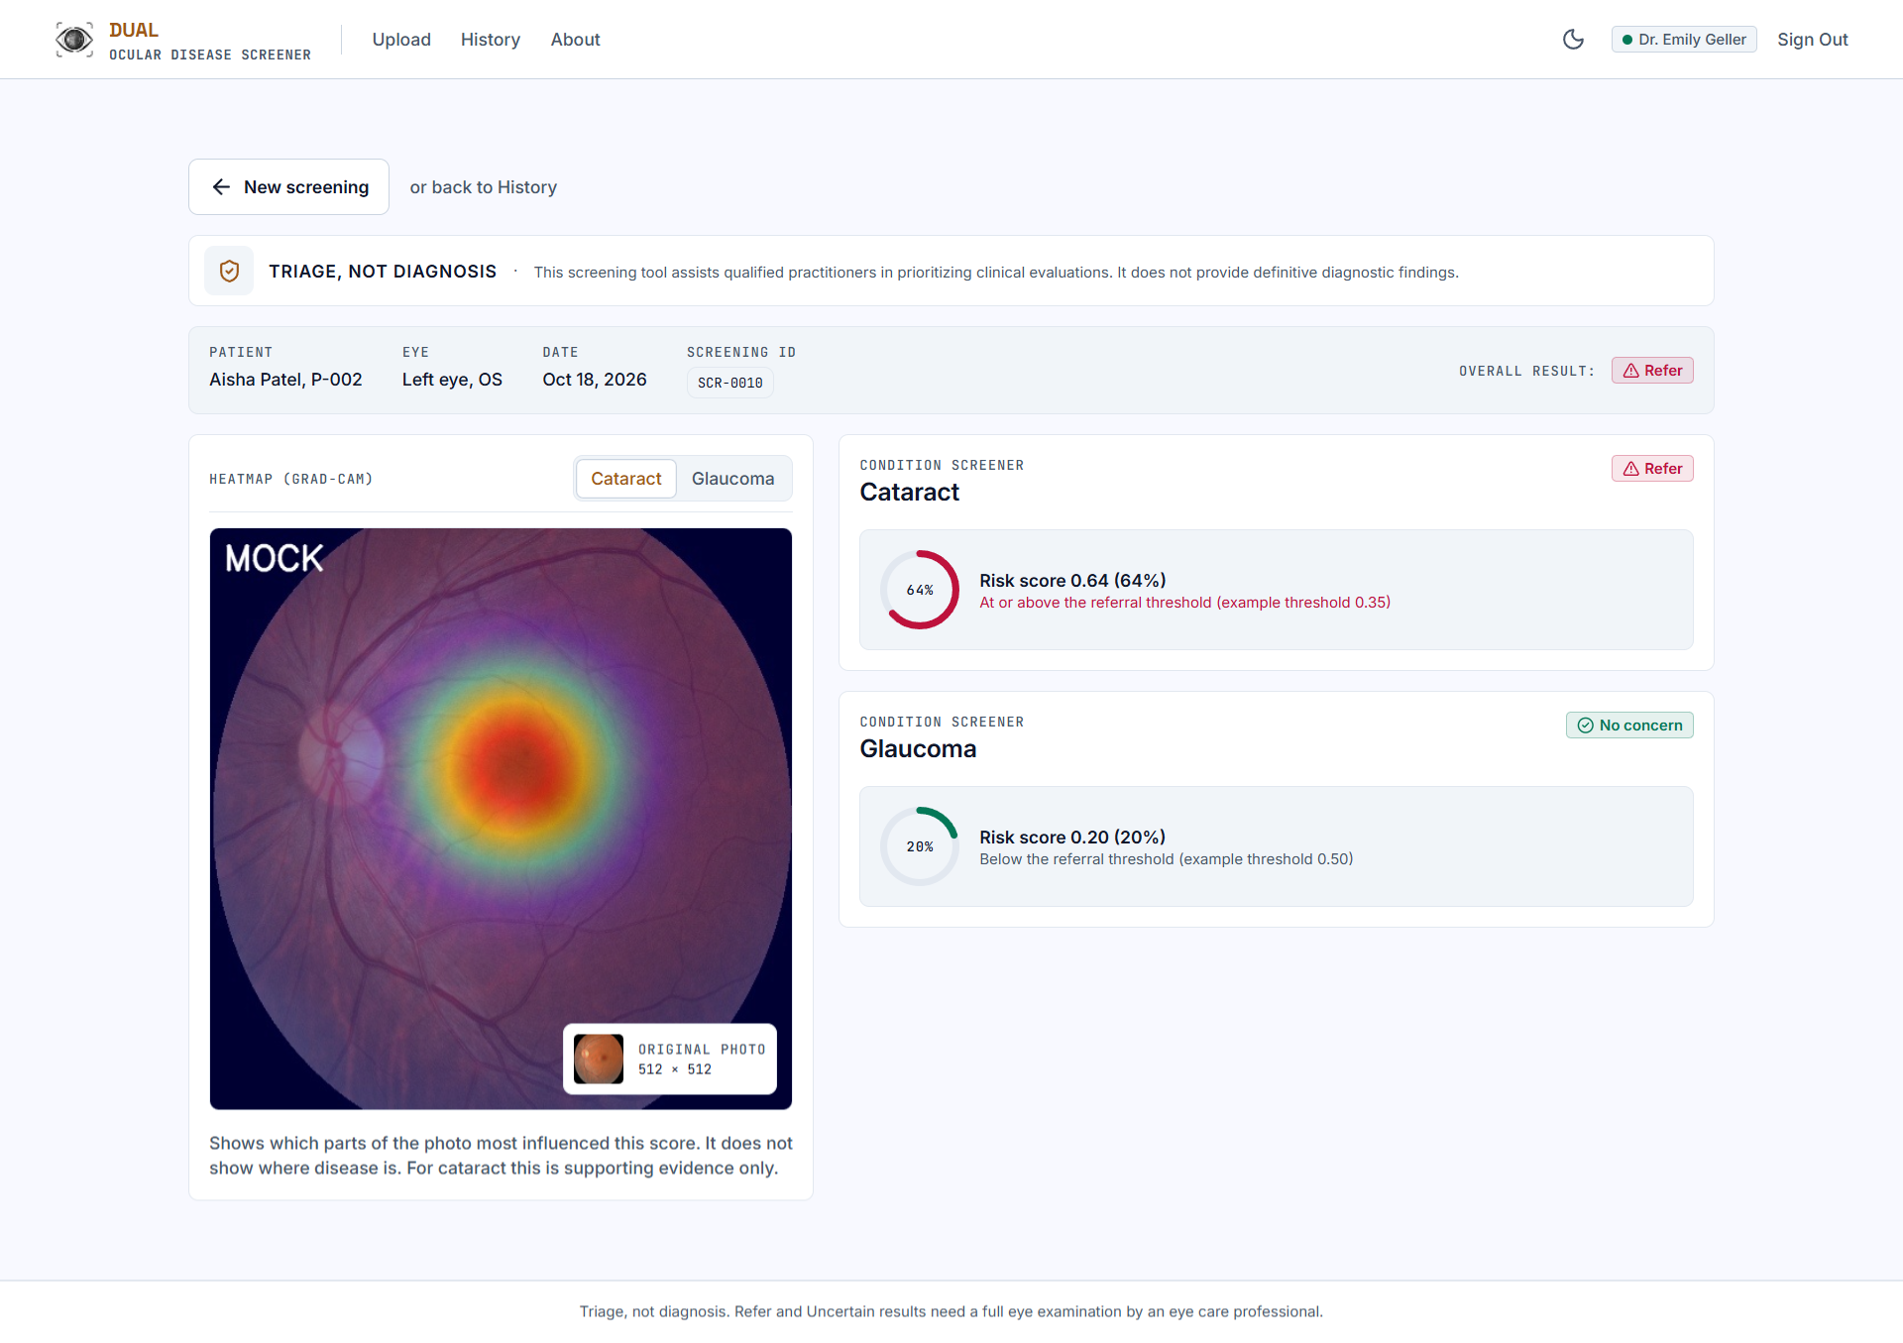
15 · DEMO
App screenshots: Result screen
Notes:
Once a screening is complete, the clinician is directed to the Results screen.
At the top, we display the patient information, the selected eye, and the overall screening outcome.
Below that, cataract and glaucoma have separate results, including their risk scores and screening classifications.
We also display a heatmap alongside the photograph to visualize regions associated with the model's output.
For Sprint 1, these scores and heatmaps are generated using our mock model. They demonstrate how results will be presented once our trained models are integrated.

Slide 48


15 · DEMO
App screenshots: History screen
Notes:
The History screen allows clinicians to access previous screening records.
Rather than losing the results after each screening, the application retrieves stored records and displays them in a table, with the most recent screenings appearing first.
Each entry includes the patient, eye, date, overall result, and individual cataract and glaucoma outcomes.
We've also included patient filtering and the ability to open a screening record to review its results in more detail.

Slide 49


15 · DEMO
App screenshots: About screen
Notes:
The About screen provides more technical information about DUAL and its intended purpose.
It explains that the application is designed for screening and triage rather than medical diagnosis.
It also describes our current model approach, the datasets being used for training and evaluation, and the limitations we're working to address.
We've included the prototype version so that users can identify which version of the application they're using.

Slide 50





15 · DEMO
App screenshots: Responsive Design
Notes:
Finally, we've focused on making the application responsive across different screen sizes.
Here, we're showing how the Home, Upload, Results, History, and About pages adapt to a narrower, mobile-sized layout.
Rather than simply shrinking the desktop interface, the content reorganizes to fit the available space while keeping the main features accessible.
This allows clinicians to navigate the application, upload photographs, and review screening information across different devices.

Slide 51
15 · DEMO
API: what the back end offers
Method | Endpoint | What it does
POST | /auth/login | Sign in; sets a session cookie
POST | /auth/logout | Sign out
GET | /auth/me | Signed-in user
GET | /patients | Patients, sorted by last name
POST | /patients | Add a patient
GET | /patients/{id} | Patient, last visit, latest result per eye
GET | /patients/{id}/screenings | A patient's screenings, newest first
GET | /patients/{id}/export | Patient dossier (PDF)
GET | /patients/next-id | ID for the next new patient
Method | Endpoint | What it does
POST | /images | Upload a photo; quality check runs at once
GET | /images/{id} | 512 x 512 preprocessed photo
GET | /images/{id}/original | Photo as uploaded
DELETE | /images/{id} | Discard an unscreened photo (retake)
GET | /heatmaps/{id} | Heatmap image (mock for now)
POST | /screenings | Screen a photo, or skip an eye
GET | /screenings | History, newest first
GET | /screenings/{id} | Results of one screening
GET | /screenings/{id}/export | Screening summary (PDF)
GET | /model | Model version and thresholds
FastAPI with Supabase (PostgreSQL and photo storage). The endpoints are unchanged. The API tests were written for the earlier SQLite version; updating them for Supabase is planned for Sprint 2.

Slide 52


15 · DEMO
API: what the back end offers
Sign-in and patients
Photos, screenings and model
Generated by FastAPI at http://localhost:8000/docs when the back end runs. Each endpoint can be tried from this page.

Slide 53

15 · DEMO
Project demo

Slide 54
AI DISCLOSURE
Use of AI tools
Tools used
Where it helped
The team used AI assistants as support tools during Sprint 1, as allowed by Professor Wong.
First, the app design. We used AI to generate the initial screen mockups and our frontend developer used those as references to build the screens in React.
Secondly, Personas. The persona images shown earlier were AI generated and represent fictitious people.
Third, project organization. We used AI to check our slides and Wiki against the requirements of the course and to prepare backlog tables and burndown charts using Jira data.
Human review
Responsibility
We reviewed and modified AI assisted work prior to using it with our team. We also validated the project data with Jira and GitHub.
We made all the final decisions, and we are responsible for the code, the documentation and the results we present.

Slide 55
GROUP WIKI
https://github.com/htmw/F2026-Team1/wiki
Earlier Detection. Brighter Tomorrows.
Notes:
Group wiki link on its own slide, per the checklist.

Slide 56
Thank you
TEAM EYEQ
Notes:
Closing slide.

