Slide 1

Supro
Final Presentation by: Brian Hoang
& Chris Villegas

Slide 2
Outline
Introduction: What is Supro?
Early Development / Initial Research
Building and Testing
New Features
Refactor
Conclusion
Acknowledgements

Slide 3

Introduction to SuPro
SuPro is a Prism-hosted real-time
Supervisor dashboard
Used for monitoring and managing
processes running across an
autonomous fleet.
SuPro allows the user the ability to track and
control multiple supervisor servers

Slide 4
Objective

Slide 5
Our approach

Slide 6
Early Development / Initial Research
Web Sockets
Multithreaded Programming
Queues
JSON

Slide 7
Websockets
Web Sockets makes it possible to open an interactive session between the user’s browser and a server.
With Web Sockets you can send messages to a server and receive event driven responses without having to poll the server for a reply.
We use a web socket to connect the Supro backend with web clients opened by users.
Once a web socket connection is established, messages can be sent from the UI to the backend and vice versa.

Slide 8
Autobahn Vs. SockJS

Slide 9
Python Multithreaded Programming
Running several threads is similar to running several different programs concurrently, but with the following benefits –
Multiple threads within a process share the same data space with the main thread
Threads do not require as much memory usage as processes.
Python has a Threading Module that provides high-level support for threads
The threading module has a Thread class that implements threading
We use the run() method from the Thread class which will execute the thread activity.

Slide 10
Python Multithreaded Queue
The Queue module allows you to create a new queue object that can hold a specific number of items.
We use these following methods to control the Queue:
put(): adds items to a queue
empty(): returns True if queue is empty; otherwise, False
get(): removes and returns an item from the queue

Slide 11
Supro Queue
In Supro we have two queues that transfer messages between the front end and the back end.
_supervisor_update_q: Adds the state and process info of a supervisor instance to the queue and sends it to the ui.
_messages_to_backend_q: Adds messages in the form of commands from the UI and sends it to the backend.

Slide 12
Supro Multithreading
Supro classes that implement threading module:
SuproProcessor – maintains a connection between supervisor on a single machine and Supro.
Connect to supervisor if connection has not yet been made or is lost
Send supervisor status updates to the UI
Report a loss of connection to the UI if unable to reach supervisor
SuproSwarm – creates and manages all ‘swarm entities’.
Get next message from UI and process its command
See if any processor threads have crashed and restart them if they have
Execute command on appropriate swarm entity
Broadcast swarm status updates

Slide 13
JSON
When exchanging data between a browser and a server, the data can only be text.
Sending Data: JavaScript objects can be converted into JSON to be sent to the server.
Receiving Data: JSON received from the server can be converted into JavaScript objects.
Since JSON format is text only, it can be easily sent to and from a server, and used as a data format by any programming language.

Slide 14
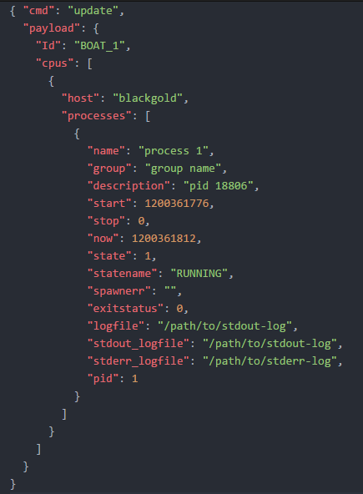
Supro JSON
This is the update message in JSON format that is sent to the UI by each supervisor instance.
The message includes supervisor state and process information.

Slide 15
Building and Testing

Slide 16
First Websocket Class

Slide 17
Incorporating the Front-end

Slide 18
Building RPMs

Slide 19
New Features
Stop/Start/Restart All Buttons
Logging
Testbed Support

Slide 20
Stop/Start/Restart All

Slide 21
Logging

Slide 22
Testbeds

Slide 23
Refactor

Slide 24
Hierarchical Structure

Slide 25
Changing the web_socket class

Slide 26
Cleaning up the code

Slide 27
Documentation

Slide 28
Conclusion

Slide 29
Things we learned

Slide 30
Challenges we faced

Slide 31
Final thoughts

Slide 32
Acknowledgements

