Slide 1
Warehouse-Based Automated Detection And Classification Of Screen Defects In Returned Phones For Mobile Carrier Notification
Name: Bhogasena Reddy Kalakata
University: Liverpool John Moores University
Degree: Masters in Machine Learning and AI
Supervisor: Dr. Deanne Larson
Notes:
My name is …. I am pursuing my master’s in ML and AI at ……Today, I am excited to present my thesis titled …This research was conducted under the guidance of ….

Slide 2
Title Slide | 01
Introduction | 03
Aim & Objectives | 05
Literature Review | 06
Methodology | 09
Results | 11
Discussion and Conclusion | 14
Future Recommendations | 16
Thesis Presentation Outline
Notes:
Before I delve into the details, let me first walk through the structure of this presentation.
In the introduction, will set the context and background of my research work
I will then move on to the specific aims and objectives of my study. Here, I will share what I set out to achieve with my research.
This will be followed by a review of the existing literature related to my research topic. I will discuss the current state of research and the gaps that my study aims to fill
Then in methodology I will explain the techniques and methods I used to conduct my research.
Next I will present the results of my research
I will then move to a discussion of these results and the conclusions that can be drawn from them.
Lastly, in the future recommendations section, I will suggest some potential avenues for further research based on my findings

Slide 3
Introduction
The surge of e-commerce has led to a vast increase in returned mobile phones.
Balancing environmental concerns with efficient reverse logistics poses a challenge.
Manual inspection of phone screens for damage (e.g., oil, scratches, stains) is resource-intensive and prone to inconsistency.
Glass damage specifically creates significant costs and delays due to repairs or recycling needs.
Notes:
The booming e-commerce industry has led to a surge in returned mobile phones. This creates a crucial challenge: balancing environmental responsibility with efficient reverse logistics.
Currently, inspecting phone screens for damage is labor-intensive and prone to inconsistencies, leading to inaccuracies and delays. screen damage, in particular, is costly and time-consuming, requiring repairs or recycling.

Slide 4
Introduction
This research proposes a novel solution: An automated system leveraging machine learning for screen damage detection and classification.
This research aims to develop a scalable, robust, and diversified mobile screen damage detection and classification system.
Benefit: Streamlined reverse logistics, reduced costs, and a more eco-friendly system.
Notes:
My research proposes a solution: an automated system using machine learning to detect and classify screen damage. This system will be scalable, robust, and adaptable to various types of damage.
The benefits are twofold: streamlining reverse logistics through automation and contributing to a more environmentally friendly approach by minimizing manual inspections.

Slide 5
Aim & Objectives
Aim: To develop a scalable, robust, and diversified mobile screen damage detection and classification system, specifically focusing on the detection and classification of oil, scratch, and stain defects.
Objectives:
Develop an algorithm to identify and classify the 3 damage types.
Leverage transfer learning for improved accuracy.
Boost system diversity through data augmentation.
Prevent overfitting with regularization and dropout methods.
Rigorously test the system on a high-resolution dataset.
Notes:
"The principal aim of this study is to develop a scalable, robust, and diversified system for detecting and classifying mobile screen damages, specifically oil marks, scratches, and stains. To achieve this, I’ve set specific objectives:
The initial objective is to develop an efficient algorithm capable of identifying and categorizing the three types of screen damage. This will be the foundation of the research work.
Boost accuracy: In order to enhance the system's accuracy, I intend to apply transfer learning. This approach allows to use pre-trained neural networks, which have already learned from vast datasets, thus boosting the model's performance.
System Diversity: To ensure the system can handle a broad spectrum of screen damages, I’ll employ data augmentation. This method creates new training samples through modifications to existing images, improving the diversity of training data.
Overfitting Prevention : To avoid overfitting, i use regularization and dropout methods. These techniques help ensure the model generalizes well to unseen data.
Rigorous System Testing: Lastly, I plan to thoroughly test our system on a high-resolution dataset. This will allow us to assess the system's performance and make required adjustments.
By fulfilling these objectives, I aim to develop an automated system that can significantly enhance the process of detecting and classifying screen damages

Slide 6
Literature Review
Introduction
Explores the current state of knowledge in automated damage detection and classification systems.
Focuses on screen defects in returned mobile phones within the logistics sector.
Sections Covered
Automation in Logistics
Automation in Damage Detection
Broad Applications of Damage Detection Systems
Screen Damage Detection and Classification in Returned Phones
Related Research
Summary
Notes:
Moving on, let's discuss the Literature Review. This section explores the current state of knowledge in damage detection and classification systems, with a particular focus on mobile screen defects.
I’ll start by looking at the role of automation in the logistics sector. Next I’ll examine how automation has transformed logistics operations, and the challenges and opportunities it presents.
Next, I’ll delve into the topic of automation in damage detection. Here I’ll explore different automated systems used for damage detection, their techniques, and their effectiveness.
Then, I’ll discuss the broad applications of damage detection systems, highlighting how these systems are used in different industries, not just logistics.
After that, I’ll narrow down my focus to the detection and classification of screen damage in mobile phones, discussing the specific challenges this poses and the solutions that have been proposed so far.
I’ll also highlight related research in this field, discussing the findings of other researchers and how their work contributes to my understanding of this topic.
Finally, I’ll summarize the key points from the literature, and set the stage for my research methodology and findings

Slide 7
Literature Review
Automation in Logistics
Adoption of AI, ML, and deep learning in logistics for enhanced efficiency and accuracy.
Applications include automated loading/unloading systems, AGVs, AS/RS, and more.
Automation in Damage Detection
Transition from traditional methods to automated systems leveraging AI and ML.
Application of ML in image-based damage detection across various sectors.
Broad Applications of Damage Detection Systems
Versatile applications in automotive, infrastructure, energy, aerospace, e-commerce, and logistics.
Significant contributions to operational efficiency and cost-effectiveness.
Notes:
Let's talk about the role of automation in the logistics sector first. The adoption of Artificial Intelligence, Machine Learning, and Deep Learning in logistics has significantly enhanced efficiency and accuracy. These technologies have been applied in various ways, including automated loading/unloading systems, Automated Guided Vehicles (AGVs), and Automated Storage/Retrieval Systems (AS/RS), to name a few.
Next, we look at the transition from traditional methods to automated systems in damage detection. Artificial Intelligence and Machine Learning are replacing manual inspection methods, bringing a new level of accuracy and efficiency. Machine Learning, in particular, has been applied in image-based damage detection across various sectors, enhancing the speed and precision of identifying damages.
Lastly, let's consider the broad applications of damage detection systems. These systems have versatile applications across numerous sectors, including automotive, infrastructure, energy, aerospace, e-commerce, and, of course, logistics. The use of automated damage detection systems has contributed significantly to operational efficiency and cost-effectiveness in these fields.
In the following sections, we will narrow down our focus to the specific application of these technologies in detecting and classifying screen damage in returned phones, and explore the related research in this field.

Slide 8
Literature Review
Screen Damage Detection and Classification in Returned Phones
Crucial role in e-commerce and logistics sectors.
Automation facilitates efficient handling of returned devices, improving operational efficiency.
Related Research
Selvi et al., (2021) achieved an accuracy of 85% using pre-trained models such as Densenet, Resnet, and Squeezenet.
Transfer learning, data augmentation (Mahyoub et al., 2023), and regularization techniques (Farhadi et al., 2022) enhance model performance.
Summary
Highlights the potential of automation and machine learning in improving various sectors, particularly logistics.
Notes:
As we delve deeper into the detection and classification of screen damage in mobile devices, we must understand its significance in the e-commerce and logistics sectors. With the high volume of returned devices, automation is the key to efficient management, offering significant potential to enhance operational efficiency.
Let's examine some relevant research in this domain. A remarkable study conducted by Selvi and her team in 2021 achieved an impressive 85% accuracy in detecting mobile screen damage. Their approach, which is the basis for my research, utilized pre-trained models like Densenet, Resnet, and Squeezenet, demonstrating the potential of existing machine learning models for this task.
Furthermore, several techniques have been identified to boost model performance. For example, Farhadi et al., in 2022, applied regularization techniques to counteract overfitting in their research on gold price forecasting. These techniques ensure that models maintain their performance on new, unseen data.
Advancing to 2023, Mahyoub et al. implemented data augmentation techniques in their study on car damage detection, achieving improved accuracy. This approach, which involves creating a more diverse training dataset, enhances the model's ability to generalize.
In conclusion, automation and machine learning hold immense promise to revolutionize various sectors, especially logistics. The research I’ve examined today represents a fraction of this field's potential and demonstrates the transformative impact these technologies are making. By incorporating these techniques into my work, I aim to further this field of research and contribute to its ongoing evolution

Slide 9
Methodology
This section presents a comprehensive overview of the methodology utilized in this study, encompassing the following key aspects:
Data Selection:
Used publicly available datasets for replicability.
Data Pre-Processing:
Resize images and normalize pixel values.
Apply augmentation to prevent overfitting.
Allocate 20% for validation.
Notes:
Let's now transition into the methodology that underpins this study. Our process can be divided into several key stages:
Data Selection: used publicly accessible datasets for this study.
Data Pre-Processing: The raw images in this dataset underwent several pre-processing steps. resized the images to a standard size and normalized the pixel values to ensure uniformity across the dataset. To combat overfitting, we applied augmentation techniques to diversify our dataset.
After pre-processing, we set aside 20% of the dataset for validation. This allows us to evaluate our model's performance on unseen data, providing a reliable measure of its generalization ability.

Slide 10
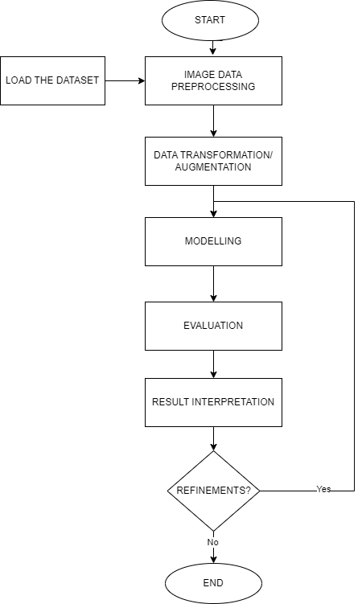
Methodology
Modeling:
Utilize transfer learning with pre-trained models.
(DenseNet201, InceptionV3, VGG16, VGG19, and Xception)
Include regularization and dropout methods.
Evaluation:
Measure accuracy, precision, recall, and F1 score.
Visualize performance with a confusion matrix.
Compare different pre-trained models.
Tools:
Python, TensorFlow, Keras, Google Colab,NumPy,
pandas, Matplotlib, Seaborn, Scikit-learn.
Logical Flow Of System
Notes:
"Moving on to the modelling stage:
Model Building:
leveraged transfer learning with pre-existing models - DenseNet201, InceptionV3, VGG16, VGG19, and Xception - to take advantage of the features these models have learned from large datasets. Alongside this, we incorporated regularization and dropout methods to prevent overfitting and enhance model performance.
Evaluation:
assessed the models based on accuracy, precision, recall, and F1 score, Additionally, visualized the model's performance using a confusion matrix and compared the performance of different pre-trained models.
Tools:
The tools used in this study include Python for programming, TensorFlow and Keras for building and training our models, Google Colab for cloud-based execution, and NumPy, pandas, Matplotlib, Seaborn, and Scikit-learn for data handling, analysis, and visualization.
This robust approach to modeling and evaluation ensures develop an effective and reliable screen damage detection and classification system.

Slide 11
Methodology
Model Architecture:
Base models of DenseNet201, InceptionV3, VGG16, VGG19, and Xception were adapted for the task.
Top layers of the base models were removed and the remaining parts were flattened to 1D.
New dense layers with ReLU activation functions were added.
Dropout layers were incorporated for regularization.
Kernel L2 regularizer was used to discourage large weights.
The final layer is a softmax layer, outputting class probabilities.
The modifications aimed to improve classification accuracy and overfitting robustness.
Notes:
"Moving on to model architecture, i began by adapting the base models of DenseNet201, InceptionV3, VGG16, VGG19, and Xception, tailoring them to specific task.
From these base models, I removed the top layers and flattened the remaining parts to a one-dimensional structure. This is an essential step as it prepares the models for the introduction of new layers.
i then added new dense layers to models, using the ReLU activation function. This function introduces non-linearity into the models, which is crucial for learning complex patterns.
To prevent overfitting, incorporated dropout layers into models. These layers randomly drop out a number of output features of the layer during training, helping to make our models more robust.
I also applied an L2 kernel regularizer. This technique discourages large weights in models, which is another effective way to mitigate overfitting.
Finally, added a softmax layer. This is our output layer, which provides the probability for each class, forming the basis of our class predictions.
Each of these modifications was carefully implemented with the aim of enhancing our models' classification accuracy and robustness to overfitting.

Slide 12
Results
Model | Accuracy | Class | Precision | Recall | F1-score | Support
DenseNet201 | 50.61% | good | 0.56 | 0.68 | 0.62 | 84
 |  | oil | 0.3 | 0.28 | 0.29 | 80
 |  | scratch | 0.49 | 0.47 | 0.48 | 80
 |  | stain | 0.51 | 0.45 | 0.48 | 80
InceptionV3 | 68.52% | good | 0.75 | 0.71 | 0.73 | 84
 |  | oil | 0.6 | 0.36 | 0.45 | 80
 |  | scratch | 0.6 | 0.66 | 0.63 | 80
 |  | stain | 0.62 | 0.84 | 0.71 | 80
VGG16 | 95.06% | good | 0.93 | 0.96 | 0.95 | 84
 |  | oil | 0.99 | 0.96 | 0.97 | 80
 |  | scratch | 0.95 | 0.91 | 0.93 | 80
 |  | stain | 0.95 | 0.97 | 0.96 | 80
VGG19 | 94.16% | good | 0.94 | 0.94 | 0.94 | 84
 |  | oil | 0.97 | 0.94 | 0.96 | 80
 |  | scratch | 0.93 | 0.95 | 0.94 | 80
 |  | stain | 0.93 | 0.94 | 0.93 | 80
Xception | 98.45% | good | 0.98 | 0.94 | 0.96 | 84
 |  | oil | 0.99 | 0.99 | 0.99 | 80
 |  | scratch | 0.94 | 0.99 | 0.96 | 80
 |  | stain | 0.96 | 0.95 | 0.96 | 80
Notes:
Let's move on to the results of our models.
Starting with DenseNet201, the overall accuracy I achieved was 50.61%. The precision, recall, and F1-score for 'good' class were 0.56, 0.68, and 0.62, respectively. For 'oil', 'scratch', and 'stain' classes, the model showed mixed results, indicating room for improvement.
Next, i have InceptionV3 with an overall accuracy of 68.52%. This model exhibited higher performance than DenseNet201, especially in classifying 'good', 'scratch', and 'stain' classes, but struggled a bit with the 'oil' class.
Moving onto VGG16, i see a significant jump in the overall accuracy to 95.06%. This model showed excellent performance across all classes, with F1-scores ranging from 0.93 to 0.97.
VGG19 also performed well with an overall accuracy of 94.16%. This model demonstrated robust performance across all classes,
Lastly, Xception provided the best overall accuracy among all models at 98.45%. The model's performance was outstanding across all classes, with F1-scores nearing perfection

Slide 13
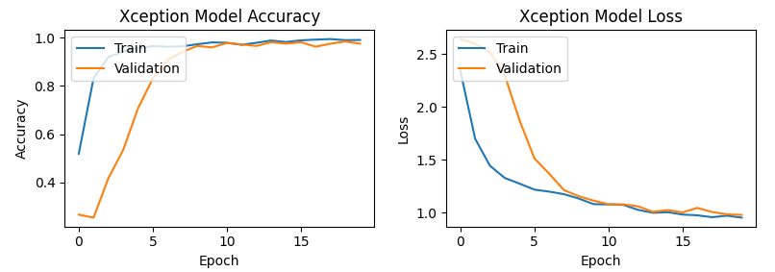
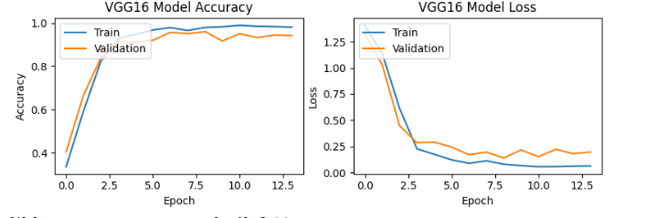
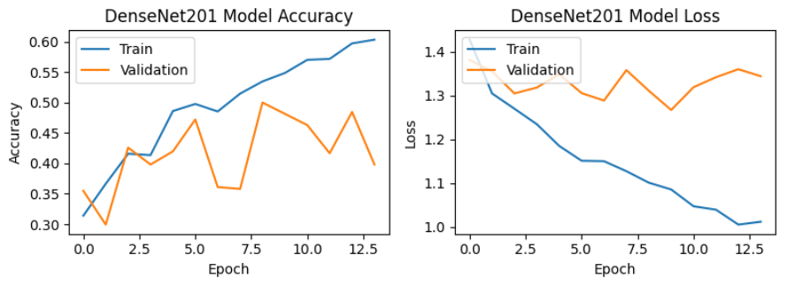
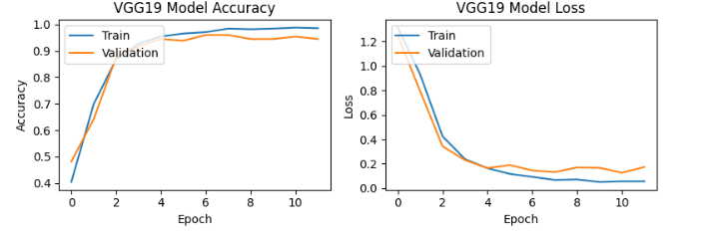
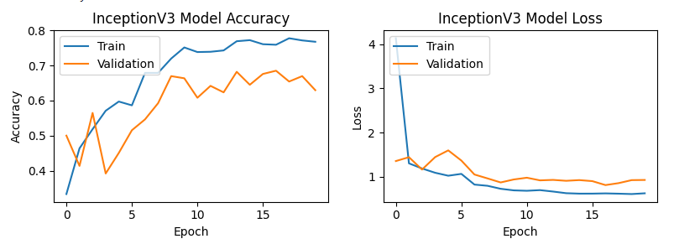
Results

Slide 14
Discussion & Conclusion
Five deep learning models: DenseNet201, InceptionV3, VGG16, VGG19 and Xception were tested.
Xception model was the most accurate with 98.45%, highlighting the effectiveness of transfer learning in mobile screen defect detection.
The research builds upon and surpasses (Selvi et al., 2021’s) work, which achieved an accuracy of 85%.
Data augmentation was found effective in enhancing the system's versatility and robustness (Mahyoub et al., 2023).
Regularization and dropout methods bolstered the model's resistance against overfitting, aligning with (Farhadi et al., 2022)'s findings.
Notes:
“As discussed in previous slides used total 5 modes and The Xception model emerged as the most accurate, achieving a remarkable accuracy of 98.45%. This result underscores the effectiveness of transfer learning in the field of mobile screen defect detection, outperforming the 85% accuracy achieved by Selvi et al., in 2021.
Furthermore, incorporation of regularization and dropout methods bolstered the model's resistance against overfitting. These findings align with the study conducted by Farhadi et al., in 2022, reinforcing the importance of these techniques in building robust models.
use of data augmentation, inspired by Mahyoub et al., in 2023, proved beneficial in enhancing the versatility and robustness of system. This technique allowed me to create a more diverse training set, improving the model's ability to generalize.
In conclusion, research demonstrates the powerful potential of deep learning models in improving efficiency and accuracy in detecting and classifying screen damage in mobile devices. i believe these findings can contribute significantly to the fields of e-commerce and logistics, leading to more effective handling of returned devices."

Slide 15
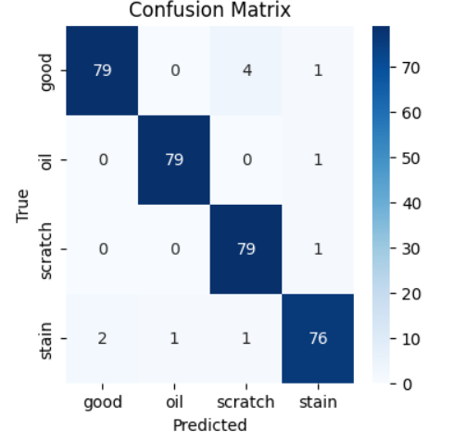
Discussion & Conclusion
Final Model Classification Report
Class | Precision | Recall | F1-score | Support
good | 0.98 | 0.94 | 0.96 | 84
oil | 0.99 | 0.99 | 0.99 | 80
scratch | 0.94 | 0.99 | 0.96 | 80
stain | 0.96 | 0.95 | 0.96 | 80

Slide 16
Future Recommendations
Explore other deep learning architectures for enhanced screen defect identification.
Experiment with larger and more diverse datasets for improved model performance.
Extend classification to include not just screen damage type, but also damage severity.
This extended classification can provide detailed information valuable for repair estimation.
Develop advanced data augmentation techniques to improve model learning capabilities and robustness.
Notes:
Move on to future recommendations,
Firstly, exploring other deep learning architectures could potentially enhance screen defect identification, offering even more accurate and efficient solutions.
Secondly, experimenting with larger and more diverse datasets could further improve model performance. More extensive datasets can provide more varied examples for the models to learn from, enhancing their ability to generalize to new, unseen data.
A third area of interest is extending the classification task to not only identify the type of screen damage but also its severity. This extended classification could provide detailed information that would be extremely valuable for repair estimation, improving service and cost efficiency.

