Slide 1
Caching
JSR-000107
https://jcp.org/aboutJava/communityprocess/implementations/jsr107/index.html

Slide 2
Caching Design Considerations
Caching design considerations include data loading/updating, performance/memory size, eviction policy, concurrency, and cache statistics. https://dzone.com/articles/introducing-amp-assimilating-caching-quick-read-fo
Data Loading/Updating
Performance/Memory Size 32/64 Bit
Eviction Policy
Concurrency
Cache Statistics
Different Implementation
Apache Ignite 1.0
Blazing Cache
cache2k
Caffeine
Coherence
Ehcache
Hazelcast
Infinispan 7.0.2
Redisson
Triava Cache
WebSphere eXtreme Scale

Slide 3
Data Loading/Updating
Data loading into a cache is an important design decision to maintain consistency across all cached content. The following approaches can be considered to load data:
Using default function/configuration provided by standard ORM framework, i.e. Hibernate or OpenJPA.
Implementing key-value maps using open-source cache APIs, i.e. Google Guava or COTS products like Coherence, Ehcache, or Hazelcast.
Programmatically loading entities through automatic or explicit insertion.
External application through synchronous or asynchronous communication.

Slide 4
Performance/Memory Size 32/64 Bit
Available memory is an important factor to achieve performance SLA and it depends on 32/64 bit JRE, which is further dependent on 32/64-bit CPU architecture machines. In a 32-bit system/JRE, ~1.5 GB of heap is left for application use, while in a 64-bit system/JRE, heap size is dependent on RAM size.
High availability of memory does have cost at runtime and can have negative consequences.
30-50% more heap is required on 64-bit compared to 32-bit due to memory layout.
Maintaining more heap requires more GC work for cleaning unused objects that can degrade performance. Fine-tuning GC can be an option to limit GC pauses.

Slide 5
Eviction Policy
An eviction policy enables a cache to ensure that the size of the cache doesn't exceed the maximum limit. To achieve this, existing elements are removed from a cache depending on the eviction policy, but it can be customized as per application requirements. There are various popular eviction algorithms used in cache solution:
Least Recently Used (LRU)
Least Frequently Used (LFU)
First In, First Out (FIFO)

Slide 6
Cache Statistics
Cache stats help identify the health of the cache and provide information about cache behavior and performance. In general, the following attributes can be used in cache statistics:
Hit count: Number of look-ups encountered when object found
Miss count: Number of look-ups encountered when object not found
Load success count: Number of successfully loaded entries
Total load time: Total time in loading an element
Load exception count: Number of exceptions thrown while loading an entry
Eviction count: Number of entries evicted from the cache

Slide 7
Questions to select Cache
Here are some questions and comparisons that can assist in identifying the most cost-effective and feasible caching solution for you.
Do you need a light-weighted or full-fledged cache solution?
Do you need an open-source, commercial, or framework-provided cache solution?
Do you need in-process or distributed caching?
What’s the trade-off between consistency and latency requirements?
Do you need to maintain the cache for transactional/master data?
Do you need a replicated cache?
What about performance, reliability, scalability, and availability?

Slide 8
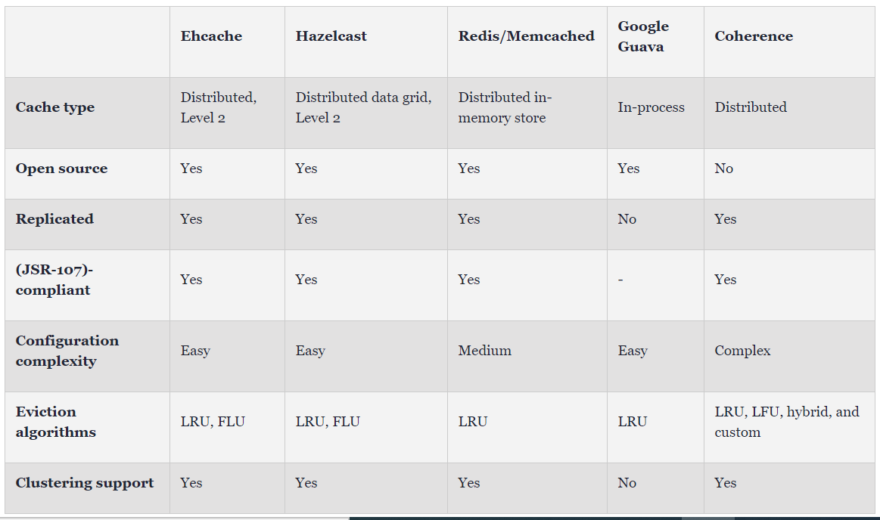

Slide 9
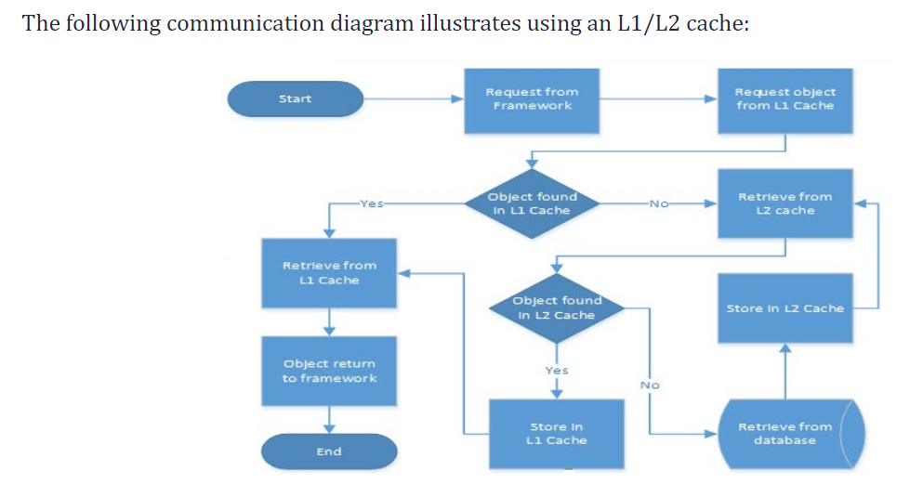
L1/L2 cache flow

Slide 10
Cache Patterns
Pattern | Notes | Consider | Advantage | Cons
Cache-Aside | Here Application will talk with cache and db. And Application will be responsible for updating same. | When you’re limited by the capabilities of your cache provider. | Application will not fail even if caching fail. As application will fetch data from DB. | The application is responsible for the cache orchestration flow
Read-Through | Here Cache is talking with DB. | Solid default | Every data will be persisted in cache first and then in DB | Memory mis may happen for very first request as there will be no data in cache. It can be solved by pre heating the cache/ preloading data in cache.
Write-Through | Here Cache is talking with DB for write operation. | Solid default | Every data will be persisted in cache first and then in DB | Latency get added
Write Around | Here application will talk with DB for write and with cache for read | When application is Write heavy means more write operation. | Here we tried to address Latency observed in Write through pattern
Write-behind |  | When performance considerations outweigh short-term consistency |  | Asynchronous systems are harder to reason with
Refresh-ahead |  | When fetching data from the datastore impairs throughput |  | Additional component to develop, deploy and maintain

Slide 11
Cache-Aside
Server / Application
DB
Client
Write
Read
Write
Read
Cache
Here application is responsible to handle caching part (Insert, update , delete)
Expiry strategy can be set as TTL (Expiry Time)
Here application Is interacting with both db and cache.

Slide 12
Read-Through
Server / Application
DB
Write
Cache
Read
Client
Read
Here Cache will reside between Application and DB
Here Application will read through cache will not call db directly anytime.
Advantage : Data will be read from cache and cache will interact with db for reading
Disadvantage : Memory mis may happen for very first request as there will be no data in cache. It can be solved by pre heating the cache/ preloading data in cache.

Slide 13
Write-Through
Server / Application
DB
Write
Cache
Write
Client
Read
Here Cache will reside between Application and DB
Here Application will Write through cache will not call db directly anytime.
Here application will wait till we get confirmation of write in both cache and DB.
Advantage : Every data will be persisted in cache first and then in DB
Disadvantage : Extra latency will be added to update records in db as application is not interacting with db directly.

Slide 14
Write-Around
Server / Application
DB
R
Cache
R
Client
W
This pattern will be used when application is Write heavy. Means more write operation and no latency required.
Here Application will Write to DB.
And Read through cache
Advantage : Latency issue in Write-Through will be addressed here .

Slide 15
Write-Back
Caching writes in bulk in DB
Server / Application
Write
DB
Client
Cache
Read
Useful for write heavy workloads.
Here cache will write the data in bulk to datastore.
Database failure can be sustained for the time cache hold data.
Used By various DB implementations
Disadvantage : Cache failure result in system failure

Slide 16
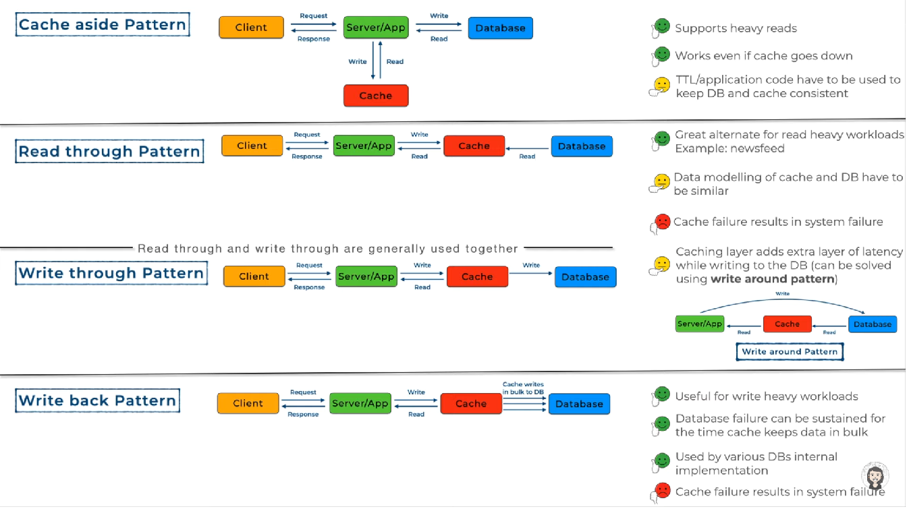

Slide 17
Important Links :
https://dzone.com/articles/where-is-my-cache-architectural-patterns-for-cachi
https://dzone.com/articles/caching-best-practices
https://www.youtube.com/watch?v=Ez1GK2imrsY
https://aws.amazon.com/caching/
https://www.cloudflare.com/learning/cdn/what-is-caching/

