Slide 1

CUSTOMER RATING ANALYSIS
IST 722 Data Warehouse
Group 2

Slide 2
Agenda
1. FudgeMart and FudgeFlix
2. Overview of Business Functions
3. Data Warehousing Strategy
4. Business Intelligence Report

Slide 3
Executive Summary
Problem /Opportunity:
Build a Business Intelligence on Customer Ratings
Solution:
Perform ETL to construct the Data Warehouse.
Projected Result:
Created Business Intelligence Reports from our Data Warehouse
Notes:
The creation of one data warehouse to store data from FudgeMart and FudgeFlix will allow for improved querying on this data, which will lead to better informed business decisions and opportunities.

Slide 4
Background
FudgeMart, Inc. is a conglomerate that currently manages two databases for its subsidiaries Fudgemart and FudgeFlix.
FudgeFlix is an at-home movie service
Fudgemart is an online retailer similar to walmart.

Slide 5

Data Warehouse Strategy
Extracting data to Stage
Transform data as per Business needs
Loading data to create views and tables

Slide 6
Business Process for integration implementation
We have selected Customer Analysis and Sales Facts for integration across both FudgeMart and Fudgeflix.
Facts​:
Customer Product Ratings – The details of reviews given by customer on the products they have bought or ordered
Dimensions:
Customers – Customer information such as name, city, state and zip
Products – Products available or sold in the organization with department details

Slide 7
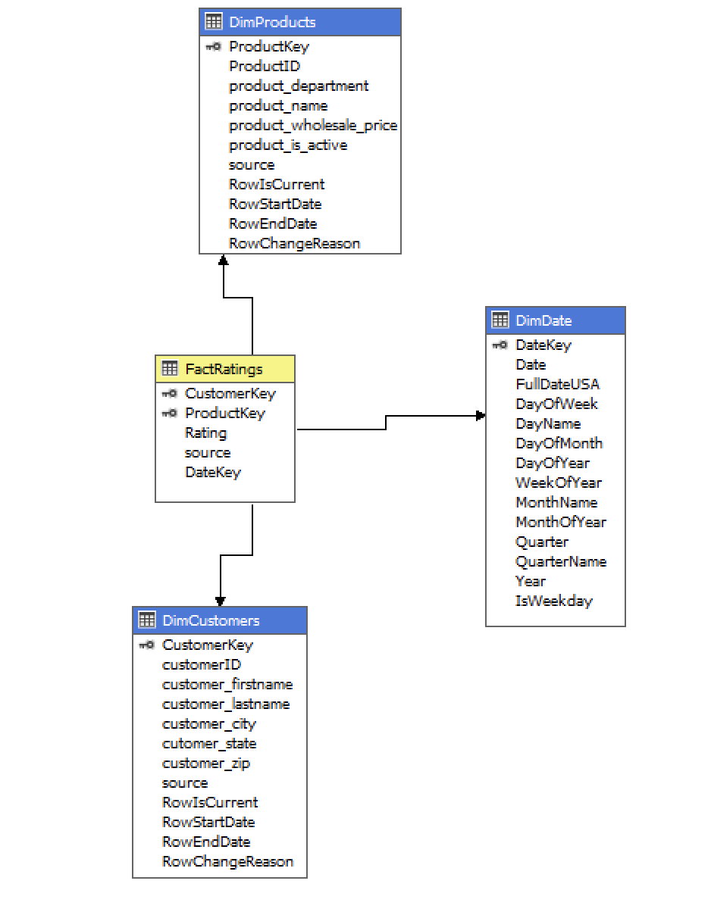
Star Schema
Notes:
Build star schema in a detailed dimensional model.
Complete the technical designs for our DDS by completing the specifics of the fact and dimension table implementations.

Slide 8
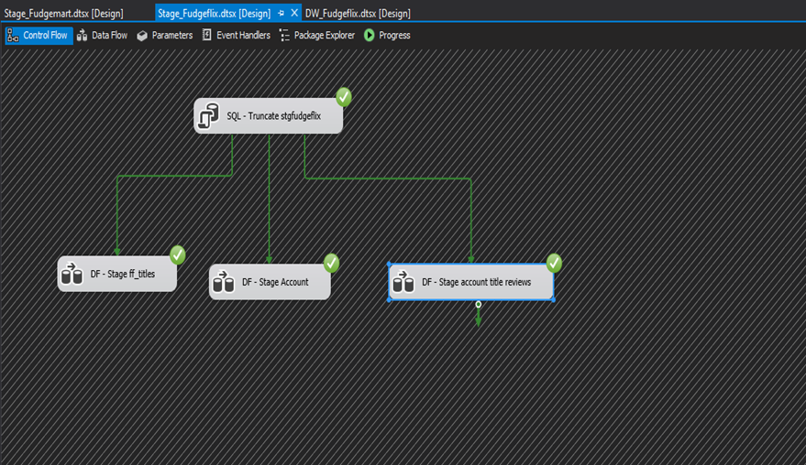
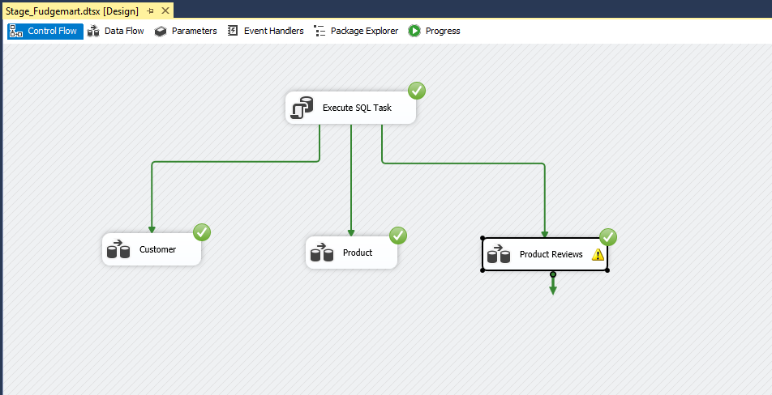
Staging FudgeMart & Staging FudgeFlix

Slide 9
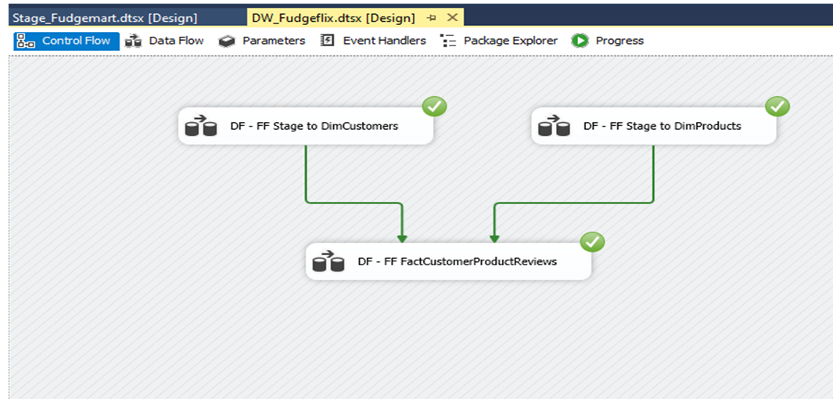
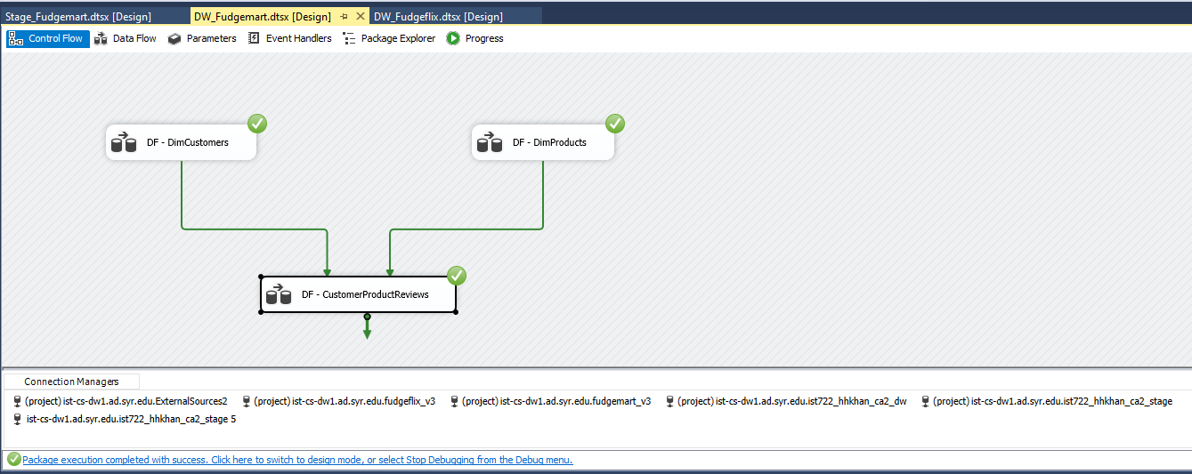
Loading stage data to data warehouse

Slide 10

Business Intelligence
The various reports and dashboard we developed using the cube, facts and dimensions

Slide 11
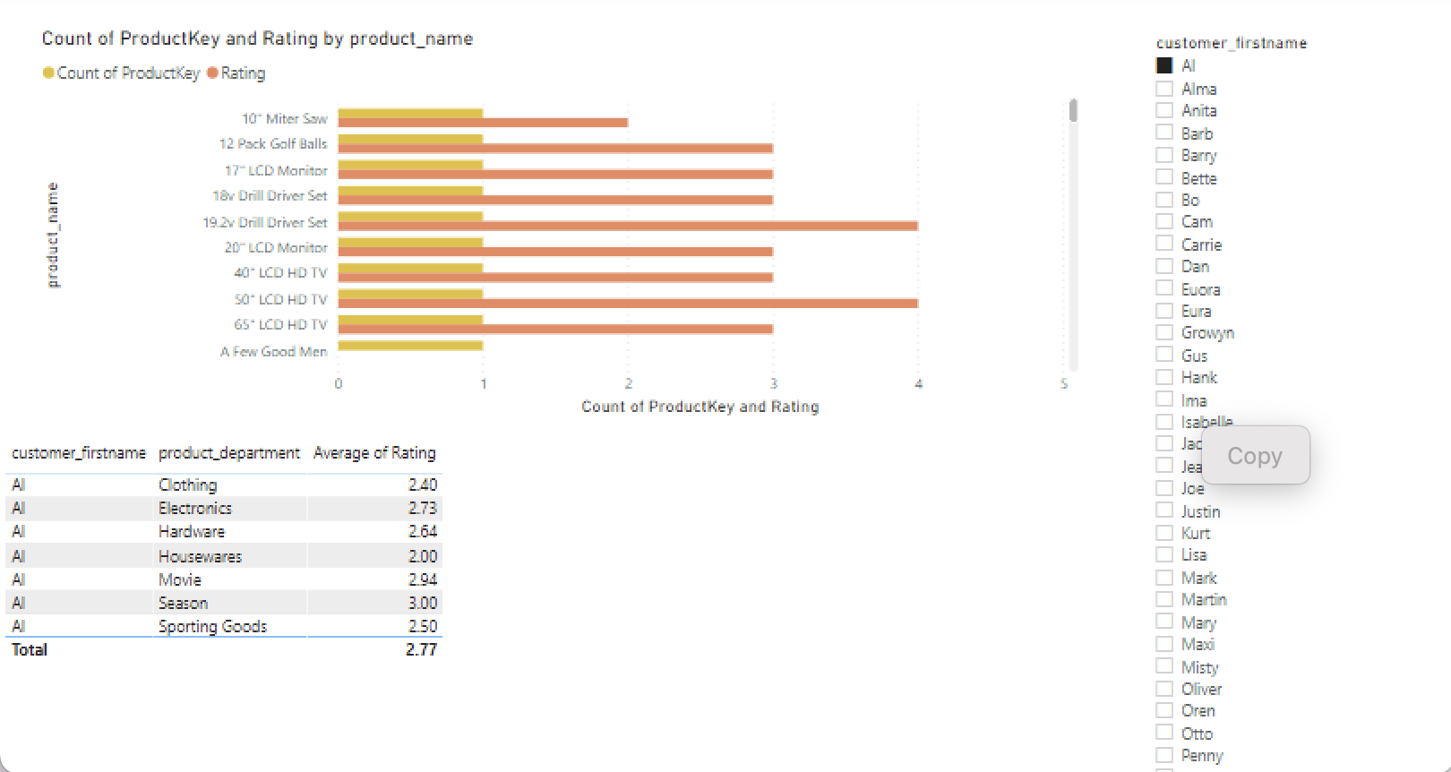
Analysis on Customer Ratings
From number of ProductKey and Rating by product name, we can see that 19.2v Drill Driver Set and 50”LCD HD TV has the highest ratings.
Based on Customer Al, the average rating of product department is 2.77.

Slide 12
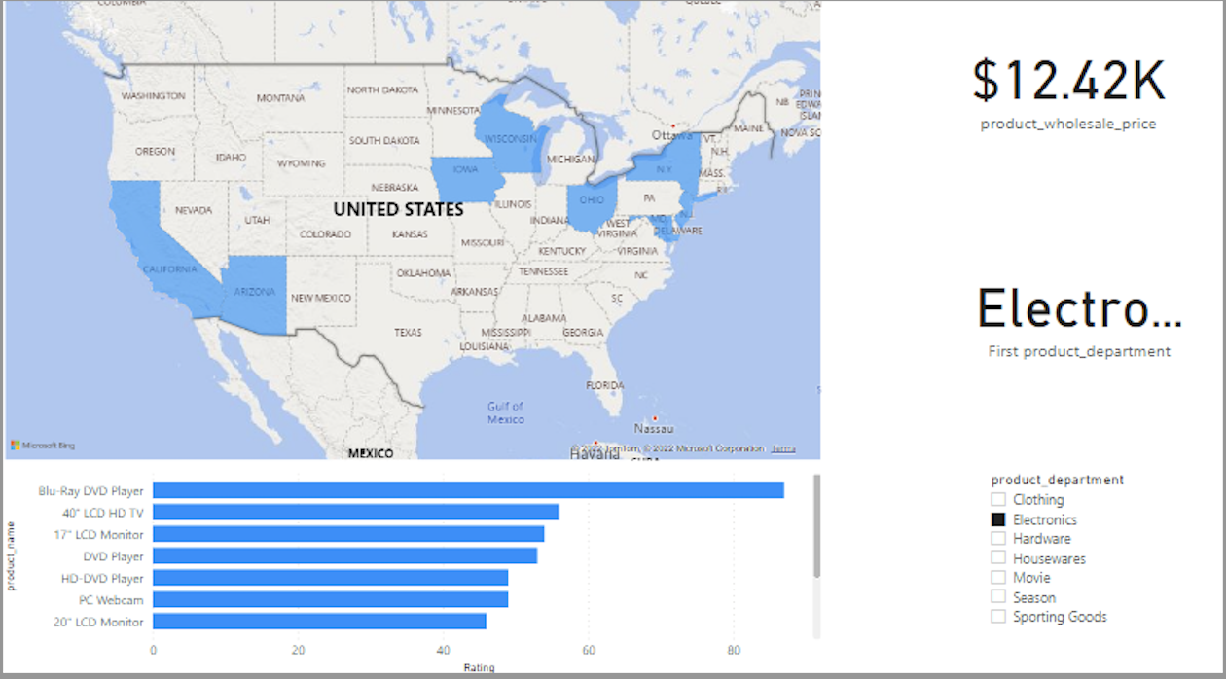
Analysis on Product Department
Insights: From the analysis, we can find out in Electronics department the Blu-Ray DVD Player has the highest rating and the least is 20” LCD Monitor.
The product wholesale price is $12.42K for Electronics Department

Slide 13
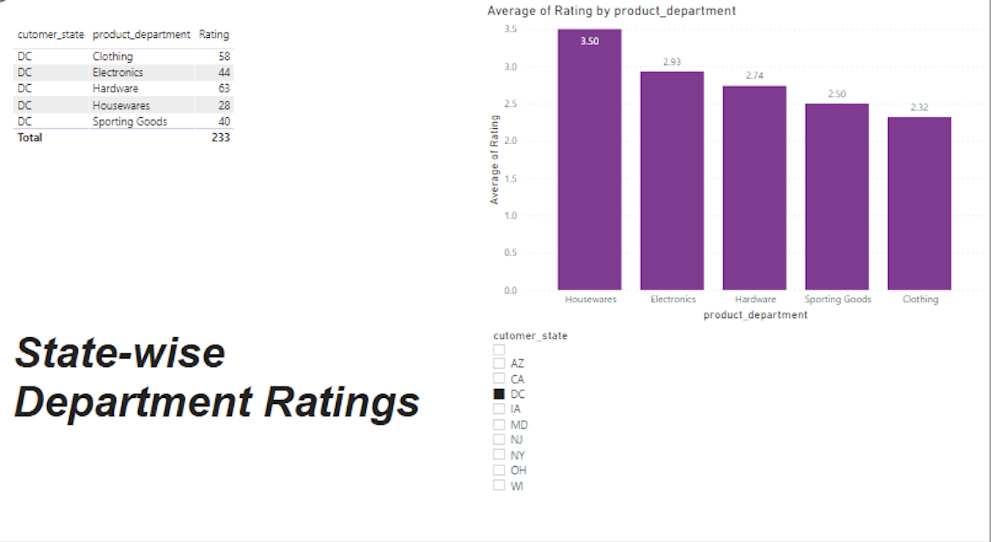
State-wise Department Ratings
Based on DC state, Housewares department has the highest rating of 3.50 and clothing with least of 2.32.

Slide 14
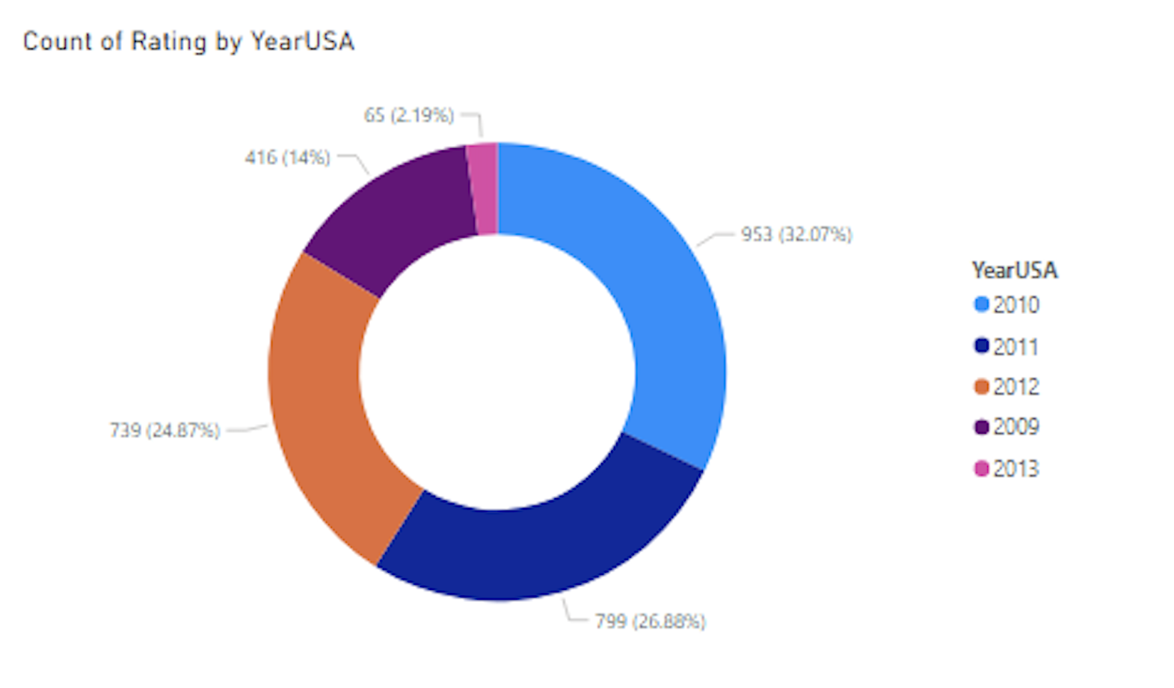
Rating by Year in US
The year 2010 has the most ratings in US which is 953 equivalent to 32.07% when compared others.

Slide 15

Questions

