Slide 1
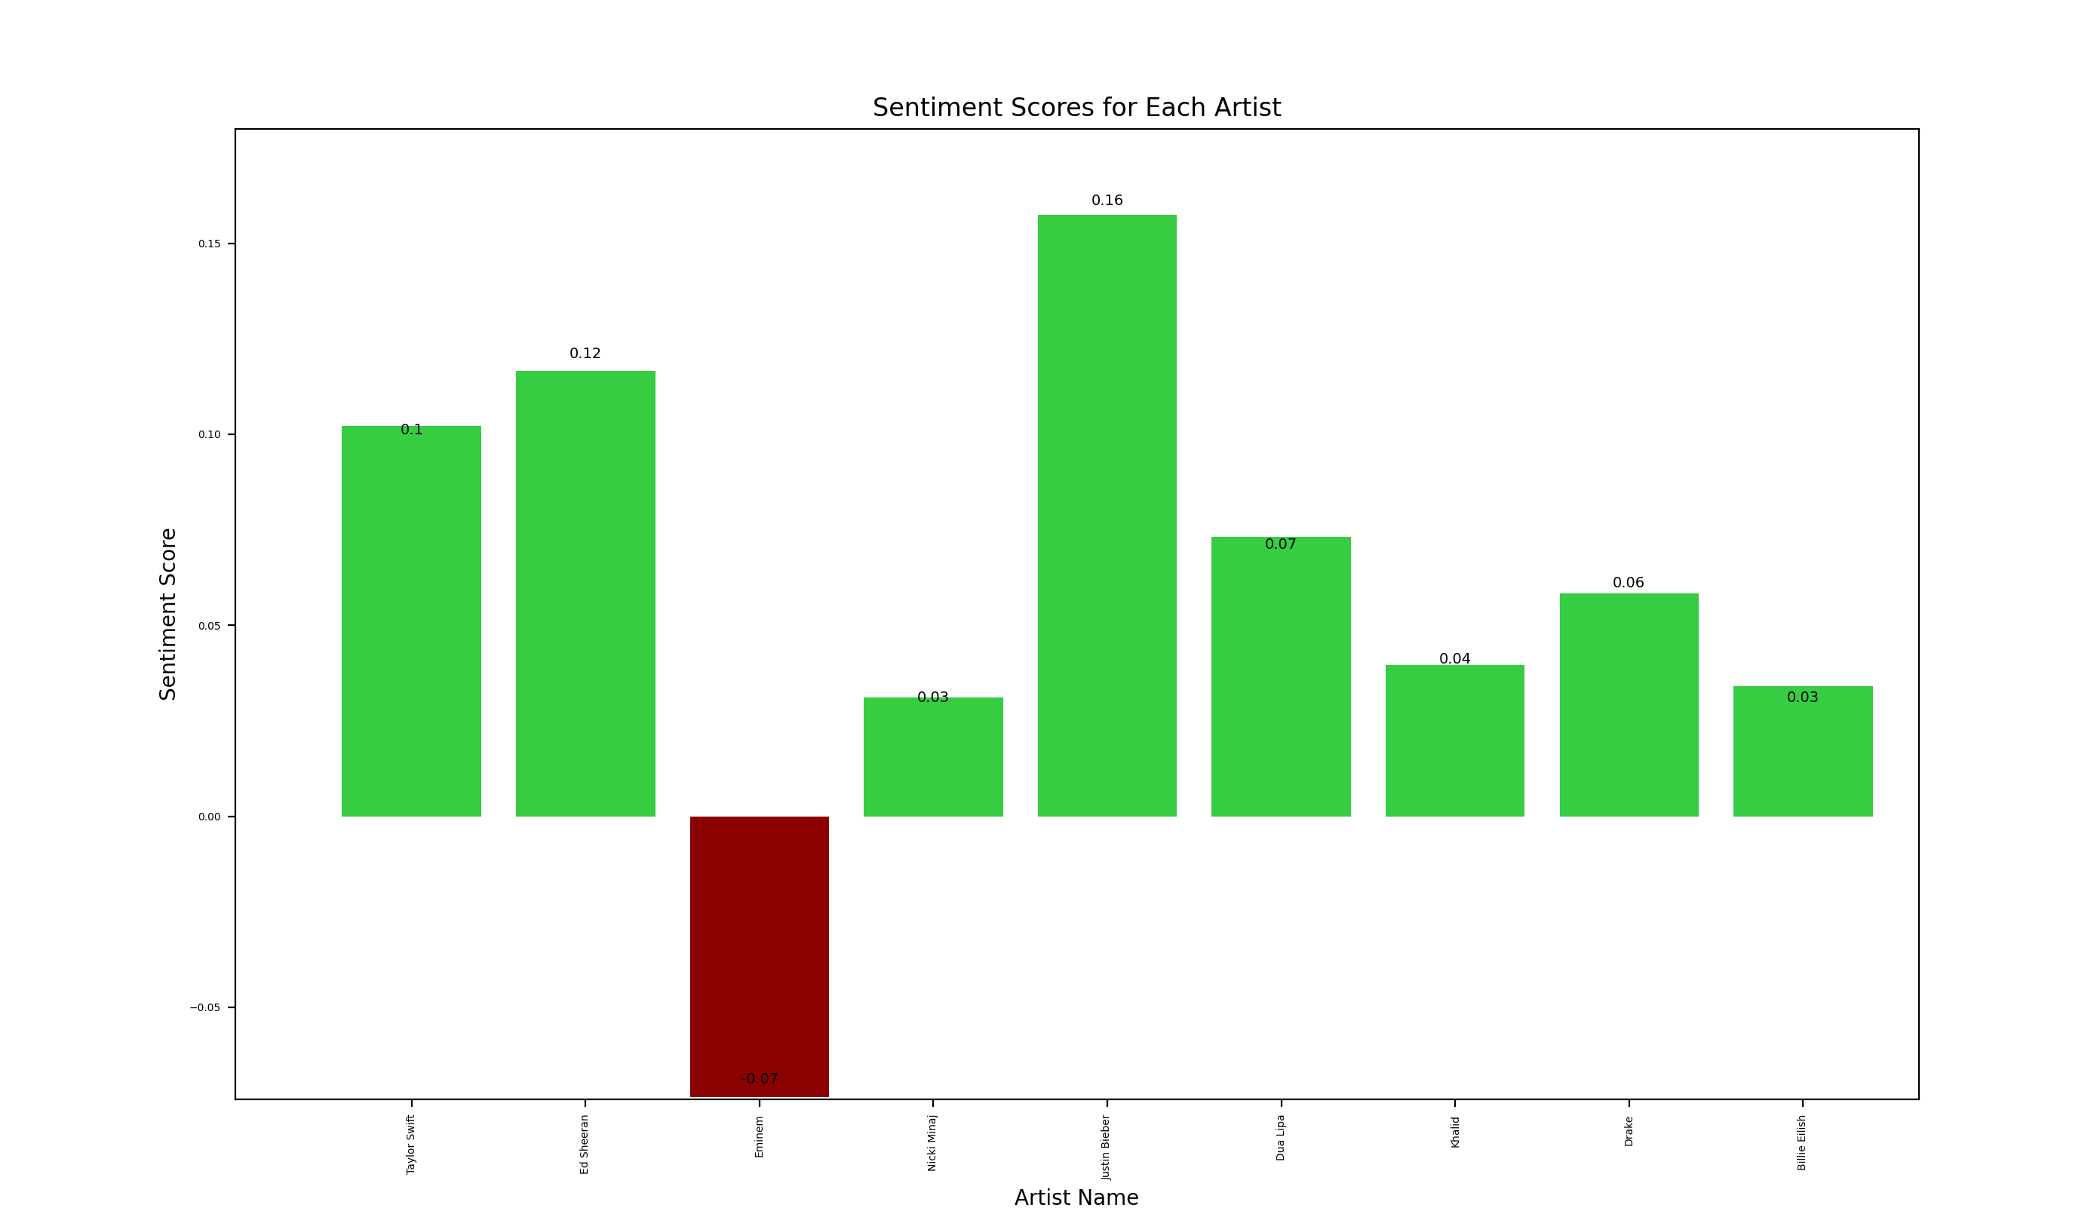
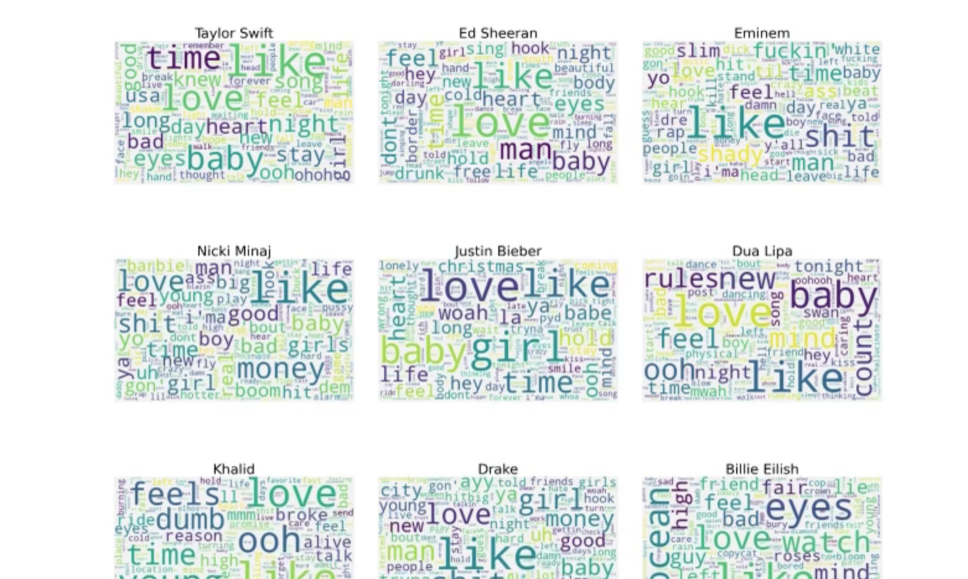
Lyricology: The Hipster's Guide to Understanding Music Trends Through NLP Urvi Bhojani, Kush Raimalani, and Rishita Shroff
Data Source: https://www.kaggle.com/datasets/deepshah16/song-lyrics-dataset/code
Data Source: https://www.kaggle.com/datasets/deepshah16/song-lyrics-dataset/code
Fig 1: Depicts subplots of Word Clouds per Artist file. Illustrates that some of the most common words across all files are ”like” and “love”.
Fig 2: Depicts the Sentiment Score for each Artist. Illustrates that Just Bieber has the highest positive sentiment score, while Eminem had the lowest negative sentiment score.

