Slide 1
Swypa
Mobile App

Slide 2
DASHBOARD
CUSTOMER
ADMIN
DRIVER
SUPPLIER

Slide 3

CUSTOMER
Favorites
Show how long the supplier will prepare the order
Show estimated time after collection
view promotions
Search store
List stores
One order per store after completion choose to make another order from new or same store
order must go straight to the supplier and the admin
client is going to see the driver status(e.g order collected)

Slide 4

ADMIN
Top 5 best customers in a month - to receive a free delivery from Swypa (Loyalty programme)
Category of Stalls (Local restaurant, National Franchise, Beverages, laundry …) each has its own price.
Admin must see new stalls and accept/decline them before they can be public to the customers (Manual to automated process)
admin can accept the order
admin manages the deliveries(assign driver for collection)

Slide 5
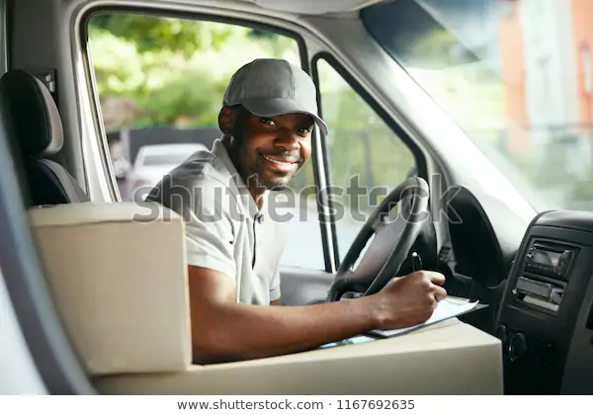
DRIVER
see deliveries
Delivery route button for driver( supplier route, after collection Customer route)
Call client button
driver will update status accordingly

Slide 6

SUPPLIER
Accept the order
Notify - prepared (ETA), ready for collection
Disable unavailable items eg Chips/Burger
Add menu items after admin approval .
supplier can accept the order

Slide 7
PAYMENT AND ORDER CANCELLATION
CASH ON DELIVERY
CARD (SPEED POINT ON DELIVERY)
ORDERS CAN NOT BE CANCELLED

Slide 8

THANK YOU

