Slide 1


Slide 2
Vue vs React
Which one should you choose for your next project?
Bhojendra Rauniyar
Software Engineer
@YoungInnovations
younginnovations.com.np

Slide 3

Which one to choose?

Slide 4

What do you think about me?

Slide 5

Similarities
Reactive
RX = OBSERVABLE + OBSERVER + SCHEDULERS
Source: https://medium.com/exploring-code/what-is-reactive-programming-da37c1611382

Slide 6

Similarities
Reactive
BTW, They’re actively gazing you!

Slide 7
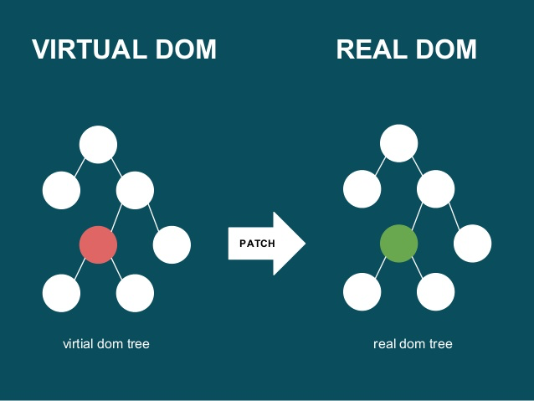
Similarities
Virtual DOM
Virtual dom tree
real dom tree

Slide 8

Similarities
Performance
Both React and Vue are exceptionally and similarly fast, so speed is unlikely to be a deciding factor in choosing between them.
Benchmark: http://www.stefankrause.net/js-frameworks-benchmark7/table.html

Slide 9
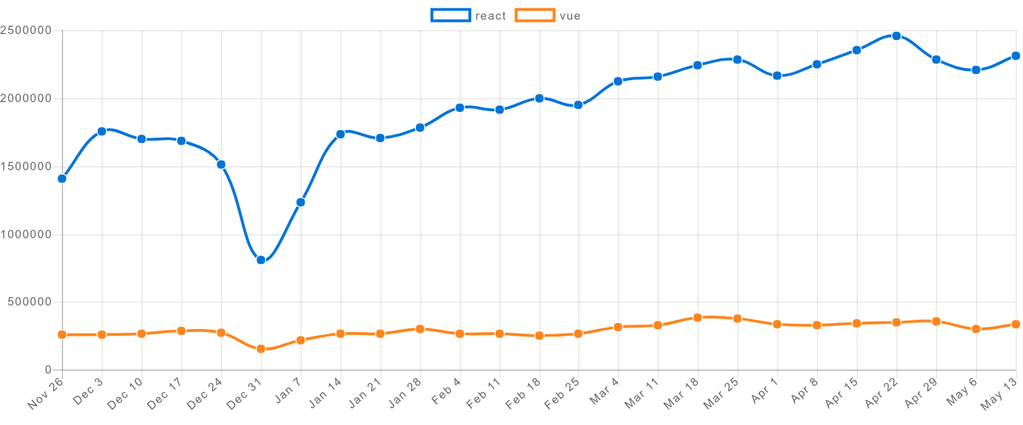
Similarities
NPM Download Chart
Source: http://www.npmtrends.com/react-vs-vue

Slide 10

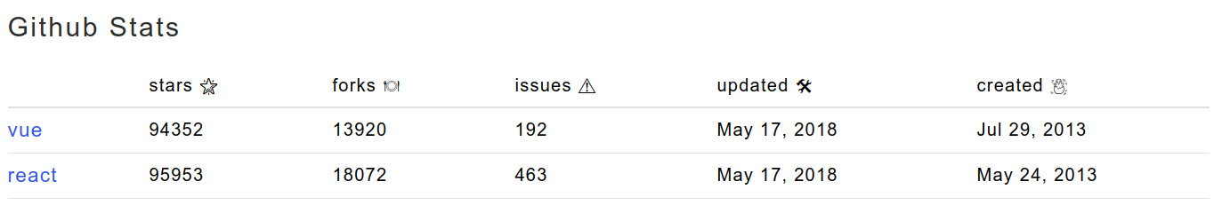
Similarities
Github Stats
Source: http://www.npmtrends.com/react-vs-vue

Slide 11

Features of React.js

Slide 12
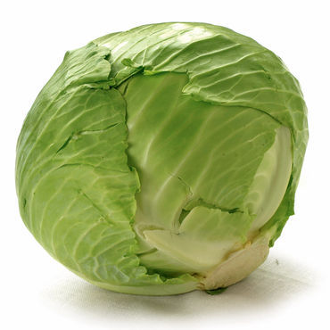
Single piece of components
Keep your component small

Slide 13

JSX
const organizer = <h1>Young Innovations Pvt. Ltd.</h1>;
Write everything in JavaScript

Slide 14

Rendering elements
Update only when required.

Slide 15
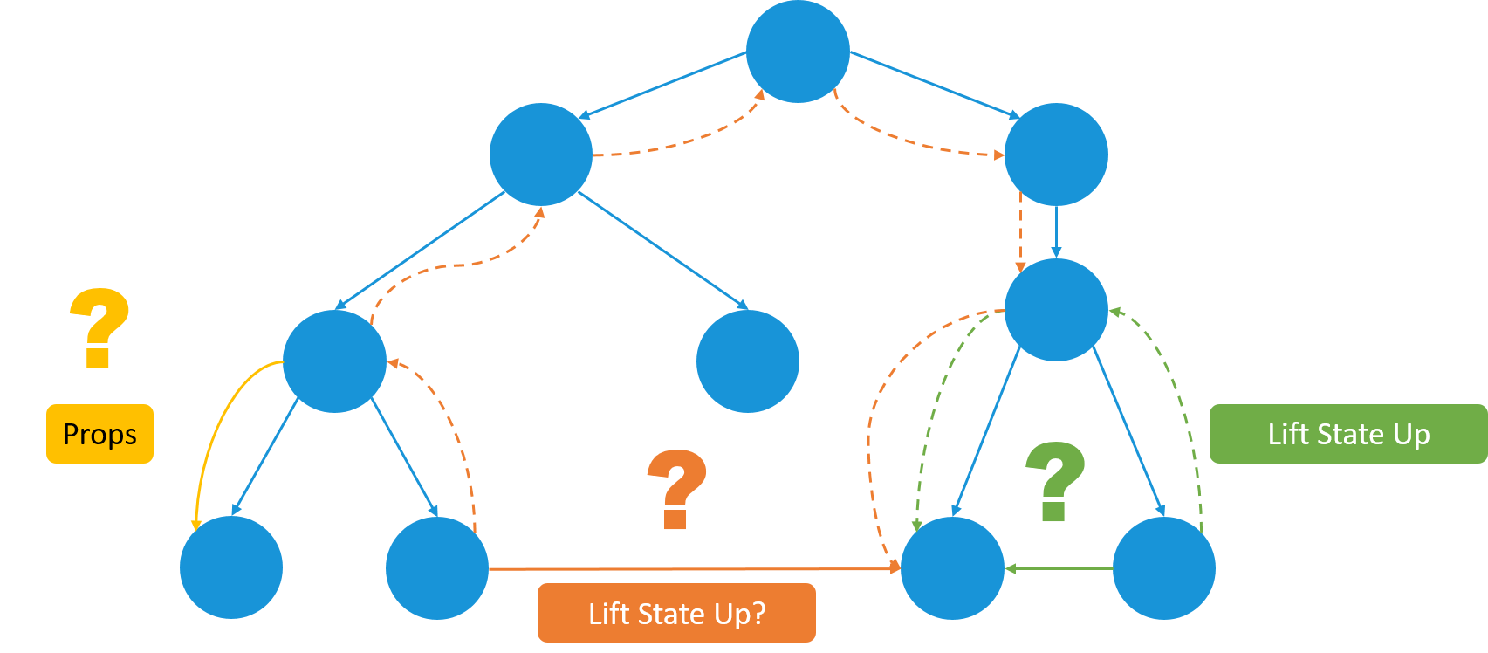
Props & States
Props are read only.
Props cannot be modified.
State changes can be asynchronous.
States can be modified using this.setState.

Slide 16


Slide 17

Features of Vue.js

Slide 18

Templates

Slide 19

Form input bindings

Slide 20
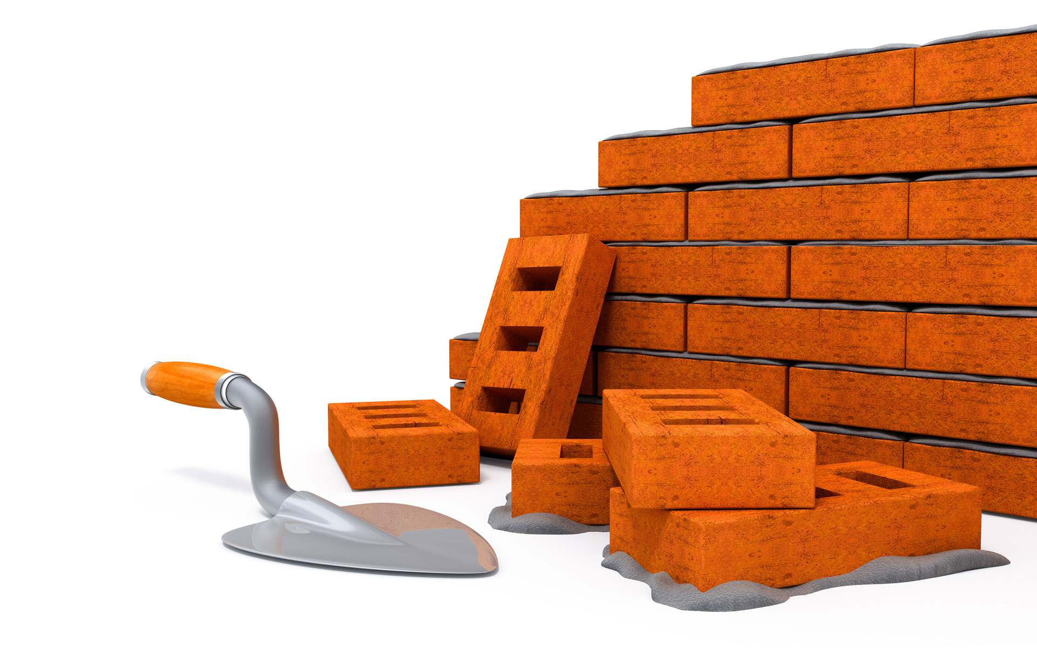
Slots

Slide 21
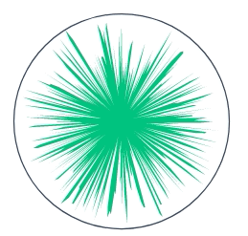

Transitions
<div id="demo">
<button v-on:click="show = !show">
Toggle
</button>
<transition name="fade">
<p v-if="show">hello</p>
</transition>
</div>
new Vue({
el: '#demo',
data: {
show: true
}
})
.fade-enter-active, .fade-leave-active {
transition: opacity .5s;
}
.fade-enter, .fade-leave-to {
opacity: 0;
}

Slide 22
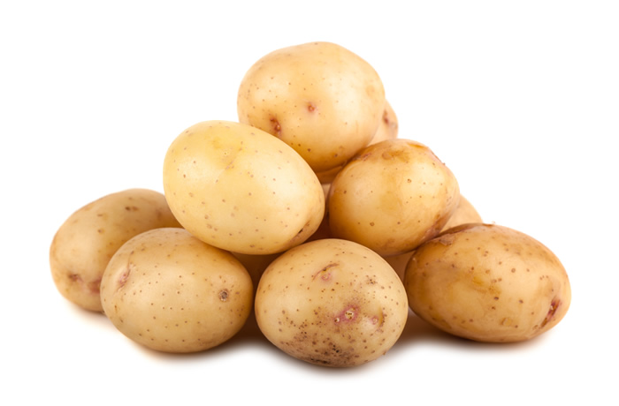
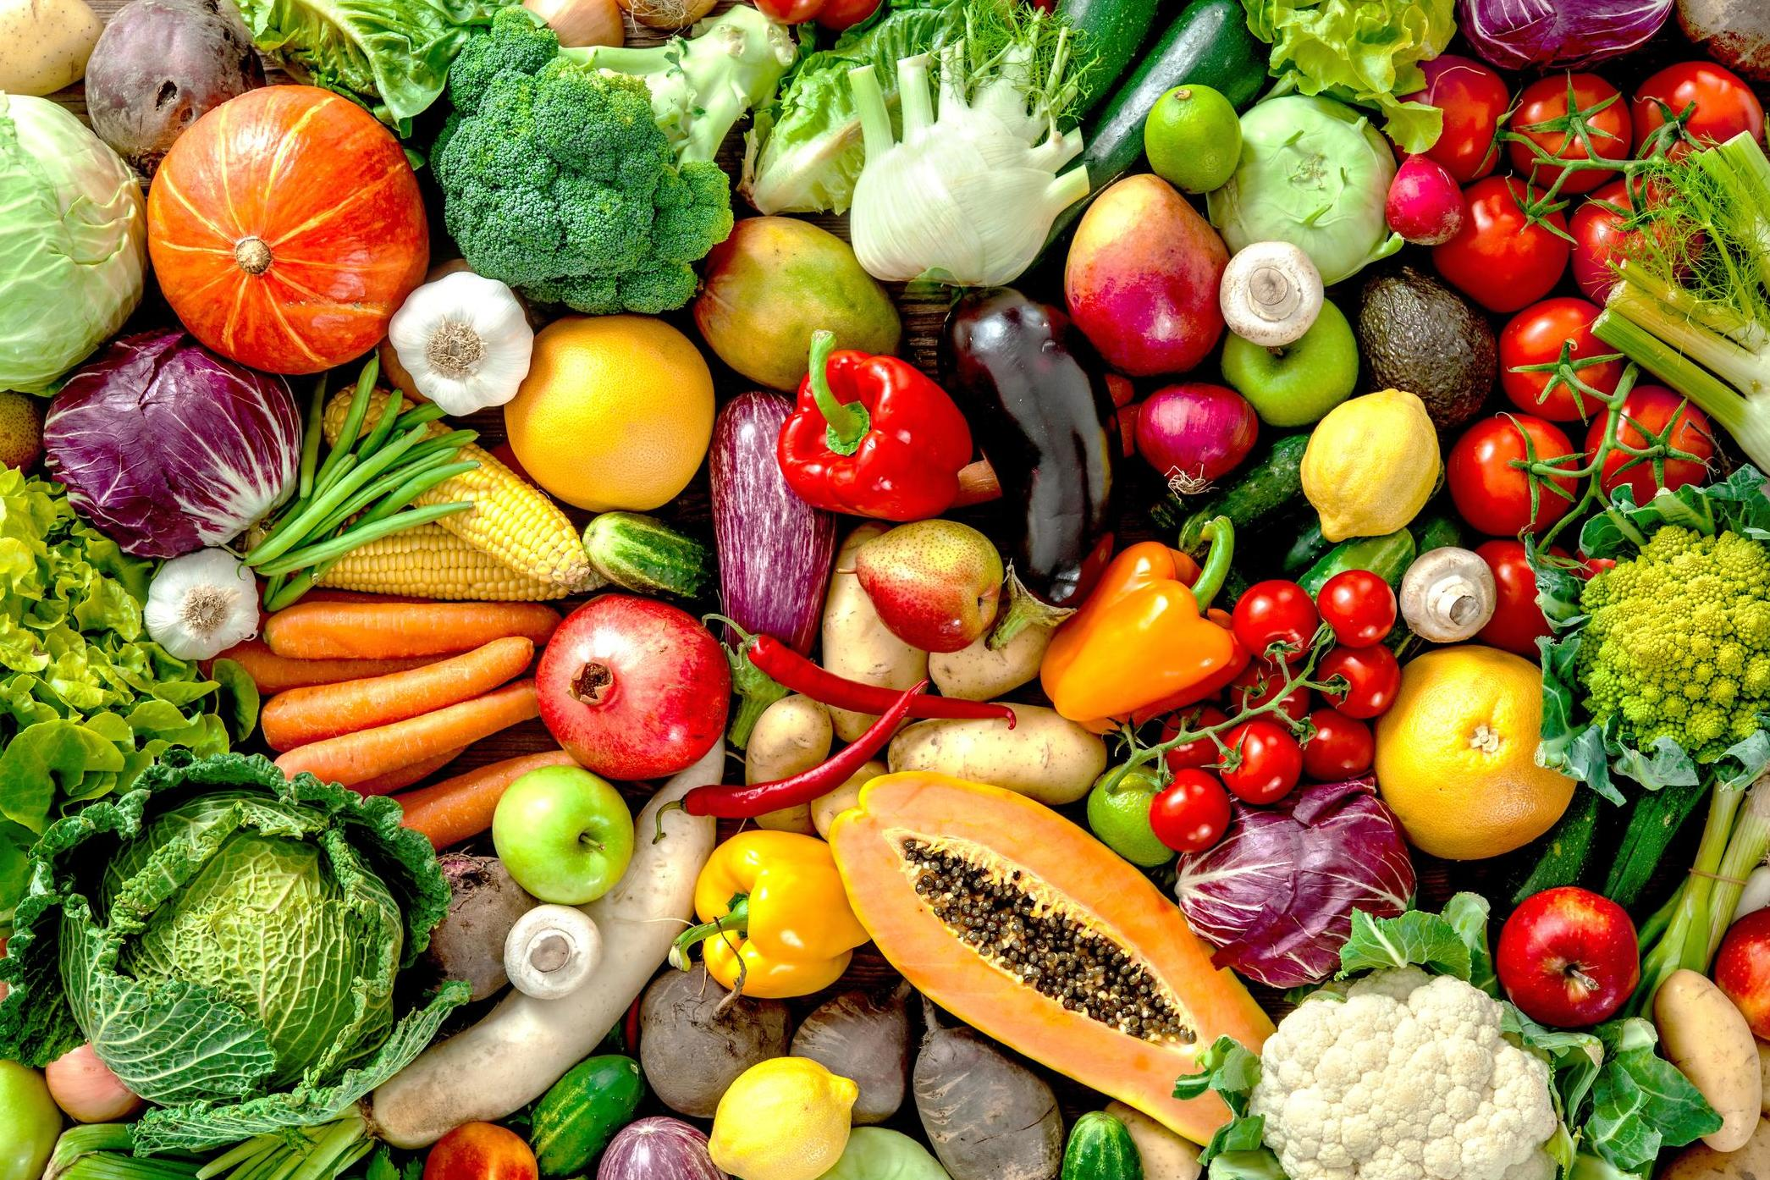
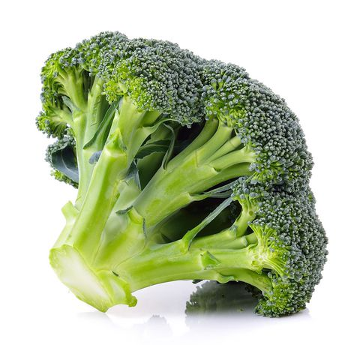
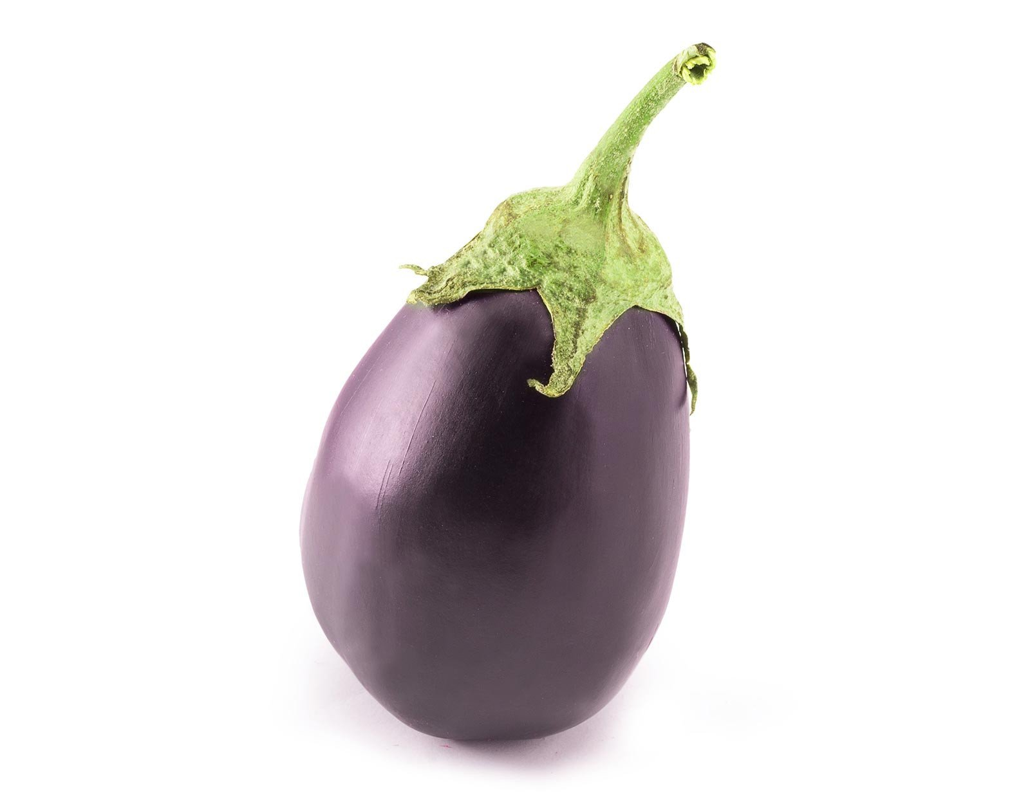
Mixins
// define a mixin object
var potatoMixin = {
created: function () {
this.slice()
},
methods: {
slice: function () {
console.log('sliced potato')
}
}
}
// define a component that uses this mixin
var Brinjal = Vue.extend({
mixins: [potatoMixin]
})
var curry = new Brinjal() // => "sliced potato"

Slide 23

Directives

Slide 24
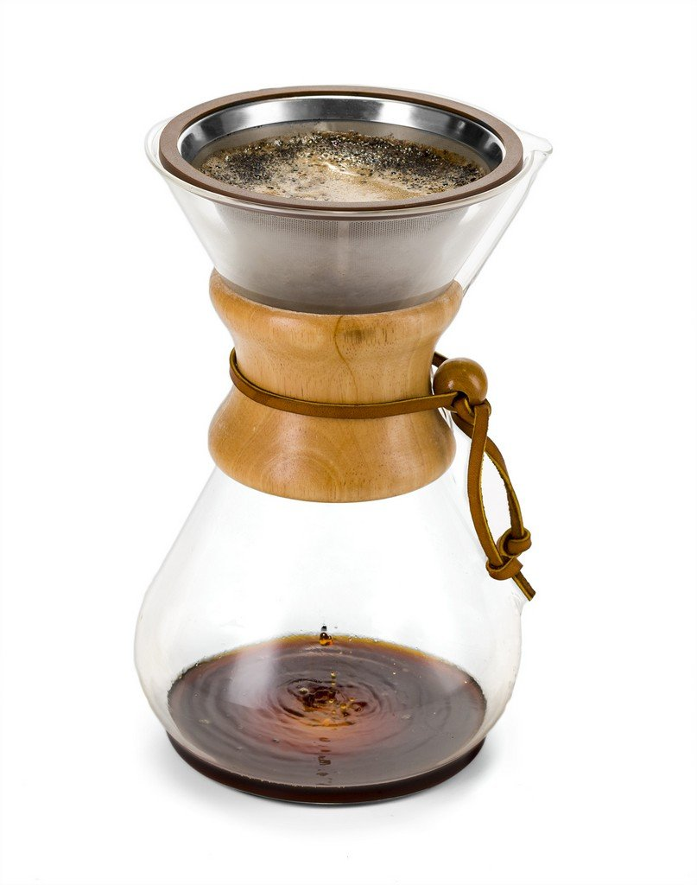
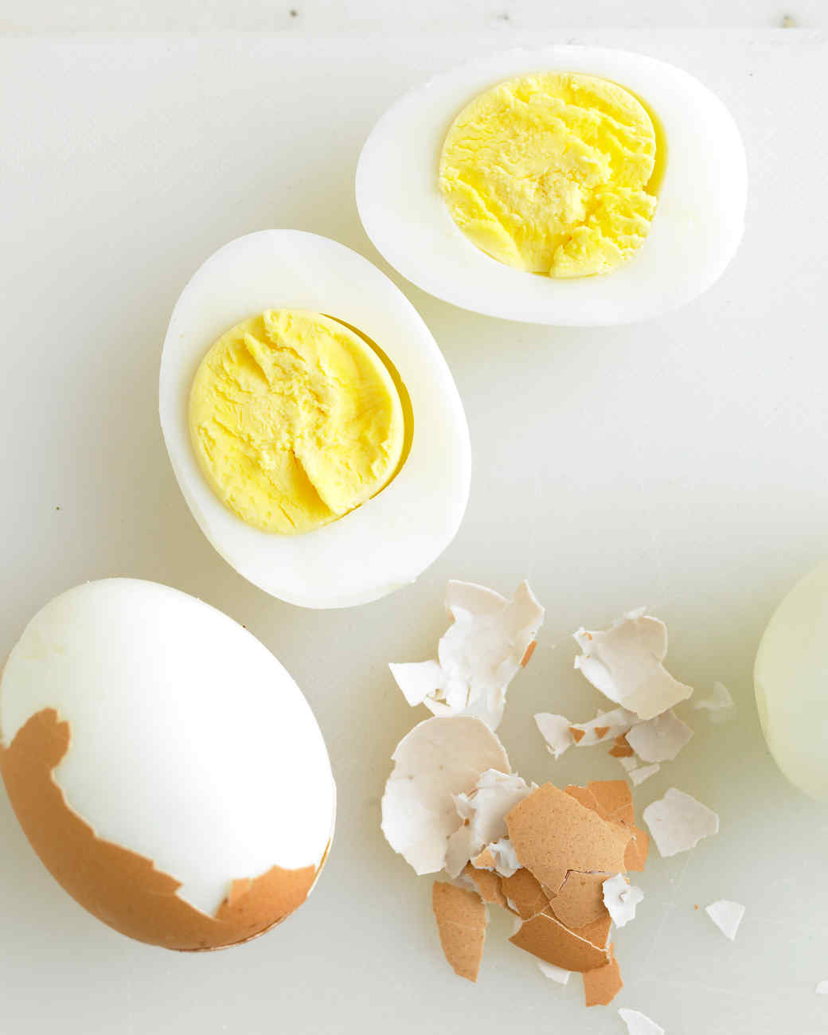
Filters

Slide 25
Filters
Why do I fart so much?

Slide 26


Slide 27
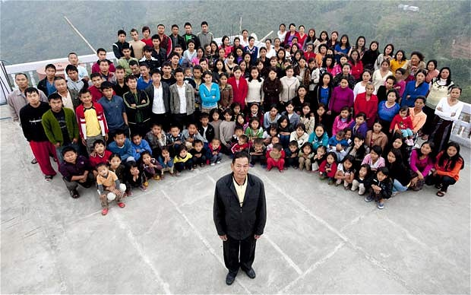
Missing Features
React
This photo is actually of an Indian man with 39 wives, 94 children and 33 grandchildren

Slide 28

Issues / Difficulties
React

Slide 29

Issues / Difficulties
React

Slide 30
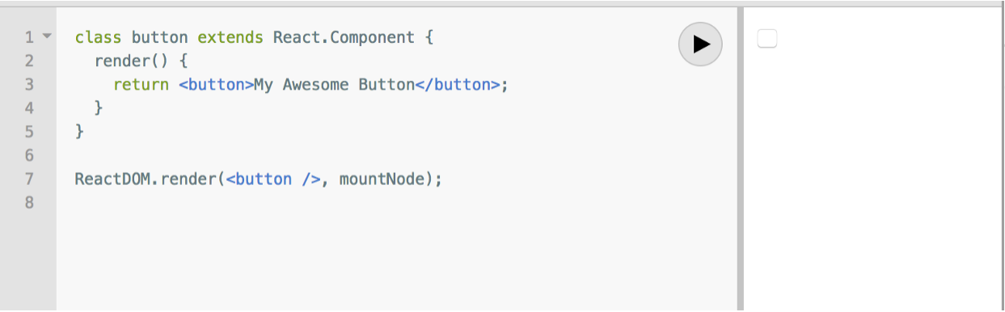
Issues / Difficulties
React
Do not forget to use component name with a capital letter.

Slide 31
Issues / Difficulties
React
Confusing curly braces {} with parentheses ()
Instead of:
You need:
Instead of:
You need:
return {
something();
};
return (
something();
);
const Greeting = () => {
<div>
Hello World
</div>
};
const Greeting = () => (
<div>
Hello World
</div>
);

Slide 32
Issues / Difficulties
React
Not wrapping objects with parentheses
Instead of:
You need:
const myAction = () => { type: 'DO_THIS' };
const myAction = () => ({ type: 'DO_THIS'});
this.setState(prevState => { answer: 42 });
this.setState(prevState => ({ answer: 42 }));

Slide 33
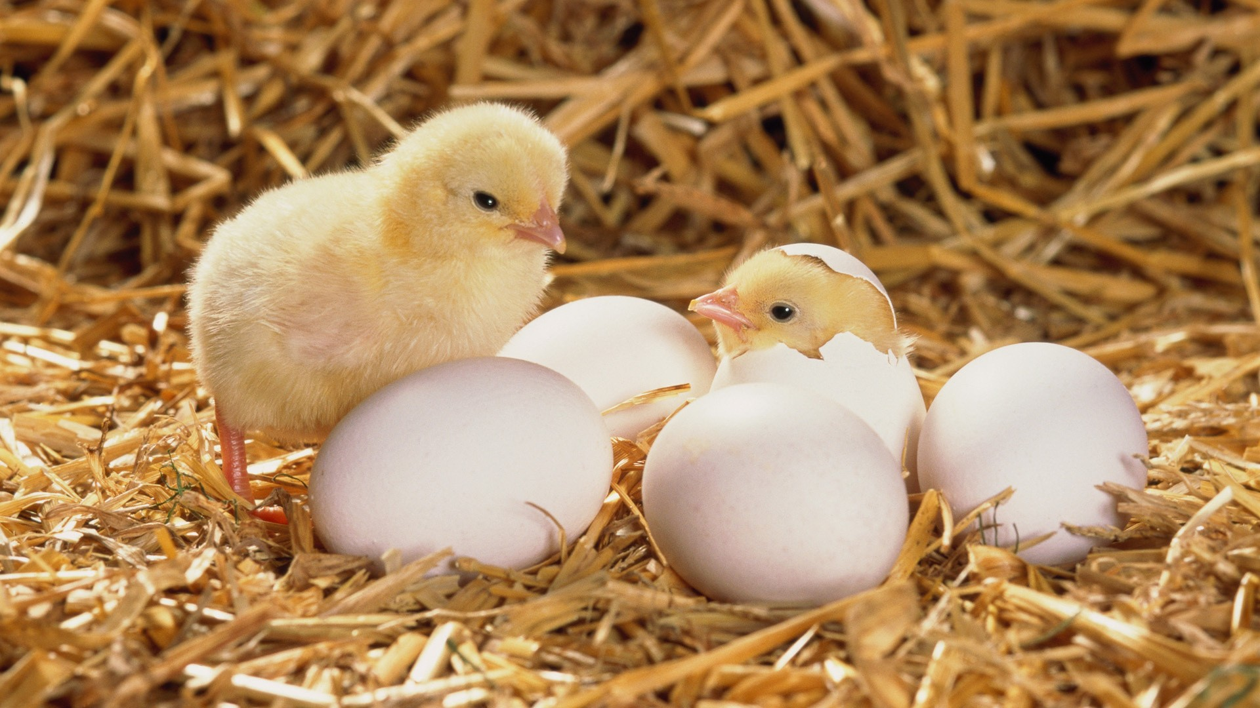
Issues / Difficulties
Vue

Slide 34

Issues / Difficulties
Vue

Slide 35


Differences
React

Slide 36


Differences
Vue

Slide 37

Differences
~= ticks => politics
~= ticks => politics

Slide 38
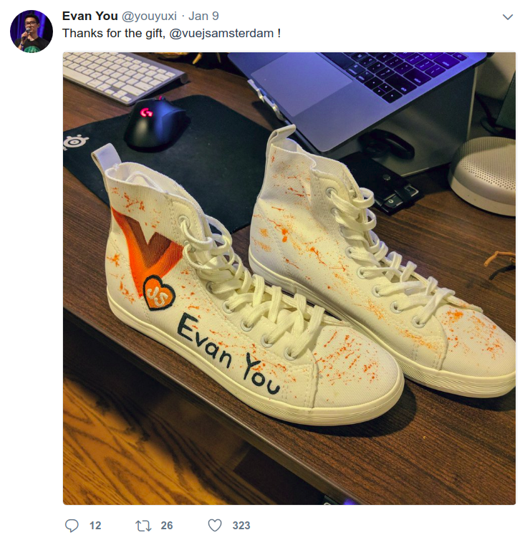
Misconception
Vue is for small application.
~= ticks => politics

Slide 39

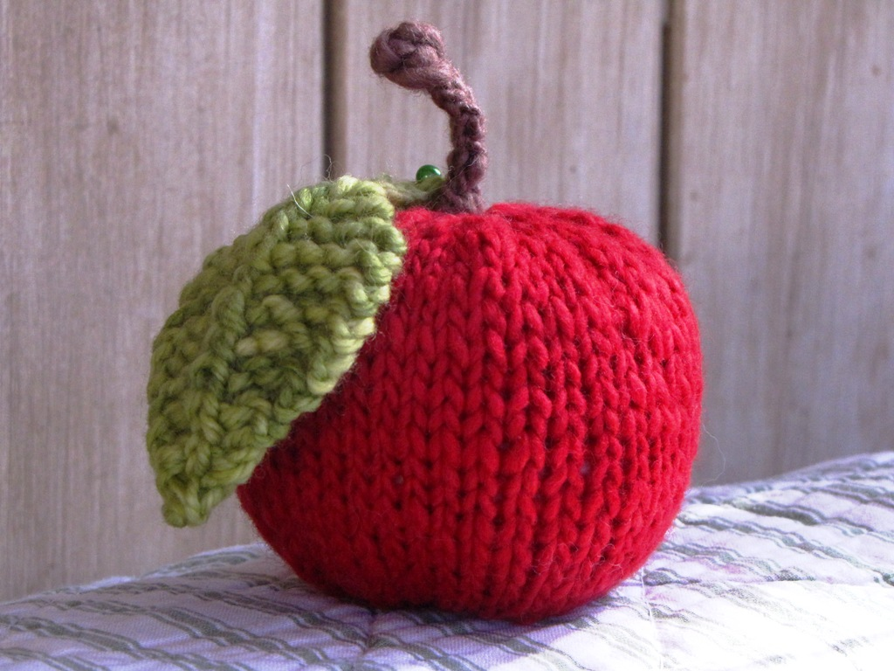
Misconception
=>
Thinking in React’s single piece of components
~= ticks => politics

Slide 40
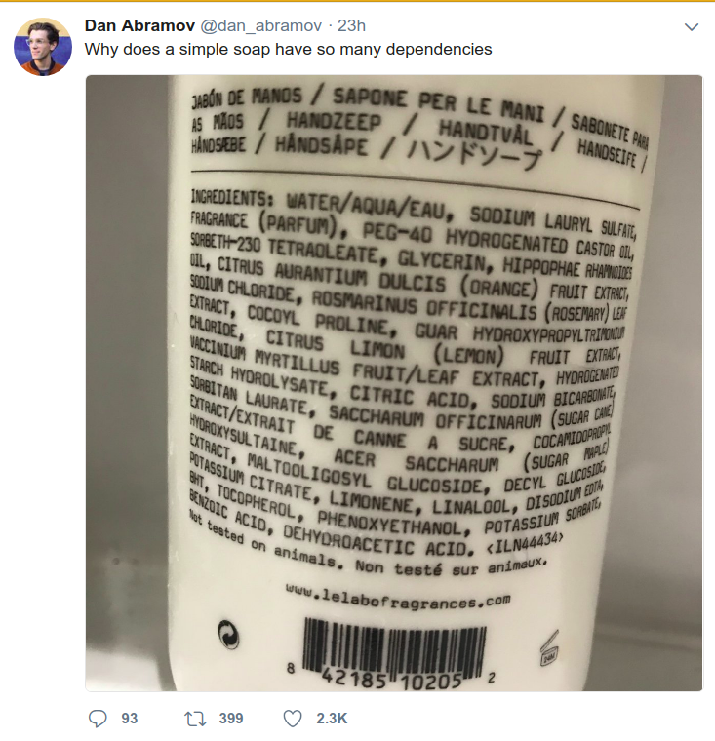
Tweets
No necessity to wrap whole component in one place.
~= ticks => politics

Slide 41

Final Thoughts
When all answers in an exam seems correct… But you have to
Choose the right one...
Which one should I choose for my next project?
~= ticks => politics

Slide 42
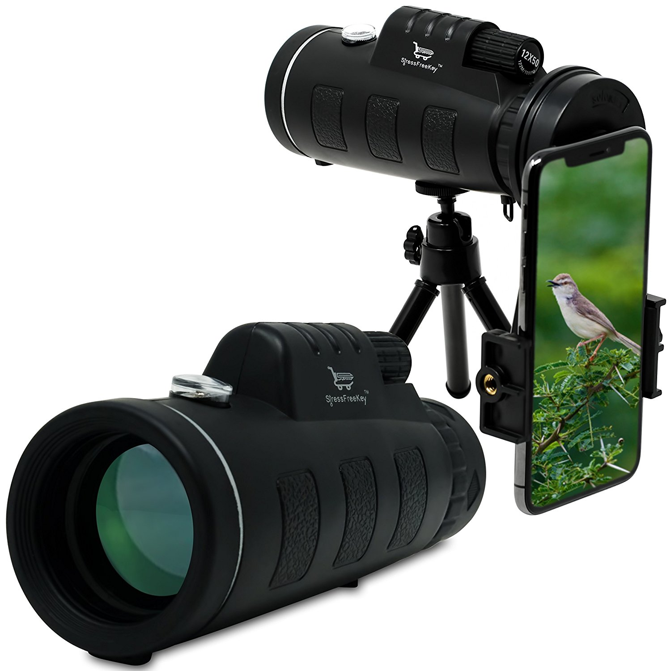
Final Thoughts
~= ticks => politics

Slide 43

Final Thoughts
~= ticks => politics

Slide 44

Final Thoughts
~= ticks => politics

Slide 45

Final Thoughts
~= ticks => politics

Slide 46

Untouched Topics
~= ticks => politics

Slide 47

Thank you.
Any Question?
~= ticks => politics

